Slide 1


The essential AIoT device
enablement

Slide 2


Digital transformation and challenges
The essential AIoT device enablement
Connected buildings
Connected mobility
Connected goods
Connected manufacturing
Hardware2Software
Cloud2Edge
Local compute
Intelligence on the device
Notes:
https://projects.eclipse.org/proposals/eclipse-kanto
challenges – complexity of hardware, complexity of software , diverse data , security, limited resources, limited connectivity/offline,faster dev cycle for aiot devices

Slide 3










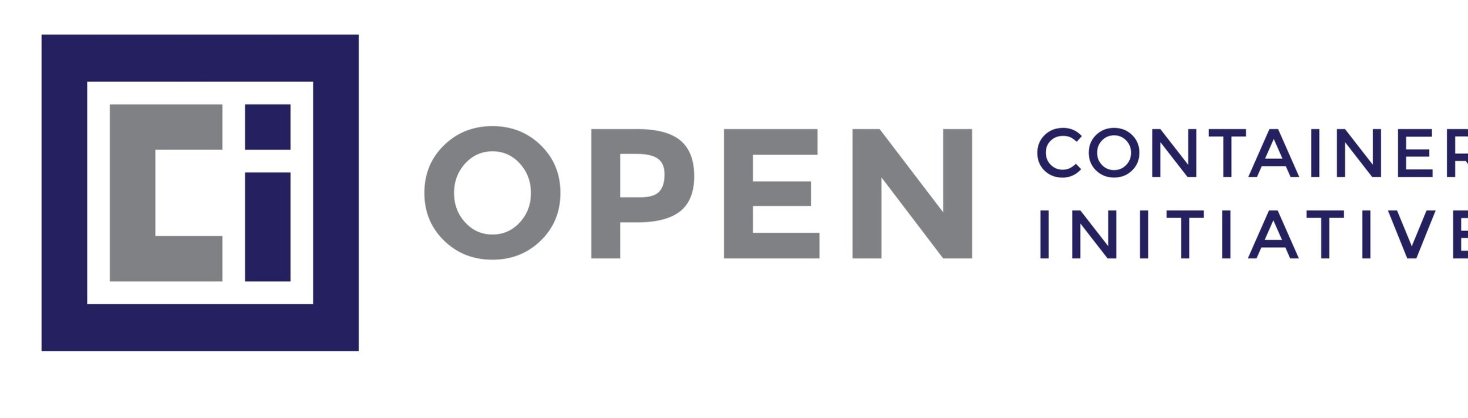






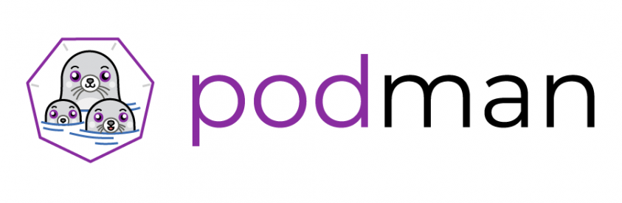



Adopting open source and open standards
The essential AIoT device enablement
Updates
Deployments
Connectivity
Device twin
VSS
MEC
VSC
Communication
Containerization
Model
Orchestration
3
Notes:
solution: open source eco system
Bringing edge expertise into the open source to solve complexity via open ecosystem approach

Slide 4
Adapting cloud-native technology for cloud-neutral edge
The essential AIoT device enablement
Lightweight
Deployable on various constrained edge
devices with ranging hardware capabilities
to scale hardware and connect diverse edge
devices and data sources.
Containerized
Develop edge applications using most fit-for-purpose languages and frameworks, manage
diverse device software with cloud-native
technology in uniform way
Connected
Connect to most-fit-for-purpose public IoT
platforms, manage devices and device data
via digital twins from the cloud with minimum customization, and prototype quickly
Flexible
Choose and combine reusable configurable and interoperable building blocks to bring the
right IoT edge capabilities depending
on the hardware and use case
Notes:
solution – technology advantages

Slide 5
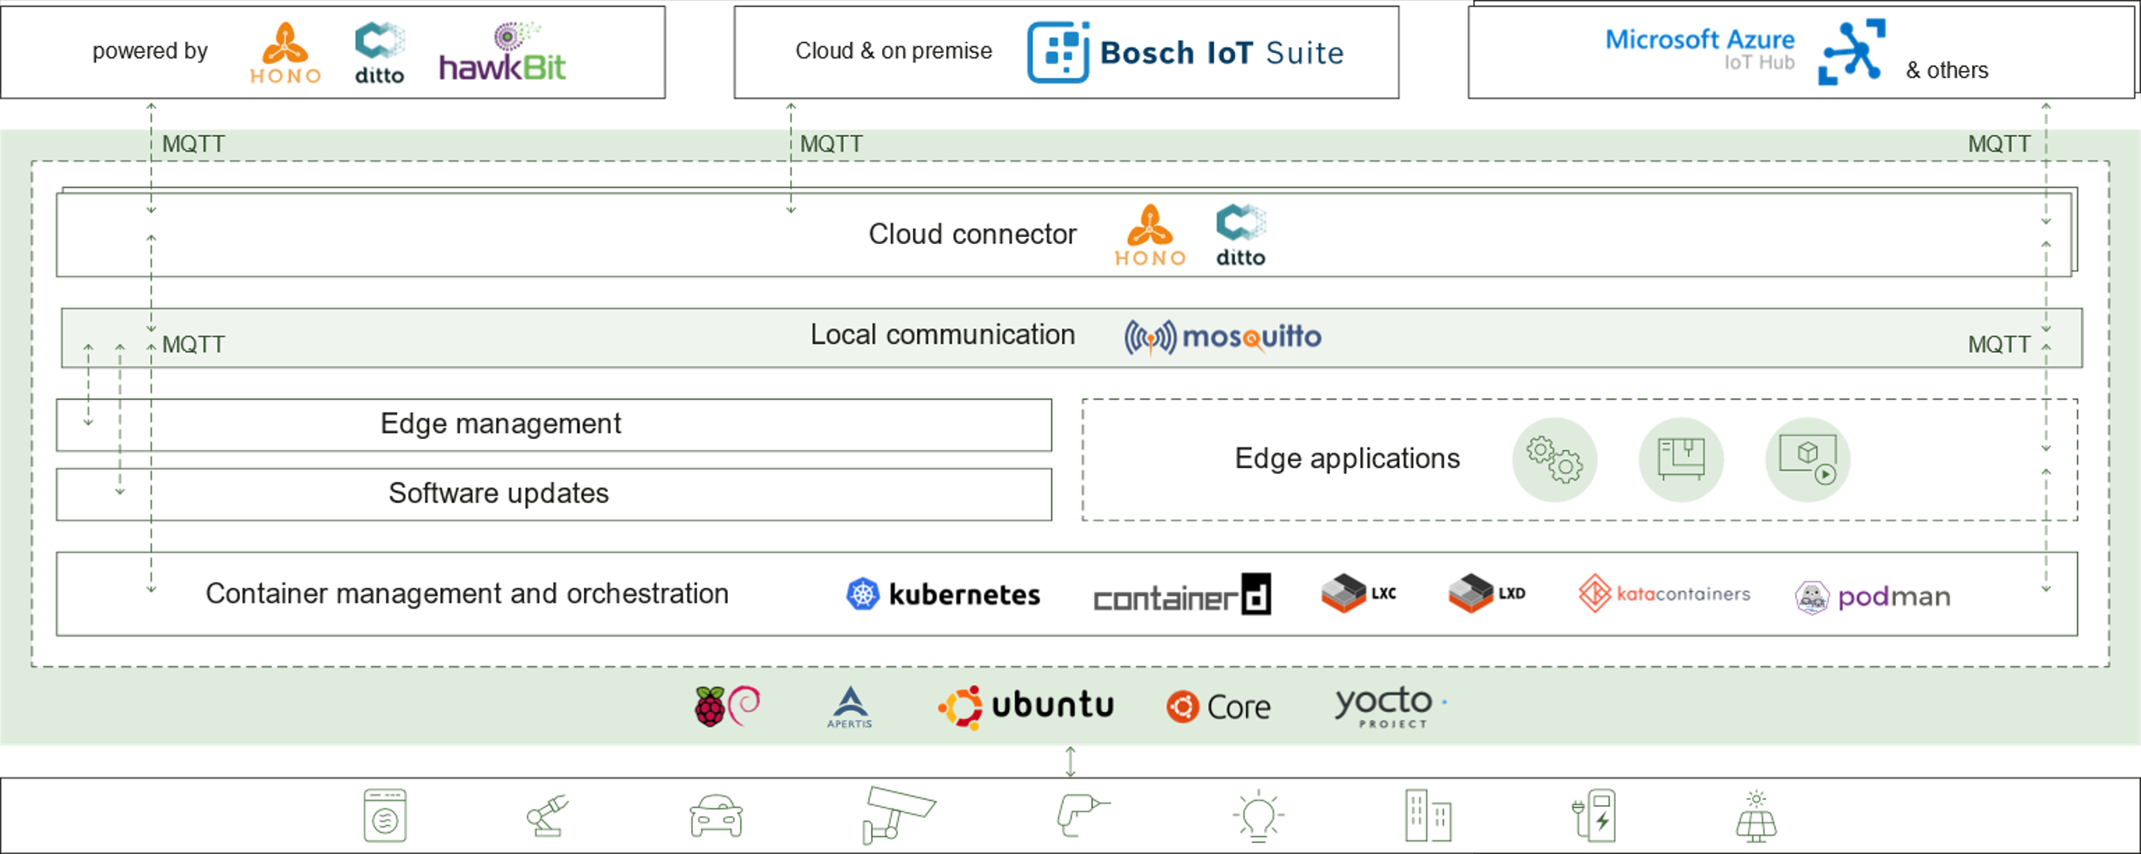
Technology building blocks
The essential AIoT device enablement

Slide 6
in action
Get in touch!
kanto-dev@eclipse.org
https://www.eclipse.org/kanto/
https://github.com/eclipse-kanto

Slide 7










Digital Twin
Resources:
Getting Started with Kanto
Ditto Python Client Library
Kuksa VISS Client Library
Kuksa.VAL Server
Kuksa.VAL GPS Feeder
Suite Connector
Local Communication
Container Management
Client
Server
VSS
VSS
VSS
GPS Feeder
NMEA
VISS
VSS
VISS

Slide 8
Comming up next
The essential AIoT device enablement
Eclipse Kanto launch!
02/2022
User onboarding fundamentals
03/2022
More features and user documentation
04/2022
More features
06/2022
More deployments
07/2022
Initial contribution
from Bosch.IO
available!
https://www.eclipse.org/kanto/
https://github.com/eclipse-kanto
First M1 release
and getting started available!
https://github.com/eclipse-kanto/kanto/releases/tag/v0.1.0-M1
https://www.eclipse.org/kanto/docs/getting-started/
More features and user documentation available!
https://www.eclipse.org/kanto/docs/
Cloud connectivity for Microsoft Azure IoT Hub
Bootstrapping agent
Local digital twins
System metrics
More features
State-driven containers management
LXD integration
File-based backup/restore
Lightweight orchestration
SoftwareUpdatable library
More deployments
Apertis integration
Yocto meta-layers
… and more to come driven by the community!
Cloud connectivity to Bosch IoT Device Management powered by Eclipse Hono, Ditto, and hawkBit
Vorto semantic modelling
Local communication with MQTT
Lightweight OCI-compliant containers management
Script-based software updates
File uploads via AWS, Azure
Debian packages for Linux ARM, ARM64, x86_64
CI/CD

Slide 9
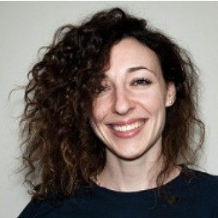

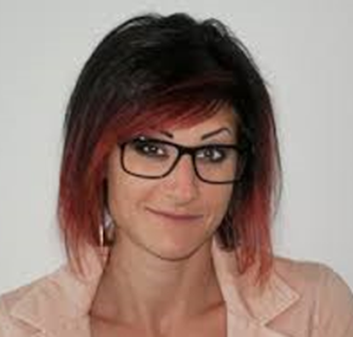
Elena Gramatova-Andreeva
Bosch.IO, Device and Data Management and Analytics
Lead Product Owner - Bosch IoT Edge Software
Project Lead Business – Eclipse Kanto
elena.gramatova@bosch.io
egramatova
Get in touch!
kanto-dev@eclipse.org
https://www.eclipse.org/kanto/
https://github.com/eclipse-kanto
Dr. Konstantina Gramatova
Bosch.IO, Device and Data Management and Analytics
Product Architect - Bosch IoT Edge Agent
Project Lead Technology – Eclipse Kanto
konstantina.gramatova@bosch.io
konstantina-gramatova

