Slide 1

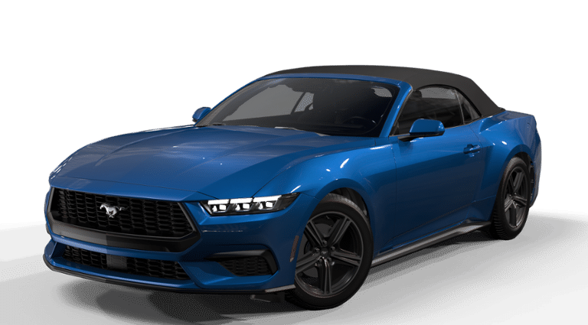
Integrating Vehicle Signals
with VSS and Metadata

Slide 2

Alan Freedman
Principal Data Architect
Ford Motor Company
afreedm2@ford.com
Notes:
Alan Freedman
Joined Ford as Principal Data Architect on 7/31/2023
Before that with Autonomic

Slide 3
Agenda
The requirement: Integrate vehicle signals from multiple sources into a common model and interact with VSS
Demo
  Generate metadata from vspec
  Automate vspec generation and signal mapping
The solution: Associate signals at the semantic level
MVP – Extend VSS
MDP – Reorganize Entries
Notes:
Requirement
Ford has an immediate requirement to add thousands of native vehicle signals (CAN bus, DTC, etc.) to our new data model.
We want that new data model to be able to interact with partners who have adopted the VSS.
Demo: I'll briefly demo:
…how we used an extended version of VSS to generate the metadata
…then how we used the metadata to automate the generation of signals, objects, and properties and their mapping to VSS
Solution
Define "signal" so that humans and machines are clear about its meaning
Specify each signal according to the definition
Rather than map signal-to-signal, we'll associate them by their semantics
MVP – Extend the VSS to express a data model
Added types that represent signal domain classes
Added key-value pairs that allow non-tree associations and make each entry independent of tree structure
MDP
Remove constraints and invert relationships to act as model rather than tree

Slide 4
Requirement
Given a source signal:
  Capture the source signal and its semantics in a metadata store
  If corresponding VSS signal exists, we're good
  Else If corresponding VSS object and property exist, automatically create VSS signal
  Else If corresponding object(s) are missing, automatically create VSS objects and signal
CAN bus signal | VSS signal for data model
PreCondRecrc_D_Actl
Vehicle.Cabin.HVAC.IsRecirculationActive
PreCondAC_D_Actl
Vehicle.Cabin.HVAC.IsAirConditioningActive
AirDamPos_D_Stat
Vehicle.Cabin.HVAC.Station.AirDistribution
AirAmb_Te_ActlFilt
Vehicle.Cabin.HVAC.Station.AmbientAirTemperature
PreCondAC_D_Dft
Vehicle.Cabin.HVAC.AirConditioning.Temperature
StrWhlTelExt
Vehicle.Chassis.SteeringWheel.TelescopicExtensionPercent
Notes:
Thousands of signals from CAN bus, Diagnostic Trouble Codes, and several other sources.
(For the PoC, I just worked with the HVAC tree
These first two have a signal that corresponds to the object and property
The second two have a signal that corresponds to a class and property
The final two have no corresponding signal and are missing a corresponding object and/or property

Slide 5
Requirement
Object
Signal
Property
Notes:
The one thing that makes everything else possible is specifying that a signal is A Registry Entry that specifies a Property of a particular Feature of Interest (or Object)
…and that we specify that to humans and machines alike

Slide 6


Slide 7
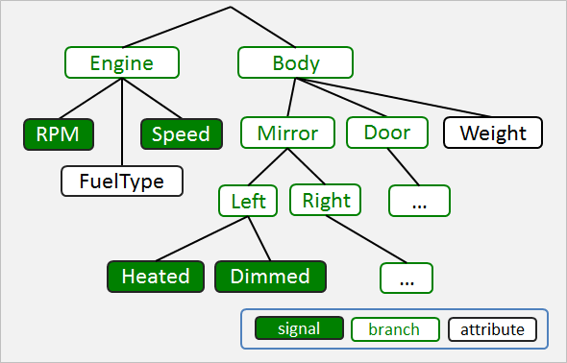
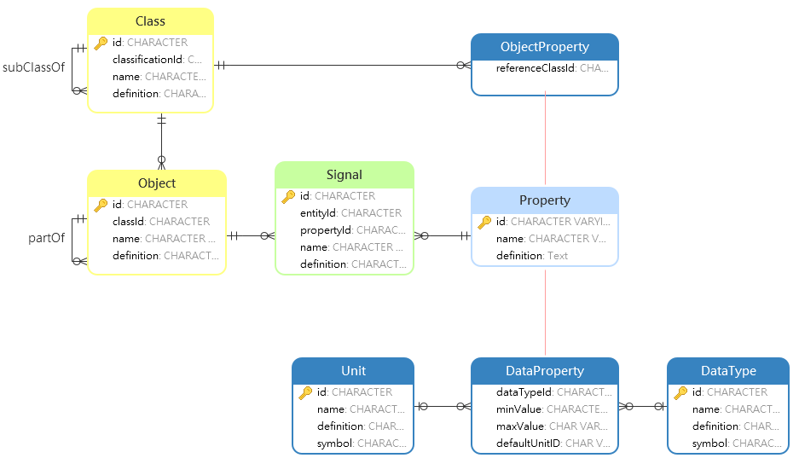
Solution
Associate Signals at the Semantic Level
Step 1: Extend the VSS yaml
from a tree
to a network
to enable a data model
Object
Signal
Property
Notes:
The tree connections between branches become partOf associations for objects
The tree connections between branches and actuators/sensors/attributes are become signal associations
The tree connections between branches and instances transform to classes and objects

Slide 8
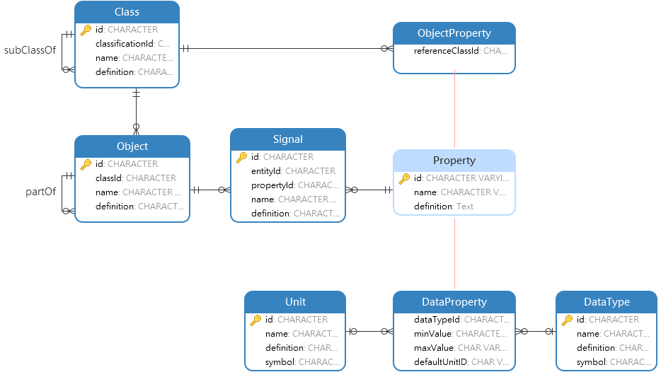
Solution
Associate Signals at the Semantic Level
Signal
AirDistribution:
datatype: string
type: actuator
allowed: ['UP', 'MIDDLE', 'DOWN']
description: Direction of airstream
definition: The z-axis relative direction of a HVAC Station
schemaElementType: Signal
id: Vehicle.Cabin.HVAC.Station.AirDistribution
name: Vehicle.Cabin.HVAC.Station.AirDistribution
propertyId: VerticalAirstreamDirection
objectId: Vehicle.Cabin.HVAC.Station
isDefinedBy: FordMotorCompany, COVESA
VerticalAirstreamDirection
Vehicle.Cabin.HVAC.Station.Row1.Driver
Vehicle.Cabin.HVAC.Station.Row1.Driver.AirDistribution
Notes:
Signal…
…A property…
…describing a particular object
We've extended the yaml
…first by adding a type that corresponds to the domain object, in this Case Signal
…and it conforms to our definition by specifying which property it reports for which object (or feature of interest)
…we've decoupled its identifier and name from the tree so that the entry is independent of any others…like a row in a database
…and added a definition to convey to humans the necessary and sufficient conditions that would be specified in our metadata

Slide 9
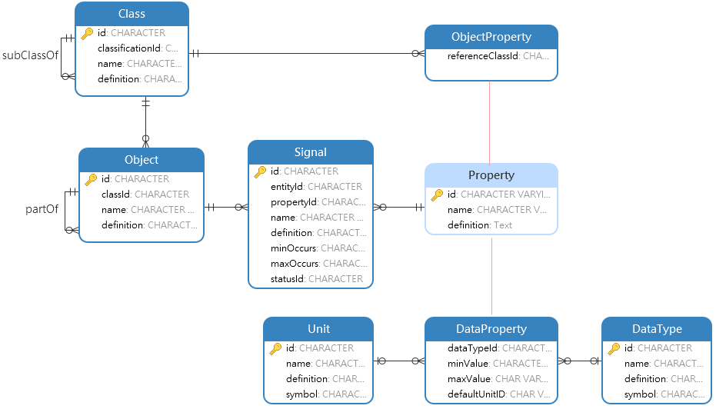
Solution
Associate Signals at the Semantic Level
Object Property
VerticalAirstreamDirection:
type: property
id: VerticalAirstreamDirection
name: Vertical Airstream Direction
schemaElementType: ObjectProperty
classId: RelativeDirection.Z
definition: A relative direction on the z-axis (up, down, etc.) of an air stream
isDefinedBy: FordMotorCompany
RelativeDirection.Z
An ordinal category indicating the spatial relation between something and the course along which it points or moves on the vertical axis (up, down, etc.)
VerticalAirstreamDirection
A relative direction on the z-axis up, down, etc.)
of an air stream
A higher place or position
UP
A place or position relatively equidistant between UP and DOWN
MIDDLE
A lower place or position
DOWN
Vehicle.Cabin.HVAC.Station.Row1.Driver.AirDistribution
Notes:
Object Property – The value is an object.
You can think of those values as elements in an enumeration
But we think of them as instantiated members of a class
But defined as knowledge rather than in code and now we can express much more about these things, like definitions for a start
Here's the YAML
We've promoted the property type from a member of a struct to a first-class citizen
We've stated that this is an object property
whose value will be an object of type RelativeDirection.Z

Slide 10
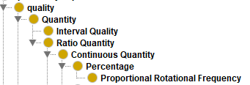
Solution
Associate Signals at the Semantic Level
Data Property
ProportionalFanSpeed:
type: property
id: ProportionalFanSpeed
name: Proportional Fan Speed
schemaElementType: DataProperty
classId: ProportionalRotationalFrequency
definition: The Rotational Frequency of the blades of a fan as a percent of maximum
isDefinedBy: FordMotorCompany
datatype: percent
ProportionalFanSpeed
The rotational frequency of the blades of a fan as a percent of maximum
percent
min: 0
max: 100
uint8
Vehicle.Cabin.HVAC.Station.Row1.Driver. FanSpeed
Notes:
Data Property – The value is a literal
Those values can be constrained by such things as a range of values
Each has a data type
And perhaps a default unit (of measure or concentration)
Of course we give it a precise definition
….here's the spec for a property
We've promoted the property type from an attribute of a struct to a first-class citizen
The values for this are literals, so a data property
And given it the class it instantiates…in this case we've expressed a deep property type hierarchy for demo purposes, but it's not necessary for MVP

Slide 11
Solution
Associate Signals at the Semantic Level
Class and Object
Station:
type: branch
instances:
- Row[1,4]
- ["Driver","Passenger"]
description: HVAC for single station in the vehicle
id: Vehicle.Cabin.HVAC.Station
name: Vehicle.Cabin.HVAC.Station
schemaElementType: Class
classId: VehiclePart
definition: A vehicle part that regulates the HVAC for a region of the vehicle
isDefinedBy: FordMotorCompany, COVESA
partOf: Vehicle.Cabin.HVAC
#include SingleHVACStation.vspec Station
HVAC:
type: branch
description: Climate control
id: Vehicle.Cabin.HVAC
name: Vehicle.Cabin.HVAC
schemaElementType: Object
classId: VehiclePart
definition: A vehicle part that controls the humidity, purity, and temperature of the air in the cabin
definitionSource: VehicleSignalSpecification
isDefinedBy: FordMotorCompany, COVESA
partOf: Vehicle.Cabin
#include HVAC.vspec HVAC
VehiclePart
Vehicle.Cabin.HVAC.Station
Vehicle.Cabin.HVAC
1
0..*
Vehicle.Cabin.HVAC.Station.Row1.Driver
Vehicle.Cabin.HVAC.Station.Row1.Driver
Notes:
Object – A vehicle part, occupant, geolocation, or other physical object that is being described or manipulated by a signal
Objects can be part of other objects, declared explicitly instead of implied via naming convention
Each object has a type explicitly denoted by its class
Classes can participate in generalization hierarchies

Slide 12
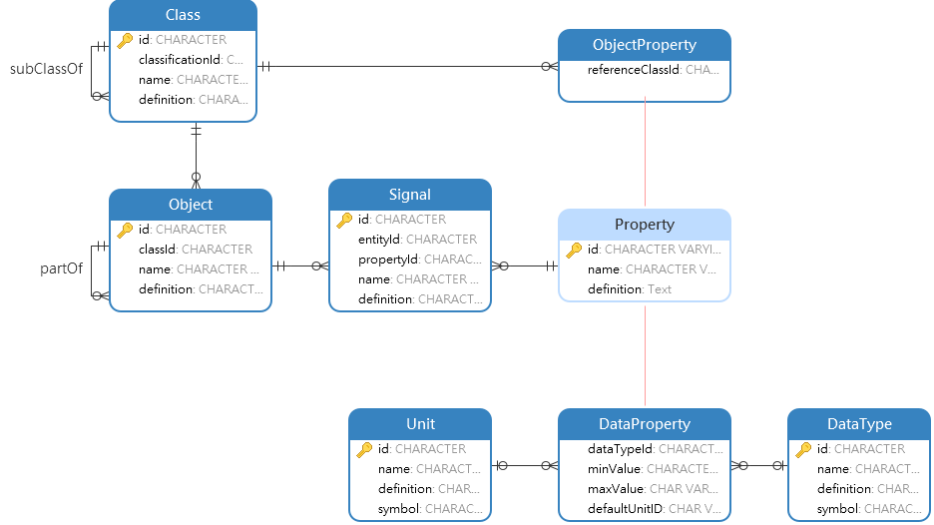
Solution
Associate Signals at the Semantic Level
Model
branch
instance
allowed value
actuator
attribute
sensor
struct
property
Notes:
Here is a comparison of the models. But the pic on the left illustrates a sample sub-graph rather than a model
This is how we might depict the model: A branch can contain other branches or any of these other items, and a struct can contain properties
When we view the models in an apples-to-apples comparison, it becomes pretty obvious that the data model is more expressive

Slide 13
PoC – Extend VSS
New Types
  Signal
  Data Property
  Object Property
  Class
  Object
New Key-Value Pairs
  schemaElementType
  id
  name
  classId
  definition
  part of
  propertyId
  objectId
IsRecirculationActive:
datatype: boolean
type: actuator
description: Is recirculation active.
id: Vehicle.Cabin.HVAC.IsRecirculationActive
name: Vehicle.Cabin.HVAC.IsRecirculationActive
schemaElementType: Signal
propertyId: IsActive
objectId: Vehicle.Cabin.HVAC.Recirculation
definition: Indicates whether the cabin air is being recycled
isDefinedBy: FordMotorCompany, COVESA
definitionSource: VehicleSignalSpecification
Notes:
So here is what a signal might look like with the extensions
Now that we define the property independently, no need for the data type
Now that we've defined it as a signal we no longer need Actuator
And the description can be replaced by the definition

Slide 14
PoC – Extend VSS
branch
IsRecirculationActive:
datatype: boolean
type: actuator
description: Is recirculation active.
id: Vehicle.Cabin.HVAC.IsRecirculationActive
name: Vehicle.Cabin.HVAC.IsRecirculationActive
schemaElementType: Signal
propertyId: IsActive
objectId: Vehicle.Cabin.HVAC.Recirculation
definition: Indicates whether the cabin air is being recycled
isDefinedBy: FordMotorCompany, COVESA
definitionSource: VehicleSignalSpecification
instance
allowed value
actuator
attribute
sensor
struct
property
Notes:
So although the extensions provide the necessary functionality, this MVP is like grafting a data model on top of a tree

Slide 15
MDP – Keep the Good Stuff
Keep Existing Signals
Keep Existing Objects and Classes
(as References rather than Parent Branches)
Add Properties as References
Vehicle.Cabin.HVAC.Station
Vehicle.Driver
Vehicle.Cabin.HVAC.Station.Row1.Driver
Vehicle.Cabin.HVAC.Station.Row1.Driver.AirDistribution
Vehicle.Driver.DistractionLevel
DistractionLevel
VerticalAirstreamDirection
IsOpen
Vehicle.Body.Hood.IsOpen
Vehicle.Body.Hood
TransmissionGear
Vehicle.Powertrain.Transmission.SelectedGear
Vehicle.ADAS.CruiseControl.SpeedSet
Speed
Vehicle.Powertrain.Transmission
Vehicle.ADAS.CruiseControl
Notes:
Keep the signals, they’re good. Just specify them at the object level instead of class level for instances
Keep the branches that represent classes and objects
Add properties as first-class citizens

Slide 16
MDP – Remove the Constraints
Remove Artificial Object Distinctions
Remove Artificial Signal Distinctions
Remove Artificial Types
Remove Tree Structure
branch
struct
instance
property
Object
allowed value
actuator
Signal
attribute
sensor
Notes:
Remove the Tree Structure
Remove Artificial Types (branch)
Remove the signal distinctions and have signal refer to property
Allowed Values are objects that instantiate classes, as are Instances, and have Signal refer to object

Slide 17
MDP – Invert Tree Syntax - Signals
Vehicle.Cabin:
type: branch
description: All in-cabin components, including doors.
#include Cabin/Cabin.vspec Vehicle.Cabin
HVAC:
type: branch
description: Climate control
#include HVAC.vspec HVAC
partOf: Vehicle.Cabin
Station:
type: branch
instances:
- Row[1,4]
- ["Driver","Passenger"]
description: HVAC for single station in the vehicle
#include SingleHVACStation.vspec Station
partOf: Vehicle.Cabin.HVAC
FanSpeed:
datatype: uint8
type: actuator
min: 0
max: 100
unit: percent
description: Fan Speed, 0 = off. 100 = max
Temperature:
datatype: int8
type: actuator
unit: celsius
description: Temperature
AirDistribution:
datatype: string
type: actuator
allowed: ['UP', 'MIDDLE', 'DOWN']
description: Direction of airstream
propertyId: AmbientAirTemperature
objectId: Vehicle.Cabin.HVAC.Station
propertyId: VerticalAirstreamDirection
objectId: Vehicle.Cabin.HVAC.Station
propertyId: ProportionalFanSpeed
objectId: Vehicle.Cabin.HVAC.Station
Notes:
Currently we must descend the tree
To act like a flexible data store, it must support associative relationships

Slide 18
MDP – Invert Tree Syntax - Instances
Vehicle.Cabin.HVAC.Station.Row1.Driver:
  schemaElementType: object
  classId: Vehicle.Cabin.HVAC.Station
  partOf: Vehicle.Cabin.HVAC
Vehicle.Cabin.HVAC.Station.Row1.Passenger:
  schemaElementType: object
  classId: Vehicle.Cabin.HVAC.Station
  partOf: Vehicle.Cabin.HVAC
Vehicle.Cabin.HVAC.Station.Row2.Driver:
  schemaElementType: object
  classId: Vehicle.Cabin.HVAC.Station
  partOf: Vehicle.Cabin.HVAC
Vehicle.Cabin.HVAC.Station.Row2.Passenger :
  schemaElementType: object
  classId: Vehicle.Cabin.HVAC.Station
  partOf: Vehicle.Cabin.HVAC
Station:
id: Vehicle.Cabin.HVAC.Station
schemaElementType: class
type: branch
instances:
- Row[1,4]
- ["Driver","Passenger"]
description: HVAC for single station in the vehicle
#include SingleHVACStation.vspec Station
Station:
id: Vehicle.Cabin.HVAC.Station
schemaElementType: class
type: branch
instances:
- Row[1,4]
- ["Driver","Passenger"]
description: HVAC for single station in the vehicle
#include SingleHVACStation.vspec Station
Vehicle.Cabin.HVAC.Station.Row3.Driver:
  schemaElementType: object
  classId: Vehicle.Cabin.HVAC.Station
  partOf: Vehicle.Cabin.HVAC
Vehicle.Cabin.HVAC.Station.Row3.Passenger:
  schemaElementType: object
  classId: Vehicle.Cabin.HVAC.Station
  partOf: Vehicle.Cabin.HVAC
Vehicle.Cabin.HVAC.Station.Row4.Driver:
  schemaElementType: object
  classId: Vehicle.Cabin.HVAC.Station
  partOf: Vehicle.Cabin.HVAC
Vehicle.Cabin.HVAC.Station.Row4.Passenger :
  schemaElementType: object
  classId: Vehicle.Cabin.HVAC.Station
  partOf: Vehicle.Cabin.HVAC
Vehicle.Cabin.HVAC.Station.Row2.Center
  schemaElementType: object
  classId: Vehicle.Cabin.HVAC.Station
  partOf: Vehicle.Cabin.HVAC
  LateralPosition: Left
  occupantRole: Driver
  LongitudinalPosition: Rear
  VentType: Fixed
Notes:
It's a no-no for a parent to know of its children
So we invert the relationship
Then we can append a new child with no modifications (Open/Closed Principle)
We can delete or deprecate unwanted children
We can append new information about each object with no modifications

Slide 19
MDP – Invert Tree Syntax
Class
VehiclePart
Vehicle.Cabin.HVAC.Station
Object
Signal
Property
Vehicle.Cabin.HVAC.Station.Row1.Driver
Vehicle.Cabin.HVAC.Station.Row1.Driver.FanSpeed
ProportionalFanSpeed
partOf
Vehicle.Cabin.HVAC.Station. Row1.Driver. Temperature
AmbientAirTemperature
Vehicle.Cabin.HVAC
Vehicle.Cabin.HVAC.Station. Row1.Driver. AirDistribution
VerticalAirstreamDirection
partOf
Vehicle.Cabin
Notes:
To visualize the previous yaml entries:
We have signals
…and they report properties (which are now first-class citizens)…
…of particular objects…
…which can be components of other objects
…each of which instantiate a class

Slide 20


Questions

Slide 21
Property Independence
IsLocked:
type: property
id: IsLocked
name: Is Locked
schemaElementType: DataProperty
classId: BooleanValue
definition: The object is secured to prevent unauthorized access
datatype: boolean
Vehicle.IsLocked
Vehicle.Cabin.Door.Row1.Driver.IsLocked
Vehicle.Chassis.SteeringWheel.IsLocked
Vehicle.Powertrain.CombustionEngine.Crankshaft.IsLocked

Slide 22
MVP – Extend VSS
Property
A type of quality whose value helps to identify, define, describe, distinguish or otherwise characterize things
Data Property
A property whose values are literals
IsActive:
id: IsActive
name: Is Active
schemaElementType: DataProperty
definition: A boolean variable indicating that an object is currently performing its fundamental action or activity
dataType: DataTypeSpecification.boolean
AmbientAirTemperature:
id: AmbientAirTemperature
name: Ambient Air Temperature
schemaElementType: DataProperty
definition: The temperature of the air in a site or spatial region
dataType: DataTypeSpecification.float
unit: Celsius
Temperature:
datatype: int8
type: actuator
unit: celsius
description: Temperature
definition: The degree or intensity of heat set for a HVAC station
schemaElementType: Signal
signalName: Vehicle.Cabin.HVAC.Station.Temperature
propertyId: AmbientAirTemperature
objectId: Vehicle.Cabin.HVAC.Station
Notes:
I'll go through the k/v pairs later, but for now…
Property – Liberate from struct and recast as first-class citizen that helps define signals
Data property - A property whose values are literals.
Signals (VSS actuators, attributes, and sensors) explicitly name their objects and properties

Slide 23
New VSS Types
Object Property
A property whose values refer to objects
RelativeDirection.Z.UP:
id: RelativeDirection.Z.UP
name: UP
schemaElementType: Object
classId: RelativeDirection.Z
definition: A higher place or position
VerticalAirstreamDirection:
id: VerticalAirstreamDirection
name: Vertical Airstream Direction
schemaElementType: ObjectProperty
classId: RelativeDirection.Z
definition: A relative direction on the z-axis (up, down, etc.) of an air stream
RelativeDirection.Z:
id: RelativeDirection.Z
name: Relative Direction - Z Axis
schemaElementType: Class
classId: OrdinalCategory
RelativeDirection.Z.DOWN:
description: Climate control
id: RelativeDirection.Z.DOWN
name: DOWN
schemaElementType: Object
classId: RelativeDirection.Z
definition: A lower place or position
AirDistribution:
datatype: string
type: actuator
allowed: ['UP', 'MIDDLE', 'DOWN']
description: Direction of airstream
definition: The z-axis relative direction of a HVAC Station
schemaElementType: Signal
signalName: Vehicle.Cabin.HVAC.Station.AirDistribution
propertyId: VerticalAirstreamDirection
objectId: Vehicle.Cabin.HVAC.Station
RelativeDirection.Z.MIDDLE:
description: Climate control
id: RelativeDirection.Z.MIDDLE
name: MIDDLE
schemaElementType: Object
classId: RelativeDirection.Z
definition: A position relatively
equidistant between up and down
Notes:
We think of these as relationships, or foreign keys

Slide 24
New VSS Types
Class
A category of things determined to be of the same type
Station:
type: branch
instances:
- Row[1,4]
- ["Driver","Passenger"]
description: HVAC for single station in the vehicle
id: Vehicle.Cabin.HVAC.Station
name: Vehicle.Cabin.HVAC.Station
schemaElementType: Class
classId: VehiclePart
definition: A vehicle part that regulates the HVAC for a region of the vehicle
partOf: Vehicle.Cabin.HVAC
RelativeDirection.Z:
id: RelativeDirection.Z
name: Relative Direction - Z Axis
schemaElementType: Class
classId: OrdinalCategory

Slide 25
New VSS Types
Object
A category of things determined to be of the same type
HVAC:
type: branch
description: Climate control
id: Vehicle.Cabin.HVAC
name: Vehicle.Cabin.HVAC
schemaElementType: Object
classId: VehiclePart
definition: A vehicle part that controls the humidity, purity, and temperature of the air in the cabin
definitionSource: VehicleSignalSpecification
isDefinedBy: FordMotorCompany, COVESA
partOf: Vehicle.Cabin
#include HVAC.vspec HVAC
Station:
type: branch
instances:
- Row[1,4]
- ["Driver","Passenger"]
id: Vehicle.Cabin.HVAC.Station
schemaElementType: Class
partOf: Vehicle.Cabin.HVAC
Vehicle.Cabin.HVAC.Station.Row1.Driver
schemaElementType: Object
classId: Vehicle.Cabin.HVAC.Station
partOf: Vehicle.Cabin
Vehicle.Cabin.HVAC.Station.Row1.Passenger
Vehicle.Cabin.HVAC.Station.Row2. Driver
Vehicle.Cabin.HVAC.Station.Row2.Passenger
Vehicle.Cabin.HVAC.Station.Row2. Driver
Vehicle.Cabin.HVAC.Station.Row2.Passenger

Slide 26
New VSS Types
Property Class
A classification of properties that share equivalent extensions
Temperature:
id: Temperature
name: Temperature
schemaElementType: PropertyClass
classId: ContinuousQuantity
definition: A Continuous Quantity indicating the degree or intensity of heat present in a substance or object
isDefinedBy: FordMotorCompany
AmbientAirTemperature:
id: AmbientAirTemperature
name: Ambient Air Temperature
schemaElementType: DataProperty
classId: Temperature
definition: The temperature of the air in a site or spatial region
isDefinedBy: FordMotorCompany
dataType: DataTypeSpecification.float
unit: Celsius
Temperature:
datatype: int8
type: actuator
unit: celsius
description: Temperature
definition: The degree or intensity of heat set for a HVAC station
schemaElementType: Signal
id: Vehicle.Cabin.HVAC.Station.Temperature
propertyId: AmbientAirTemperature
objectId: Vehicle.Cabin.HVAC.Station
isDefinedBy: FordMotorCompany, COVESA
Notes:
Property Class – AKA quantity kind.
All properties whose class is temperature take values in degrees Celsius, Fahrenheit, or Kelvin
All properties whose class is speed take values length divided by distance: meters per second, kilometers or miles per hour, etc.

