Slide 1
SDVoF
Software Defined Vehicle of the Future EU initiative

Slide 2
Software Defined Vehicle of the Future Initiative
The Software Defined Vehicle of the Future initiative (SDVoF) is a partnership between the EU commission and the industry to tackle the challenges in the global SDV market together.

Slide 3
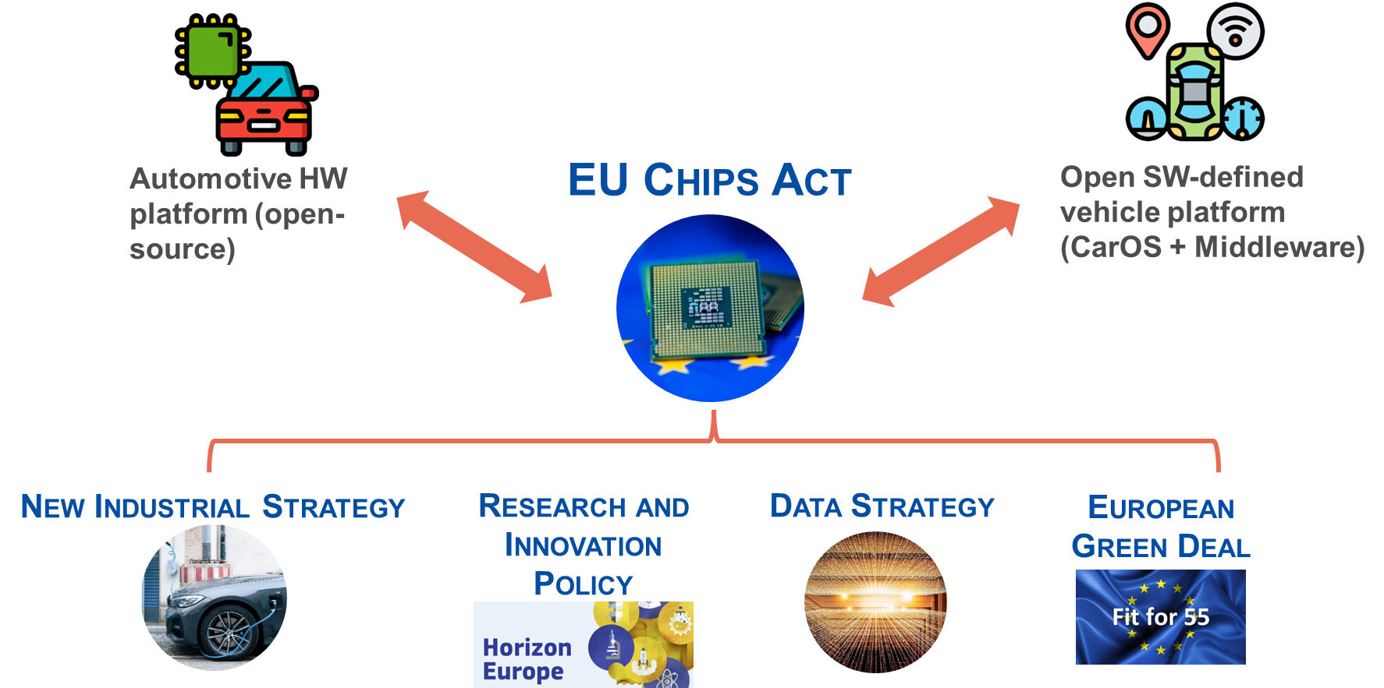
Overview
FEDERATE and subsequent Coordination projects
Coordination
SDVoF
(SHERPA)
HAL4SDV
definition of scope
identification of topic areas
Future projects
WPx defined in HAL4SDV
(definition of additional topics/WPs)
WP4
WP5
WP6
WP3
WP1
WP2
WP3
WPx

Slide 4
TIMELINE
2023
2024
2025
2026
2027
2028
2029
KDT/
Chips JU
HAL4SDV
SDV: Middleware
Subsequent projects on SDV platform
Chips JU project(s) on automotive HW platform
CCAM
Focusing on automated driving applications
2ZERO
Focusing on electric vehicle applications
Member States
National projects (e.g. NeveOS (FR), SofDCar (DE), CeCaS (DE), …)

Slide 5
Phase Approach – Roadmap
Phase 1 (EU Project A)
Definition phase
WP A.1
WP C.1
WP B.1
Phase 2 (EU Project B)
WP B.2
WP A.2
WP A.3
WP C.2
Phase n (EU Project X)
WP B.3
WP C.3
Time

Slide 6

Consolidation of PAIN POINTS EU Commission + Project Partners
A Hardware/Software Abstraction
B API
C Development Process Tools
D Integration, Testing, Simulation
HW Abstraction – Hypervisor
Middleware besides AUTOSAR Adaptive
Communication Middleware (DDS and other solutions)
Defragmentation of interfaces
Interface concept for service oriented and signal-oriented functions
Data Architecture for Automotive
Container/isolation for complex application (like HMI)
VSS – Vehicle Signal Specification
Efficiently integrating SDV
Mapping for internationalization
Plug & charge according to ISO standards available as open implementations
Linux Ecosystem for Safety
Memory safe languages for critical systems
Open tool for architecture modelling following a model-based-systems-engineering approach for overall vehicle definition
Tooling for performance
Tools interoperability in automotive SW dev area
Software testing on integration – level
Virtualisation for vehicle subsystems
Reprocessing / replay and simulation
E SW Maintenance & Updateability
F Open Source
G Mindset & Ecosystem
H Governance
Isolation of applications
Sustainable maintenance
OSS blueprints for compliance with EU regulations (e.g. cyber security)
Define and show “automotive grade”
Process Mapping: CRA Compliance with OSS supply chains
Open-Source Governance Model

Slide 7

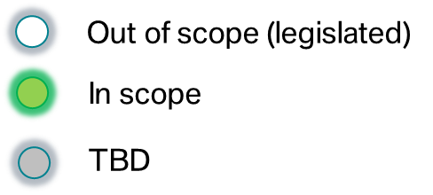


COVESA: Scope
Key
…
Mobile device
Charging point
Cloud
B
A
HAL4SDV targets to implement the lines
Native OS
Hosted
OS
AI
C
Legacy networks
D
Common consistent data BASIS across multiple touch-points.
https://www.covesa.global/

Slide 8


COVESA: Vehicle architecture pattern to illustrate the needs identified in the EU SDVoF Initiative
Android Application
Internet
Middleware
Internet
Android
Data Store
C
Cloud2cloud
BSP
VHAL
COVESA Software Defined Vehicle (SDV)
HPC HW
wireless, e.g., 4G, 5G
B
Wireless, e.g., BLE, Wifi
A
HAL4SDV targets to implement lines
HU
Computing
TCU
ADAS
High Bandwidth
Sensors
wired, e.g., ETH
D
Zone ECU
Zone ECU
Zone ECU
Zone ECU
ECU
ECU
ECU
ECU
ECU
ECU
ECU
ECU
ECU
ECU
ECU
ECU
ECU
ECU
ECU
ECU
wired, e.g., CAN, LIN, FlexRay
wired, e.g., CAN, LIN, FlexRay
wired, e.g., CAN, LIN, FlexRay
wired, e.g., CAN, LIN, FlexRay
ECU
ECU
ECU
ECU
ECU
ECU
ECU
ECU
Sensor
Actuator
ECU
ECU
ECU
ECU
ECU
ECU
ECU
ECU

