Slide 1
CVIS Multiple Trees VSS Alignment
Ulf Björkengren Ford Motor Company
February 10 2025

Slide 2
CVIS path compatibility with VSS
It is desirable that CVIS is path compatible with at least the most common VSS signals.
Currently that is implemented by
  including VSS objects in the Truck tree.
  Naming the Truck tree root node “Vehicle” when configured.
Another alternative is to create a separate “VSS core” tree.
  This tree is path compatible with the standard VSS tree for the subset of signals it includes.
  It will make it easier to validate that these signals with the standard VSS tree.
  It will make it clearer which signals are Vehicle common vs Truck specific.
  It may be possible that the VSS community takes over the maintenance later on.
COVESA EU Data Act Charter
  “A likely side benefit may be that VSS evolves to be a better solution for OEMs complying to the Act.”
  A good opportunity to propose an evolved VSS tree acceptable by passcar/truck/etc OEMs.

Slide 3
CVIS path compatibility with VSS – VSS Core tree
The Commercial Vehicle project is conducting Data campaigns creating lists with most significant signals for Fleet management and Insurance.
ACEA also created list with 40-ish signals (Niklas signal set?)
Use the above to create a VSS Core tree.
  Signals that are shared with the official VSS tree shall be path compatible.
  Other signals from the input above may be added. They should then be proposed to the VSS WG for inclusion in the VSS tree.
This tree could then be proposed to the EU Data Act project.

Slide 4
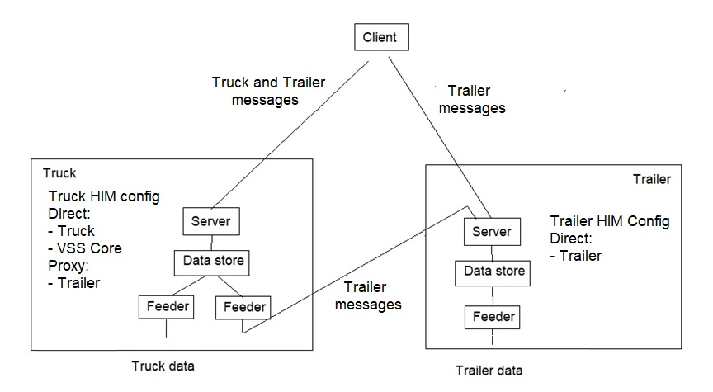
CVIS truck-trailer multiple trees configuration (PoC?)
Requests to Truck with a path starting with Vehicle or Truck are served with Truck data.
Requests to Truck with a path starting with Trailer are forwarded to the Trailer server.
Requests to Trailer, direct from Client or via Truck, are served with Trailer data.

