Slide 1
CVIS retrospect, planning, system design and experimentation setup
Ulf Björkengren Ford Motor Company
December 2 2024

Slide 2
CVIS retrospect: What should be the CVIS project results?
A model for how to represent signals for different vehicle types.
A framework for the development of different signal taxonomies.
Signal taxonomies for different vehicle types.

Slide 3
CVIS retrospect: What have we achieved so far?
Common agreement on a model that uses multiple trees for the signal representation
  -> The HIM Resource profile.
Creation of a framework that supports development of multiple different trees with a common base of shared objects.
  -> HIM configurator with the trees/objects structure
A first draft of truck signal tree definition.
Skeletons for trailer and bus signal trees.

Slide 4
CVIS retrospect: What is left to do?
Definition of the contents of the different trees.
  Initial drafts of trailer tree(s), bus tree, and for other vehicle types.
    Driver tree, body fitters?
  Release level version of the different trees.
System design for truck – trailer integration and its implications on tree content?

Slide 5
CVIS retrospect: What should be the next step?
Refine the truck tree?
Work on initial trailer tree draft?
System design and experimentation?

Slide 6
CVIS truck-trailer system design
Deployment of vehicle API servers?
  In truck only, or separately in truck/trailer?
What trailer specific data, if any, should be available in the truck tree?
  Trailer identity, type, position, ..?

Slide 7
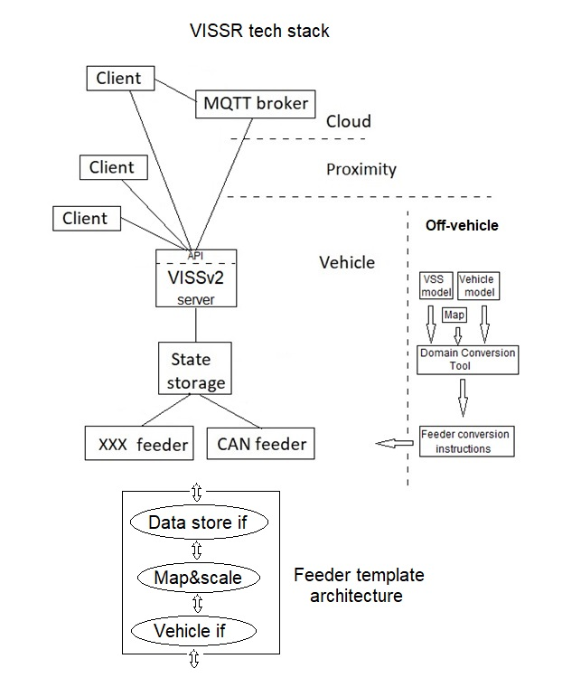
Experimentation: VISS reference implementation (VISSR)
VISSR implements the VISS specification.
  VISSv2.0 available on v2.0 branch, VISSv3.0 on main branch
The VISSR tech stack contains an almost full stack, from vehicle sources to clients (in cloud/proximity/in-vehicle).
What needs to be done to complete the stack?
  Implement the vehicle interface driver in the feeder.
  Map vehicle native data to VSS data.
    A truck/trailer/… tree definition must be available.
  Provide signal data
    Live data by connecting the feeder to real vehicle data sources.
    Simulated data. Several options are available to realize this.

Slide 8
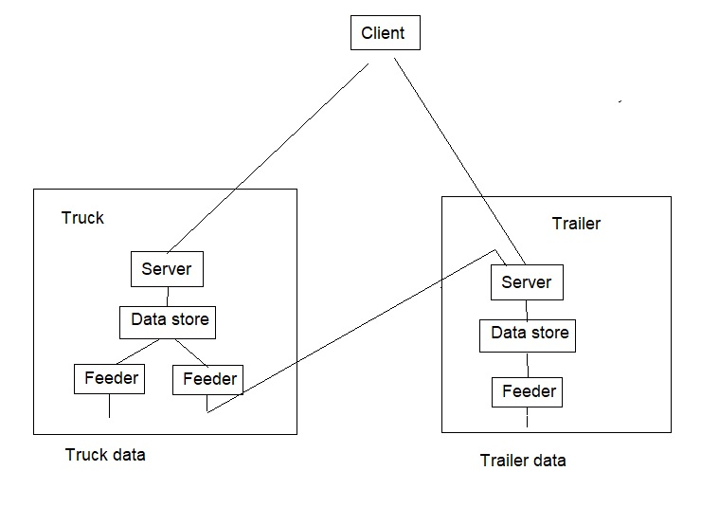
Experimentation: Truck-trailer VISSR architecture
Truck VISSR tech stack on one computer
Trailer VISSR tech stack on another computer
Client-server access alternatives
  Truck and trailer separately
  Both via the truck access
Alternative access technologies
  WiFi
  Cellular
  BT
  CAN (truck feeder-trailer server)
System design questions
  ???

