Slide 1
Aug 2025
PUBLIC
CVIS trailer tree proposal
Ulf Bjorkengren, Ford Motor Company

Slide 2
CVIS project proposal on how to represent trailer data in a single tree
Volvo Trucks proposed a solution where trailers are represented in the same tree as used for the Truck data. Using the VSS-tools instances mechanism to create a tree that can support the maximum instances of:
- Number of trailers (max 5)
- Number of axles on a trailer (max 15)
- Number of wheel positions on an axle (10)
The tree that this creates by using the VSS-tools has
- About 16.700 nodes (standard VSS tree has about 1.400 nodes)
- About 12.700 leaf nodes (standard VSS tree has about 1.100 leaf nodes)
This tree has the ability to accommodate up to 5 trailers with any axle/wheel configuration, but the utilization of the nodes of the tree is likely to be low.
To mitigate that an “on-line” tool would have to be developed that can modify the tree to represent the signals that are present in the trailers.
Another issue is the case where a trailer has signals that are not represented in the standard trailer subtree.

Slide 3
CVIS project proposal on how to represent trailer data in separate trees (1): Overview
An alternative to representing the trailers in the truck tree is to take advantage of the Data profile of the Hierarchical Information Model (HIM) which supports scenarios where multiple trees are used.
Using HIM each trailer will have a separate tree, and in the truck tree the only data representing the trailers is the Vehicle.TrailerCount signal, an uint8 that represent the number of trailers being towed by the truck.
The trailer tree will be assigned a root node name “TrailerX” where X is a number from 1 to 5. The number it is assigned tells its position in the row of towed trailers, with 1 being assigned to the trailer directly behind the truck.
The sequence of steps that will happen when a trailer is attached to be towed is described on the next slides.

Slide 4
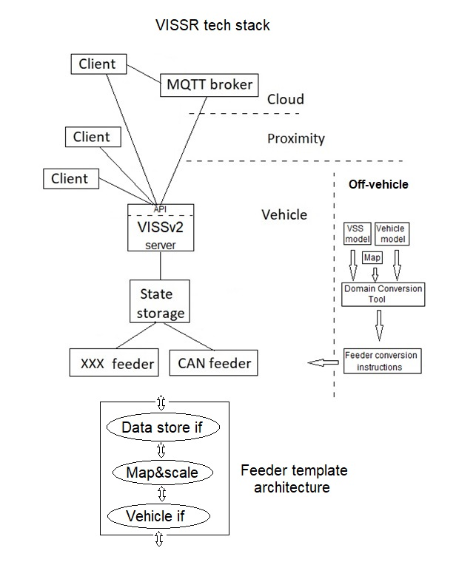
CVIS project proposal on how to represent trailer data in separate trees (2.1): Sequence when attaching a trailer – Scenario assumptions
Scenario assumptions:
- The trailer will connect via a CAN bus over which the trailer signals are transported.
- The trailer configuration data is represented by the three files below. They are provided to the truck over e. g. WiFi.
* DBC file: for encoding of CAN frames to CAN signals
* CAN-to-VSS mapping file: for encoding between CAN signal representation and VSS representation (This might be more than one file)
* Trailer tree file: containing the tree representing the trailer signals that are exposed to the truck
- The vehicle server in the truck is an instance of the VISSR server and accompanying tech stack.
- The VISSR tech stack is augmented with a “Trailer manager” that is involved in configuring the tech stack when a trailer is added or removed from being towed.

Slide 5
CVIS project proposal on how to represent trailer data in separate trees (2.2): Sequence when attaching a trailer
The described scenario starts after that the trailer is physically attached to the truck, the CAN bus and WiFI are connected.
The driver starts the Trailer Manager (TM) and via the UI (truck integrated or on a mobile phone, etc) the TM gets information about the tow position of the trailer, and possibly some help with downloading the three configuration files from the trailer.
The TM then instantiates a CAN feeder and provides it with the DBC file for CAN frame encoding and the CAN-to-VSS file for CAN to VSS encoding.
The TM then updates the HIM file that contains information about the set of trees that the server is to manage. This involves the following:
    The trailer tree that it received over WiFi is stored in the file system and the path to it is saved in the HIM file.
    The position of the trailer received from the driver is used to generate the root node name for the tree, and saved in the HIM file.
The TM triggers the truck server to re-read the HIM file to discover the new trailer tree added to it.
Clients can now access data from the trailer via the truck server.

Slide 6
VISS client example reading from truck and trailers
In a scenario where two trailers have been attached for towing and the sequence described on the previous slide has been performed for each of them, an example of client requests and responses when reading data from the truck and the trailers is shown below. The syntax shown is a condensation of the payloads transported over any VISS supported transport protocol, e. g. gRPC.
Read the number of attached trailers:
GET Vehicle.TrailerCount
Response: Value: 2
Read the trailer type of the first trailer in the row:
GET Trailer1.TrailerIdentification.TrailerType
Response: Value: CONVERTER_DOLLY
Read the trailer type of the second trailer in the row:
GET Trailer2.TrailerIdentification.TrailerType
Response: Value: TOWING_FULL_TRAILER

Slide 7
Comparison with the single tree proposal
The number of nodes in the truck tree is basically the same as in the standard VSS tree.
A trailer tree that was generated using the HIM configurator, having three axles with 2, 4, and 4 wheels respectively, otherwise with the same signals as in the trailer subtree provided by Volvo Trucks, have a size of 229 nodes in total, of which 183 are leaf nodes.
One truck tree and five trailer trees will then have a total node count of about 2545 of which about 2000 are leaf nodes. With the truck towing only one trailer the numbers become 1629 in total with 1283 leaf nodes
In comparison the single tree proposal had a total node count 0f about 16.700 of which 12.700 are leaf nodes.
Trailer trees do not have to conform to a “fixed” trailer representation, they can contain different signals, which then can be discovered by the client through signal discovery requests.
The only code to be written to enable a running demo of this proposal is the Transport Manager, the CAN driver part of the feeder, and the client accessing the data from the truck and trailers. The CAN driver probably already exists, which then can be connected to the feeder via IPC.
The trailer configuration data items must also be created.

Slide 8
HIM configuration file modifications
The part shown in red below is the representation of a trailer tree that needs to be added (or removed) from the HIM configuration file.
HIM:
type: branch
description: The set of trees that the truck server manages as one virtual domain.
HIM.Vehicle:
type: direct
domain: Vehicle.Truck.Data
version: X.Y.Z
local: file://<full-path-name>
description: Truck signal tree.
HIM.Trailer1:
type: direct
domain: Vehicle.Trailer.Data
version: X.Y.Z
local: file://<full-path-name>
description: Trailer signal tree.

Slide 9

CAN to VSS mapping file generation
The VISSR tech stack contains a Domain Conversion Tool (DCT) that is used to generate the feeder conversion instructions file that is used by a feeder for converting between CAN and VSS.
DCT takes three YAML formatted files as input:
- Vehicle model: Contains at a minimum the name, datatype, and unit of all the CAN signals
- VSS model: Contains at a minimum the name, datatype, and unit of all the VSS signals
- Map file: Contains an array of signal name tuples (CAN name, VSS name) that are to be mapped with each other.
The output file is typically stored in the same directory as that where the feeder executable is stored.
The feeder reads the file at startup and then uses it as a look-up table for the name mapping and the scaling of the signal if needed.

