Slide 1
CVIS Status spring 2025
Ulf Bjorkengren, Ford Motor Company
AMM Berlin 2025-05-14

Slide 2
CVIS goals
Create a framework for development of vehicle signal trees for different vehicle types.
Create signal trees for different vehicle types.
  Truck / Trailer / Bus / Car / Van / Pick-up / Motorcycle / …
VSS alignment has high priority.
Development of apps that can be used with trees for multiple vehicle types shall not be too cumbersome.

Slide 3
Data model supporting multiple trees
Hierarchical Information Model (HIM)
  Resource profile: Vehicle signal rule set identical with the VSS rule set.
  Service profile: Vehicle service(Procedure-based), syntax inherited from the VSS rule set.
  Support for defining a forest of multiple trees.
The CVIS project will use the HIM resource profile for defining trees for different vehicle types.

Slide 4
CVIS Development framework
Generation 1 (symbolic links):
  Trees for different vehicle types are created separately.
  “Objects” that are commonly used in different trees are located on a common “vspec object files” directory branch.
  The vspec tree includes the vspec objects using symbolic links.
  Vspec files with symbolic links are compatible with VSS-tools exporters.
Generation 2 (HIM configurator):
  A tool that pre-processes vspec2 files, converting them to vspec format.
  Converted vspec tree is used as input to the VSS-tools exporters.
  Preprocessing features:
    Variation points
      Global
      Local
    Asymmetric instantiation
    Common allowed definitions
    Configuration of default values and descriptions

Slide 5
HIM configurator features
Asymmetric instantiation
  Enables e. g. axles to have different number of wheels
Variation point
  Global
    Enables selection of zero or more subtrees
      Can be used for complete removal of subtrees.
  Local
    Enables e. g. instantiated axles to be differently configured
External reference to Allowed definition
  Enables Allowed definitions to be shared / reused
Default value and description configuration
  Enables default values and descriptions to be updated/added

Slide 6
CVIS trees under development
Generation 1:
  Separate trees referencing common objects.
  Separate input configuration to the HIM configurator.
  Trees started (not completed): Truck / Trailer / Bus / Driver (supplementary tree for Trucks)
Generation 2:
  A common, vehicle type agnostic tree that after HIM configuration becomes vehicle specific.
  Separate input configurations for different vehicle types.
  Trees started (not completed): VSS-core
    Configuration files for Truck / Car
    Car configuration produces a YAML file that is basically identical to the standard VSS YAML tree.

Slide 7
Supplementary slides

Slide 8
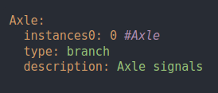
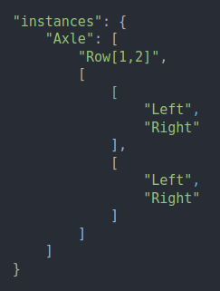
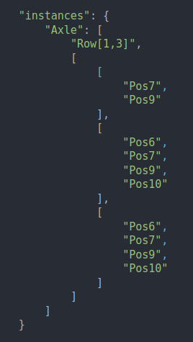
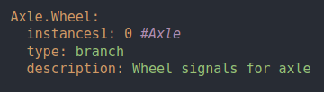
Pre-processor asymmetric instantiation
Chassis.vspec2 himConfig-car.json himConfig-truck.json

Slide 9
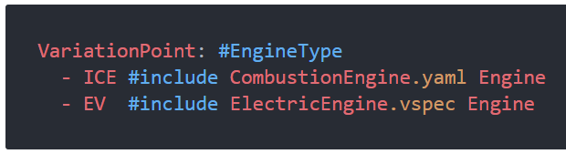
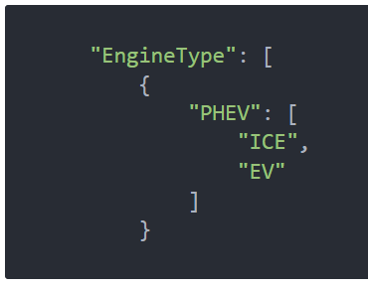
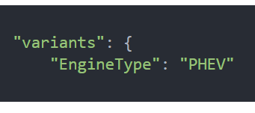
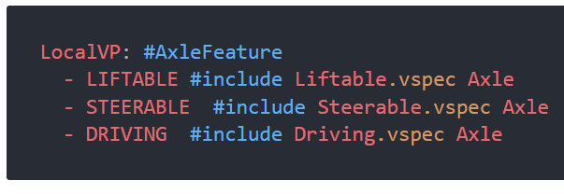
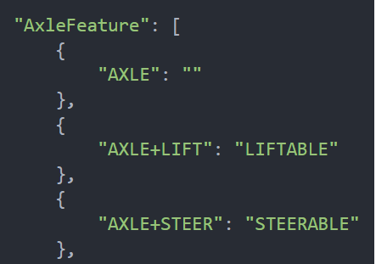
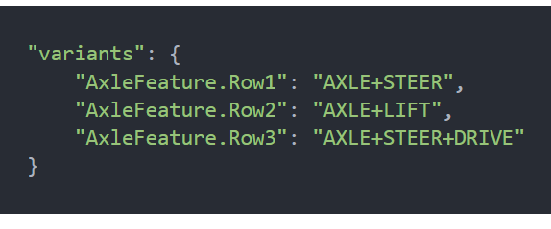
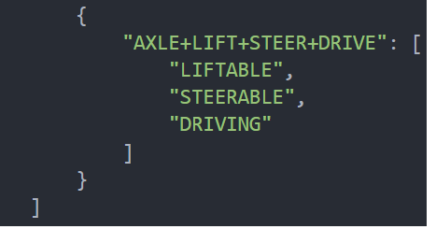
Pre-processor variation points
Global variation point
VssCoreSignalSpecification.vspec2 Variability.json himConfig-xx.json
Local variation point
Chassis.vspec2 Variability.json himConfig-xx.json

