Slide 1
Automotive AOSP App Framework Standardization Expert Group
Entertainment Working Stream
October 31, 2024

Slide 2

Introduction, the problem + the solution
In vehicles without Google Automotive Services (GAS), essential features like Google Maps and reverse geocoding are unavailable. This limitation means that while these vehicles can access GPS coordinates, they often can’t determine their exact location, such as the current country or state.
Identifying a vehicle’s location is especially important to comply with content licensing restrictions, as certain features—like video playback—are often dependent on knowing the country where the vehicle is located.
Our solution: Reverse geocoding, a process that converts geographic coordinates (latitude and longitude) into readable addresses, enabling location-specific functionalities and enhancing the user experience.

Slide 3

Problem Statement for Non-GAS Solution
OEMs need to integrate media streaming solutions into cars to provide the desired functionality natively. Media content services require localization information to define licensing and content restrictions based on the user's location. These services infer the user's location based on their IP address.
However, automotive connectivity infrastructure may present IP addresses from static locations based on tunneling agreements with telecommunications companies, rather than the user's actual location. This makes IP-based location inference unviable.
The automotive industry will need media providers to adapt by receiving location information as a header parameter, rather than inferring it from the IP address. For this purpose, the car must communicate its actual location to the media service provider.
Non-GAS automotive solutions do not have native access to GPS location, making it impossible to pass location information to the media provider.

Slide 4
Topic
Problem
Solution
Short-term goal
Android Automotive OS (AAOS) without Google Automotive Services (GAS) Geolocation
Vehicles without Google Automotive Services (GAS) lack access to Google Maps and its reverse geocoding functionality. Consequently, while these vehicles can retrieve GPS coordinates, they typically cannot convert them into the current country or state
To comply with content licensing restrictions, vehicles often need to identify their current country to enable video playback or other location-dependent features
Reverse geocoding is the process of converting geographic coordinates (latitude and longitude) into a human-readable address
The COVESA Video Expert Group is exploring solutions to replace Google Reverse Geocoding APIs with alternative services that do not rely on Google

Slide 5
In-Car Experience Landscape

Slide 6
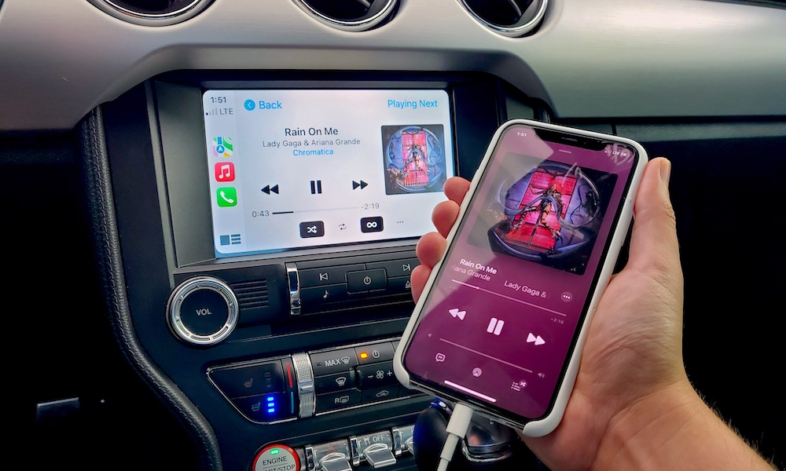
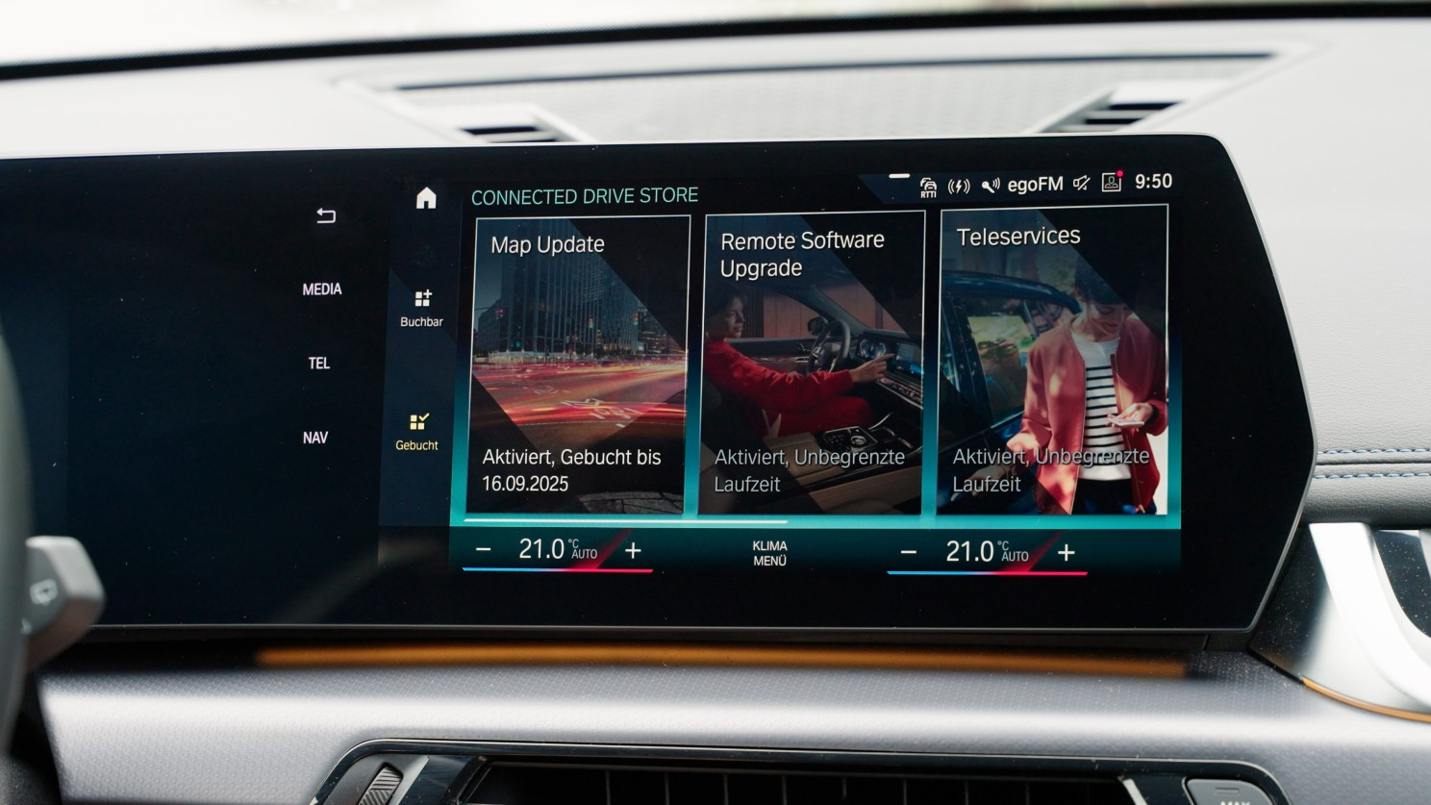
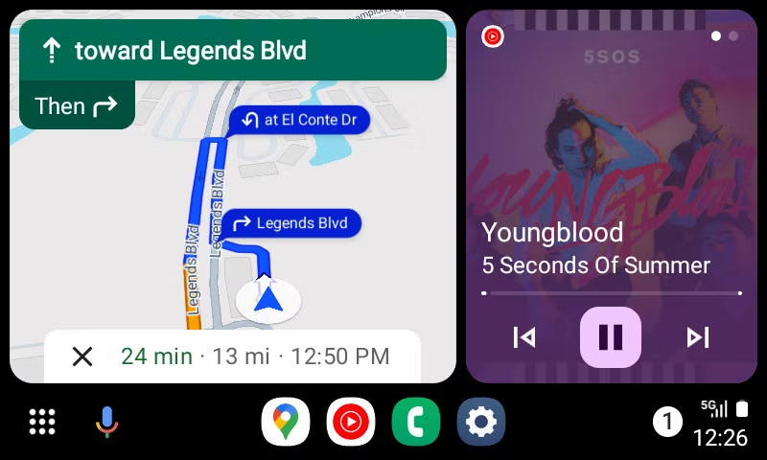
Landscape of In-Car Entertainment
Phone based experience
(Android Auto & Car play)
AAOS based experience
(Non-GAS)
Phone based experience
(Android Auto & Car play)
Many drivers find their smartphones more user-friendly and feature-rich compared to in-car systems. With faster updates and better app integration, it's no surprise they prefer using their phones for navigation, music, and communication.
Android Automotive Operating System (AAOS) is designed for in-vehicle infotainment (IVI) systems, providing a robust platform for essential features like navigation, media playback, and phone integration. By being built directly into the vehicle, AAOS allows for deeper integration with the car's hardware, enhancing functionality and user experience.
Google Automotive Services aim to integrate familiar smartphone features directly into the car, enhancing convenience while minimizing distractions. Google Automotive Services aim to integrate familiar smartphone features directly into the car, enhancing convenience while minimizing distractions.

Slide 7
2. Solution

Slide 8
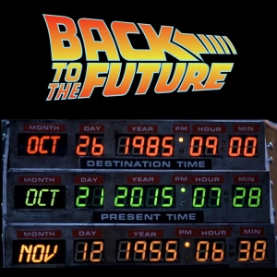
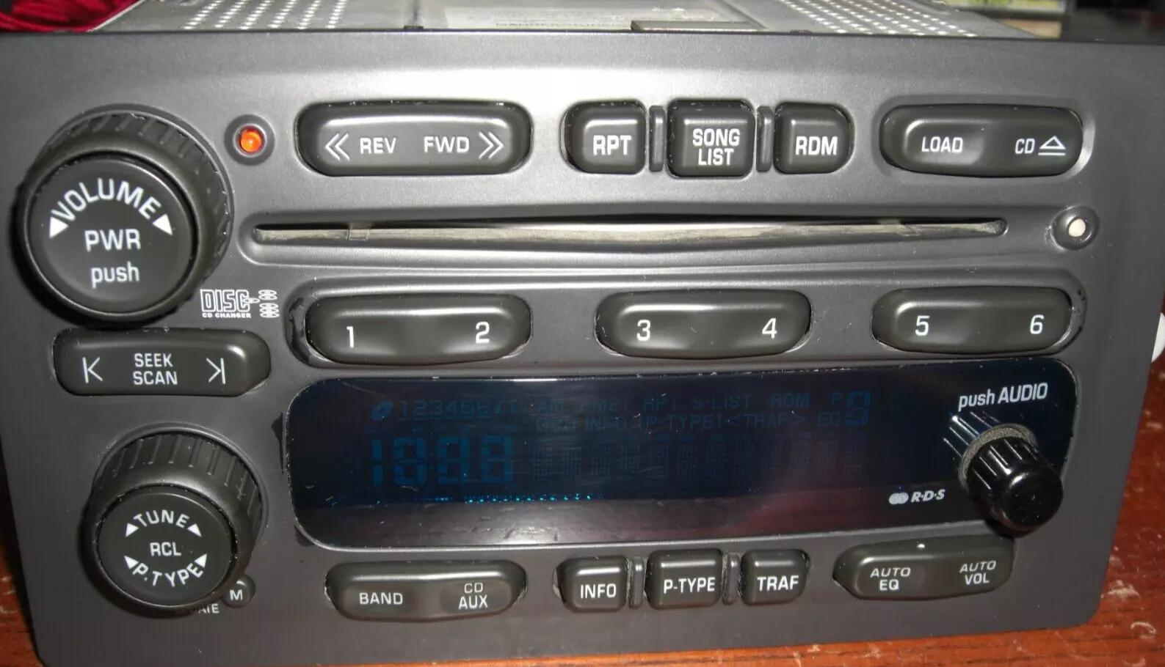
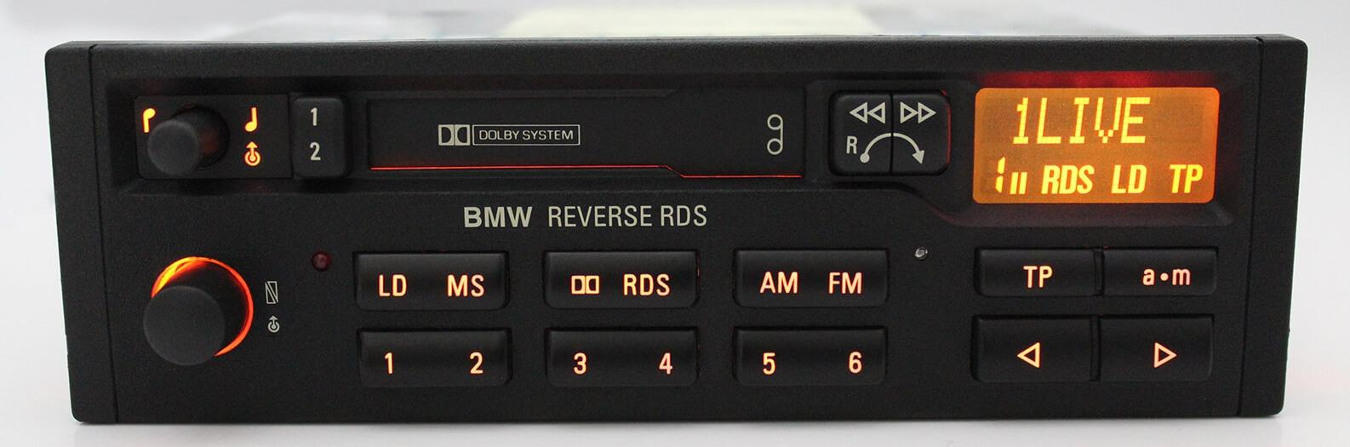
Problem Statement for Non-GAS Solution - Details
GM P/N: 15184935
BMW P/N: 7.643.836.340

Slide 9

Utilize the existing AM/FM Tuner
Both the IEC standard for Radio Data System (RDS) and the North American Radio Broadcast Data System (RBDS) variant utilize Program Identification (PI) codes and Extended Country Codes (ECC) to provide approximate location information. This data, captured from FM radio broadcasts, can be used by applications requiring location services.
Since the early 2000s, an estimated 420 million vehicles have been manufactured with RDS/RBDS-capable AM/FM tuners globally.
From the 2006 model year onwards, most vehicle head units have been designed to support RDS/RBDS and its digital equivalent, SIS/PSD for HD Radio. This enables applications to use data from the radio tuner for basic positioning.

Slide 10
How: Existing AM/FM Tuner
Utilize the PI codes and ECCs of the RDS and RBDS global standard to determine position.
The RDS PI (Program Identification) code is a 16-bit number that uniquely identifies a radio station within a specific region. It's a crucial component of the Radio Data System (RDS) used for FM broadcasting
Structure
16 bits in total, represented as a 4-digit hexadecimal number (e.g., C201)
Country/Area Symbol: The first 4 bits (first hexadecimal digit) represent the country or region.
Remaining Bits: The remaining 12 bits are assigned by authorities within each country, often with a structure to indicate coverage area and program reference number
Functionally
+-----------------------+---------------------------+
| Country/Area Symbol |Rest of PI Code|
| (4 bits) | (12 bits) |
+-----------------------+---------------------------+
| C | 201 |
+-----------------------+---------------------------+
Example
The BBC Radio 1 PI Code is C201
C: Country Code for the UK
201: The remaining bits likely encode information about the program’s
coverage area
*EN 60067:1998 defines the PI structure, code assignments, country codes, area of coverage, and program
reference number in hexadecimal format.The PI code is transmitted in every RDS group, and the ECC is transmitted
in Group 1A. Both are updated 11 times per second by AM/FM transmitters per the global RDS/RDBS standards
Code Assignments
Country/Area Symbol- These codes are essential for international roaming, allowing receivers to identify stations from different countries.
Each country or region is assigned a unique 4-bit code (hexadecimal digit)
Examples: (see RDS/RBDS standards documentation for a full list)
  C: United Kingdom, Lithuania, Croatia, Malta
  D: Germany, Austria, Switzerland
  E: France, Belgium, Luxembourg
Rest of PI Code:
The remaining 12 bits are often assigned in a structured way, such as:
  Bits 5-8: Area of coverage (e.g., national, regional, local)
  Bits 9-16: Program reference number
Country Codes:
  These codes are essential for international roaming, allowing receivers to identify stations from different countries.
Area of Coverage:
  This may be encoded within the PI code, depending on how the country implements the standard
  It indicates whether the station has national, regional, or local coverage
Program Reference Number:
  This is a unique identifier for the specific program being broadcast
  It helps differentiate between different programs on the same station or network

Slide 11
How in Reality: Existing Vehicle Head Unit
All vehicle manufacturers require RDS/RBDS/HD Radio support in their head units, and this data is often displayed in various locations within the vehicle, including:
Head Unit Display
Instrument Cluster
Rear-Seat Entertainment Systems
Passenger Information Displays
The AM/FM/HD Radio tuner decodes the RDS/RBDS data, which is then transmitted within the vehicle's network (often using the CAN bus) to be displayed on the head unit and other screens. The specific implementation and display of RDS/RBDS/HD Radio data can vary depending on the vehicle manufacturer and head unit design. However, an arbitrary text function is typically required for displaying program information as part of the vehicle's Human-Machine Interface (HMI).
The Tier 1 supplier who designed or manufactured the head unit can likely access the PI code and ECCs from the tuner without the data leaving the head unit. This would allow installed applications to access basic positioning information sufficient for managing content restrictions.
But then there is the RDS Traffic Message Channel, and there is also HD Radio. Even if the RDS PI implementation proves unusable, both the Traffic Message Channel and HD Radio contain hyper-local location information within the allowed output of the broadcast tower. All of this information can easily be utilized to determine location.

Slide 12


Bad news
Good news
OEMs don’t own their hardware designs.
Each Tier 1 head unit supplier to the OEM for the head unit would have to implement and test the changes.
In some instances, it may be necessary to manually decode the PI code and store a local database of PI codes; however, this requires only trivial amounts of memory. IEC 62106-9:2021 Annex A provides the PI coding for North America and includes a Decimal Call Letter Conversion Method.
Tier 1 suppliers do not design their radios the same way internally, but they all must meet the same requirements. Therefore, in theory, each one should be capable of implementing the fix. Performance will vary depending on each OEM’s requirements for tuner performance and antenna implementation for the given head unit.
We need to conduct drive testing and port applications to validate that the system will work well enough to be production viable. Simulations won’t suffice without very expensive RF broadcast and test equipment, along with an anechoic chamber.
It's Free! (No recurring data costs, API calls, or per-transaction fees!)
It’s Global! (Or mostly global!)
RDS PI, RDS ECC, RDS TMC, and the HD Radio equivalents are all candidates for location information. In some cases, the implementation requires only an Engineering Change Order (ECO) by the OEM and a firmware update to the head unit to transmit the information from the tuner.
This solution (if it works) is backward compatible, which could allow vehicles already on the road to implement apps that were previously not viable. Fringe coverage and issues such as phantom intermediate frequency (IF) feedback are already addressed in the AM/FM specifications of the tuner performance by the OEM. Most likely, this solution is sufficient to cover the intended use case.
Most of the OEM’s work is already done, so this won’t take long to reach the field test phase.

Slide 13
3. Commercial Challenges

Slide 14

Who is this solution for?
OEMs
OEMs with funding and willing to test the approach
EOM / Budget Owner / Interest Status
OEMs Using AAOS and Non-GAS
OEMs with funding and willing to test the approach

Slide 15
Next Steps
The required next steps are:
Define interested stakeholders and funding.
Determine the test plan.
Identify content partners.
Establish milestones.
Implement the fix at the Tier 1 head unit vendor for initial testing.
Determine CDN requirements from media providers.
OEM’s need to obtain CAN bus information internally to check if this data is an existing CAN message.
OEM to review original head unit design requirements for AM/FM/HD Radio to validate arbitrary text functionality.
Determine which apps/content providers we can live test with.
Provide demo vehicles for testing and validation.
Align with media providers to support the feature change request for the automotive industry.
Biggest Challenges
All of this requires funding and resources to move forward.
Every OEM’s test plan will be different on the back-end.

Slide 16
4. Test Plan & Companies Collaboration strategy

Slide 17

Test plan
All OEMs
Drive Test Plan: AM/FM/HD Radio for tuner performance requirements (2024 Version)
  Head unit candidate and Tier 1 support to validate the output of RDS data to the tuner.
  Head unit candidate AM/FM/HD Radio requirements for RDS on CANBus/GMLAN/.etc, remote displays, and arbitrary text.
  Test Vehicle.
  Globant & Google-hosted sandbox test for the AAOS app and test Content Delivery Network (CDN) for short-term drive testing.
Test App Features:
  Display AM/FM tuner diagnostics?
  Content bitrates?
  TBD
Native App Implementations on production Vehicle Head Unit:
  YouTube?
  BBC?
  Bloomberg?
  All the new content partners from the IBC meeting and Detroit?
  Globant to visit for porting: Hulu, Disney+, FIFA app, F1 app, La Liga app, etc.
  What does each automaker want to achieve here?
    Proprietary app store backend validation with OEM?
  Tier 1 Head Unit Supplier Test Plans:
    Panasonic Automotive
    Harman
    Alps-Alpine
    Clarion
    Denso
    Legacy Delphi/Delco?
  Q: Do we need a production DVT plan?

Slide 18
Thank you!

Slide 19
Relevant Resources
RDS Standard IEC 62106-9
NRSC PI Code Allocations
FCC License Management System
FCC Channel Maps USA
Title 47 Channel Separation Minimum Distance
NRSC-G300-C RDS Usage Guidelines
ontact:
covesa@globant.com
Daniel Daogaru, Executive Vice-President
Diego Bruhega, Senior Vice-President of Technology

