Slide 1
Android Automotive SIG – Vehicle Data APIs / VHAL
Working session
Alexander Domin, BMW
Stefan Wysocki, TietoEVRY
GENIVI Tech Summit | October, 2020

Slide 2
DEMO - recap
Implementation of „Modern approach”
Implementation of „VHAL adaptation”
Workflow, sequence diagrams
Configuration of TietoEVRY’s VHAL
Plugin in JAVA to use GraphQL
Notes:
https://www.apollographql.com/docs/android/tutorial/10-authenticate-your-queries/

Slide 3
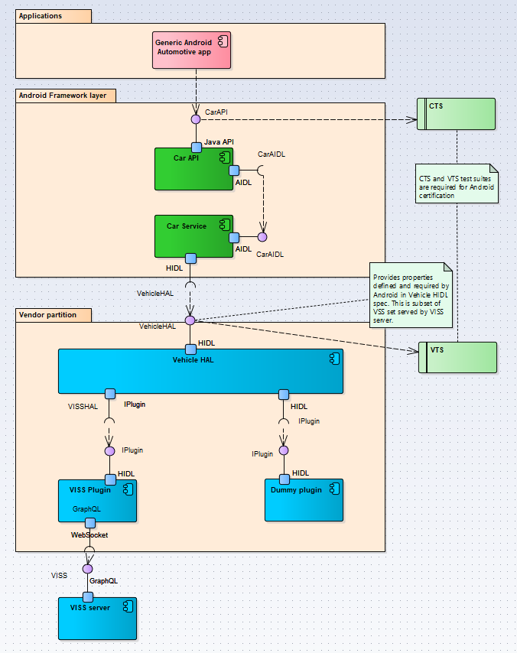

Slide 4
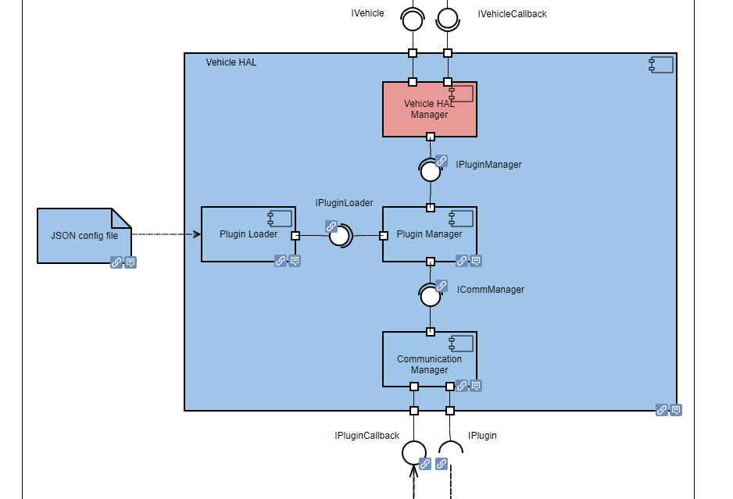

Slide 5
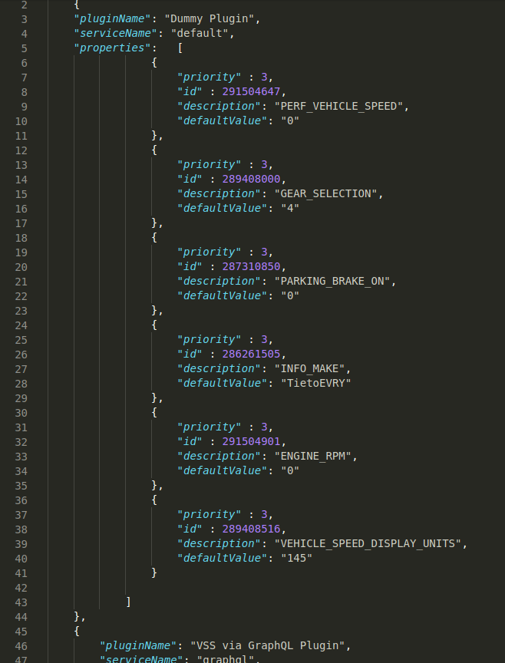
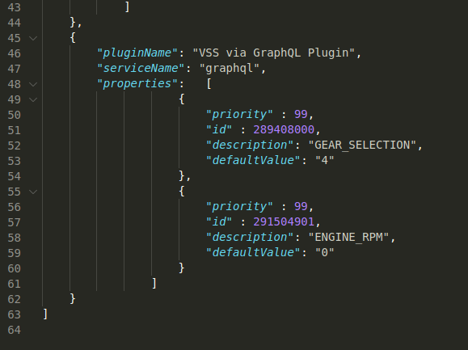

Slide 6
AOSP 11 - permission customization
New property SUPPORT_CUSTOMIZE_VENDOR_PERMISSION
The VHAL needs to return the config with a map between the props and permissions.
https://cs.android.com/android/platform/superproject/+/master:packages/services/Car/car-lib/src/android/car/hardware/property/VehicleVendorPermission.java;l=27?q=VehicleVendorPer&sq=&ss=android%2Fplatform%2Fsuperproject
Is it enough?
Notes:
Compare AOSP approach to VSS Layer permissions (show the first example about data access)
Collect some arguments

Slide 7
Security aspects
GraphQL query has a token with permissions included
How secure is the token?
Is it possible to verify the signature?
Signed with shared key? Use asymmetric encryption?
How much privilage should have the legacy solution?

Slide 8
Common Vehicle Interface Initiative (CVII)
A lot has been said during this conference about the Common Vehicle Interface Initiative
The initiative is a joint initiative from GENIVI and W3C to start a conversation with all other parts of the automotive industry to drive towards a common vehicle data model, and then do the same for service/interface descriptions.
VSS has been proposed as the start of the common model, but additional input from participants might come.
After successful OEM-only roundtables, and two great workshops during this AMM week we feel a strong support for making this a reality.
Next steps are to organize towards reaching the goal, including the creation of sub-projects (in addition to already existing projects such as VSS, W3C-VISS, CCS, (and AASIG-VHAL).
Reaching out to many other organizations has already started but needs to be done more widely.
This should include Google/Android of course.
The connection to AASIG-VHAL is obvious – a primary reason to investigating VSS-based solutions combined with Android is to ensure that Android Automotive fits into a bigger picture. There is a potential to use a common data model in the entire vehicle and cloud. Android does not address the whole scope of vehicle-data, and probably shouldn’t. Therefore, it is worth discussing how Android can fit into a comprehensive automotive strategy.

Slide 9
GENIVI scope of exposing vehicle data
VSS as a standard describing Vehicle Properties (with permissions)
GraphQL: No library for native services
Implement or research for other simmilar solutions (GraphQL, MQTT, VehicleHAL props)
Is the „way of access” should be in scope of standarization or focus only on VSS as meta language

Slide 10
Accuracy lost between the Android and VSS
Example: Fuel level.
OpenDS (59.682[L]) -> VSS (99[%]) -> Android (59400[ml])
Android can influence VSS

Slide 11
Architectural Option
Internal Data Server
cmp Internal Data Server
Defined by
Application layer
Head Unit (on-board)
Google
App 2
Genivi
OEM / Tier1
Framework layer
Virtual ECU (same / different ECU)
Data Server
Socket
VSS Server
Package Manager
Socket
HAL layer
VSS Feeder
VSS Database

Slide 12
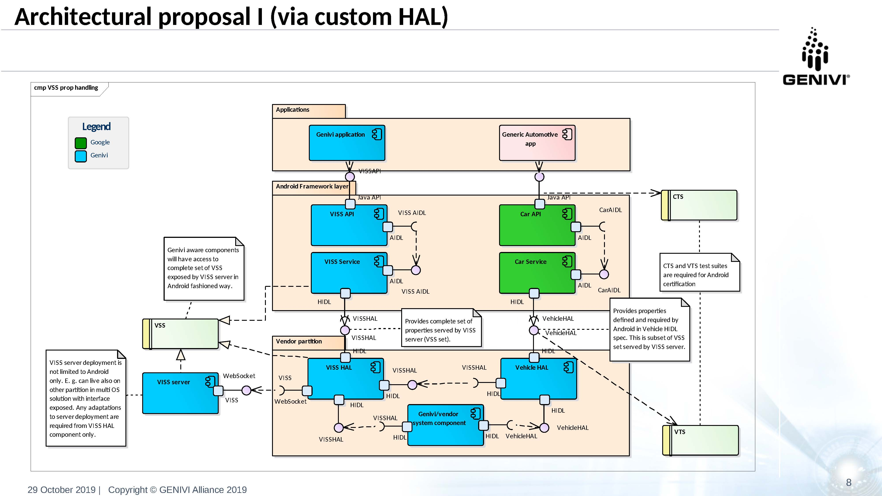
Architectural Option
Vehicle Data Access via Customized HAL - Google VHAL + OEM Extensions inside

Slide 13
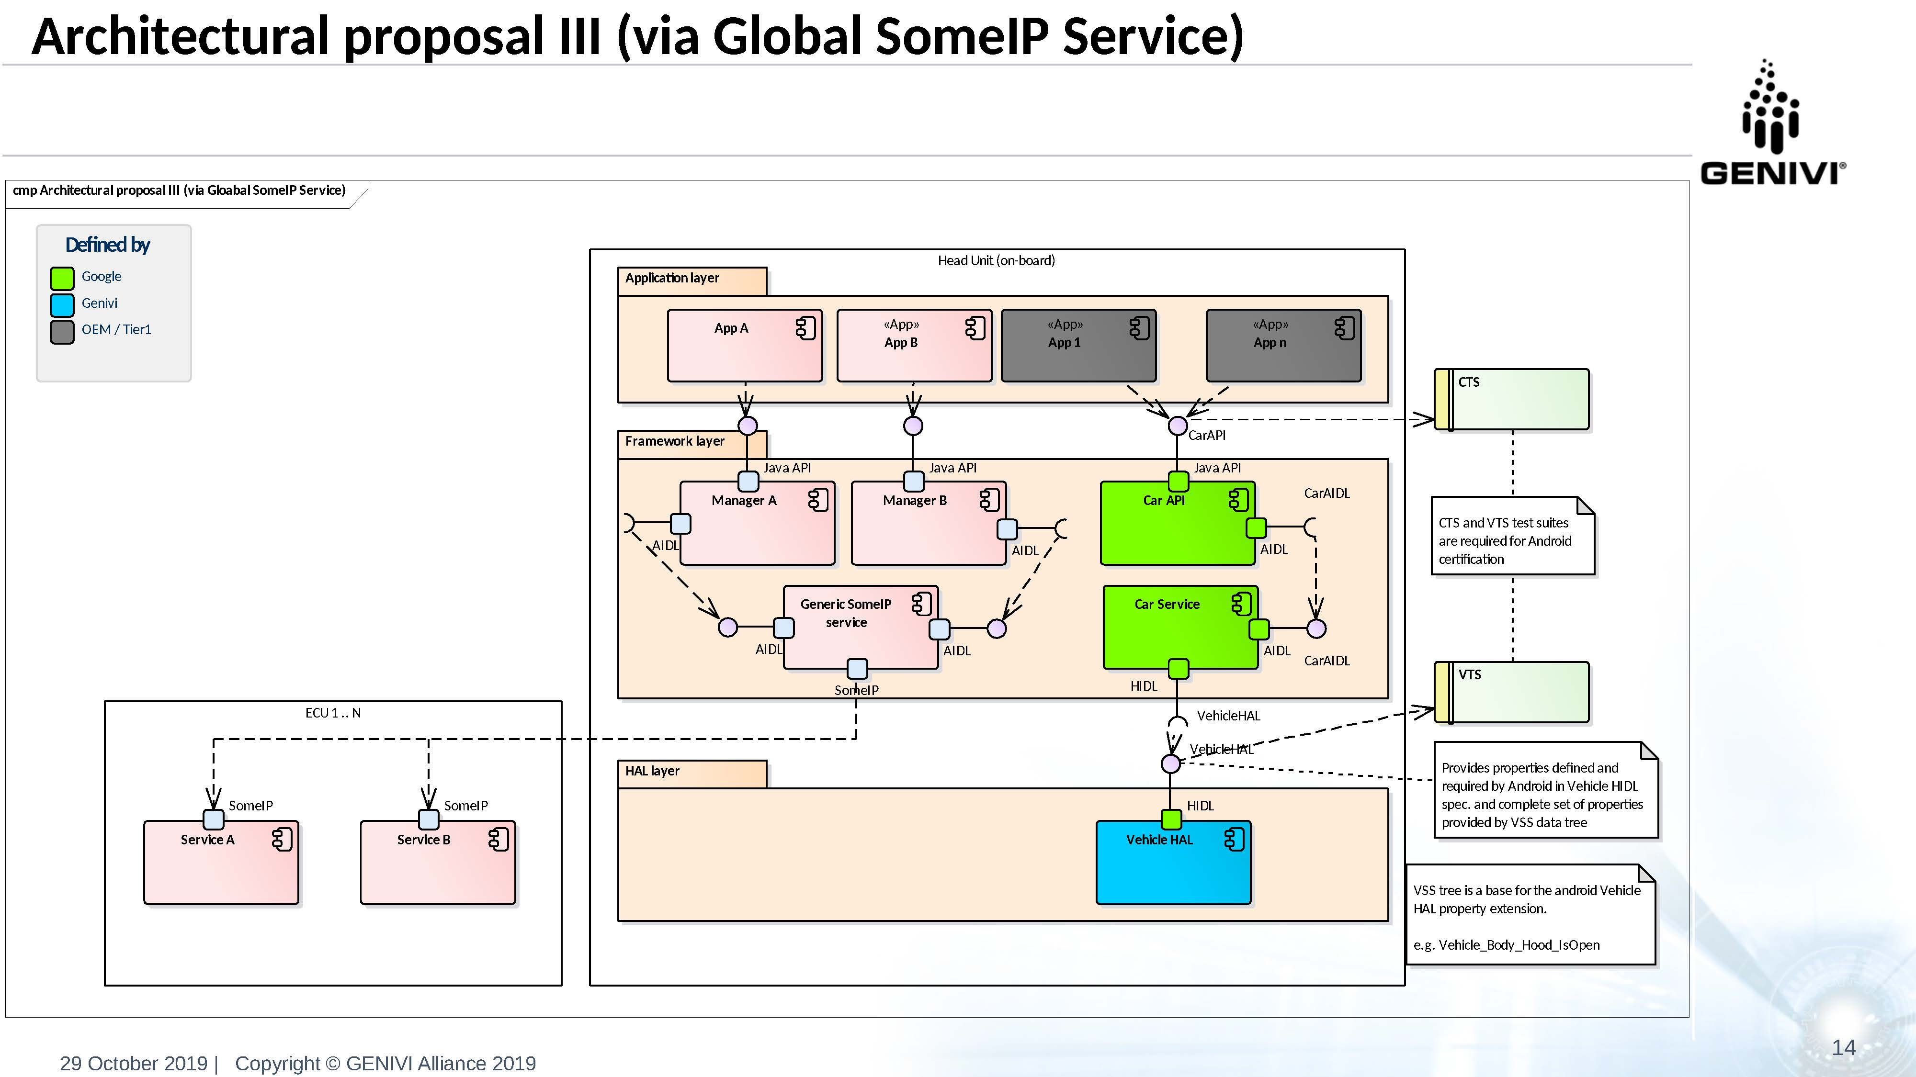
Architectural Option
Vehicle Data Access – via Some/IP Service - SomeIP stack inside the Framework
Look at vsomeip port to AOSP : https://github.com/GENIVI/vsomeip/pull/107

Slide 14
Standards
AOSP 11 ?
Property names format
OEM Permissions?
Lost the Accuracy between the Android and VSS

Slide 15
Workshop
Discussion topics; started from Confluence page
interest of the graphql concept : open question to the participants: since there is no graphql libraries, it is the correct path to go ?
other architectures are possible, rediscuss the other options, e.g. the internal data server
there was some changes in aosp 11 to enable more customizable permissions for oems (permission granularity)
alignment of android and non android data models
from the discussion we are having on CVII, it seems that android will not drive the vehicle data model definition

Slide 16

Thank you!
Visit GENIVI:
http://www.genivi.org
http://projects.genivi.org
Contact us:
help@genivi.org

