Slide 1
AUTOMOTIVE AOSP APP FRAMEWORK STANDARDIZATION
EXPERT GROUP
OCTOBER 11TH, 2023

Slide 2
Antitrust Note Well
Before we begin, we would like to make clear that COVESA is committed to compliance with the antitrust laws in all of its activities, and that it expects all participants to similarly comply with the antitrust laws. We will not engage in--and members must refrain from--any discussion of, or understandings regarding competitively sensitive topics. If you have any doubts regarding whether a matter is appropriate for discussion, please consult with your antitrust counsel.

Slide 3
Agenda
OCTOBER 11TH, 2023
9:00AM – 9:45AM EST

Slide 4
Agenda
Why is there the need for an AOSP App Framework Standardization Expert Group?
What already happened on the topic at COVESA
Status update on ongoing work streams
What’s next
Questions

Slide 5
Why is there the need for an AOSP App Framework Standardization Expert Group?

Slide 6

Traditional Approach vs. Platform Ecosystem Approach.
# Develop app once, deploy to many OEMs via an App Store.
# No need for OEM specific development work.
OEM A
COVESA
OEM A
OEM A Requirements
OEM A Requirements
OEM A
OEM B Requirements
OEM B
Aligned Requirements
OEM B
Requirements
OEM B
App Developer
App Developer
Store Provider
OEM B
OEM C Requirements
OEM C Requirements
OEM C
OEM C
OEM C
Traditional Approach
Platform Ecosystem Approach

Slide 7














With an AOSP-based App Store,
OEMs support a relevant 3rd Party Ecosystem to emerge.
App Provider
OEM Customers
1
1
1
APP
APP
APP
1
1
1
APP
APP
APP
Platform ecosystems need to attract and coordinate two different target groups – app developers and OEM customers.
In order to grow the portfolio of the AOSP based App Store we need to focus on the App Providers as an important customer group.

Slide 8
Goals Automotive AOSP App Framework Standardization.
1
Enabling innovation and rich experiences.
2
Frictionless onboarding and testing for app developers.
3
Building a Cross-OEM App Ecosystem.
3
Avoid fragmentation.

Slide 9
What already happened on the topic at COVESA

Slide 10
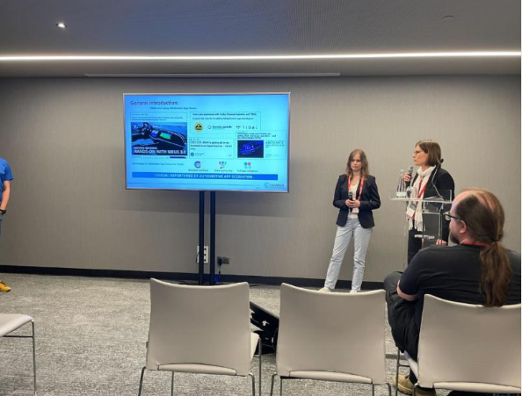
April 2023: AMM in Portugal
Presentation of the initiative related to Automotive AOSP App Framework Standardization Expert Group to COVESA members
Attendance of several OEMs, App Store Providers, Tier 1s and app developers
Interest expressed by the attendees
Jointly identified TOP3 topics:
  Non-GAS Emulator (independent of OEM)
  Push Notifications
  Camera API

Slide 11



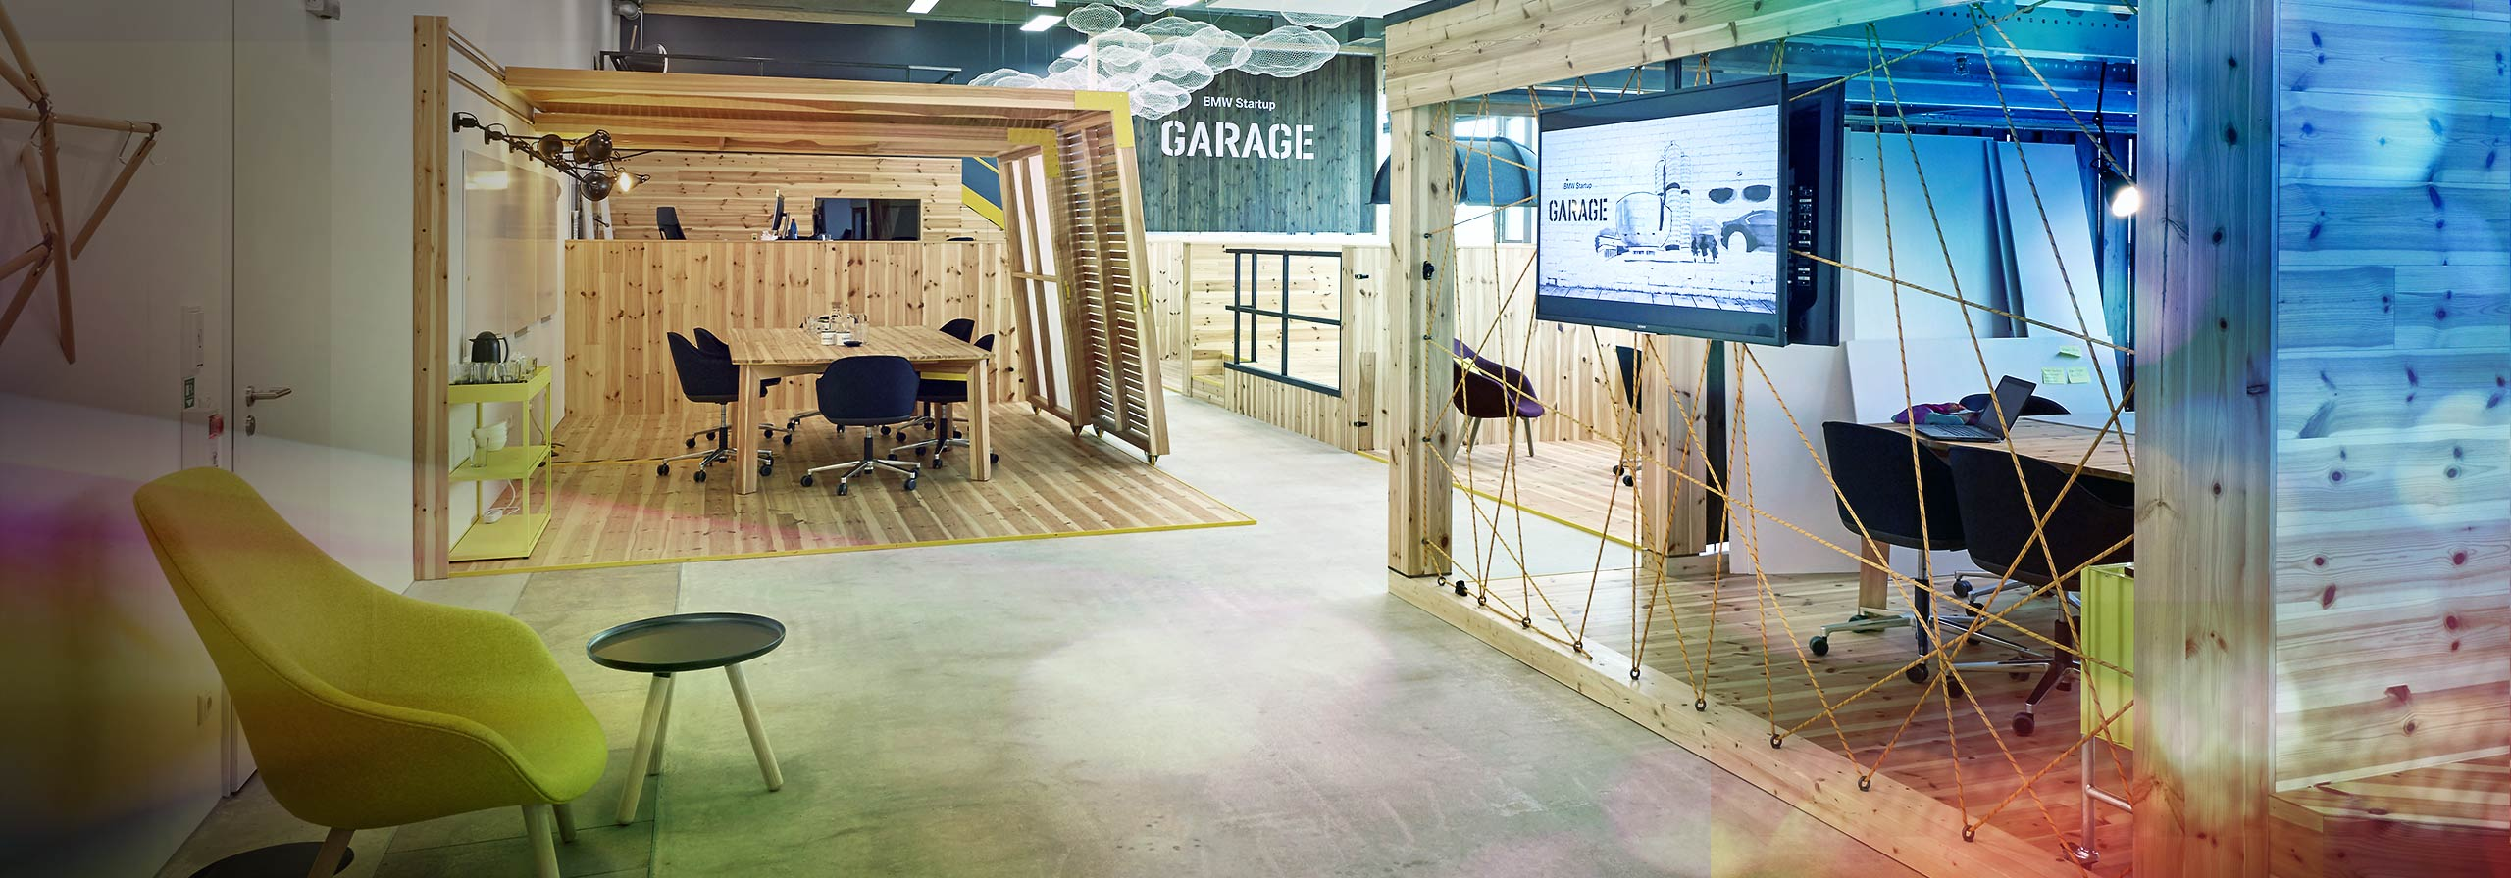
F2F Meeting June 2023: Munich
ACHIEVEMENTS
Election of Chairs
  BMW (Melina Mascolo)
  General Motors (Richard Fernandes)
  Forvia / Faurecia Aptoide Automotive (Camille Ghibaudo)
Definition of main work streams
  Camera API
  Push Notifications
  Cross-OEM emulator
Presentation of potential reference implementation for In-Vehicle Camera Access
Notes:
Election of Chairs – Camille Ghibaudo (Faurecia Clarion Electronics), Melina Mascolo (BMW) and Richard Fernandes (GM)
Meeting Cadence – Every Monday from 5-6PM CET/11AM EST
Critical success and goals:
Members of the Expert group, both OEM and Suppliers to agree on a common protocol and solutions that will help in development of apps in the automotive environment
In Vehicle Camera Access:
Discussed how to access in-vehicle cameras in an automotive environment that can be used in conjunction with Communication/Social Media Apps such as WebEx/Zoom etc. to provide a good customer experience.
Best Practices:
Discussed the difference between AOSP/AAOS and GAS Ecosystems. And how Apps integrate in the automotive infotainment platform.
Why Fragmentation should be avoided – this makes it harder for app developer to develop apps for OEMs
Identified the structure/biggest pain points:
Differences Android vs. Android Automotive
- Audiofocus
- Link handling (developers should not assume that OEMs provide browser for external link handling)
- Interaction with back button /home button
- Solving GMS dependencies, e.g. Firebase, Google Login, Google Play linking
- Payment
→Already existing group regarding payment in COVESA (involving Stellantis, mavi.io)
→@Vamsi Krishna (mavi.io): Providing update to Expert group about existing payment activities
- Login process
- Notifications
- Camera access
- Immersive mode: Interaction climate bar / full screen
- How to integrate/test app
It was decided to have two All Members Meeting a year → 1 in Europe and 1 in US
2024 in the US at the CES

Slide 12
Status update on ongoing work streams

Slide 13
In-Vehicle Camera Access: Deliverable & Status
DELIVERABLE
Defining default in-vehicle camera for Developers to access
Transparency for Developers which in-vehicle cameras can be accessed (+ its location)
Definition reference implementation along existing Google standard (across OS versions)
Ensurance for developers that this reference implementation works across multiple OEMs
Future: Enabling 3rd Party Developers to test camera integration with Cross-OEM emulator
Feedback on
reference implementation
Demo of POC / solution
Clarification timeline
OEM Platform Support
Publishment reference implementation
Positive feedback already provided by:

Slide 14
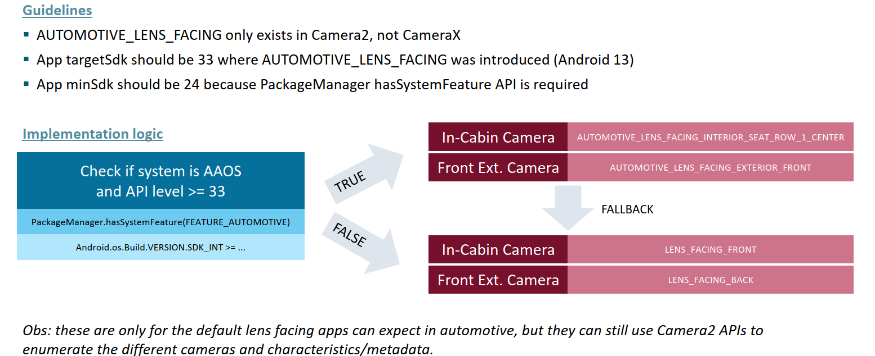
In-Vehicle Camera Access:
Reference Implementation Deep Dive

Slide 15






Push Notifications: Deliverable & Status
DELIVERABLE
Agreeing upon a common service/protocol of how 3rd Parties can provide push notifications.
INTERIM STEPS
Deciding who is building and financing the reference implementation
Deciding who is hosting and financing the necessary backend service
→ COVESA vs. every OEM individually
→ If OEM specific implementation: Test suite to ensure compatibility for 3rd Party Developer
Definition
possible solutions
First POC
OEM &
app feedback
Decision implementation logic
Implementation & publishment solution
Working POC on basis of Unified Push
Currently app feedback
is being gathered
Android Automotive VHAL

Slide 16
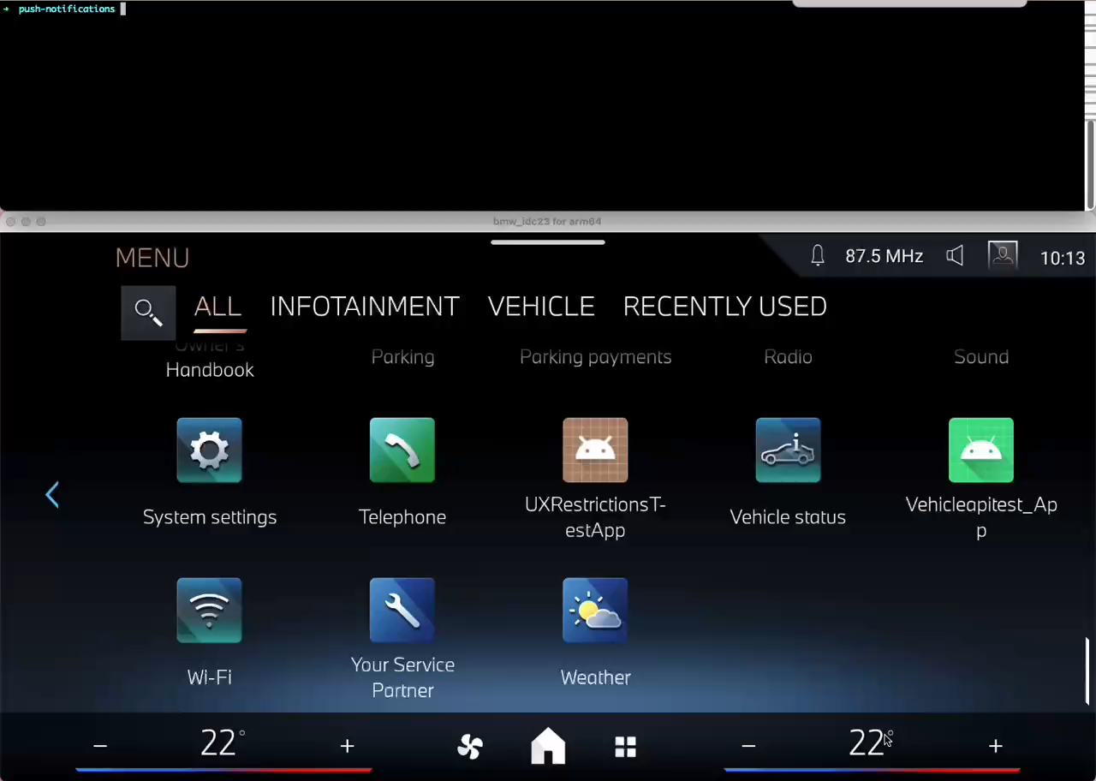
Status update: Push Notifications
Push Notification POC on basis of Unified Push

Slide 17
Status update: Emulator
Two possible directions for Cross-OEM availability:
  Snapp
      Agreed to provide a generic emulator
  Harman
      Have a more customizable emulator and currently working to define next steps.

Slide 18
What's next?

Slide 19

What’s next: Events
  COVESA AMM
    Brainstorming session on topics for expert group
    Working session on push notifications
    Round table
  CES 2024 on January 9th
    Joint podium discussion
    Vehicle demonstration

Slide 20
Questions

Slide 21
Thank You For your Time

Slide 22
Back Up Slides

Slide 23
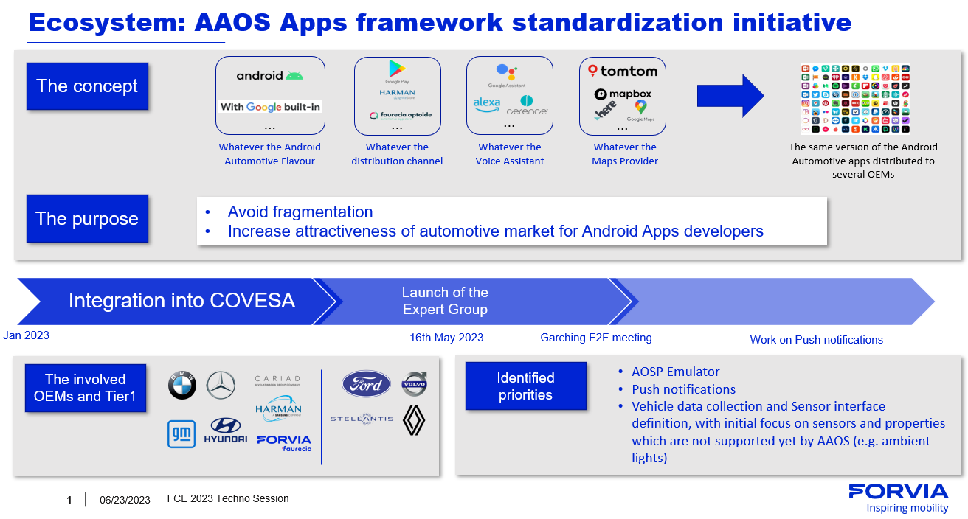

Slide 24
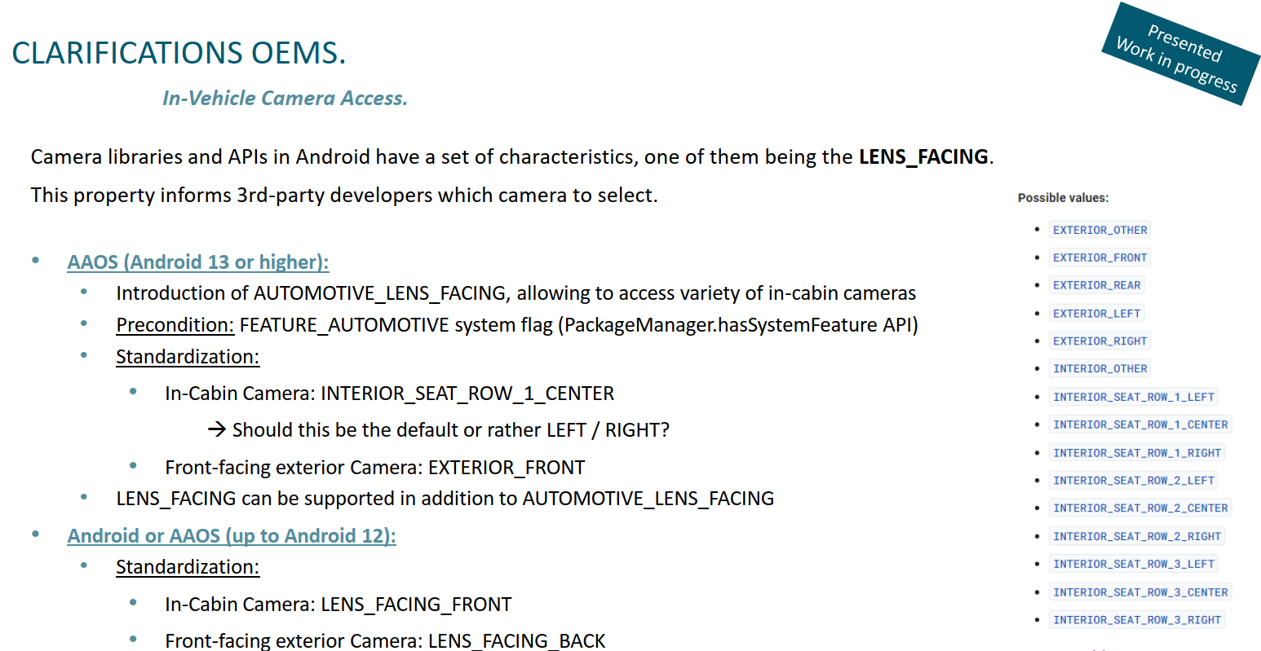
Status update: Camera API

