Slide 1
Alternative to Push Notifications Working Session
Faurecia Aptoide, BMW, GM
11th October 2023

Slide 2
Agenda
Summary of previous discussions
Topics for the working session

Slide 3
Context
Push notifications are needed to support use cases in which an app that is not currently running needs to be “waken up” to receive data such as:
  VoIP calls
  Messages
From previous analysis performed independently by different parties – Faurecia Aptoide, BMW, FORVIA - UnifiedPush seems the most promising solution:
  Provides a specification
  OEMs have freedom to select their solution (implement their own or use an existing one compatible with the spec)
  Apache 2.0 licensed, same as AOSP
  Compatible with webpush (transition for 3PAs simpler since some of them already support it)

Slide 4
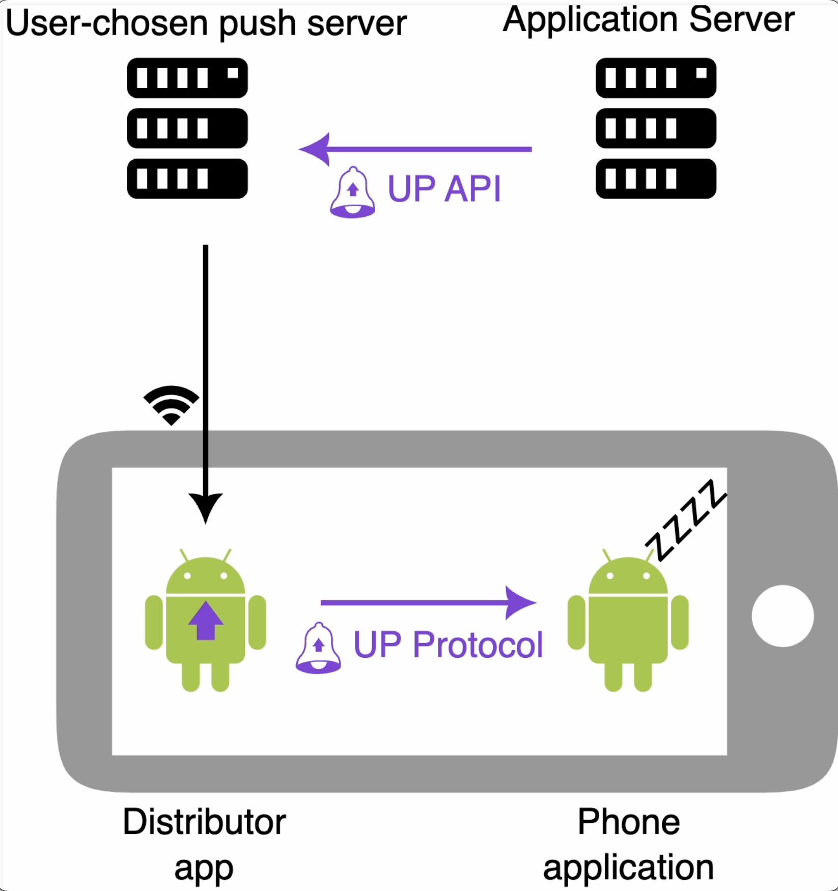
UnifiedPush Protocol
UnifiedPush is a specification, split in two:
  Client side - App-Distributor API: API to allow any application (ex. a messaging app) to communicate with any distributor application (ntfy, NextPush, etc.)
  Server side – App server-Push server API: on the server side, the API describes how the application server sends messages to the push server
    → basic compatibility with RFC 8030 (web push)
All distributors are compatible with all apps
Client libraries and the reference proxies assist in implementing both sides of the specification, respectively.
Multiple “ready to use” implementations already exist
(see: https://unifiedpush.org/users/distributors/)
https://unifiedpush.org/
https://f-droid.org/en/2022/12/18/unifiedpush.html

Slide 5
UnifiedPush – COVESA Scope
COVESA provides the specification:
ideally reusing UnifiedPush Protocol ”as is”
Test Suite to ensure compatibility of:
  UP API: Back-end to Back-end server API
  UP Protocol: Head-unit distributor to 3PA client App
Provide the tools, PoC, reference documentation to support 3PAs adoption
COVESA

Slide 6
UnifiedPush – OEMs
OEMs
OEMs:
Integrate the distributor app on Head Unit (custom developed, COVESA, or other)
Distributor app is usually linked to a Push server
Ensure compatibility on their systems through test suites (supported by COVESA)

Slide 7
UnifiedPush – 3rd Party Apps (3PAs)
3PAs
3PAs:
Make sure their Apps and Application Server are compatible with Unified Push
a
a

Slide 8
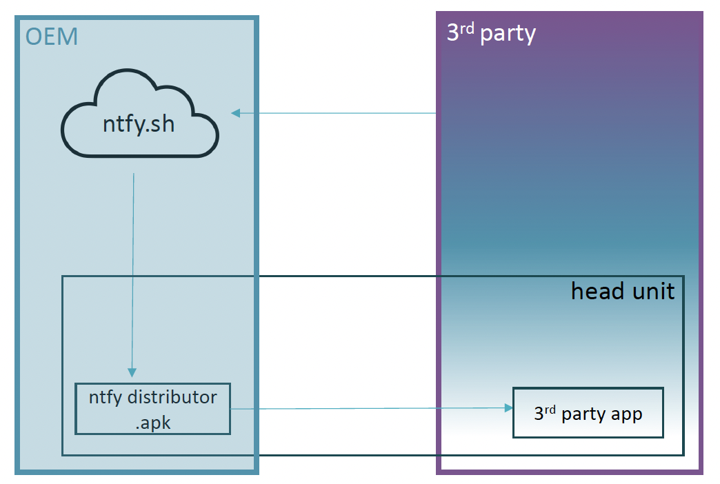
UnifiedPush BMW PoC
Existing solution for OEM part / 3rd party application POC
Use ntfy.sh as the push server and distributor
  Easily installable on the head unit as an .apk1
  Provides a free push server we can use for the POC
2. Install the 3rd party application POC that implements UnifiedPush
→ Evaluate the end-user experience
Time requirements: <1 hour once the 3rd party application POC is available

Slide 9
Sequence Diagram (I)
3PA
Distributor
Push Server
3PA App Server
org.unifiedpush.android.connector.NEW_ENDPOINT
org.unifiedpush.android.connector.MESSAGE
org.unifiedpush.android.connector.UNREGISTERED
org.unifiedpush.android.connector.REGISTRATION_FAILED
org.unifiedpush.android.distributor.REGISTER
org.unifiedpush.android.distributor.UNREGISTER
org.unifiedpush.android.distributor.MESSAGE_ACK
REGISTER (Application, Token)
web push protocol RFC8030
Registration / Subscription
Interactions between Distributor and Push server are not defined by Unified Push
NEW_ENDPOINT (Token, Endpoint) or REGISTRATION_FAILED
Unique endpoint associated with the token: RFC 3987
Distribute Subscription
SetPushSubscription (Endpoint, <3PA specific client id>))
ENDPOINT Get
UnifiedPush specific (?)
{"unifiedpush":{"version":1}}
PushMessage: Post (Message)
PushMessage: Post (Message)
MESSAGE (Token, Message, ID(optional))
Send Push Message
MESSA_ACK (ID)
Result (2xx OK, 4xx error)
Notes:
https://www.w3.org/TR/push-api/
https://unifiedpush.org/spec/android/
https://unifiedpush.org/spec/server/

Slide 10
Sequence Diagram (II)
3PA
Distributor
org.unifiedpush.android.connector.NEW_ENDPOINT
org.unifiedpush.android.connector.MESSAGE
org.unifiedpush.android.connector.UNREGISTERED
org.unifiedpush.android.connector.REGISTRATION_FAILED
Push Server
3PA App Server
org.unifiedpush.android.distributor.REGISTER
org.unifiedpush.android.distributor.UNREGISTER
org.unifiedpush.android.distributor.MESSAGE_ACK
REGISTER (Application, Token)
web push protocol RFC8030
Registration / Subscription
Interactions between Distributor and Push server are not defined by Unified Push
NEW_ENDPOINT (Token, Endpoint) or REGISTRATION_FAILED
Unique endpoint associated with the token: RFC 3987
Distribute Subscription
SetPushSubscription (Endpoint, <3PA specific client id>))
ENDPOINT Get
UnifiedPush specific (?)
{"unifiedpush":{"version":1}}
PushMessage: Post (Message)
PushMessage: Post (Message)
MESSAGE (Token, Message, ID(optional))
Send Push Message
MESSA_ACK (ID)
Result (2xx OK, 4xx error)
CancelPushSubscription (Endpoint, <3PA specific client id>))
UNREGISTER (Application, Token)
UNREGISTERED
Notes:
https://www.w3.org/TR/push-api/
https://unifiedpush.org/spec/android/
https://unifiedpush.org/spec/server/

Slide 11
Differences wrt to Web Push
Register vs Subscribe
  UnifiedPush: register/unregister
  WebPush:
    Register/unregister + Subscribe/unsubscribe
    Subscription may have an expiration date
Endpoint get returns “UnifiedPush”

Slide 12
Agenda
Summary of previous discussions
Topics for the working session

Slide 13
Topics for the Working Session
Gaps wrt FCM – if thre are gaps (not sure yet) do they affect use cases that we need to support?
Robustness of Push Messages: Configuration, Retry, Error handling
Integration for 3PAs – what is needed on the Android side and on the Application Server side
Integration and Hosting strategy for OEMs

Slide 14
Alternative to Push Notifications Working Session
Faurecia Aptoide, BMW, GM
11th October 2023

Slide 15


Push notifications
Server-push notification example
While it is technically possible for each application to connect to its own server and receive notifications directly, there are several reasons why this approach may not be practical or effective.
Application Server
Push Server
Distributor app has special permissions to be always running and distributing the messages to registered apps
Receiver Apps (A, B, C) don't need to be running in the background to receive the messages (system resource optimization)
Usually, there is a single distributor app in the system
A push notification service consists of both a backend API and a client service
Distributor
ZZZ
APP A
APP B
APP C
https://f-droid.org/en/2022/12/18/unifiedpush.html

Slide 16
Preliminary comparison of initially identified alternatives
 | UnifiedPush | Pushy | Remote VHAL
Openness | Open source Open specification Being proposed to Lineage OS | Proprietary | AOSP
Scalability / Stability | Limited use so far / Depends on chosen implementation | Proven scalability | Not released yet
Fit for purpose | Flexible to allow each OEM to have it’s own distributor and push server | Proven usage on mobile / Not designed to be integrated by an OEM | Not clear if it was designed to be used for 3PA in a scalable way

Slide 17
FCM Capabilities
Key capabilities | Details
Send notification messages or data messages | Data structured with all the necessary components for a standard Android notification. Data messages to enable specific functionalities within the application without necessarily triggering a notification.
Versatile message targeting | Single devices Groups Devices subscribed to a given "topic"
Send messages from client apps | Send data directly to the server
https://firebase.google.com/docs/cloud-messaging

