Slide 1
Workshop
Automotive Push Notification Protocol
29.01.2024

Slide 2
Problem Statement
“A push notification (also known as a server push notification) is the delivery of information to a computing device from an application server where the request for the transaction is initiated by the server rather than by an explicit request from the client“ [1]
Common use-cases:
  Delivery of messages
  Incoming VoIP calls
  Live updates in a running app (e.g., update list of upcoming meetings)
Problem:
  Apps get killed by the system and cannot rely on being able to communicate with their backend
  There exists no standardized push notification service for AOSP

Slide 3
Goal of This Workshop
Align on a common AOSP push notification service
  Reduce fragmentation as much as possible
  Agree on a common ground to ensure compatibility across OEMs
  Allow 3rd parties to build once and deploy anywhere (outside of GAS)
Define the minimum common ground for the minimum set of functionality for such a push notification service
Focus will be on the 1-1 communication channel from 3rd party application servers to a specific app instance (not to any specific app)
Focus is on Android Automotive Apps working independently of a customers brought in device (not phone projection)
Its not about the notifications, its about pushing a message to the car

Slide 4
Topics For This Workshop
Discuss the proposal
  does this work for everyone?
Need to specificy more than Web Push (RFC8030) does?
  Like message delays, rate limits etc.
Discuss integration and hosting strategy for OEMs
Discuss reference implementation
Discuss testing suite
Discuss working model with UnifiedPush

Slide 5
What is out there
  Apple Push Notification service (APNs) – only usable on Apple devices
    https://developer.apple.com/documentation/usernotifications
  Firebase Cloud Messaging (FCM) – only usable with Google’s Play services / Google Automotive Services
    https://firebase.google.com/docs/reference/fcm/rest/v1/projects.messages?hl=en#AndroidConfig
  Huawei Mobile Services (HMS) – only usable on Huawei devices
    https://developer.huawei.com/consumer/en/doc/HMSCore-References/https-send-api-0000001050986197#EN-US_TOPIC_0000001562768322__p153162820230
  Amazon Device Messaging (ADM) – only usable on Amazon devices
    https://developer.amazon.com/docs/adm/overview.html
  Web Push (RFC8030) – THE standard for browsers
    https://developer.mozilla.org/en-US/docs/Web/API/Push_API
  UnifiedPush – a Web Push inspired protocol for native applications on Android and Linux
    https://unifiedpush.org/

Slide 6
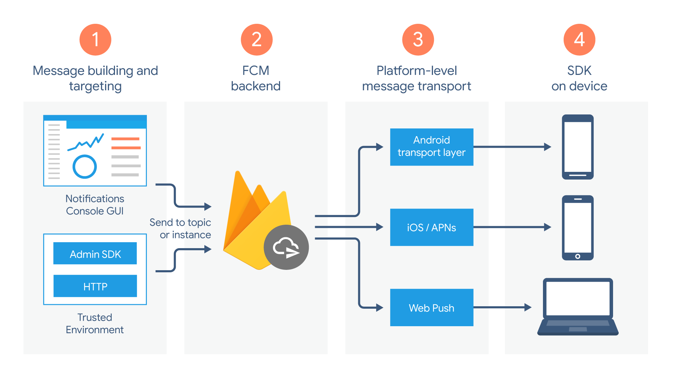
Beware
We want to standardize for the automotive space
Firebase Cloud Messaging is both:
  the official push service for Chrome and Android
  a commercial push service that can send notifications to APNs, Web Push and Android, similar to Pushpad, OneSignal, Pushy and others.
Regardless of what we do, our solution will not be compatible with Firebase (unless Google adds us as a platform)
See: https://firebase.google.com/docs/cloud-messaging/fcm-architecture

Slide 7



Similarities
A push notification service generally consists of four parts
Notifications are triggered by an HTTP POST request to the respective service
The exact type of the connection between the distributor and the push server varies
  This part has a big influence on the energy efficiency and each vendor has its own secret sauce
The mechanism used by the distributor to talk to the application depends on the platform
  On Android this is done using Intents
HTTP based interface
Push Server
3rd Party
Application Server
Platform specific IPC (e.g., Intents)
Distributor
App
3rd Party
Application

Slide 8
Proposal

Slide 9
Proposal
From previous analysis performed independently by different parties – Faurecia Aptoide, BMW, FORVIA - UnifiedPush seemed the most promising solution:
  Provides a specification
  OEMs have freedom to select their solution (implement their own or use an existing one compatible with the spec)
  Apache 2.0 licensed, same as AOSP
  Compatible with Web Push (transition for 3PAs simpler since some of them already support it)
However, it does not support any of the industry standard features like:
  Application Server Authentication
  Time-to-live
  Urgency
  Push message receipts
  Replacing/Updating Push Messages

Slide 10
Proposal
Integrated /Provided by the OEM
Provided by the 3rd party
Push server
corresponding to the distributor app
Extend UnifiedPush to support these features
  Push server <-> app server API: switch to a fully Web Push compatible API
  Client side <-> App-Distributor API: extend the existing UnifiedPush specification to support the changes in the server side API
Keeps the main characteristics of UnifiedPush
  All distributors are compatible with all apps
  Separate specification for the server and the client giving a lot of freedom to the implementation
Web Push
3rd Party
Application Server
(RFC8030
+RFC8291
+RFC8292)
Adapt and extend the existing UnifiedPush specification¹
3rd Party
Automotive
App
Distributor
App
¹ Changes to the UnifiedPush Android specification are necessary to support all features from RFC8030 and RFC8292.

Slide 11
Proposal – Necessary Changes to UnifiedPush
Integrated / Provided by the OEM
Provided by the 3rd party
Push server
corresponding to the distributor app
Server side: full rewrite of the specification
  Existing services that support UnifiedPush (i.e., ntfy.sh) won’t be compatible with the new spec
Client side: only minor changes needed
  Make the existing MESSAGE_ACK feature mandatory
  Add the mandatory option to include a VAPID key in the REGISTER intent
Web Push
3rd Party
Application Server
(RFC8030
+RFC8291
+RFC8292)
Adapt and extend the existing UnifiedPush specification¹
3rd Party
Automotive
App
Distributor
App
¹ Changes to the UnifiedPush specification are necessary to support all features from RFC8030 and RFC8292.

Slide 12




VAPID: Voluntary Application Server Identification
VAPID answers the following questions:
Who sends the notification?
Are they allowed to send notifications to the car?
OEM
Push Server
3rd Party
Application Server
OEM custom interface
3rd party custom interface
How VAPID works:
Create a Public/Private key pair
Include the public key in the app and include it when subscribing to push notifications
3rd Party
Automotive
App
Create a new URL endpoint that only accepts requests signed with the private key associated with the provided public key
OEM
Distributor
App
Include a signed JWT containing some contact information in every push notification request

Slide 13
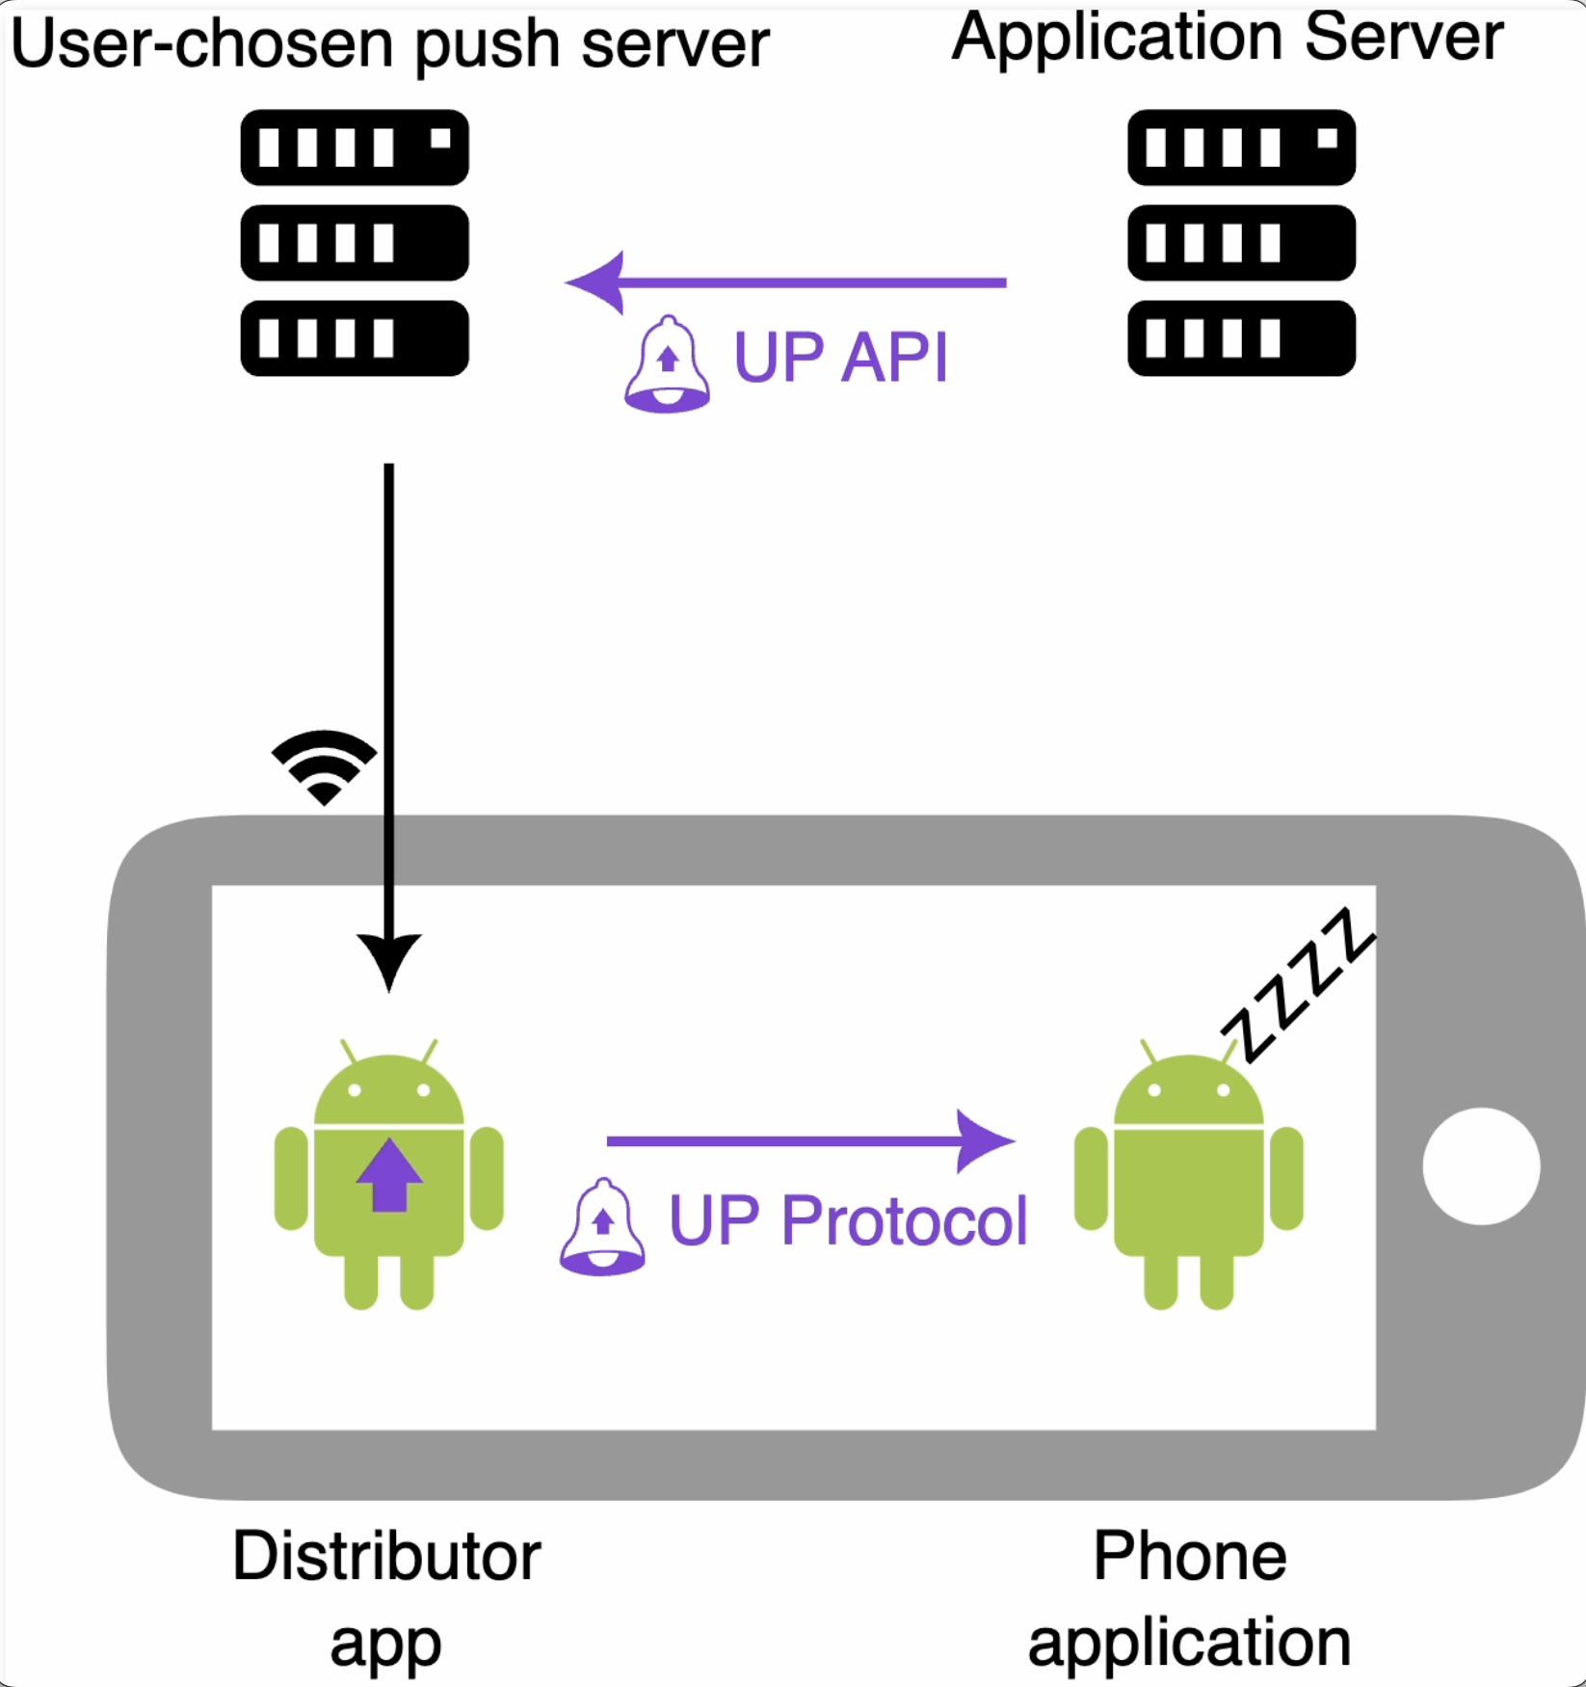
Proposal - Sequence Diagrams
3PA
Distributor
org.unifiedpush.android.connector.NEW_ENDPOINT
org.unifiedpush.android.connector.MESSAGE
org.unifiedpush.android.connector.UNREGISTERED
org.unifiedpush.android.connector.REGISTRATION_FAILED
Push Server
3PA App Server
org.unifiedpush.android.distributor.REGISTER
org.unifiedpush.android.distributor.UNREGISTER
org.unifiedpush.android.distributor.MESSAGE_ACK
REGISTER (Application, Token, VAPID key)
web push protocol RFC8030
Registration / Subscription
Interactions between Distributor and Push server are not defined by Unified Push
NEW_ENDPOINT (Token, Endpoint) or REGISTRATION_FAILED
Unique endpoint associated with the token: RFC 3987
Distribute Subscription
SetPushSubscription (Endpoint, <3PA specific client id>))
ENDPOINT Get
UnifiedPush specific (?)
{"unifiedpush":{"version":1}}
PushMessage: Post (Message, signed VAPID JWT, TTL, Urgency, etc.)
MESSAGE (Token, Message, ID(optional))
PushMessage: Post (Message)
Send Push Message
MESSAGE_ACK (ID)
Result (2xx OK, 4xx error)
CancelPushSubscription (Endpoint, <3PA specific client id>))
UNREGISTER (Application, Token)
UNREGISTERED
Notes:
https://www.w3.org/TR/push-api/
https://unifiedpush.org/spec/android/
https://unifiedpush.org/spec/server/

Slide 14
Proposal – OEMs
Integrated / Provided by the OEM
Provided by the 3rd party
Push server
corresponding to the distributor app
OEMs:
  Integrate a distributor app on the Head Unit
    Custom implementation
    Other 3rd party implementation
  The chosen distributor app is linked to a push server meaning that depending on the chosen distributor your cars will use either
    Your own infrastructure
    The infrastructure of you distributor supplier
Compatibility between all the different implementations will be ensured by a COVESA developed testing suite
Web Push
3rd Party
Application Server
(RFC8030
+RFC8291
+RFC8292)
Adapt and extend the existing UnifiedPush specification¹
3rd Party
Automotive
App
Distributor
App
¹ Changes to the UnifiedPush specification are necessary to support all features from RFC8030 and RFC8292.

Slide 15
Proposal – 3rd Parties
Integrated / Provided by the OEM
Provided by the 3rd party
Push server
corresponding to the distributor app
3rd Parties:
  Client side: Integrate their app with the provided connector library (slightly changed from the existing UnifiedPush one)
  Backend side: Integrate Web Push functionality if not already existing
Web Push
3rd Party
Application Server
(RFC8030
+RFC8291
+RFC8292)
Adapt and extend the existing UnifiedPush specification¹
3rd Party
Automotive
App
Distributor
App
¹ Changes to the UnifiedPush specification are necessary to support all features from RFC8030 and RFC8292.

Slide 16
Outlook
Extend this 1-1 message channel to a more fully fledged push service

Slide 17
Thank you!

Slide 18
Backup

Slide 19
Time to live (TTL)
How long the message should be kept in the push server storage if the device is offline. Some push messages are not useful once a certain period of time elapses.
Example:
Short TTL: Imcoming call
Long TTL: New content in a social media app

Slide 20
Urgency/Priority
To avoid consuming resources to receive trivial messages, it is helpful if an application server can communicate the urgency of a message and if the user agent can request that the push server only forwards messages of a specific urgency.
Example:
Low urgency: Advertisement
High urgency: Incoming call

Slide 21
Push message receipts
A way for application servers to know when a given notification was actually delivered to a device/app.

Slide 22
Encryption
Encrypt the content of push messages.

Slide 23
Replace push messages
A push message that has been stored by the push service can be replaced with new content. If the user agent is offline during the time that the push messages are sent, updating a push message avoids the situation where outdated or redundant messages are sent to the user agent.
Example:
Updating the score of a soccer match

