Slide 1
Zoom to Support Covesa
June 3, 2024

Slide 2
Meeting transfer from one device to another
Contacts presence status change
Meeting invitation
Zoom Push Notification Service
App in the background
App in the foreground
Notes:
Focusing today on 2 components of our framework: embed (APIs/Meeting SDK), and build (Video SDK)

Slide 3
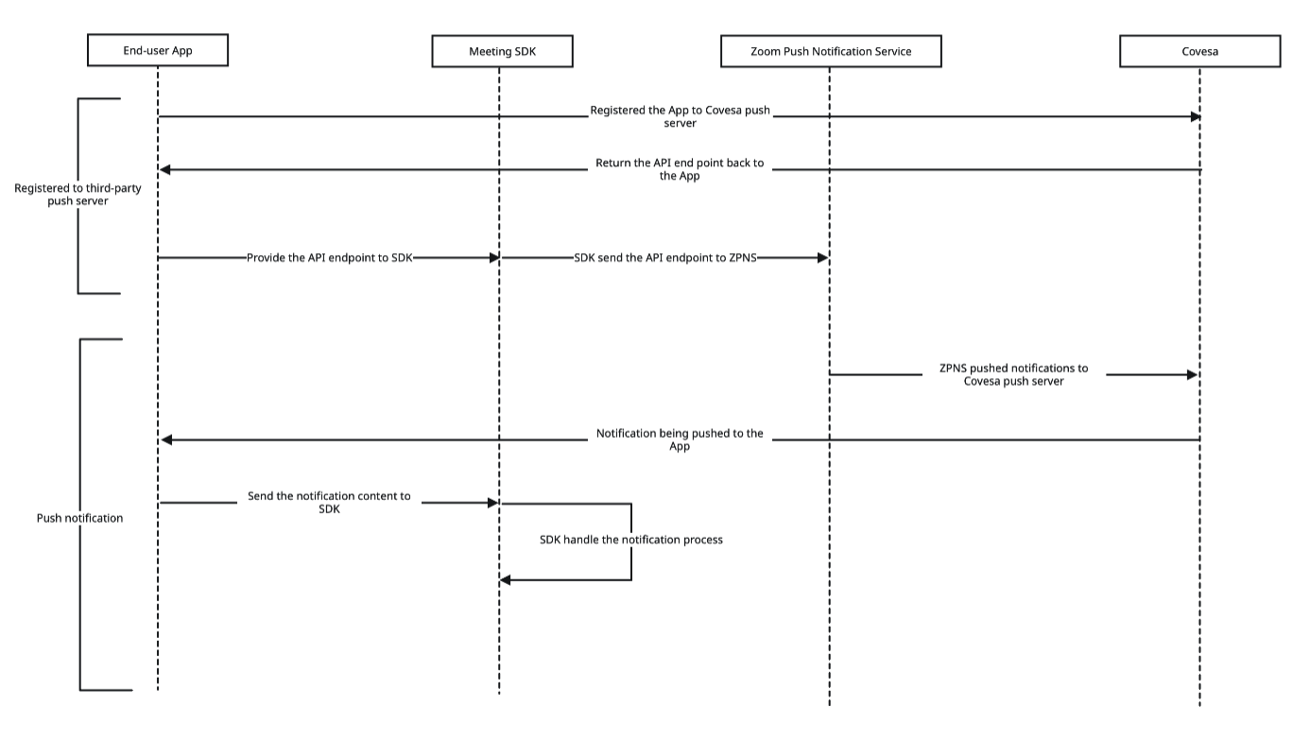
How Do We Plan to Support?

