Slide 1
GAS-related references coupled within Android for Cars library
24/02/2025
Nuno Palma – Appning by Forvia

Slide 2
Agenda
1
Context
2
Problem statement
3
Next steps

Slide 3
context
Template Host: Intermediate between third-party applications and the system.
  Part of the unbundled apps: https://source.android.com/docs/automotive/hmi/aosp_host
  Provides UI components, customizable by the OEM, that are already optimized for driving.
  Could be referenced to as AOSP Host OR Google’s Host
Android for Cars library: Integrated by third-party applications.

Slide 4
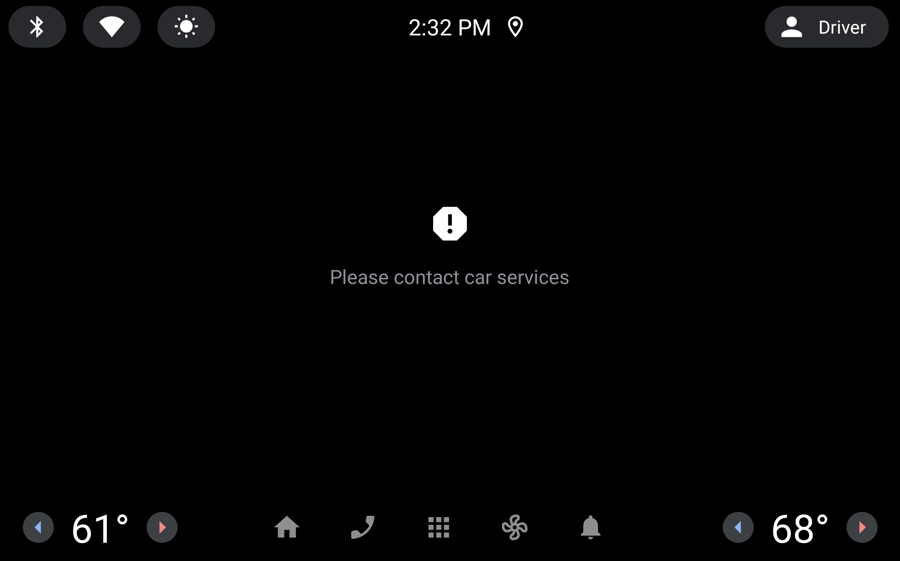
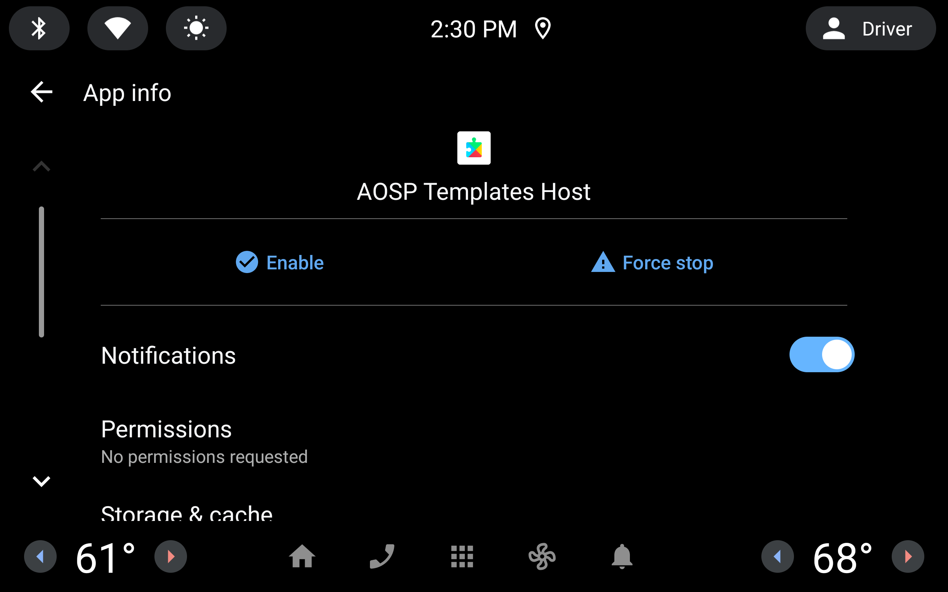
Non-gas environment
Well known error message – “Please contact car services”
Seen in any standard AAOS image from AAOS 11 to AAOS 12L or any image without a Host.
Can be forced by disabling the Host in AAOS 13+ (Snapp emulators)
Standard error message on AAOS
Appning’s Host - disabled

Slide 5
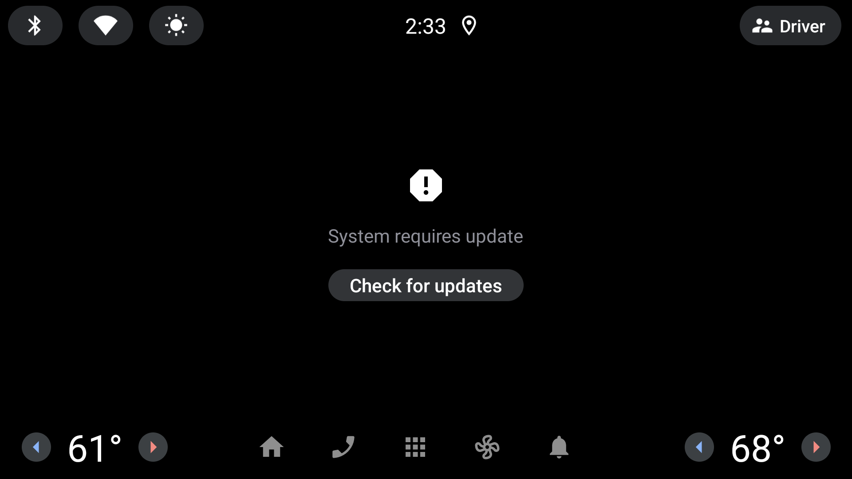
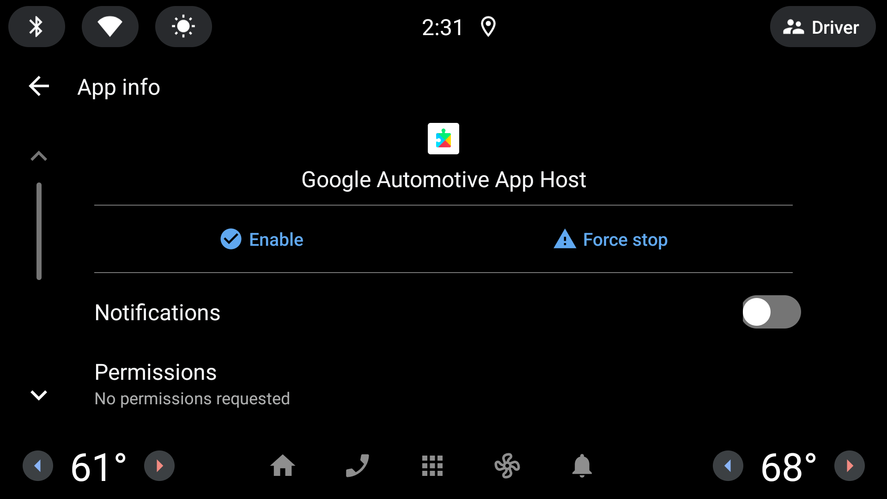
GAS ENVIRONMENT
Disabling the Host on a GAS environment leads to a different error message.
User can “check for updates”.
Error message – GAS environment
Google’s Host - disabled

Slide 6
Please contact car services
Different behaviors on non-GAS & GAS environments - which means that this error
view is being dispatched directly from the Android for Cars library.

Slide 7
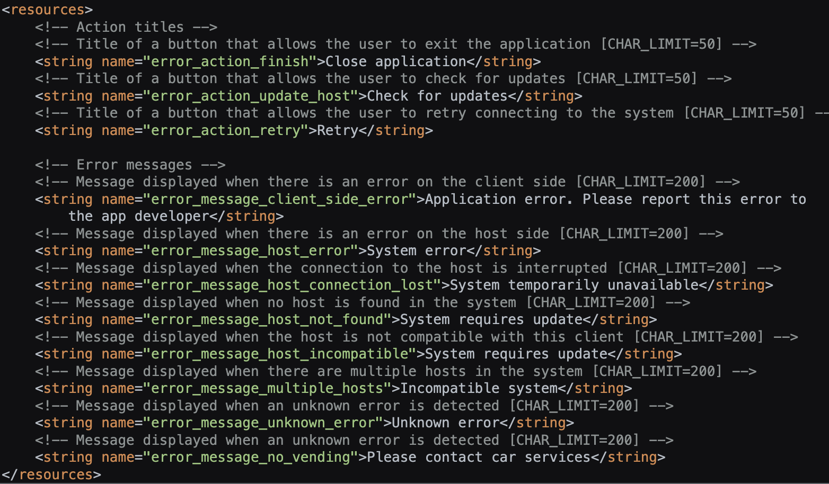
Please contact car services – string resource
Different behaviors on non-GAS
& GAS environments -
which means that this error
view is being dispatched
directly from the
Android for Cars library.
Slightly misleading
– “error_message_no_vending”
The infamous message
”Please contact car services”
can refer to the fact that there
is no “vending” (Apps Market?)
in the system.
  Play Store’s package name is
  com.android.vending.
https://cs.android.com/androidx/platform/frameworks/support/+/androidx-main:car/app/app-automotive/src/main/res/values/strings.xml

Slide 8
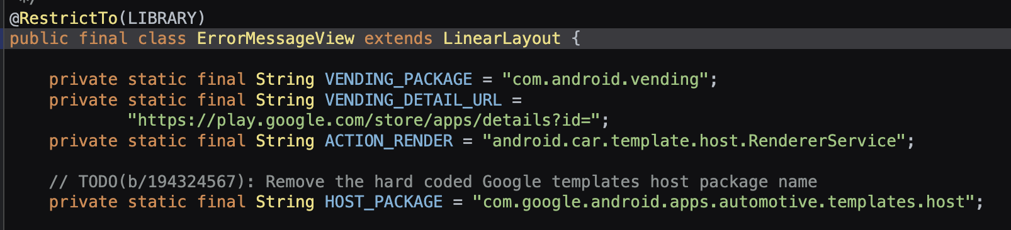
Hardcoded GAS REFERENCES
Play Store’s package name hardcoded as the “vending” package for the Android for Cars library.
Direct, non-standard, URL to open a specific package within the Play Store.
Google’s Host package hardcoded as the “official” Host for the Android for Cars library.
  AOSP Host’s package name: com.android.car.templates.host
https://cs.android.com/androidx/platform/frameworks/support/+/androidx-main:car/app/app-automotive/src/main/java/androidx/car/app/activity/ui/ErrorMessageView

Slide 9
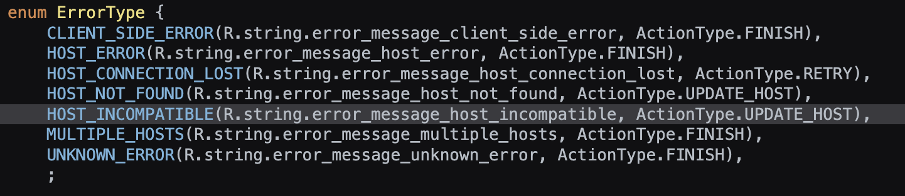
Error types
If Host is either incompatible or isn’t present in the system – it will lead to an “UPDATE_HOST” action.
error_message_no_vending is not listed… where is it dispatched?
https://cs.android.com/androidx/platform/frameworks/support/+/androidx-main:car/app/app-automotive/src/main/java/androidx/car/app/activity/ErrorHandler.java;drc=a775989d0657e5fcbd86bf7949d95a190deb2334;l=61

Slide 10
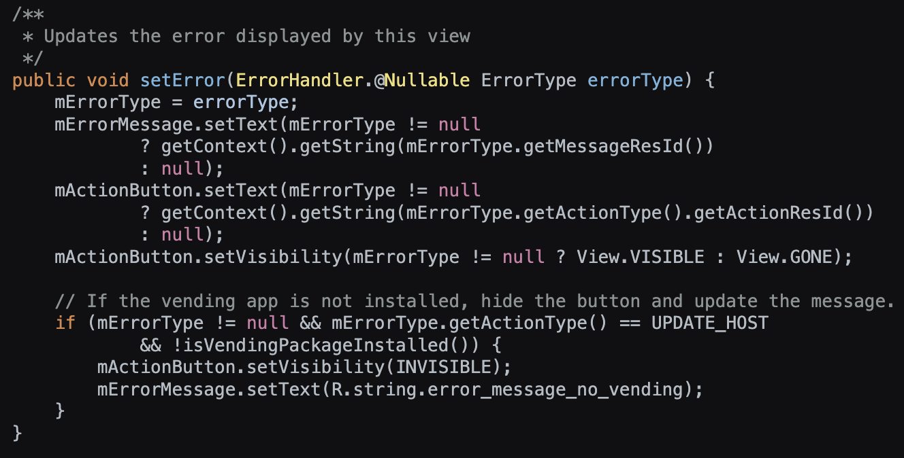
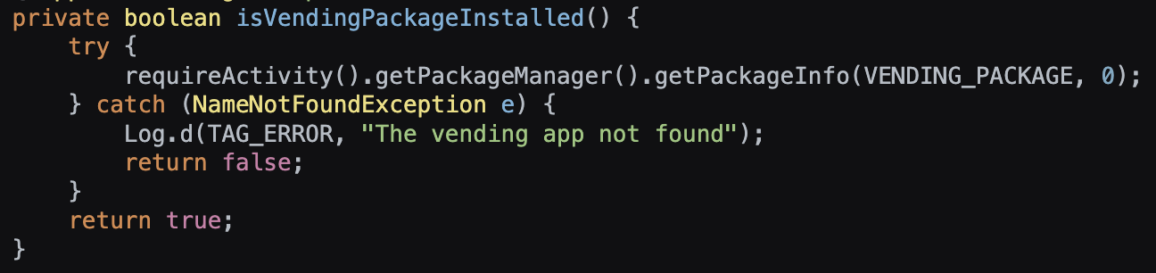
Update button
Update button is hidden when the Play Store
is not installed!
https://cs.android.com/androidx/platform/frameworks/support/+/androidx-main:car/app/app-automotive/src/main/java/androidx/car/app/activity/ui/ErrorMessageView

Slide 11
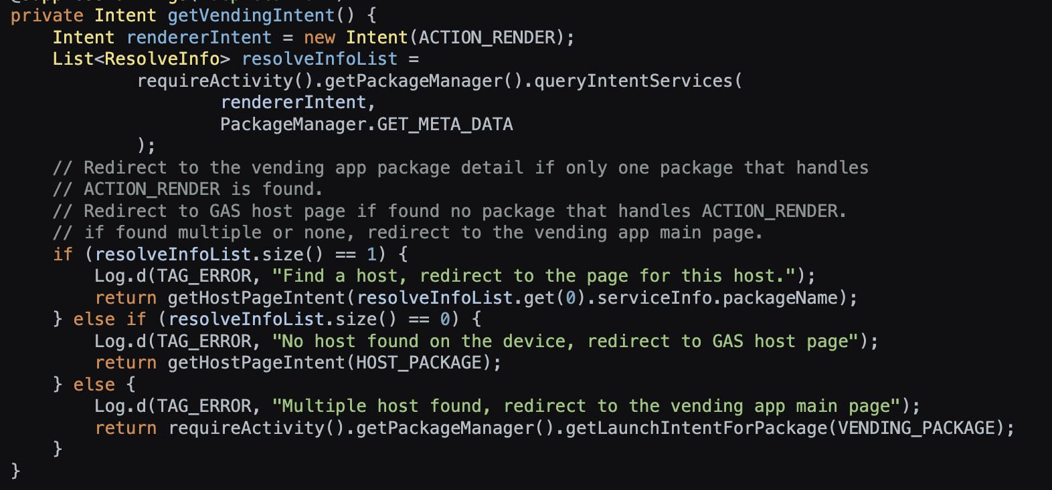
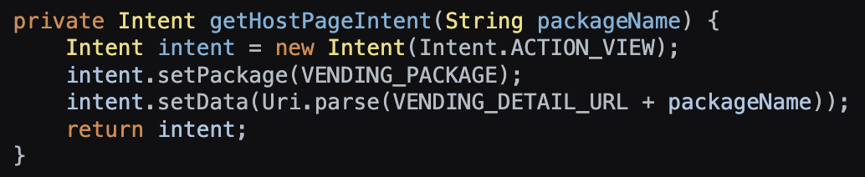
Why is this an issue?
  Assuming that the “Update“ button would be rendered regardless of having the Play Store in the system or not:
    Host is not installed
      Android for Cars library decides when an update is required.
      the user would be redirected to:
        Google‘s Play Store
        To Google‘s Host details view page.
    Host is installed
      Android for Cars library decides when an update is required.
      If only one Host is installed, the user would be redirected to Google‘s Host details view page – in the Play Store
      If multiple Hosts are installed, then the user could be redirected to a different Host‘s page – in the Play Store.
Play Store is not available
    Android for Cars library does not enable the “Update“ button.

Slide 12
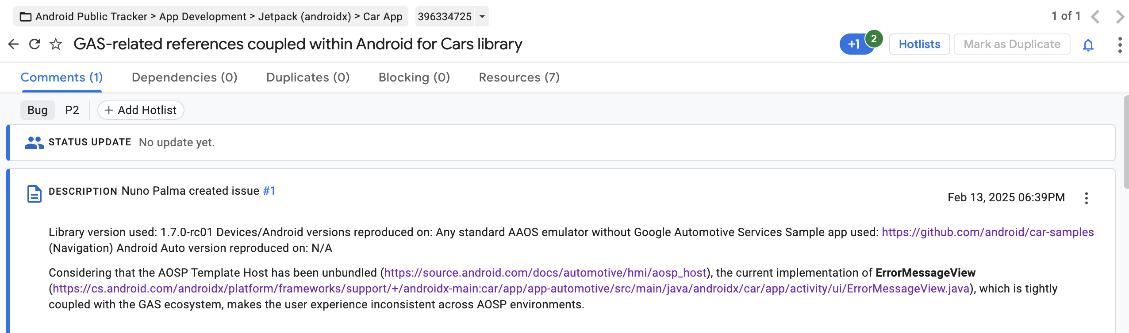
Questions raised
https://issuetracker.google.com/issues/396334725

Slide 13
Next steps
Hopeful thought process: getting some feedback from Google.
Realistic thought process: Understand the remaining gaps between the AOSP Host & GAS.
  Unsupported templates
    E.g., TabTemplate
  Unsupported features
    E.g., Car App actions

