Slide 1
Automotive AOSP Vehicle Data Workstream – AMM Update
AMM Berlin, May 14, 2025

Slide 2
Antitrust Note Well
Information
Before we begin, we would like to make clear that COVESA is committed to compliance with the antitrust laws in all of its activities, and that it expects all participants to similarly comply with the antitrust laws. We will not engage in--and members must refrain from--any discussion of, or understandings regarding competitively sensitive topics. If you have any doubts regarding whether a matter is appropriate for discussion, please consult with your antitrust counsel.

Slide 3
Vehicle Data: Reason why, Requirements

Slide 4
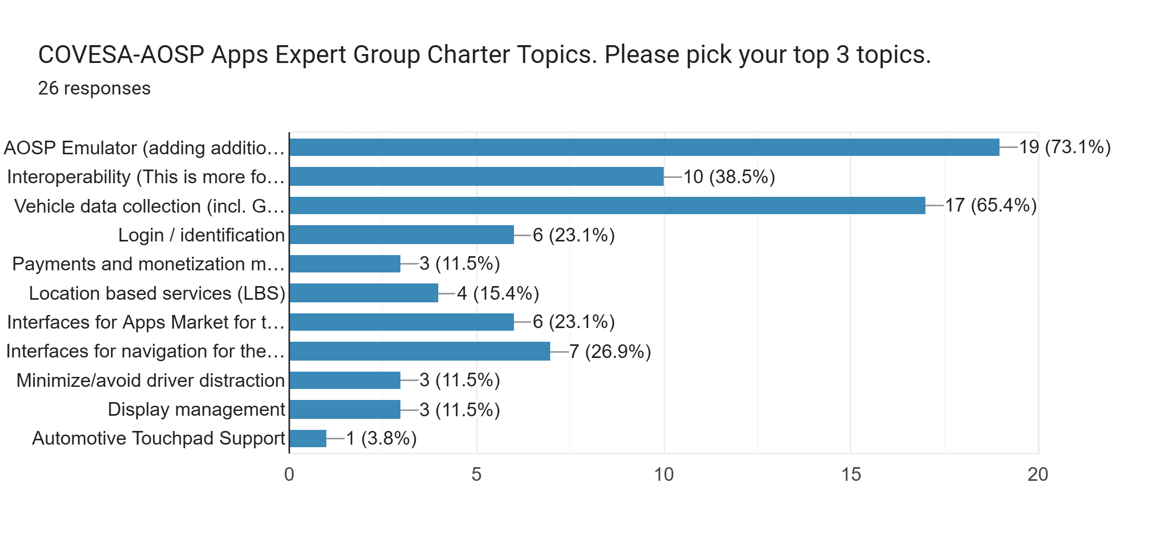
2024 Topic Survey of COVESA – AOSP Expert Group:
Vehicle Data collection among Top 3 ranks
Topic: Vehicle data collection using vehicle properties and making them available to the Android OS.
Proposal: Create COVESA Vehicle Signals to AOSP translator.
COVESA AOSP Data weekly meeting: on Thursdays, Kickoff on Jan. 23, 2025.
Source: Polling results. Survey sent out to group members on October 14th, 2024 and the results were reviewed on November 1st .
The topics were pulled from the AOSP Expert Group Charter.

Slide 5


Vehicle Data – Use Cases, Problem Statement
Use Cases (examples from Bosch and Insurance companies):
  Fleet Management: Notification of service, Vehicle Health Status (Odometer, Fuel, Tire Pressure)
  Insurances (Allianz, Moter, Valtech Mobility):
  https://drivertechnologies.com/, https://valtech-mobility.de/produkte/ridewise/
Problem Statement:
Permission handling to access vehicle data for third party apps and
access to COVESA properties which are defined in VSS, but not yet part of Android.
Source: https://wiki.covesa.global/display/WIK4/COVESA+AOSP+Data+Weekly
AOSP Data: Use Cases and potential Concepts

Slide 6
Vehicle Data – Requirements
All VSS nodes mapped to vehicle properties must be usable by 3rd party apps.
Consistent cross-OEM Ids for properties.
Extendable outside the platform.
Permission per vehicle property. Permission per read/write.
Defined access, dynamic permission grants.
Consistent VSS based mapping.
Frequency / Samle Rate.
Availability of Properties across different targets (Emulator, Hardware).
Source: Android Vehicle Data Requirements

Slide 7
Vehicle Data – Solution Concepts / PoCs

Slide 8
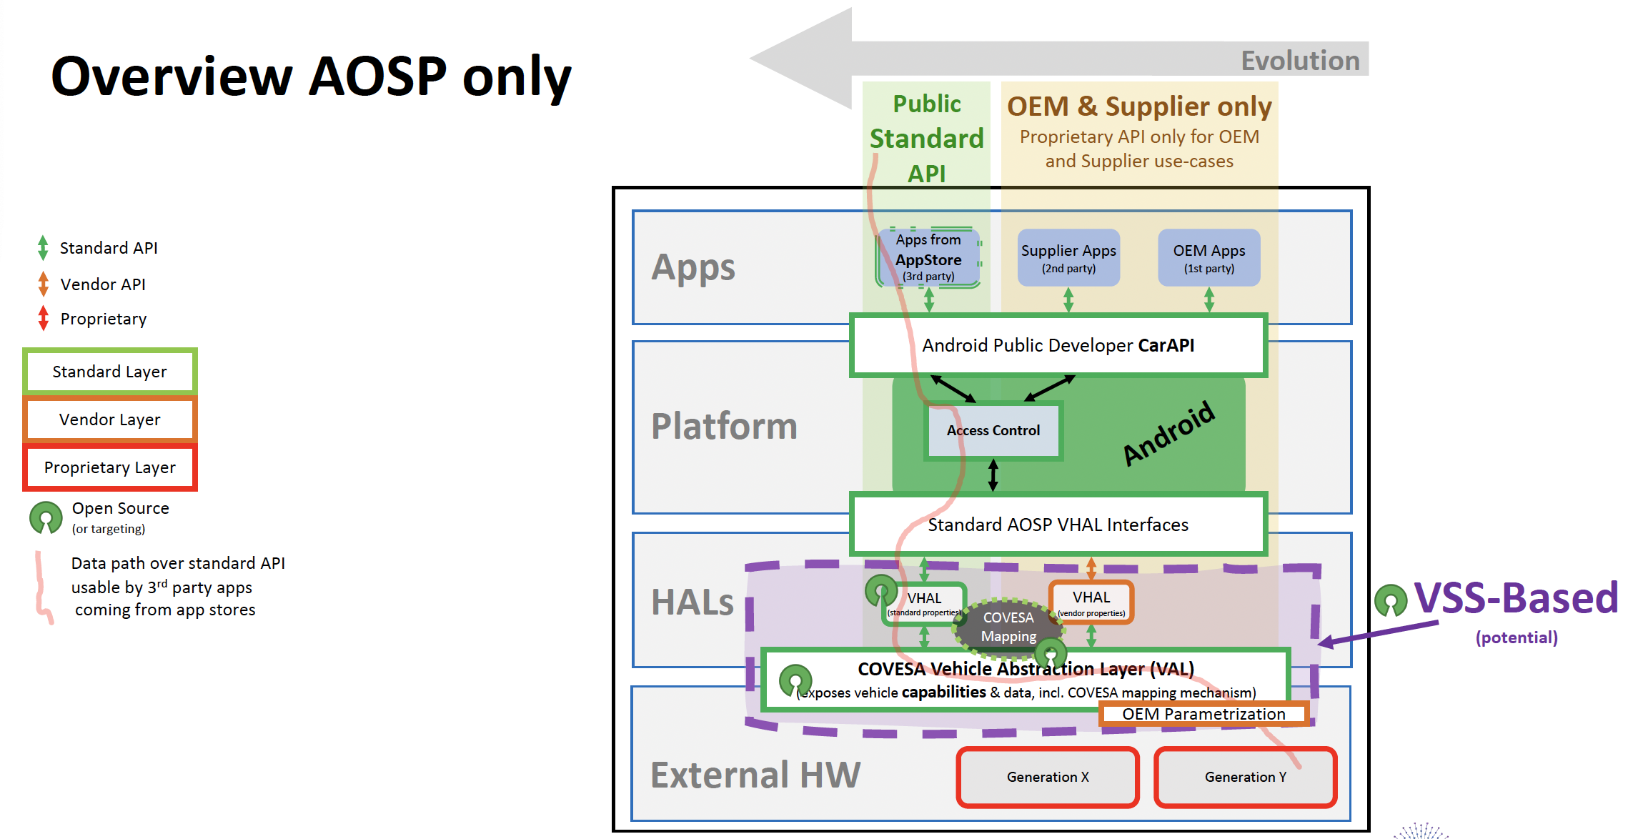
Vehicle Data – Solution Concepts (1): Mapper & Config File
VSS to VHAL Mapper and Config-file (AOSP-Patch) for Access Control / Permissions.
Source: BMW, see AOSP Data: Use Cases and potential Concepts

Slide 9
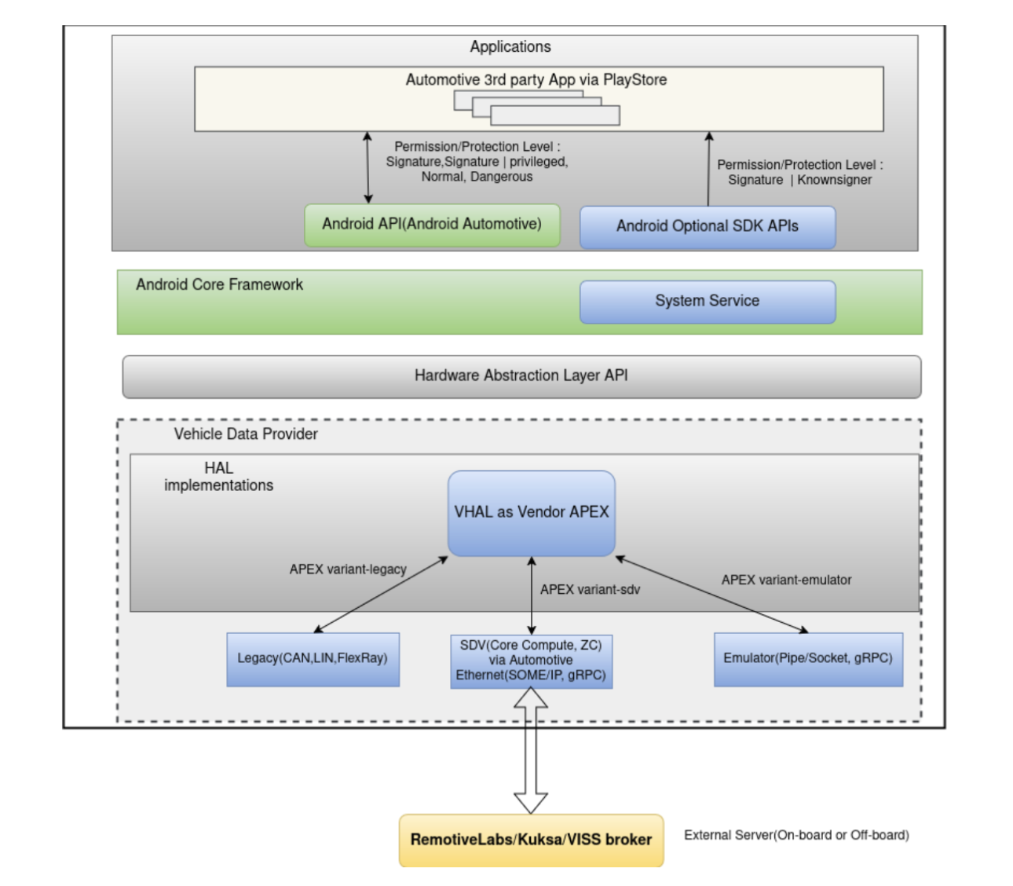
Vehicle Data – Solution Concepts (2): Optional SDK APIs
PoC based on a system app
that grants protection level
respecting Android security model and
following an AOSP zero patch policy.
Idea to work with permission groups
to govern protection levels.
Source: Volvo, see AOSP Data: Use Cases and potential Concepts

Slide 10
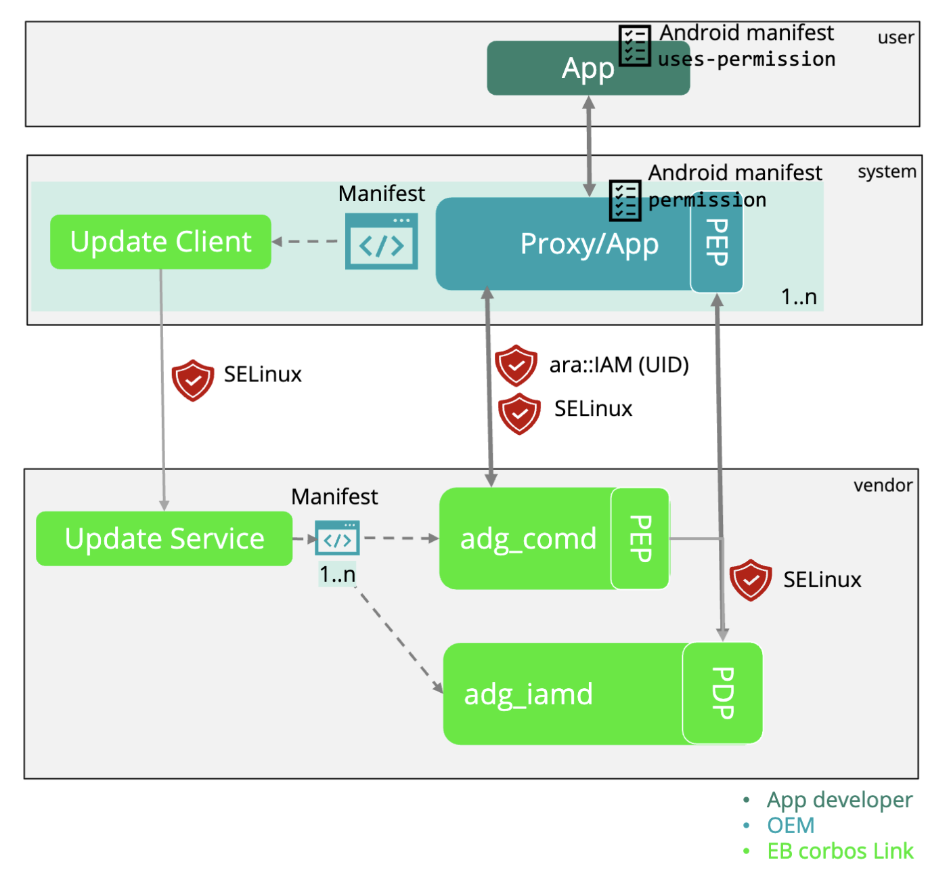
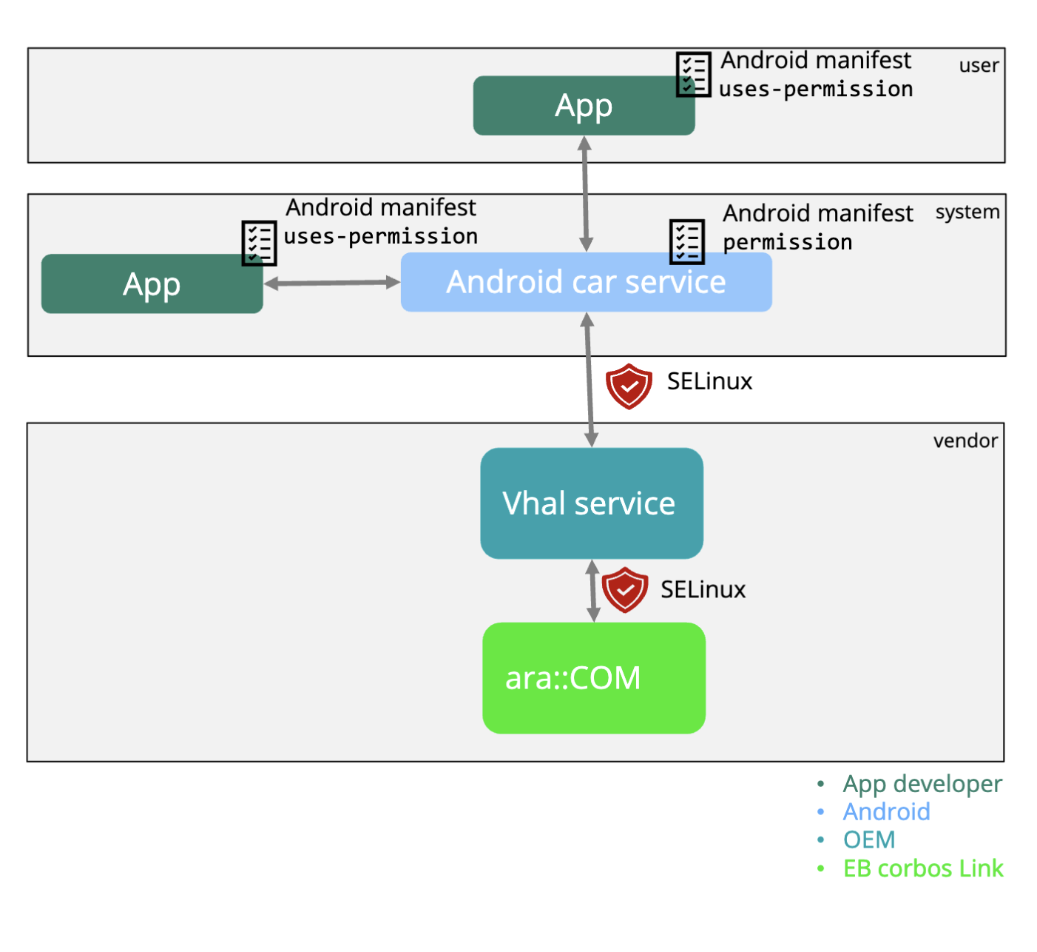
Vehicle Data – Solution Concepts (3)
Source: Elektrobit, see AOSP Data: Use Cases and potential Concepts

Slide 11
Vehicle Data: Summary, Next Steps

Slide 12
Vehicle Data – Summary and Next Steps
Summary:
  Main problem is on how to handle permissions to access vehicle data for third party apps and on how to deal with COVESA properties which are not yet part of Android.
  Requirements have been defined.
  Three solution concepts have been drafted.
Next Steps:
  Map the identified requirements to the PoC concepts.
  Compare the different PoC concepts presented
  Provide an overview and roadmap for accessing vehicle properties.
For the next steps, you are very welcome to join us and contribute at the AOSP Data Working Group meetings:
https://wiki.covesa.global/display/WIK4/COVESA+AOSP+Data+Weekly
AOSP Data: Use Cases and potential Concepts

Slide 13
Template
Template
Xxx
Xxx
Info box
template

