Slide 1
WE BUILD THE ECOSYSTEM
TECHNOLOY ENABLES BUSINESS
COVESA All Member Meeting, September 25th, 2024
Gerhard Grossberger

Slide 2
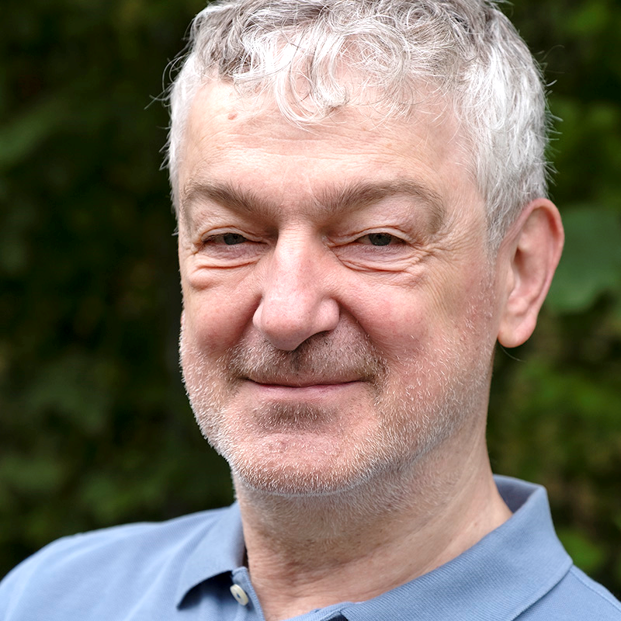
Introduction
Gerhard Grossberger
Director
App Store Content Strategy
HARMAN Automotive
Ulm, Germany

Slide 3
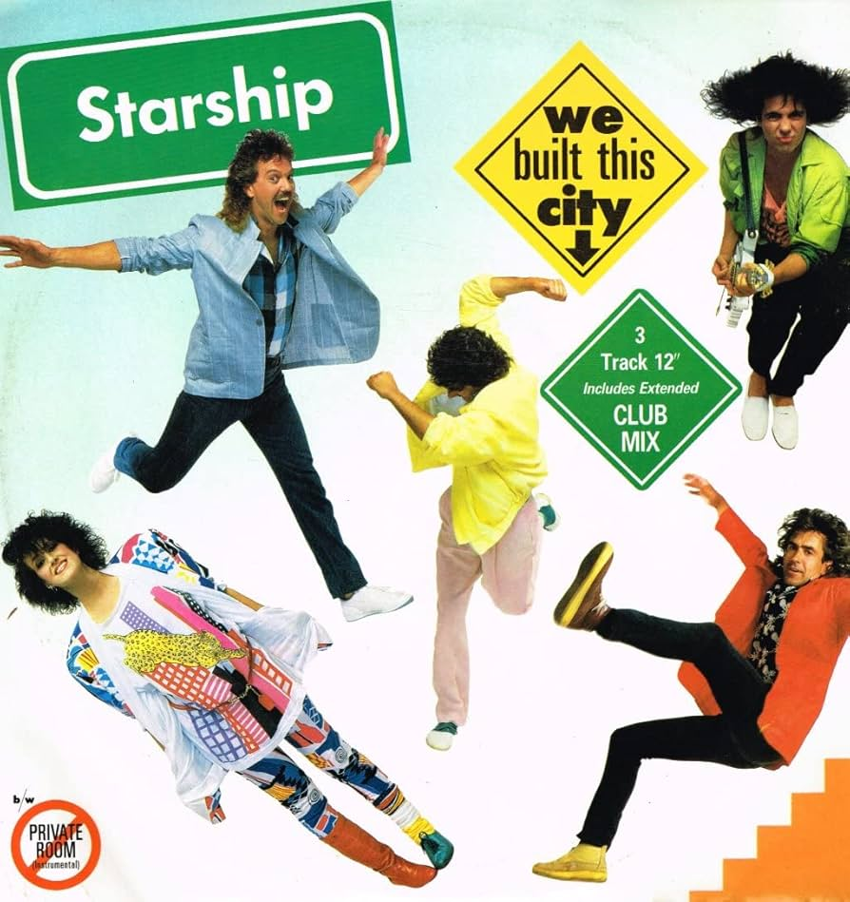
Introduction
1985
… on Rock and Roll
Image source: Discogs

Slide 4
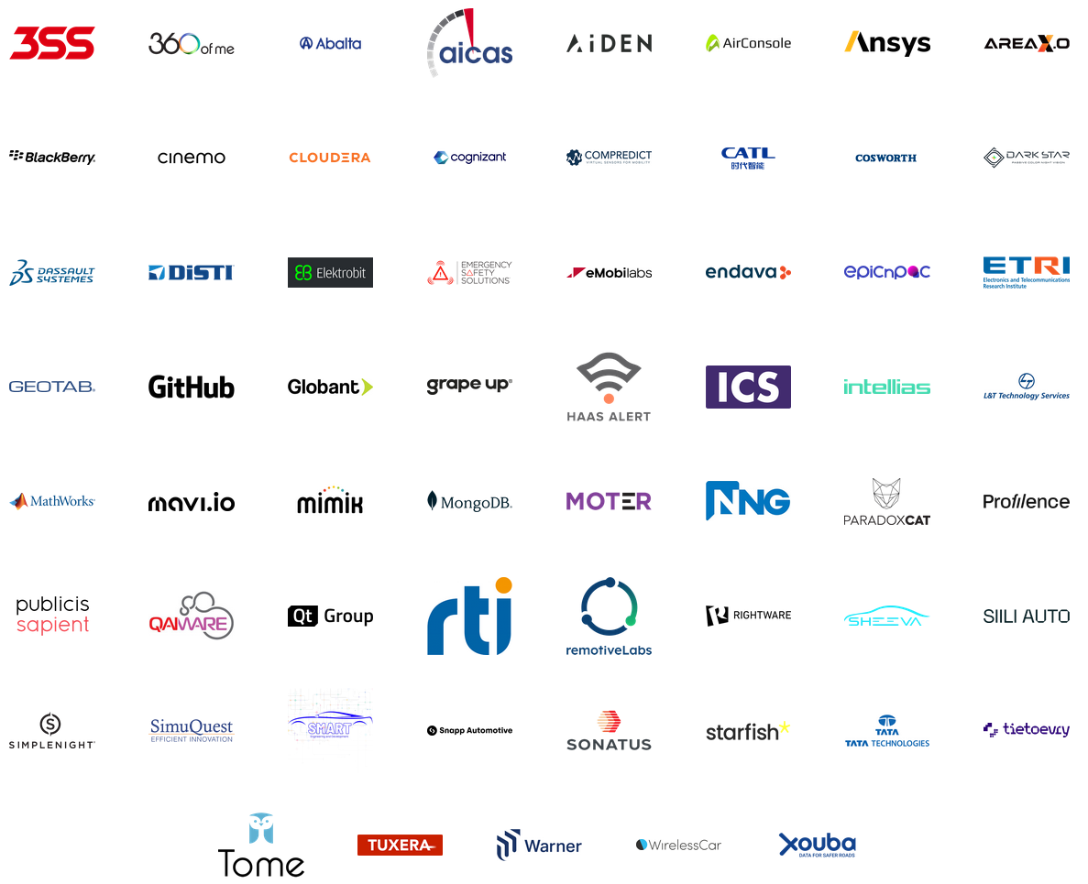
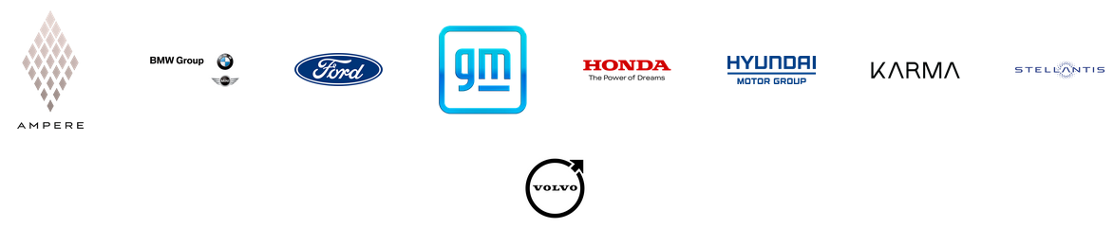
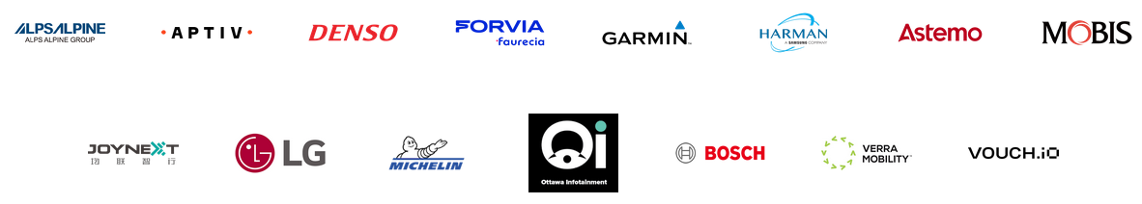



Introduction
We…
…built the Ecosystem on

Slide 5

Introduction
Is this an Egosystem or Ecosystem?
A Community of living and nonliving things considered as a unit.
Complex relationship among living things, habitats and resources.
Image source: zdf.de

Slide 6
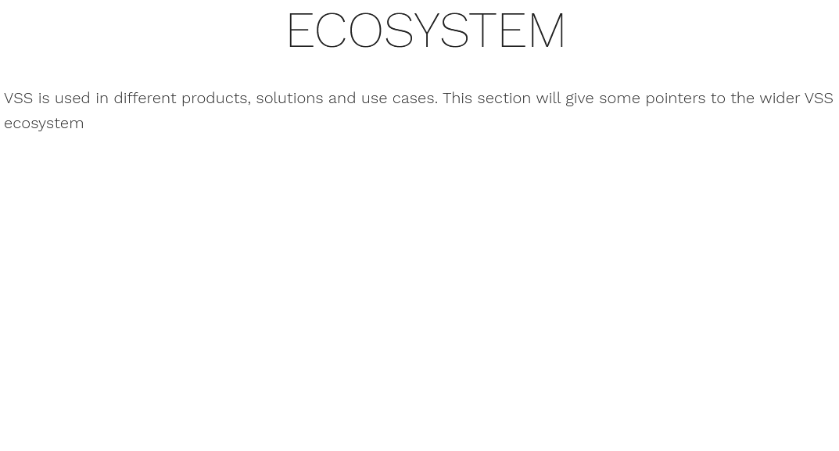
Ecosystem
COVESA and Ecosystems
Complex relationship among things, habitats and resources.
Source: https://covesa.github.io/vehicle_signal_specification/ecosystem/index.html

Slide 7
Complexity
Linux
Domain Controller
Connectivity
COMPLEXITY Hypothesis
Ethernet
ADAS
OTA
Sound
Battery
Security
Diagnostics
Engine
Driver Distraction
Problems with a certain complexity need
Solutions with a certain complexity.
ABS
Central Compute
Wireless Key
Sensors
SDV
CAN
Cloud / Edge
Navigation
Powertrain
4G / 5G
Zone Controller
Climate Control
Infotainment
Smartphone Projection
Airbag
Android
Cameras
Real-time
Displays
Lights
Radar
Lane Control
V2X
NCAP
A modern car can incorporate up to 3.000 individual semiconductors and 100,000.000 lines of code!

Slide 8
Complexity
COMPLEXITY on Use-Cases
Data Privacy, Car Data, Localization
Legacy Laws, NCAP, WP.29
E/E System Architectures
New Business Models
Software Regulations
Standards
Open Source
SaaS Platforms
New OEM – Tier - Relationships
New Products, Services & Suppliers
Digital Twin
Data as a Service
Cybersecurity
Function as a Service
Chipset & Sensor Technologies
Connectivity, MNOs
OTA
Mobility as a Service
AI Technologies
BEV, Charging
Source: Egil Juliussen

Slide 9
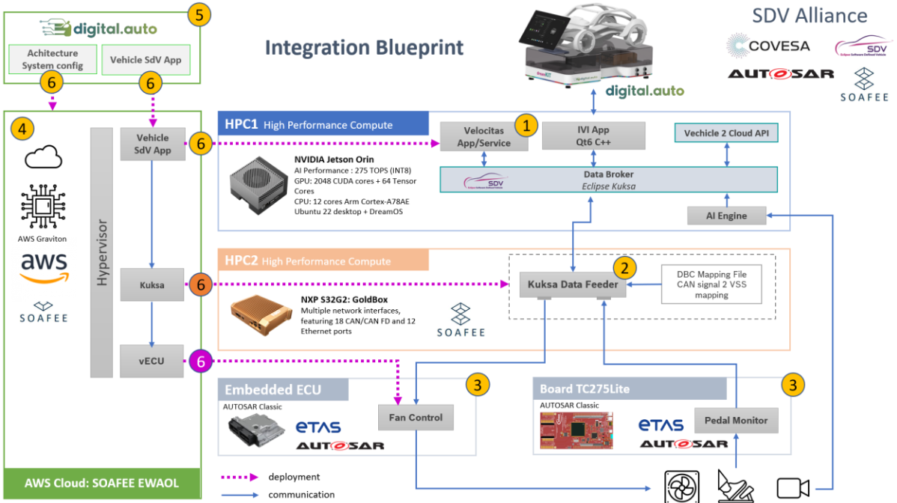
Complexity
COMPLEXITY on System (Vehicle) Level
Source: https://covesa.global/wp-content/uploads/2024/05/SDV-Alliance-Integration-Blueprint-20240109.pdf

Slide 10
Complexity
COMPLEXITY is Relative
OEM, Suppliers
Are experts on automotive systems design, development and manufacturing
Know all the regulations, standards, rules…
Have all the complex processes and toolchains installed and working
Understand the today’s stakeholders, their needs and pain points
…
Complexity: The car (and its surrounding systems)
How to build a car
New Stakeholders
Come from different domains / industries
Have a different culture than automotive
Don’t care about all the complexity of how to build a car
Want to do something new and exciting
May see opportunities which are sometimes invisible to traditional stakeholders
…
Complexity: Functions & Experience
How to leverage a car (beside pure driving)

Slide 11

Complexity
New Stakeholders to leverage from COVESA
Smart Things and IoT Providers and Integrators
Gaming Industry
Communities, Traffic Managers and Public Transport
Fleet Operators and Managers incl. Car Rentals, Car Sharing…
Any App Developer who is today working on OBD-II based hardware
Related automotive Standards like V2X, PaK
Audio and Video Streaming Content Providers
Insurances who rely today on telematics hardware
First Responders and Emergency Services
and many more…

Slide 12




Way to go
Building the Ecosystem
can solve pain points for everyone
Technology
Enablers
APIs
SDKs
…
Developer
Community
Embedded
AAOS
iOS, Android
Cloud/Edge
…
Experience

Slide 13
We build the Ecosystem
Conclusion
Complex Systems need certain complexity to be implemented
This complexity can (should) be hidden to Stakeholders outside this System
Open and transparent Standardization is key for such a separation
COVESA and SDV build the Standards & Tools from the inside to the outside
  Technology is the glue to build the Ecosystem
  Let’s consider the outside world!
  And NOT build an Egosystem…

Slide 14
THANK YOU

