Slide 1
9-1-1’s Role in the Connected Safe System Approach
Panel

Slide 2







911’s Role in the Connected Safe System Approach
Brian Tegtmeyer
Coordinator,
National 911 Program
NHTSA
Jim Lanier
Public Safety Outreach
OnStar
April Heinze
VP, Chair of Operations
Director, NENA
Tim Van Goethem
Chief Product Officer
Emergency Safety Solutions
Brian Allan
CRO, ReviverMX
Steve Coker, Sr. Vice
President, SiriusXM
Connect
Ty Wooten
Director of Govt
Affairs, IAED

Slide 3


Slide 4
911’s Role in Connected Safe System Approach
Panel Discussion
COVESA All Member Meeting
September 25, 2024
Novi, MI
Brian Tegtmeyer, ENP
Coordinator, National 911 Program
Office of Emergency Medical Services
National Highway Traffic Safety Administration
US Department of Transportation
Notes:
BLS SOC

Slide 5
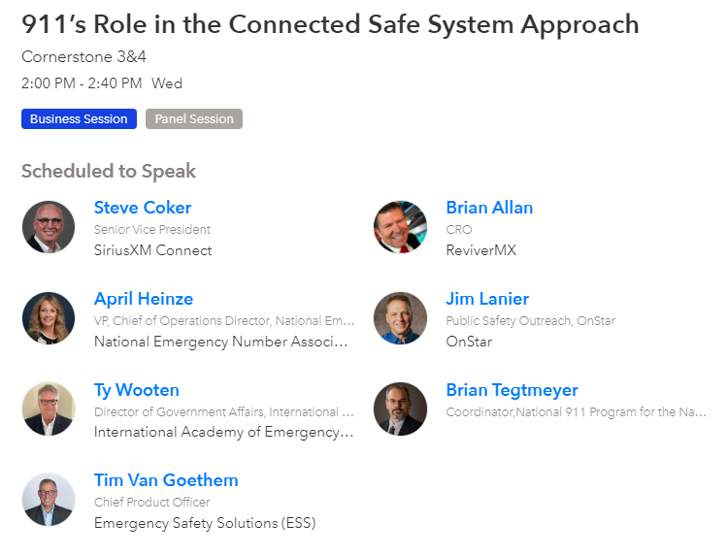

Slide 6


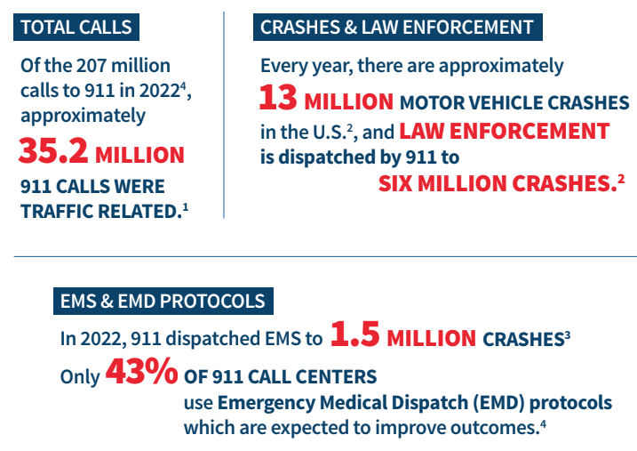
911’S IMPORTANT ROLE IN HIGHWAY SAFETY
911 is the first, critical step in the life-saving system of care on the roadways.

Slide 7
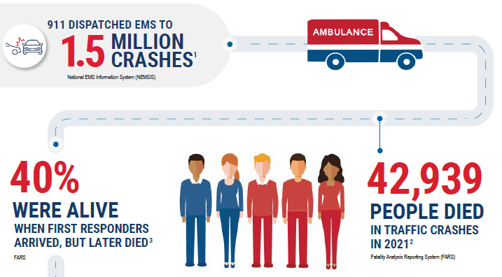
911’S IMPORTANT ROLE IN HIGHWAY SAFETY

Slide 8

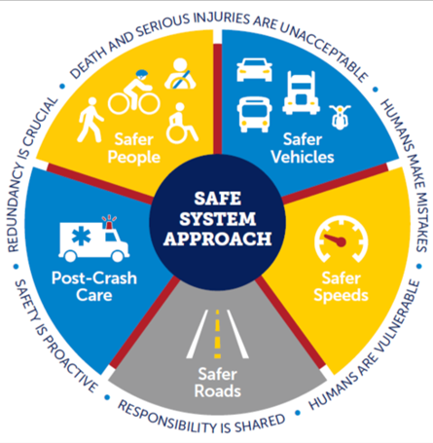
NATIONAL ROADWAY SAFETY STRATEGY:
The Safe System Approach
911’s Role in All Five Elements
  Risky behavior reported to 911 (DUI, reckless/distracted driving)
Safer People
  Unsafe conditions are reported
  to 911 (debris, lights, hazards)
Safer Roads

Slide 9

NATIONAL ROADWAY SAFETY STRATEGY:
The Safe System Approach
  911 centers are an integral part of the enforcement of speed and traffic laws by dispatching and recording law enforcement actions.
Safer Speeds
  Automatic Crash Notification/Advanced Automatic Crash Notification (ACN/AACN) systems connect 911 centers and transmit critical data through telemetry.
Safer Vehicles
  Post-crash care begins with a call to 911.
  Telecommunicators must work with the caller to identify the location, nature and severity of the crash and dispatch help.
Post-Crash Care

Slide 10



FOLLOW ME
Brian Tegtmeyer, ENP
NHTSA National 911 Program, Coordinator
(202) 366-2705
brian.tegtmeyer@dot.gov

