Slide 1
Connected Vehicle Cloud Architecture
Design For Interoperable Digital Trust
COVESA All Member Meeting
September 25th, 2024

Slide 2



Introduction
Ted Guild
Ansgar Gerlicher
Philippe Le Berre
Connectivity Standards Lead at GEOTAB
Portland, USA
Professor, Startup Mentor & Entrepreneur
Stuttgart, Germany
CTO at 360ofMe
Geneva, Switzerland
https://www.linkedin.com/in/tedguild/
https://www.linkedin.com/in/ansgar-gerlicher-0949a84b/
https://www.linkedin.com/in/philippe-le-berre-964a3716a/

Slide 3
Agenda
Open discussion on what is needed to enable automotive as a cohesive, cross industry ecosystem, empowering end users and enabling services
State of the Industry
Liabilities and issues with current approach
Importance of Privacy and User Data Rights
Relevant laws and regulations
Importance of accurate and beyond the car personal data
Design goals
Benefits to separation of roles
Possible Information Architectures
Notes:
I would suggest with the point “Importance of accurate and beyond the car personal data” to advocate that better privacy practice leads to more accurate data and ability to access to a greater set of personal data, for instance health data in the context of safety feature like crash care/ecall. This such as not be stucked into the “compliance” pit. (PLB)

Slide 4
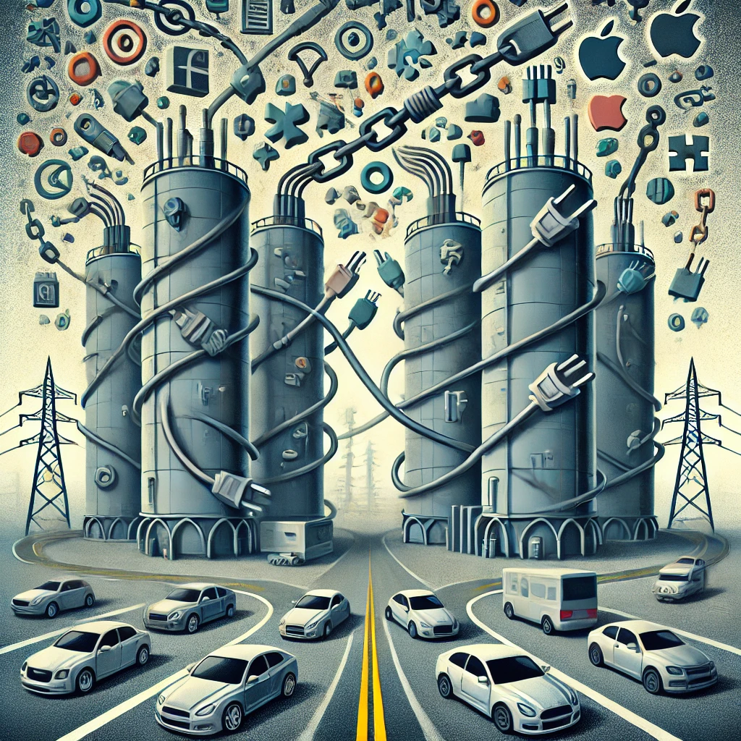
The Unsustainable State of the Industry
Silo approach - per OEM
  No widespread interoperability only one off partnerships
  No consistent data model
  No consistent privacy & consent model
  Mismatched protocols
  Lack of portability for vehicle owner, driver, passengers and service providers
  Lack of transparency to vehicle owner, driver, passengers
  In North America usually consent buried in initial purchase agreement, in EU often consent required per drive
  Inability or unwillingness to make individual exceptions
Consent for data collection either missing, blanket default with notice only or OEM specific, turning silo into a tower
Often poor user experience and limited services*
Smartphone (Android + iOS) as the main challengers
Notes:
TG slide: Adding portability (PLB) TG to review and pare down

Slide 5
Creating a Trusted Digital Experience: Enhancing UX through Safety, Security, and Privacy
Apps & Services Space
Guidelines and Standards are required to achieve this transition!
High
Automotive Apps & Services tomorrow
Provides a great UX while not accomplishing security & privacy objectives
Accomplishes safety, security & privacy objectives while providing a great UX
Usability & UX
Quadrant I
Quadrant II
Quadrant III
Quadrant IV
Automotive Apps & Services today
Neither provides a great UX nor accomplishes security & privacy objectives
Accomplishes security & privacy objectives while providing a bad UX
Low
Low
Digital Trust
High
*Graphic based on IEEESSIT, 2017: https://technologyandsociety.org/deconstructing-the-relationship-between-privacy-and-security/
Notes:
AG User-Centric Design Approach
Empathy for Users: Understand the needs and preferences of users, balancing security measures with ease of use. Implement user-friendly interfaces for privacy settings, allowing users to easily control what data is shared and with whom.
Transparent Communication: Clearly communicate privacy and security features, so users are aware of how their data is protected. This builds trust without overwhelming the user with technical details.
2. Adaptive Security Levels
Context-Aware Security: Implement security mechanisms that adapt based on the context (e.g., driving vs. parked). For instance, require stronger authentication when accessing sensitive information but minimize interruptions during driving.
Customizable Security Settings: Allow users to choose their desired level of security, with default settings that protect them without requiring complex configurations.
3. Minimize Data Collection
Data Minimization: Collect only the data necessary for the service to function effectively. By reducing the amount of data collected, you minimize potential risks while simplifying the user experience.
Edge Computing: Process data locally in the vehicle rather than sending it to the cloud, reducing the amount of data transmitted and stored externally, thereby enhancing privacy.
4. Seamless Authentication
Biometric Authentication: Use biometric methods (e.g., fingerprint, facial recognition) for seamless yet secure authentication. These methods provide high security while being quick and easy for the user.
Single Sign-On (SSO) Integration: Integrate with existing SSO services so users can log in once and access multiple systems without repeatedly entering credentials, improving both security and convenience.
5. Regular Security Updates
Automatic Updates: Ensure the vehicle's system can receive and install security updates automatically with minimal disruption to the user. This keeps the system secure without requiring user intervention.
OTA (Over-the-Air) Updates: Use OTA updates to keep the vehicle’s software current, protecting against new vulnerabilities without the need for users to take action.
6. Privacy by Design
End-to-End Encryption: Implement strong encryption for data both at rest and in transit. This ensures that even if data is intercepted, it remains inaccessible to unauthorized parties.
Anonymization and Pseudonymization: Whenever possible, anonymize or pseudonymize data to protect user identity while still allowing data analysis for improving services.
7. User Feedback Loop
User Feedback Mechanisms: Continuously gather user feedback on privacy and security features. Use this feedback to iteratively improve the balance between security and user experience.
Educational Interfaces: Educate users about the importance of privacy and security within the UI. Empower users to make informed decisions about their data without feeling overwhelmed.
8. Redundancy and Reliability
Fail-Safe Mechanisms: Implement fail-safe mechanisms that maintain the security and privacy of user data even in the case of a system failure. Ensure that these mechanisms do not degrade the user experience.
Data Recovery and Backup: Ensure data is securely backed up and can be recovered in case of a system failure, without compromising user privacy or experience.
9. Human-Machine Interaction (HMI)
Intuitive Interfaces: Design intuitive interfaces that make it easy for users to understand and manage their data security. Use visual cues and simple language to guide users through privacy settings.
Voice-Controlled Security Features: Enable voice-activated commands for security features, allowing users to manage their data without taking their eyes off the road or going through complex menus.
10. Regulatory Compliance
Compliance with GDPR and Other Regulations: Ensure that the vehicle’s data handling practices comply with relevant privacy regulations (e.g., GDPR). Compliance builds trust and demonstrates a commitment to user privacy.
Audit and Transparency: Regularly audit data security practices and be transparent about how user data is handled and protected.
Conclusion
Balancing UX and Security: Emphasize that achieving a balance between user experience and security is not only possible but necessary. By integrating security seamlessly into the user experience, it’s possible to protect user data without compromising the convenience and enjoyment of using the vehicle.

Slide 6
Creating a Trusted Digital Experience: Enhancing UX through Safety, Security, and Privacy
Apps & Services Space
User-Centric Design
  Prioritize ease of use while maintaining security
  Simple digital trust settings: easy control over data sharing
  Clear communication of privacy & security features (without overwhelming users)
Seamless Authentication
  Use biometric methods (fingerprint, facial recognition)
  Vehicle integration: FIDO & Single Sign-on (SSO) standards
  Multi-Factor/Multi-Modal Authentication
Intuitive Interfaces
  Human-Centered Design (HCD) for intuitive interfaces
  Voice control for driving convenience; research needed for safe LLM use
Balancing UX and Security & Privacy
  Seamless security and privacy integration improves both safety and user experience
High
Provides a great UX while not accomplishing security & privacy objectives
Accomplishes safety, security & privacy objectives while providing a great UX
Usability & UX
Quadrant I
Quadrant II
Quadrant III
Quadrant IV
Neither provides a great UX nor accomplishes security & privacy objectives
Accomplishes security & privacy objectives while providing a bad UX
Low
Low
Digital Trust
High
*Graphic based on IEEESSIT, 2017: https://technologyandsociety.org/deconstructing-the-relationship-between-privacy-and-security/
Notes:
AG slide User-Centric Design Approach
Empathy for Users: Understand the needs and preferences of users, balancing security measures with ease of use. Implement user-friendly interfaces for privacy settings, allowing users to easily control what data is shared and with whom.
Transparent Communication: Clearly communicate privacy and security features, so users are aware of how their data is protected. This builds trust without overwhelming the user with technical details.
2. Adaptive Security Levels
Context-Aware Security: Implement security mechanisms that adapt based on the context (e.g., driving vs. parked). For instance, require stronger authentication when accessing sensitive information but minimize interruptions during driving.
Customizable Security Settings: Allow users to choose their desired level of security, with default settings that protect them without requiring complex configurations.
3. Minimize Data Collection
Data Minimization: Collect only the data necessary for the service to function effectively. By reducing the amount of data collected, you minimize potential risks while simplifying the user experience.
Edge Computing: Process data locally in the vehicle rather than sending it to the cloud, reducing the amount of data transmitted and stored externally, thereby enhancing privacy.
4. Seamless Authentication
Biometric Authentication: Use biometric methods (e.g., fingerprint, facial recognition) for seamless yet secure authentication. These methods provide high security while being quick and easy for the user.
Single Sign-On (SSO) Integration: Integrate with existing SSO services so users can log in once and access multiple systems without repeatedly entering credentials, improving both security and convenience.
5. Regular Security Updates
Automatic Updates: Ensure the vehicle's system can receive and install security updates automatically with minimal disruption to the user. This keeps the system secure without requiring user intervention.
OTA (Over-the-Air) Updates: Use OTA updates to keep the vehicle’s software current, protecting against new vulnerabilities without the need for users to take action.
6. Privacy by Design
End-to-End Encryption: Implement strong encryption for data both at rest and in transit. This ensures that even if data is intercepted, it remains inaccessible to unauthorized parties.
Anonymization and Pseudonymization: Whenever possible, anonymize or pseudonymize data to protect user identity while still allowing data analysis for improving services.
7. User Feedback Loop
User Feedback Mechanisms: Continuously gather user feedback on privacy and security features. Use this feedback to iteratively improve the balance between security and user experience.
Educational Interfaces: Educate users about the importance of privacy and security within the UI. Empower users to make informed decisions about their data without feeling overwhelmed.
8. Redundancy and Reliability
Fail-Safe Mechanisms: Implement fail-safe mechanisms that maintain the security and privacy of user data even in the case of a system failure. Ensure that these mechanisms do not degrade the user experience.
Data Recovery and Backup: Ensure data is securely backed up and can be recovered in case of a system failure, without compromising user privacy or experience.
9. Human-Machine Interaction (HMI)
Intuitive Interfaces: Design intuitive interfaces that make it easy for users to understand and manage their data security. Use visual cues and simple language to guide users through privacy settings.
Voice-Controlled Security Features: Enable voice-activated commands for security features, allowing users to manage their data without taking their eyes off the road or going through complex menus.
10. Regulatory Compliance
Compliance with GDPR and Other Regulations: Ensure that the vehicle’s data handling practices comply with relevant privacy regulations (e.g., GDPR). Compliance builds trust and demonstrates a commitment to user privacy.
Audit and Transparency: Regularly audit data security practices and be transparent about how user data is handled and protected.
Conclusion
Balancing UX and Security: Emphasize that achieving a balance between user experience and security is not only possible but necessary. By integrating security seamlessly into the user experience, it’s possible to protect user data without compromising the convenience and enjoyment of using the vehicle.

Slide 7
Trends & Challenges in Providing Digital Services
Trends
OEM-Owned systems compete with CarPlay & Android Automotive
  Some OEMs struggle in Software-Development and shift to third-party systems
Growing demand for connected features and services
  Requires individual user profiles across multiple vehicles
  Standardized interfaces and signals required for app & service development
Challenges
Multiple proprietary interfaces from OEMs, Google and Apple complicate service provider efforts
User lock-in: difficult to switch smartphone or car brand without losing functionality
Lack of standardized privacy, data protection, and user control over data flow
Proprietary interfaces
User lock-in
Security & Privacy
Usability & UX
User Profiles / Digital Identities
Guidelines
Standards
Regulations
Challenges & Opportunities
In-Vehicle Apps (Android, CarPlay, games, social media, e-mail, …)
Remote Apps (car-sharing, vehicle control, parking, …)
Cloud Services (insurance, fleet-mgmt remote diagnostics, …)
Data & Services
OEM1
OEM2
Android Automotive
CarPlay
OEM3
OEM4
Vehicle Platforms
Notes:
AG slide

Slide 8

Building an Interoperable Ecosystem in an increasing diverse regulatory environment
All designs must address present and future regulatory requirements.
66% of all countries have privacy laws:
  EU-27 leading personal privacy and data access (GPDR, NIS2, RED, DMA, DSA, Data Act, Digital Id, etc)
  Drivers Privacy Protection Act (DPPA)
  Japan, Act on the Protection of Personal Information (APPI)
  Australian Privacy Principles
  Personal Information Protection and Electronic Documents Act (PIPEDA)
  California Consumer Privacy Act (CCPA) & California Privacy Rights Act (CPRA)
  Privacy and Electronic Communications Regulations
Enabling cross-border connected services so the vehicle can adjust its configuration to applicable laws, possibly consent renewal or new consent, based on its location.
Dynamically adjust Data Residency based on vehicle location and applicable laws to the owner, driver, passengers.
Designing for the most restrictive provides more future proofing and less costly revision especially if adopted industry wide - collective lift.
Notes:
TG slide, others or skip?

Slide 9
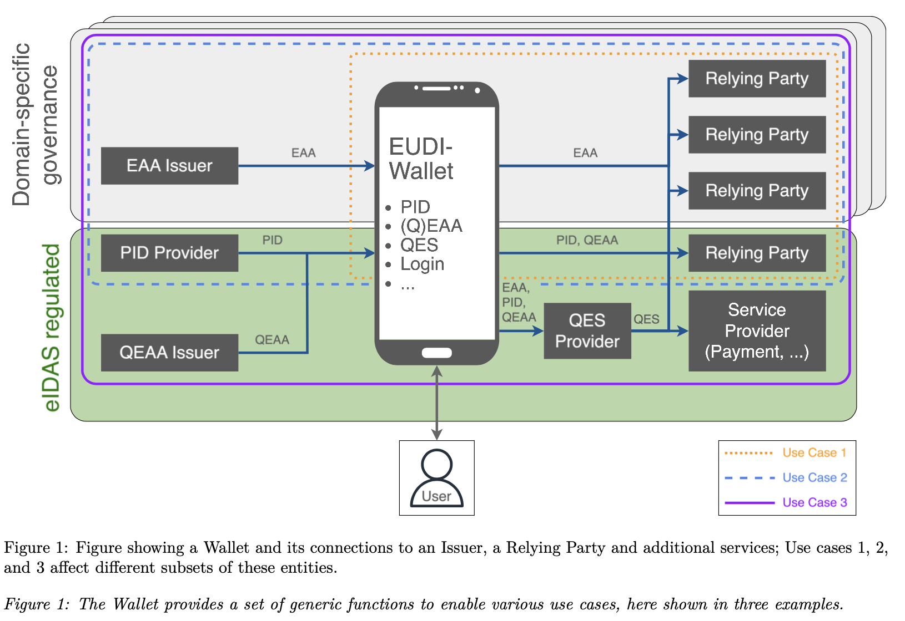
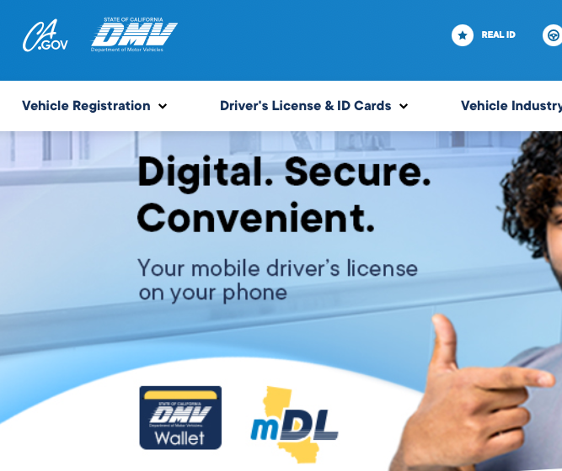
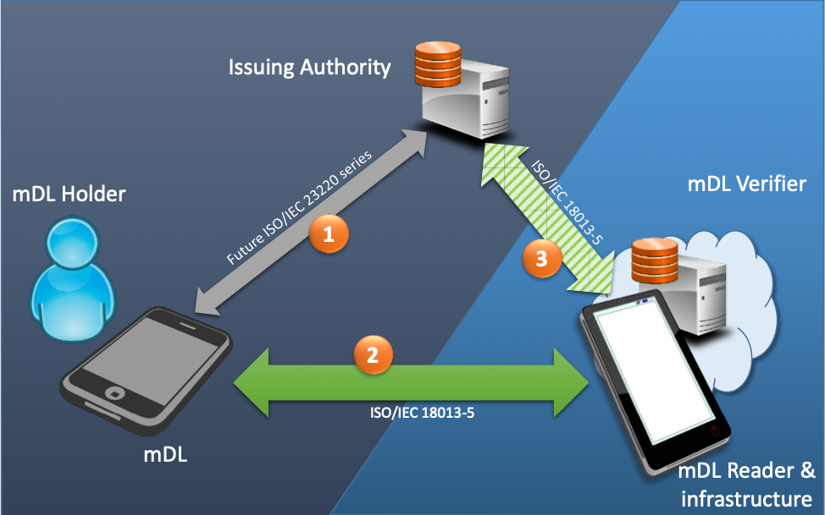
Is it possible to ignore Digital Id and Digital Driving License?
The EU will introduce the European Digital Identity Wallet (EUDI-Wallet)
  Personal digital wallet for all EU citizens, free, open-source and secure
  All public and private organisations as well as large online platforms must accept a EUDI-Wallet if requested (e.g. for login / authentication)
  Until beginning 2027 all EU states are required to provide a EUDI-Wallet solution to their citizens
California, mDL, Digital Driver License - supported by Apple Wallet.
  ISO/IEC 18013-5 Personal identification — ISO-compliant driving licence
India, Japan, etc, most countries have a Digital Id program underway.
Digital IDs are smartphone-centric; the role of the vehicle in it needs to be defined.
Sources: https://gitlab.opencode.de/bmi/eudi-wallet/eidas-2.0-architekturkonzept/-/blob/main/architecture-proposal.pdf?ref_type=heads, https://www.aamva.org/getmedia/261ed16b-3f5c-4678-a2db-cc3016934234/MobileDLImplementationGuidelines-Version1-3.pdf
Notes:
AG slide
Add references: https://bmi.usercontent.opencode.de/eudi-wallet/eidas2/projekt/
European Digital Identity Wallets (EUDIW) as envisioned by the ARF and this document shall provide a set of well-defined, generic functions. Use cases are implemented by ecosystem participants on top of these functions as required. Figure 1 illustrates this concept.
EUDI musst provide exclusion of tracking and ensuring the unlinkability of user behavior, including by publishers of evidence and by service providers

Slide 10
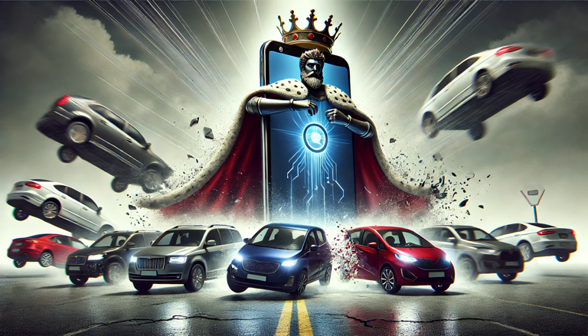
Reclaiming the In-Car Experience: How a Unified Ecosystem Can Outpace Smartphone Dominance
SmartPhone is the personal digital assistant, ruling the life of (most) people.
SmartPhone knows more about the individual digital life and real life than any other device.
SmartPhone is covering the full mobility spectrum from airports, airlines, public transportations, walking, biking, hiking, boating, riding, parking, charging and driving.
Regaining Control of In-Vehicle Digital Experiences Requires Ecosystem Unity
to Create a Mobility Roaming Profile That Outperforms Smartphones
Notes:
PLB and TG slide
Almost went with abandoned nuclear silo image instead https://www.thevintagenews.com/wp-content/uploads/sites/65/2019/11/vault.jpg
Nuke silo perhaps better analogy, the amount of construction cost for something that (fortunately) was never fully utilized

Slide 11
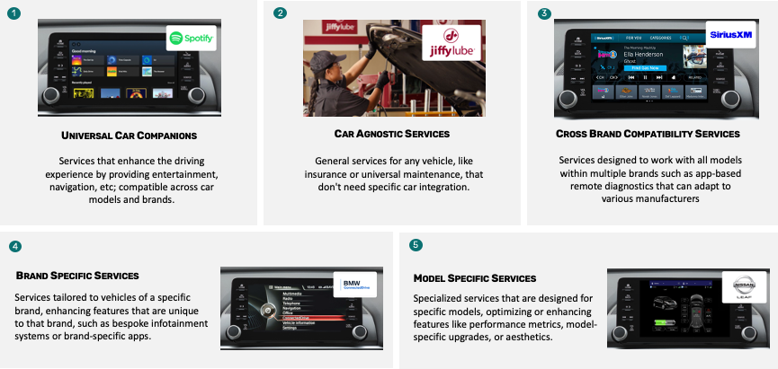
A Typology of Vehicle Digital Services
The Smartphone can access all service categories - provided they are integrated into a mobile app.
OEMs are solely aware of their own category 4 and 5 services, along with the associated owner subscriptions.
OEMs are not competing in category 3 (cross brand), which is the main battleground for large-scale deployment.
OEMs cannot deliver a comprehensive digital mobility experience without an appropriate individual profile that encompasses all 5 categories.
Notes:
PLB slide
5 types of services, OEM knows 2
User Profile enabling Services (DV) provisioning into the car.
Profile roaming over brand and models
Generic profile with a custom parts owned by OEM (based on collected data).
Coalescing profile to one identity (link to country based digital identity)
Global service meta-registry enabling to cross-link in-car implementation.
COVESA as authority for roaming profile and meta-registry

Slide 12
Delivering the ultimate in-car experience requires more accurate data than the car or the OEM can ever gather
The data supply chain is plagued by misalignments between available, desired, and essential data, creating a paradox of incompleteness
  The data you have may not be the data you want
  The data you want may not be the data you need
  The data you need may not be the one you can get
The Risks of Inaccurate Data in the Data Supply Chain
  Inaccurate data is worthless
  Inaccurate data leads, at best, to bad user experience
  Inaccurate data drugs AI into hyper-hallucination
Notes:
PLB slide - others Connected Vehicles future sales will be driven by their quality as an information platform and operators can trust you with their data
Organizations often collect vast amounts of data, but much of it may be irrelevant or not immediately useful for the specific objectives at hand. The data you have is usually raw, unstructured, or incomplete—requiring significant cleaning, transformation, and enrichment before it can meet the desired business requirements.
Sometimes, the data that teams or decision-makers believe they want may not actually be the data that leads to impactful insights or decisions. There’s often a focus on collecting trendy or high-visibility data without aligning it with the actual business questions or outcomes that need to be addressed.
Even when the true data needs are identified, organizations often find that the data they need is difficult, expensive, or impossible to acquire. It could be due to privacy regulations, technical limitations, or the fact that the data is owned by external parties.

Slide 13
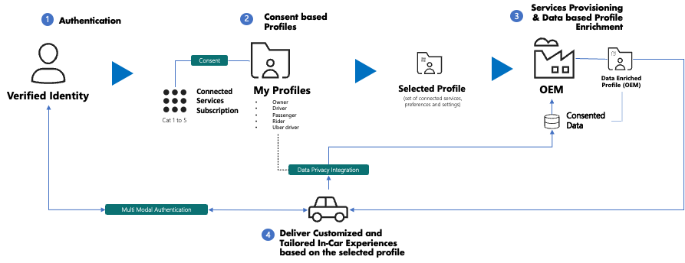
A Food-for-Thoughts High-Level Blueprint for OEM Mobility Roaming Profiles
Notes:
PLB slide

Slide 14
Design goals: Call To Action
General Goals
  Good Usability & User Experience
  Ease of use
  Safety / Security
  Interoperability
Opt out per trip
  use cases, domestic violence, undercover law enforcement operations
Roles - driver, owner, passenger, AV passenger
Trusted 3rd Party role for data exchange
Resilience to compliance and regulatory changes
Notes:
PLB - start of conclusion. open discussion and try to engage audience at this point - want to form a Consent / Privacy BoF (outside of but related to CV group)

Slide 15
Next steps
Much of this is outside the scope of the COVESA Commercial and Fleet Vehicle Expert Group, additional groups must be formed with strong coordination starting with a Consent and Privacy Birds of a Feather (BoF) activity.
Automotive Telematics Ecosystem Needs
Profile management
Consent & Privacy management
Common data model (COVESA VSS)
Industry vertical requirements (Commercial and Fleet EG)
Consistent protocols and authentication means (FIDO involvement)
Streamlined information flows - provisioning services for vehicles at delivery or subscription
…
Convene group to sketch out specifics on information architecture, flows, prioritized areas of focus, identifying existing external efforts to leverage
Notes:
get contacts, create an BoF charter, want input and early stakeholder involvement in defining - TG to ask if we can create wiki and Google group + slack channel, generate QR code

Slide 16
Questions ?
Comments ?
Feedbacks ?
Ideas ?

Slide 17
Thank You!

Slide 18
Benefits to separation of roles
Separating authentication/authorization from providing and processing data provides interoperability and mitigate provider/processor financial risk
Auth*n provider should be independent of OEMs
Examples / Use Cases
  Drivers do not operate a single vehicle nor vehicles solely from one manufacturer
  Reluctance to enter personal information per OEM (driver’s license, insurance, services, contacts, preferences)
Notes:
PLB/TG slide - all speak to and again attempt engage audience
eg IETF GNAP - also a mandate from EU Digital Identity

Slide 19

Reclaiming the In-Car Experience: How a Unified Ecosystem Can Outpace Smartphone Dominance
Notes:
PLB and TG slide
Almost went with abandoned nuclear silo image instead https://www.thevintagenews.com/wp-content/uploads/sites/65/2019/11/vault.jpg
Nuke silo perhaps better analogy, the amount of construction cost for something that (fortunately) was never fully utilized

Slide 20
RACI / Data Model / Data Flow
Roles & Responsibilities of each party
Baseline/high level data model from identity, authentication, profile, consent, privacy level, to service/subscription to link to VISS/VSS (entities)
High level Data Flow of all key functions
Notes:
PLB slide - what we should be working on first in Consent/Privacy BoF

Slide 21
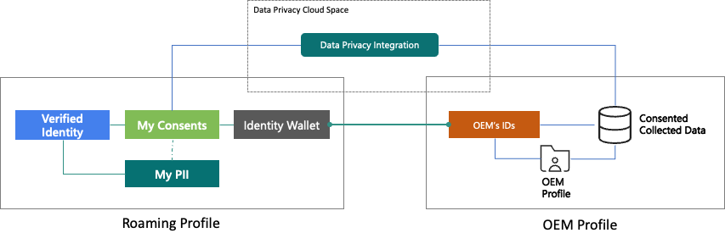
Integrating Privacy and Consent: Trust as a Competitive Advantage
Notes:
PLB slide - BACKUP

Slide 22
Building an Interoperable Ecosystem: EU
European Union has been making broad legislative requirements on the collection, use and individual access to data
EU Data Act
  IoT device (definition extends to connected vehicles) that collect data must make it available to owners
EU General Data Protection Regulation (GDPR)
  follows citizens regardless of what country they are in and who is collecting data
EU Digital Identity - Self Sovereign Identity (SSI)
  Lower cost, increased security, empowers individuals, creates interoperability instead of silos
Selling connected vehicles in the EU requires clear informed consent, SSI-based authentication,
and user-controlled third-party data access
Notes:
TG slide

