Slide 1

Member Keynote – Spring 2025 AMM
STEVE CRUMB, Executive Director, COVESA

Slide 2
Antitrust Note Well
Before we begin, we would like to make clear that COVESA is committed to compliance with the antitrust laws in all of its activities, and that it expects all participants to similarly comply with the antitrust laws. We will not engage in--and members must refrain from--any discussion of, or understandings regarding competitively sensitive topics. If you have any doubts regarding whether a matter is appropriate for discussion, please consult with your antitrust counsel.

Slide 3
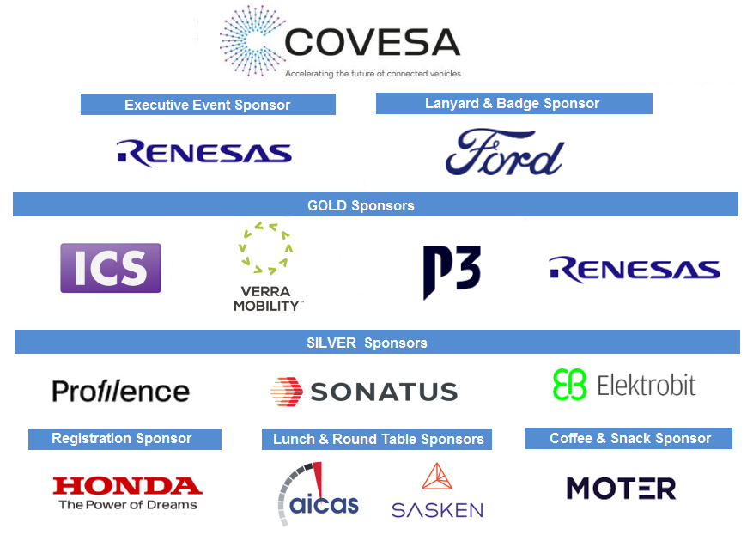
Please Thank Our Event Sponsors!!

Slide 4
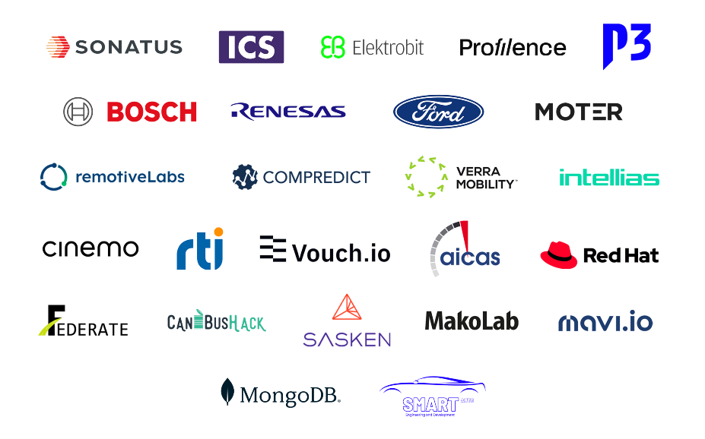
Visit Our Showcase Participants Tonight!!

Slide 5
What’s New?
| 5

Slide 6
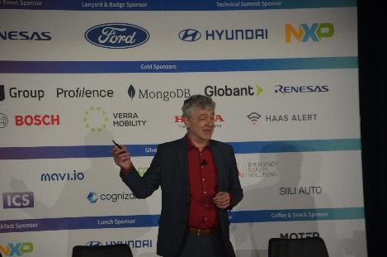
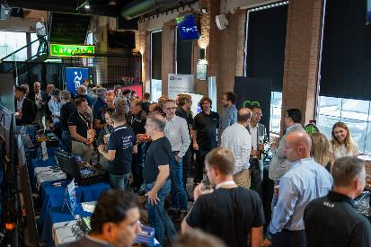
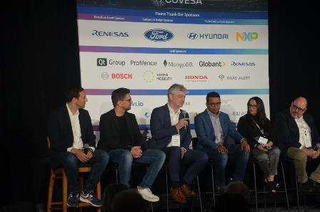
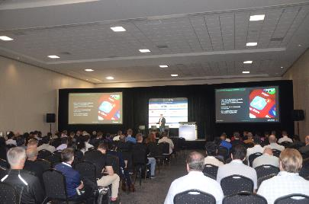
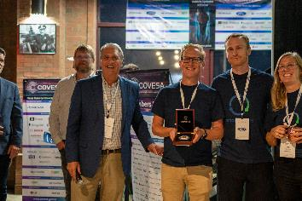
Novi AMM: September 2024

Slide 7
















New Memberships Since Fall 2024 AMM
Other Memberships In Process

Slide 8
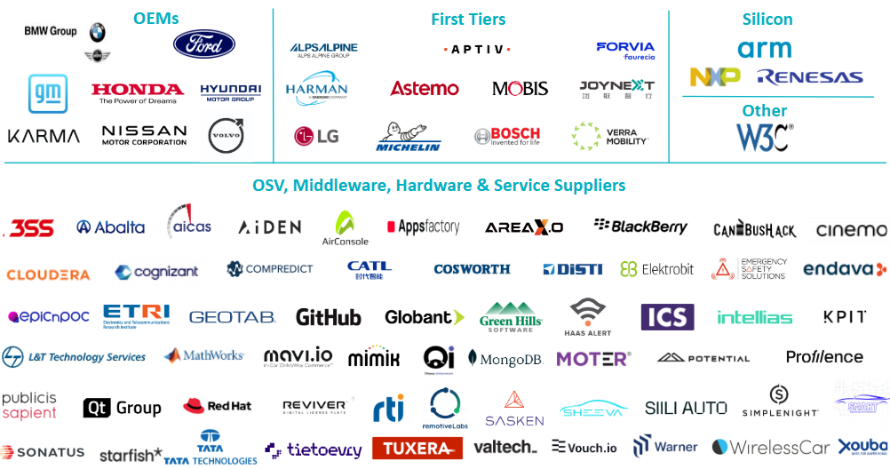

COVESA Members

Slide 9
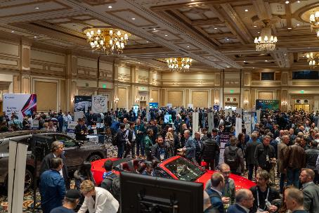
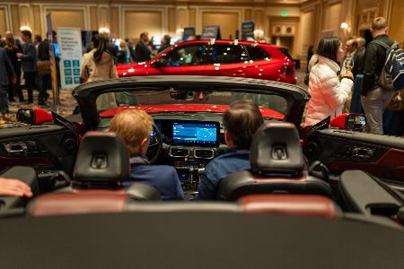
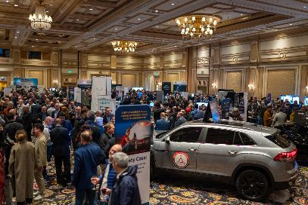
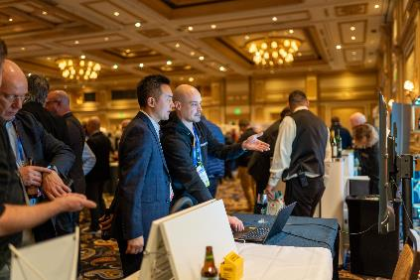
CES 2025
1800+ attended

Slide 10
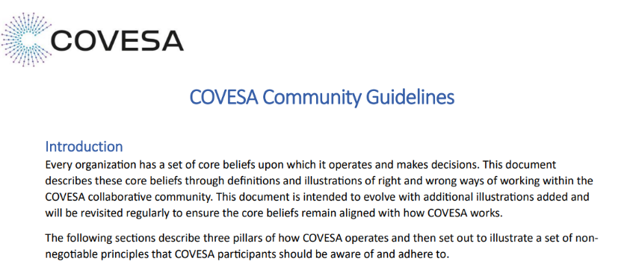
Recently Published Document
Hot off the press…
https://covesa.global/wp-content/uploads/2025/04/COVESA-Community-Guidelines-April-2025.pdf

Slide 11
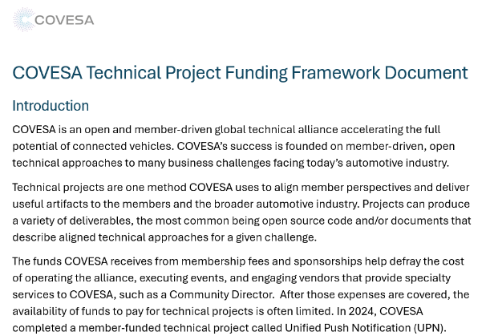
Soon to be Published Document
Coming this summer!

Slide 12
Amended Bylaws and IP Policy
| 12

Slide 13
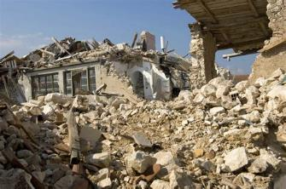

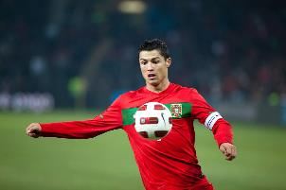
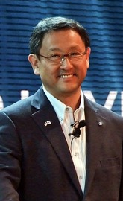
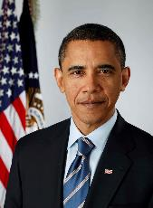
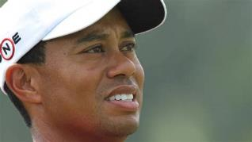
Guess what year?
L’Aquila, Italy earthquake
Bitcoin network introduced
Player of Year
Car Accident
Akio Toyoda – President of Toyota
Inaugurated as US President

Slide 14
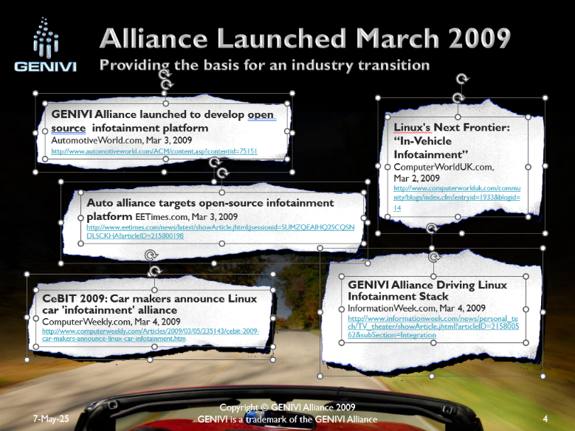
Also in 2009

Slide 15
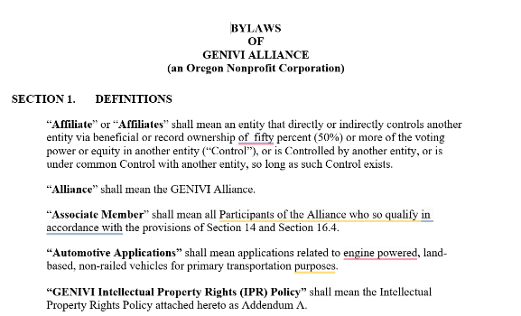
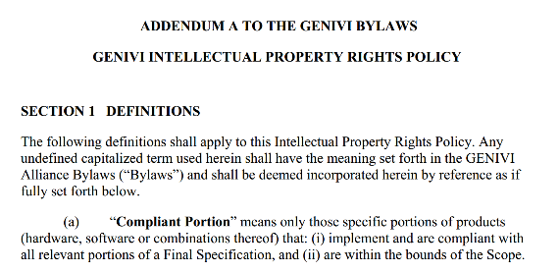
And when the COVESA Bylaws & IP Policy were Created
And have had limited amendments since then!

Slide 16
Board-Approved Amended Bylaws & IP Policy
COVESA completed an IP Policy refresh project, and the Board voted to approve the amended Policy (and related amendments to the Bylaws) during its 12 March 2025 meeting
A 45-day member review period was opened on 21 March and closed on 6 May with no substantive comment or any disagreement received from any member
Pursuant to the Bylaws (Section 4.2p), the Board has the duty to approve for instatement the amended Bylaws (including the IP Policy as an Exhibit)
Motion: To approve for instatement the amended Bylaws, including the amended IP Policy, effective immediately. PASSED UNANIMOUSLY
As of Monday, the amended Bylaws and IP Policy are instated
Both may be downloaded at: covesa.global/join-covesa

Slide 17
Summary of IP Policy Amendments
Fundamental shift from Board-approved final deliverables with heavy-weight IPR management to CURRENT way-of-working – open collaboration, open licensing
Three Categories of Amendments
  Definitions – many removed; some added; COVESA Deliverables most important
    “COVESA Deliverables mean any document, code, or other Alliance output, in draft or final form, produced by a Team, Group, or Project of the Alliance”.
  Removal or replacement of language from previous policy – approvals, licensing of IP, inventions, out-of-scope
  New language in the new policy – licensing of COVESA Deliverables, contributing as a member and non-member, updated, state-of-the-art legal boilerplate
Note: A more detailed amendment summary for both the IP Policy and Bylaws was sent to the primary contact of
record on 21 March 2025, at the start of the Member review period. Copy available upon request.

Slide 18
Summary of Bylaw Amendments
Rationale: Align IPR Policy terminology and bring Bylaws current
Replacement of previous alliance outputs with “COVESA Deliverables” throughout
Update Specific Objectives section to reflect Connected Vehicle orientation
Renaming of System Architecture Team to Technical Steering Team
Addition of Start-up Associate member category
Note: I’m happy to discuss these with any member. Email me at scrumb@covesa.global.

Slide 19
Call for Participation in Fall AMM Program
Opening today the CFP for session proposals for the Fall AMM (22-23 October, Ann Arbor, MI)
Program Themes:
  Strategies for Delivering an Up-to-Date, In-Vehicle Digital Experience
  Embracing the Digital Life of Vehicle Occupants
  Integrating Connected Vehicles for Enhanced Mobility
  Enabling/Enriching Vehicle Data through Artificial Intelligence
  Industry Approaches for Data Privacy
  Simplifying Fleet Management
More information at: https://wiki.covesa.global/display/WIK4/COVESA+Fall+2025+AMM+Call+for+Participation
Email will be sent to all Members in next 2-3 weeks

Slide 20
A Couple of Reminders …
Download the EventLeaf app for best view of agendas
Lunch sessions today and tomorrow:
  Wednesday – MOA 4 - Connected Safety Birds of a Feature (BoF) Lunch & Learn
  Thursday – MOA 4 – COVESA Marketing & Member Visibility Workshop
Tonight (1730) - COVESA Showcase & Reception – MOA 6+9

Slide 21


Innovator / Adopter / Contributor Award
To encourage demonstrating COVESA technologies during the AMM and other showcases, we will continue to award organizations meeting the below criteria at their showcase table
Broad criteria for selecting whom to award include:
  Adoption of COVESA technologies
  Contribution back to COVESA
  Innovative use of the technology
  Openness of solution (Bonus)
A team of Board and TST members will visit showcase tables, explore what is being demonstrated and identify 1-3 “winners” of the award

Slide 23
Please Thank Our Event Sponsors!!

