Slide 1
COVESA: Today and Tomorrow
COVESA Board of Directors Panel

Slide 2
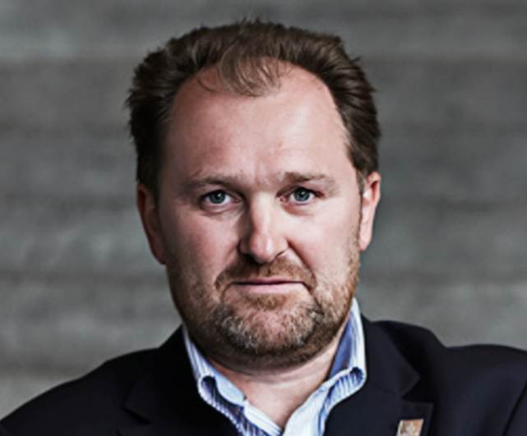
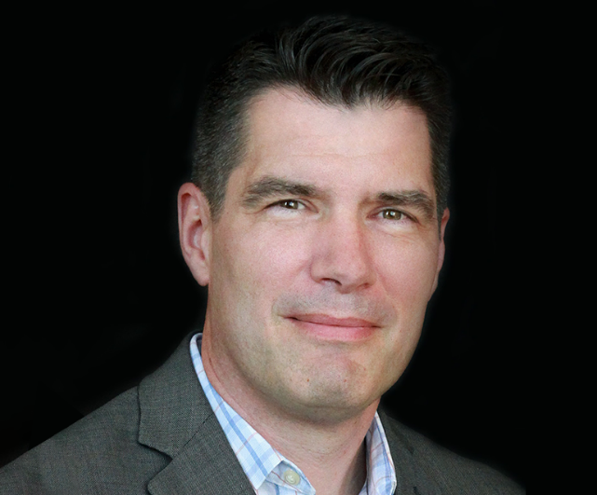
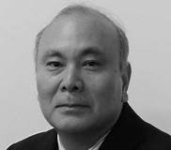

COVESA: Today and Tomorrow
Moderator: Steve Crumb, Executive Director
Graham Smethurst, BMW
Thomas Bloor, RTI
Hisao Munakata,
Renesas
John Sergakis, GM

Slide 3
COVESA’s Four Primary 2024 Strategic Initiatives
Increase community alignment resulting in unity of direction and resource management
Improve COVESA Communication content, cadence and channels resulting in improved member and industry awareness of COVESA’s purpose, projects/products and potential
Enable experimentation with COVESA work products resulting in increased contributions, feature requests and reference code
Maintain a responsible financial model resulting a well-funded community with sufficient reserves

Slide 4
DRAFT 2025 Initiatives (Still under discussion)
Enhance Operational Maturity
- Better execution
- Increase Community Alignment
- Understand and meet member’s expectations
Continue Improving COVESA Communication
- Increase awareness
- Engage new & prospective members
- Simplify access to key information
Position COVESA in the SDV context
- Apply existing technical patterns and architectures
- Explore potential partnerships
- Consider impact of AI on data initiatives
Maintain momentum from 2024
- Expand membership and financial health
- Allocate operational funds to code development
- Strength Japan engagement

Slide 5
Improved & Simplified IP Policy Coming
Current IP Policy is 25 years old!
COVESA’s openness and way of working not sufficiently reflected in the current policy
Board funded project to develop a “simplified and streamlined” policy
Draft policy under review by Board member legal teams
Members will have a 60-day review period before the policy goes into effect

