Slide 1
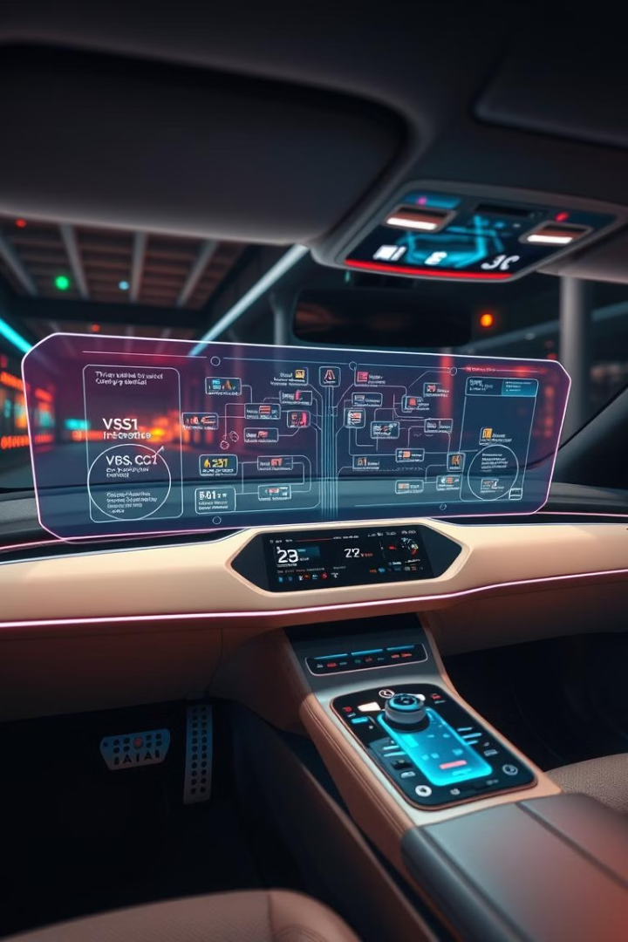

Boosting COVESA Marketing with VSS Explorer
The VSS Explorer is a powerful tool to expand COVESA VSS standard acceptance. It offers visual features to explain VSS, excite non-technical audiences, and engage the external community. Let's explore how it can boost our marketing efforts.
by Dirk Slama, Bosch

Slide 2

Boosting COVESA Marketing with VSS Explorer
1
VSS Content Campaign
Develop short videos and blog posts showcasing the full potential of VSS
2
VSS Community Buzz
Generate Exciting Updates from Our VSS Community for Everyone
3
External Community Engagement
Build relationships, share knowledge, and promote collaboration around VSS

Slide 3
Boosting COVESA Marketing with VSS Explorer
1
VSS Content Campaign
Develop short videos and blog posts showcasing the full potential of VSS
2
VSS Community Buzz
Generate Exciting Updates from Our VSS Community for Everyone
3
External Community Engagement
Build relationships, share knowledge, and promote collaboration around VSS

Slide 4
VSS Content Campaign
1
Content Types
Content Modules
Broad Audience
Create a series of short videos and blog posts to communicate the value of COVESA VSS
Create easy to digest and highly relevant content, using
modular structure
Use this to translate the COVESA VSS value proposition from technical benefits to a non-technical audience

Slide 5
VSS Content Modules
1
General
Use Cases
1.1 VSS Functional Overview
1.4 Range Extension
1.2 Use Case Overview
1.5 Variant Management
1.3 VSS and GenAI

Slide 6




1.1 Showcasing COVESA VSS Functional Coverage
Body and Cabin
Powertrain and Chassis
Connectivity and OBD
Explore vehicle structure and interior components.
Dive into vehicle performance and handling systems.
Highlight data exchange and diagnostics capabilities.

Slide 7
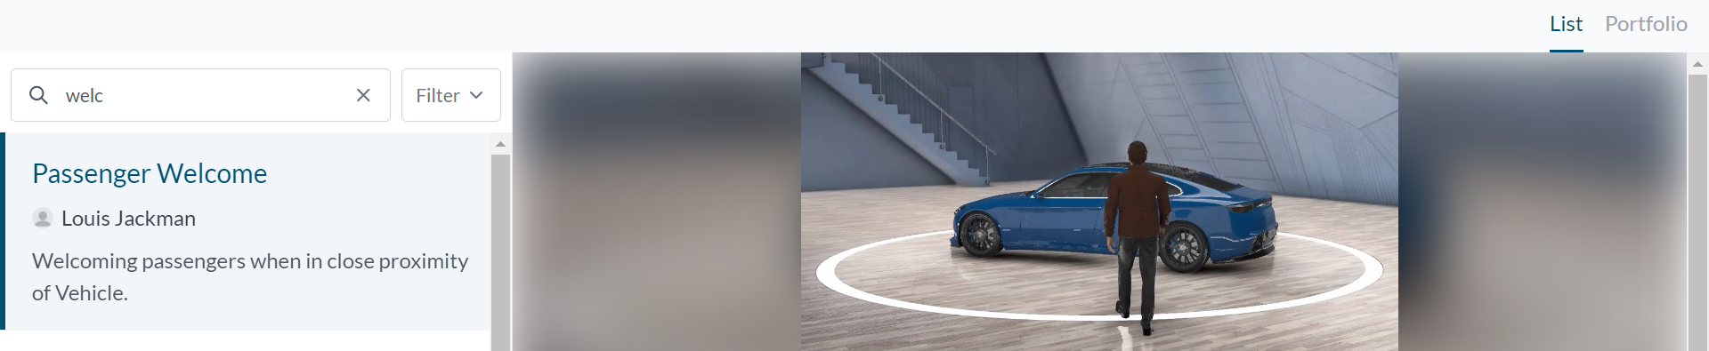
1.2 VSS Use Case Overview
Overview
Basic Use Cases
Advanced Use Cases
A short video showcasing different use cases utilizing the COVESA VSS tree
Showcase basic apps like wiper management
Show more advanced use cases like subscription business models

Slide 8

1.3 VSS and GenAI
Overview
A short video showcasing how COVESA VSS can be combined with GenAI to rapidly create working vehicle applications
Partners
Bosch, ETAS, AWS

Slide 9
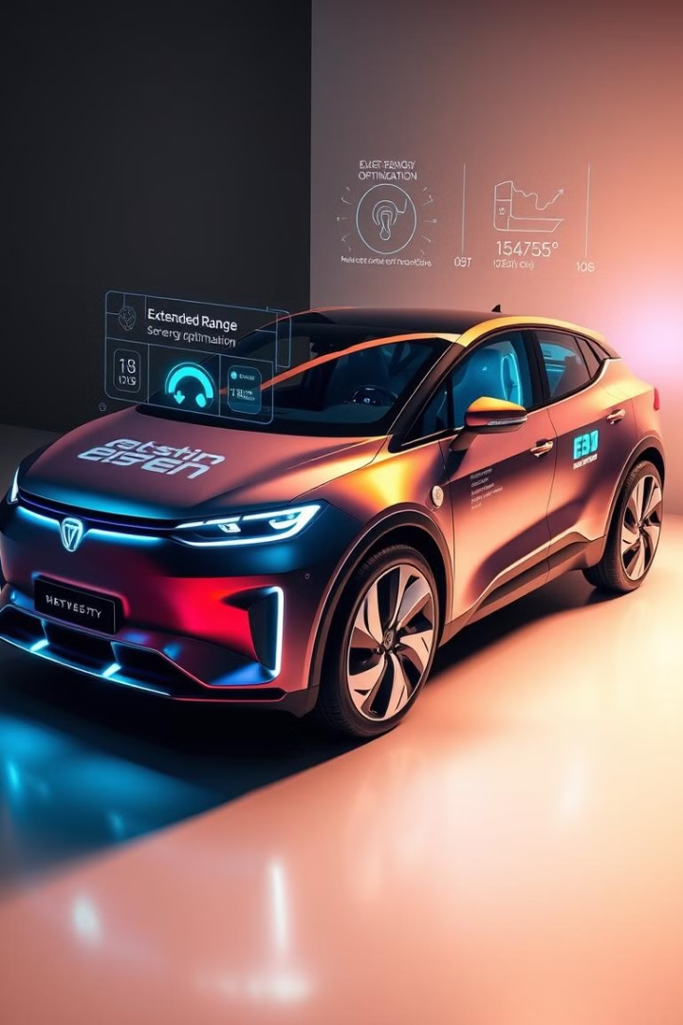



1.4 Use Case:
Range Extension
Vehicle Intelligence
Showcase how VSS data improves BEV vehicle range
Simulation with VSS
Illustrate simulation of VSS values using advanced simulation (ANSYS)
Partner Synergy
Emphasize the collaborative effort in developing this use case:
Hyundai Mobis, Bosch, ETAS, AWS, ANSYS, Steinbeis

Slide 10

1.5 Use Case: Vehicle
Variant Management
Partner
Contribution
Bosch
System integration
Mercedes
OEM variant data
Steinbeis
Research support

Slide 11
Boosting COVESA Marketing with VSS Explorer
1
VSS Content Campaign
Develop short videos and blog posts showcasing the full potential of VSS
2
VSS Community Buzz
Generate Exciting Updates from Our VSS Community for Everyone
3
External Community Engagement
Build relationships, share knowledge, and promote collaboration around VSS

Slide 12
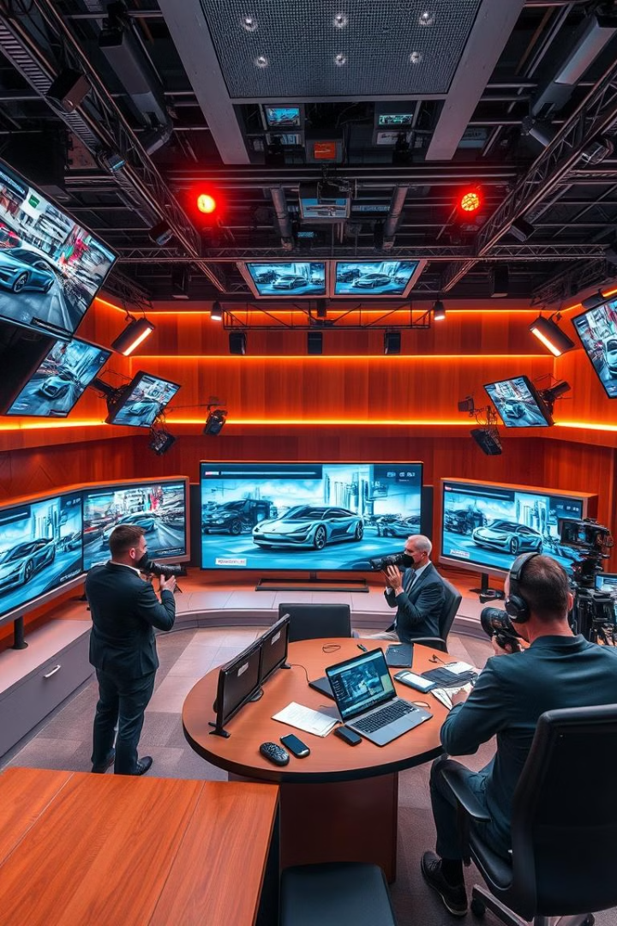
VSS Community Buzz
Visual Prototypes
Create prototypes for each COVESA VSS functional extension, e.g. VSS 4.1
Use Case Communication
Develop short videos explaining new features and their applications.
Regular Updates
Maintain a steady stream of news to keep the community engaged.
Showcase Innovation
Highlight how extensions enable cutting-edge automotive solutions.

Slide 13
Boosting COVESA Marketing with VSS Explorer
1
VSS Content Campaign
Develop short videos and blog posts showcasing the full potential of VSS
2
VSS Community Buzz
Generate Exciting Updates from Our VSS Community for Everyone
3
External Community Engagement
Build relationships, share knowledge, and promote collaboration around VSS

Slide 14


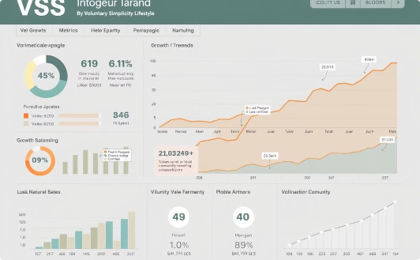
External Community Engagement
Hands-On Experience
Community Growth
Increased Visibility
Encourage non-members to try COVESA VSS with open-source
tools and GenAI
Foster discussions and collaborations around VSS applications.
Track and boost VSS adoption through targeted community engagement.

Slide 15

Proposed Project
Setup
IP Policies
IP for all newly created content managed according to COVESA policies
Source Code
Code for underlying playground in Eclipse SDV; code for SDV prototypes with COVESA
Cost Model
Open source = free usage; server operations costs to be discussed

