Slide 1
Moving Beyond IF-ELSE: Integrating Rule-Based Semantic AI in CDSP
AI Reasoning enables Consistent Decision-Making
Haonan Qiu, Christian Mühlbauer
BMW AG
May 2025 | Berlin COVESA AMM

Slide 2
Outline
MOTIVATION: KNOWLEDGE LAYER, A NEW PARADIGM IN ARCHITECTURE
REALIZATION: INTEGRATION OF FIRST USE CASE IN COVESA CDSP
DEEP DIVE: SEMANTIC REASONING
CUSTOMIZATION: ADAPTING IMPLEMENTATION FOR DIVERSE USE CASES
OUTLOOK: REMAINING CHALLENGES
Copyright ©2025 COVESA
May 2025 | Berlin COVESA AMM

Slide 3
Motivation
Realization
Deep Dive
Customization
Outlook
MOTIVATION
KNOWLEDGE LAYER IN AUTOMOTIVE DATA Centric ARCHITECTUREs
Copyright ©2025 COVESA
May 2025 | Berlin COVESA AMM

Slide 4
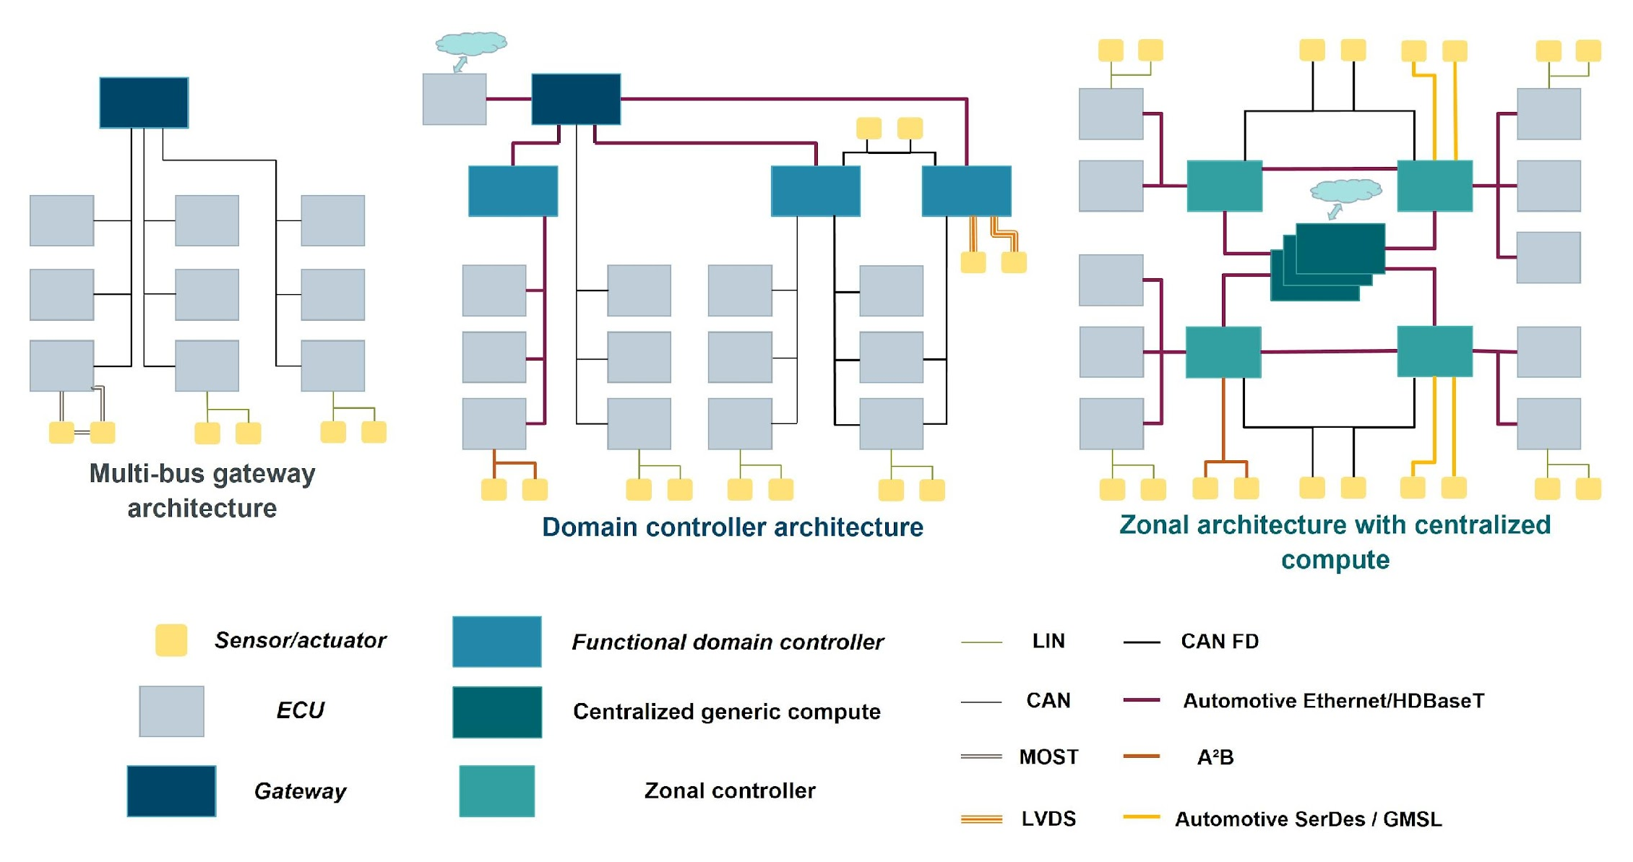
Starting Point: Common Data Challenges in Zonal Architectures
Motivation
Realization
Deep Dive
Customization
Outlook
  … centralizing data architectures is essential now to eliminate challenges of siloed and application centric infrastructures once and for all!
  Future automotive architectures
  are centralized …
Common
Data
Challenges
Modeling
Integrity
Availability
Synchronization
Access
Aggregation
Abstraction
Relationships
Analysis
…
Use-case specific
challenges
Ultra-low latency systems
Disaster Recovery Plans
…
Use-case specific
challenges
Zero-downtime
Safety critical
…
https://www.eetasia.com/identifying-e-e-architecture-requirements-for-autonomous-vehicle-development/
Automotive Application 1
Automotive Application n
Copyright ©2025 COVESA
May 2025 | Berlin COVESA AMM

Slide 5
Distribution of Common Data Challenges to different Levels of the DIKW Pyramid
Motivation
Realization
Deep Dive
Customization
Outlook
Common Data Challenges: Modeling, Abstraction, Availability, Synchronization, Access, Aggregation, Integrity, Relationships, Analysis
Architectural / infrastructural components
Zonal ECU 1 (Head Unit)
Zonal ECU 2 (Telematic)
Mobile
Cloud
Wisdom
(Customer) App)
(Customer) App
(Customer) App
(Customer) App
Person.
DrivingStyle = „aggressive“
Access
Access
Access
Access
If Wheel Angle
changes more than 200 degrees and Speed is greater 10 km/h,
then aggressivedriving
Analysis
Analysis
„Knowledge Layer“
Analysis
„Knowledge Layer“
Analysis
„Knowledge Layer“
„Knowledge Layer“
Relations
Relations
Relations
Relations
Knowledge
Access
Access
Access
Access
Modeling
Modeling
Modeling
Modeling
VSS
„Information Layer“
„Information Layer“
„Information Layer“
„Information Layer“
Information
Sync
...
Sync
Sync
Sync
Availability
Availability
Availability
Availability
Vehicle.Speed = 110
Integrity
Integrity
Vehicle.SteeringWheelAngle= 220
Integrity
Integrity
Abstraction
Access
Abstraction
Access
Abstraction
Access
Abstraction
Access
Boardnet Abstraction
Boardnet Abstraction
Mobile Data Abstraction
Cloud Data Abstraction
Raw Data
220
Electrical system
Electrical system
110
Copyright ©2025 COVESA
May 2025 | Berlin COVESA AMM
| 5

Slide 6

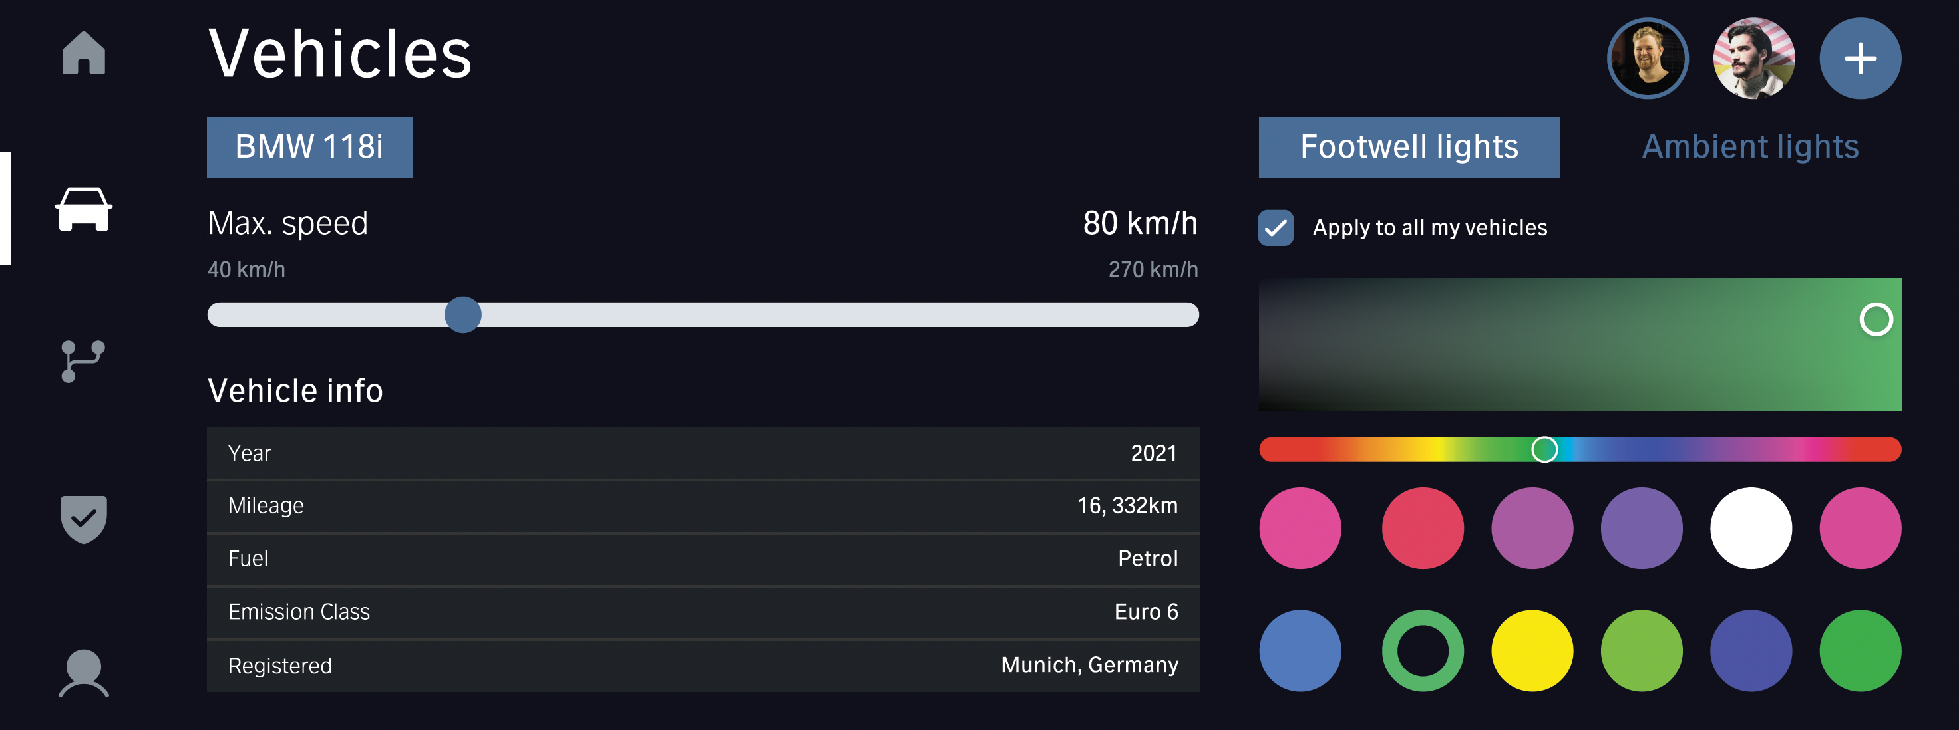
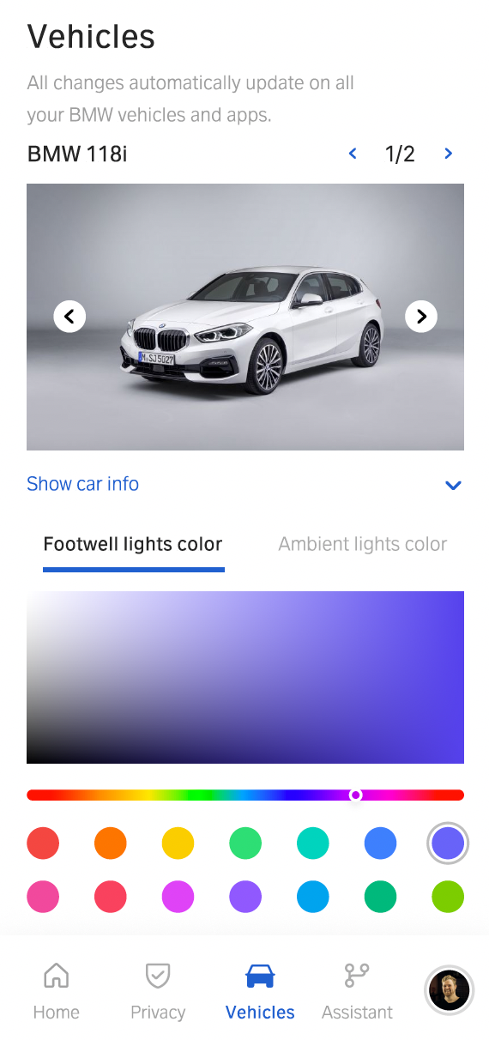
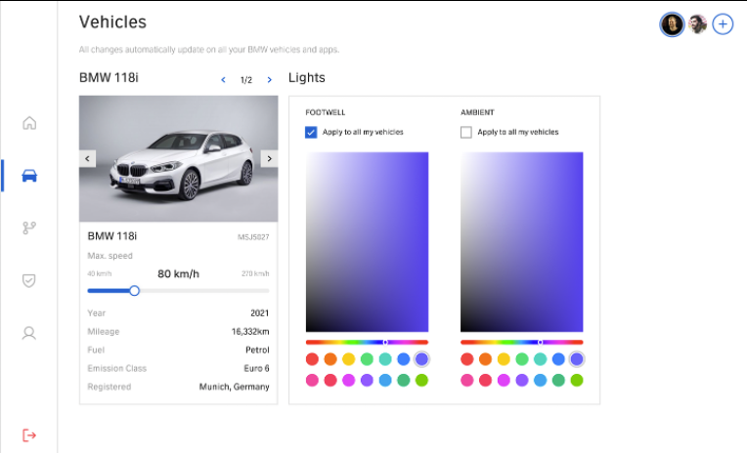
„Information Layer“ Challenges with Common Data Middleware addressed
Motivation
Realization
Deep Dive
Customization
Outlook
How and where to solve this?
Common Data Challenges: Modeling, Abstraction, Availability, Synchronization, Access, Aggregation, Integrity, Relationships, Analysis
X
X
Zonal ECU 1 (Head Unit)
Zonal ECU 2 (Telematic)
Mobile
Cloud
Wisdom
Access
Access
Access
Access
Analysis
Analysis
Analysis
Analysis
Relations
Relations
Relations
Relations
Knowledge
Access
Access
Access
Access
Modelling
Modelling
Modelling
Modelling
WIFI
Internet
Information
Sync
Sync
Sync
Sync
Availability
Availability
Availability
Availability
VSS
...
...
Integrity
Integrity
Integrity
Integrity
Domain Service (e.g. Personalisation)
Abstraction
Access
Abstraction
Access
Abstraction
Access
Abstraction
Access
Raw Data
API Gateway
(e.g. Pennybacker)
Electrical system
Copyright ©2025 COVESA
May 2025 | Berlin COVESA AMM
| 6

Slide 7
Typical architecture without Information Layer
Motivation
Realization
Deep Dive
Customization
Outlook
Common Data Challenges: Modeling, Abstraction, Availability, Synchronization, Access, Aggregation, Integrity, Relationships, Analysis
Common Data Challenges: Modeling, Abstraction, Synchronization, Access, Aggregation, Analysis, …
Analysis can be done by:
Humans
(AI) Systems (Humans always involved)
Zonal ECU 1 (Head Unit)
Zonal ECU 2 (Telematic)
Mobile
Cloud
2.
1.
Analysis
Analysis
Sync 4
Typical Obstacles:
Data Synchronization Issues
Infrastructure Limitations
Conflict Resolution Challenges
Connectivity
User Management Complexity
API Fragmentation
Data Integration Barriers
Endpoint Management Difficulties
Vendor Dependence
Sync 3
Decision
Sync 1
Access 4
Access 3
Access 1
Abstraction 3
Aggregation
Abstraction 1
Data 2
Data 3
3.
Data 4
Data 1
Sync 2
ACTION
Copyright ©2025 COVESA
May 2025 | Berlin COVESA AMM
| 7

Slide 8
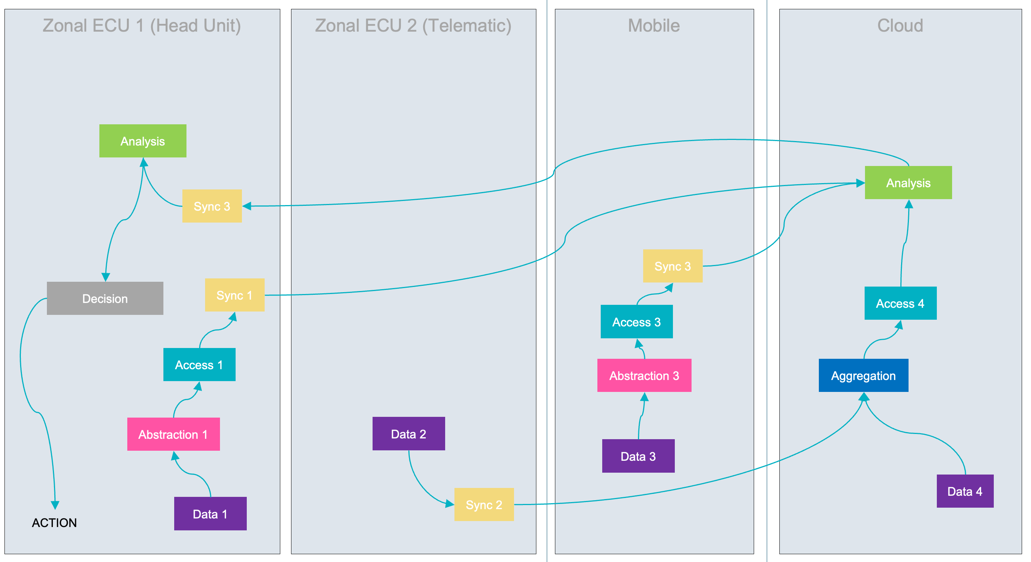
Desired architecture with Information Layer
Motivation
Realization
Deep Dive
Customization
Outlook
Common Data Challenges: Modeling, Abstraction, Availability, Synchronization, Access, Aggregation, Integrity, Relationships, Analysis
Today‘s focus!
Zonal ECU 1 (Head Unit)
Zonal ECU 2 (Telematic)
Mobile
Cloud
Wisdom
Knowledge
Analysis
Information
Information
Domain Service
Raw Data
Data 1
Data 2
Data 3
Data 4
ACTION
Copyright ©2025 COVESA
May 2025 | Berlin COVESA AMM
| 8

Slide 9
Solving „Knowledge Layer“ Challenges
Motivation
Realization
Deep Dive
Customization
Outlook
Effective analysis relies on the connections between data, supporting both informed decisions by people (e.g. on dashboards) and software systems triggered by real time data changes.
  Typical architecture
  without Information Layer
  Clean and unified architecture with Information Layer
Today‘s focus!
Zonal ECU 1
(Head Unit)
Zonal ECU 2 (Telematic)
Mobile
Cloud
Zonal ECU 1 (Head Unit)
Zonal ECU 2 (Telematic)
Mobile
Cloud
Sync 3
Decision
Conversion
Analysis
Analysis
Analysis
Analysis
Analysis
Sync 1
Sync 3
Abstraction 3
Information
Abstraction 1
Data 2
Data 3
Conversion 2
Domain Service
Data 1
Data 1
Data 2
Data 3
Data 4
Sync 2
Data 4
ACTION
ACTION
Copyright ©2025 COVESA
May 2025 | Berlin COVESA AMM
| 9

Slide 10


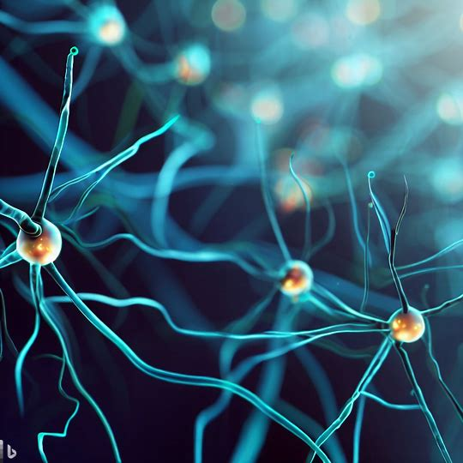
Solving „Knowledge Layer“ Challenges: Let‘s start with an concrete example
Motivation
Realization
Deep Dive
Customization
Outlook
Other Data Domains
VSS
Today‘s focus!
How would you develop a function responsible for detecting when the driver has an aggressive driving style?
Zonal ECU 1
Zonal ECU 2
Mobile
Cloud
Wisdom
„If SteeringWheel Angle changes by more than 200 degrees in less than 3 seconds and Speed is greater than 10 km/h, then flag as aggressivedriving.“
Analysis
Knowledge
{…}
Reasoning
Code
ML-Inferenz
Reasoning
Code
ML-Inferenz
Input
Output
Input
Output
Person.givenName = „MARY“
Person.givenName = „MARY“
Person.givenName = „MARY“
Person.givenName = „MARY“
Person.drivingStyle = „aggressive“
Person.drivingStyle = „ aggressive“
Person.drivingStyle = „ aggressive“
Input Information needed:
Steering wheel angle (VSS)
Time
Vehicle Speed (VSS)
Output Information generated:
Driving style of person sitting on driver seat
Person.drivingStyle = „aggressive“
Person.drivingStyle = „???“
Information
Person.fatigueScore = „… “
Person.fatigueScore = „… “
Person.fatigueScore = „… “
Person.fatigueScore = „… “
Vehicle.Speed = „54 KM/H“
Vehicle.Speed = „54 KM/H“
Vehicle.Speed = „54 KM/H“
Vehicle.Speed = „54 KM/H“
„Vehicle.SteeringAngle = „231 degree“
Vehicle.SteeringAngle = „231 degree“
Vehicle.SteeringAngle = „231 degree“
Vehicle.SteeringAngle = „231 degree“
Raw Data
Copyright ©2025 COVESA
May 2025 | Berlin COVESA AMM
| 10

Slide 11
Motivation
Realization
Deep Dive
Customization
Outlook
REALIZATION
INTEGRATION IN COVESA CDSP
Copyright ©2025 COVESA
May 2025 | Berlin COVESA AMM

Slide 12
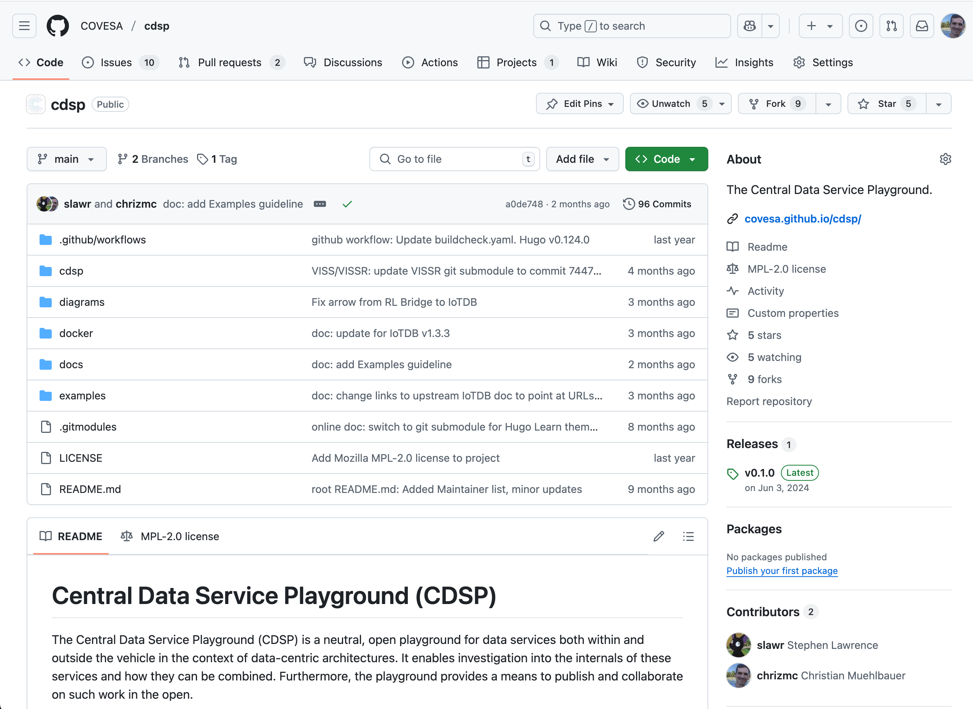
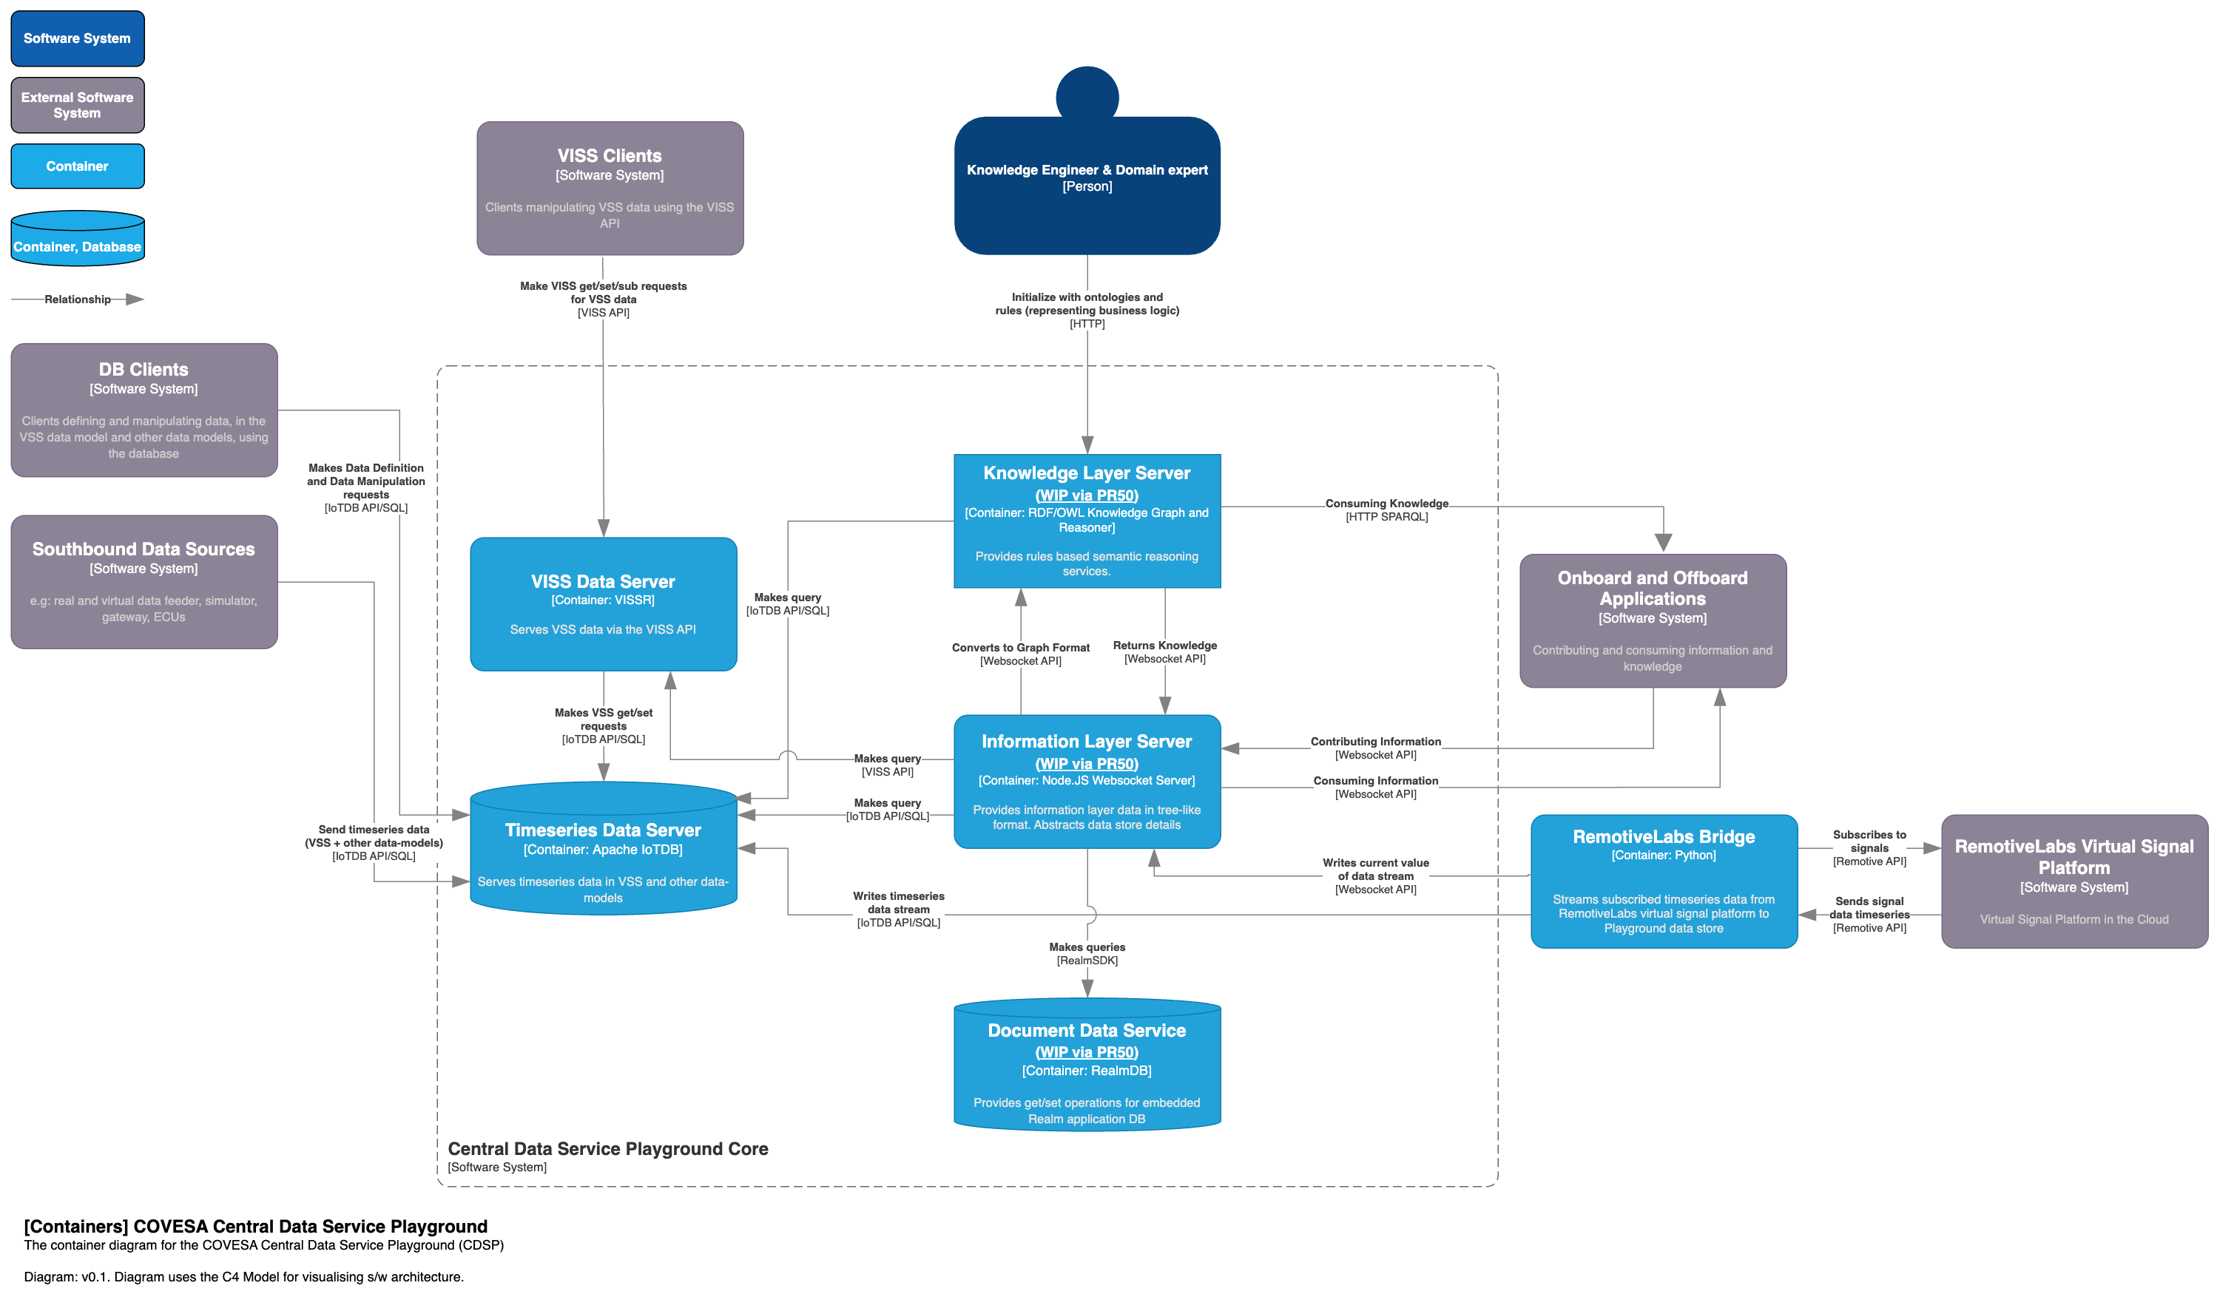
Integration of Hello World Use Case into COVESA CDSP: Repo & Architecture
Motivation
Realization
Deep Dive
Customization
Outlook
Contribution:
Two new major Components in CDSP
Repo:
C4 Level Architecture:
https://github.com/COVESA/cdsp/blob/main/diagrams/CDSP-C4-Model-Container-diagram.drawio.svg
https://github.com/COVESA/cdsp
Copyright ©2025 COVESA
May 2025 | Berlin COVESA AMM

Slide 13
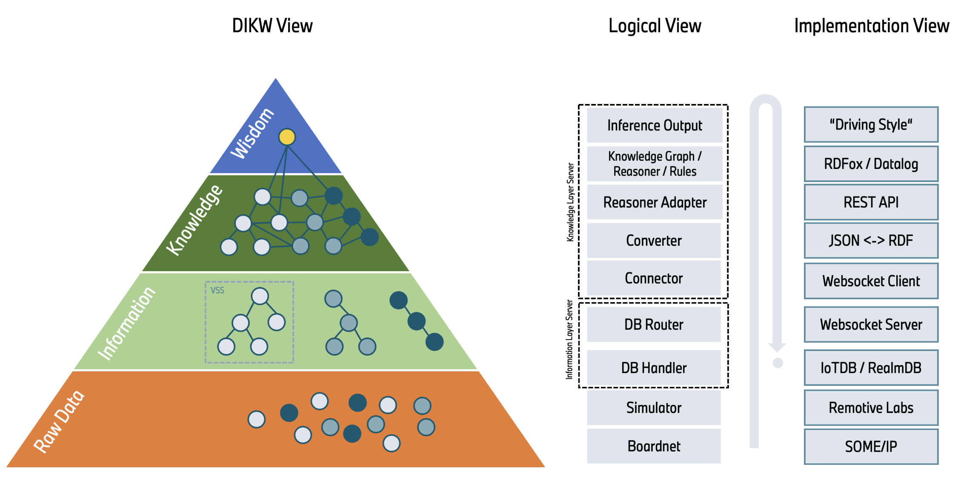
Integration of Hello World Use Case into COVESA CDSP: Tech Stack
Motivation
Realization
Deep Dive
Customization
Outlook
Copyright ©2025 COVESA
May 2025 | Berlin COVESA AMM

Slide 14
Motivation
Realization
Deep Dive
Customization
Outlook
DEEP DIVE
How AI can benefit from rule-based reasoning
Copyright ©2025 COVESA
May 2025 | Berlin COVESA AMM

Slide 15



Quiz
Motivation
Realization
Deep Dive
Customization
Outlook
Who is this?
Logic and reasoning
Perception and intuition
Thinking fast
Thinking slow
Who was his predecessor?
Who was his predecessor’s vice-president?
Copyright ©2025 COVESA
May 2025 | Berlin COVESA AMM
Notes:
First question
“Who is this?” → fast answer (perception, learned).
“Who was his predecessor? Who was the predecessor’s VP?” → slower (logical reasoning).
Emphasize: two types of thinking: fast (pattern recognition), slow (inference).
👉 Transition:
“Let’s break down exactly what’s happening in your mind as you answer those questions — it mirrors how AI systems are designed.”

Slide 16
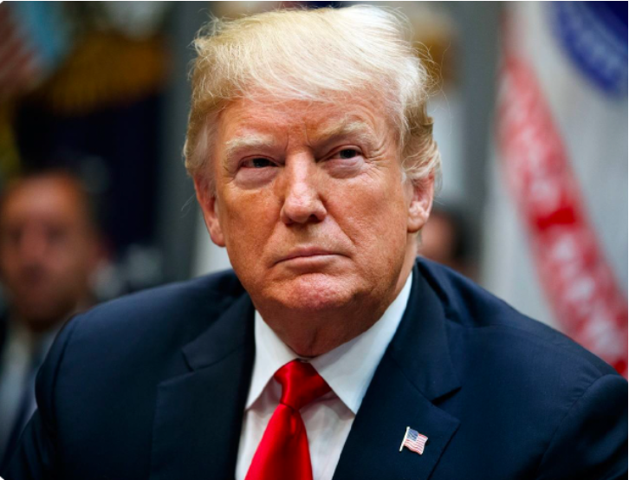

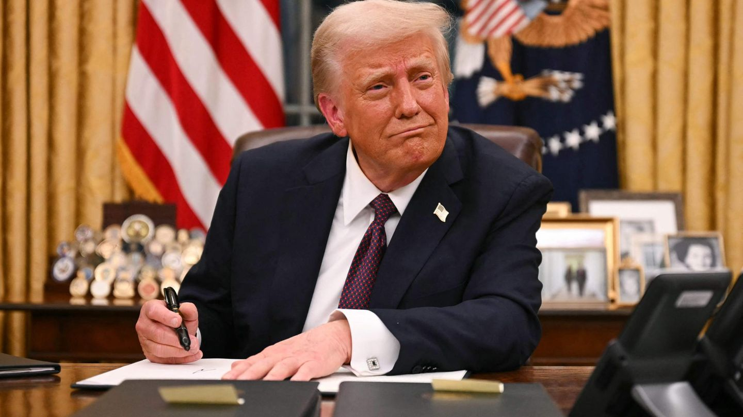
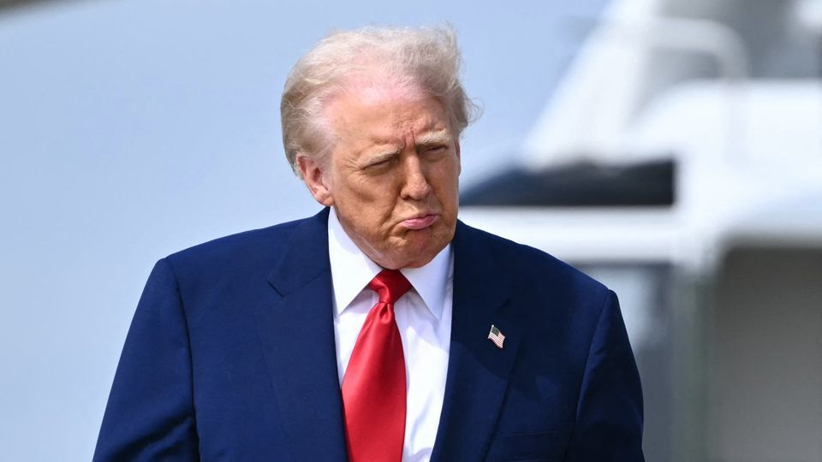

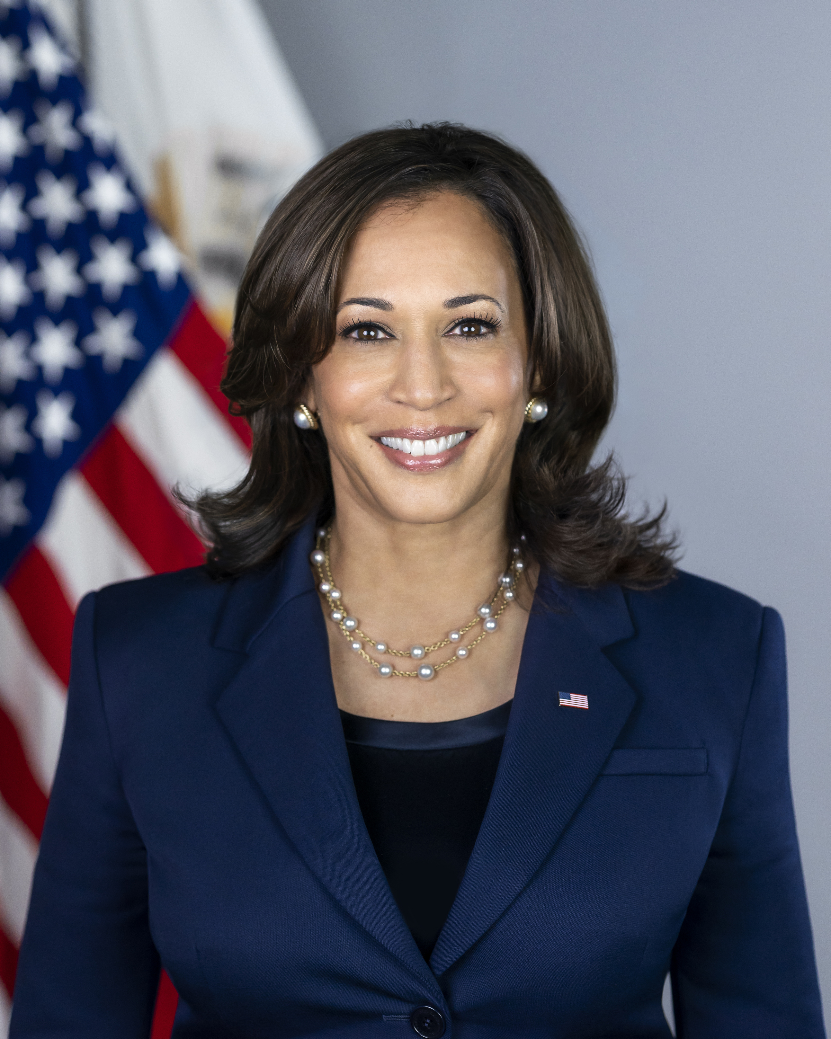
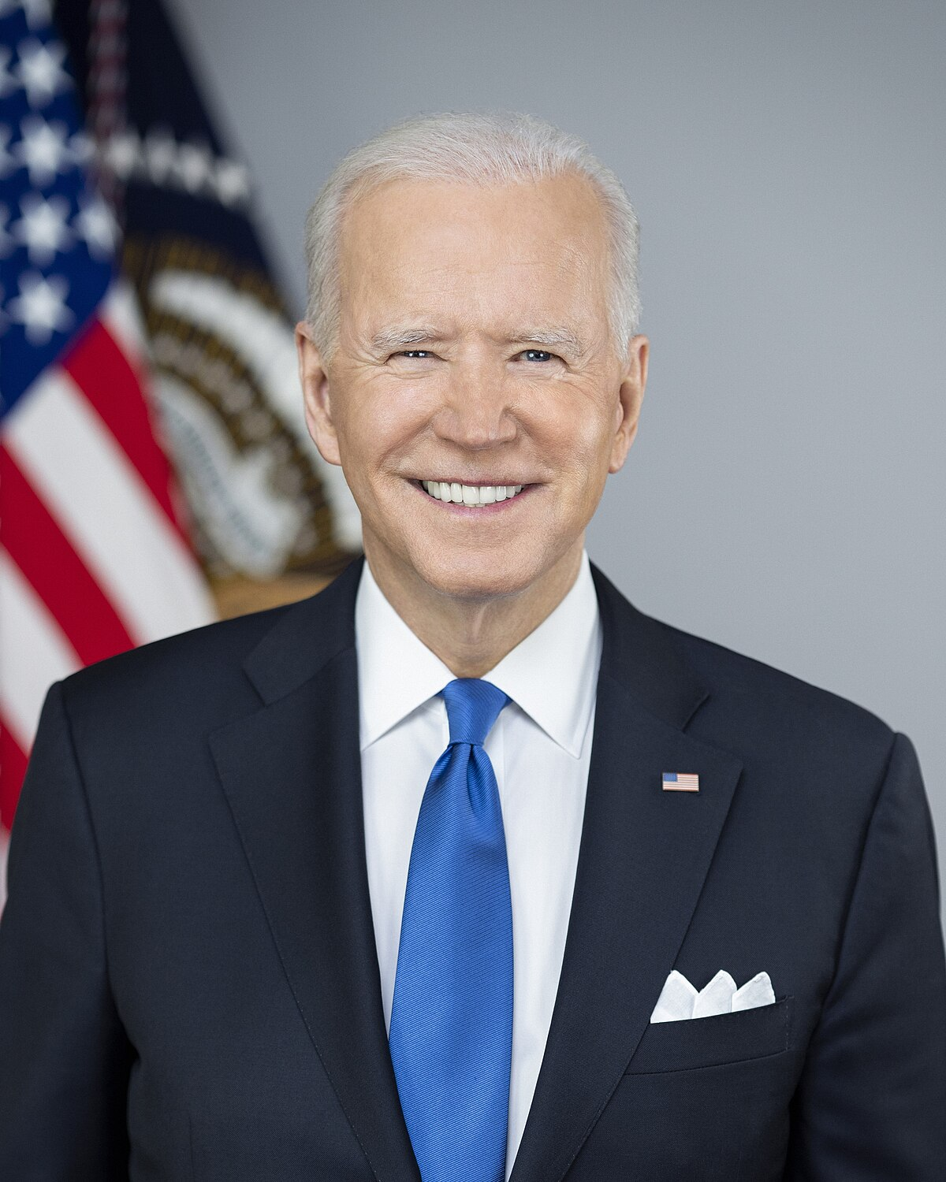

AI Mimics Human Intelligence
Motivation
Realization
Deep Dive
Customization
Outlook
Learning
Pattern recognition
Perception
IsPredecessorOf(x, y):-
endOfPresidentShip(x, m),
startOfPresidentSip(y, m).
Donald Trump
Donald Trump
Knowledge
Representation
Reasoning
Logical deduction
Donald Trump
Donald Trump
Donald Trump
Planning
Thinking fast
Kamala Harris
IsPredecessorOf
Executing
Joe Biden
Donald Trump
Thinking slow
2025-?
2021-2025
Copyright ©2025 COVESA
May 2025 | Berlin COVESA AMM
image source: https://medium.com/edureka/knowledge-representation-in-ai-553b5eb3026a
Notes:
Slide 3: AI Mimics Human Intelligence
Go through each step:
Perception → you recognized the image.
Learning → you’ve seen him before.
Knowledge representation → you know facts like “Biden is also a president.”
Reasoning → you deduce connections (predecessor = ends when other begins).
Planning → decide whether to answer aloud.
“This is how human intelligence works — and how AI tries to mimic it.”
click
“ML and reasoning both try to extract knowledge — one via patterns, one via logic.”
👉 Transition:
“But they don’t do everything equally well. Let’s look at where reasoning begins to outperform.”

Slide 17
Problem (1/4) – ML Cannot answer new questions!
Motivation
Realization
Deep Dive
Customization
Outlook
Machine Learning
Pattern recognition
Reasoning(rule)
Logical deduction
Pattern recognition
Logical deduction
data
train
models
models
data
predict
data
data
deduce
data
☹
Which country is Donald Trump a citizen of?
never seen the data during training
☺
isCitizenOf(x ,y):-
isPresidentOf(x, y).
No answer- standard ML classifier
US
isCitizenOf
isPresidentOf
isPresidentOf
Kamala Harris
Joe_Biden
Donald Trump
2025-?
2021-2025
Copyright ©2025 COVESA
May 2025 | Berlin COVESA AMM
Notes:
ML cannot answer new questions
“ML learns from patterns — but what if the question wasn’t in the training data?”
“It can’t reason through new logic — it only interpolates.”
For example, lets ask which country is
Click, ML has no NO
Click, reasoning can using a rule saying every president of a coutry must be the citizen of that country.
👉 Transition:
..even if ML gives an answer… can it explain why?”

Slide 18
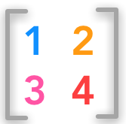
Problem (2/4) – ML Cannot explain why
Motivation
Realization
Deep Dive
Customization
Outlook
What factors influenced this outcome?
Can I trace the decision step-by-step?
Machine Learning
Pattern recognition
Reasoning(rule)
Logical deduction
Pattern recognition
Logical deduction
data
train
models
models
data
predict
data
data
deduce
data
Which country is Donald Trump a citizen of?
Why?
Find fitting (w1,w2,…), correlate
isCitizenOf(donald_trump, us):-
isCitizenOf
isPresidentOf(donald_trump, us).
Black Box
isCitizenOf (100%)
isCitizenOf (75%)
Because there exists:
1) isPresidentOf(donald_trump, us).
2) isCitizenOf(x ,y):-
isPresidentOf(x, y).
isPresidentOf
Logically, I don’t know why
“black box problem”
more data
Internal behavior of the model is unknown
Copyright ©2025 COVESA
May 2025 | Berlin COVESA AMM
Notes:
ML cannot explain why
Lets see why:
Click fro ML, lets give additional data, ML correlates that Trump is a citizen from Biden, but can’t explain.
Click A reasoning system uses the rule: presidents must be citizens → explains Trump’s citizenship.
Analogies
memorizing exam vs can understanding.
following others without understanding why.
👉 Transition:
“And there’s a third issue: even when ML is correct — it might not be consistent.”

Slide 19
Problem (3/4) – ML is not deterministic
Motivation
Realization
Deep Dive
Customization
Outlook
What factors influenced this outcome?
Can I trace the decision step-by-step?
Machine Learning
Pattern recognition
Reasoning(rule)
Logical deduction
Pattern recognition
Logical deduction
data
train
models
models
data
predict
data
data
deduce
data
Which country is Donald Trump a citizen of?
Why?
Which country is Donald Trump a citizen of?
Find fitting (w1,w2…), no logic
isCitizenOf(donald_trump, us):-
US (100 %),
isCitizenOf
isPresidentOf(donald_trump, us).
Black Box
US (75%)
isCitizenOf
US (65%)
Because there exists:
1) isPresidentOf(donald_trump, us).
I2) sCitizenOf(x ,y):-
isPresidentOf(x, y).
isPresidentOf
US (53%)
“black box problem”
more data
Internal behavior of the model is unknown
Copyright ©2025 COVESA
May 2025 | Berlin COVESA AMM
Notes:
“Train the same model twice — get different answers.”
“Why? Because training involves random seeds, initial weights, etc.”
Click,
we might get us with different probabilities.
“This isn’t ideal for critical or regulated systems.”
Clinck
Contrast with reasoning: same facts + rules = always the same result.
👉 Transition:
“Meanwhile, LLMs seem to reason — let’s briefly look at what they can and can’t do.”

Slide 20
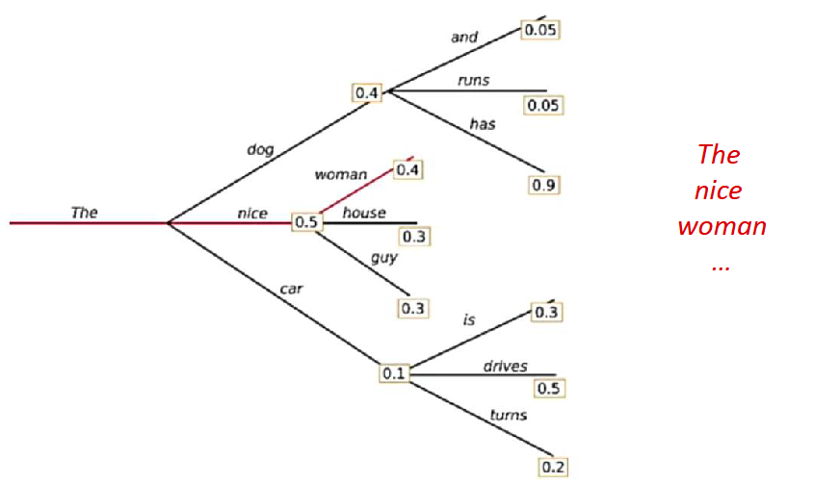
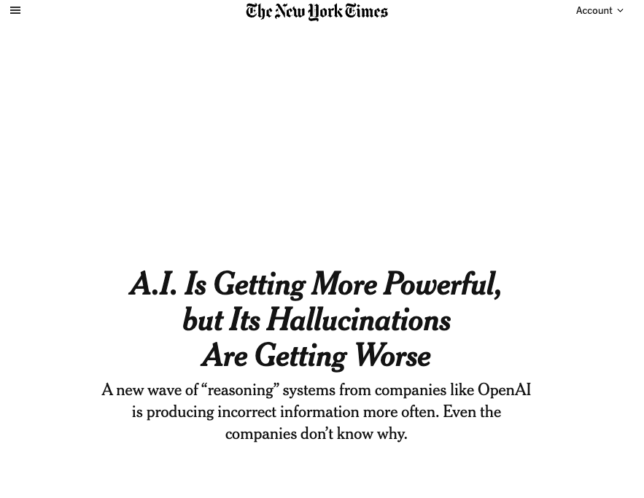
Problem (4/4) – LLM Mimics reasoning
Motivation
Realization
Deep Dive
Customization
Outlook
Machine Learning
NLP
Things where LLM’s are not very good at
LLM
Contextual understanding (reasoning)
Visual-spatial learning (navigation, planning)
Mathematical reasoning
Relational understanding
Logic reasoning
LLM can do magic
LLMs predict the next word given the context, and then the next, etc.
Summarization
Ideating
Translation
Poetry
Story telling
And more
Source: Williams, Sean, and James Huckle. "Easy Problems That LLMs Get Wrong." arXiv preprintarXiv:2405.19616 (2024).
Source: https://www.nytimes.com/2025/05/05/technology/ai-hallucinations-chatgpt-google.html
Copyright ©2025 COVESA
May 2025 | Berlin COVESA AMM
Notes:
“LLMs show some reasoning — but it’s still pattern completion, not structured logic.”
“Context, spatial reasoning, long chains of logic? Still very limited.”

Slide 21
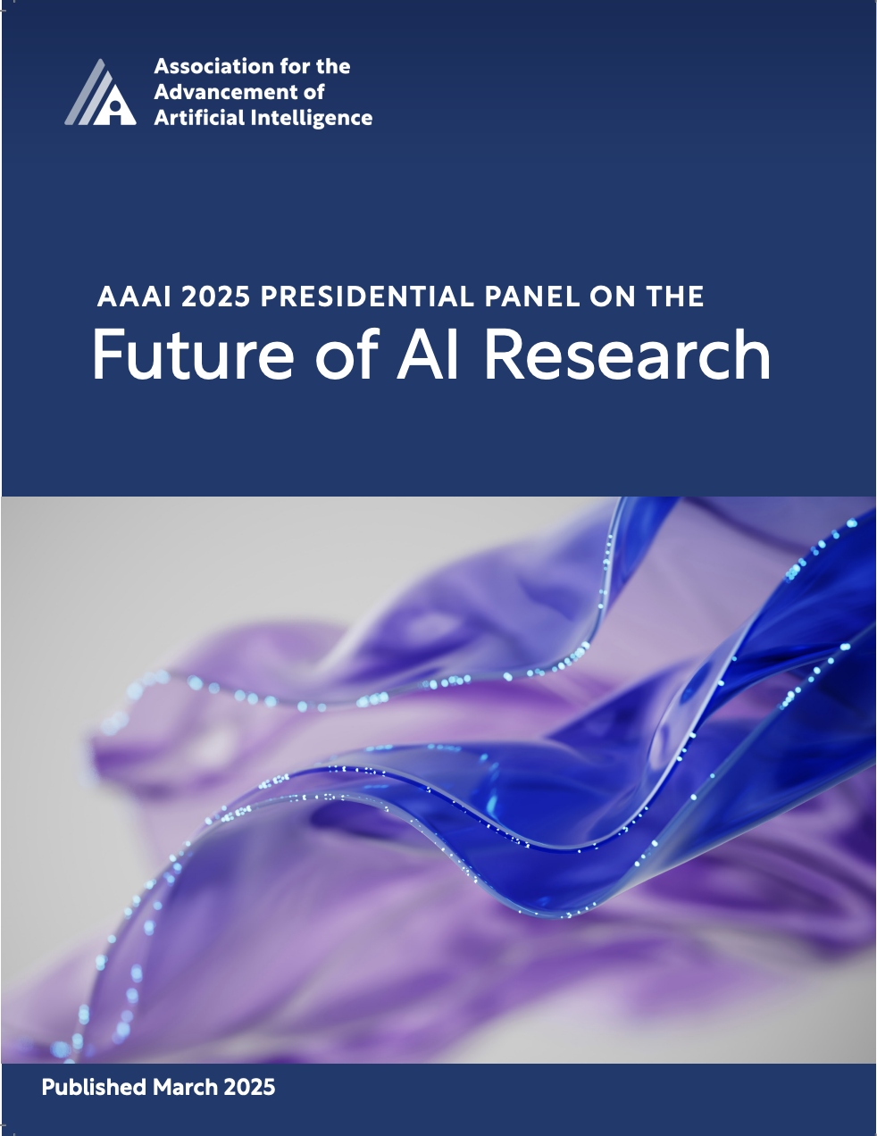
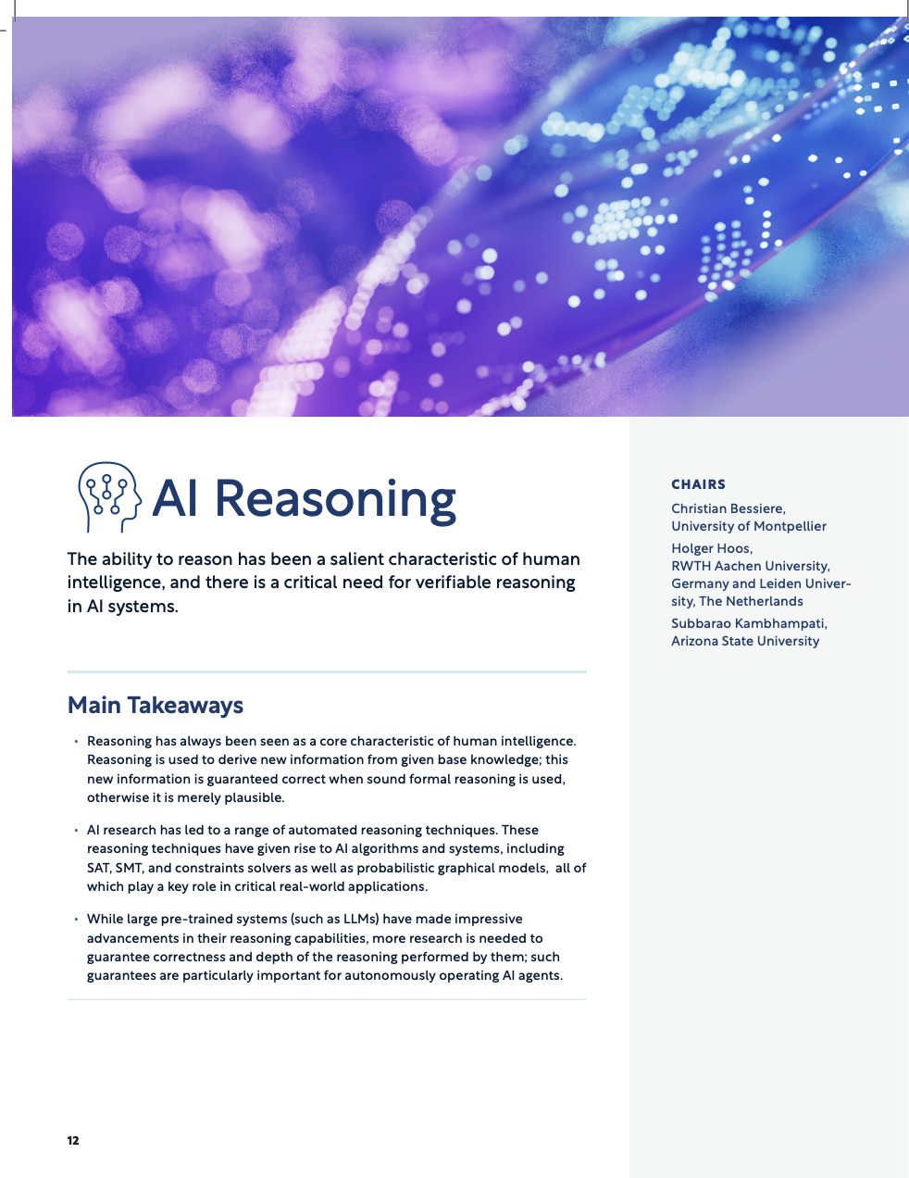
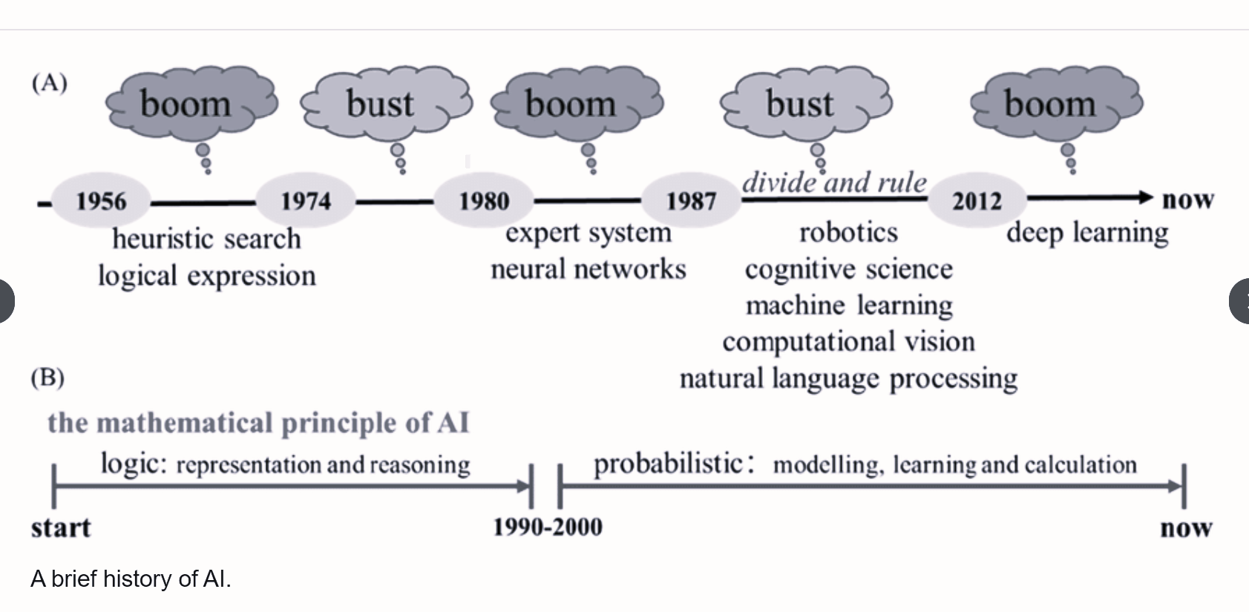
The bottom line: AI can benefit from reasoning!
Motivation
Realization
Deep Dive
Customization
Outlook
Learning
Perception
Knowledge
Representation
Reasoning
Planning
Executing
2025
Reasoning
Learning
LLM
Reasoning
Image source (left): https://rathi-ankit.medium.com/a-brief-history-of-ai-2eced3fa8361
source (right):https://aaai.org/wp-content/uploads/2025/03/AAAI-2025-PresPanel-Report-FINAL.pdf
Copyright ©2025 COVESA
May 2025 | Berlin COVESA AMM
Notes:
As we have seen so far Learning based approaches have limitations, and researchers in AAAI now say reasoning is critical to move forward.
The rise of reasoning is not by change, it is following patterns of teachonlog’s rise and fall. Before 2000, it was reasoning, afterwards until now it is learning. -now we’re returning to logic and structure.”
So the bottom-line is AI needs reasoning.
“The, Let’s see how rule-based reasoning works .”

Slide 22

What is rule based reasoning?
Motivation
Realization
Deep Dive
Customization
Outlook
IsPredecessorOf(x, y):-
endOfPresidentShip(x, m),
startOfPresidentSip(y, m).
facts + logic (rules)+ inference(reasoner) = conclusions
No black box. No randomness. Just structured thinking
Order does not matter
Rule:
Head:- Atom1, Not Atom2.
Not is the negation-as-failure operator.
A program is a set of rules.
isCitizenOf(x ,y):-
isPresidentOf(x, y).
Reasoning (rules)
models
isCitizenOf
data
Infer:deduce
data
isPresidentOf
2021-2025
2025-?
2021-2025
2025-?
Copyright ©2025 COVESA
May 2025 | Berlin COVESA AMM

Slide 23
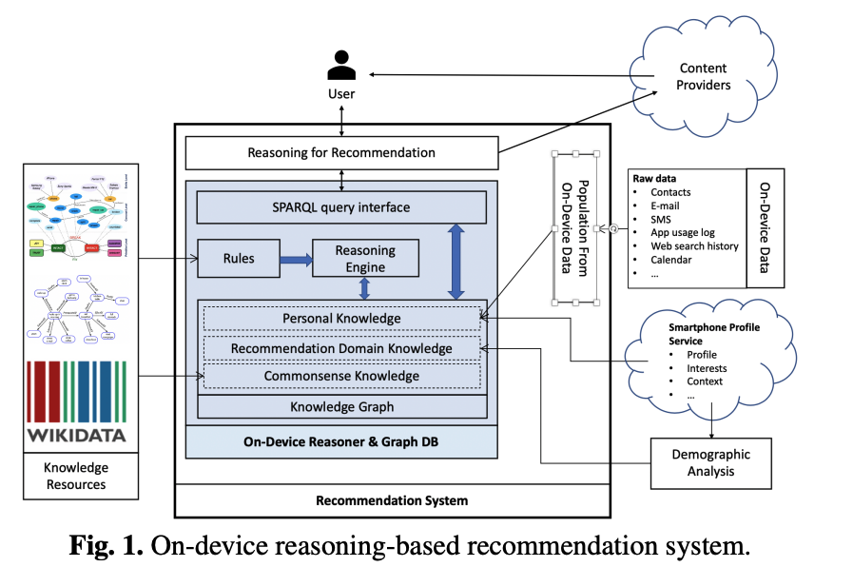
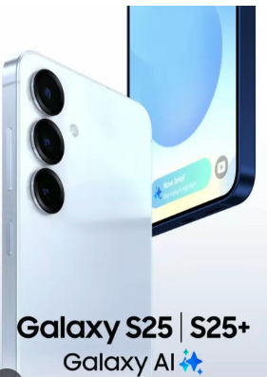

Real world example: Samsung galaxy s25
Motivation
Realization
Deep Dive
Customization
Outlook
“Our reasoning-based approach is economical with computational resources and does not require large amounts of training data; it also mitigates the cold-start problem, and supports explanation for recommendations”
Cold start problem = Poor performance at the beginning due to lack of data.
Reasoner
a small memory footprint (less than 6MB on ARM)
source: https://www.oxfordsemantic.tech/blog/improving-smartphone-recommendation-services-without-the-data-security-risk
Image source: https://www.cs.ox.ac.uk/people/boris.motik/pubs/lhplmh20context-aware-recommendation.pdf

Slide 24
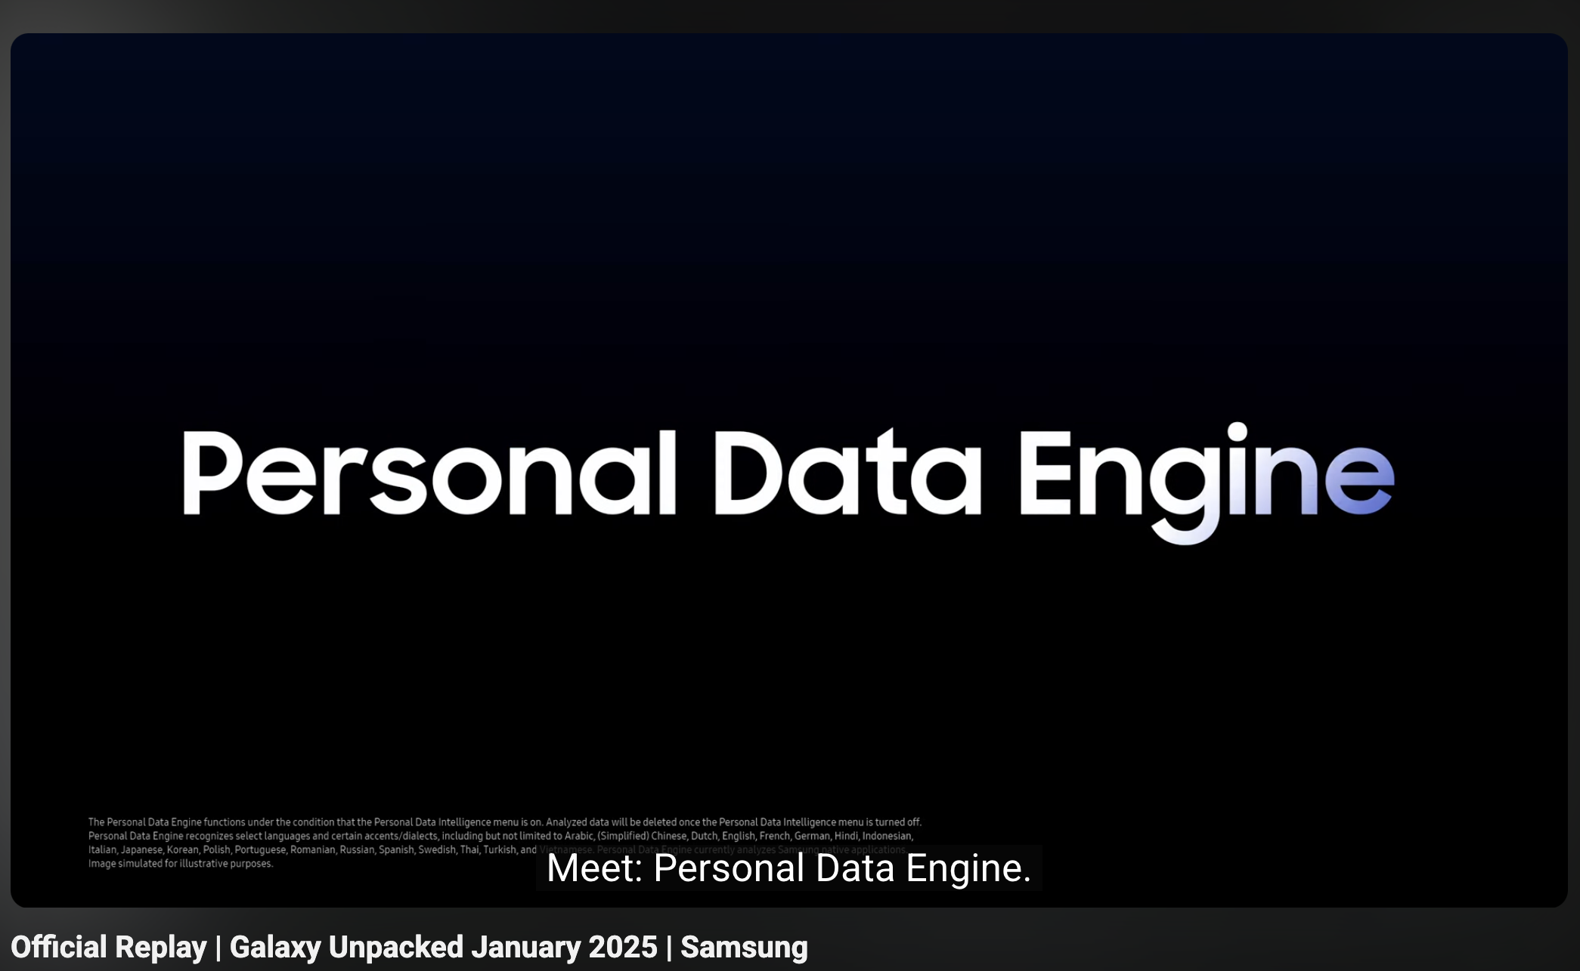
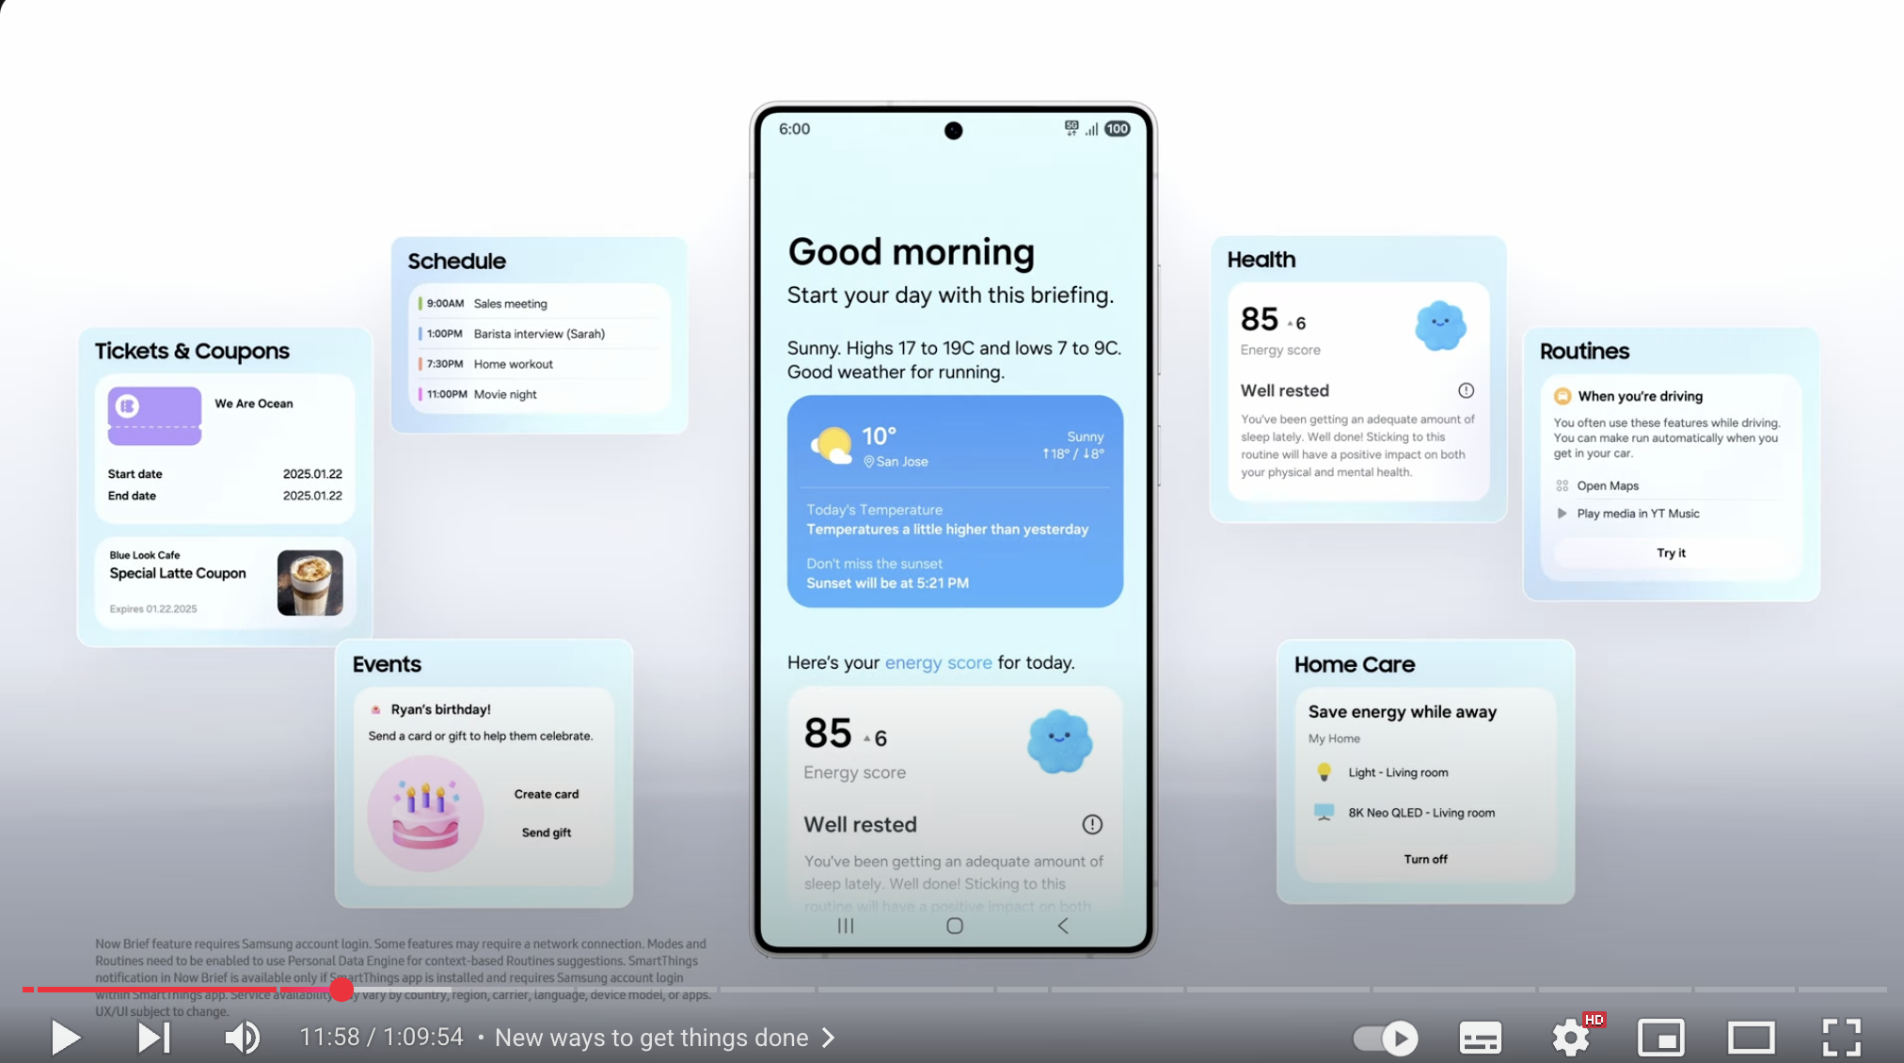
Motivation
Realization
Deep Dive
Customization
Outlook
OUTSIDE-IN Context-aware recommendation on MASSIV SCALE by SAMSUNG (video)
https://www.youtube.com/live/HinL5jCy_oI?si=U9WU2soBt-vA0DAS&t=711
Start 11:51
end 15:20
This same approach has applications in the automotive industry…
40mil+ users
Notes:
Play video
Optional voiceover: “You’ll see what is the use cases of their person data engine , and udnerth techonology like knowlge graphs, and rules are triggered by context to recommend relevant actions.”
👉 Transition:
“This same approach has powerful applications in the automotive industry…”
https://www.cs.ox.ac.uk/people/boris.motik/pubs/lhplmh20context-aware-recommendation.pdf
https://www.youtube.com/live/HinL5jCy_oI?si=U9WU2soBt-vA0DAS&t=711
Start 11:51
Until 15:25

Slide 25
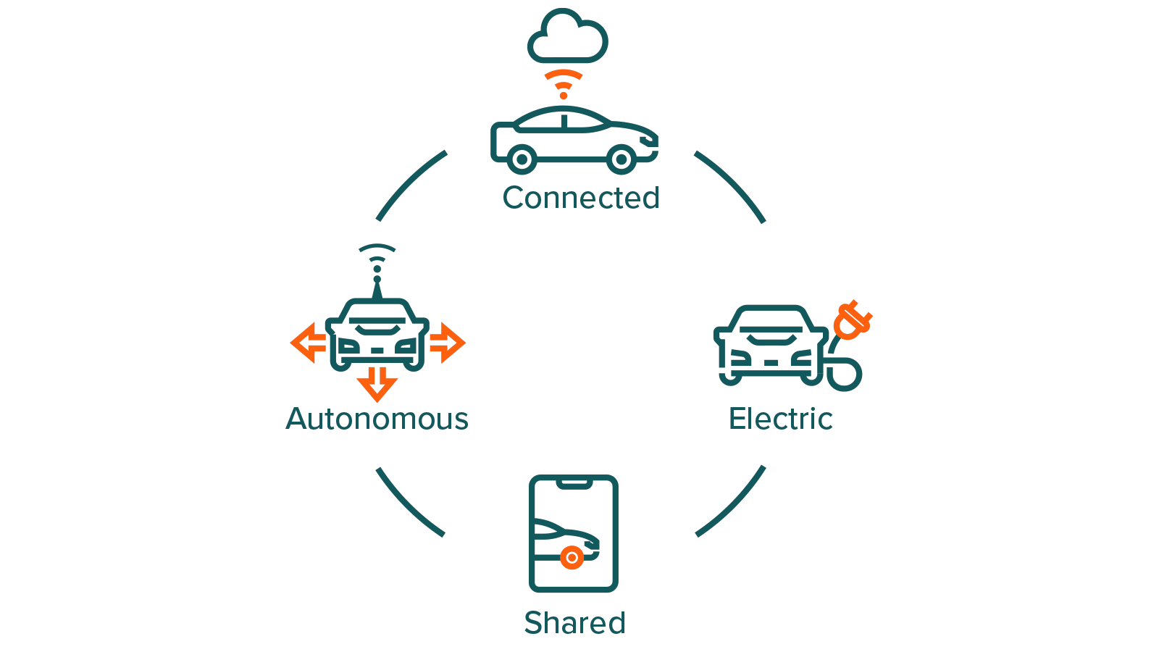

Reasoning in automotive C.A.S.E.
Motivation
Realization
Deep Dive
Customization
Outlook
Real-time decision making from sensor & network data. Policy compliance across regions (e.g., data privacy rules vary by country). Dynamic rule updates as network and traffic regulations change. Recommend and explain routing decisions (why this route, not that one).
Explainable behavior for safety-critical decisions
-(why the car stopped, why it yielded).
Handling edge cases not seen in ML training data (construction zones, unusual obstacles).
Logic for fallback and safety protocols
-("If sensor X fails, switch to protocol Y").
Certifiability for regulatory approval (auditable logic).
Recommend dynamic ride allocation
  -(who gets the ride first? based on location, urgency, priority).
Transparent pricing and allocation explanations.
Trust-building with users through explainable policies
-(why you were paired with certain routes or passengers).
Battery management strategies
- (e.g., prioritize charging based on route length, station availability).
Recommendation of energy optimization rule:
-when to charge, how much to reserve.
Diagnostic reasoning for electrical system health.
Copyright ©2025 COVESA
May 2025 | Berlin COVESA AMM

Slide 26

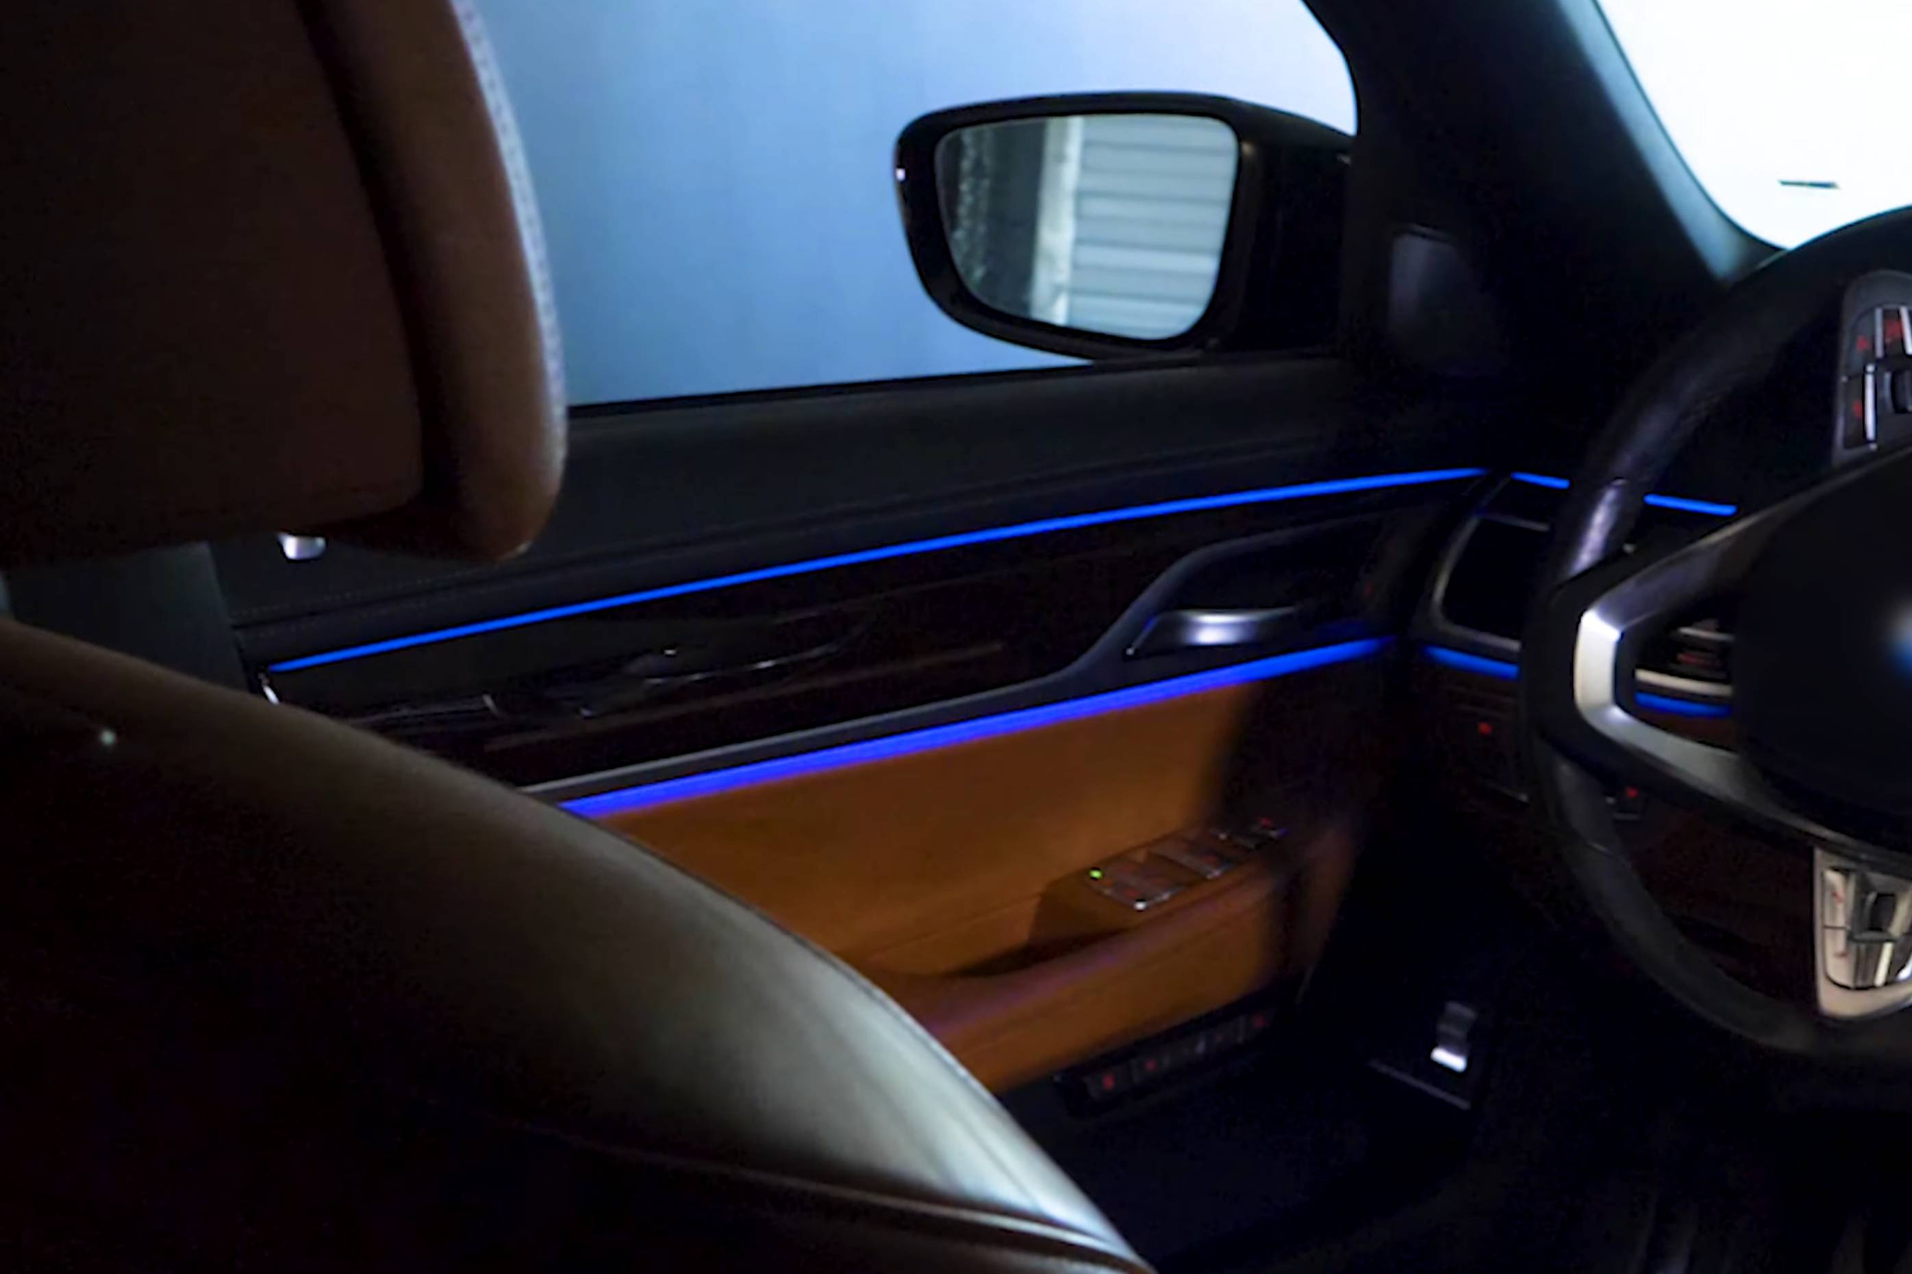
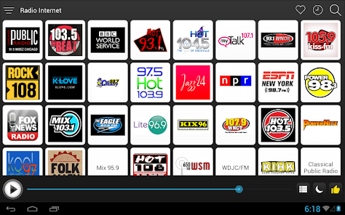



Realized PoCs
Motivation
Realization
Deep Dive
Customization
Outlook
A traffic jam on your daily trip,
notify you when it is a good time to leave?
7:00-7:30
8:00-8:30
19:00-19:30
17:00-18:30
AmbientLightOn/Off
Radio
station
Now
Playing
Private Address
Business Address
Service
Rule
genre
Function
Person
TargetState
Daily User Trip
Service
Radio Station Recommendation
One infrastructure 3 uses cases!
1. Fast use case built with expert knowledge using rules
Copyright ©2025 COVESA
May 2025 | Berlin COVESA AMM

Slide 27

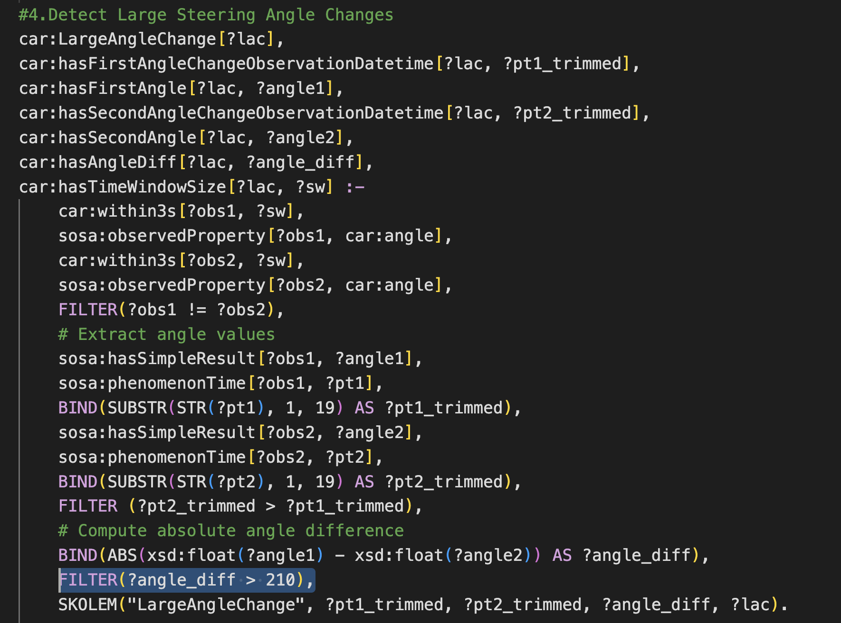

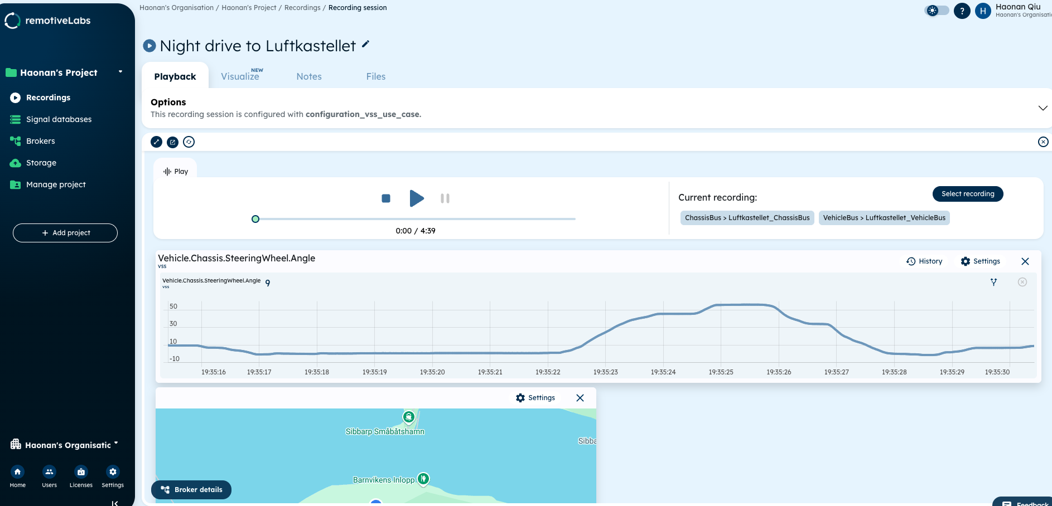
CDSP Use Case: Aggressive Driving
Motivation
Realization
Deep Dive
Customization
Outlook
ECU
{
"Vehicle": {
"AI.Reasoner.InferenceResults": {
"DrivingStyle": {
"AvgAngleChange": 225,
"Duration": 3,
"End": {
"Latitude": 55.569948,
"Longitude": 12.898002,
"Timestamp": "2023-11-08T19:35:11"
},
"Speed": 13,
"Start": {
"Latitude": 55.5699,
"Longitude": 12.89795,
"Timestamp": "2023-11-08T19:35:08"
},
"segment": ”segment123"
}
}
}
Wisdom
Model
Queries
Rules
Ontology & SHACL
Knowledge
„Knowledge Layer“
Reasoner (RDFox)
Information
„Information Layer“
Vehicle.Chassis.SteeringWheel.Angle
Vehicle.CurrentLocation.Latitude
Vehicle.CurrentLocation.Longitude
Vehicle.Speed
Raw Data
Copyright ©2025 COVESA
May 2025 | Berlin COVESA AMM
Notes:
The use case is not the main focus rather the infrastructure

Slide 28
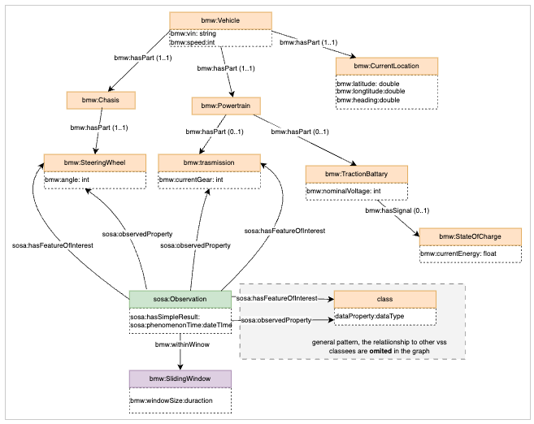
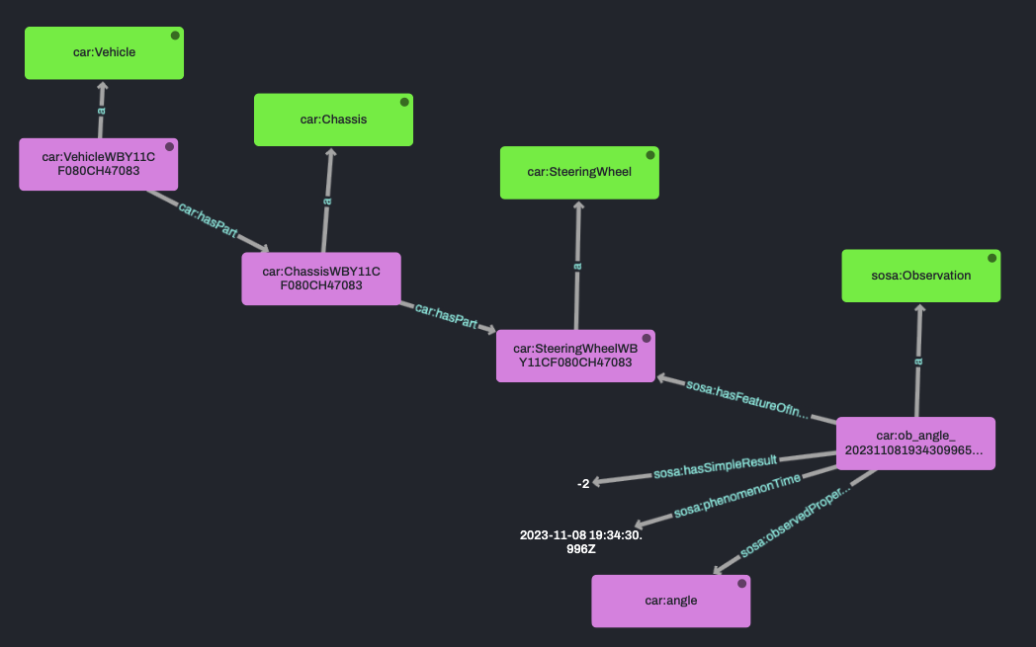
Ontology and RDF Data
Motivation
Realization
Deep Dive
Customization
Outlook
Model
Queries
Rules
Ontology & SHACL
Reasoner (RDFox)
Copyright ©2025 COVESA
May 2025 | Berlin COVESA AMM
Notes:
car:ObANGLE_20231108193431926659000
a sosa:Observation ;
sosa:hasFeatureOfInterest car:SteeringWheelWBY11CF080CH47083 ;
sosa:hasSimpleResult "-2"^^xsd:int ;
sosa:observedProperty car:angle ;
sosa:phenomenonTime "2023-11-08T19:34:31.926659000Z"^^xsd:dateTime .

Slide 29
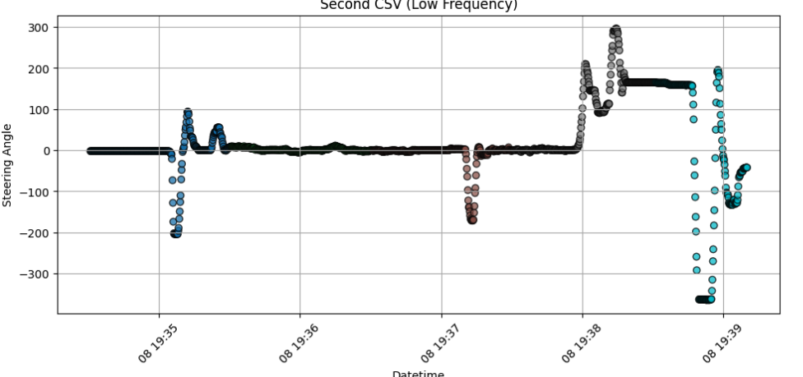
The detected aggressive driving events
Motivation
Realization
Deep Dive
Customization
Outlook
Angle_diff > 210
Angle_diff > 100
Copyright ©2025 COVESA
May 2025 | Berlin COVESA AMM

Slide 30
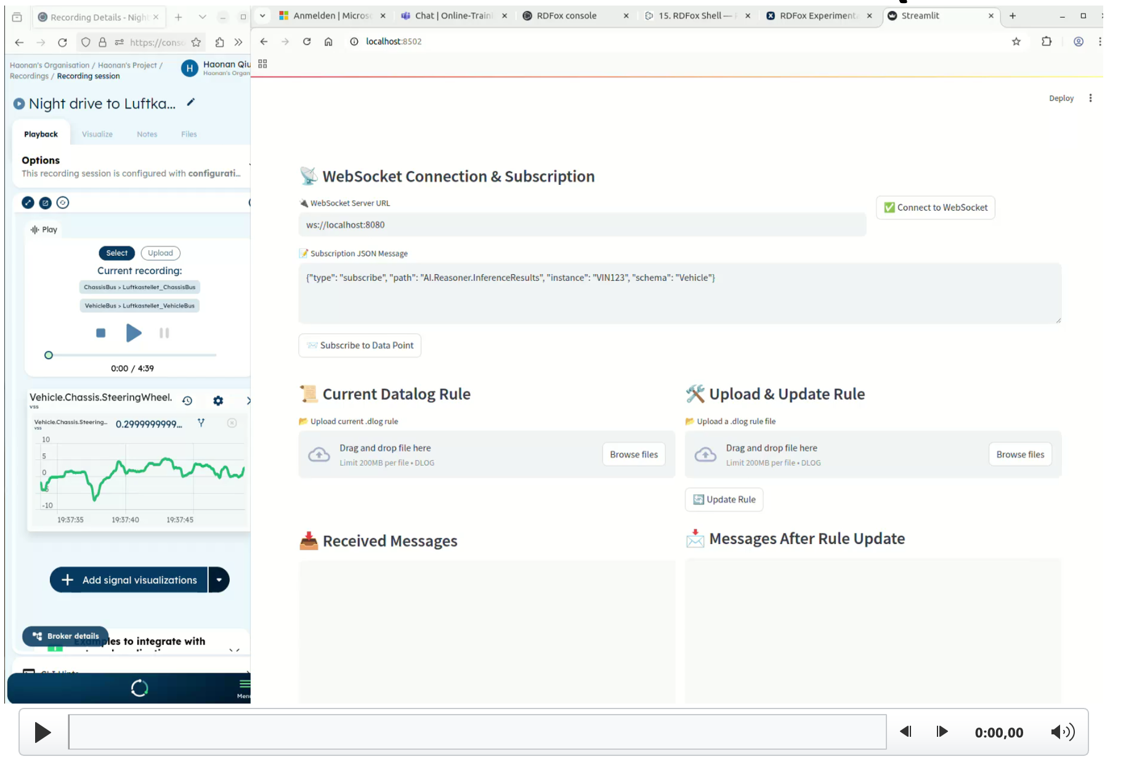

UPDATE RULES DURING RUNTIME
Motivation
Realization
Deep Dive
Customization
Outlook
Model
Queries
Rules
Ontology & SHACL
Reasoner (RDFox)
Copyright ©2025 COVESA
May 2025 | Berlin COVESA AMM

Slide 31
UPDATE RULES DURING RUNTIME(Showcase)
Motivation
Realization
Deep Dive
Customization
Outlook
Model
Queries
Rules
Ontology & SHACL
Reasoner (RDFox)
Copyright ©2025 COVESA
May 2025 | Berlin COVESA AMM

Slide 32
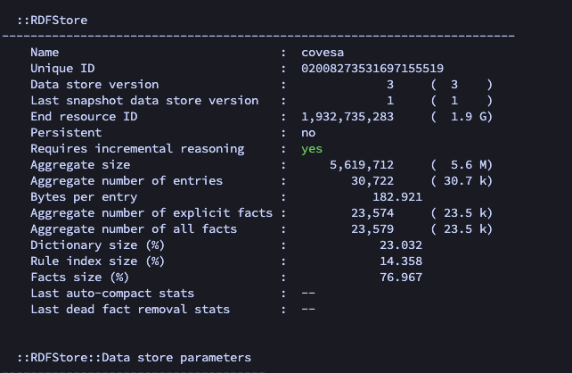
Statistics
Motivation
Realization
Deep Dive
Customization
Outlook
Item | number
Types of data points | 4
No.of received signals | 4,601
No.Triples | 23,574
No.Rules | 8
Mem of Triple | 5.6M
Bytes per entry | 182 byte
Copyright ©2025 COVESA
May 2025 | Berlin COVESA AMM
Notes:
Number of data points :4
Number of data signals: 4601
Nuber of explicit facts : 23,574
Number of implicit facts: 23,579
Number of rules:8
The memory from the tripels :5.6M
Bytes per entry: 182,921

Slide 33
Motivation
Realization
Deep Dive
Customization
Outlook
CUSTOMIZATION
ADAPTING IMPLEMENTATION FOR DIVERSE SET OF USE CASES
Copyright ©2025 COVESA
May 2025 | Berlin COVESA AMM

Slide 34
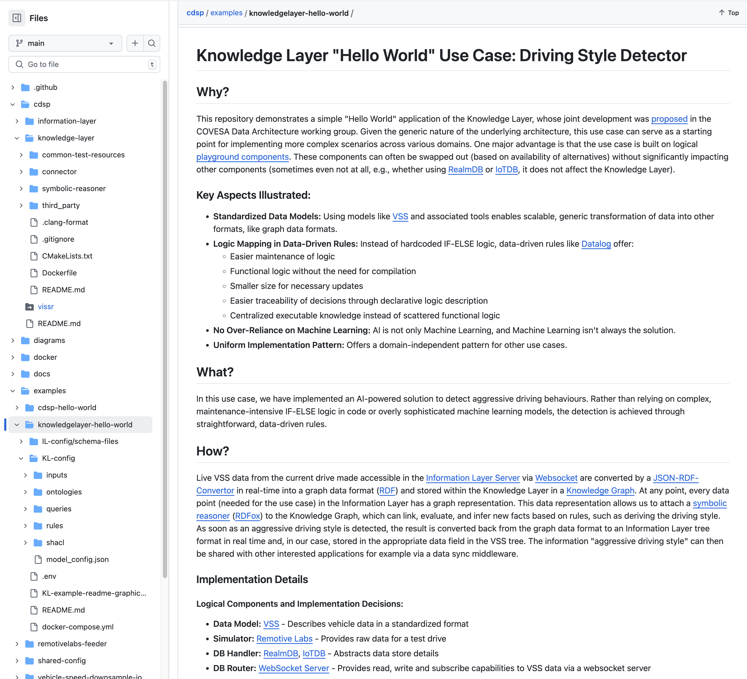
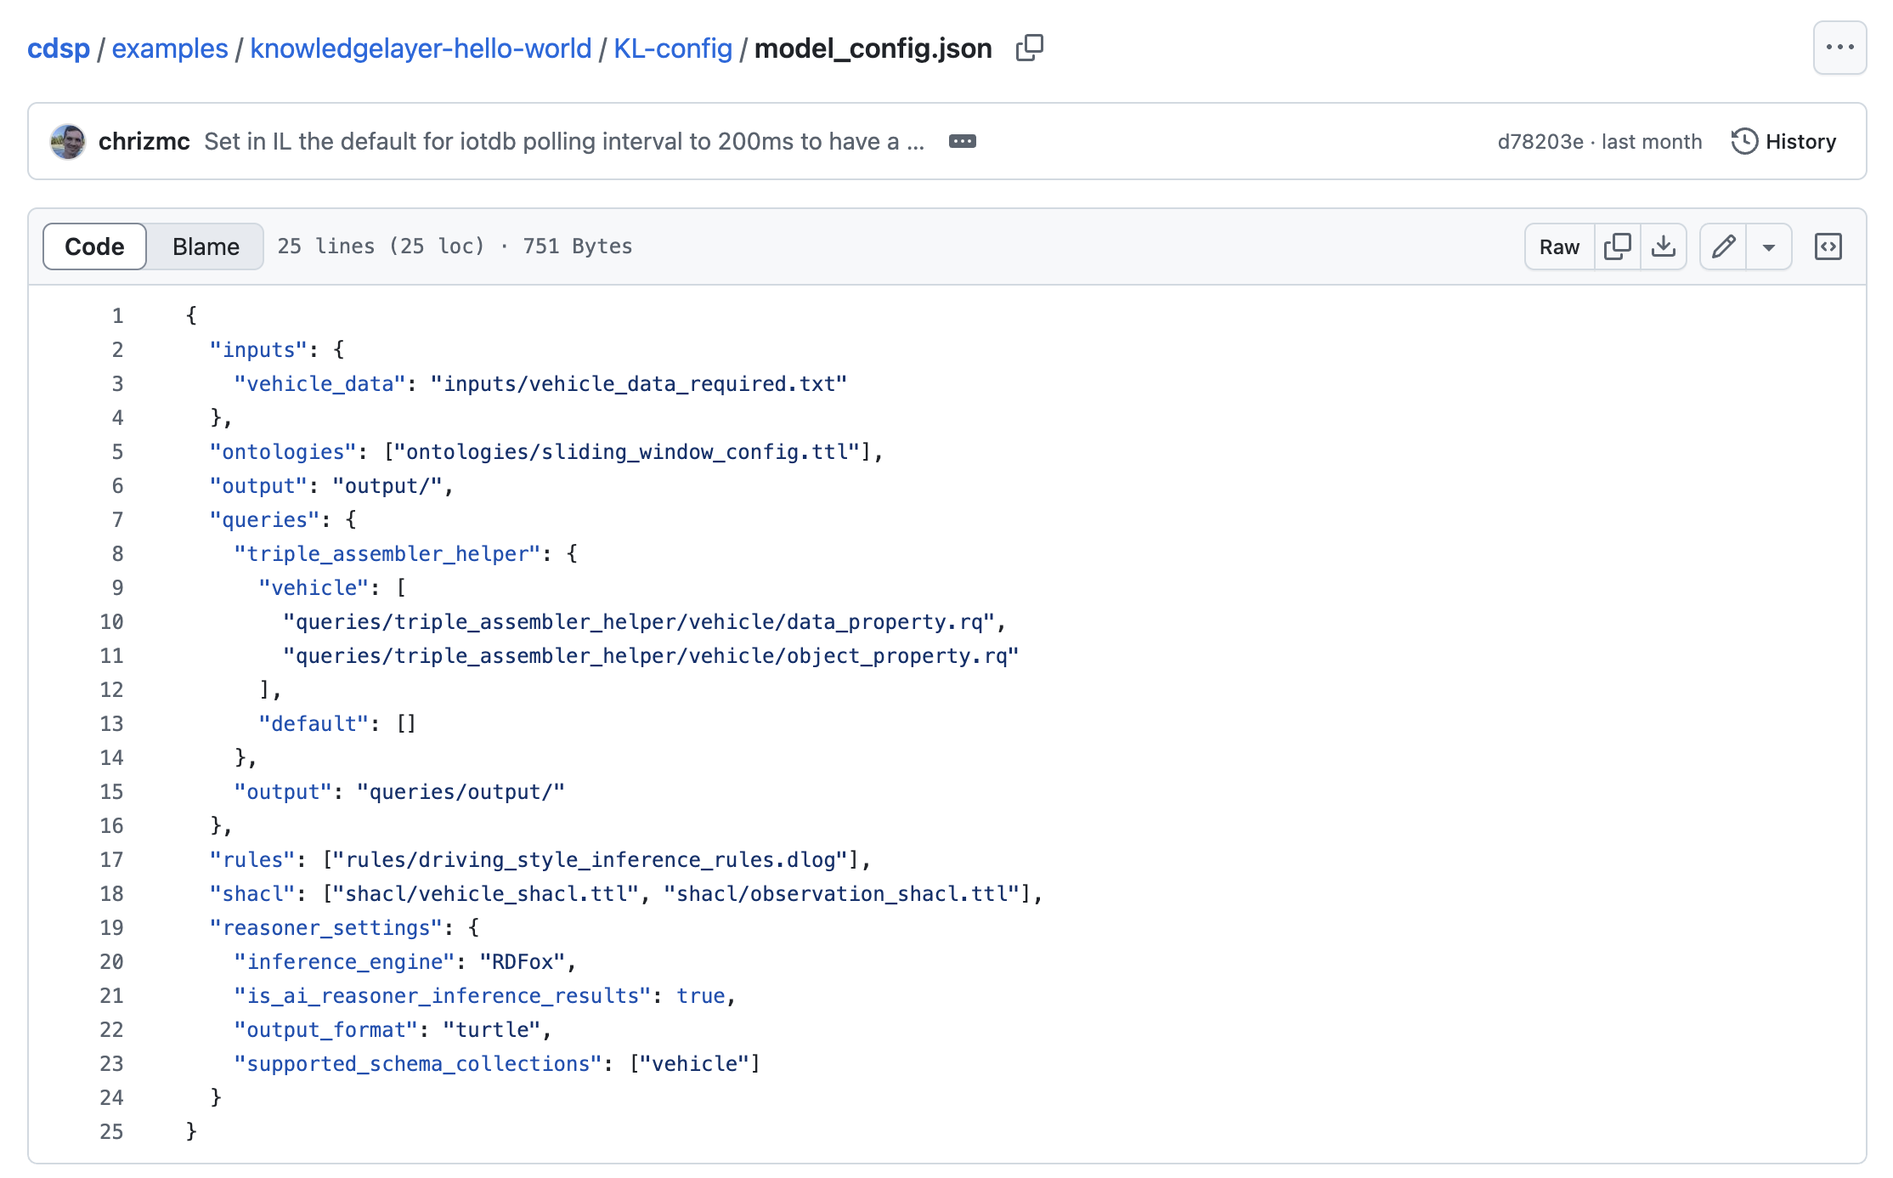
Adapting the code to your own use case
Motivation
Realization
Deep Dive
Customization
Outlook
Core components,
(no adaptions)
Adaptions are made here:
https://github.com/COVESA/cdsp/tree/main/examples/knowledgelayer-hello-world
Copyright ©2025 COVESA
May 2025 | Berlin COVESA AMM
Notes:
Number of data points :4
Number of data signals: 4601
Nuber of explicit facts : 23,574
Number of implicit facts: 23,579
Number of rules:8
The memory from the tripels :5.6M
Bytes per entry: 182,921

Slide 35
Motivation
Realization
Deep Dive
Customization
Outlook
OUTLOOK
WHAT IS STILL OPEN
WHAT IS NEXT
Copyright ©2025 COVESA
May 2025 | Berlin COVESA AMM

Slide 36
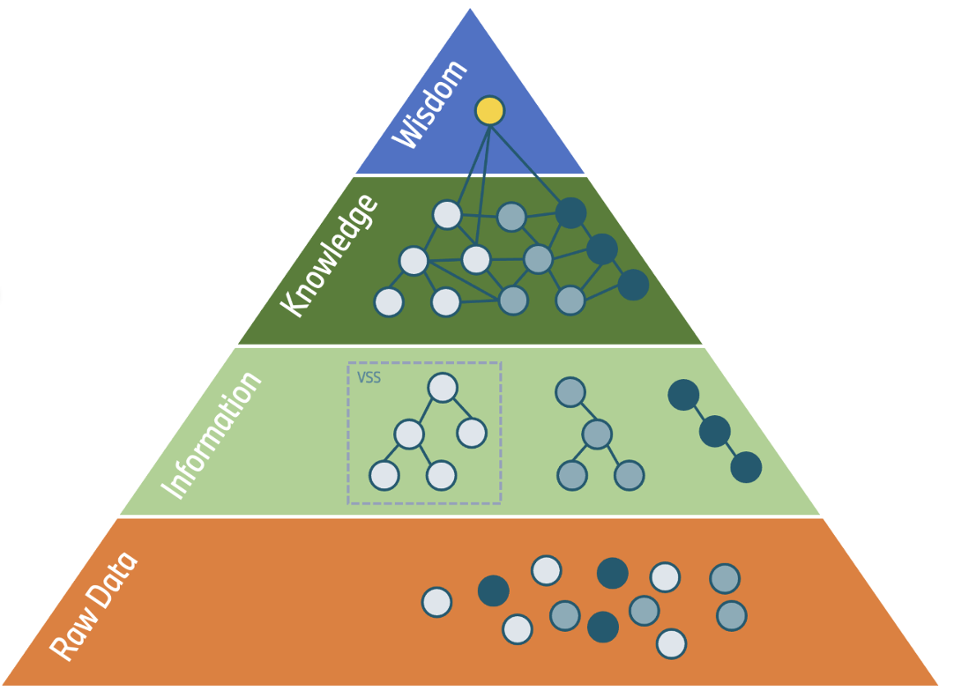
Most important open points / next steps
Motivation
Realization
Deep Dive
Customization
Outlook
3. Investigating the intersection of reasoning and propabilistic AI
such as LLMs in the context of automotive architectures
2. As availability of suitable other reasoners is still very limited:
Search for other suitable open source reasoner engines and encourage contribution
4. Forming a community
around the topic for mutual learning and further development of the approach
1. VSS Data Modelling Approach needs to be changed:
    vspec is not expressive enough to serve as base for Multi-Domain Modelling and semantic Reasoning
Thank you! And Questions?
Copyright ©2025 COVESA
May 2025 | Berlin COVESA AMM

Slide 37
BACKUP
Copyright ©2025 COVESA
May 2025 | Berlin COVESA AMM

Slide 38
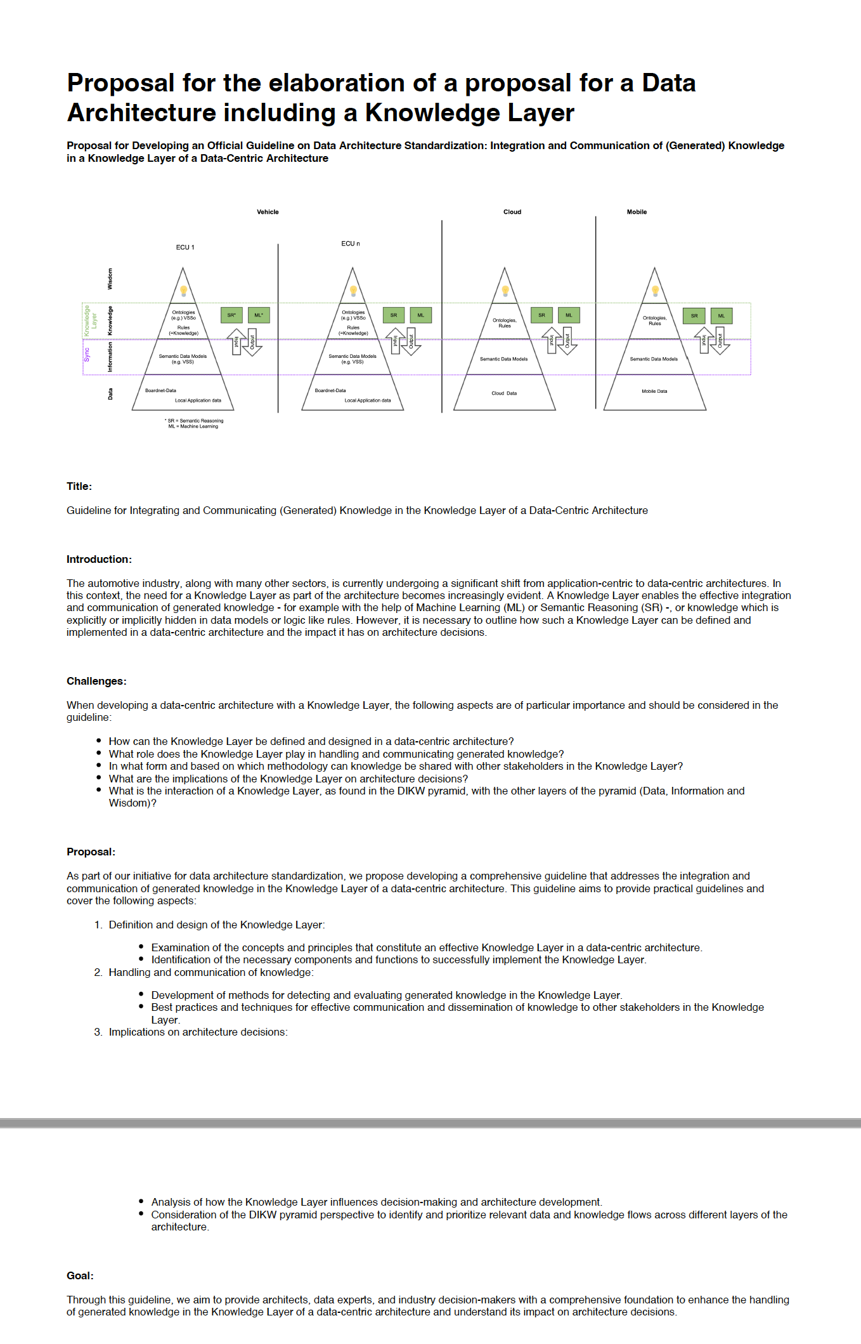
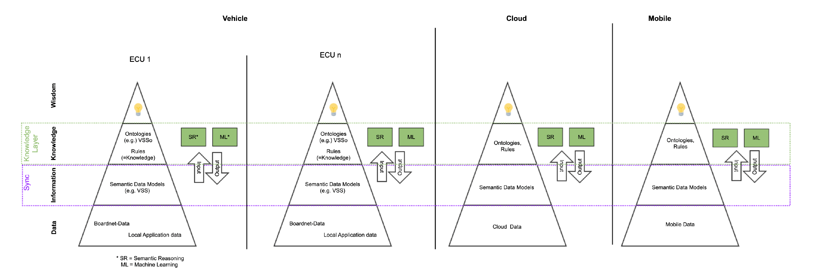
Proposal for the elaboration of a Data Architecture framework / guidelines including a Knowledge Layer
https://wiki.covesa.global/pages/viewpage.action?pageId=71074417
Copyright ©2025 COVESA
May 2025 | Berlin COVESA AMM

Slide 39
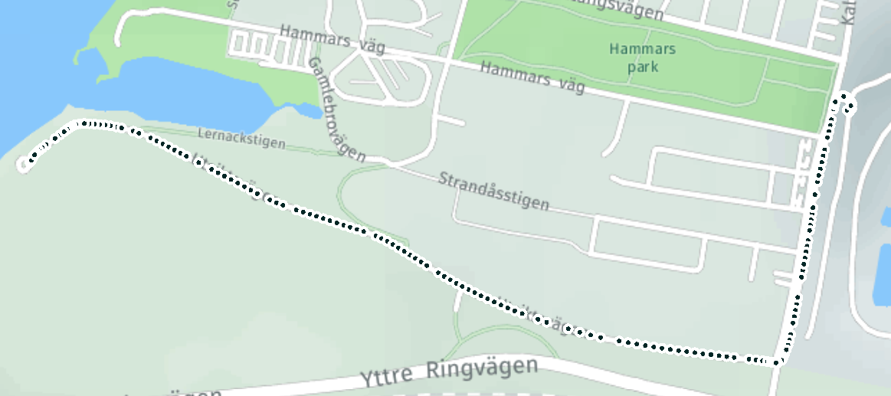
The setup
Vehicle.Chassis.SteeringWheel.Angle: The current angle of the steering wheel.
Vehicle.CurrentLocation.Latitude: The latitude of the vehicle's current location.
Vehicle.CurrentLocation.Longitude: The longitude of the vehicle's current location.
Vehicle.Speed: The current speed of the vehicle.
Aggressive driving event 2
Aggressive driving event 1
Copyright ©2025 COVESA
May 2025 | Berlin COVESA AMM
Notes:
Vehicle.Chassis.SteeringWheel.Angle: The current angle of the steering wheel.
- Vehicle.CurrentLocation.Latitude: The latitude of the vehicle's current location.
- Vehicle.CurrentLocation.Longitude: The longitude of the vehicle's current location.
- Vehicle.Powertrain.TractionBattery.NominalVoltage: The nominal voltage of the vehicle's traction battery.
- Vehicle.Powertrain.TractionBattery.StateOfCharge.CurrentEnergy: The current energy level of the traction battery.
- Vehicle.Powertrain.Transmission.CurrentGear: The current gear of the vehicle's transmission.
- Vehicle.Speed: The current speed of the vehicle.
423 observations
The length of the trace

Slide 40
Event 1
Segment 2:
[
{
"Vehicle": {
"AI.Reasoner.InferenceResults": {
"DrivingStyle": {
"AvgAngleChange": 225,
"Duration": 3,
"End": {
"Latitude": 55.569948,
"Longitude": 12.898002,
"Timestamp": "2023-11-08T19:35:11"
},
"Speed": 13,
"Start": {
"Latitude": 55.5699,
"Longitude": 12.89795,
"Timestamp": "2023-11-08T19:35:08"
},
"segment": "segment20231108T19350820231108T193511"
}
}
}
}
]
Copyright ©2025 COVESA
May 2025 | Berlin COVESA AMM
Notes:
{
"type": "subscribe",
"path": "AI.Reasoner.InferenceResults",
"instance": "VIN123",
"schema": "Vehicle"
}

Slide 41
Event 2
Segment 1:
{
"Segment": [
{
"Vehicle": {
"AI.Reasoner.InferenceResults": {
"DrivingStyle": {
"AvgAngleChange": 249.5,
"Duration": 3,
"End": {
"Latitude": 55.570824,
"Longitude": 12.923335,
"Timestamp": "2023-11-08T19:39:00"
},
"Speed": 14,
"Start": {
"Latitude": 55.570785,
"Longitude": 12.923318,
"Timestamp": "2023-11-08T19:38:58"
},
"segment": "segment20231108T19385820231108T193900"
}
}
}
}
]
}
Copyright ©2025 COVESA
May 2025 | Berlin COVESA AMM

Slide 42
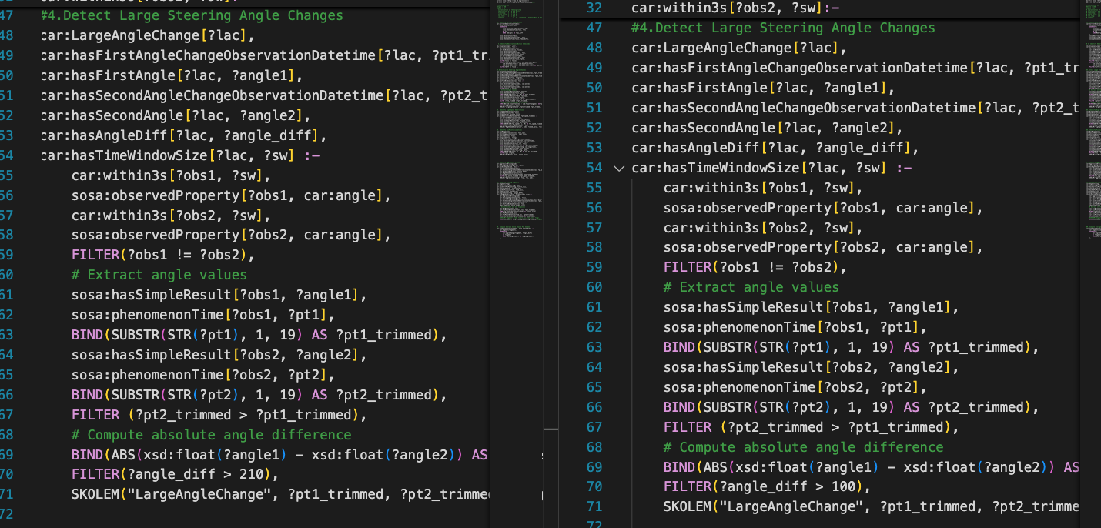
Change the Angle Threshold from 210 to 100
[
{
"Vehicle": {
"AI.Reasoner.InferenceResults": {
"DrivingStyle": {
"AvgAngleChange": 108,
"Duration": 3,
"End": {
"Latitude": 55.566387,
"Longitude": 12.921101,
"Timestamp": "2023-11-08T19:37:13"
},
"Speed": 20,
"Start": {
"Latitude": 55.566388,
"Longitude": 12.92102,
"Timestamp": "2023-11-08T19:37:11"
},
"segment": "segment20231108T19371120231108T193713108"
}
}
}
}
]
Copyright ©2025 COVESA
May 2025 | Berlin COVESA AMM
Notes:
Delete the rules:
curl -i -X PATCH "http://localhost:12110/datastores/ds-test/content?operation=delete-content" \
--user project-x-admin:test \
-H "Content-Type: application/x.datalog" \
-T driving_style_inference_rules.dlog
Update the rules
curl -i -X PUT "http://localhost:12110/datastores/ds-test/content?rules" \
--user project-x-admin:test \
-H "Content-Type: application/x.datalog" \
-T driving_style_inference_rules_update.dlog
Take the screenshot of what was created, what was later included
curl -X PUT "http://localhost:12110/datastores/dks/content?rules" \
-H "Content-Type: application/x.datalog" \
-T context_situation_food_recommendation_new.dlog

