Slide 1
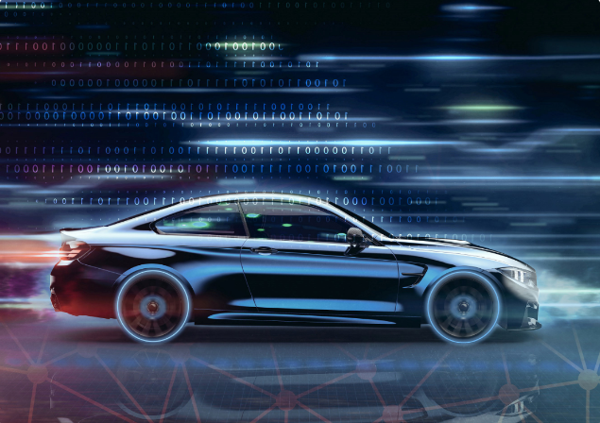
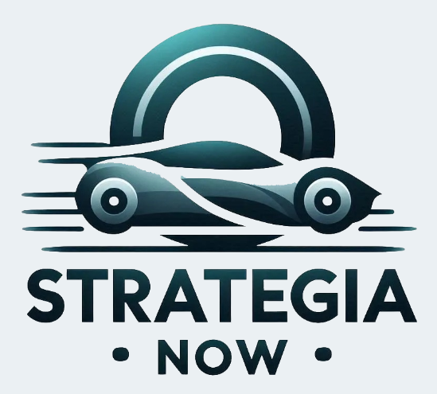
Satellite Connectivity
Changes Everything
COVESA All Members Meeting – September 2024

Slide 2
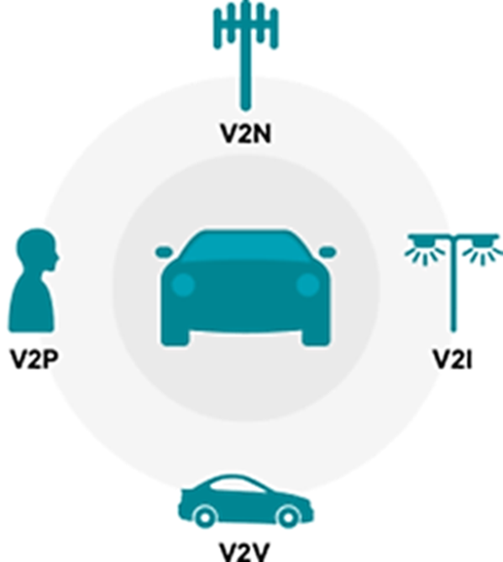

What automakers want
Ubiquitous coverage without exception
Best signal available at all times
Carrier independence
Wi-Fi offload where practical
Priority carriage for emergency, safety-related communications
Prioritization of car connectivity concerns

Slide 3


Connectivity is everything
Location enhancement/GPS error correction
Hybrid/connected radio
Hybrid/connected navigation
Digital assistant/search
Software updates
Cybersecurity
Real-time/predictive traffic
Streaming audio/video
Live gaming
Social media access
E/V-commerce
App downloads
Sensor data sharing
Customer relationship management
Next gen 911/eCall
Remote control/teleoperation
THEN:
1996 -
NOW:
2024 -
Automatic crash notification
Stolen vehicle tracking/recovery
Remote diagnostics
Remote start
Remote lock/unlock
Car locator
Roadside assistance
Wi-Fi

Slide 4
Connectivity is evolving
Connectivity is not optional – Toyota: 10 years of free connectivity; GM: 8 years of free connectivity; Volvo: 5 years of free connectivity
Multi-modality is essential:
5G, Wi-Fi, Private 5G, C-V2X, Satellite (NTN)… and ATSC 3.0
In a “horses for courses” scenario ATSC 3.0 will be used for content delivery and software updates

Slide 5
Timing of satellite
5GAA technical paper on non-terrestrial-network connectivity, BMW NTN demonstration at Berlin 5GAA event in October: https://5gaa.org/maximising-the-benefit-of-future-satellite-communications-for-automotive/
First NTN capable NAD – YE 2024 – SOP: 2027+ (Rolling Wireless, Monogoto/Murata)
Proprietary direct-to-device – Globalstar/Apple, Starlink/TMO, Skylo/Google, Amazon Kuiper? vs. standards-based 5G R17
NB-NTN – Skylo – Volkswagen? – narrowband, requires additional hardware to manage RF swap, uses same antenna
NR-NTN – R18/R19 – 2027+

Slide 6
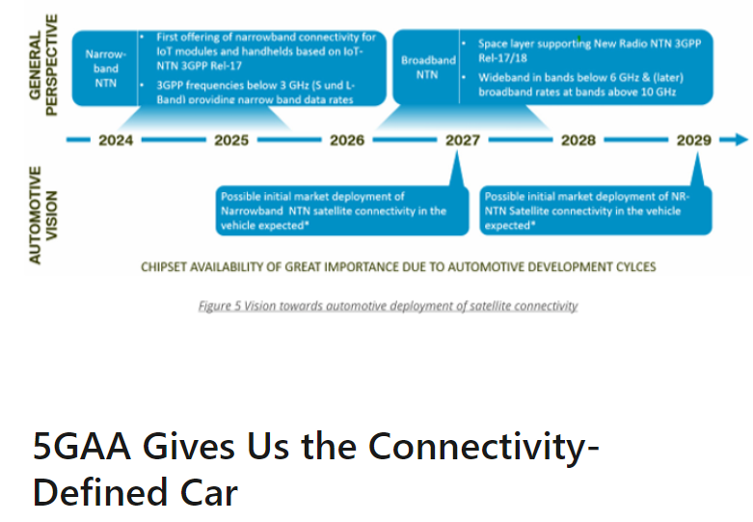
5GAA Defines the Satellite Roadmap
From narrowband
to wideband

Slide 7
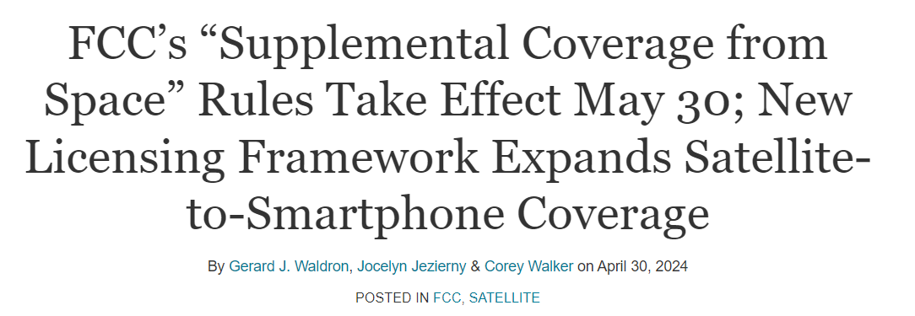
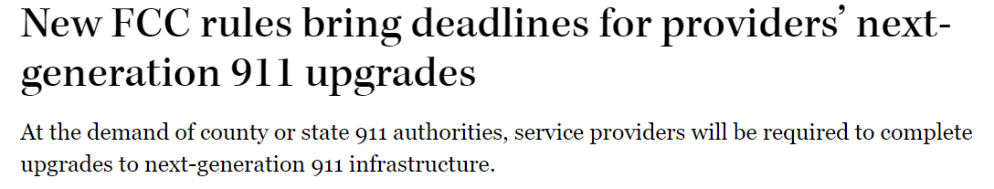
Recent FCC Actions

Slide 8
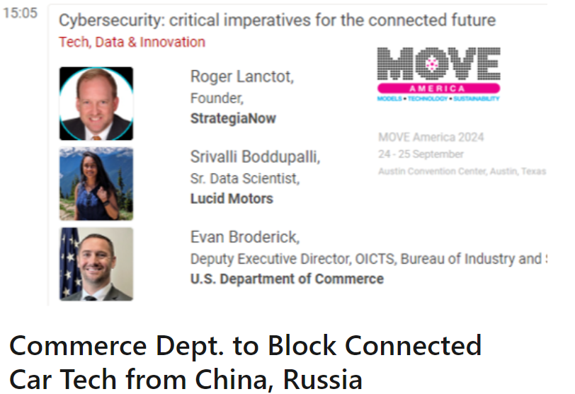
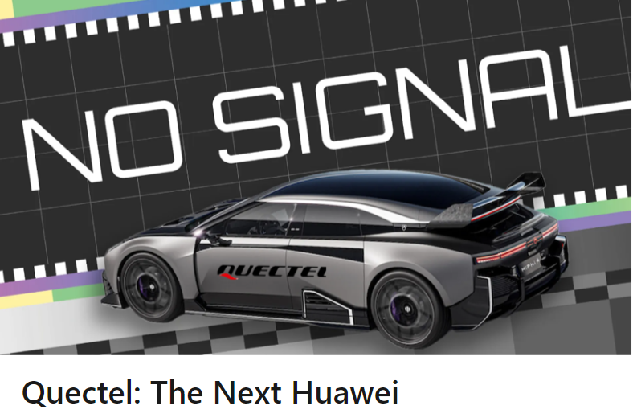
Commerce Dept. Action
One Question: If cars are national security threat what
about all otherconnected things? Is this just the beginning?

Slide 9
Timing of C-V2X
USDOT V2X Deployment Plan:
2024-2026 – 2 OEMs commit to 5.9GHz-capable vehicles by 2027
2027-2029 – 5 models are 5.9 capable; 3 active deployments generate Infrastructure Owner-Operator (IOO) data used by 2 OEM production vehicles 4 suppliers; 3 OEMs demonstrate interoperable connectivity
2030-2034 - 6 OEMs have 5.9 GHz capable production vehicles for safety use cases; 20 vehicle models are V2X capable
Reality
Chicken-and-egg – infrastructure vs. vehicles – struggle continues
FCC rule-making expected soon
No 5-star/NCAP support
No funding
No penalties
Best news: emergence of solutions (Haas Alert, Applied Information) bridging cell-5.9GHz gap

Slide 10
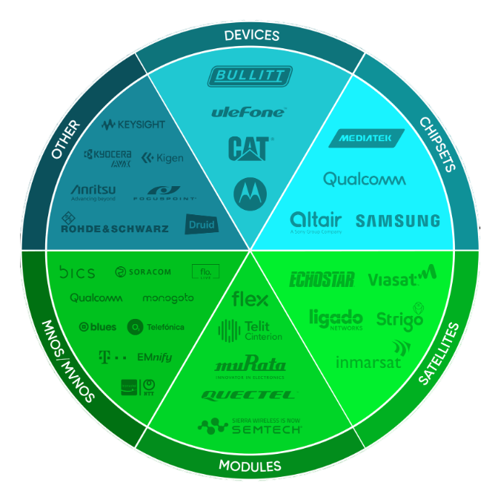
Evolving eco-system
Increasing importance of module makers
- Fibocom sells Rolling Wireless stake
- Kontron acquires Telit Cinterion auto unit
- Teltonika gets new CEO
- VVDN emerges as important player
- Quectel is the big loser from Commerce Dept. ruling
SIM/MVNO eco-system
- Thales, G+D, Valid, Idemia, NXP
- NTT/Transatel, 1nce
- KDDI, Flowlive
- Cubic, Teal
- Truphone, Kore
- Aeris, Monogoto
- Eseye, Conekt.ai
OEM Objective:
Own your own SIM
SOURCE: Skylo

Slide 11
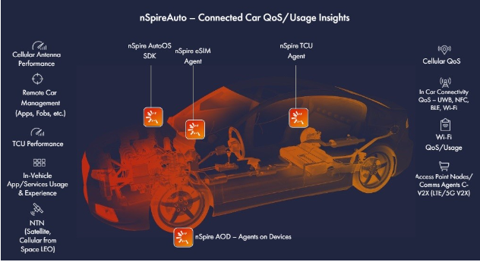

Software as key differentiator
Connectivity is essential yet unreliable
Connectivity is critical for crash detection/avoidance
Car makers will solve coverage challenges with NTN
Car makers will solve inter-vehicle coms with C-V2X
All of this will require software to optimize data mgmt.
and connectivity – safety, infotainment, content
Diagnostic agents will be necessary to discriminate
between hardware, software, and network failures
Game changing on-device agents

Slide 12
OTA as table stakes
Tesla is still the “gold standard” other auto makers seek to emulate
Weekly? Monthly updates?
Critical for the functioning of safety systems – i.e. General Motors Super Cruise
Essential for future subscription-centric business models
Some updating via “thumb” drives, smartphone apps, and dealers still in the market
A bigger issue at stake
Using OTA to:
Add features and functions; fix bugs; update algorithms; meet regulatory requirements;
Leverage new business models – pay per use, subscriptions
How to update overall vehicle systems?
- Plug-in Modules?
- Blades?
- Intelligent displays?

Slide 13
Final thoughts
Satellite connectivity will deliver true ubiquity
Auto makers still assessing what exactly to do with satellite connectivity
Car makers have a tough enough time with wireless carriers – how will
satellite operator relationships emerge and evolve
Starlink? – Musk, again!
Most important – connectivity opens the door to
direct B2C engagement with consumers for OEMs

Slide 14

Any Questions?
Roger C. Lanctot
Founder
StrategiaNow Consulting
roger@strategianow.com
(703) 860-2005

