Slide 1
Data Expert Group Update
COVESA AMM
2024-09-25

Slide 2
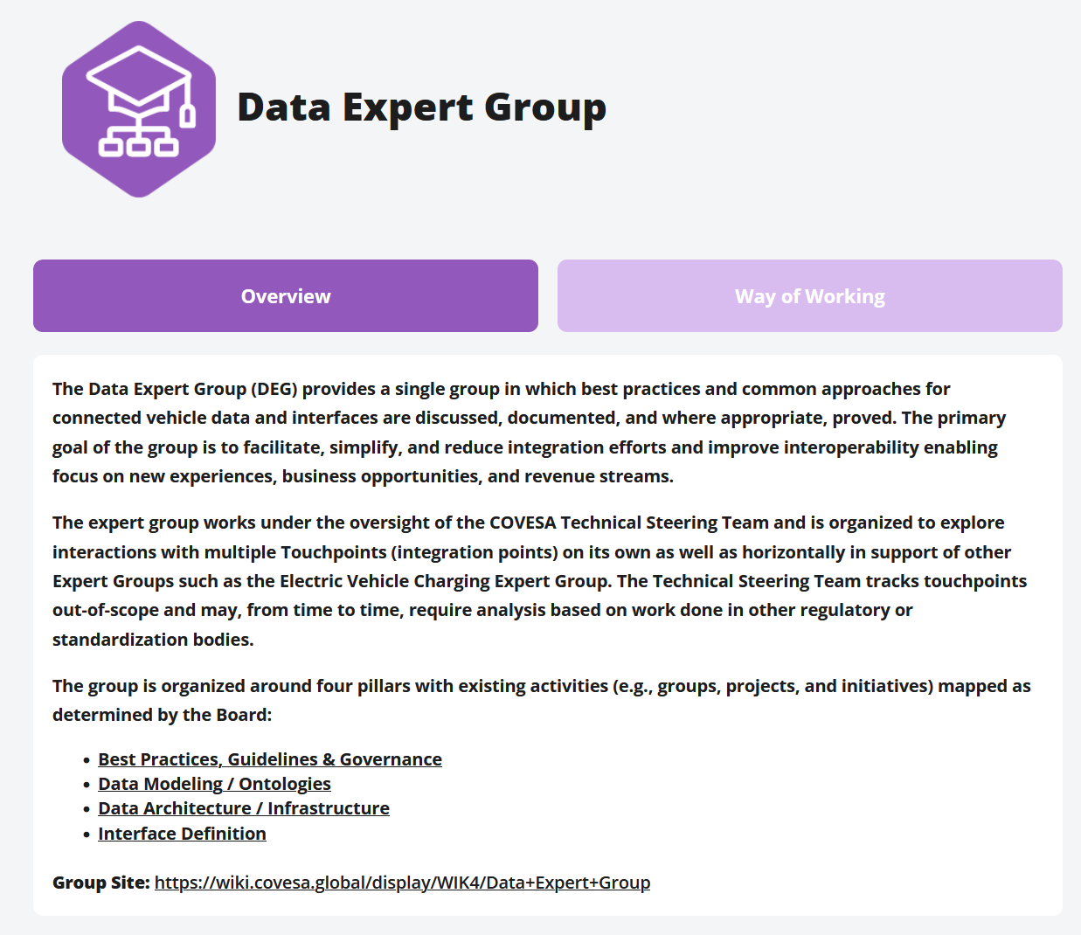
Data Expert Group Introduction

Slide 3
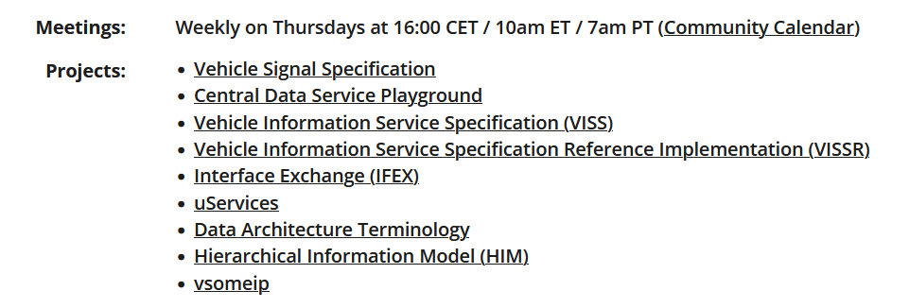
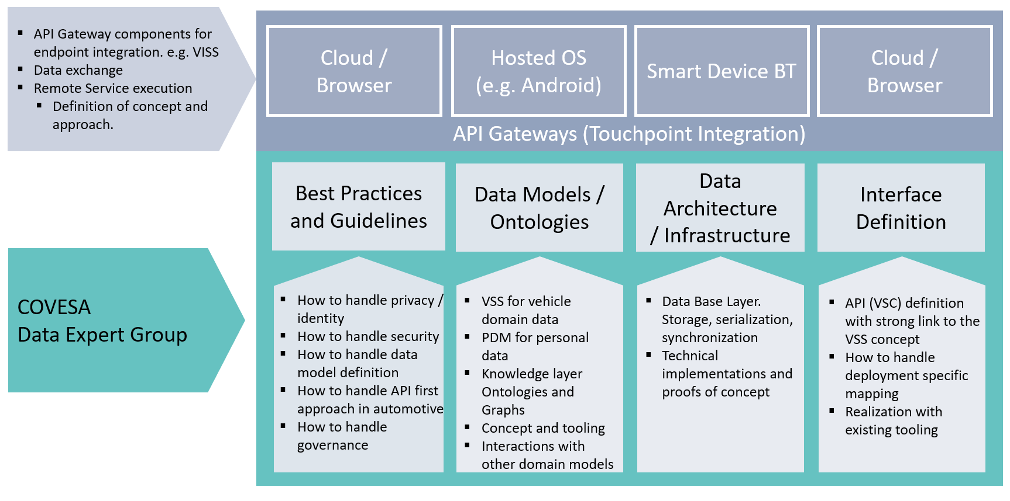
Data Expert Group Introduction
Data Expert Group Review and Wrap-Up
4:00 PM - 5:10 PM Thu

Slide 4
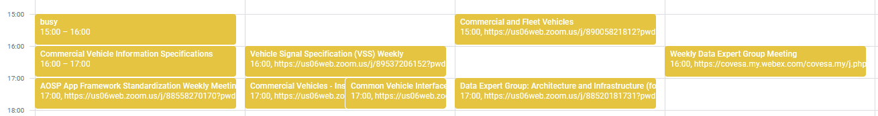
Regular Meetings related to Data Expert Group
Mondays
  Commercial Vehicle Information Specification
  AOSP App Framework
Tuesdays
  VSS
  Commercial Vehicles – Insurance Signals
  Common Vehicle Interfaces
Wednesdays
  DEG - Architecture and Infrastructure
  Commercial and Fleet Vehicles
Thursdays
  Data Expert Group
All welcome to join!
All meetings visible in the COVESA Community Calendar

Slide 5
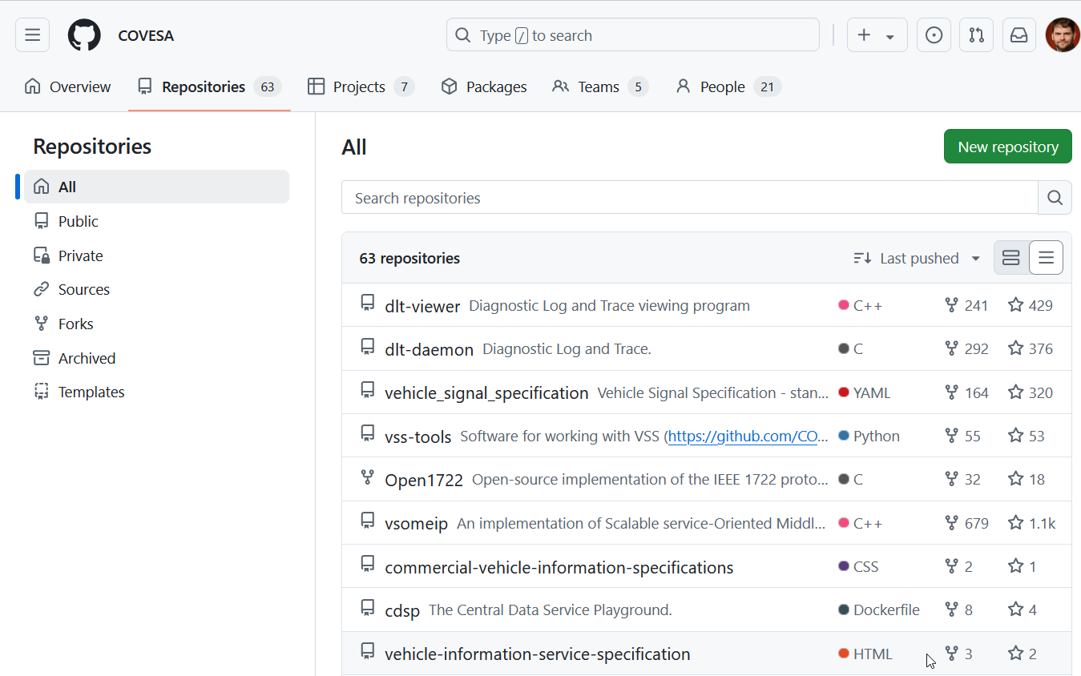
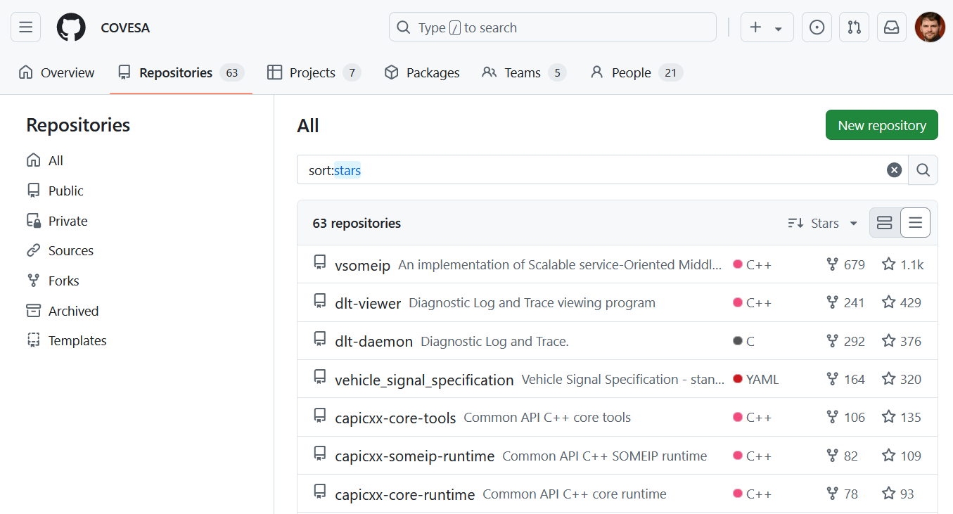
Github Activity

Slide 6
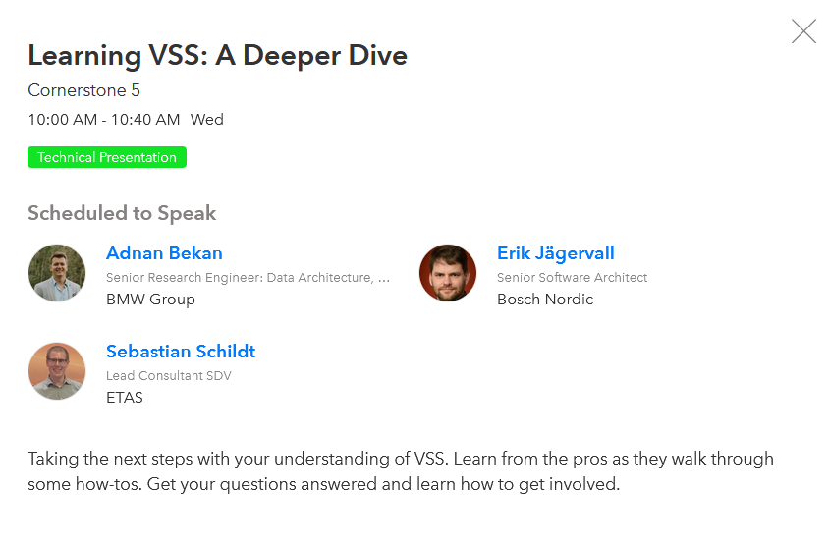
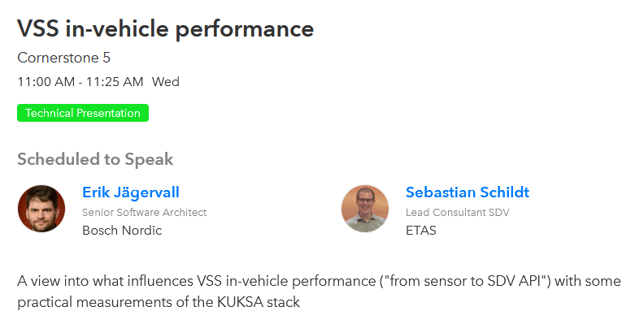
VSS Sessions Today

Slide 7
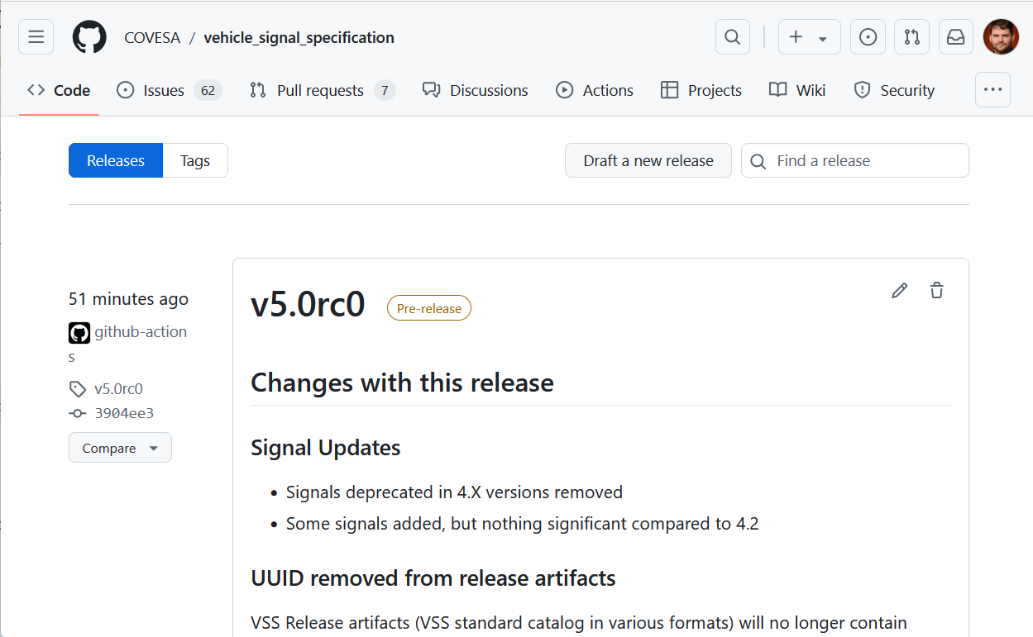
VSS 5.0 is coming!
RC0 just released!
Significant changes:
  OBD branch deprecated
  UUID removed from release artifacts
  New tools (SAMM, APIGEAR) added
  Major tool refactoring

Slide 8
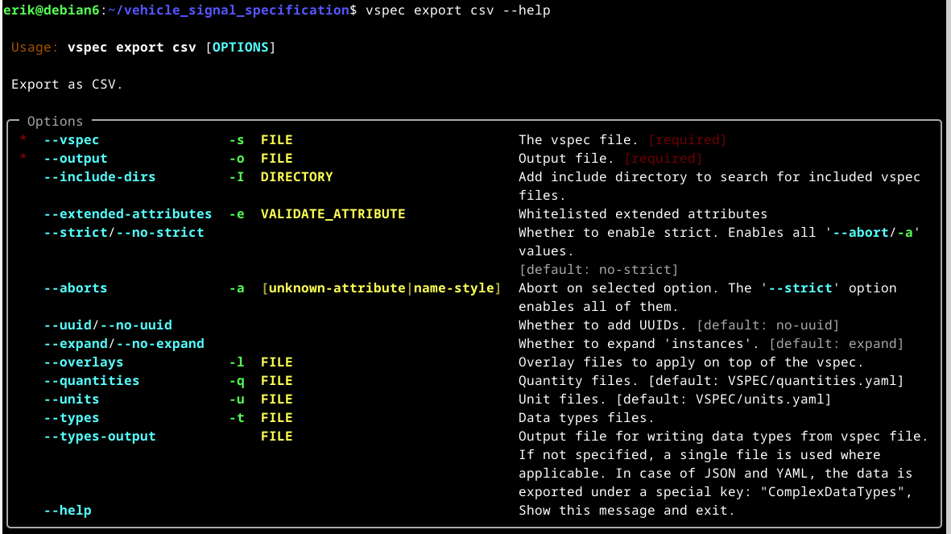
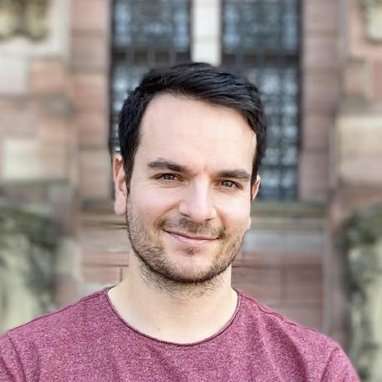
VSS Updates – Tool Framework
Refactored Tooling
New UI
Kudos to Sebastian Schleemilch, BMW

Slide 9
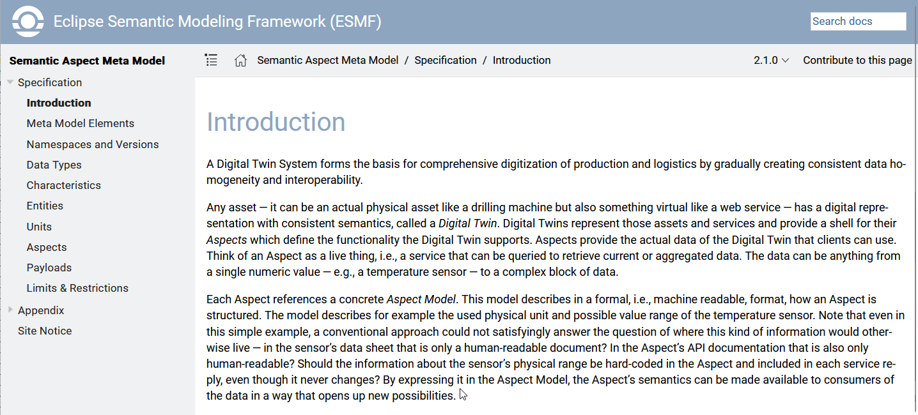
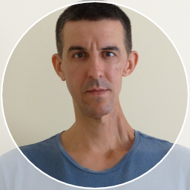
VSS Updates - Semantic Aspect Meta Model (SAMM) exporter
Helper exporter to convert VSS specification (.vspec) file(s) into ESMF - Semantic Aspect Meta Model (.ttl) files, which then can be further used in the Eclipse Semantic Modeling Framework (ESMF) - Aspect Model Editor (AME).
Kudos to Kostadin Ivanov, Bosch

Slide 10
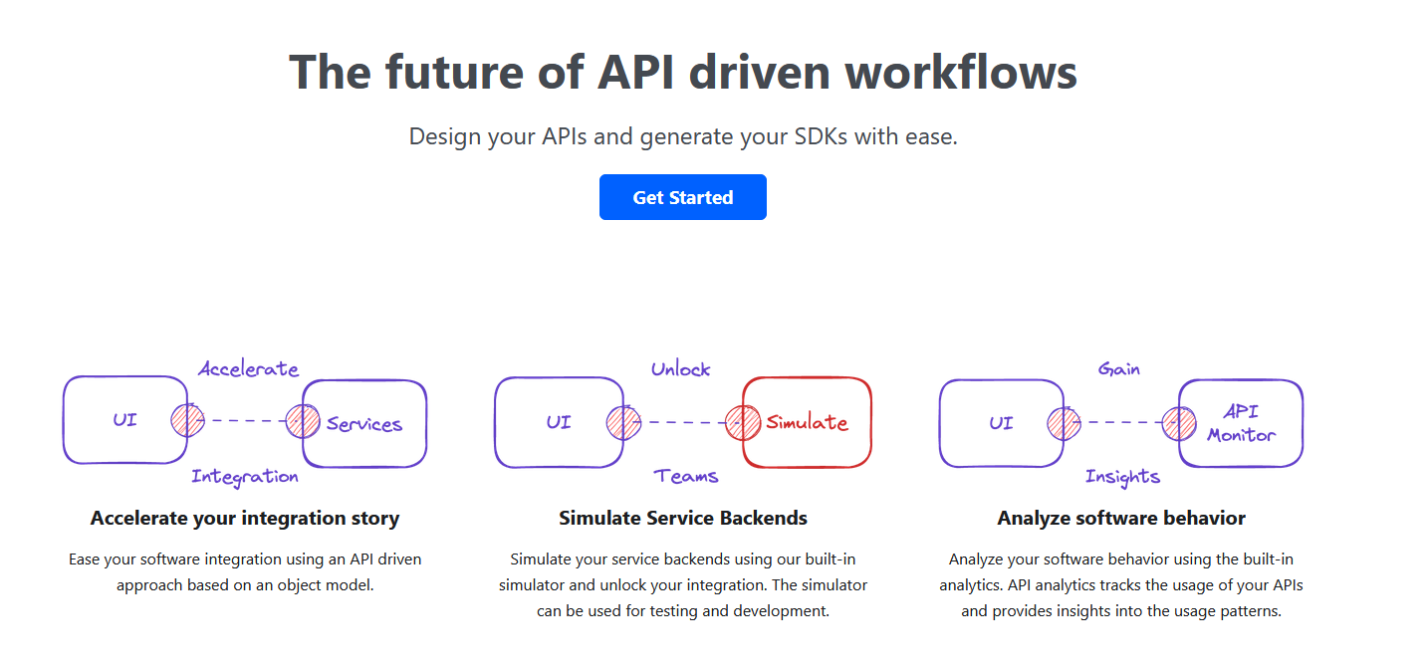

VSS Updates - Vspec ApiGear exporter
Generates a solution and a module file for ApiGear from VSS
Kudos to Kamil Machniki

Slide 11
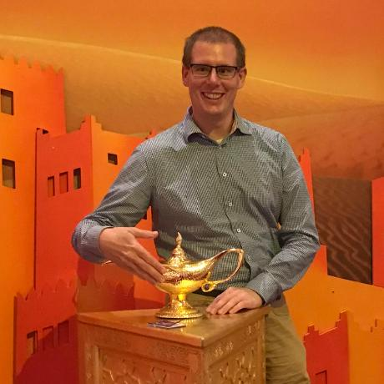

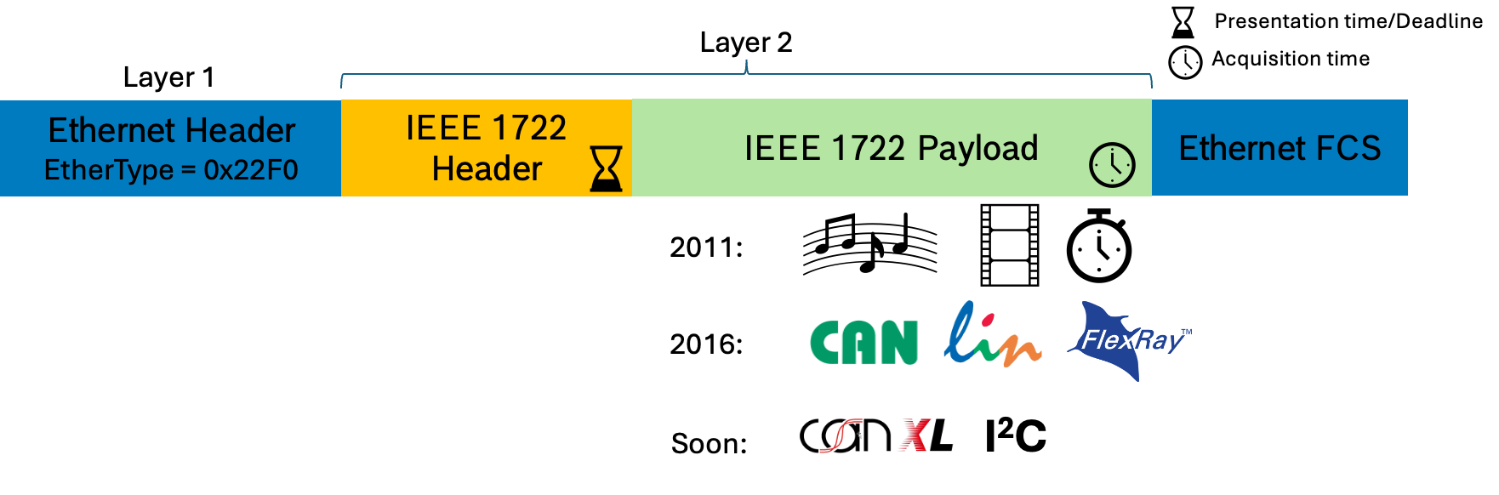

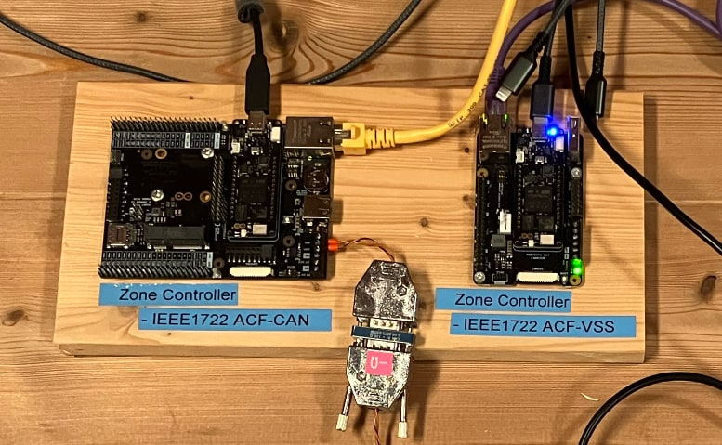
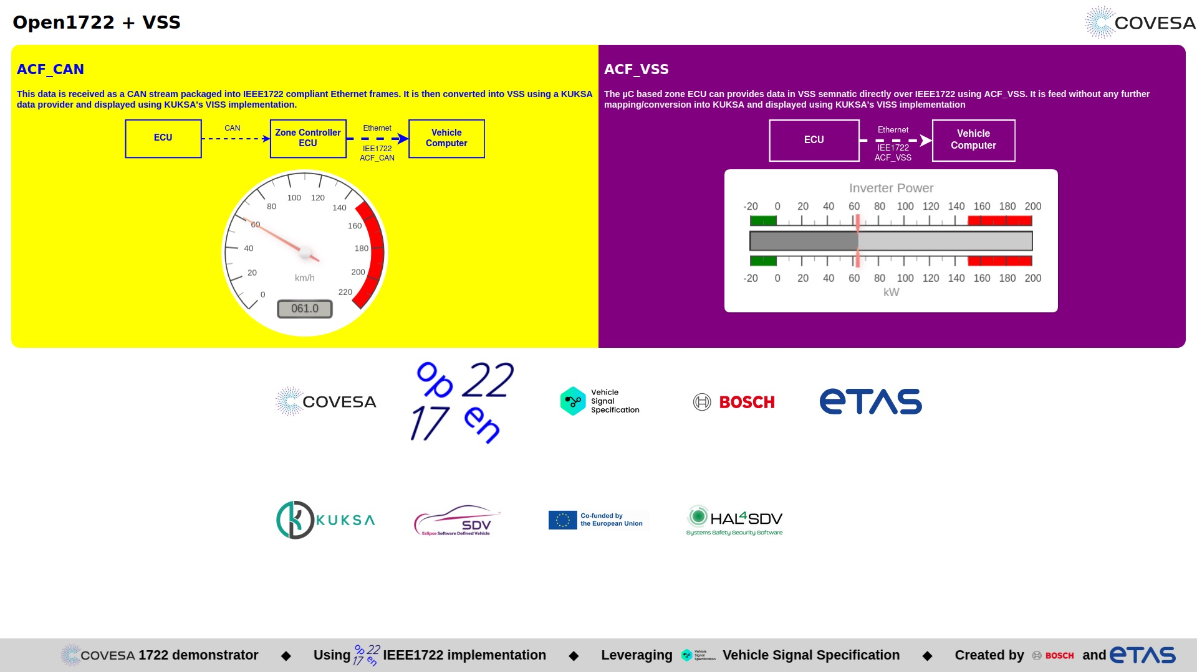
New DEG Project Open1722
IEEE1722 An efficient Ethernet L2 (UDP optional) transport protocol. The Open1722 project is a new COVESA project, that already provides running code to use IEEE1722
Join Open1722 talk Thursday 2pm for details!
and
Live Demo at Showcase event this evening

Slide 12
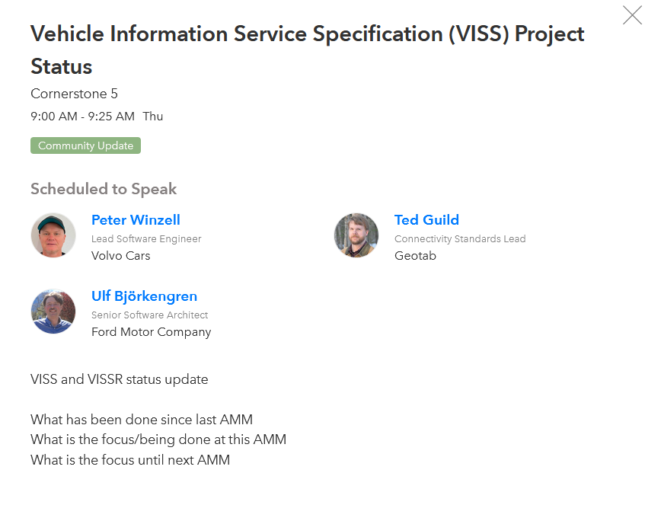
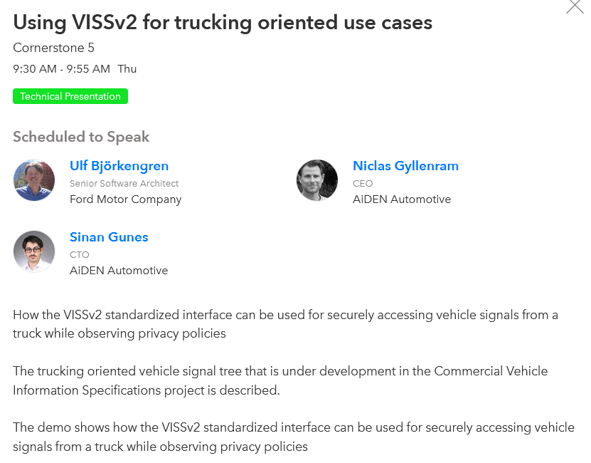
VISS/VISSR

Slide 13

IFEX and similar solutions

Slide 14
Data Architecture and Infrastructure group
Changes to COVESA Central Data Service Playground (CDSP) since the Spring AMM:
  Released CDSP v0.1.0.
  Published sample RemotiveLabs Bridge to stream data from the RemotiveLabs virtual cloud platform.
  Significantly expanded the built-in timeseries processing capabilities to include multiple functions in the areas of Data Quality, Data Profiling, Anomaly Detection, Frequency Domain Analysis, Data Repair and Series Discovery.
  Added a timeseries processing example that intelligently down-samples high frequency VSS data.
  Enabled using Grafana to manipulate timeseries data in the data store.
  Significant work on WIP implementing the AI Knowledge Layer proposal.
  Welcomed a new maintainer Christian Muehlbauer from BMW who is an active contributor.
Continued co-operation with the wider community.
Notes:
Since Spring AMM
CDSP v0.1.0 release
RL feeder
Data Quality / Grafana + examples
KL Connector WIP
Second maintainer added

Slide 15
DEG Retrospective & Discusison
The weekly meetings are not always that well structured
Many of the DEG “members” are very busy on other topics, either in COVESA or at their home organization
  Limited time available to “keep things together”
  Your contribution is very welcome!
Original pillar definition is quite outdated

