Slide 1
Collaboration through Interoperability
Unlocking the software potential
in the automotive industry

Slide 2

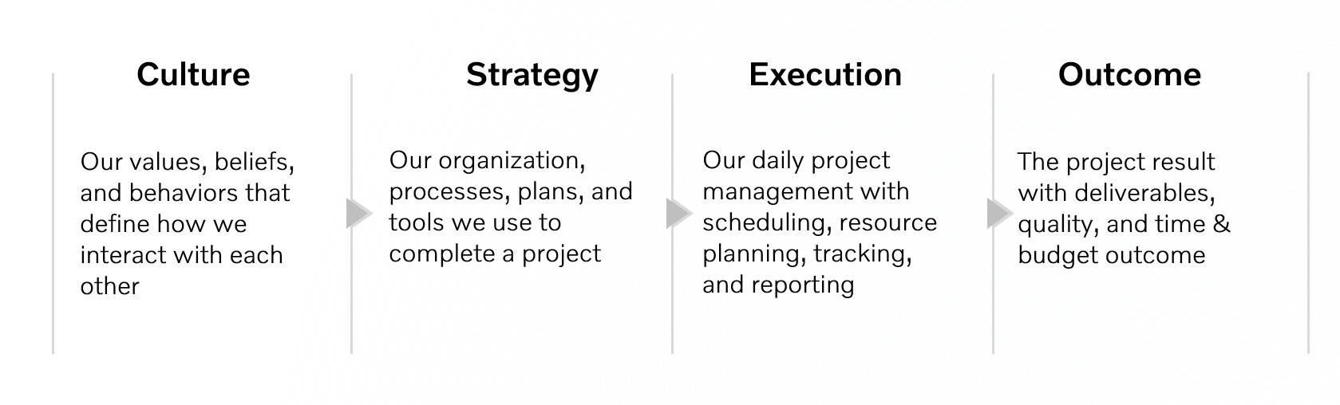
Previously on “Why do we suck so badly at this?”
Today’s topic

Slide 3

What are we trying to solve today?
Today there are often inefficiencies and conflict between software domains inside an OEM due to incompatible
development strategies, processes, and tooling.
How do we build bridges between engineering cultures
without disrupting existing ways of working?

Slide 4
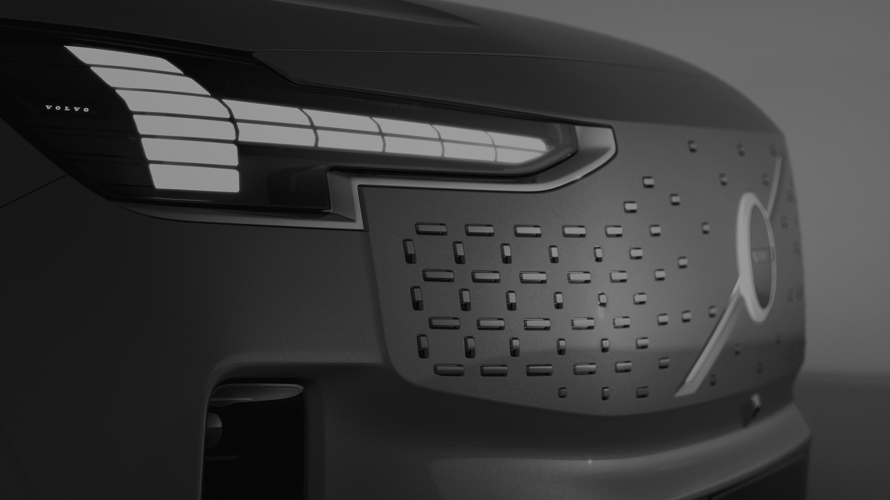
Use Software Defined Vehicle concepts to create interoperability between engineering cultures, driving faster execution, scalable designs, and better products.

Slide 5
SDV, SOA, API-First: Different impacts from a single philosophy
BETTER PRODUCTS
SCALABLE DESIGNS
FASTER EXECUTION
Software Defined Vehicle
Service Oriented Architecture
API First
Better products for less through software-driven value creation
Better products for longer through
OTA upgrades
Better products for tomorrow through fleet performance data analysis
Scales our software designs by separating API lifecycle management from that of implementation
Scales our design processes by shifting focus from signals and protocols to solutions and features
Scales our testing using mock API implementations to find bugs earlier
Faster feature readiness by building on auto-generated network bindings
Faster cross-ECU feature development by extending existing AUTOSAR tooling
Faster inner-cycle development through retention of familiar and proven tools
Faster final-integration using auto-generated profiling and inspection code to find bugs quicker

Slide 6

Bridging the cultures of
AUTOSAR and POSIX

Slide 7

Core Engineering Principles (from 2024 spring AMM)
Be sympathetic to the needs of others
  Mechatronics have different requirements than high-level software
Trust your colleagues
  There are several different paths to your common goals
Balance the now with the future
  Start of production is important, but so is the time after
Notes:
READ SLIDE!

Slide 8

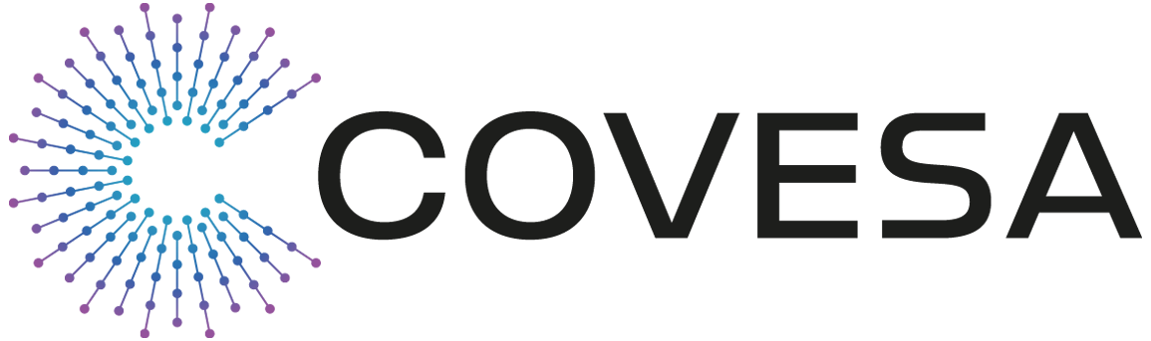

Cross-team interoperability through tools bridging
Hosts POSIX services (TCU, IVI, etc)
IFEX Formatted YAML
Integrated into CI/CD WoW
AUTOSAR services created
directly in AUTOSAR tooling
Merges with POSIX services
Specification
Converter
Converts IFEX specifications to ARXML
Off the shelf AUTOSAR service management tool
Hosts master signal database
Generates network releases
Reads ARXML export from AUTOSAR tool
Generates VSOMEIP network stubs
Network Code Generator
Network Code Generator
Application
Code
IVI
TCU
...
Zone
Controller
Application
Code
SOME/IP
Auto-generated interoperability
AUTOSAR payload

Slide 9
Accelerated dev cycles using exported network release
Rapid cycle service spec update
Isolated in git dev branch
AUTOSAR ARXML export
Provides baseline specs
Exported from latest network release
Specification
Converter
ARXML Export
Updated ARXML imported to AUTOSAR tool at end of dev cycle
Integrated into next network release
Joins AUTOSAR and IFEX ARXML data
IFEX used to update network release with specs under development
Specification
Merger
Network Code Generator
Network Code Generator
Application
Code
IVI
TCU
...
Zone
Controller
Application
Code
SOME/IP

Slide 10

Developing POSIX services
Hosts services owned by POSIX teams
IFEX Formatted YAML
Integrated into CI/CD WoW
Converts IFEX to protobuf
protobuf converter
Standard tool provided by Google
Targets Java, Python, and C++
protoc Network Code Generator
Application
Code
Application
Code
IVI
gRPC
Central Compute
Auto-generated interoperability
protobuf payload

Slide 11

IMPACT

Slide 12
How does this make us better software developers?
Scalability
  Drives solution-oriented engineering, focusing the design process on domains, use cases, and call flows
  Drives code maintainability through decoupled API and implementation lifecycle management
Interoperability
  Retains community-specific culture, processes, and tools through bridge tooling
  Combines flexibility of Git, CI/CD, and rapid releases with the formality of AUTOSAR
Left-shifted testing
  Mock API implementations, delivered with the architecture spec, enables day one integration testing
  Mitigates delivery-shock regression through incremental, deterministic software upgrades

Slide 13
Thank you

