Slide 1
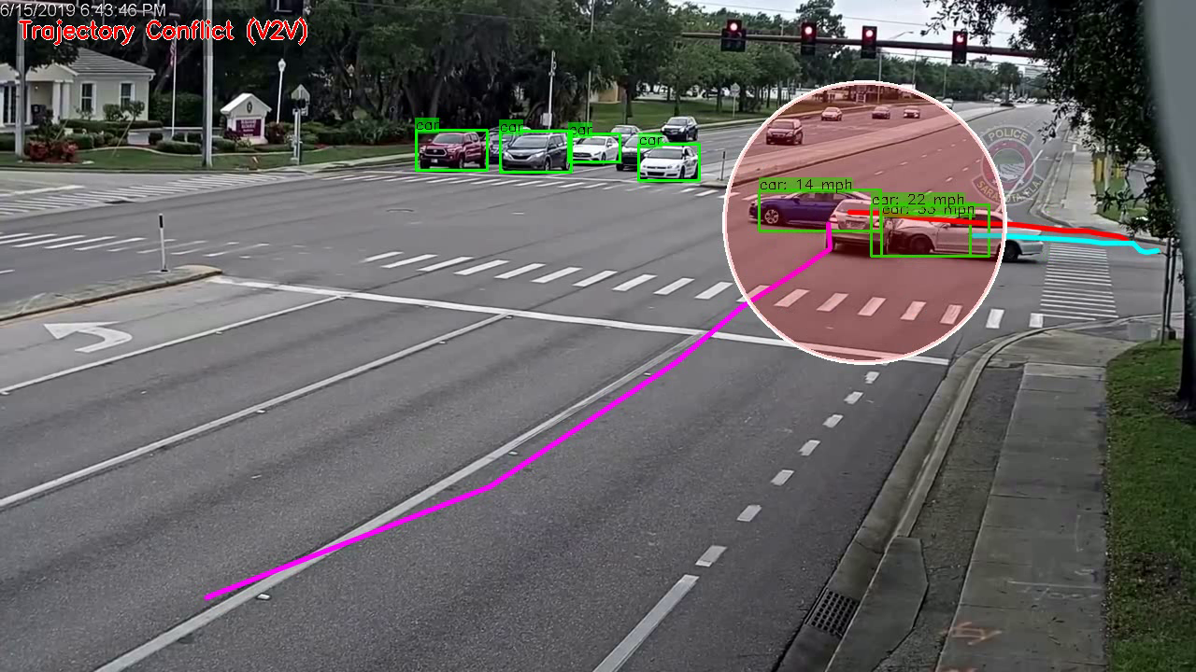


CONNECTED SAFETY:
REAL-TIME COLLISION DETECTION & NEXT GENERATION 9-1-1 TO ADVANCE POST-CRASH CARE
Real-Time Accident Detection in Traffic Surveillance Using Deep Learning https://ar5iv.labs.arxiv.org/html/2208.06461

Slide 2
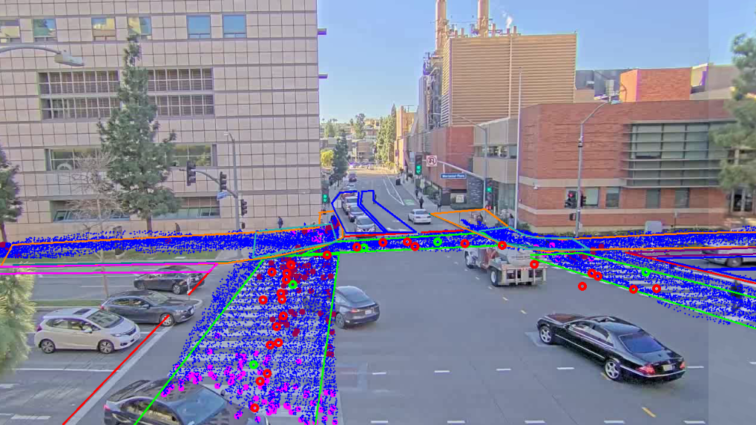

SENSAVISION
COMPUTER VISION AI DATA AND ANALYTICS PLATFORM
Proprietary and Confidential Information @ 2024 Sensagrate, INC. All rights reserved.

Slide 3
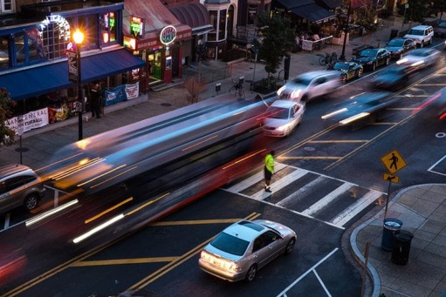

Moving Closer to Vision Zero Safety through Smart Transportation
A SHARED GOAL VISION ZERO
Help drivers, pedestrians, cyclists, and e-scooters use the road together in a safe manner while reducing congestion and travel times.
2
Proprietary and Confidential Information @ 2022 Sensagrate, INC. All rights reserved.

Slide 4
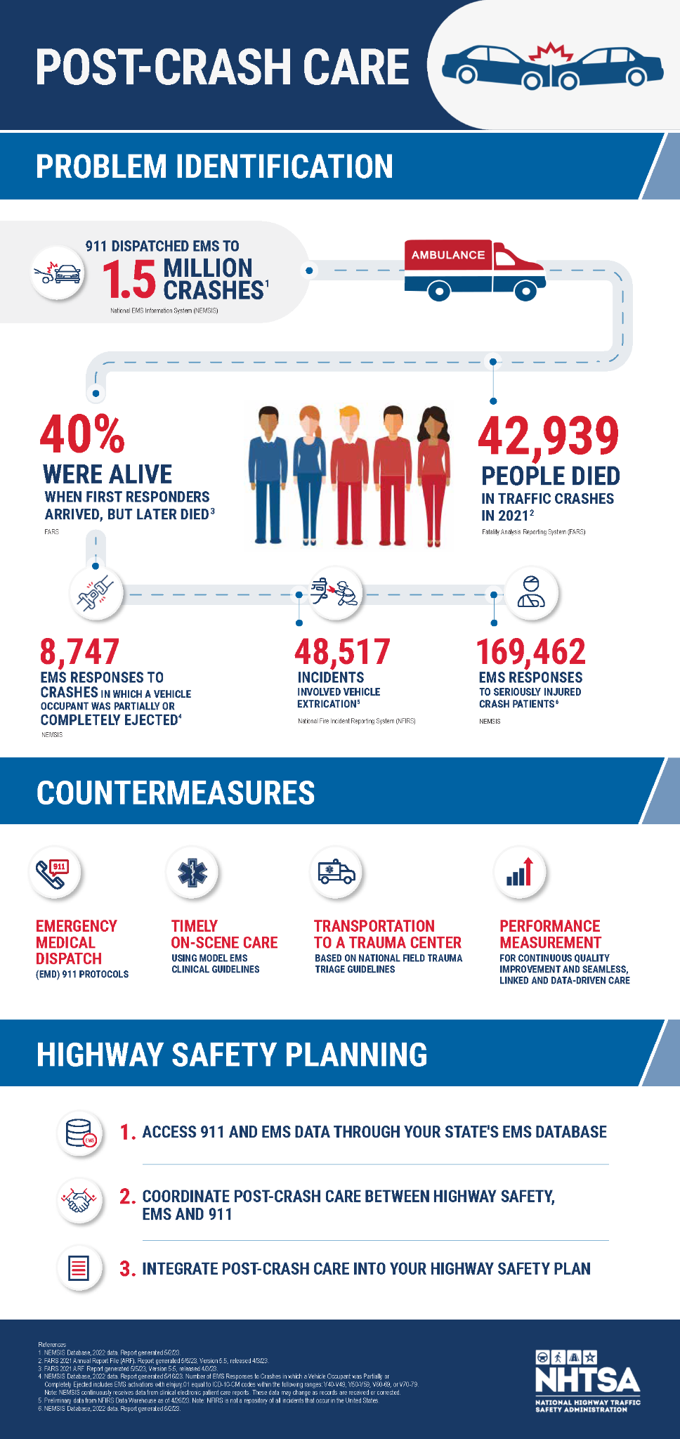
A LACK OF ACCURATE DATA
THE PROBLEM: DAILY FATALITIES
https://www.transportation.gov/NRSS/PostCrashCare

Slide 5
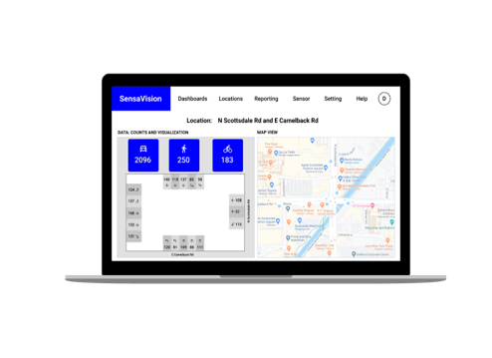
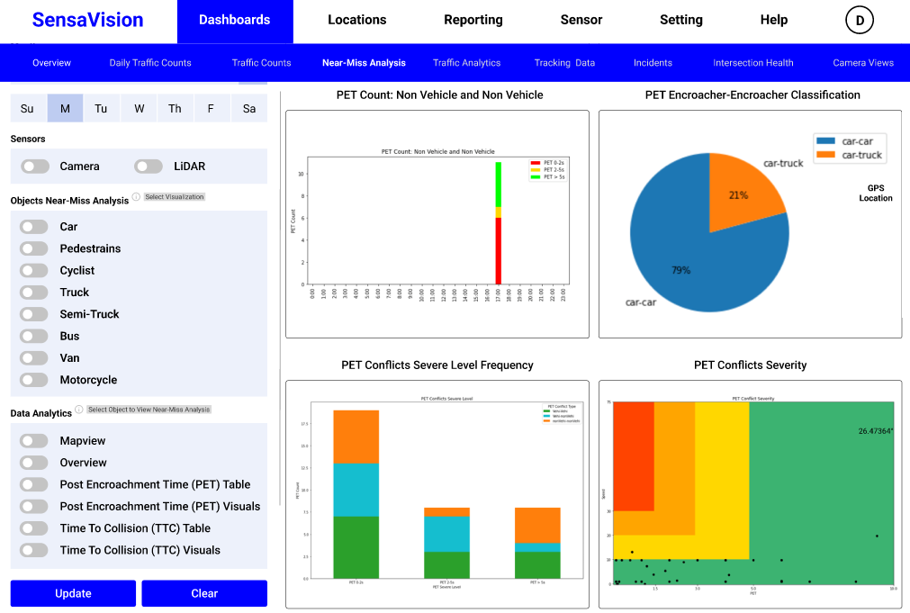
THE SOLUTION
“Proactively Advancing Safer and Smarter Roads.”
SensaVision is a state-of-the-art computer vision AI data and analytics platform developed to improve transportation and urban planning to save lives.
SOLUTION
Proprietary and Confidential Information @ 2024 Sensagrate, INC. All rights reserved.

Slide 6
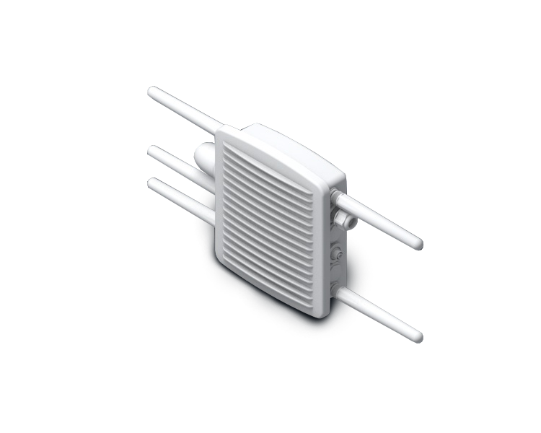
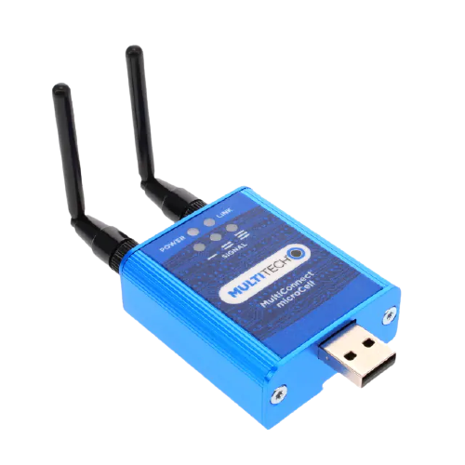
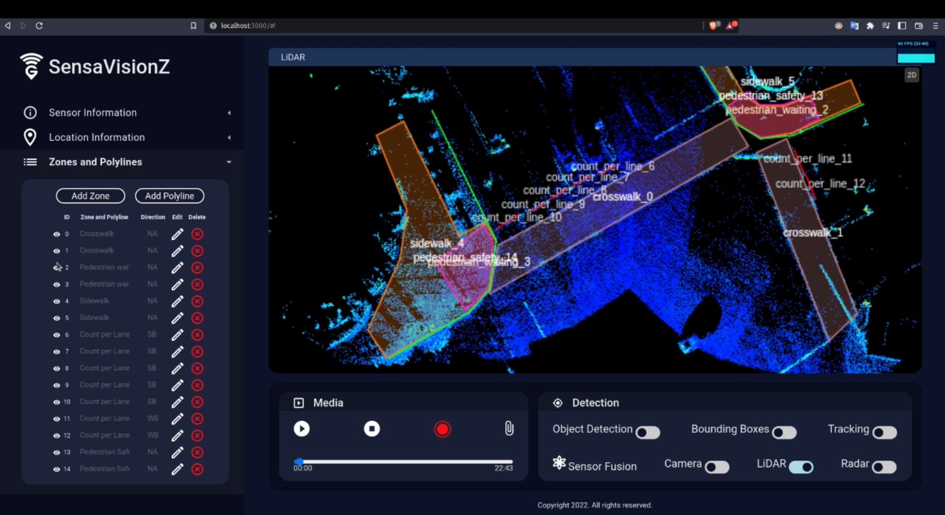
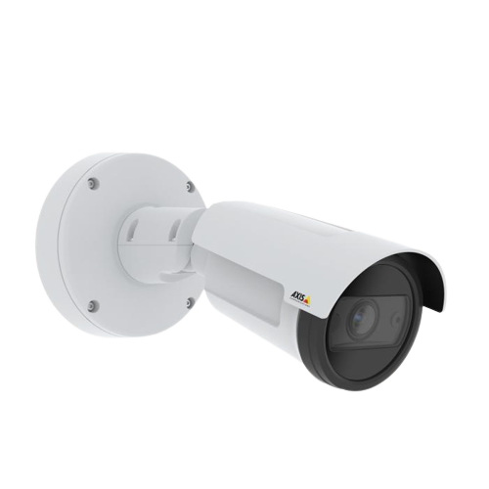
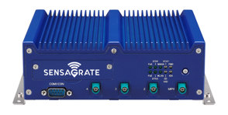
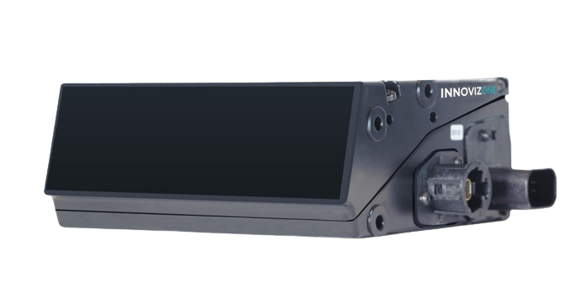
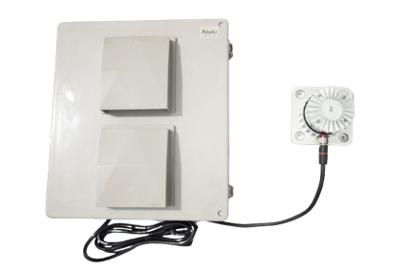
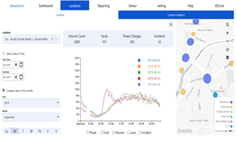
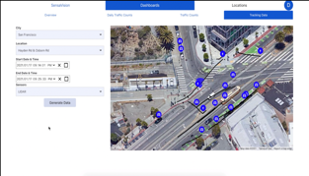
A LOOK AT
SENSAVISION
Out-of-the-Box Solution
SensaVision Computer Vision Software
SensaVision Web App with Predictive Analytics
Roadside Unit for V2X and I2X communications
GIS Location Data
API Integration
Installation and Technical Support
SENSAVISION
Proprietary and Confidential Information @ 2022 Sensagrate, INC. All rights reserved.

Slide 7
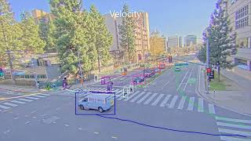
CASE STUDY
SAFER AND SMARTER INTERSECTIONS
SensaVision Use Cases
Vulnerable Road Users Detection and Tracking Near-Miss Collision and Speed Analysis Infrastructure-to-Vehicle Communication Real-time Collision Detection Automated Crash Detection with Instantaneous IP-Based Notification to Next Generation 9-1-1 Emergency Vehicle Traffic Signal Preemption and Transit Priority
THE BUSINESS MODEL
Proprietary and Confidential Information @ 2024 Sensagrate, INC. All rights reserved.

Slide 8
Intelligent Crash Data Network
ROADMEDIC
Intelligent Crash Data Network
Digital emergency data network enables faster, more effective Next-Generation 9-1-1 Dispatch of post-crash care creating safe streets and roads for all.

Slide 9
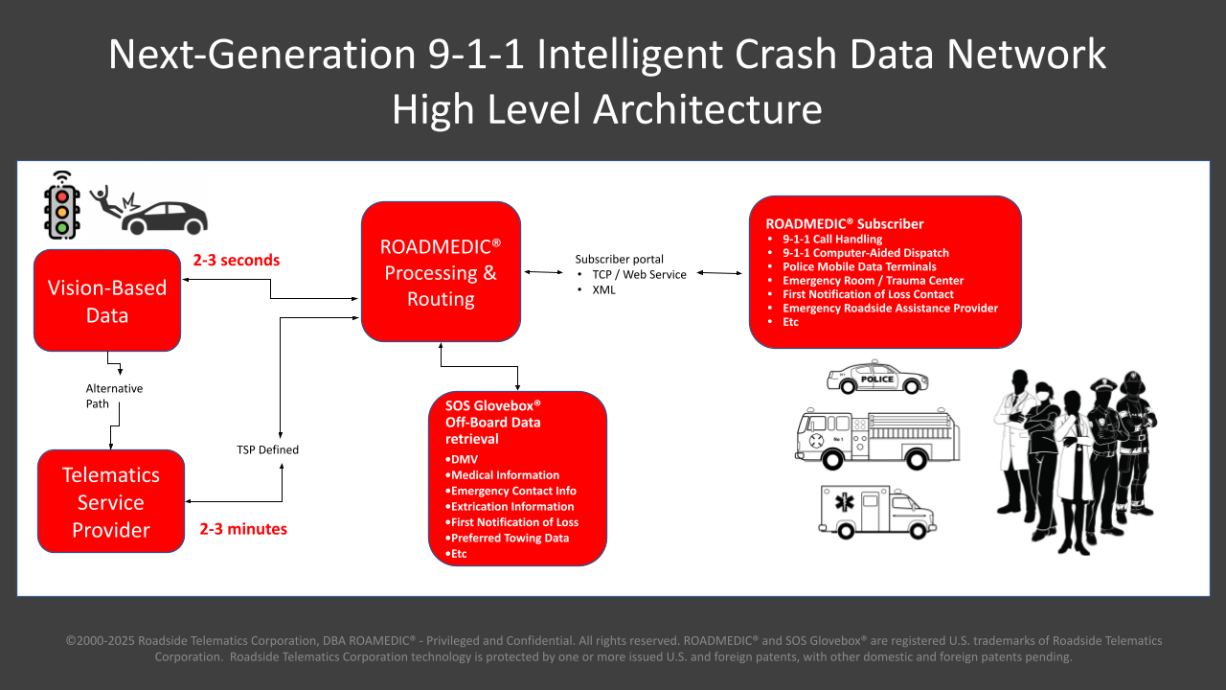
ROADMEDIC
Intelligent Crash Data Network
ROADMEDIC

Slide 10
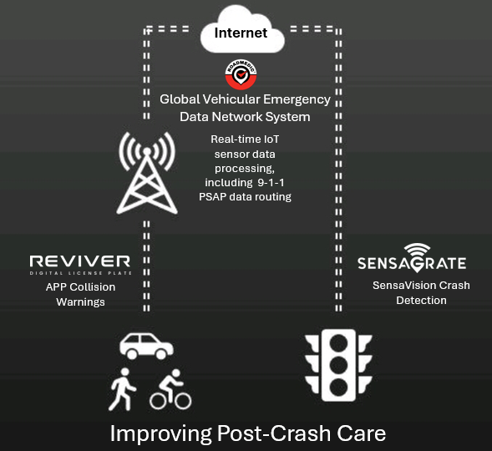
9-1-1 DISPATCHER VISIBILITY DEMONSTRATION PROJECT
Post-Crash Care
Collision Detection and Safety Analysis
Signal Preemption
Post-Crash Care
Collision Alerts
DEMONSTRATION PROJECT

Slide 11
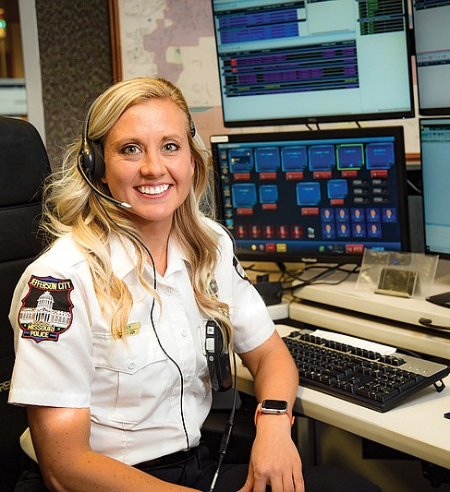
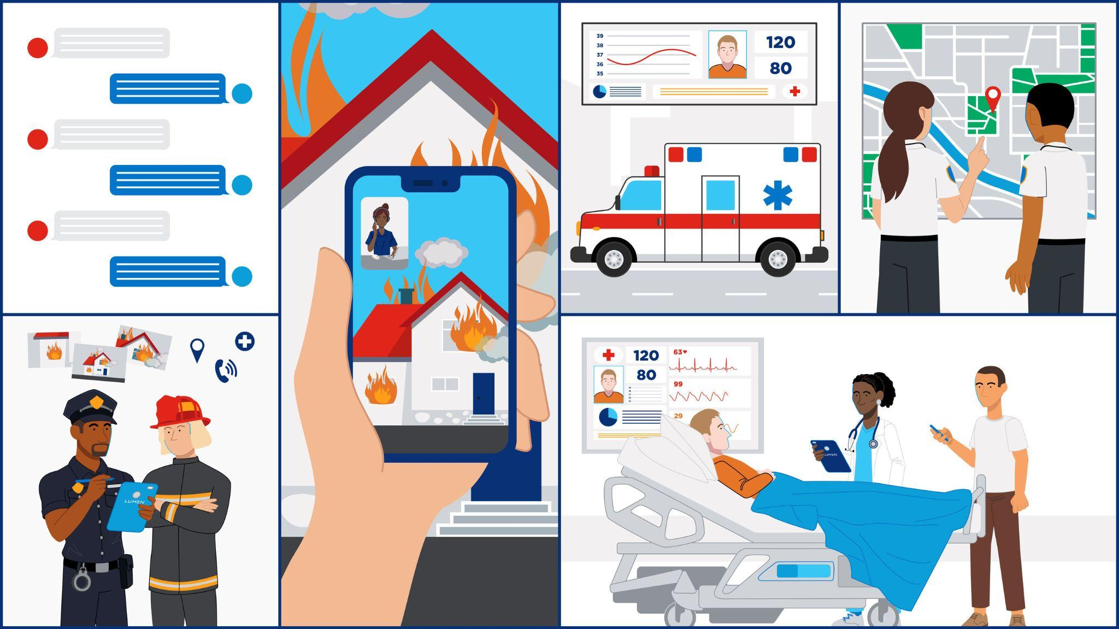
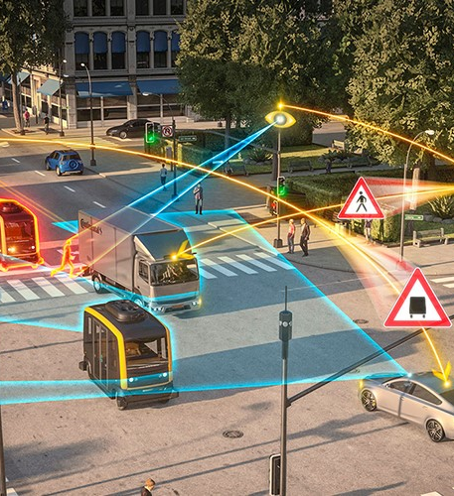
THE BENEFITS
Seconds Matter
Vision Based Data
Next Generation 9-1-1
Collision Prevention
THE BENEFITS

Slide 12
COLLISION DETECTION AND SAFETY ANALYSIS
Real-Time Collision Detection
Collision Detection and Safety Analysis

Slide 13
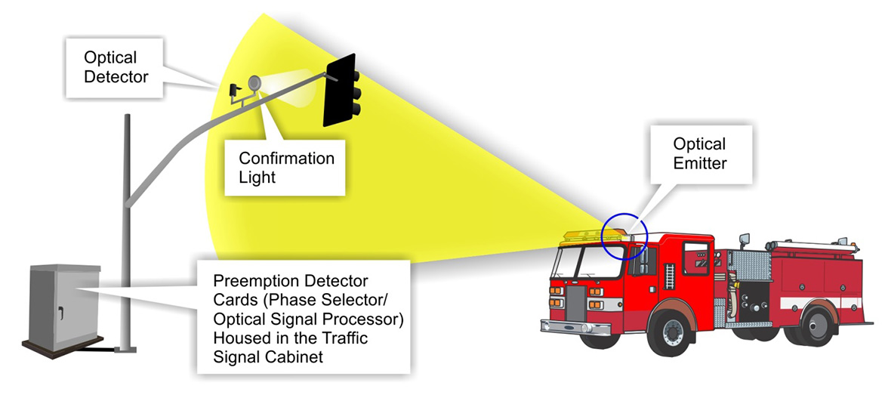
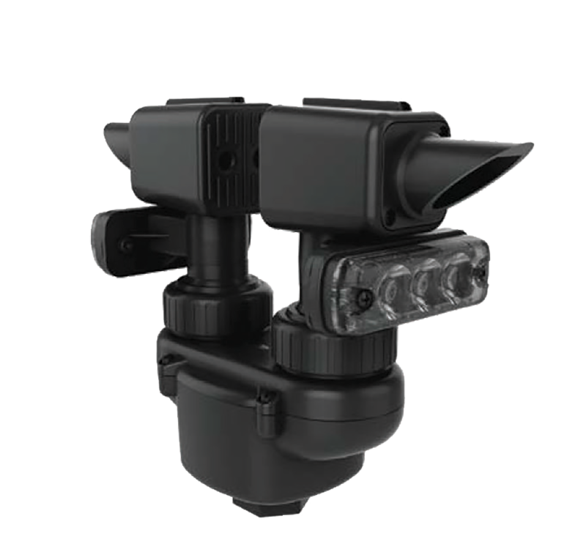
SIGNAL PREEMPTION - CURRENT
Seconds Matter
SIGNAL PREEMPTION

Slide 14
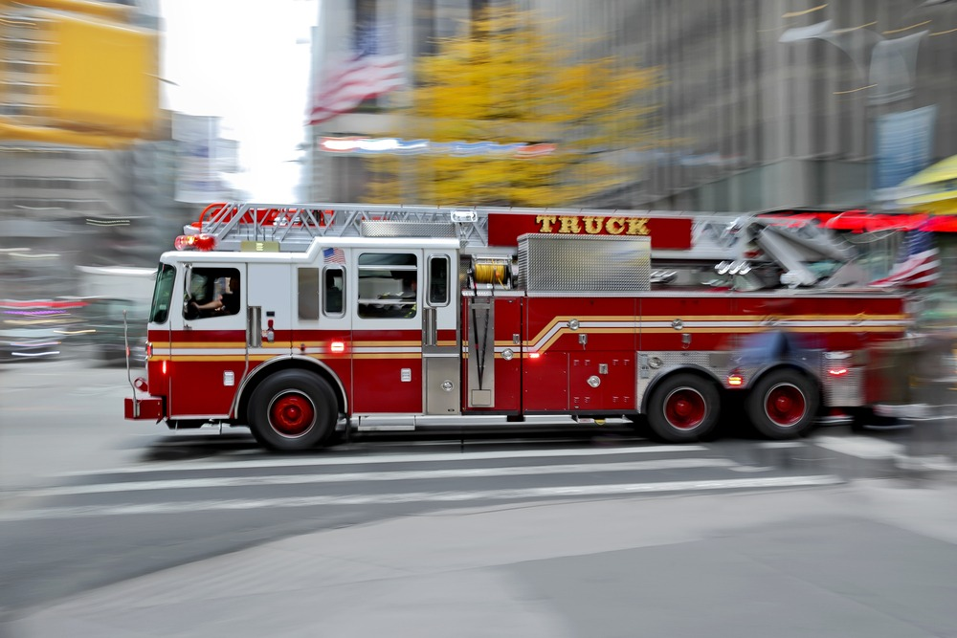
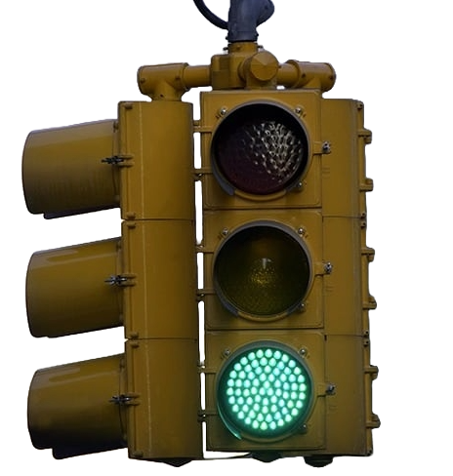
SIGNAL PREEMPTION
Seconds Matter
SIGNAL PREEMPTION

Slide 15
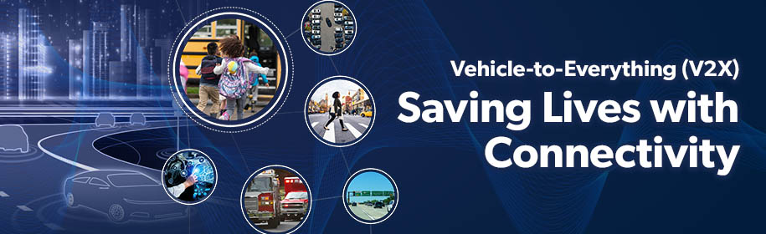
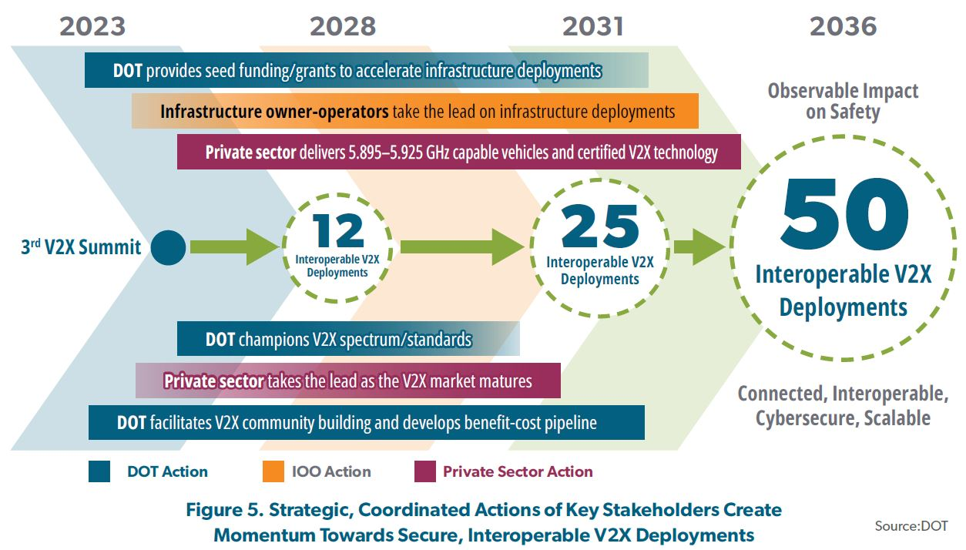
USDOT: V2X PLAN
Seconds Matter
SIGNAL PREEMPTION

Slide 16
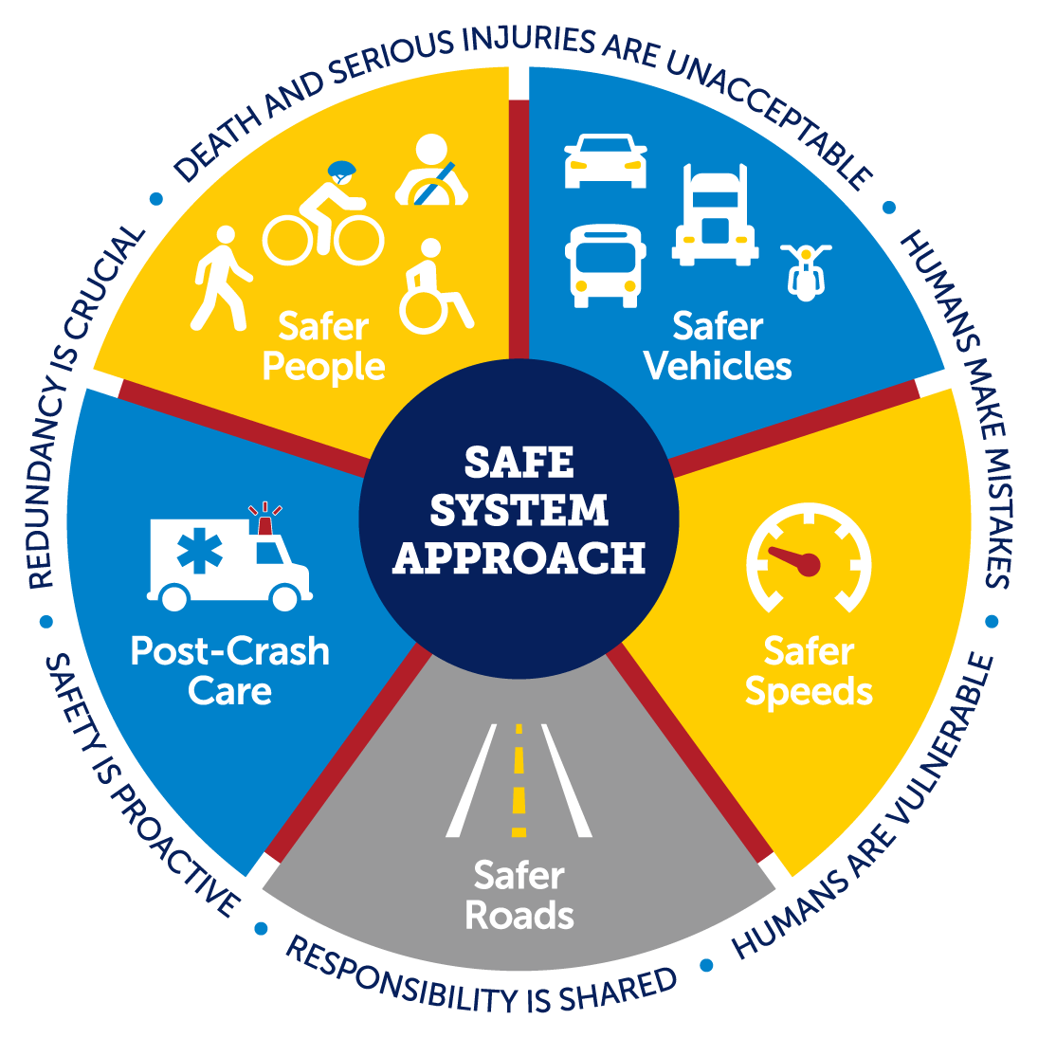
POST-CRASH CARE
What is Post-Crash Care
First Response & Medical Care
Rescue Operations
Transportation to Trauma Centers
Hospital Treatment
Rehabilitation and Long-Term Care
Legal and Insurance Support
Psychological Support
POST-CRASH CARE
Notes:
https://www.nsc.org/road/post-crash-care
Post-crash care refers to the critical medical and logistical support provided to individuals following a vehicle crash. This care aims to minimize fatalities and long-term injuries through timely intervention, which includes:
First Response & Medical Care:
Emergency medical services (EMS) respond as soon as possible to assess injuries, provide on-site care (such as stopping bleeding, stabilizing fractures, etc.), and transport victims to hospitals.
Rescue Operations:
In severe crashes where individuals are trapped, rescue teams (firefighters, paramedics) work to extract victims from wreckage using specialized equipment like the Jaws of Life.
Transportation to Trauma Centers:
Victims of serious crashes should be transported to Level I or II trauma centers where specialized care for traumatic injuries is available.
Hospital Treatment:
Once in the hospital, trauma teams continue care, which may involve surgery, intensive care, and rehabilitation.
Rehabilitation and Long-Term Care:
Depending on the severity of injuries, individuals may require ongoing physical therapy, mental health support, and sometimes long-term rehabilitation to recover.
Legal and Insurance Support:
Post-crash care often involves dealing with legal procedures and insurance claims. Victims may need assistance from lawyers or advocates to ensure proper compensation and coverage of medical expenses.
Psychological Support:
Crashes can have significant emotional and psychological effects on victims, and post-crash care should include mental health support like therapy or counseling.

Slide 17
POST-CRASH CARE
Countermeasures
POST-CRASH CARE

Slide 18
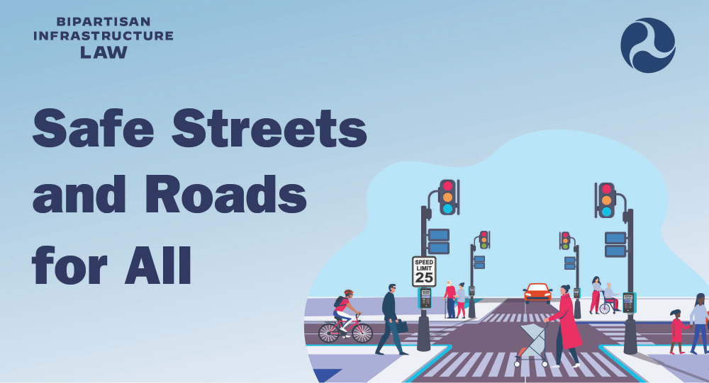
USDOT GRANTS
FUNDING
USDOT Funding
Notes:
Script Slide 8 Grants
Opportunities for funding include USDOTs Safe Streets and Roads for All. We’re looking to partner with cities for demonstration grants.

Slide 19

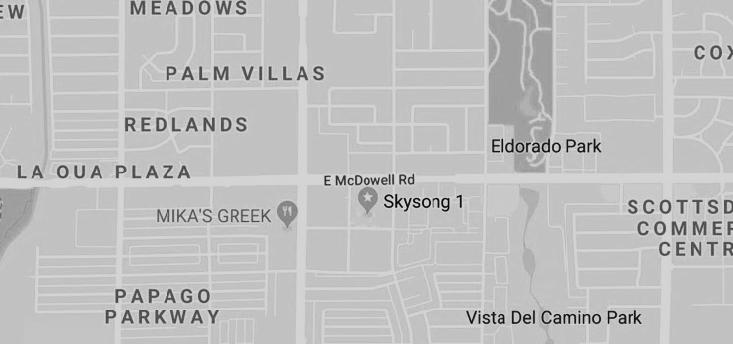
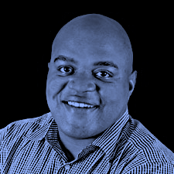


THE FUTURE OF
SMARTER AND SAFER ROADS
Darryl Keeton, Founder and President
+1 480.240.2184
dkeeton@sensagrate.com
www.sensagrate.com
facebook.com/sensagrate
linkedin.com/company/sensagrate
Scottsdale, AZ 85257
Proprietary and Confidential Information @ 2024 Sensagrate, INC. All rights reserved.

