Slide 1
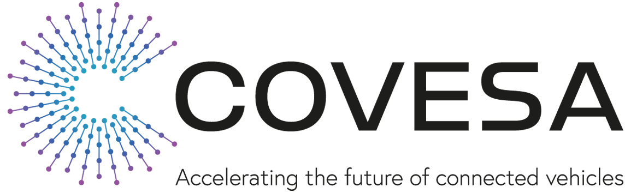
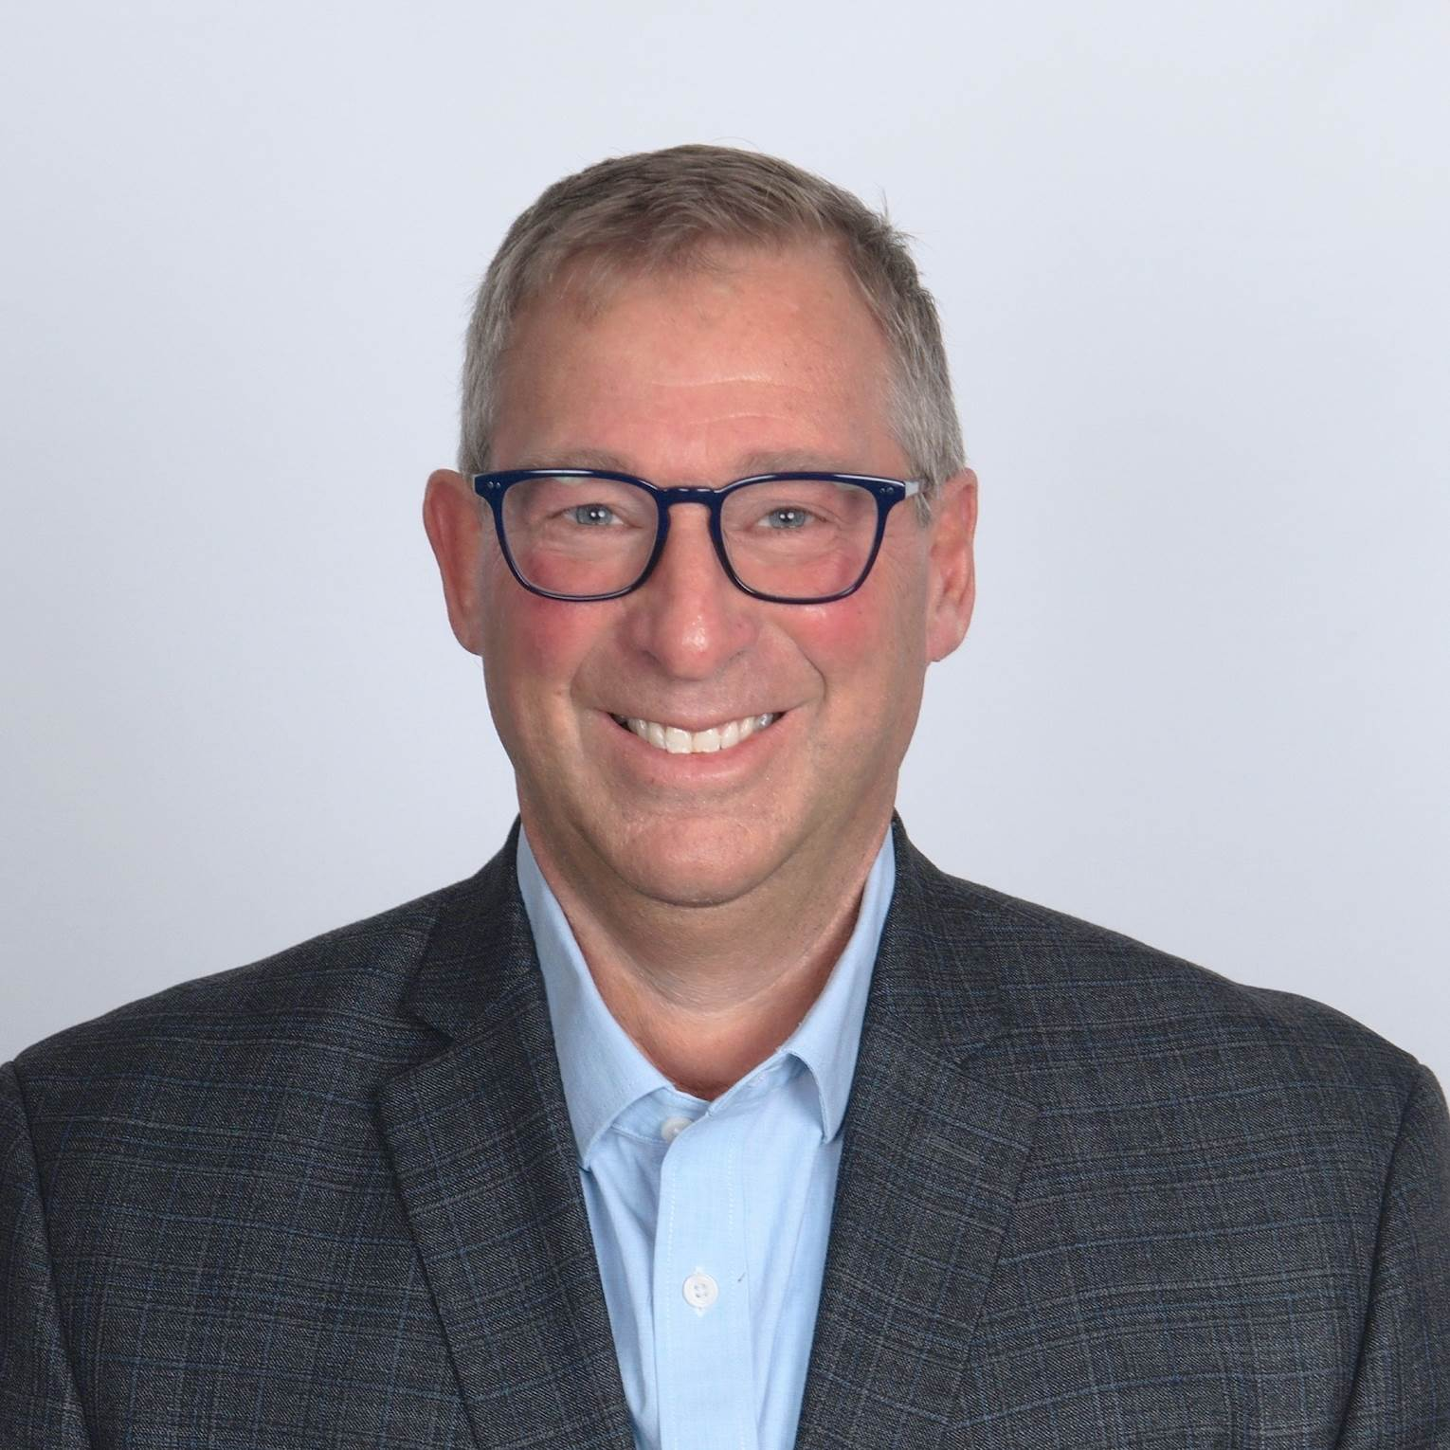

Connected Safety Birds of a Feather Working Group
All Members Meeting
September 25, 2024
Hosted by:
Tim VanGoethem
Chief Product Officer
Emergency Safety Solutions
Larry Williams
Co-founder
LiDAR Saving Lives Public Safety Coalition
Page 1

Slide 2
COVESA Connected Safety BoF catalyzing change
Connected Safety BoaF Goal & Strategies
Connected Safety BoaF Result
Bring together public safety, automotive, commercial transportation, and government to make our roadways safer for everyone:
Define comprehensive stakeholder-based safety-related scenarios and value propositions
Collaborate with COVESA members and others safety-related organizations to develop safety expertise and community within COVESA
Develop integrated safety system prototypes and references implementations
Publish white papers on key findings, best practices, and implementation recommendations
Accelerate delivery of connected technologies to benefit everyone that shares, protects, and maintains our roadways. Examples:
Protect and give aid to vulnerable vehicles and occupants stranded along roadways
Reduce response time and secondary collision risk for motorists involved in a crash
Provide 911 Public Safety organizations with critical information so that they dispatch the right personnel and equipment to the scene
Mitigate liability and lost productivity for commercial vehicles involved in roadway crashes

Slide 3
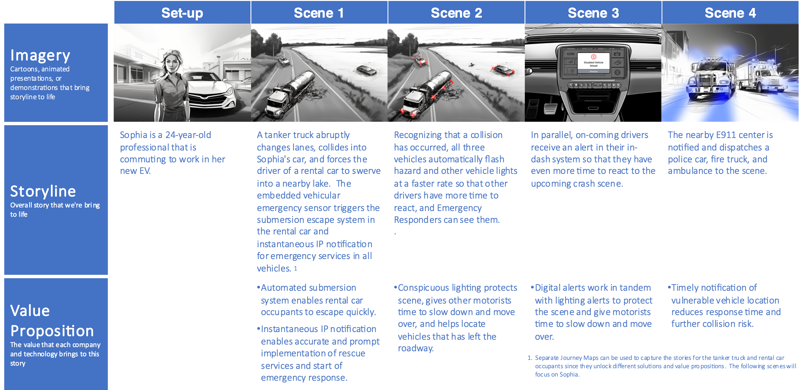
Connected Safety Journey Map (1 of 2)

Slide 4
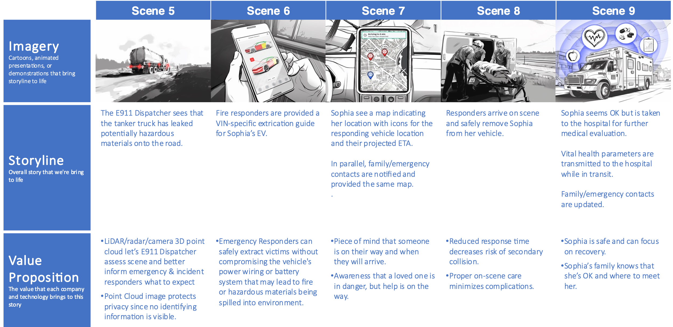
Connected Safety Journey Map (1 of 2)

Slide 5
Proposed Projects
Extend Vehicle Signal Specification (VSS) and publish a common data interface for sensor-based data as key components of an end-to-end reference solution
Protect the Scene
9-1-1 Dispatcher Visibility
Build prototype system to showcase the following:
Simulate having on-board sensors determine root cause of crash (e.g., submersion, collision, tire blow-out, etc.)
Leverage conspicuous lighting to warn on-coming motorists of disabled vehicles
Develop instantaneous IP connection to post-crash care Cloud ecosystem augmenting 9-1-1 voice call using extended VSS payload to exchange critical data
  TSP use data to decrease 9-1-1 response time
  Post-crash care Cloud ecosystem uses data to create in-app / in-dash warnings to approaching motorists
Build prototype system to showcase the following:
Simulate having on-board sensors determine root cause of crash (e.g., submersion, collision, etc.)
Send vision-based sensor data (e.g., LiDAR, radar, camera) via instantaneous IP connection to post-crash care Cloud ecosystem using extended VSS payload/control
Route vision-based data and controls to Next-Generation 9-1-1 call handling and computer-aided dispatch systems
9-1-1 Dispatcher uses vision-based data to accurately identify, verify and deploy the appropriate equipment and personnel

Slide 6

Next steps
Advancing 9-1-1 Dispatcher Visibility for Post-Crash Care
Cornerstone 6
4:30 – 5:10 PM
You’re Cordially Invited

