Slide 1
Introduction to the COVESA Central Data Service Playground
Why/What/How, what has been done and where we are going
Stephen Lawrence, Renesas Electronics,
COVESA Data Architecture and Infrastructure group Lead

Slide 2
Agenda
Introduction to Why/What/How?
Recent work and where we are going

Slide 3
Why?

Slide 4
Why? Problem to be solved
COVESA Data Architecture team has been discussing problems such as the following:
“Key questions for an End-to-End Data Architecture:
How data can be shared between all touchpoints?
How different domains of data share same tech stack?
How should a bidirectional sync work?
Who is responsible for conflict management?
Who takes care about permissions, roles, rights and privacy?
How the data model can be updated and synced?
How subscriptions can be handled?
How to handle historized and time series data …
…on different touchpoints?
How to handle multiple sync endpoints?
How to handle unidirectional data streams?
How (new) knowledge …
… can be shared with others?”
Source: “Building Bridges with a common Data Middleware”, OEM, COVESA Autumn 2023 AMM
But how to tackle such problems in open, collaborative way, whilst maintaining flexibility in system architecture, technology selection and implementation?
Also to publish openly the results
Notes:
Tackle problems:
in open, collaborative way,
allowing flexibility in architecture and technology selection
Openly publish the results
Illustrate with OEM Research paper example. People can trial what is being described.

Slide 5
Why?
Conceived by the COVESA Data Architecture team to meet their needs in addressing these problems.
We also recognized similar needs in the wider community inside and outside COVESA.
  For example, for COVESA to demonstrate how VSS data can be used with its eco-system for newcomers.
COVESA is a grass roots OSS automotive alliance. Community collaboration is supported through using both logical and implementation concepts.
  Logical concept can be proved in implementation.
  Yet allows for other possible implementations of the logical concept.
Notes:
Conceived for needs of Data Arch team but recognized this was also something useful for the wider community
Favor loose coupling of components
Playground shall provide a toolset that can be combined in various ways for the use
Logical concepts (flexibility), proven in implementation

Slide 6
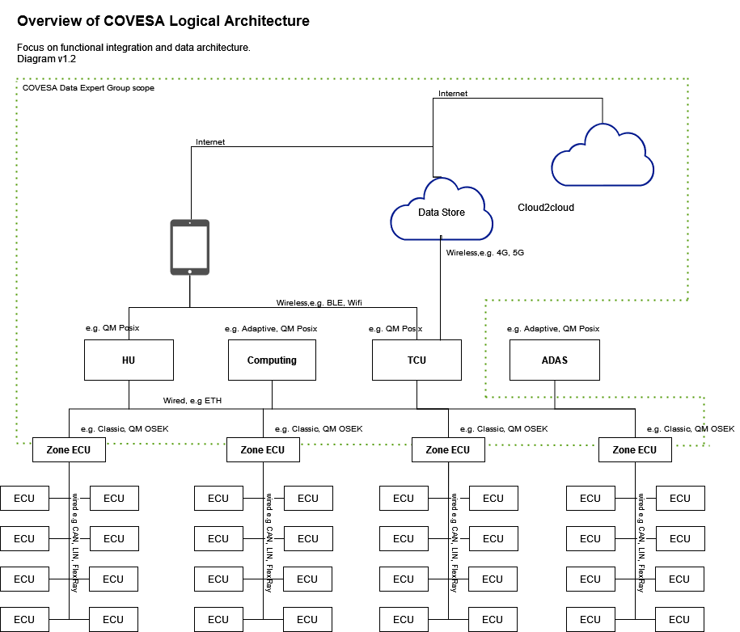
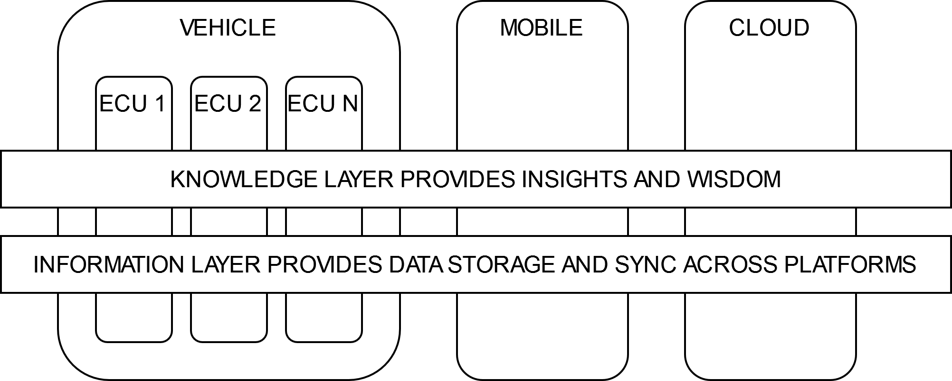
Why Central Data Service?
VSS is a mechanism of abstraction.
The COVESA logical architecture focuses on ‘big ECUs’. Hence Central.
A repeating pattern is the combination of VSS Data Server and VSS Data Store with advanced features supporting an information and knowledge layer. Hence Data Service.

Slide 7
Why Playground? Why not PoC or something else?
A PoC is often a snapshot in time and often specific in scope. Playground suggests greater flexibility
The central service, the Lego building block, is intended to be flexible and evolving. Similarly, with what it is combined with to illustrate COVESA concepts and technology.
The Playground could certainly be used to implement a PoC.
The Playground is the means to investigate open questions in next-gen data-centric architectures and illustrate the results in an open community.

Slide 8
What?

Slide 9
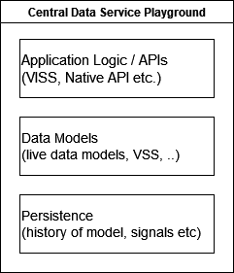
What? Requirements
At its core, the service has requirements in three key areas:
Data Models: the live data models - VSS as the abstracted view of the vehicle, along with other adjacent data models such as personal data.
Persistence: history of the model and signals etc - historical and cached timeseries data.
Application logic / APIs: standardized APIs for accessing the data such as the Vehicle Information Service Specification (VISS), GraphQL or Native APIs.
Additional requirements: It is recognized that additional features are absolutely desirable and have been a part of discussions in the Data Architecture team, e.g.:
Synchronization
Data processing
Favor loose coupling of components
Provide a toolset that can be combined in various ways to meet the requirements of the use-case.
Notes:
Favor loose coupling of components
Playground shall provide a toolset that can be combined in various ways for the use

Slide 10
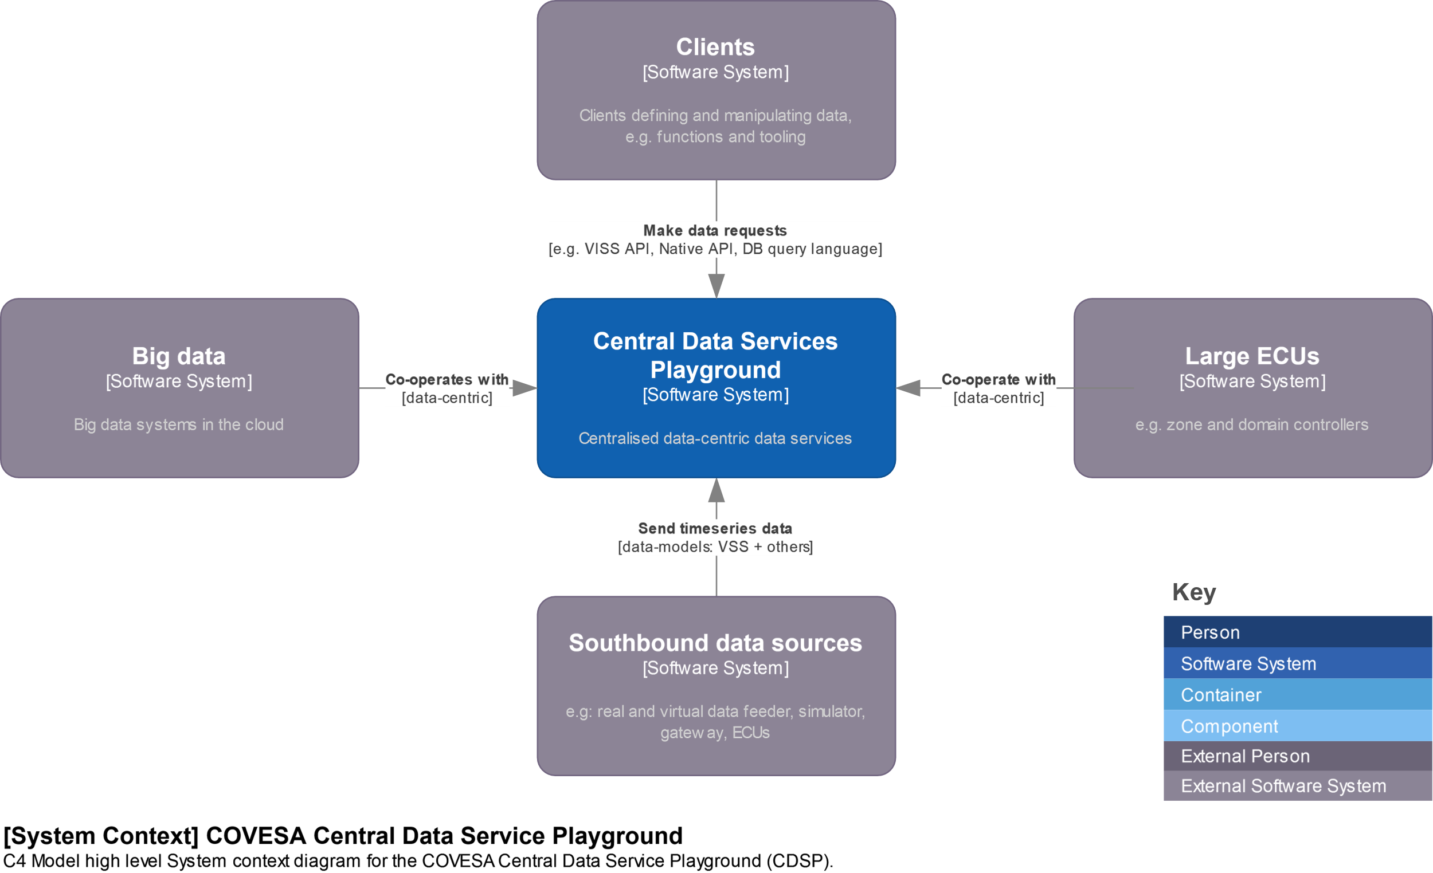
What? High level System context diagram
Notes:
Description of C4 Model for s/w architecture visualisation can be found here https://c4model.com/

Slide 11
How?

Slide 12
How? Major building blocks
The playground has been realized as a ‘project of projects’ to create the basic building block data service.
Combining a VISS API Data Server with highly functional VSS Data Stores.
VISS API Data Server:
  Provides northbound get/set/sub application logic using the VISS API developed with W3C.
  Along with the secondary benefit of any additional features provided by the server.
VSS Data Store:
  ‘Highly functional’ in the context of the VSS Data Store means the flexible means to store, query, process and analysis timeseries data.
  An archetype would be a database server that can operate in-vehicle and the cloud.
  Such a component provides the possibility of using a variety of different architecture patterns, such as both client-server and event-driven, or data processing approaches.
These provide the toolbox of functions from which you build your use-case.

Slide 13
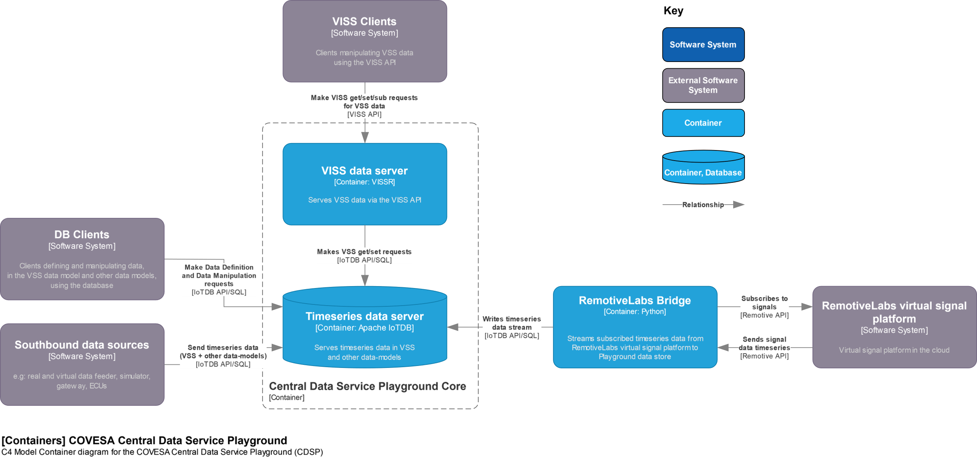
How? Container diagram (level 2 abstraction)

Slide 14
VISSv2 specification overview
From VISSR project
The Vehicle Information Service Specification development was started at W3C
  https://github.com/w3c/automotive
Where it was discontinued and in March 2024 migrated to
  https://github.com/COVESA/vehicle-information-service-specification
VISSv2 features
  Supported transport protocols: HTTP / Websocket / MQTT
  Methods: Get / Set / Subscribe (Unsubscribe)
  Subscription filters: Timebased / Change / Range / Paths / Curve logging / History
  Access control: Token based, OAuth2 inspired, RBAC support, single node granularity
  Consent support: Obtaining consent delegated to an External Consent Framework, acts as firewall

Slide 15
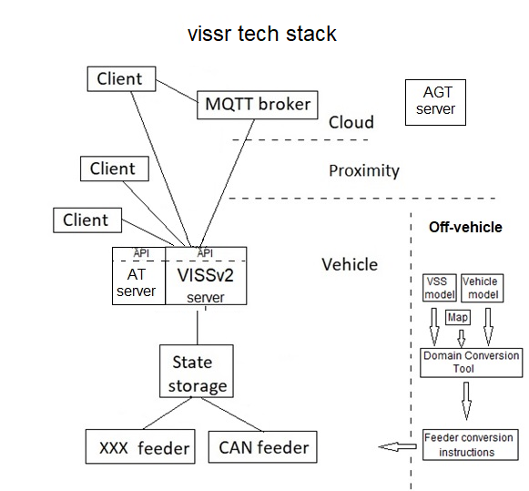
VISSv2 reference implementation overview
From VISSR project
The VISS reference implementation (vissr) is after migration found at
  https://github.com/COVESA/vissr
vissr features
  Complete VISSv2 feature support, plus
  gRPC
  SwCs to realize a complete tech stack:
    Data store: SQLite / Redis / IoTDB / ..
    Feeder: Template where only the vehicle interface client needs implementation / RL-feeder / EVIC-feeder / …
    Client: JS based: AGT, AT, HTTP, WS, integrated access control,.. / Go-based: MQTT, curve log to CSV file, …
    Domain Mapping Tool: creates feeder conversion instructions from YAML input

Slide 16
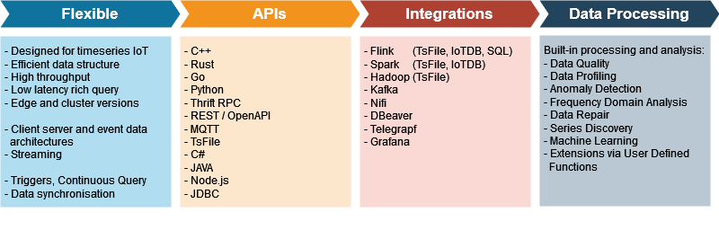
Apache IoTDB
Built for IoT timeseries. “Edge server” and cluster versions available
Not picking winners. Point is to drive towards and illustrate solutions.
API, SQL and big data integrations give a degree of portability to other technology choices.
Some of the features that make it attractive:

Slide 17
How? Docker Deployment
Easy to develop: make it easy to build, modify and trial by providing a containerized instance running on a host using Docker containers.
Docker containers are chosen to facilitate the rapid integration and/or swapping of technology options.
  Be it internals of the playground itself, or connection to other components.
  For example, users can easily integrate the playground into their own docker compose containing other components.
The Playground provides a reference Docker Compose definition for a single CDSP instance. This instance can be duplicated to represent different systems, e.g. Central ECUs, Mobile or Cloud.
Notes:
Closer to production: the same base code should be deployable to systems closer to production, including on automotive hardware (or its simulation), e.g. Yocto, container orchestration, Service-orientated architecture (SOA) etc.

Slide 18
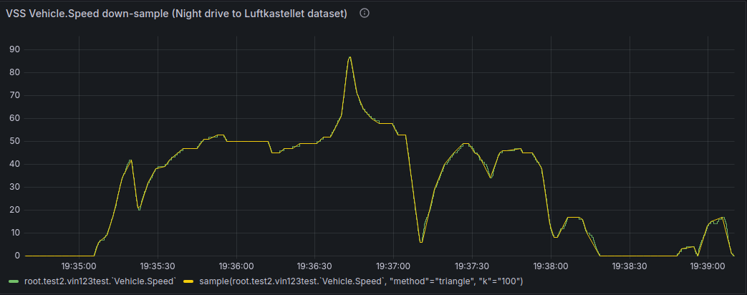
VSS vehicle.speed timeseries down-sample example
Example illustrates ETL/ELT (Extract, Transform, Load) style operation using the Apache IoTDB VSS data store.
Real drive dataset with just over 13500 values recorded over approximately 5 minutes at 20ms interval.
Sample algorithm in IoTDB used to intelligently down-sample the data to 100 values.
  SELECT SAMPLE() FROM <ts1> or SELECT SAMPLE() INTO <ts2> FROM <ts1>
Could be used in-vehicle to down-sample days journey before offboarding.
Notes:
Example scenario: journey analysis
Processing could follow the following steps:
A vehicle could generate a day's worth of high frequency GPS location data which is stored in a database as the timeseries day-journey.
At the end of each day the day-journey timeseries could be down-sampled and stored in a new timeseries day-journey-upload. The down-sampling performed by an intelligent algorithm that retains important information whilst greatly reducing the number of data points.
The day-journey-upload timeseries can then be used as input to the vehicle's car2cloud subsystem to upload to the cloud for further ETL/ELT processing, e.g. identification of regular routes for use in an assistant.
In-vehicle processing like this can save in-vehicle network bandwidth, whilst also significantly reducing data transmission costs in the upload.
Additionally, with the focus on a data centric architecture the same data models and processes can be used both in-vehicle and the cloud.

Slide 19
Community status, timeline and roadmap
Recent work and where we are going

Slide 20
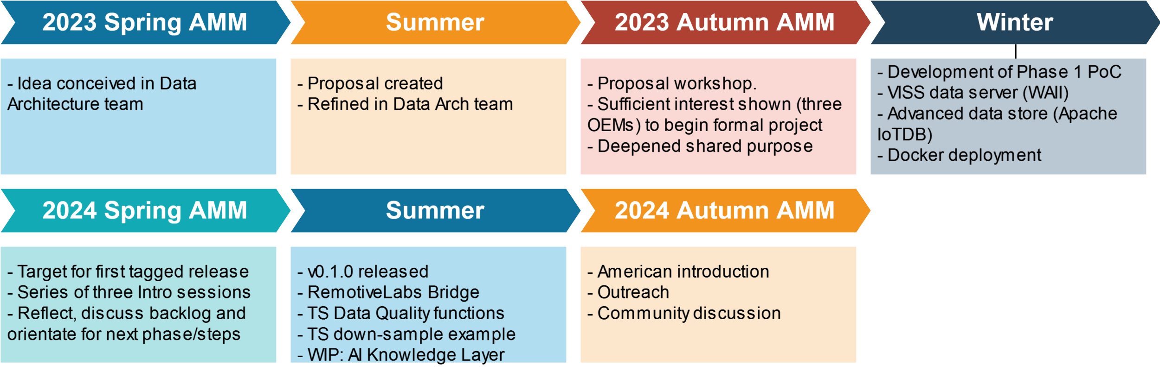
Community status and timeline
Community project originating in the COVESA Data Architecture team
Diverse group of contributors
  E.g. Major code contributors in this founding phase have been Renesas Electronics, BMW and Ford
Resources:
  Source (Github)
  Documentation site
  Project management (Github Kanban)
  Project page in COVESA Confluence wiki
  COVESA Slack channel #data-architecture-pillar
Notes:
Timeline:
2023 Spring/Summer: Idea and proposal creation
2023 Autumn AMM: Workshop and decision to go ahead:
2023/24 Winter/Spring: Creation of first release
2024 Summer: various new features

Slide 21
Changes since Spring AMM
Published RemotiveLabs Bridge which subscribes to signals from RemotiveLabs virtual cloud platform and writes the received data to the Playground IoTDB data store.
Released CDSP v0.1.0.
Significantly expanded the built-in timeseries processing capabilities
  New functions in the areas of Data Quality, Data Profiling, Anomaly Detection, Frequency Domain Analysis, Data Repair and Series Discovery.
Enabled using Grafana to manipulate timeseries data in the IoTDB data store.
Published a timeseries processing example that intelligently down-samples high frequency VSS data.
Significant work on implementing the Knowledge Layer proposal using Semantic Reasoning
Welcomed a new maintainer Christian Muehlbauer from BMW who is an active contributor.
Notes:
Since Spring AMM
CDSP v0.1.0 release
RL feeder
Data Quality / Grafana + examples
KL Connector WIP
Second maintainer added

Slide 22
Roadmap big picture
Complete Knowledge Layer initial development
VISSR, IoTDB version update
General:
  Outreach
  Data sets
  Use-cases / Examples / patterns / etc.
  Improving guides
  Expanding Feeders
Notes:
AOSP gateway API for VSS signals
Roadmap – next 3 months or so
Data Quality Library extensions
KL Connector
Examples / patterns / etc.
Data sets
Outreach
Improving guides
VISSR, IoTDB version update
Expanding Feeders

Slide 23
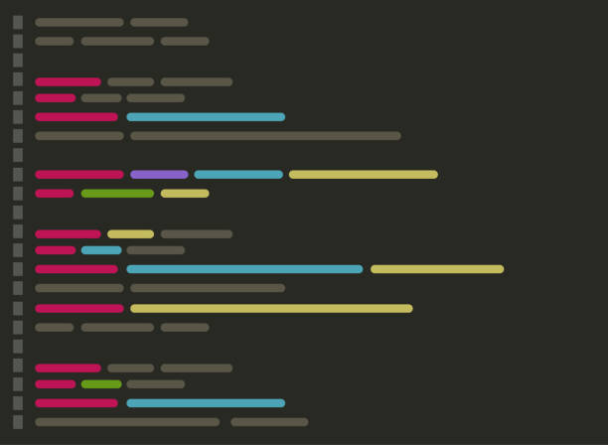

Why Knowledge layer
Data, Information, Knowledge and Wisdom (DIKW)
  A conceptual framework to utilize the data
Information layer is known, now Knowledge layer
  Offers flexibility of data interoperbility
  Reduces ambiguity and uncertainty
  Provides explainability and transparency
Wisdom
Knowledge
Information
Data
Meaning
B:- A
Select
Ontology
Rules
Queries
Value
Notes:
In the last few years, the group has focused on making the information layer ready for use, now we explore how the knowledge layer help to integrate information and extract meaningful insights.

Slide 24

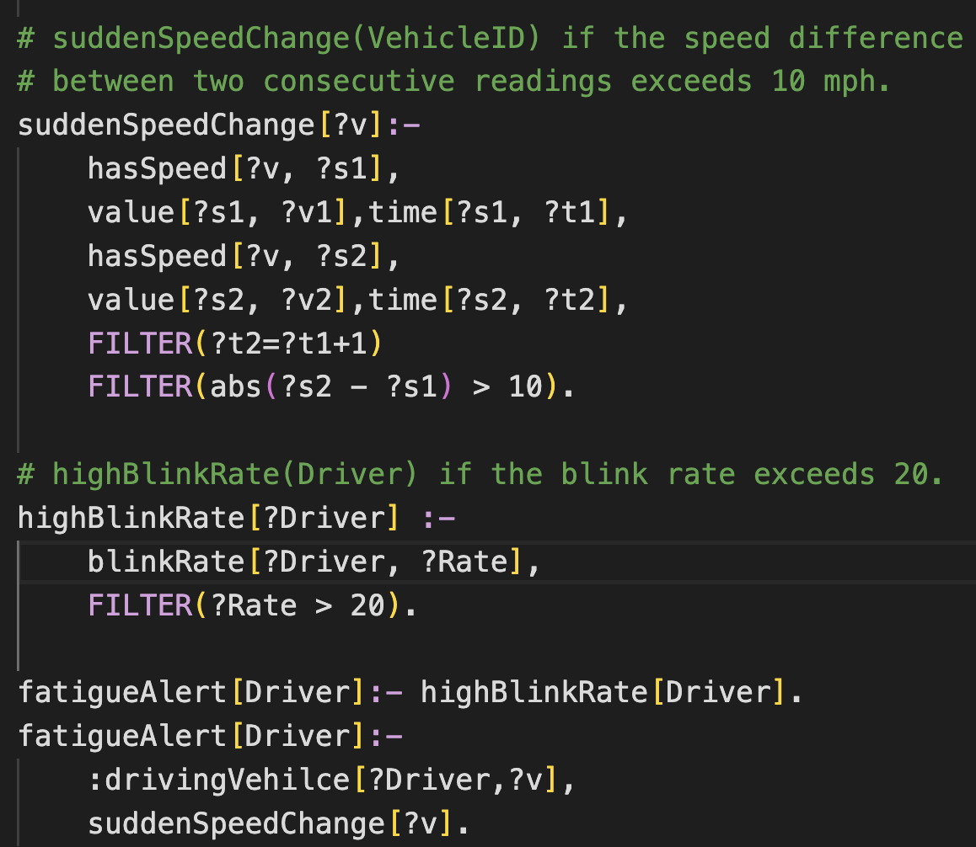
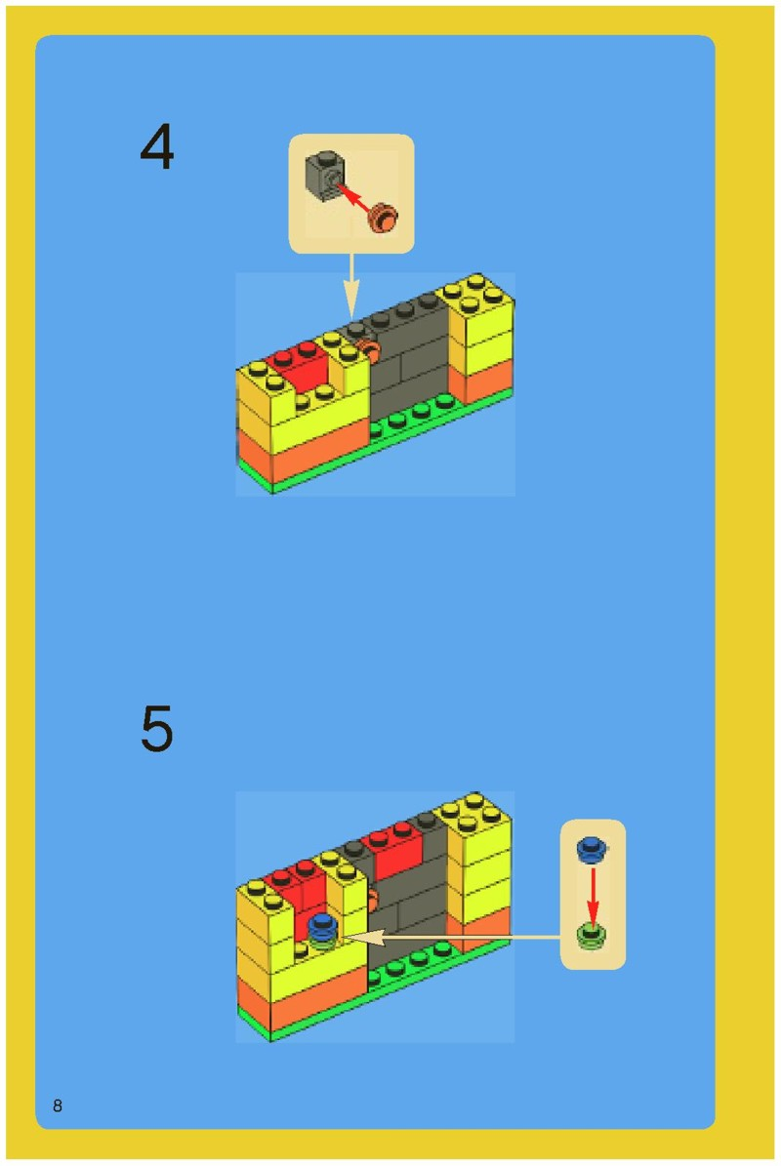
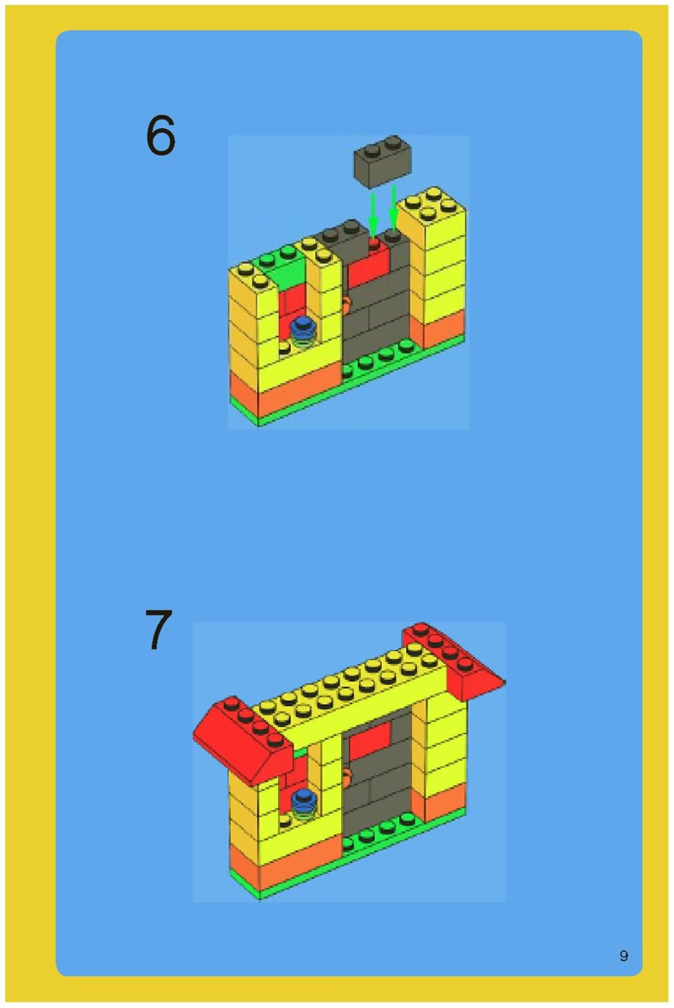
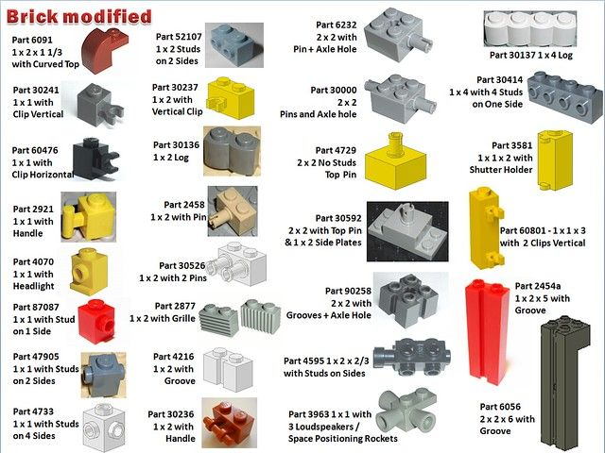
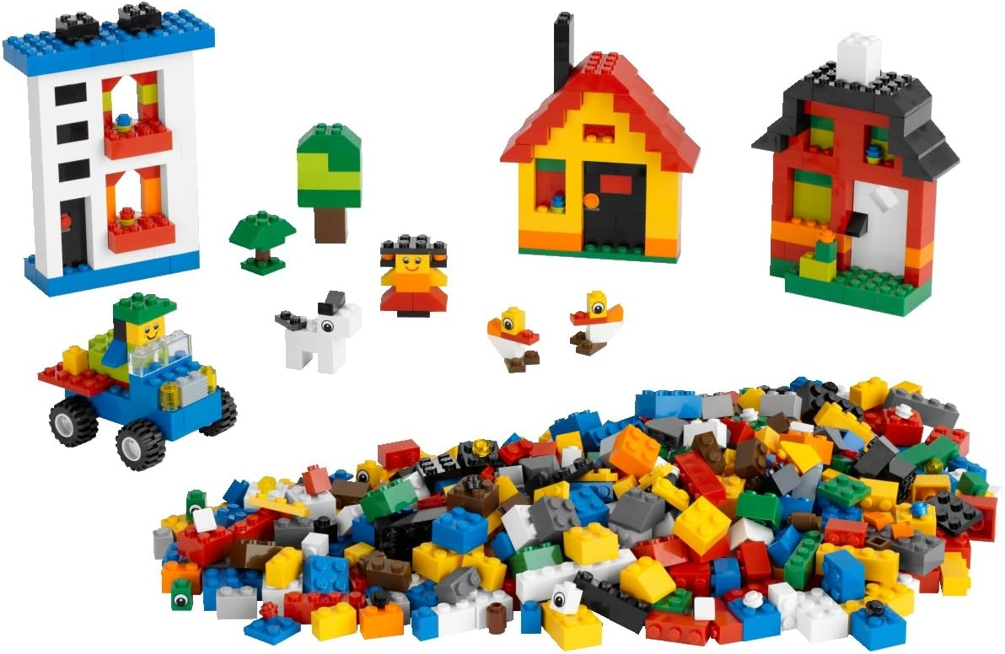

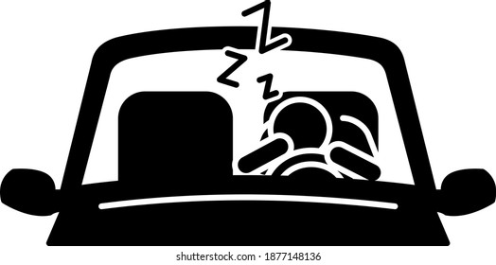
Bring Only logic!
Rule Exmaple
Model
Ontology (schema)
Rules
Queries
B:- A
Select
Reasoner
Input: speed, eye blink rate
Output: fatigue alert
Input
Ouput
t1
t2
tn
Ontologies are assumed given
Notes:
How can you use such tech?
In Short, bring your buesniess logic!
In general, there are two aspects:
1)so identify what are the inputs and output are needed
2)Then it is the core parts which enable the rule engine to understand the context and logic rules by give schema/rules/queries
For example, consider a driver fatigue alert application in its simple form.
Input: speed from the vss, eye blink rate from the camera
Output: fatigue alert
The rules: SuddenSpeedChange, highBlinkRage fatigueAlert

Slide 25
Q&A
See the Playground at the Renesas booth in the Showcase tonight

Slide 27
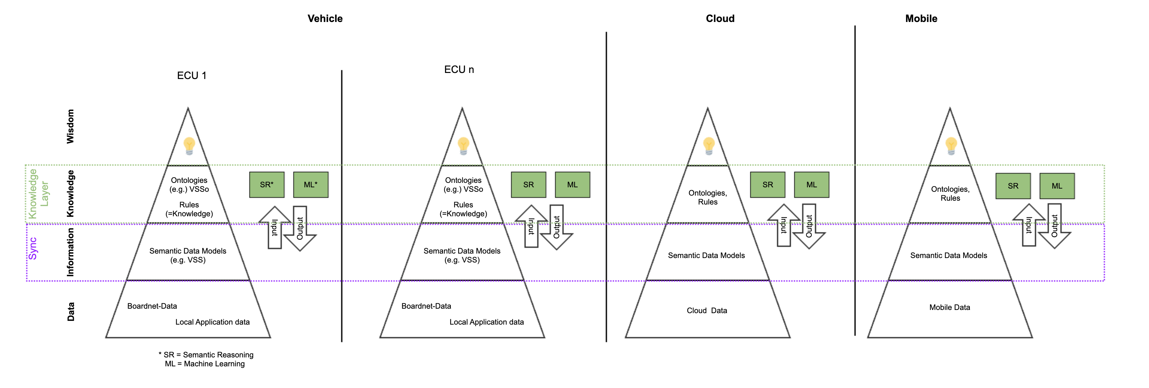
Playground in context: Other logical domains
Connections to other logical data domains. For example, there is an knowledge layer proposal made in the COVESA Data Architecture team that discusses the separation of concerns and interaction between knowledge, information and raw data layers as illustrated below. The Playground here could be used to provide the data/information layer services in its investigation.
Source: Data Architecture team: knowledge layer proposal

