Slide 1
Virtual prototyping & AI development with cloud-based VSS vehicle recordings
Gergely Simon, Data Architect, NXP.
Ola Nilsson, Cloud Engineer, RemotiveLabs
Carin Lagerstedt, CMO RemotiveLabs
Notes:
20 mins:
-2 (Carin)
-8 (Gerg)
-8 (Ola)
-2 (Carin)
Short introductions +
“Early access to vehicle data plays a crucial role in accelerating innovation and improving development processes in automotive”.

Slide 2
Unlocking vehicle software development
What can early access to vehicle data enable?
What additional values does VSS data add?
Innovation
Prototyping AI as a service
Early prototyping capabilities through shift-left development
Independent development of AI models
VSS signals enable focus on application-level value-add
Collaboration
Visualization & Co-debugging
The value of sharable and standardized vehicle data in the cloud to:
Gather it
Explore it
Consume it
Creativity
Design / UX
Use case examples, internal and external for enabling experiences:
Figma → interactive designs + enable third party designers
Designer efficiency - validate assumptions
Notes:
If you think about it, vehicle data in the cloud is a very lightweight simulation tool that can enable several use cases - so this will be a fast exploration of three of thiem - innovation, collaboration and creativity - and how VSS add unlock development possibilities even further.
- NXP AI as a service: Virtual flow for CAN recording transformed into VSS vehicle data stream is used for rapid development of AI models.
These flows can be replaced by physical CAN-based signals with minimal effort for deployed models.
Easy integration with reusable mappings (both virtual and physical) across vehicle models for all use cases.

Slide 3
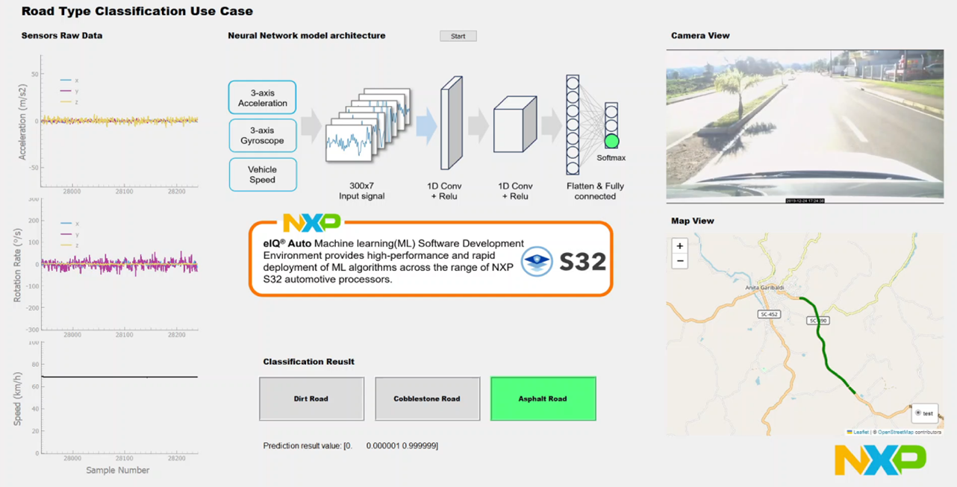
Road surface type classification
Convolutional neural network (CNN)
7 sensor input variables (non-perception), with 100 Hz frequency
Over 90% accuracy in classifying various road surface types for the CNN network architecture
Notes:
Convolutional neural network (CNN)
1D convolution layers with rectified linear unit (ReLU) activation
final flatten and fully connected layer with softmax
7 input variables: vehicle speed, vehicle acceleration (xyz) and vehicle angular velocity (xyz)
Datapoints with 100 Hz frequency (every 10 ms) and 300 of these are bundled together for a single inferencing step, thus providing a new result every 3 seconds
The model shows over 90% accuracy in classifying various road surface types for the CNN network architecture
For deployment NXP eIQ® Auto software development environment is employed, providing optimized runtime backends

Slide 4
Development flow
Python script
1
1
Online parsing and playback of CAN data – flexible seeking and charting
Easy to integrate Python playback to KUKSA
Only one additional file needed to map CAN to VSS
Dataset (.csv)
Dataset
(CAN dump)
RemotiveLabs Python playback
CAN DBC file
CAN-VSS map
unchanged
2
2
The exact same CAN dump file and DBC file can be used for physical (or virtual) CAN use cases
A bridge developed in C and with flexible deployment across SoCs and cores offers feeding to KUKSA
One additional CAN to VSS map file needed
Physical or Virtual CAN
Executable
KUKSA databroker
CAN to KUKSA VSS bridge
KUKSA client
eIQ Auto backend
Inputs: standard VSS signals, outputs: overlay created
AI/ML artifacts
CAN-VSS map
unchanged

Slide 5
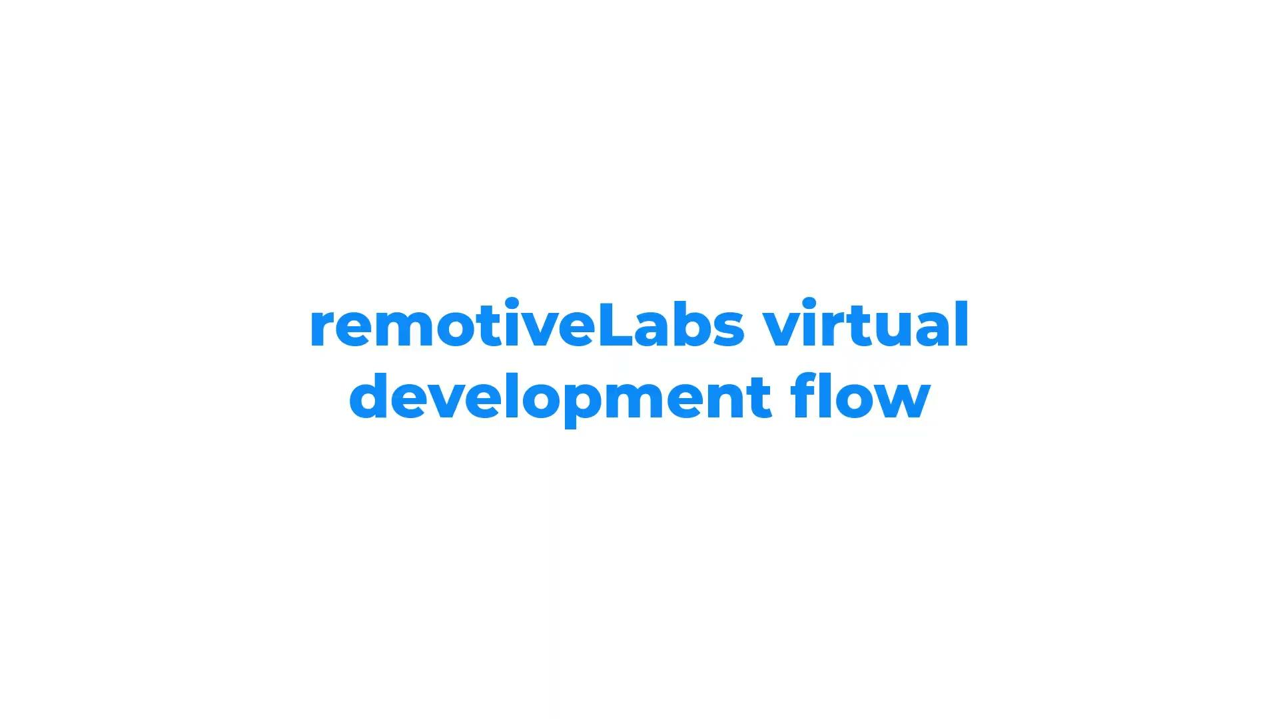
Demo

Slide 6
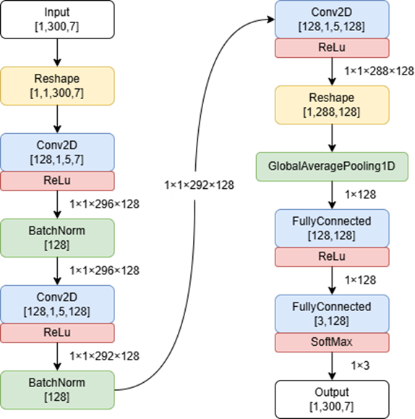
Model details
Convolutional neural network (CNN), Convolution layers with rectified linear unit (ReLU) activation.
And a final flatten and fully connected layer with softmax.
The exact model is shown on the right side.
Total number of parameters about 186k, all FP32.
Execution currently in interpreted Tflite model format, on single A53 core in base Linux BSP takes 3-4 ms.
Dataset (.csv)
Python AIML training
TFLite model
NXP eIQ Auto deployment
Deployment artifacts (.json, .tflite)
Notes:
move from virtual prototypes to physical hardware fast and cost-effectively once available.

Slide 7
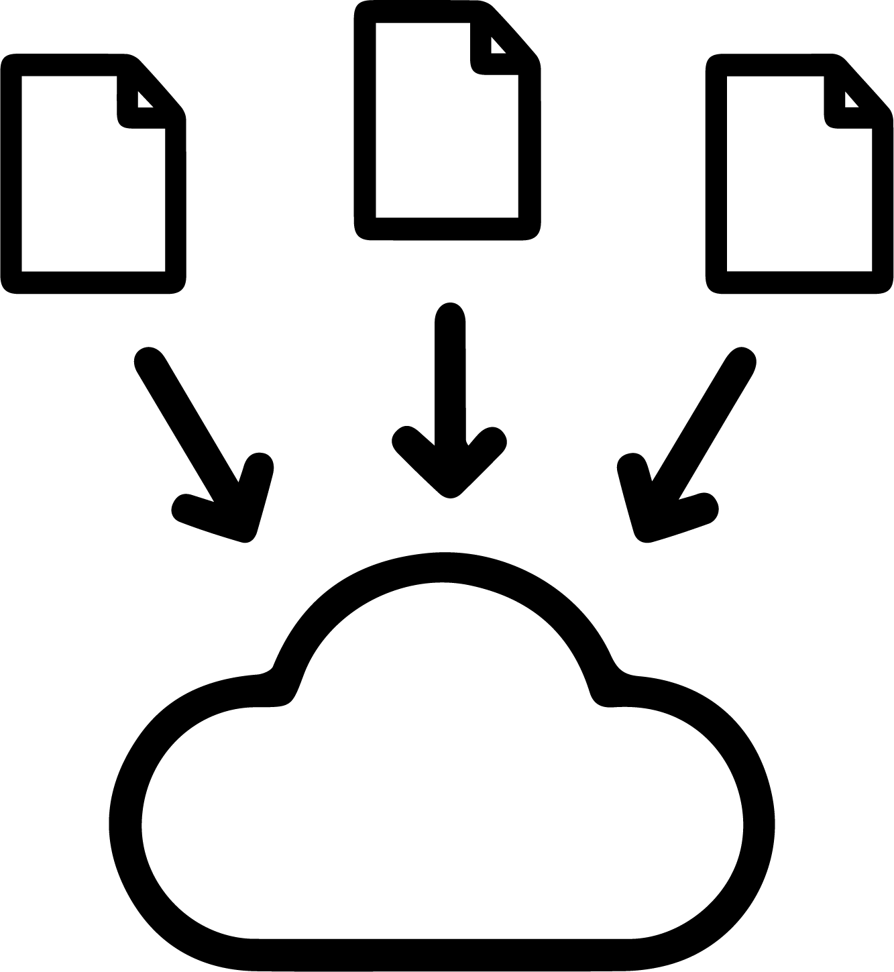

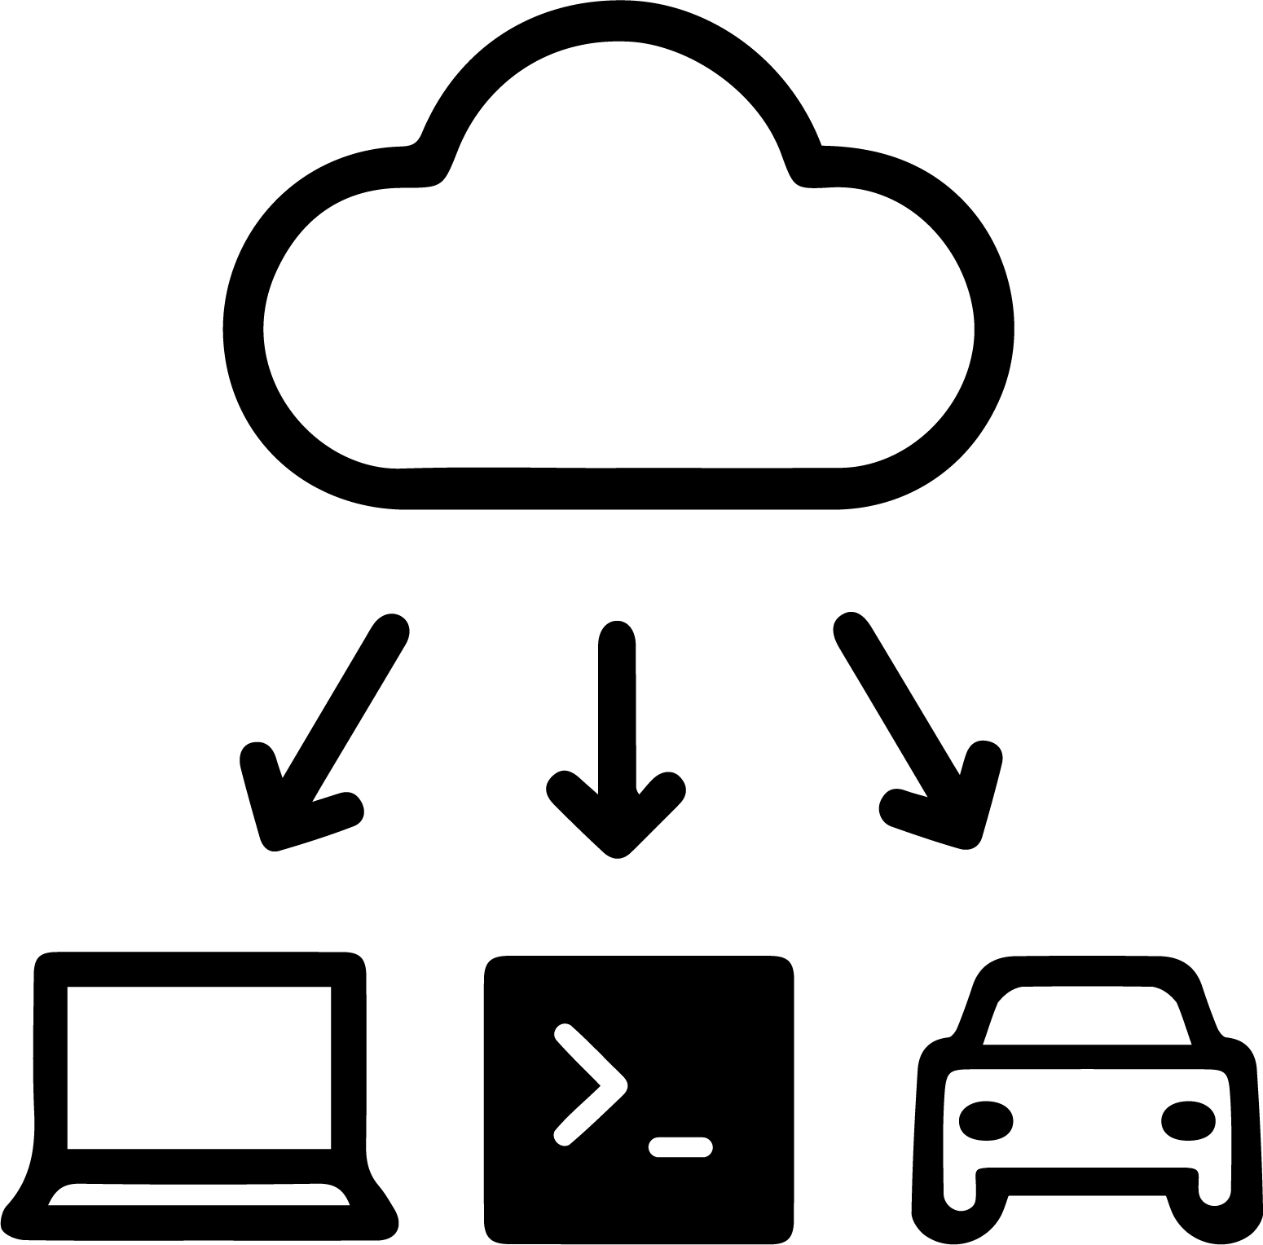
Working collaboratively - An open platform
Use cases: Sharing & exploring vehicle data, co-debugging and prototyping
Gather it
Explore it
Consume it
Notes:
Working collaboratively with other people is a skill that can be honed, but that skill is not what I will talk about today. I am going to talk about another part of collaboration, because there is something that is true no matter how skilled you are; If we can’t share information, we can’t collaborate.
In this automotive context, that information is often vehicle signal data. The sooner we have access to data, the sooner we can get stuff done.
We want to remove as many hurdles as possible.
Today I will show three simple steps how you could do just that, work collaboratively with vehicle signal data. Let’s say as an example that we are working across three teams; Platform, UI/UX and Android devs
First of all, to make sure that we have data available to all participants, I will show a shared place to gather all relevant data.
Then, I will show how to dig deeper and explore the vehicle data in shared space.
And finally, we will want to consume the data from where we need it. This is where we have found VSS to really shine!
As an engineer myself I like a challenge, so let’s dive in to a LIVE demo!
Show landing page - This is RemotiveCloud, a web-based platform that works on any OS
Show project picker - In the cloud you will have an organisation and a bunch of projects to manage access to your data
Show storage with files - here you can upload any data you think might be needed
Start an import - To dig deeper in to vehicle signal data we need to pinpoint them
Go to recordings - TV chef has prepared a vehicle data recording already
Show samples modal - One of our sample Tesla recordings from different scenarios
Go to signal databases - To make sense of the vehicle signal data you need a matching signal database
Go back to recordings - Pick one, I live in the country side so let’s pick the country road example
Go to a recording
Show the four tabs
Stay on “Visualize”
Show time series
Show trace window
Show deviation
Show map
Annotate something
Add a comment to the annotation
Go to playback
Start playback with Tesla data
Show some stuff
Start playback with VSS
Run CLI command to send data to ProtoPie
Run python command to send data to AAOS
Run curl command to send data to CLI
Wrap up, change slide and hand off to Carin

Slide 8
(DEMO)

Slide 9
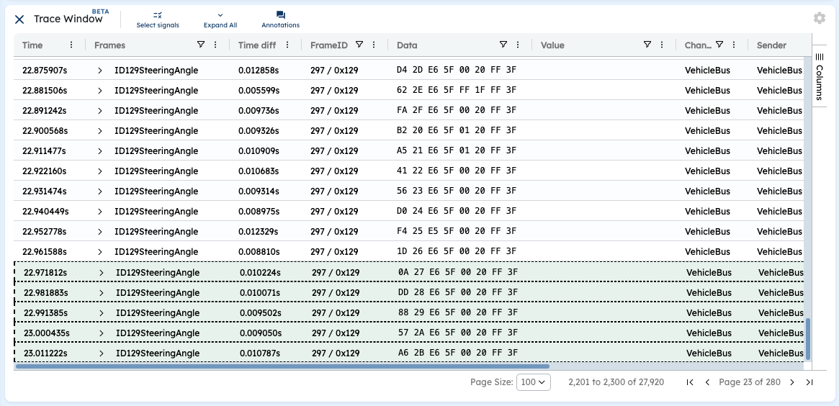
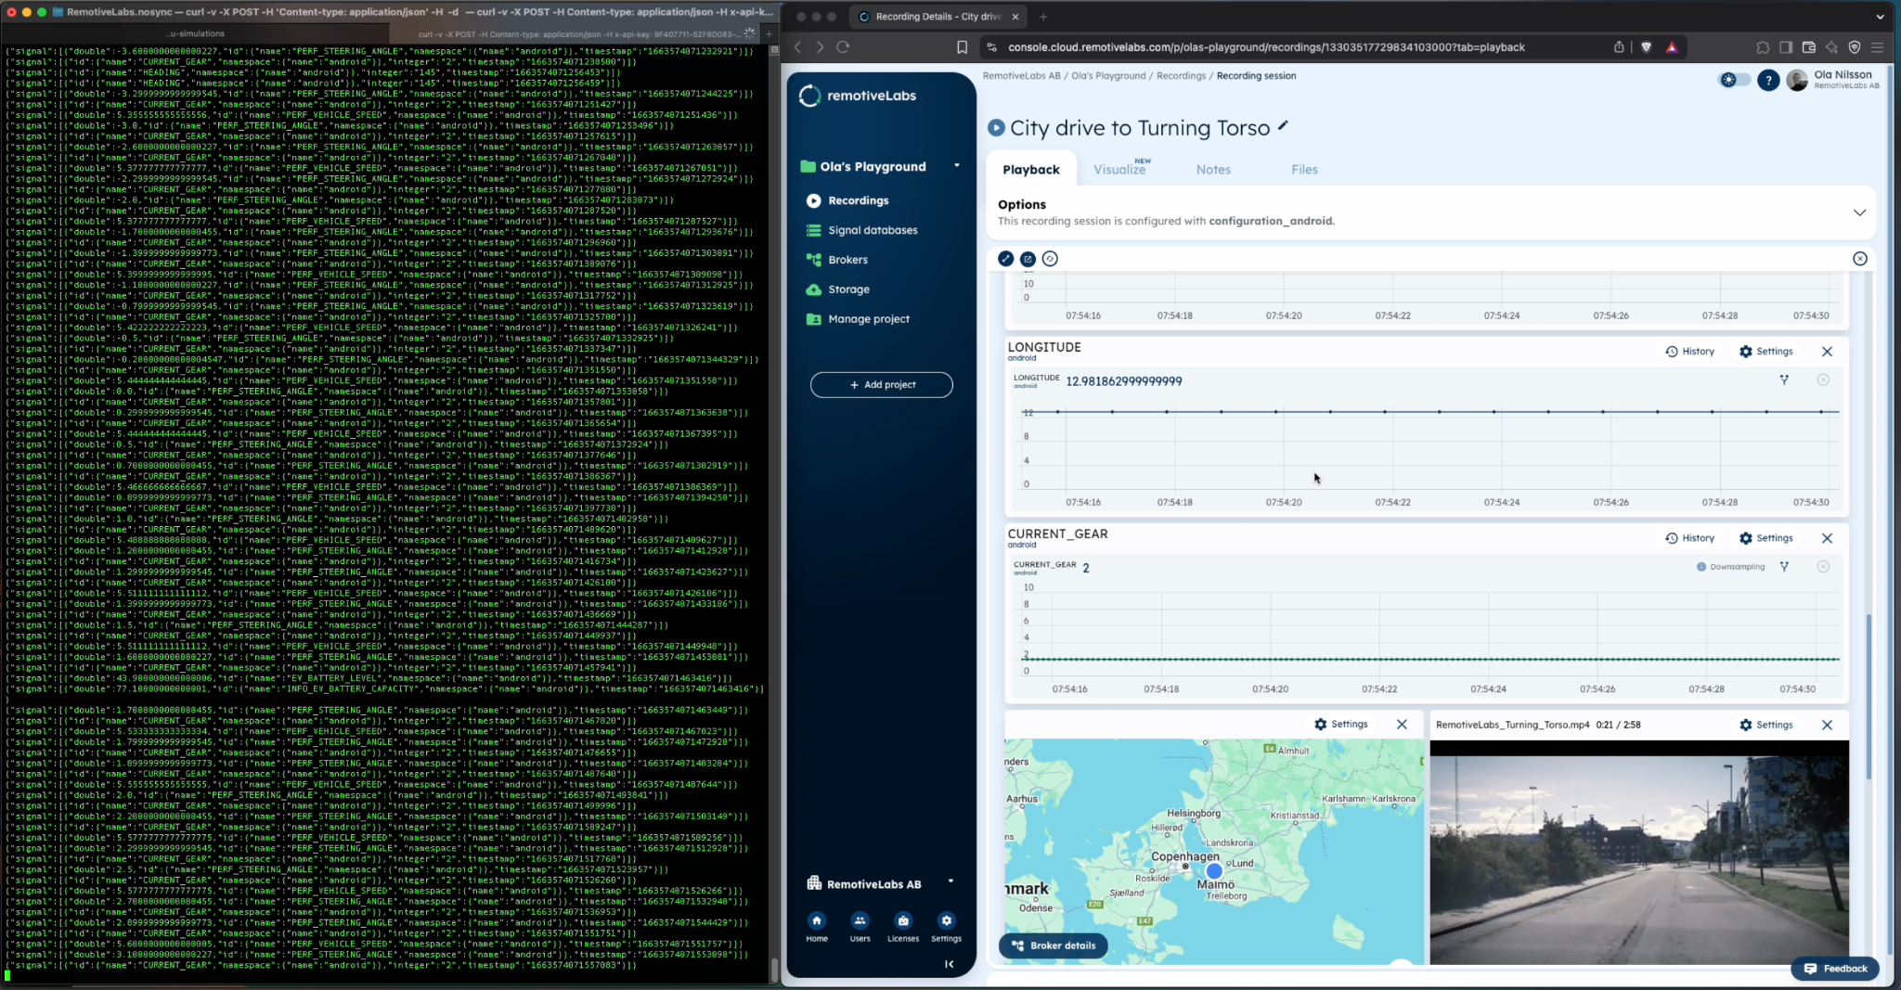
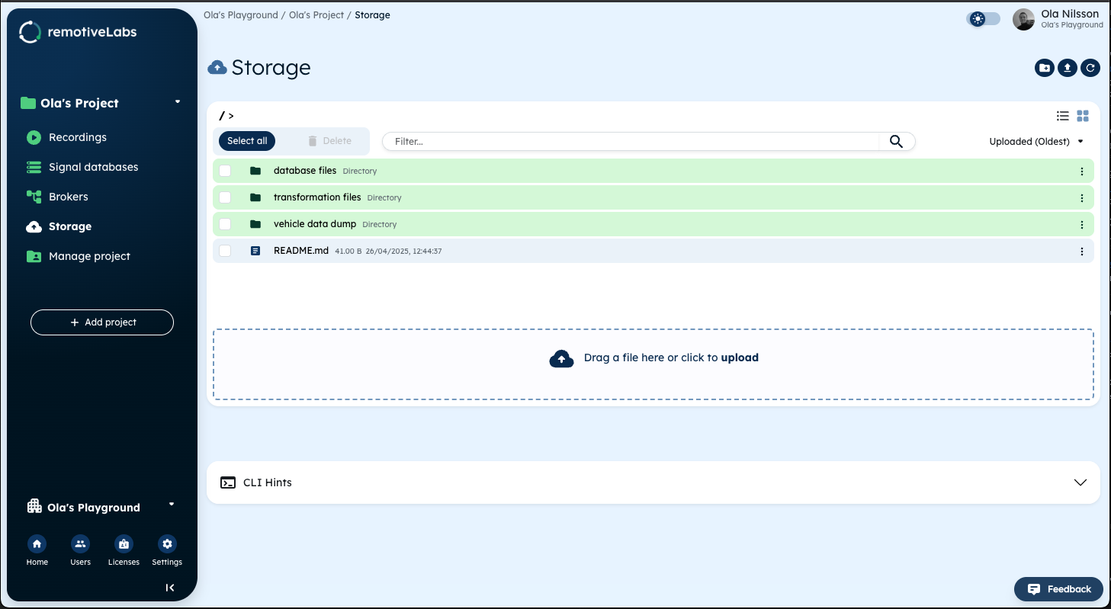
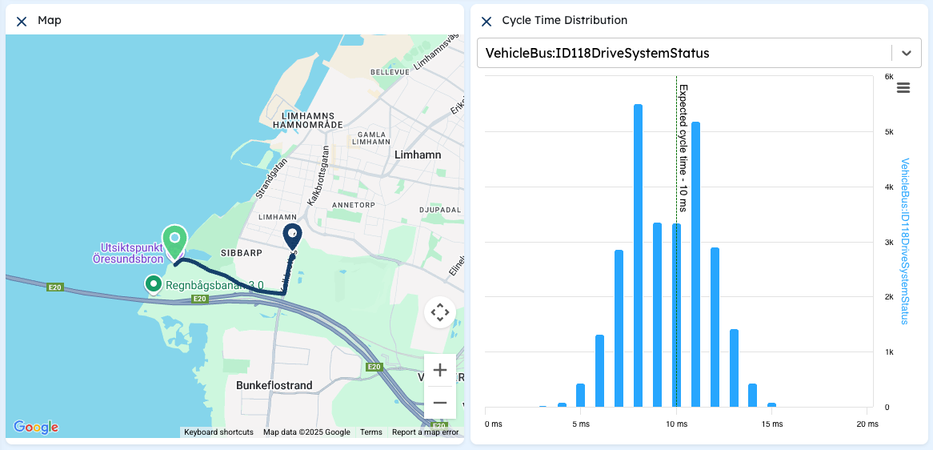
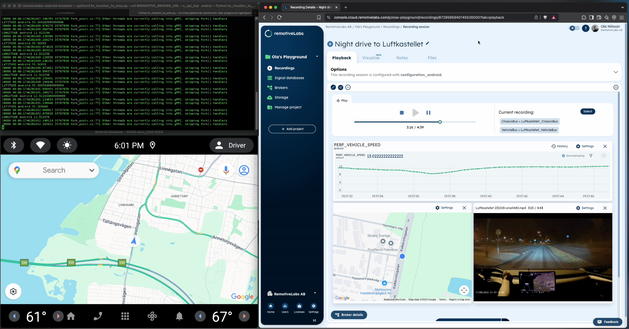
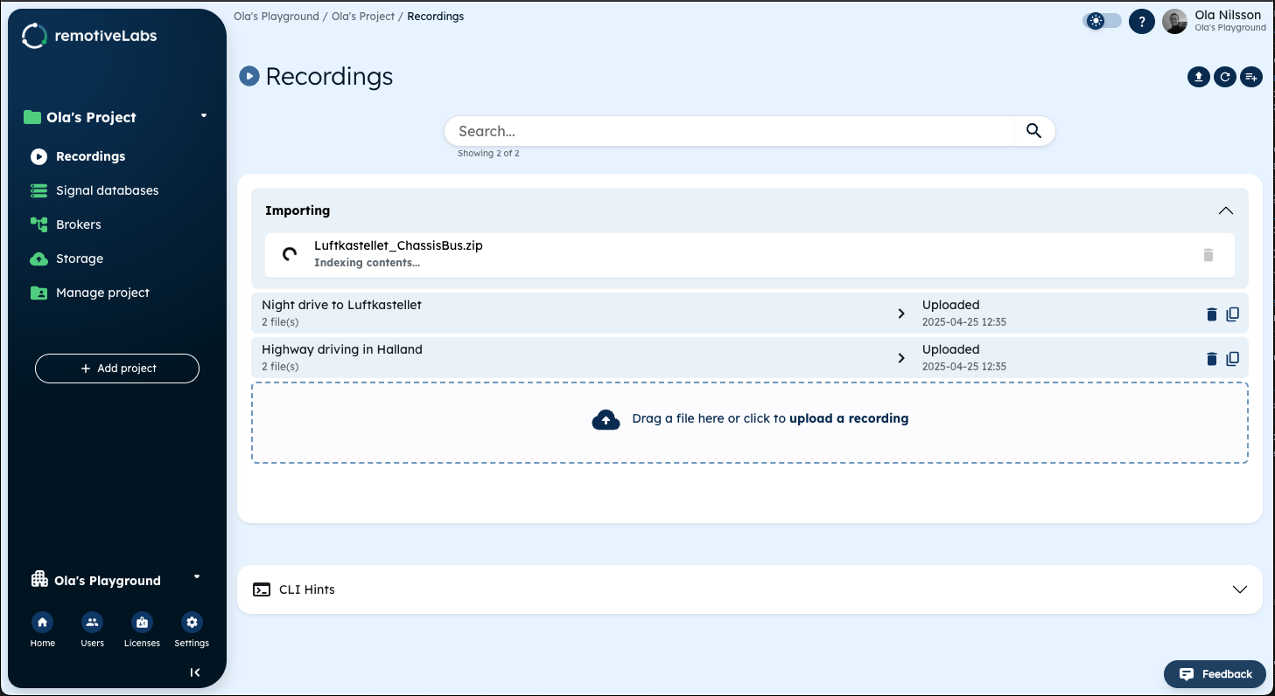
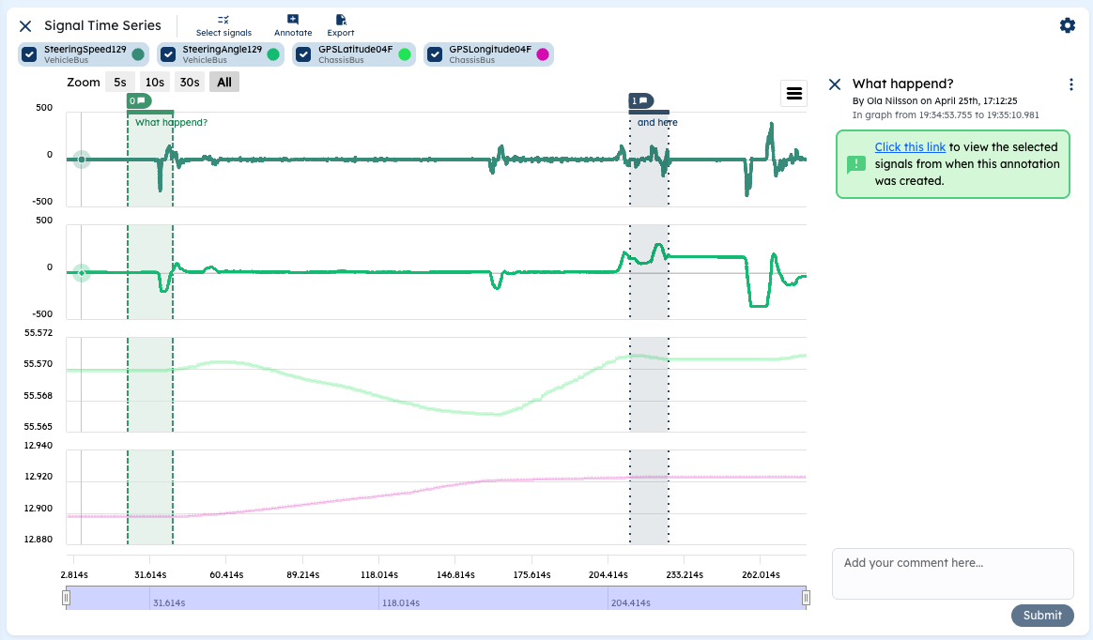
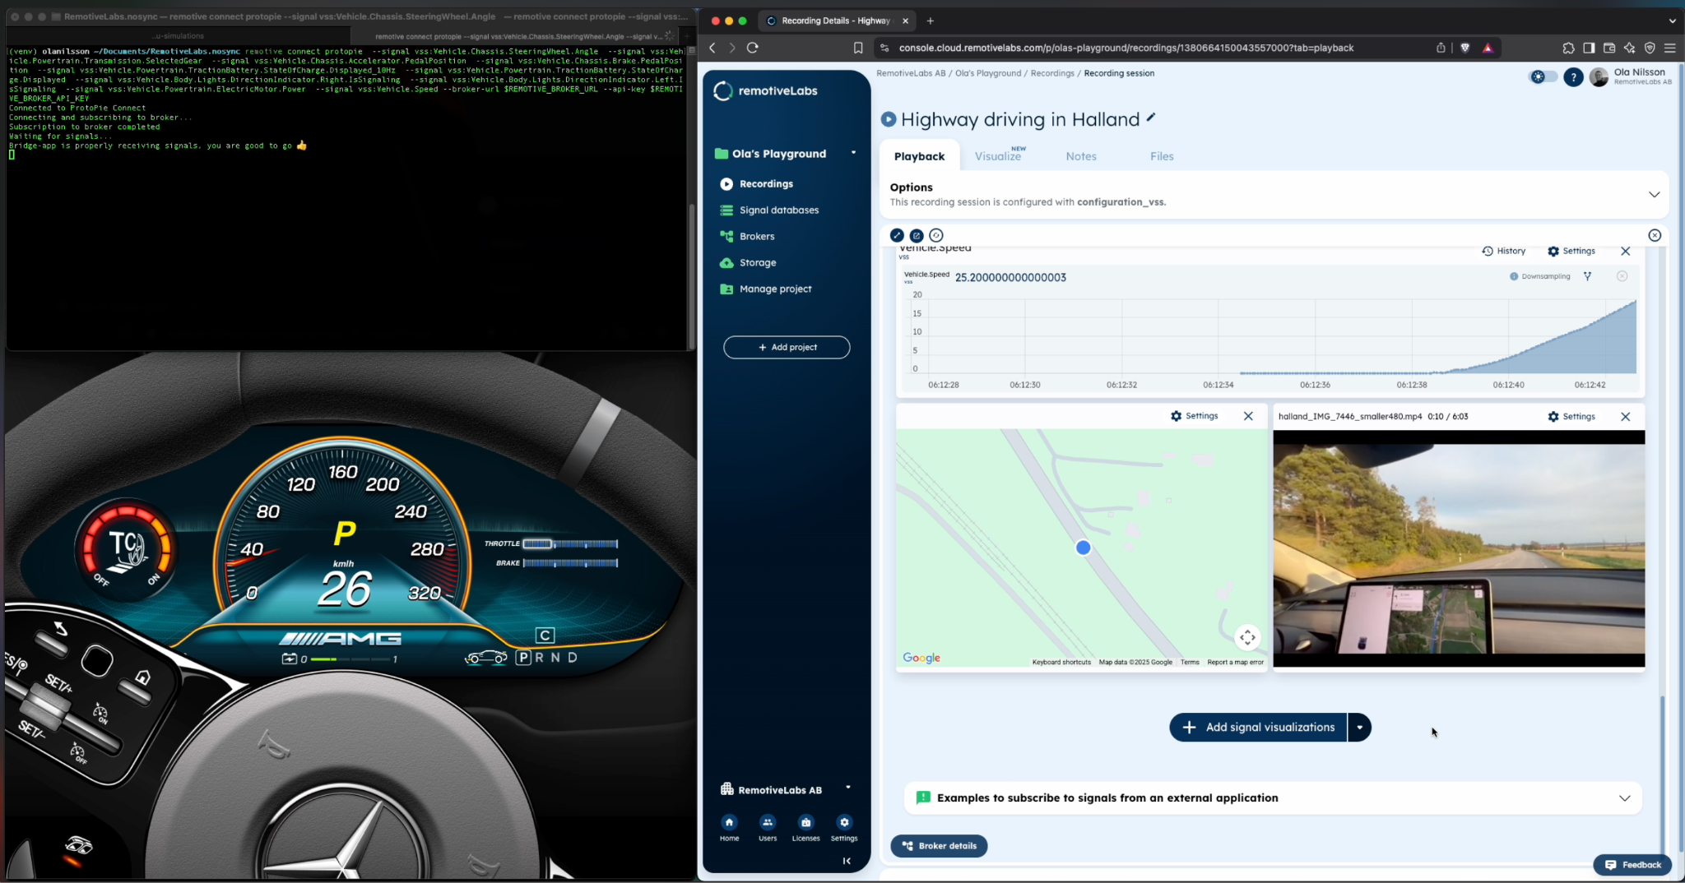
In summary
Gather it
Explore it
Consume it
Notes:
So in summary,
We just looked at a way to gather vehicle data in a shared space
How to explore the data and debug together
And finally, we consumed it in multiple different ways
With these three hurdles taken care of, magic is just waiting to happen. The kind of magic that Gergely just showed you, and now Carin will show you even more!

Slide 10
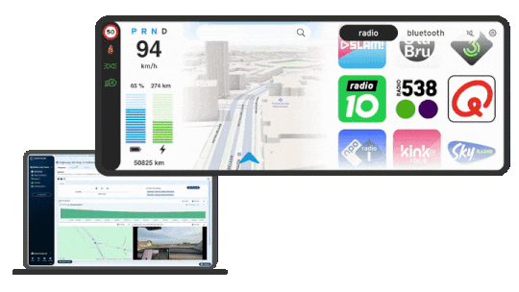
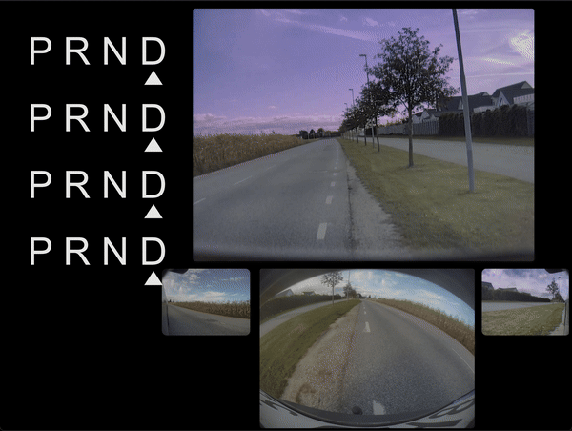






Design & UX - early validation with real data
3rd party designer: Bram Bos
From Figma to interactive UI in ProtoPie (A designer’s guide)
OEM: Ford Digital Product Design
Prototyping with VSS & cloud recordings
Design in Figma
Prototype in ProtoPie
Vehicle data RemotiveLabs
Demo experience: Gear change during three-point turn.
Bram Bos
UX and product strategy expert
“highly sophisticated & more realistic prototypes vs Figma demos”
“The nice thing about VSS is that all signals have meaningful, descriptive names”.
James Hines
Senior Product Designer
“I can provide relevant input, test and validate assumptions I wouldn’t otherwise have been able to anticipate until later”.
Justin Danielson
Director of Prototyping
“Prototypes designed and connected to VSS signals can easily be moved between bucks, mules or other platforms.”
Notes:
Last quick use case - the experience - open tooling fits with your favorite tools - Figma in this case - but sophisticated.
VSS appreciated for human readability - how can you innovate without knowing what signals are available. But don’t forget VSS is an enabler for sharing the relevant signals outside OEMs.
Access to vehicles and real data is scarce also at oems. Lightweight virtualization - recordings is like a vehicle on your laptop, verify assumptions earlier can save a lot of pain later. And if designs are connected to VSS they can be moved between vehicles for efficiency.
Integrerbar lösning → UX
Streaming data:
Stream vehicle data where you need it (tooling they use in high use is Figma – connect designs to data via protopie)
Bram On connecting vehicle data to the ProtoPie prototype: VSS readability + enabling third party designers access to the project.
OEM use case emphasising the efficiency potential if cluster designs are connected to VSS to re-utilize things.
Cloud “early assumptions” + VSS “design once, use for many”
So what happens when you unlock creativity to test things “real”?
Not included in this presentation? Separate blog? How to try the cluster in real-time in a vehicle mule or vehicle with exposed can buses.

Slide 11
Arnau Tallada Cebrián at FailFast design studio using RemotiveCloud sample data.
Notes:
Writing code as much as developing design is a creative process. Being self-sufficient in making ideas come to life, testing them out with lightweight virtualization in the cloud - and making the vehicle data understandable and sharable by leveraging VSS.

