Slide 1
Virtual Testing of Android Apps with Real Vehicle Data
Niclas Lind, Volvo Cars Corporation
Carin Lagerstedt, RemotiveLabs

Slide 2
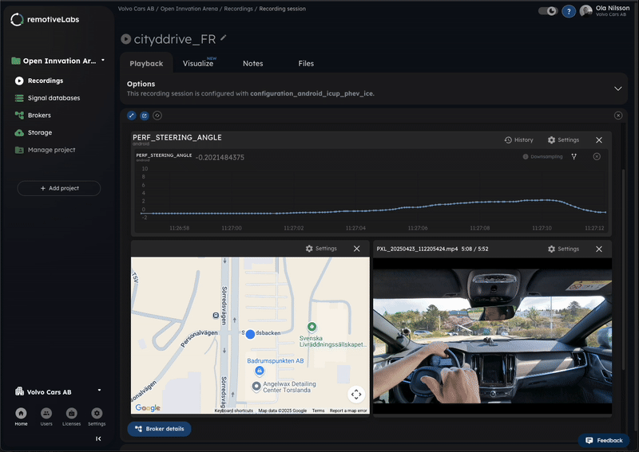
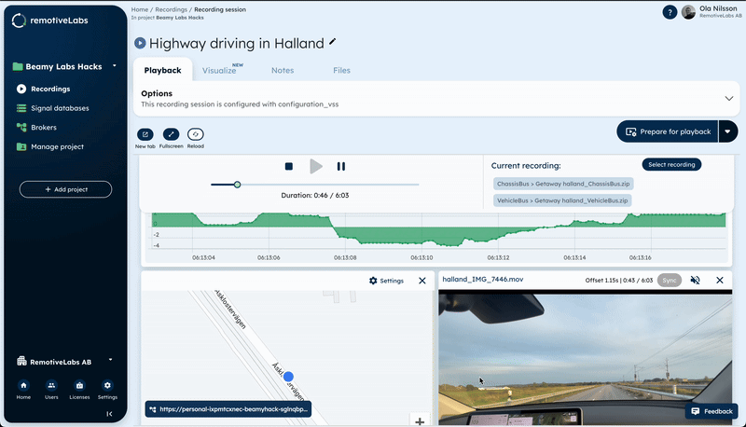
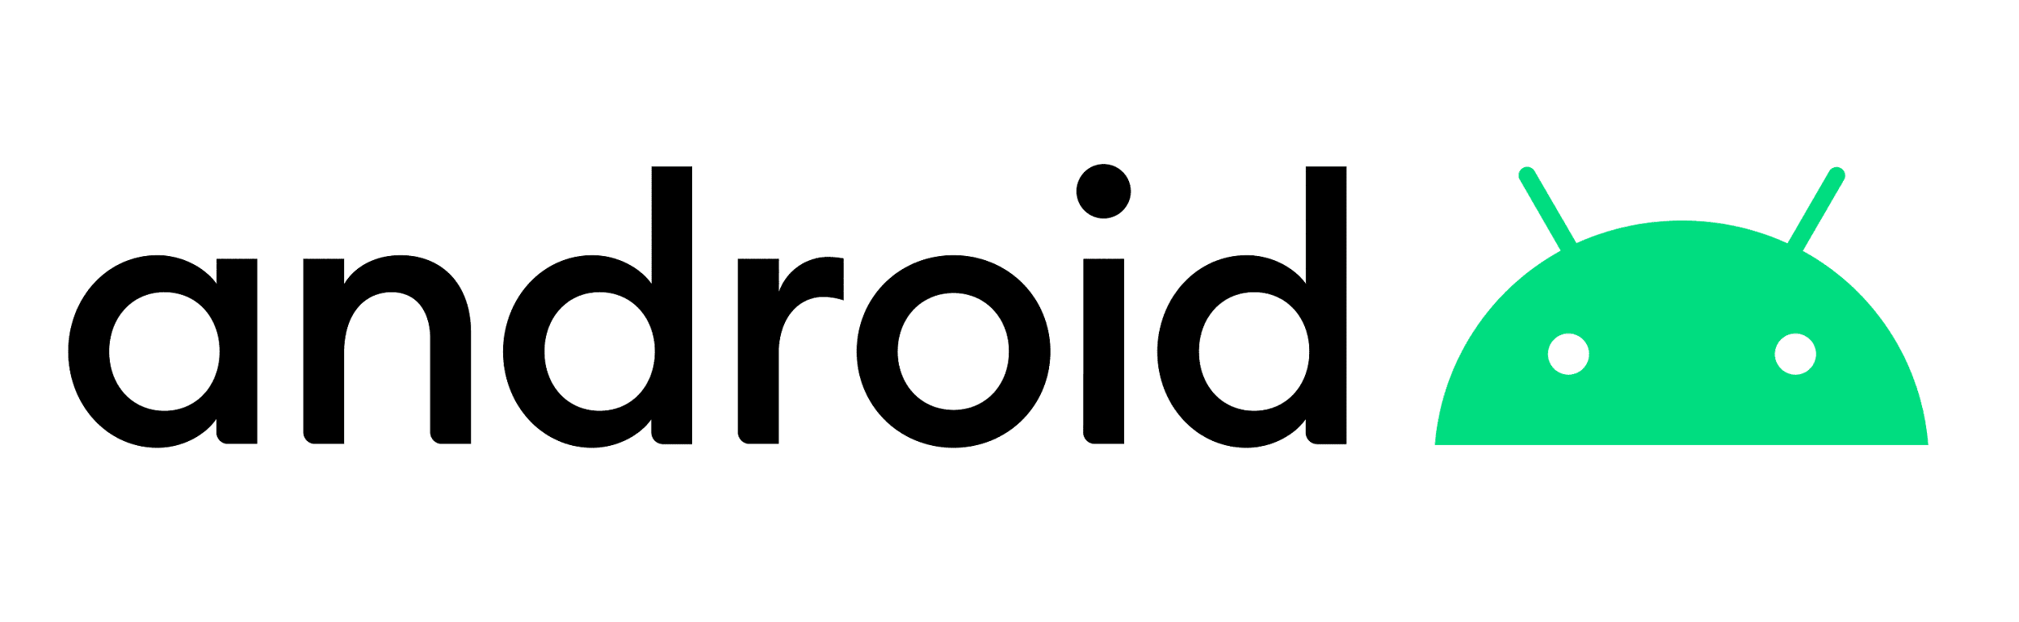
Virtual testing of Android Automotive App
“One iteration cycle takes 5 minutes, and I can work remotely with only my laptop—still testing using relevant vehicle data.”
— Niclas Lind
Apps
AAOS
VHAL

Slide 3

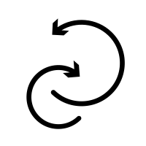
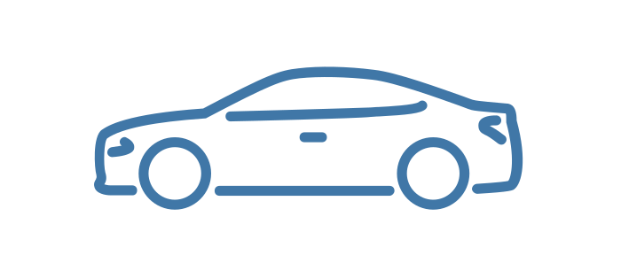
Workflow setup
RemotiveCloud
Upload the recordings to the cloud
Playback recording
and subscribe to signals
Client
Android Emulator
Inject
vehicle
signals
Record drive cycles
from a vehicle

Slide 4
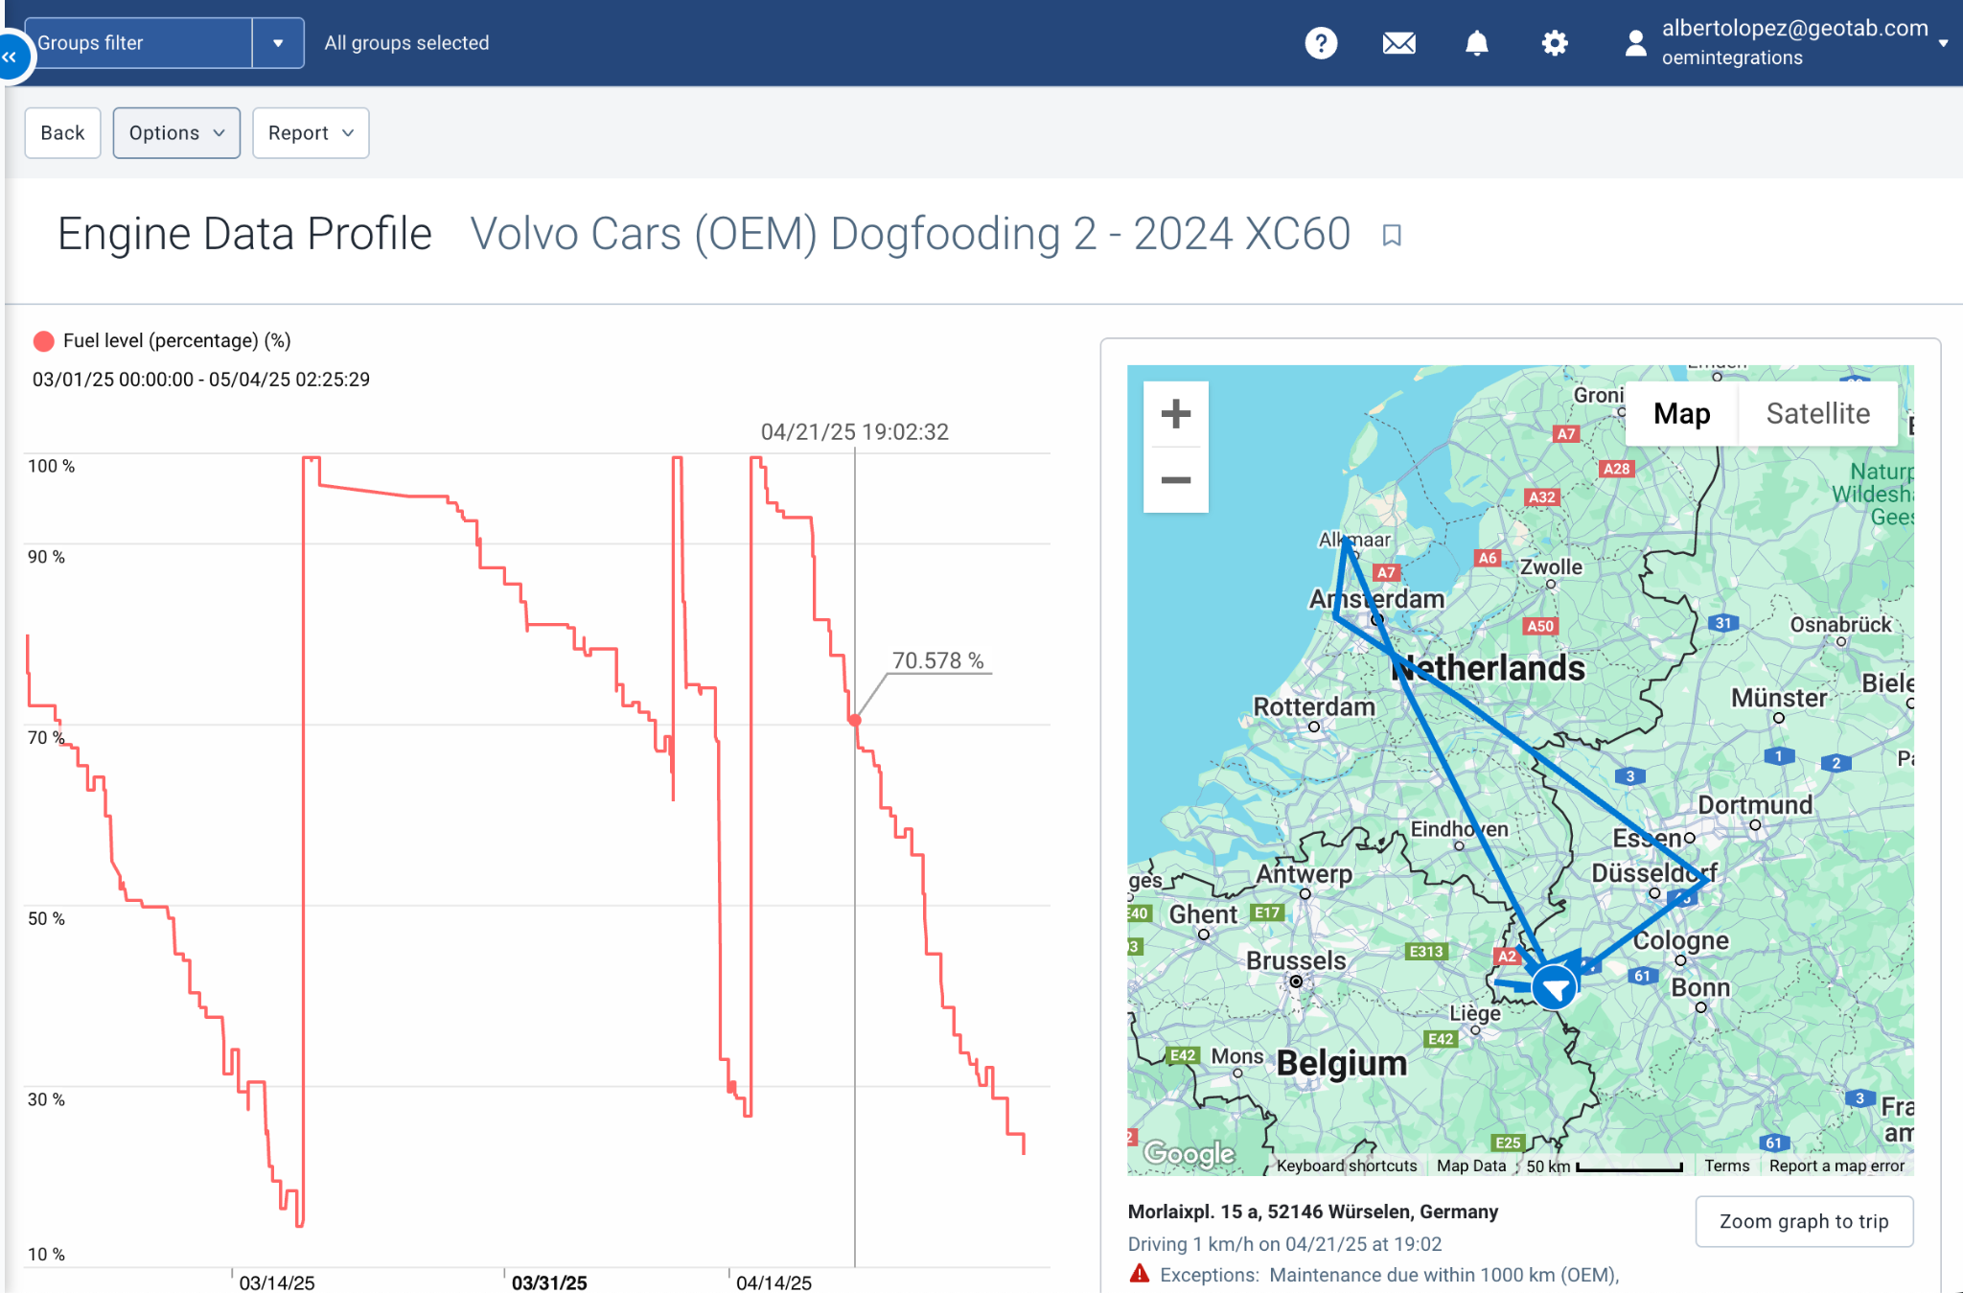
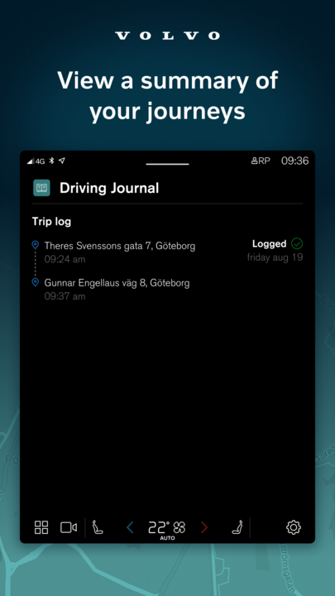
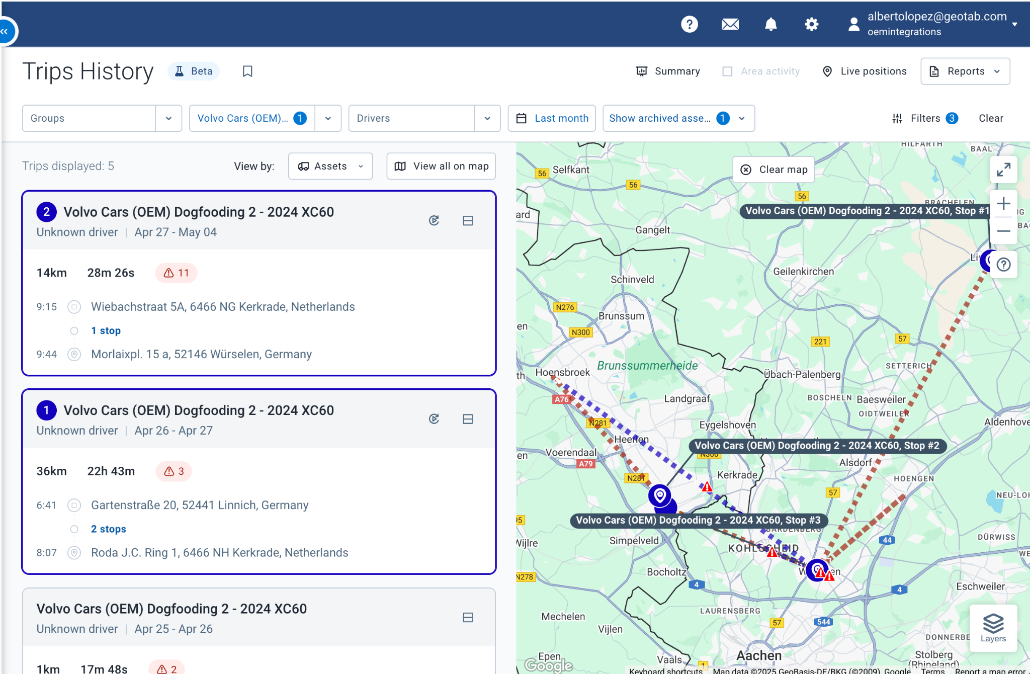
Use cases
Geotab integrates Volvo Cars in its extensive OEM partner network Upon instruction from the fleet company, telematics data from the Volvo car is displayed on Geotab’s fleet management software, MyGeotab. Get insights into fuel consumption, maintenance, vehicle health tracking & location insights, and more for efficient fleet management and sustainable fleet performance.
Fleet management app
Responsible for the Android client
Use of multiple signals, various sources
Ensure app is robust & meets specification
VCC App -
Driving journal
The driving journal automatically logs all trips made with your car. The information varies depending on car model and model year, so make sure to read the section that applies to your car. More info >>

Slide 5
DEMO!

Slide 6
Workflow setup comparison
Setup | HW setup cost | Access | Iteration speed | Accuracy
Vehicle or legacy test rig | > 100,000 SEK | Limited (on-site) | 1+ hour | Real-world fidelity
Vehicle/rig with RemotiveBroker | < 10,000 SEK | On-site | 1+ hour | Real-world fidelity
Simulated signals in GAS | Laptop only | Always | ~5 minutes | Limited
12x faster iteration time with accurate signal patterns
Recordings in RemotiveCloud | Laptop only | Always | ~5 minutes | Real-world fidelity

Slide 7
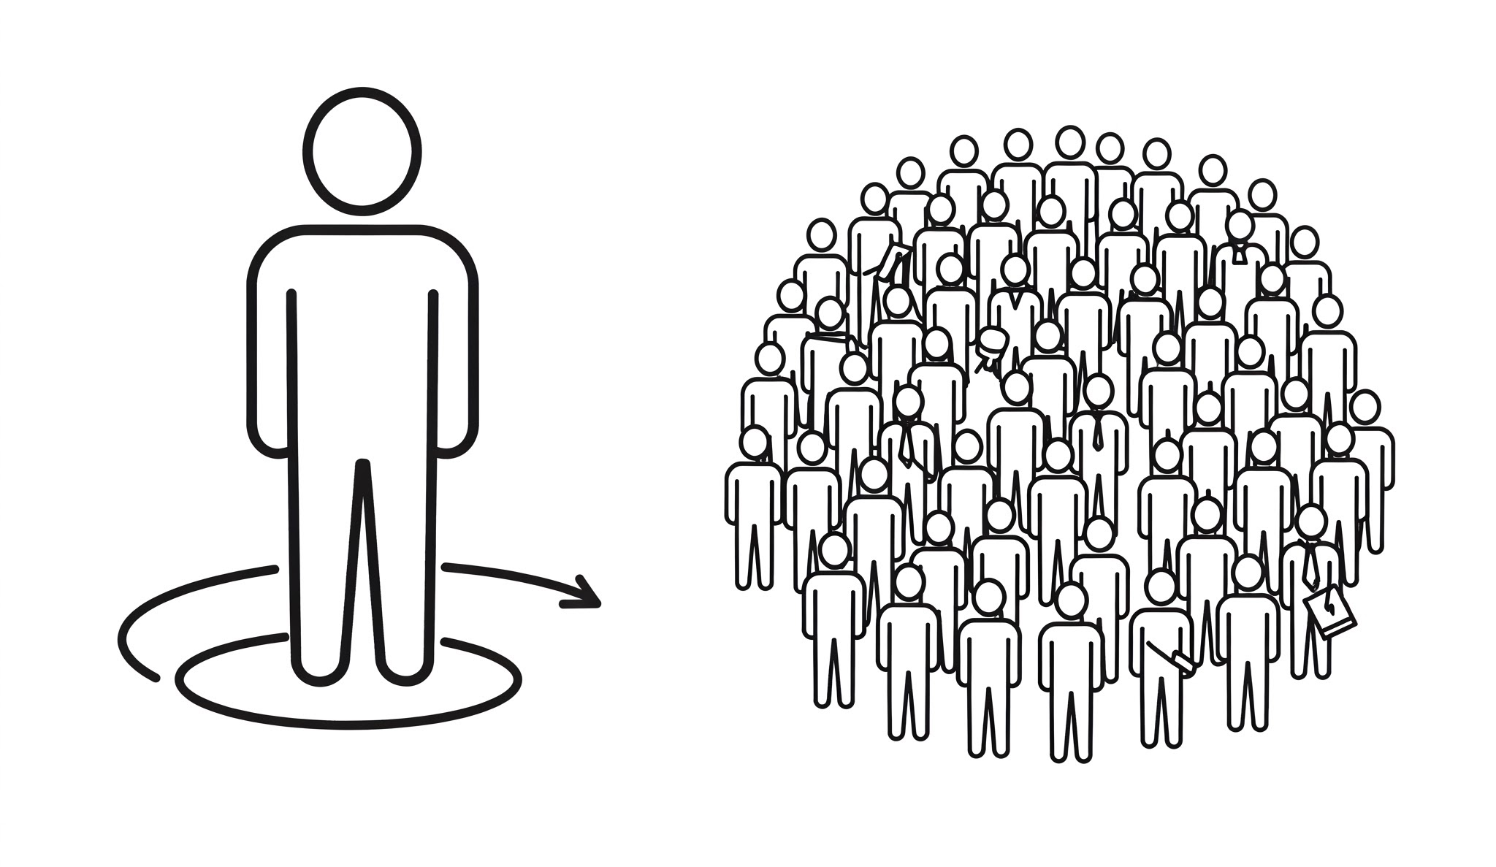
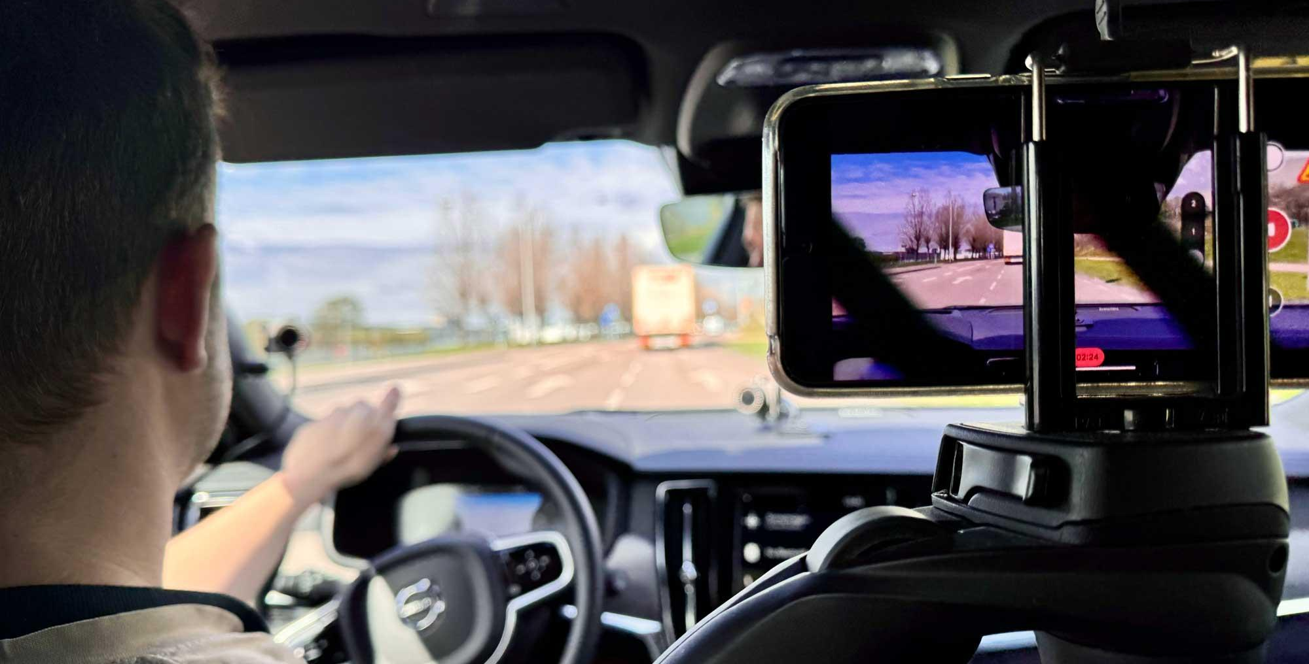
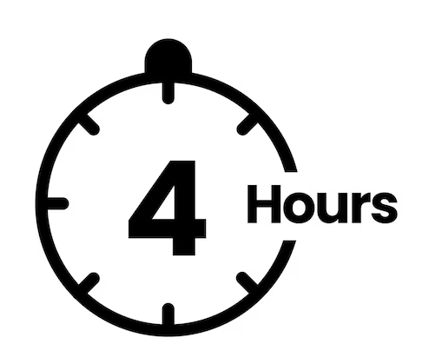
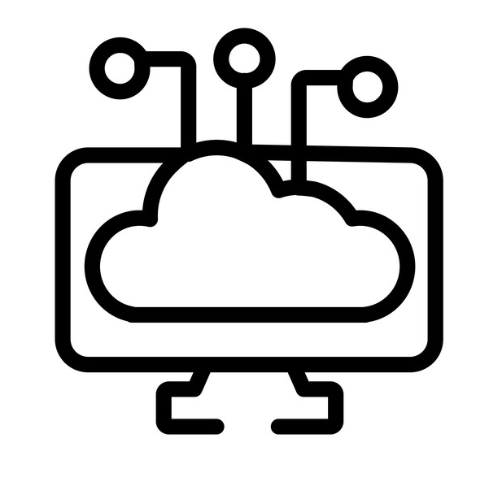
Record once, reuse infinitely
Simple setup with mobile phone
for video context.
Scalable resource: record once,
reuse infinitely - by many.
Typical time needed to record multiple drive cycles / sequences.
Edge example:
You are driving too close (1 meter) to the vehicle in front of you, having a speed of 110 kph.
“To get feedback during development, I now use cloud recordings over 80% of the time — I only record new vehicle data when I need to.”
- Niclas Lind
Inject new signals to trigger
needed edge cases.

Slide 8
Thank you!
Signup for RemotiveCloud free tier: cloud.remotivelabs.com
Sample data available - verify app behavior and robustness early & virtually!

