Slide 1
Filling gaps in Android
Automotive development
- using modern software patterns & testing best practices
Carin Lagerstedt, RemotiveLabs
Tero Aaltonen, Profilence

Slide 2
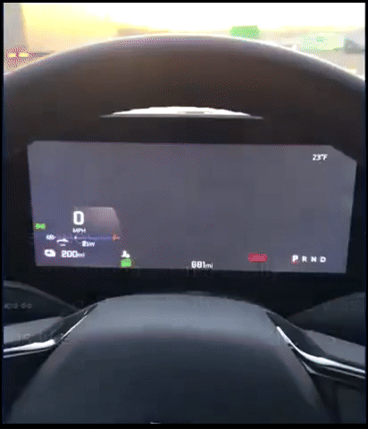
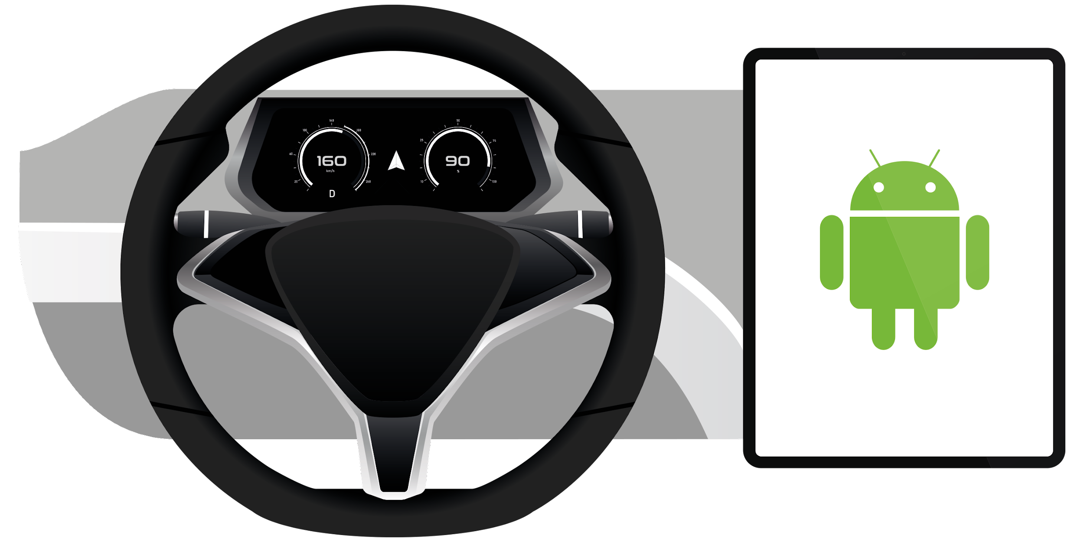






Various subsystems
over different buses.
No standards,
randomness & complexity.
Software testing best practices in the mobile industry
Including user modelling
Notes:
Why is this happening?
QA done too late, dependent on HW availability
Latest and greatest QA methods not applied
When you buy a new smartphone you get a robust product. Unfortunately, this isn’t yet the case in the automotive space.
In this presentation, we look into different ways to left-shift development

Slide 3



Developer productivity
Modern
software
approaches
Automotive software architecture
Iterative
development
Development cycles
Long development
cycles
Software-first
containerization
Hardware-
dependencies
Open
standards
Proprietary
solution
Customer-
centric design
User centricity
Engineering-
centric design
Open API: Bring
your language
Legacy
languages
Left-shift
& test your
own stuff!
Waiting for
others to
test your stuff
Software-
defined
Depend
on others
Software ownership
Access &
collaboration
Inaccessible
data

Slide 4


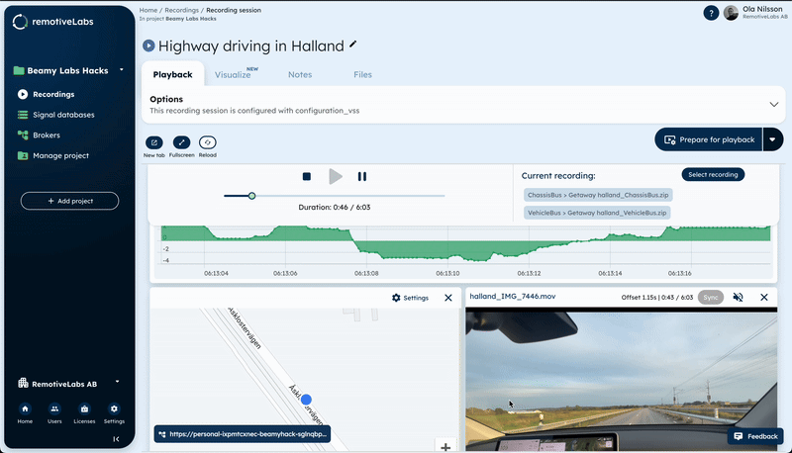

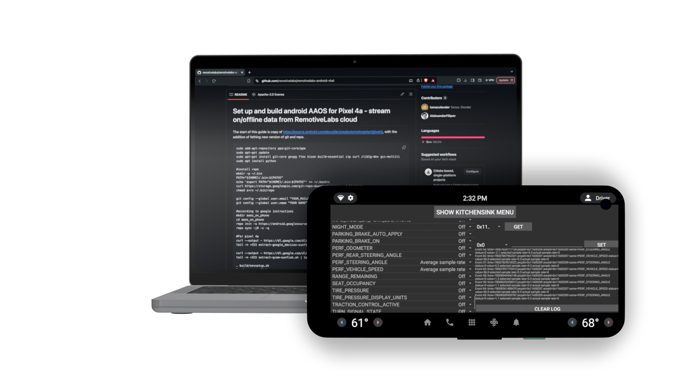

Cost efficient test drives of ideas, designs & systems
Apps
RECORDED DATA
AAOS
VHAL
HW
example:
Pixel 4a
GitHub
LIVE
DATA
third-party platforms

Slide 5
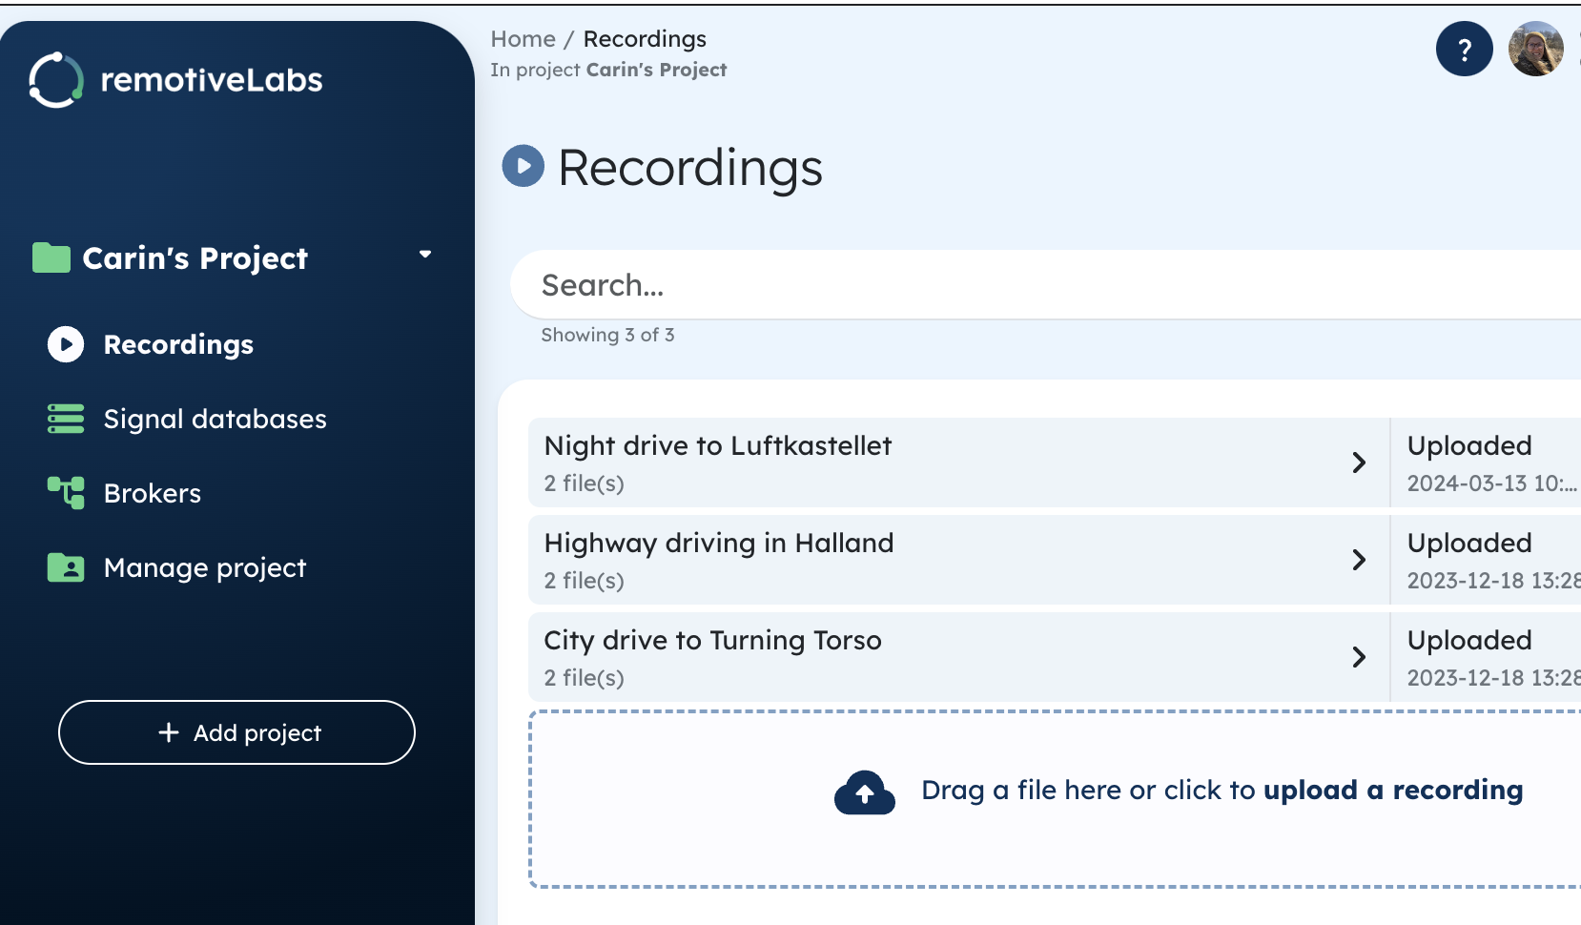
The Solution: A shareable virtual library of recordings
Common frustrations in
AAOS / AOSP development
Lack of vehicle data including knowledge
of which signals are / will be available!
Limited flexibility testing requires access to a vehicle at a fixed location and time.
Prototypes detached from reality incl late detection of feasibility / low innovation.
Recordings of drives incl. edge-case
leveraged
as a scalable resource.
Reduce gap
- between design &
engineering
Data science
- train your scenario models etc
RemotiveCloud - common satisfactions
Speed of innovation Requires no HW
+ same interface to try in vehicle etc.
Remote cloud replay test new apps
with real data using laptop as client.
Development & debugging - real time
seamless access via cloud or vehicle.
Sign up for free tier: cloud.remotivelabs.com

Slide 6
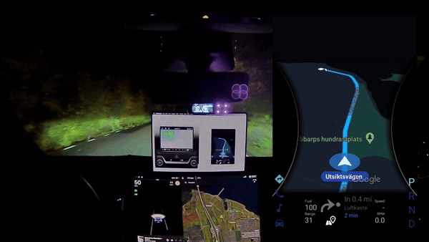
Seamless iterations: switching between
data logs, simulations, HW tests
RemotiveLabs dog-feeding: Android Maps running in a Tesla
Running the emulator in a mule it took minutes to change the URL and experience in a vehicle instead (same interface as RemotiveCloud). [Android Automotive: test on target HW] try for yourself: “git clone”.

Slide 7
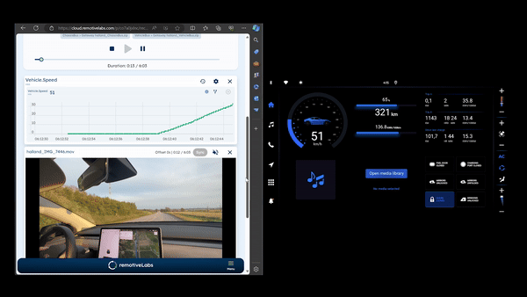
Virtualized testing with cloud recordings
Use case: P3 Sparq OS virtualized testing
Diagnostics & debugging Utilizing cloud recordings for SPARQ OS development, testing & demos. Seamless access to vehicle data in the cloud or in real time through open APIs [Read use case].
SPARQ OS– part of Android ecosystem: Proactively capture & analyze errors on test benches (HILs i.e. Profilence) & demo cars (Mules i.e. RemotiveLabs).

Slide 8
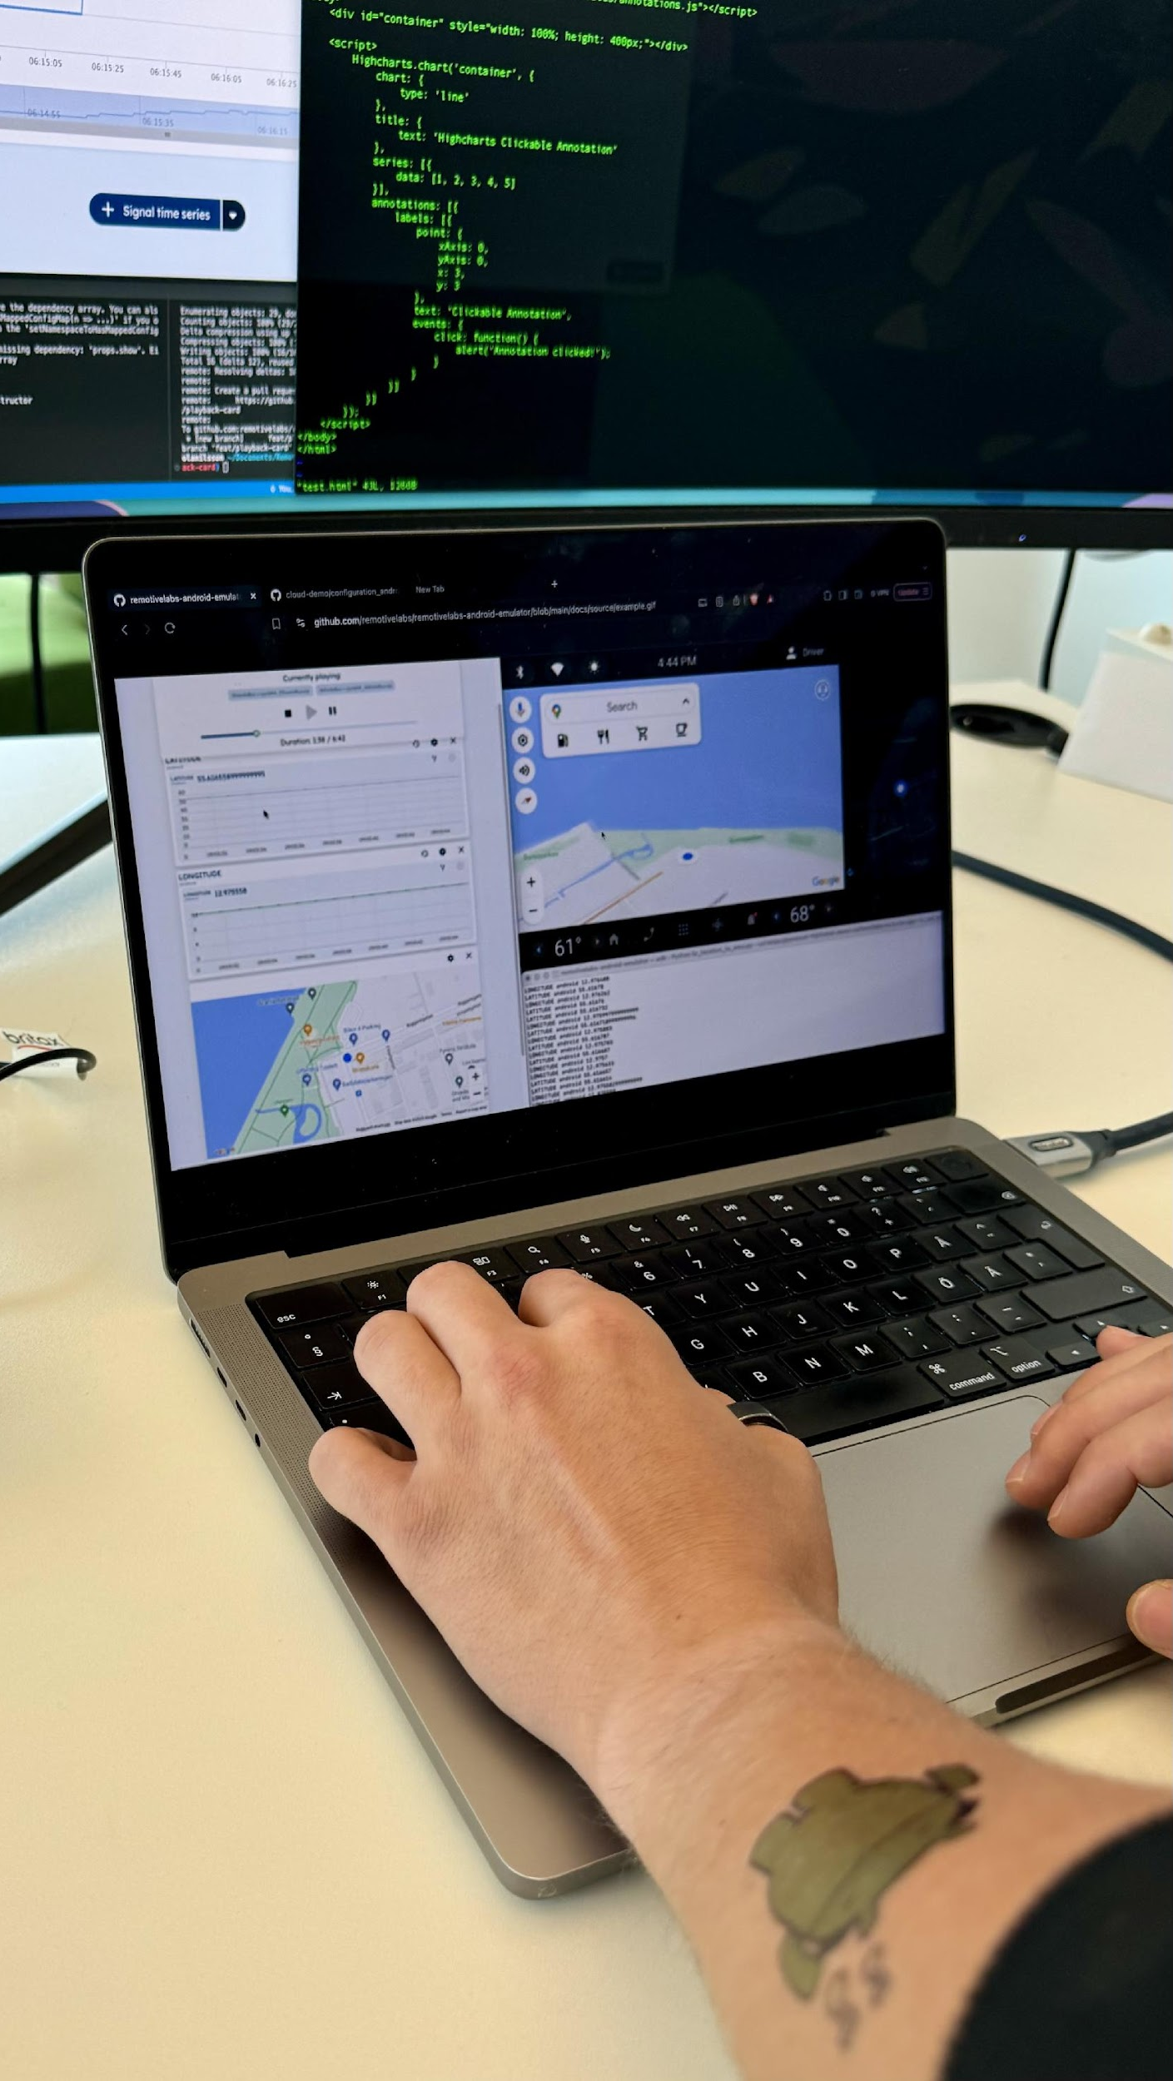
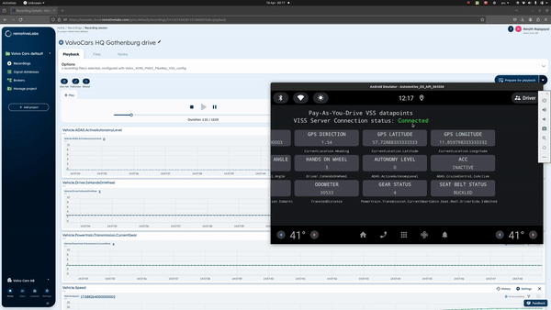
Use Case : AAOS In-Car driver safety score prototyping app instead of 'Volvo Cars app Innovation'. There is a product that Volvo has called 'Volvo Cars app'
Feed to your emulator of choice
Emulator example available on RemotiveLabs GitHub - guide here.
Use case: AAOS In-Car driver safety score prototyping app
Feed vehicle data to in-house emulator
Safety score calculation with gRPC enabled VISS API –
caters to Android Properties as well as other signals,
in an environment where recompiles are quick [Read case study].

Slide 9





Quality analytics & user modeling
Infotainment
system under test
Stream recorded &
live vehicle signals

Slide 10


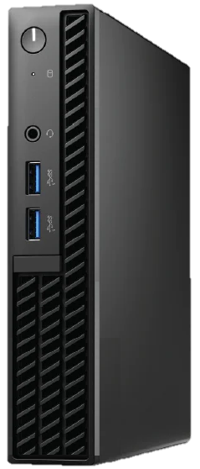


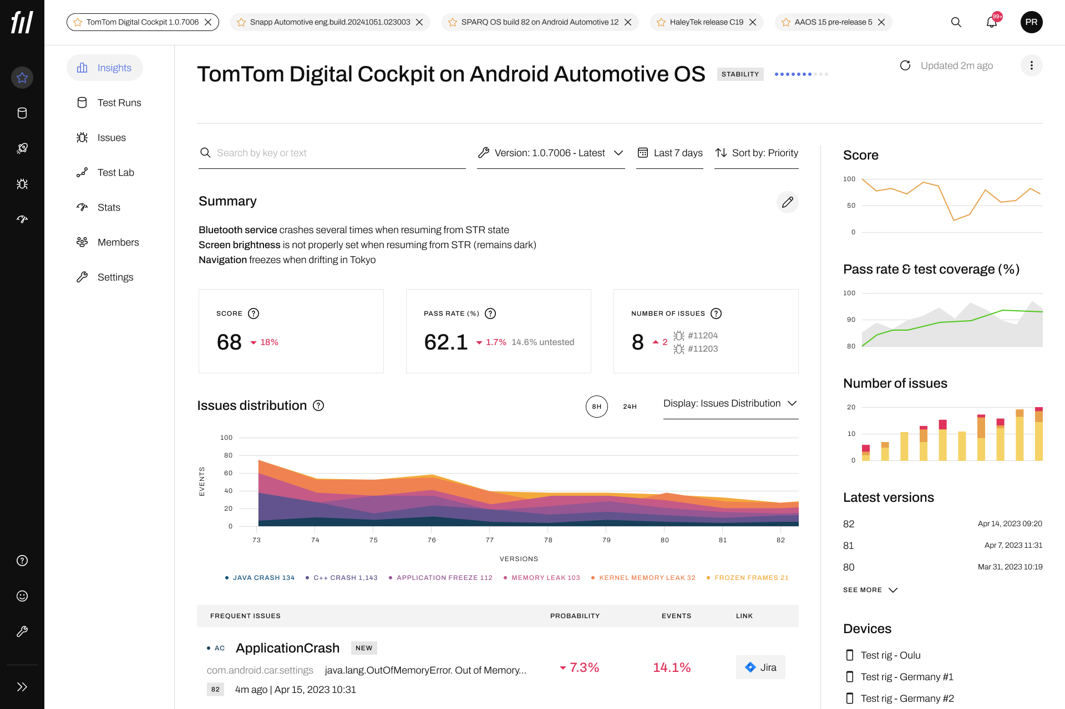


Memory leaks
QA Suite in the automotive context
Suspend-to-RAM and resuming
Main analysis / user modeling
Raw
data
UI performance
Results
Automatic quality analytics
Random crashes outside the infotainment domain

Slide 11






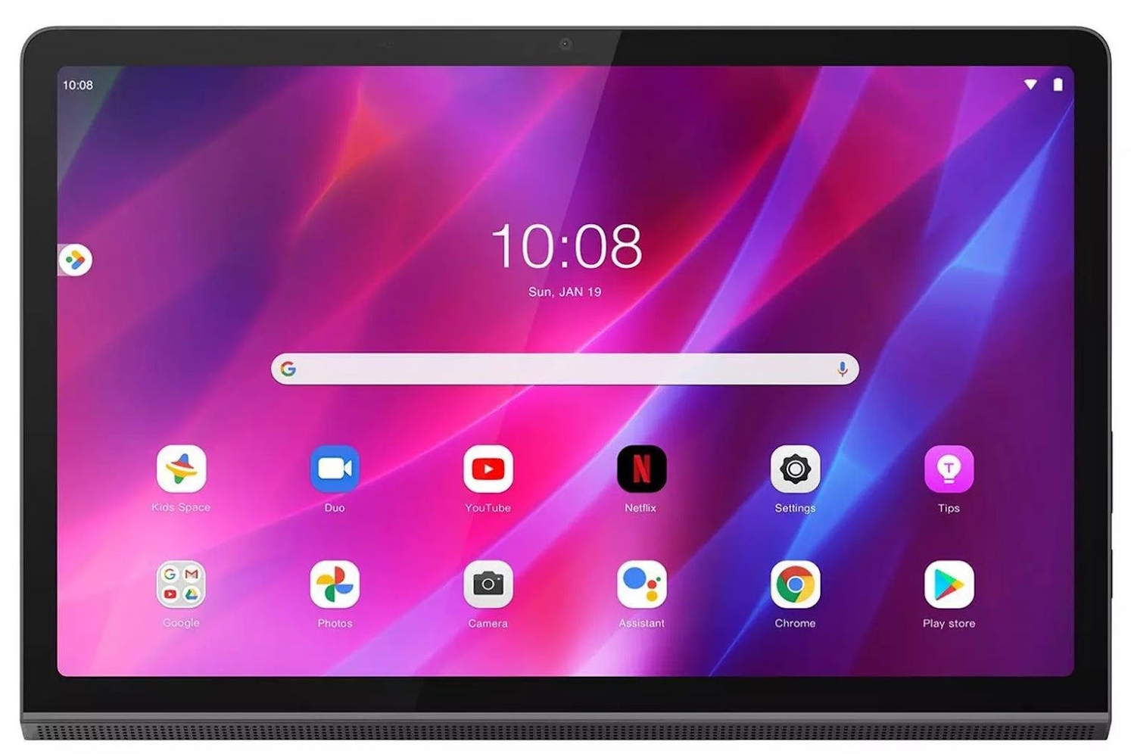
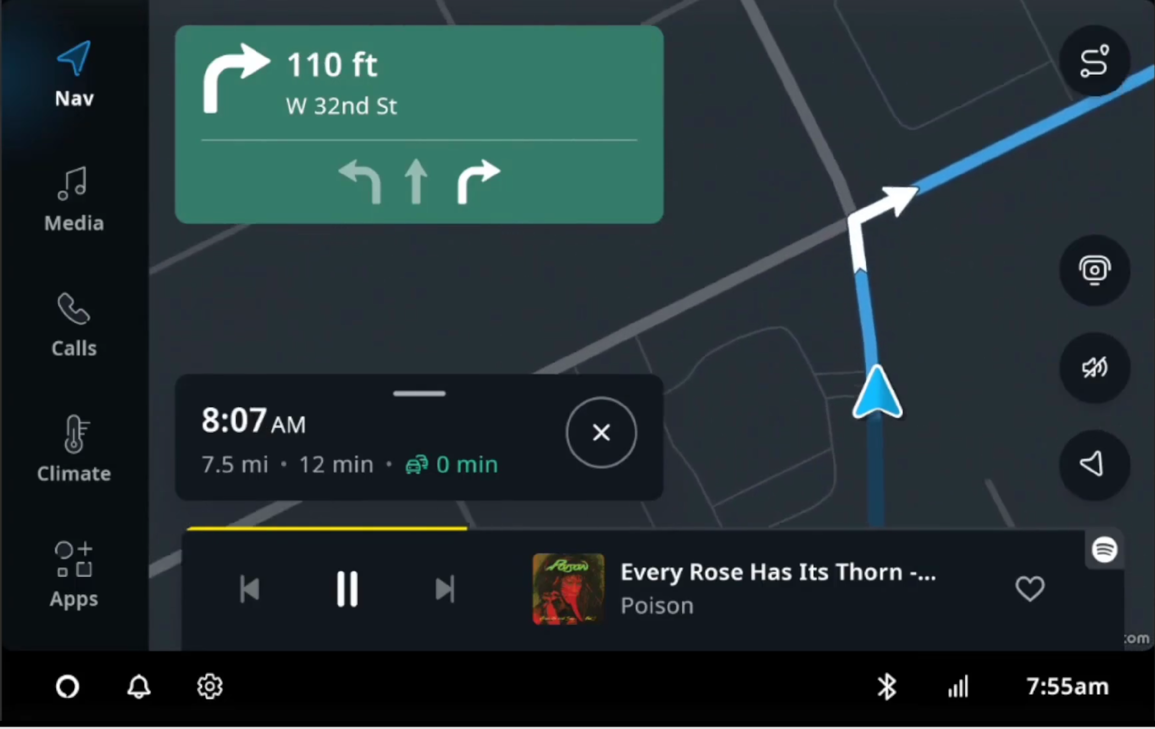
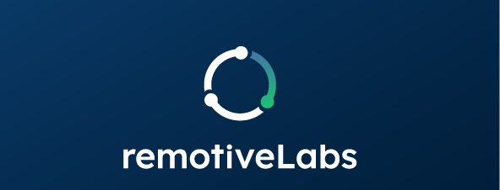
Long-term stability analysis for automotive
R&D Lab
Profilence Cloud
Raw
data
Profilence
Lab client
Data vault
Analytics
QA dashboard
User modeling &
Collecting data
Control
QA
results
QA
results
VSS Signals
QNX/Hypervisor
Log fetching, data collection, etc.
Modules with an external interface: serial, SSH, ADB, etc.
ECUs, telematics, etc.
Management
Engineering
teams
Control

Slide 12
QA dashboard for management and engineers
OEM/Tier1 gets real-time information on:
Quality trends: are things getting better or worse?
What are the most critical issues?
How likely are they to happen, and when?
What’s their impact on end-users?
What are their root causes?

Slide 13
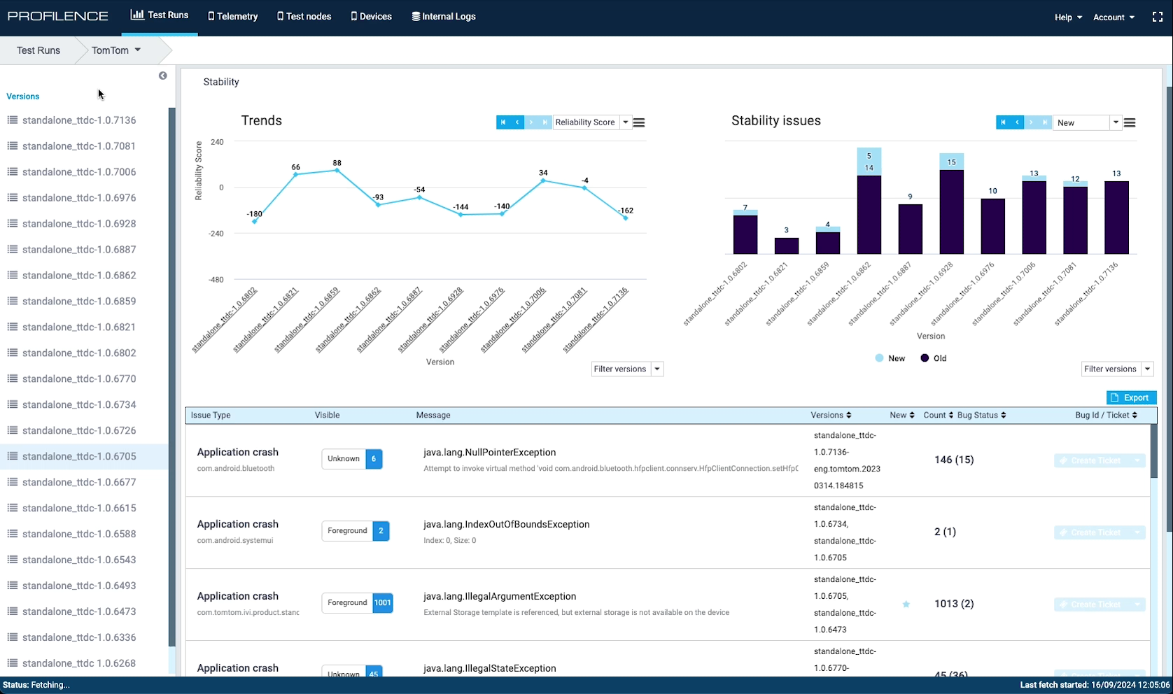

Slide 14
Process view
We integrate with your continuous development process
Real-time QA dashboard
Prioritized issues
Development
process
Stability
Analysis
process
Weekly SW release
QA findings
Backlog
Weekly meeting for reviewing QA status and planning new use cases & integrations

Slide 15
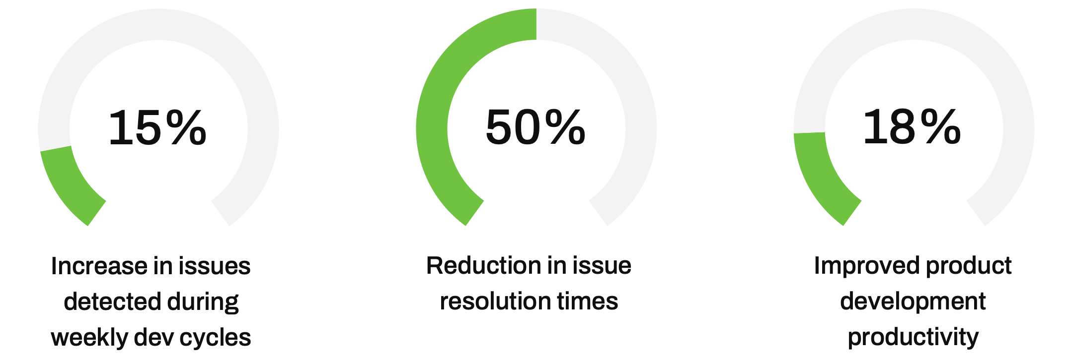
Net results
Clear improvements in R&D productivity and issue resolution times
Average results based on data from several OEM projects

Slide 16




Let’s do a pilot project together!
+ 6 other AAOS adopters

