Slide 1
Applying Model-Based Design to SDV Development
26 September 2024
Mark Danielsen MathWorks Principal Application Engineer

Slide 2
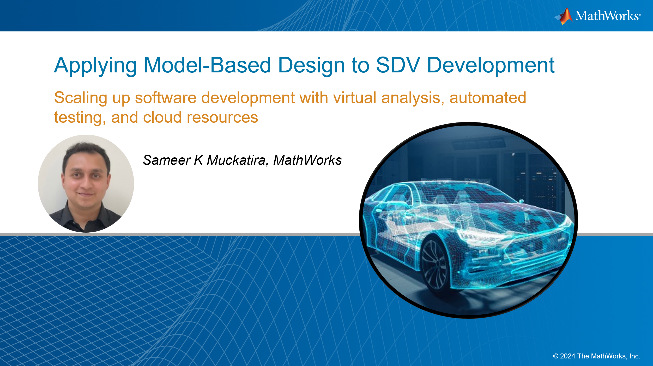

Scaling up software development with virtual analysis, automated testing, and cloud resources
Applying Model-Based Design to SDV Development: A Practical Example - Mobility Engineering Technology

Slide 3
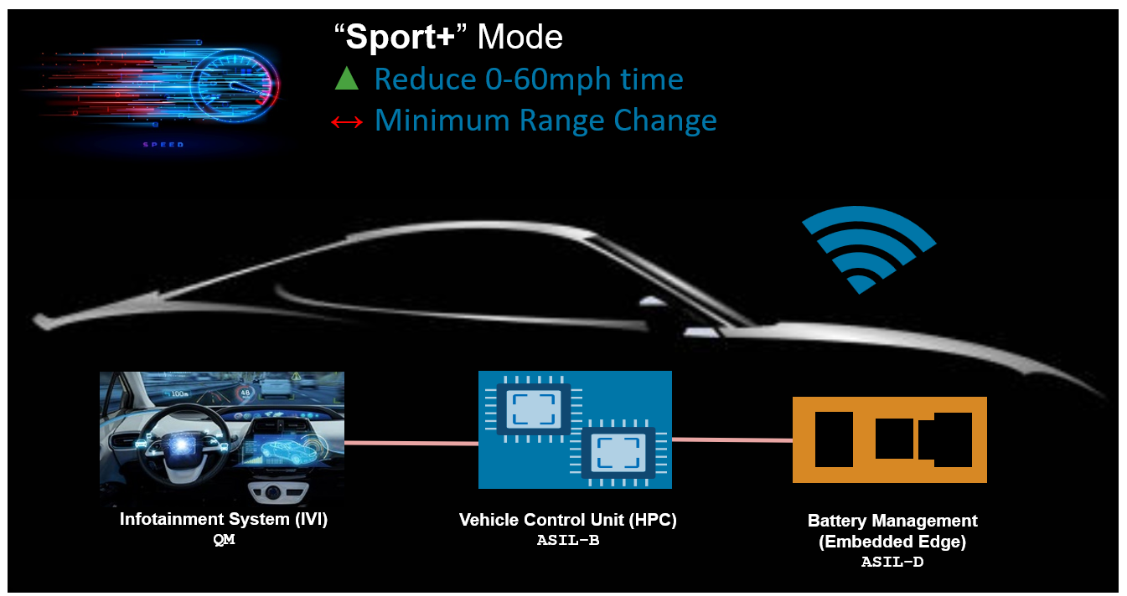
Motivation
Can we release new applcicaiton software with minimal Vehicle/HiL time?

Slide 4
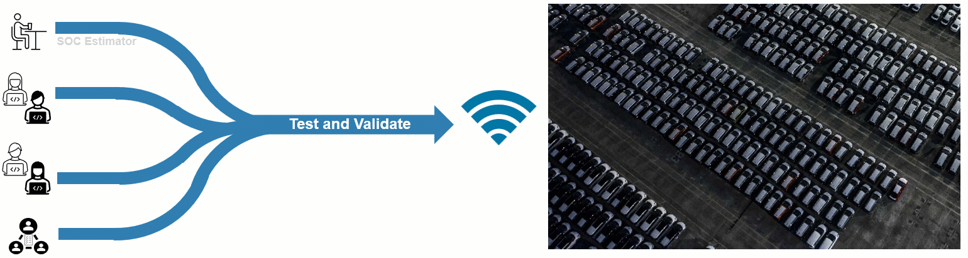
What is a Software-Defined Vehicle (SDV)?
Brand-distinctive features and main value for the customer will come from Software.
Software development extends beyond production start, with continuous updates delivered throughout the vehicle's lifetime.

Slide 5
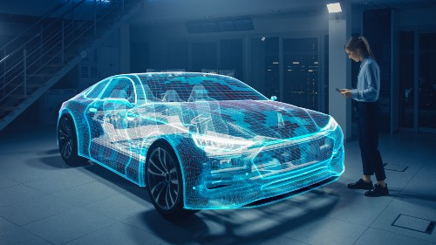
Model-Based Design in Automotive
Enabling engineers to design and test application software
E-Powertrain & Energy
Chassis Control
ADAS & AD
Body Controls
IVI/Cockpit
Connectivity
Software: that interacts with the vehicle’s sensors and actuators
that needs real-time (deterministic) execution
that requires high assurance
that meets maturity-model principles (Automotive SPICE)
that supports standard architectures (AUTOSAR Classic and Adaptive)
Software

Slide 6

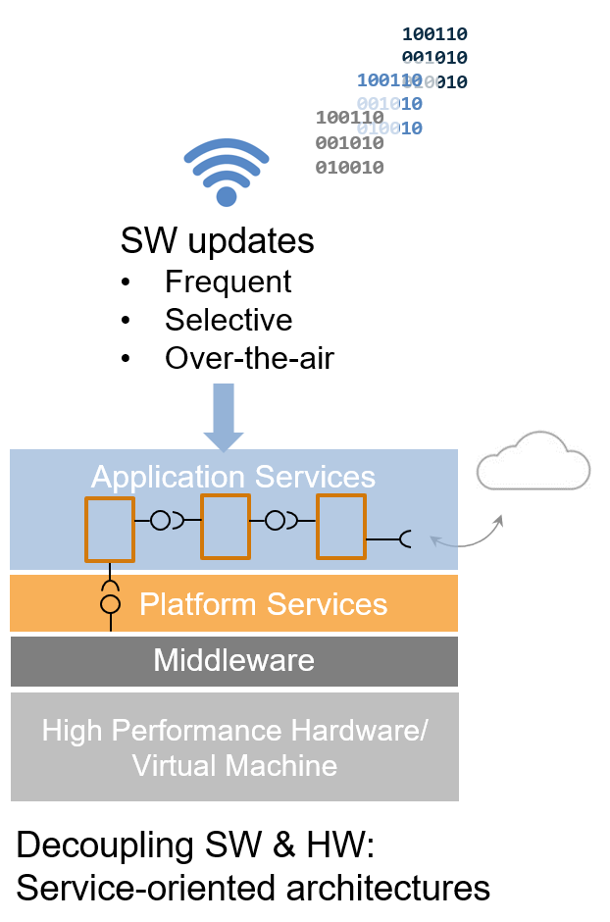
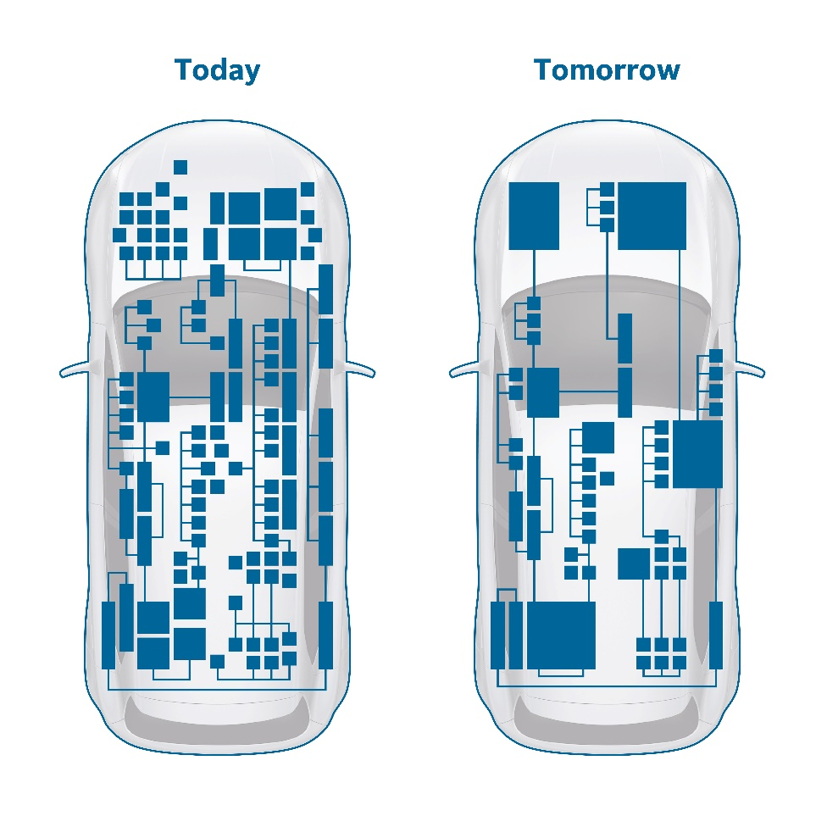
SDVs are Driving Significant Changes in Technology & Process
Centralization of computing and Services Oriented Architectures (SOA)
High-performance CPU/GPU
Consolidation and centralization of computing
New E/E zonal architectures
Notes:
From a technical perspective, a clear trend is the transition to high-performance computers and centralized architectures.
The goal is to provide processing power to deliver smart, AI-enabled, features and reduce cost and complexity at same time
These new architectures will have central vehicle controllers, based on high-performance CPUs and GPUs, coupled with zone controllers to manage sensors and actuators
Another key element to enable continuos delivery and improvement of smart SW features is selective and frequent update over the air, very similar to the updates of apps in your smartphones: service oriented architectures are going to provide this capability

Slide 7







SDVs are Driving Significant Changes in Technology & Process
Evolving Model-Based Design to address these changes
Run MATLAB and Simulink in the Cloud
Flexible Generation of SOA & Signal-Based Software
Automate Model-Based Capabilities with Continuous Integration
Shift-Left Software Integration with Simulation
Enable easy access to cloud-data
Scale up analysis/ simulations by running MATLAB & Simulink in the Cloud
Generate platform specific application software
Easily re-architect legacy applications to SOA
Consistent execution of process steps
Repeatable for each update, from each engineer
Identify issues early with MiL & SiL closed-loop testing
Collaborate with partners for tool integration and Virtual ECU testing

Slide 8



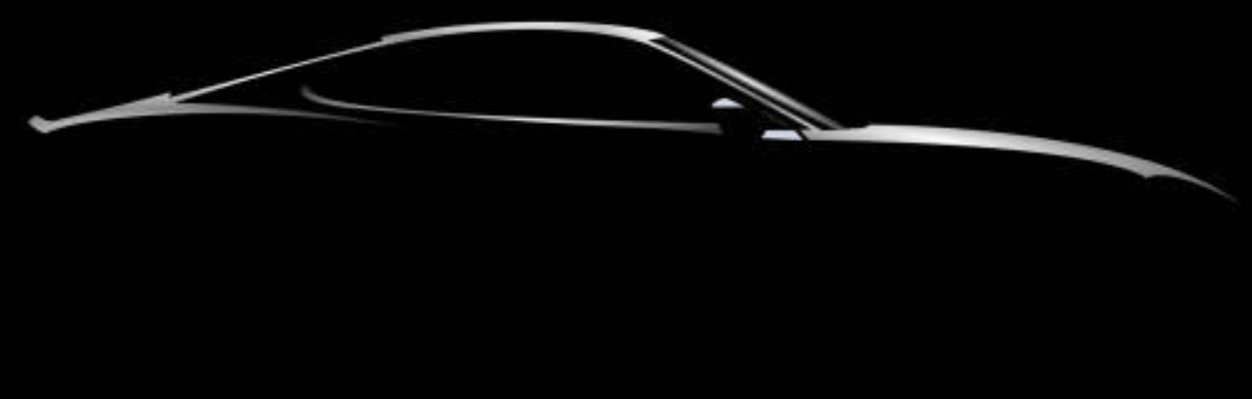
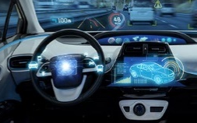
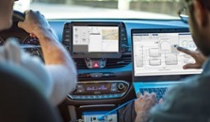
SDV Development in Action: Building a new EV Sport+ Mode
Stakeholder needs - How will it function?
“Sport+” Mode
▲ Reduce 0-60mph time
↔ Minimum Range Change
Infotainment System (IVI)
QM
Vehicle Control Unit (HPC)
ASIL-B
Battery Management
(Embedded Edge)
ASIL-D
Driver Requests for Sport+ Mode
Confirm no faults, Confirm Battery > 25%
Increase available power

Slide 9
SDV Development in Action: Building a new EV Sport+ Mode
The engineering challenges
“Sport+” Mode
▲TrqDemand ▲MaxBattCurrent
▲RegenOperation
Conflicting Design Goals
Different ECU Architectures
Multiple Engineers Involved
Infotainment System (IVI)
QM
Vehicle Control Unit (HPC)
ASIL-B
Battery Management
(Embedded Edge)
ASIL-D
Multiple Systems and ECUs Interacting

Slide 10
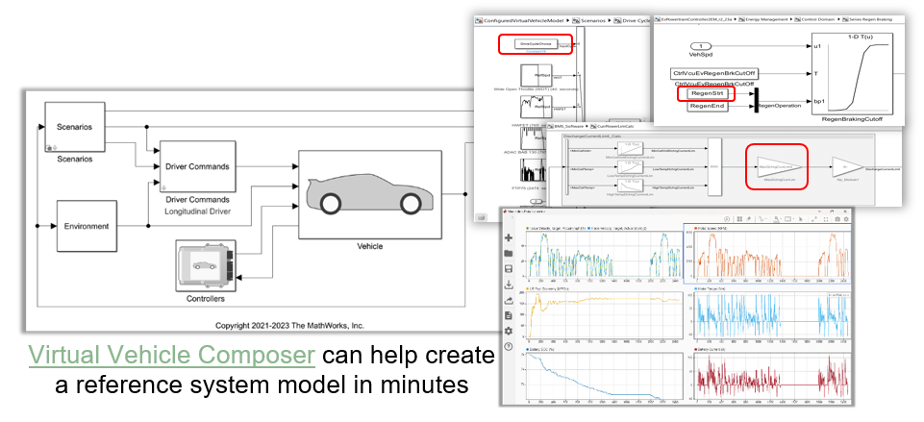
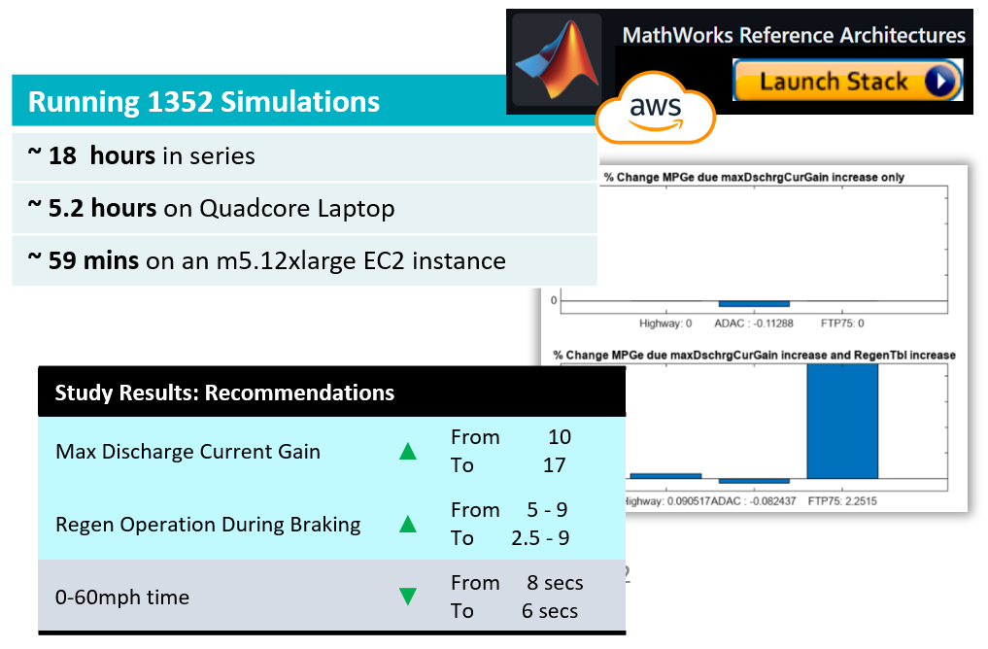

SDV Development in Action
Challenge 1: Design studies using virtual simulations
Challenge:
Identify software parameters we can vary to enhance vehicle performance
Quantify the effect of changing these parameters of at a component and system level
Solution:
Study goals
0-60 mph in <6 seconds
Quantify Loss in MPGe
Quantify gains from regen in different driving conditions
Variables
Increased Max Battery Current Lim
Increased Regen Operation Limits
Build a system level model with detailed component level models where required
Scale up simulation studies using parsim on the cloud

Slide 11

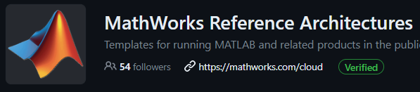
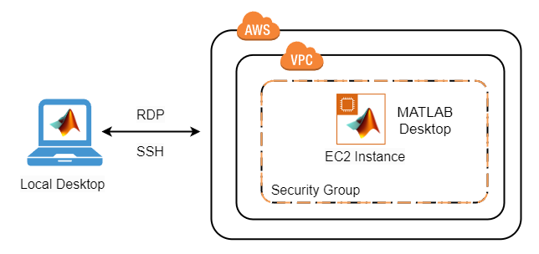


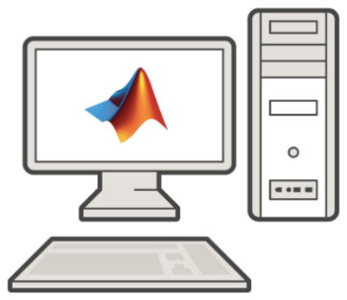
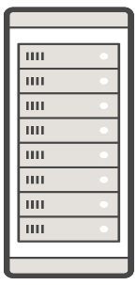



SDV Development in Action
Challenge 1: Design studies using virtual simulations
Running 1352 Simulations
~ 18 hours in series
~ 5.2 hours on Quadcore Laptop
~ 59 mins on an m5.12xlarge EC2 instance, 24 core
MATLAB on AWS EC2
Parallel Computing Toolbox
MATLAB
Worker Machine = m5.12xlarge (24 cores)
GPU
Running 1352 Simulations
~ 22.7 mins on 5 Worker machines, 120 cores
~17 mins on 10 Worker machines, 240 cores
Multi-core CPU
MATLAB Parallel Server
Learn more: MATLAB on AWS, MathWorks Reference Architecture, MathWorks CloudCenter

Slide 12
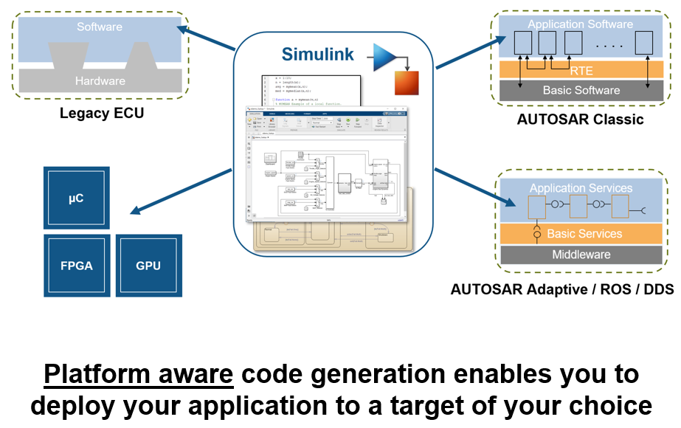
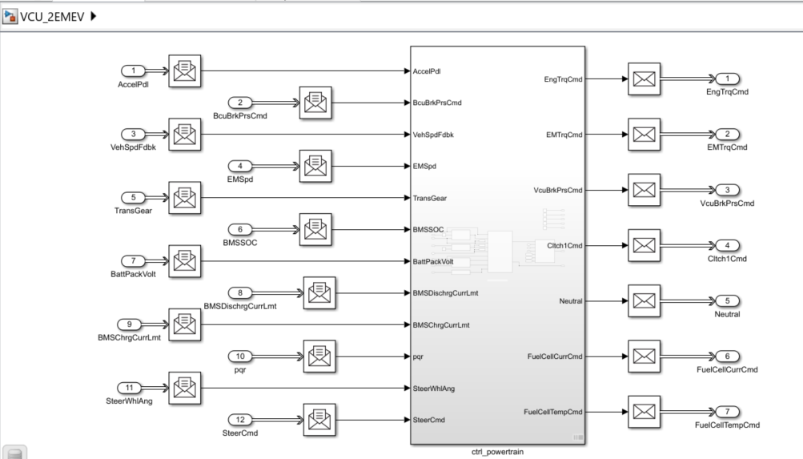
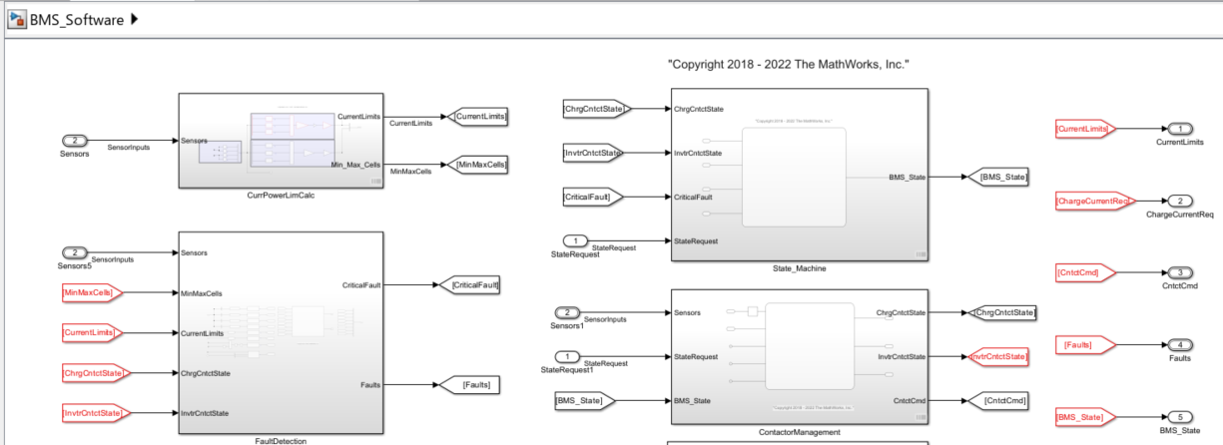
SDV Development in Action
Challenge 2: CodeGen for mixed critical architectures
Challenge:
Deploy the Vehicle Control Unit (VCU) application software as C++ code that is compliant with the Adaptive AUTOSAR platform
Deploy the Battery Management System (BMS) as C code that is compliant with the Classic AUTOSAR platform
Solution:
Leverage MathWorks’ code generation and AUTOSAR tools to customize the generated application software, depending on your platform and hardware needs.
Message based communication and interfaces setup for VCU
Signal based communication and interfaces setup for BMS
Learn more: Designing and Deploy to SOA with Simulink, Software Architectures with Simulink and System Composer

Slide 13
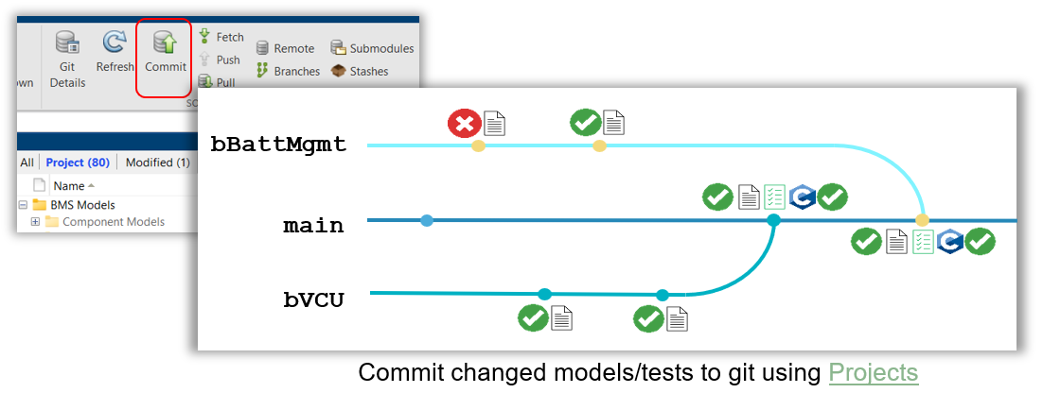
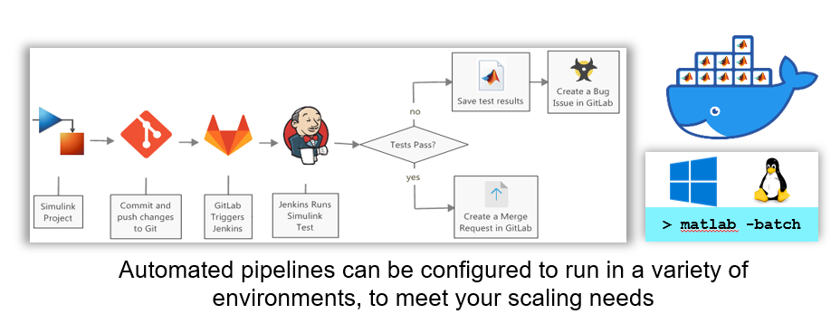
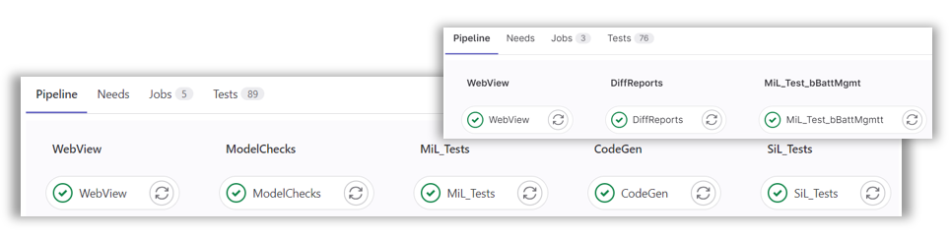
SDV Development in Action
Challenge 3: Automated testing and codegen via Continuous Integration
Challenge:
Enable multiple engineers to simultaneously develop features in parallel, but can share and sync with the other colleagues
Test application code while still in development, thereby creating a “fix-as-you-go” workflow
Automate large scale testing and code generation when development branches are merged to main/release branch
Solution:
Componentize models and place them under source control
Test at model level, application software level, and conduct MISRA C checks
Setup non-interactive MATLAB on runner computer(s); and perform automated tests, codeGen, and report authoring tasks

Slide 14
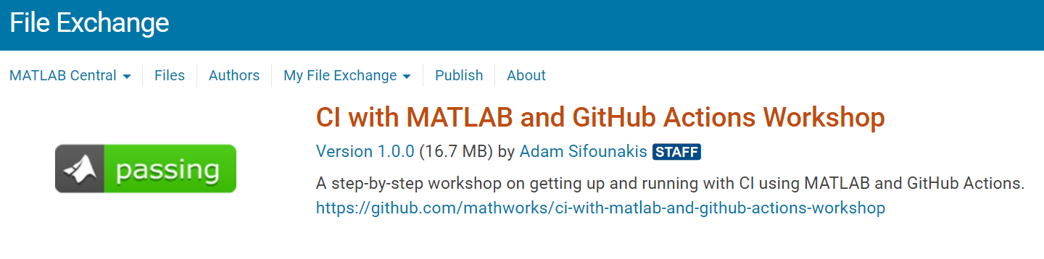
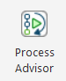
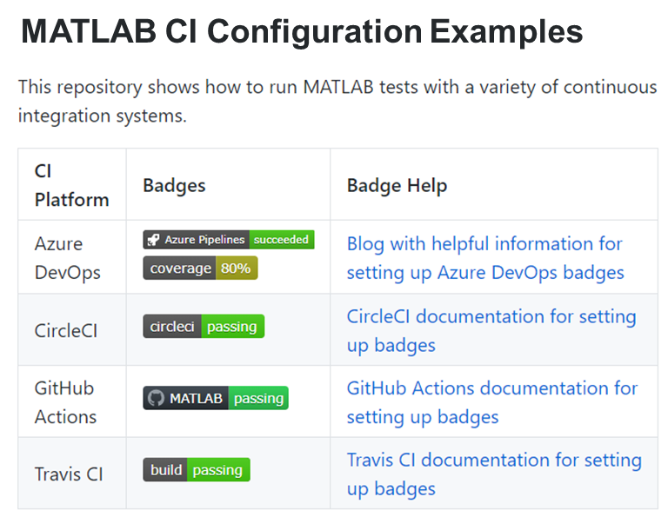
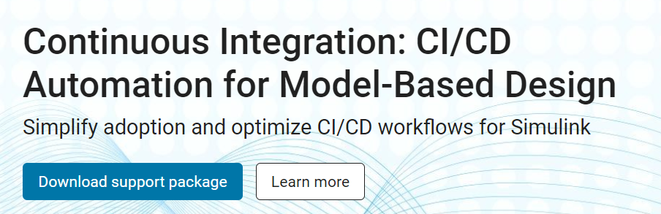
SDV Development in Action
Challenge 3: Automated testing and codegen via Continuous Integration
MathWorks has extensive support to enable your team to setup Continuous Integration
Learn more: CI/CD Automation for Model-Based Design

Slide 15
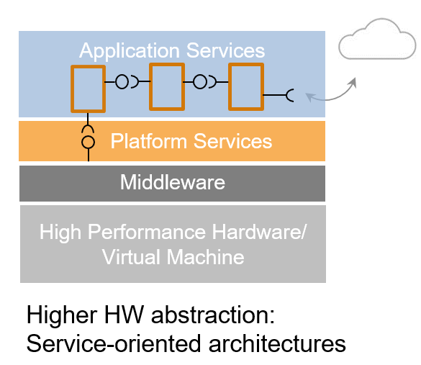
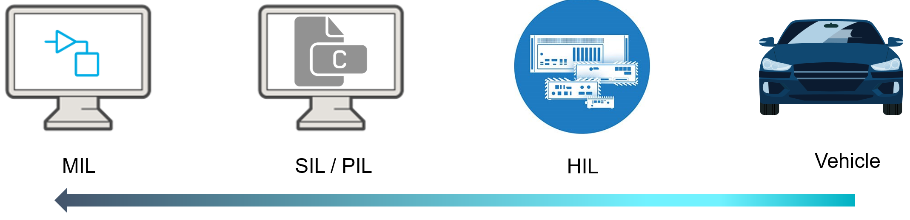
SDV Development in Action
Challenge 4: Virtual ECUs deployment and testing
Can we test and refine more virtually?
Reduce the need ECU or peripheral hardware?
Can we test and refine more virtually?
Reduce the need for ECU or peripheral hardware?

Slide 16
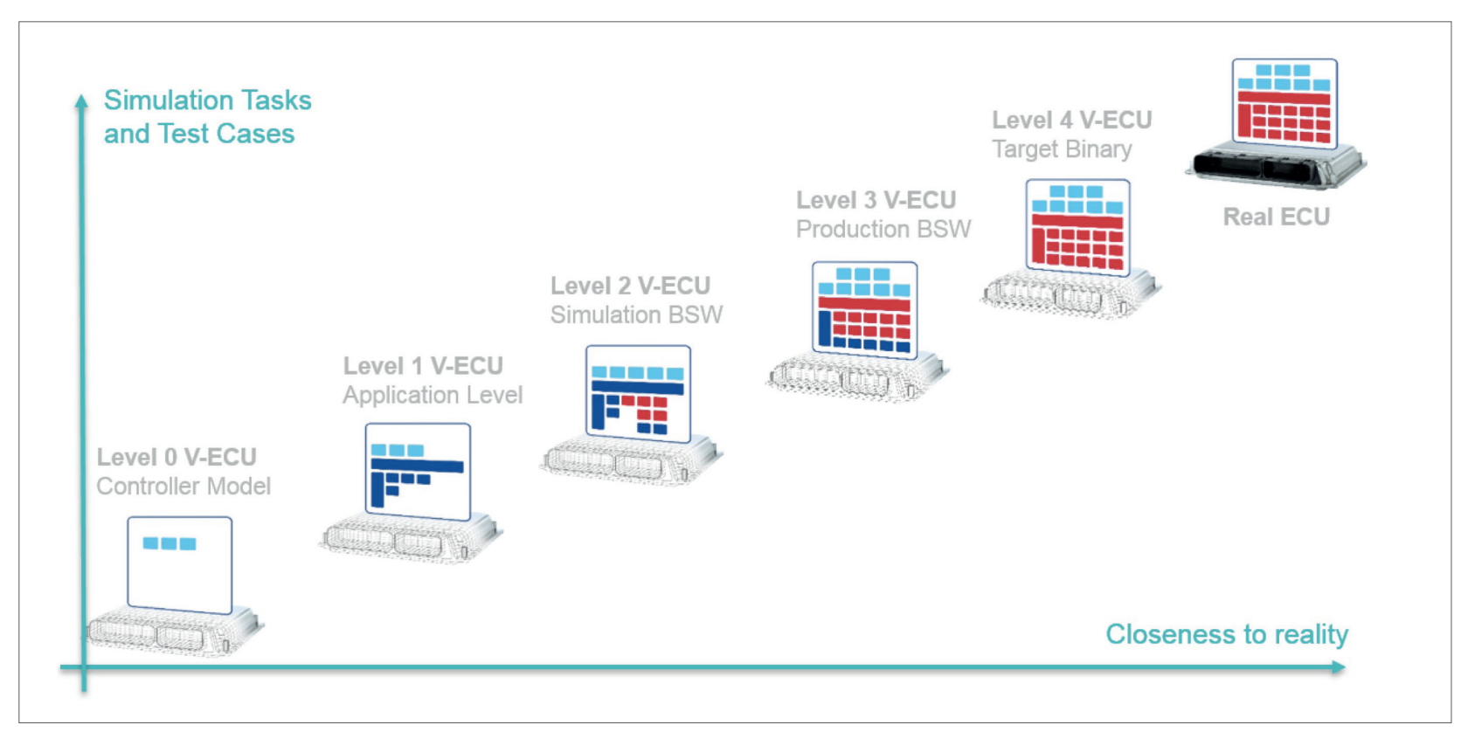

SDV Development in Action
Challenge 4: Virtual ECUs deployment and testing
Collaborate with Partners
Model + Code
Image Credit: ProSTEP iViP Association. (2020). SmartSE - Virtual Electronic Control Units. [White Paper].
Notes:
While we generally agree with this grouping, we felt the role of model is not emphasized enough. For example, at MAB keynote this morning, there was a poll on software integration strategy, model based simulation, and a mixed strategy of using both model and code represent about 73% of the votes.
As said before, Simulink has a unique position that it is a platform to support both model based and code based desktop simualtion, so for us the goal is to cover from level 0 up to level 3. For Simulink, our foucs is on where the complexity grows, which we believe most are from the application software.

Slide 17
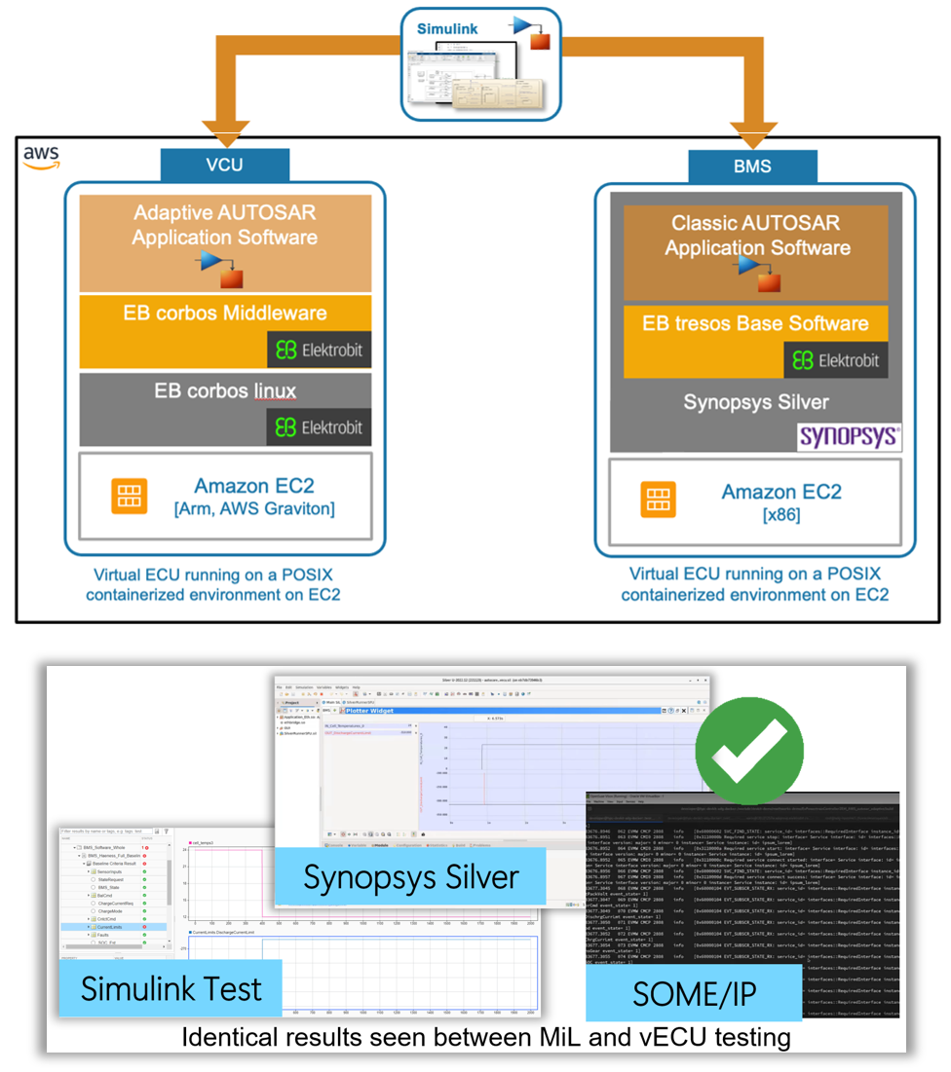

SDV Development in Action
Challenge 4: Virtual ECUs deployment and testing
Challenge:
Ensure application software can integrate into a variety of environments, depending on hardware architecture & middleware
Verify model based AUTOSAR applications on ‘road ready’ middleware in the cloud without target hardware
Solution:
Customize application code interface for specific middleware/hardware
  Classic AUTOSAR
  Adaptive AUTOSAR / DDS / ROS
Integrate application code with underlying middleware to deploy within Level 3 virtual ECUs
Run virtual ECUs in a cloud native environment and verify the vECU is equivalent to MiL/SiL tests
Virtualize
Scale

Slide 18
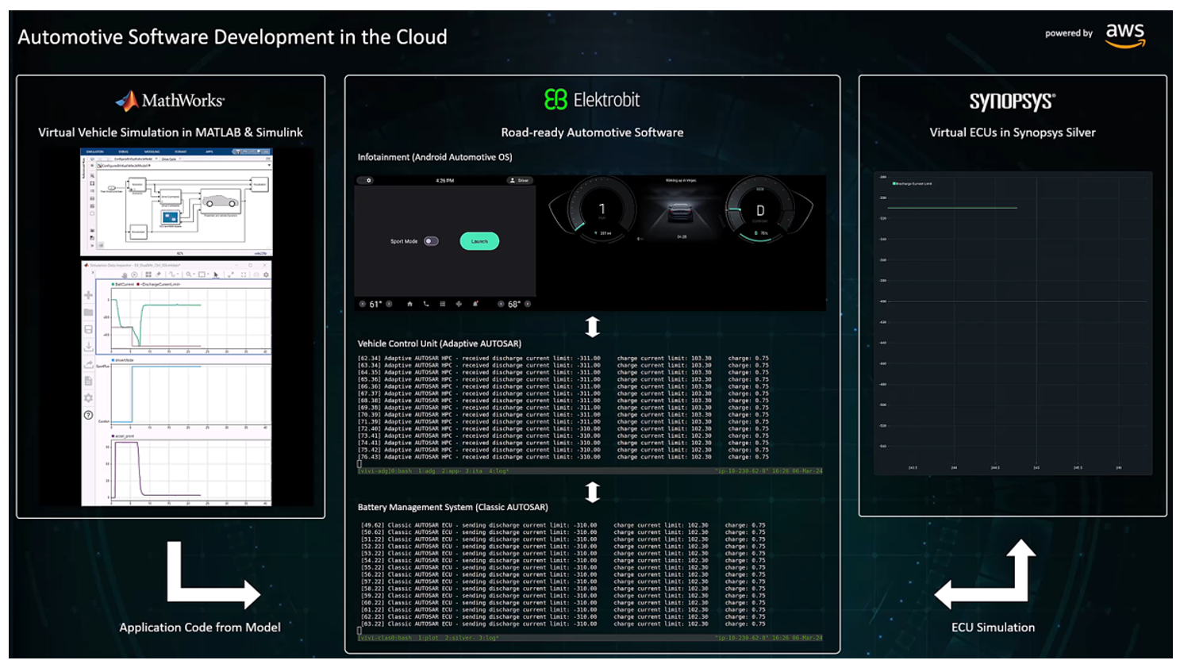

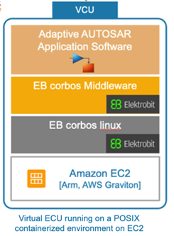
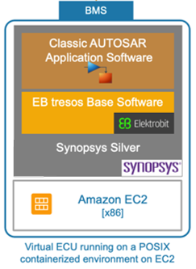
SDV Development in Action
Challenge 4: Cloud-native Virtual ECUs deployment and testing
Test Vectors & Vehicle Behavior exported from Simulink
(Injected into vECUs via SOME/IP)
Inter ECU Communication
(via SOME/IP)

Slide 19
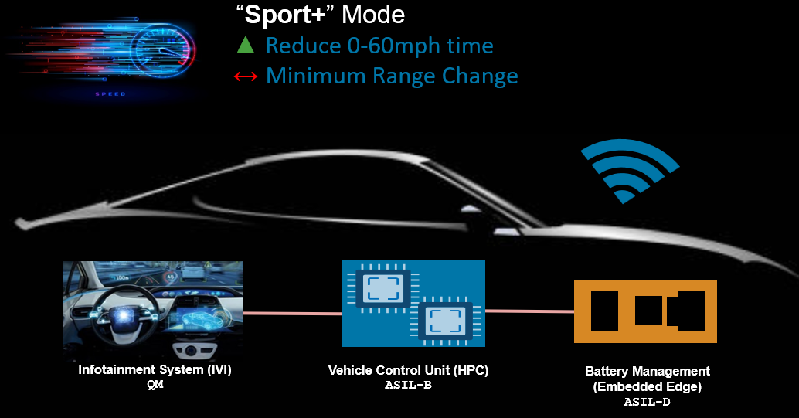
SDV Development in Action
Benefits of building your SDV with MBD
Early analysis of design options completed virtually and at large scale
Code generated to meet a specific architecture needs
Application layer tested early and often
Verify base software and application software work together
Verify communication between ECUs
Automated testing to handle commits from multiple engineers

Slide 20
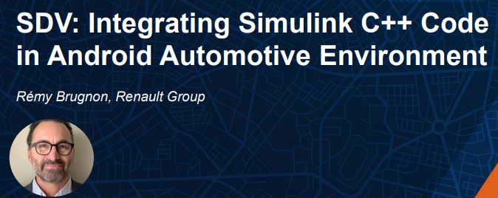
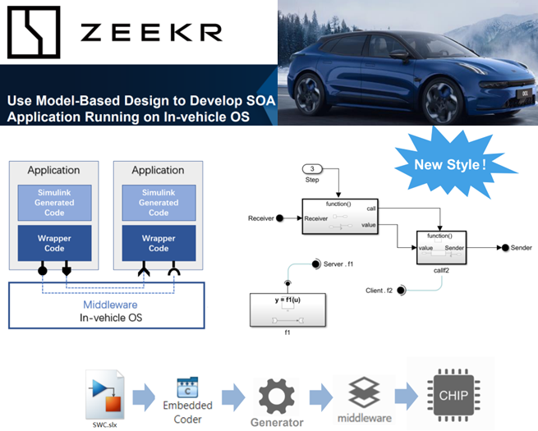

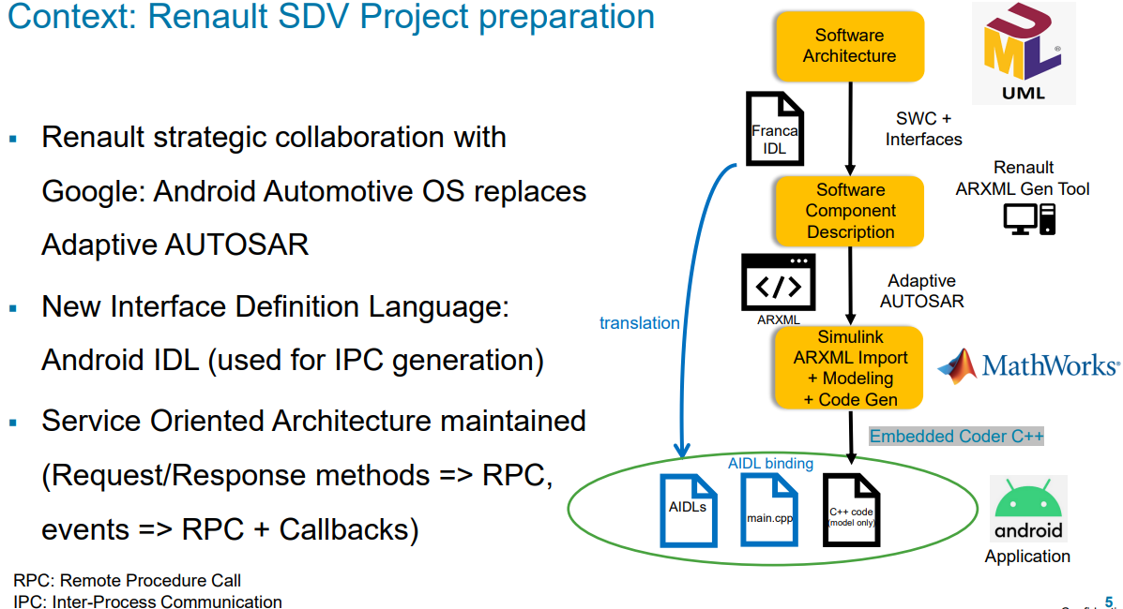
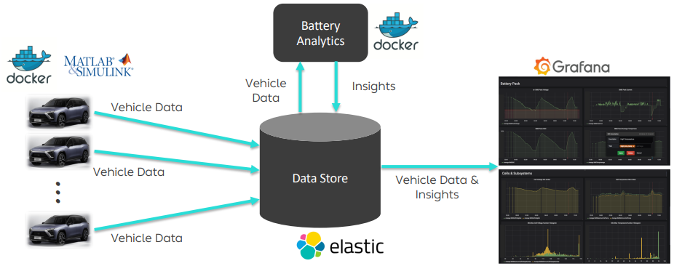





















MathWorks is Collaborating with the Ecosystem to Mature the Tooling for Software Defined Vehicle Development
Semiconductor eco-system
Supplier eco-system
OEMs
Notes:
MathWorks is an Associate Member of COVESA

Slide 21

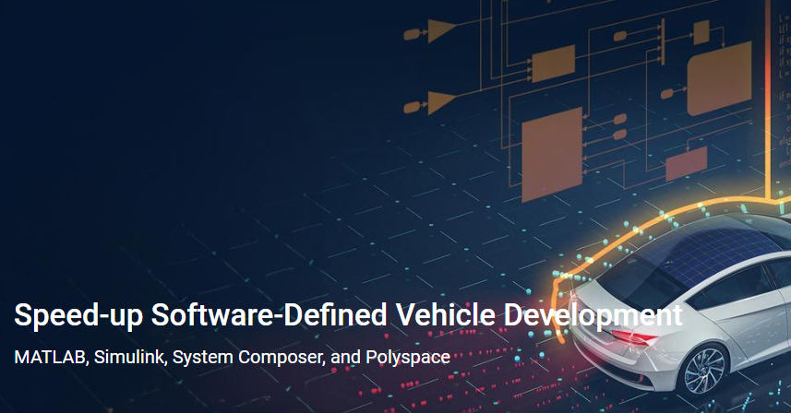
Thank You! To learn more, use the QR Code below
Overview: Software-Defined Vehicle

