Slide 1
Transforming SDV Integration: Leveraging AI, Data, and Continuous Development
BOGDAN RACOTEA
15 May 2025

Slide 2



Speakers Overview
AI Powered Automotive Innovation
Bogdan Racotea
Founder & Managing Director
Smart Engineering and Development
Josef Mleziva
CTO and AI expert
Smart Engineering and Development

Slide 3

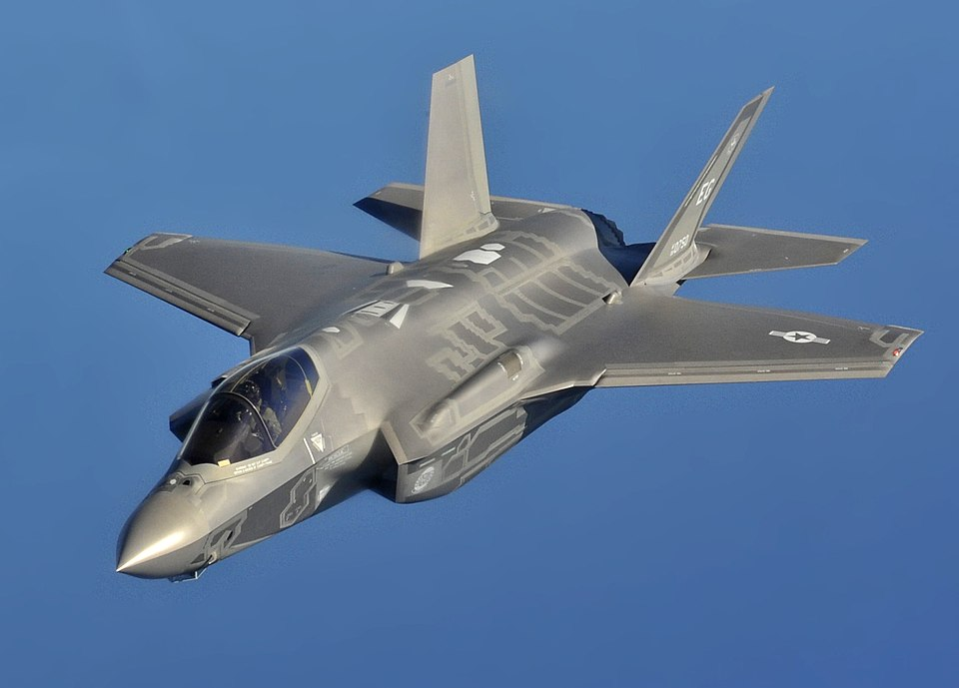

Setting the mood right
Q: How many lines of code are there in…….?
A Smartphone
  A F35 Fighter Jet
A modern car
~50 M LOC
~25 M LOC
~150 M LOC

Slide 4
Why Software Complexity Matters in SDV
150M+ LOC/Car – Doubling by 2030
Frequent OTA Updates – becoming the norm
Legacy Code + HPC = Integration Pain
High Development Cost
Needed to reduce TTM
Quality issues after SOP
Reduces costs by reducing Complexity
AI Driven Software CD/CI/CD Environment
Significantly Improves TTM
Significant reduction in Issues discovery

Slide 5
Increased SDV Complexity = Integration Technical Debt
One Integration Event/Release = Last minute Firefighting = High Peaks in Development
Wrapper/Adapter Approach = Adds Extra testing = Perpetual Testing and Maintenance
Branch and Variant explosion = High Integration complexity with high risk of issues/failures
Legacy code adapted to new architecture= Long term liability issues
Pain Stop: AI Assisted Continuous Development and Continuous Integration Environment

Slide 6
Solution: AI Assisted Continuous Development, Continuous Integration Environment and Continuous Deployment
Continuous Development
Continuous Integration
Continuous Deployment
Context-Aware Coding Assistant
Predictive Builds
Automated Release Notes Creation
Real-time Requirements/Standards Checker
Pipeline self-Tuning
Automated Test-case generation & Execution
Early Issue Detection
Self-Healing builds
Automatic Issue resolution
Compiler Copilot
Smart Merge and Branching
Build deployment
MISRA Checker & Assistant
Pre -Integration and Pre-Validation

Slide 7
Reference Architecture
Cloud Storage
Requirements Generation
Architecture Generation
Single Source of Truth
Coding/Software Implementation
Coding Assistant
Req Checker
Compiler Assistant
MISRA Assistant
PreIntegration
Issue Assistant
Deployment
AI Code Review Agent
Release notes
Testing
Integration
Issue Resolution
Predictive Integration
Self Healing Builds
Pipeline Tuning
AI Generated Test Suites
Continuous Development
Continuous Integration
Continuous Deployment

Slide 8
AI Assisted Continuous Development (or Shifting Left)
Why it matters: AI Assisted Continuous Development provides a development cadence that is fast enough to keep pace with innovation, and disciplined enough to satisfy the rigorous safety and compliance audits
Key Benefits
Typical Drawbacks
Rapid Idea-to-Code Flow: Enabled through GenAI pair programming & static template definition
Tool-Chain Complexity: Lots of AI plugins coupled together can bring unnecessary complexity
Instant requirement check: Instant Traceability and link to requirements and standards
Over-Automation Risk: Risk of Vibe-Programming is real!
Early Warning for Issues: AI coding assistant provides instant issue detection as code is written
Context miss-use: AI hallucinations can be disruptive if context is not kept throughout development
Significantly higher Developer Throughput: less waiting times (compilation, etc), less context switch
Cost with infrastructure: Appropiate storage needs to be secured for safe continuous commits
Seamless documentation creation: design documentation, code reviews, etc
Security/IP concerns: AI Prompt data or proprietary code leaks to external AI servers

Slide 9
AI Assisted Continuous Integration
Why it matters: AI Assisted Continuous Integration complements “build-green” existing CI practices with self-healing mechanism, predictive analysis, AI Enhanced test-suites, and continuous learning practices to keep the fast pace of development
Key Benefits
Typical Drawbacks
Fast Detection of Integration bugs: Fast and frequent integration events filters issues
Incomplete tests: non-deterministic simulations make pipelines unreliable
Main Baseline always deployable: Main release branch is always tested and ready to deploy
High IT Resources need : large code base is GPU and CPU dependent
Seamless compliance: ASPICE compliance is automatically ensured
Over-Automation: Self healing process can lead to hidden issues
vHIL Emulation: enables the use of virtual ECUs for fast issue detection
False sense of Safety: Automatic testing cn lead to hidden issues if left uncontrolled
Metrics for continuous improvement: Code coverage, cyclomatic complexity metrics used for automatic code refactoring
Tool chain dependency: multiple ECU tool chains must coexist and work together

Slide 10
AI Assisted Continuous Deployment
Why it matters: AI‑assisted Continuous Deployment pipeline elevates the process from “copy artifacts to production” to an adaptive, safety‑aware rollout engine: it clusters vehicles by hardware variants and driving environments, calculates ASIL‑based risk scores, schedules over‑the‑air waves when connectivity is strong, and streams telemetry through anomaly‑detection models that can halt or auto‑rollback an update in minutes.
Key Benefits
Typical Drawbacks
Ultra‑Fast Feature Roll‑out: New Functions rolled out in days not quarters
Safety and Regulatory Risks: a misdiagnosed issue can create issues
Real‑world Telemetry Feedback: Data collection for continuous improvement
Rigorous Approval Workflows Needed: Safety sign-off manual gateways still needed.
Lower Operational Overhead: nu huge release process, firefighting and hotfixes
Version Fragmentation: poor rollout orchestration leaves mixed software on identical vehicle trims
Fleet‑wide Security Patching: vulnerabilities remediated before they become exploit‑worthy
Network Connectivity: unreliable cellular/Wi‑Fi in remote causes partial updates
Increase end-User Satisfaction: Car able to improve “like a smartphone”
Attack Surface Expansion: OTA endpoints and update packages become high‑value targets for hackers.

Slide 11
Data – The Hero of AI

Slide 12


Clean and clear Input = Reliable code implementation
Ideas
Clear Boundaries
Well Defined Role
Project Context
Best Practices
Single Source of Truth
Requirements
ARXML
Architecture
Guidelines
Reliable Data

Slide 13
Reproducible CI Artifacts = Trustworthy Validation
Golden Datasets
Data Snapshots & checksums ensure deterministic tests
Digital Twins
Configuration-as –Code peer-reviewed and signed off ensures accurate testing for edge cases
Compliance Evidence
Build metadata and SBOM ledger ensures faster compliance

Slide 14


Telemetry Driven Deployment Loop
Implementation
Integration
Redeployment
Requirements Redefinition
AI driven anomaly detection dashboard triggers instant rollback in case of issue
Context Rich driving logs tagged in realtime
Automated feedback loops feed field issues back into Dev & CI pipelines
OTA
Vehicle Metrics detect OTA failures & Provide further information
Visualization
of Data
Update wave analytics
Manufacturing/calibration fingerprints

Slide 15
AI pitfalls
Privacy
Taking over jobs
AI Building/Training costs
Hallucinations
Reliability
Intensive HW costs
…..and many more still to be discovered

Slide 16
AI Pitfalls
Training costs
Use LLMs- widely available and pre-trained
Can understand human language
Privacy
Run Open Source LLMs locally using company infrastructure
High HW costs
Use smaller models that can fulfil specific tasks*
There are several thousands small models in Open Source Repositories (see Hugging Face)
HW can be scalled from 15-20K EUR up to desired computing power

Slide 17
AI Pitfalls
Hallucinations
Use LangChain method to link multiple small LLMs together to check each other's outputs
Taking over jobs
Complex tasks can be summarised and provided to human expert for further analysis
Human is the ultimate decision maker in the creative process
Reliability
Ensure consistent context for used LLMs

Slide 18
AI Implementation “Golden Rules”
LLMs to be used (pretrained)
Deploy locally for maximum Data Privacy and Security
Mitigate hallucinations by using advanced techniques
Benchmarking to ensure models used are fitting for the defined tasks
Human supervision is always needed

Slide 19
Next steps
Any development environment to be deployed in real world scenarios before mass usage
Define clear benchmarking rules and guidelines
Define/Refine Hardware Costs
Incremental increase in AI adoption across companies
Open forums for sharing AI adoption parameters and pitfalls

Slide 20
Questions?

