Slide 1
Using VISSv2 For Trucking-oriented Usecases
AMM Sept 26 2024
Niclas Gyllenram, AIDEN
Sinan Gunes, AIDEN
Ulf Bjorkengren, Ford Motor Company

Slide 2
Overview o the COVESA artefacts used in the demo
This presentation uses results from three COVESA projects:
  Vehicle Information Service Specification (VISS)
  VISS Reference Implementation (VISSR)
  Commercial Vehicle Information Specifications (CVIS)
VISSv2.0 specification
  The COVESA VISSv2.0 release was published just before the spring AMM.
    https://github.com/COVESA/vehicle-information-service-specification/releases/tag/v2.0
VISSR
  Implements all the features of VISSv2.0, such as:
    HTTP, Websocket, MQTT, and gRPC (will be part of VISSv3.0)
    Get, Set, Subscribe (timebased, range, change, curvelog, …)
    Access control (complete model)
    Consent (gateway functionality, relies on external framework for other parts)
  Components used: Server, Data store, Feeder
  https://github.com/COVESA/vissr
CVIS
  The truck tree.
    This is work in progress.
  https://github.com/COVESA/commercial-vehicle-information-specifications

Slide 3
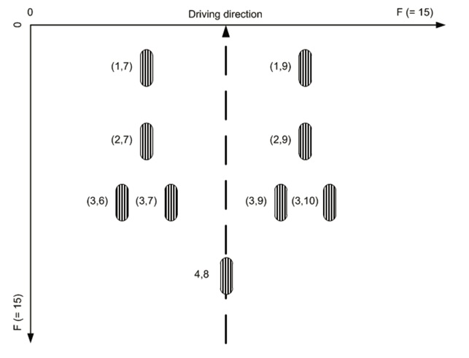
Standardized terminology for truck axle and tire locations
Input to HIM configurator:
"instances": {
"Axle": [
"Row[1,4]",
[
["Pos7","Pos9"],
["Pos7","Pos9"],
["Pos6","Pos7", "Pos9","Pos10"],
["Pos8"]
]
]
}
Example of resulting paths in a generated tree:
"Truck.Chassis.Axle.Row1.Wheel.Pos7.AngularSpeed”
"Truck.Chassis.Axle.Row1.Wheel.Pos9.Brake.FluidLevel”
"Truck.Chassis.Axle.Row3.Wheel.Pos10.Brake.IsBrakesWorn”
"Truck.Chassis.Axle.Row4.Wheel.Pos8.Speed"

Slide 4
Demo overview...
Aiden is connected as a client
VISS server connects with Aiden
Aiden includes the complete Consent Management and access control for OEMs, Service Providers and Owners/Drivers
Difference compared to VISSR:
Aiden connects with Service Providers through one common stream
Each requested data point is only sent once from the vehicle
No dependency on OEM cloud
Privacy Liability and responsibility is transferred from OEM to Aiden
OEMs retain full control

Slide 5


Slide 6
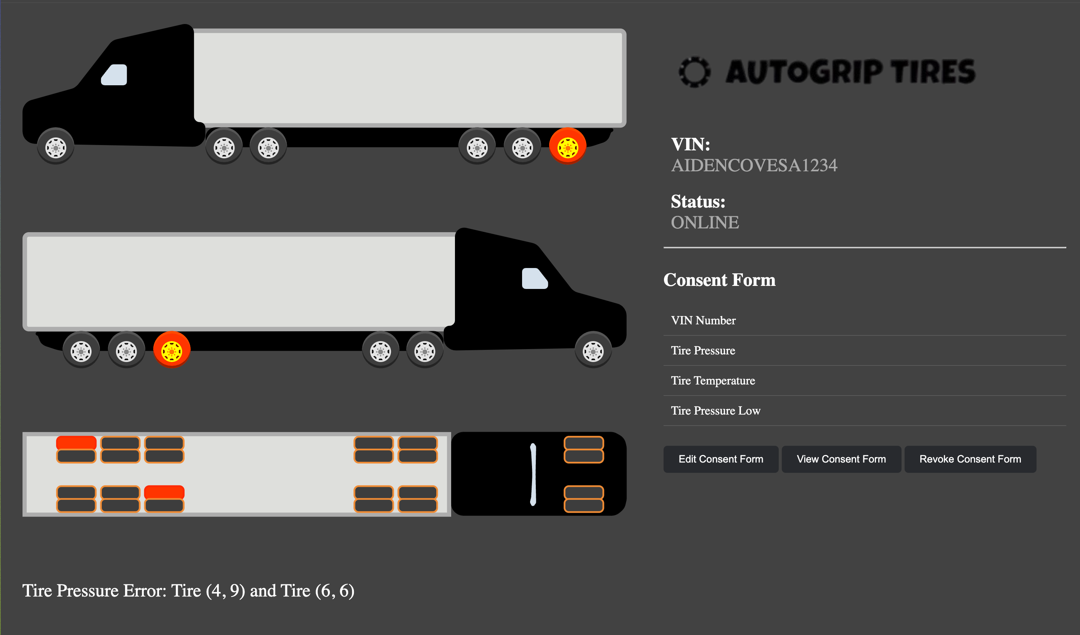
Service Provider example portal

Slide 7
ubjorken@ford.com
niclas@aidenauto.com
sinan@aidenauto.com

