Slide 1
Unlocking Mobility Potential
The Role of Consented Data in Connected Services
Panel Discussion

Slide 2
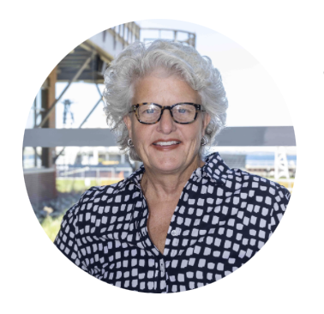
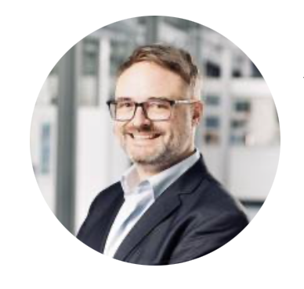
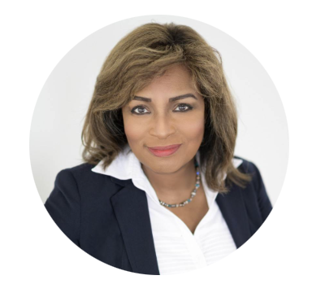
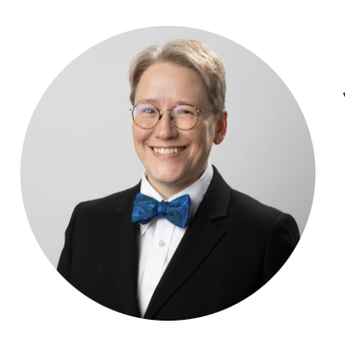
Moderator:
Panelists:
Cindy Warner
Founder & CEO
360ofme, Inc.
Ansgar Gerlicher
Deputy Head
Institute for Applied Research
Debbie Moore
Co-Founder & CEO
(former IBM Cybersecurity VP)
Quantum Crunch
Jennifer Dukarski
Attorney
(& Recovering Engineer)
Butzel Long

