Slide 1
Data Centric Interoperability
Creating a Data Architecture
September 25, 2024 – Neil Puthuff (neil.puthuff@rti.com)

Slide 2
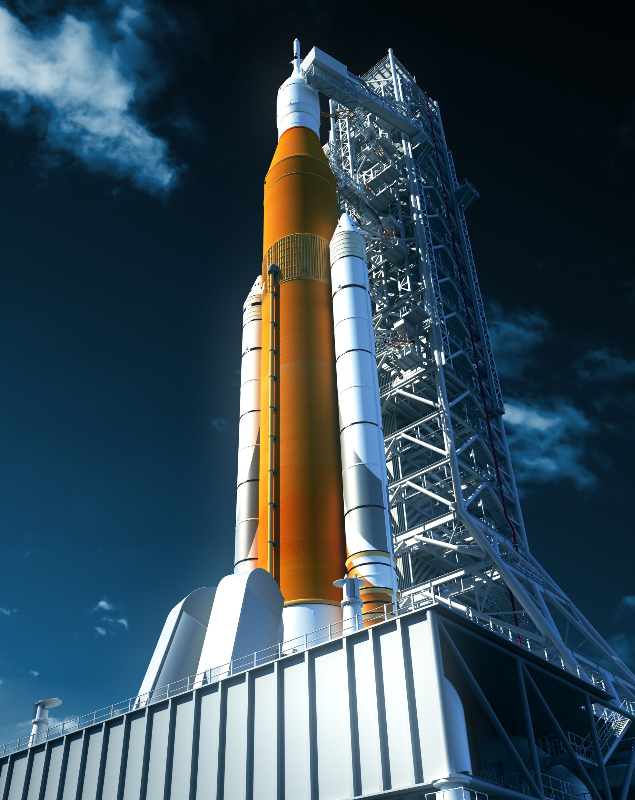
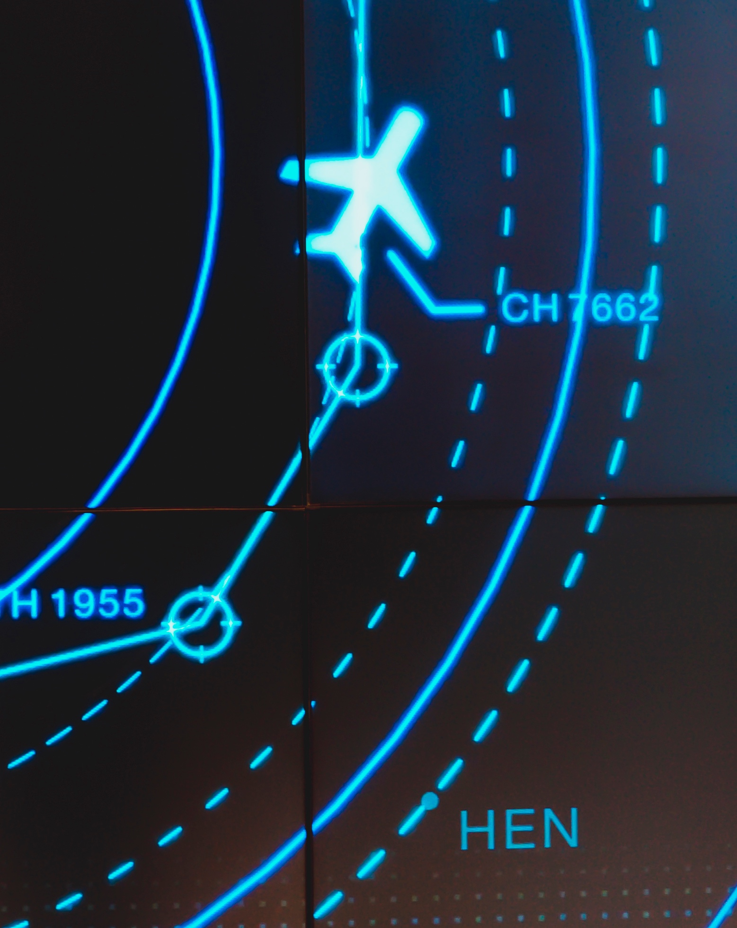







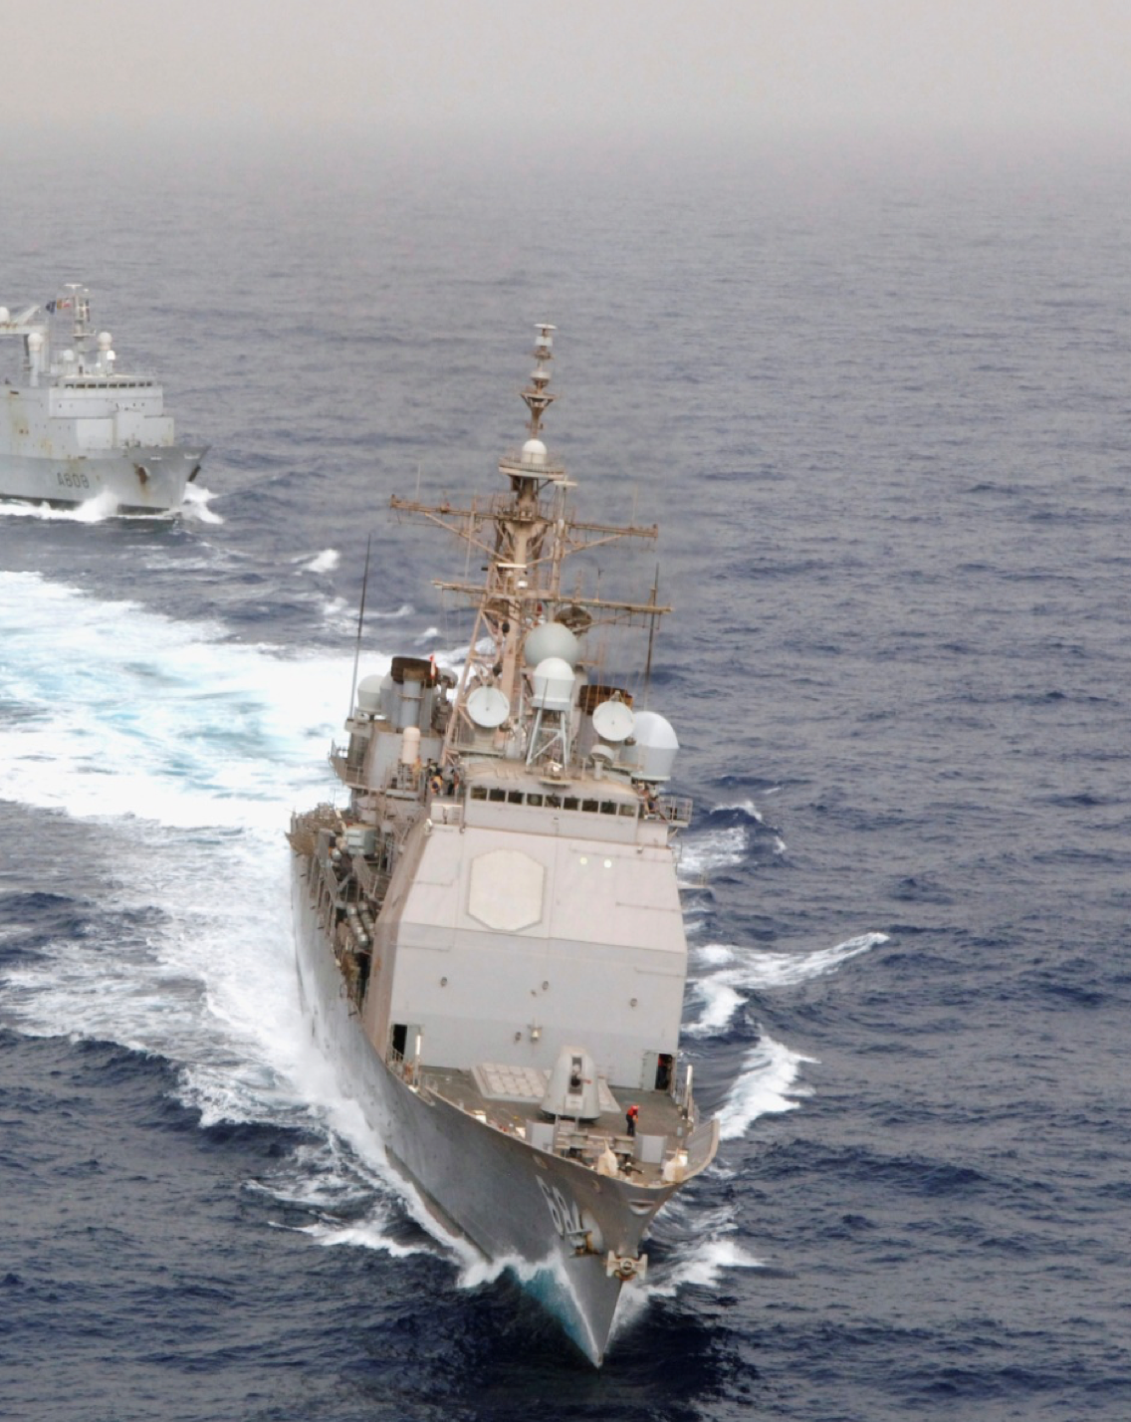
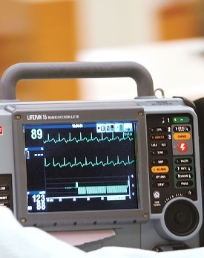

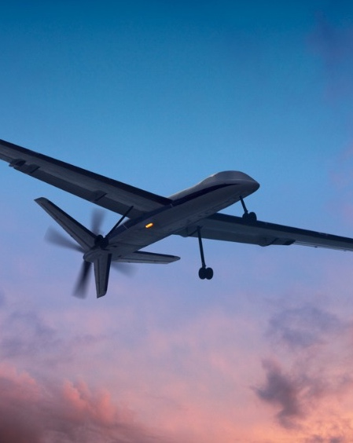
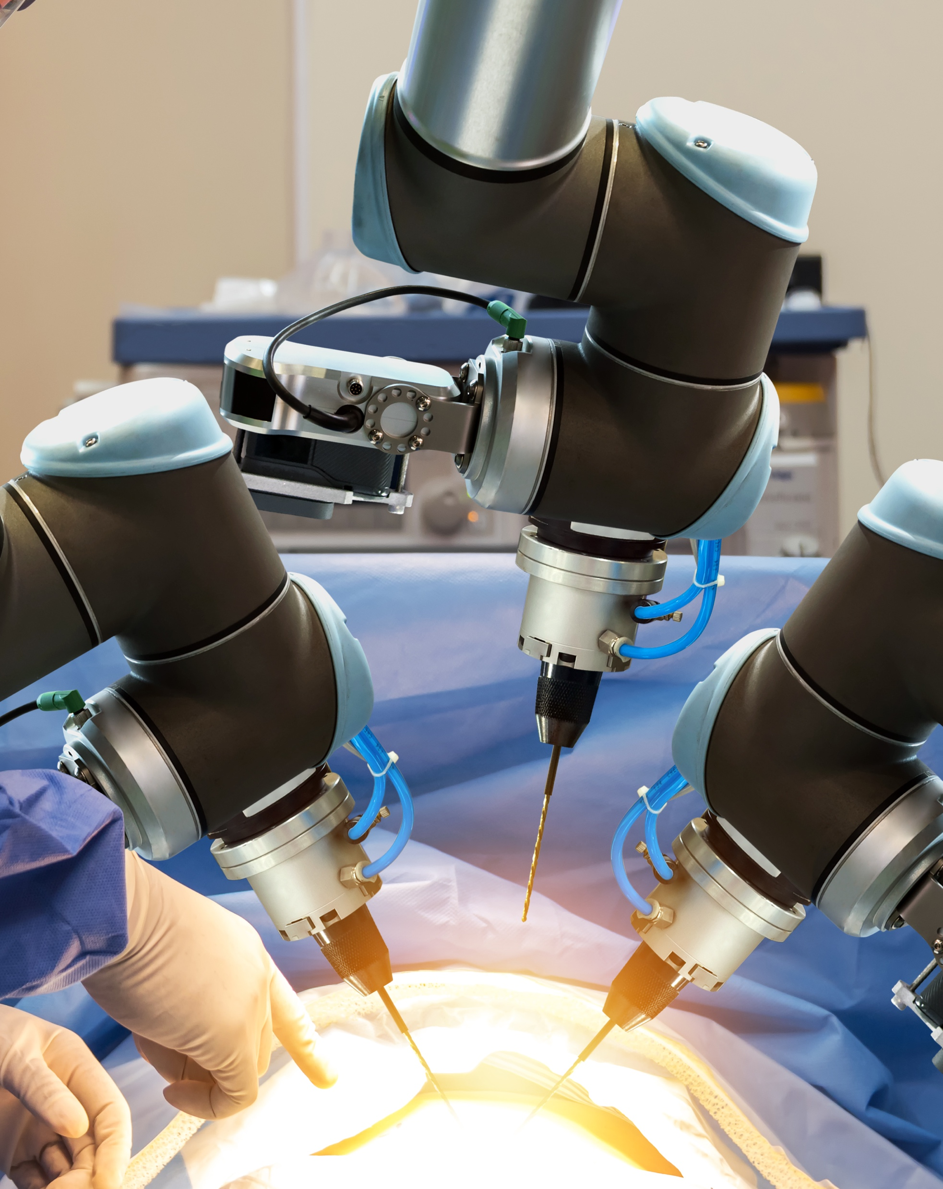
Notes:
DDS Market Leader: RTI is the leading vendor of products compliant with the Object Management Group (OMG) Data Distribution Service (DDS) standard.
1800+ designs: RTI is the best in the world at ensuring our customers’ success in deploying production systems. With over 1,800 designs, RTI software runs over 250 autonomous vehicle programs, controls the largest power plants in North America, coordinates combat management on U.S. Navy ships, drives a new generation of medical robotics, enables flying cars, and provides 24/7 intelligence for hospital and emergency medicine.
Number ONE software framework for autonomy: RTI is the largest software framework company for autonomous systems. RTI Connext is the world's leading architecture for developing intelligent distributed systems.
750+ research programs: RTI actively engages in government-funded research to solve complex distributed systems challenges that are broadly relevant to RTI customers.
Global Sales and Support: RTI’s global footprint reflects our commitment to customer success. RTI’s worldwide presence includes our North American HQ in Sunnyvale, CA, European HQ in Spain and then 6 regional teams.

Slide 3

Idealized Data-Centric Environment
Global Data Space
Hardware Abstracted
ANY DATA THAT NEEDS TO MOVE BETWEEN PROCESSES
SENSORS, STATUS, COMMANDS, RESPONSES, SIGNALS, STREAMS,
STRUCTURES, etc.
ALL DATAFLOWS
LIVE HERE
PURELY SOFTWARE
DEFINED VEHICLE
ENDLESS
FLEXIBILITY
VERY FEW
INTEGRATION
PROBLEMS
Sounds nice. How can it happen in the real world?

Slide 4
Examining Dataflows
Three Attributes:
Identity (Name)
Structure (Datatype)
Behavior (QoS Profile)
Identity
(Name)
Dataflow
Structure
(Data Type)
Behavior
(QoS Profile)

Slide 5
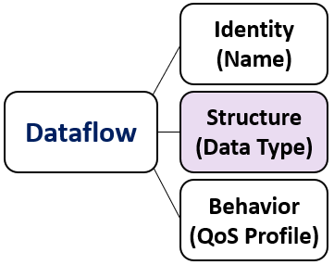
Dataflow Data Types
For interoperability and to avoid integration problems, everyone should use the same data types.
A Common Data Model:
The ‘Data Language’ for Data Communications
(example: COVESA VSS)
+ Bonus points for Type Extensibility, where data type changes maintain forward & backward compatibility

Slide 6
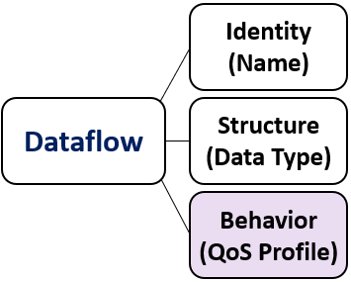
Dataflow Behaviors: Quality of Service (QoS)
Crucial and unique for every dataflow
QoS Needs of a Dataflow
Data Rate
Sub Sampling
Partitioning
Memory Mgmt
Throughput
Reliability Tuning
Filtering
Presentation
Fault Tolerance
Transports
Data Coherency
Startup Order
Stale Data
BW Shaping
Segmenting Data
Device Watchdog
Latency Mgmt
Data Caching
Meta-data
Async Sending

Slide 7
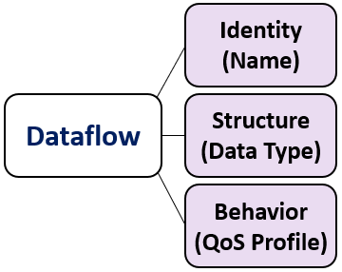
Dataflow Practical Concerns 1
Pub/sub and request/reply (w/feedback option)
Immune to Fanout/Fan-in: 1:1, 1:N, M:1, M:N
Scalable to very large systems
Efficient and Performant
Composable & Comprehensive Type System
Exception and Event handling
Portable and Predictable

Slide 8
Dataflow Practical Concerns 2
Immune to CPU or Programming Language
Endianness, register size, word size, etc.
Immune to Transport:
LAN, Shared Memory/Zero Copy, Internet, Mobile, Serial, Bus, etc.
Security option, regardless of transport
Independently authenticate, encrypt and control access
Interoperable across implementations

Slide 9
Dataflow Practical Concerns 3
Endpoints should automatically discover and verify
Safety: Cert and mixed-critical systems
Lifecycle: Dataflow CRUD support
Full software dev cycle support: concept to CI/CD
Tooling ecosystem: simulation, emulation, record/replay, visualization, introspection, 3rdParty, etc.
Code generation for relevant platforms
Linux, QNX, Android, AUTOSAR, C/C++/Java/Python/Rust/etc.
API?

Slide 10
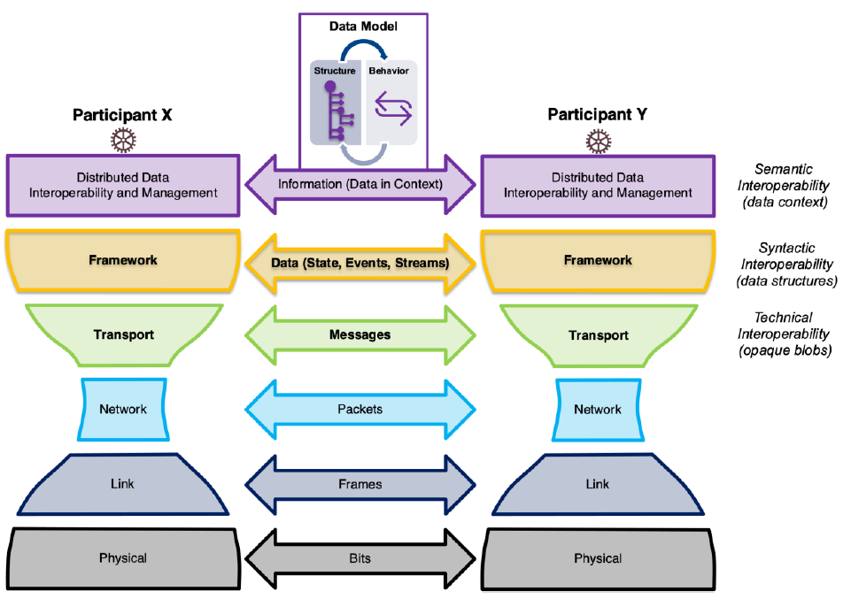
Chapter Review
Fully implemented support for Dataflows
= Connectivity Framework
More than just a protocol or transport.
Connectivity Framework
+ Data Model
= Data Architecture
The architecture of the system is designed to efficiently accommodate the dataflows, for portability, interoperability, predictability, performance and developer efficiency.

Slide 11
With a Data Architecture, the Data Flows
= PROCESS
= DATAFLOW
More time can be spent creating value

Slide 12
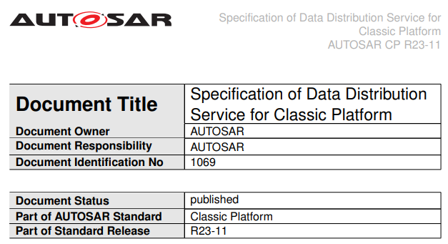
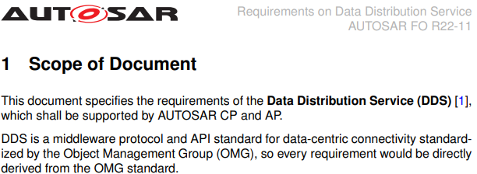
Do Any Connectivity Frameworks Do All This?
Yes: DDS (Data Distribution Service)
Data-Centric Realtime Pub/Sub Connectivity Framework
Based on Open Standard: https://www.omg.org/omg-dds-portal/
>12 FOSS and Commercial implementations
Interoperable wire protocol (RTPS)
Automotive Support:
AUTOSAR, QNX, Android, Linux, Win, RTOS, more
C, C++, Java, Python, C#, Rust, JavaScript, Go, more
IP Networks, SHMEM/0Copy, Internet, Mobile, more
Most popular CPU types and toolchains
Safety Certified to 26262 ASIL-D

Slide 13

DDS: Data is the Interface
C++
C
C
C
Java
Trad. C++
Linux
RTOS
AUTOSAR C.
AUTOSAR A.
Android
QNX
x86
AURIX Tricore
AURIX Tricore
ARM
ARM
ARM
Shared Global Data Space
DATABUS
C
C++
Applications talk to the DATA, not to each other
(Loose coupling)
Linux / QNX
x86

Slide 14
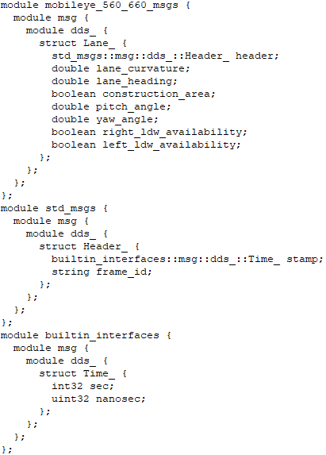
If Data is the Interface, what is the Data?
Whatever you need it to be, in your data model.
EXAMPLE:
Lane Information from Perception system
Structured data is the interface:
Publish: write() method is called on this struct.
Subscribe: Callback to function that will read() or take() the data. This global data appears local to the app.
Data types are defined in IDL or XML
Code generators convert to type support code, ARXML, etc. for your target platform and language.
Data types can also be created dynamically at runtime.

Slide 15
Data Centric Interoperable Ecosystem Examples
COVESA VSS: Automotive Data Monitoring
ROS / ROS 2: Robotics (+ Automotive, Healthcare, IA)
  Autoware: Autonomous Driving 🡪 F1Tenth, AutoDrive, Indy Autonomous Challenge
  ROS-I: Industrial Automation
  ROS-M: A&D (US Army Ground Vehicles)
NGVA: NATO Generic Vehicle Architecture
UMAA: Unmanned Maritime Autonomy Architecture
PX4: Open Source Autopilot for Drones
iDDS: Data Acquisition and Control (PnP)
STANAG 4586: NATO UAV Interoperability
TMS: Tactical Microgrid Standard
All of these use DDS
and common data models

Slide 16
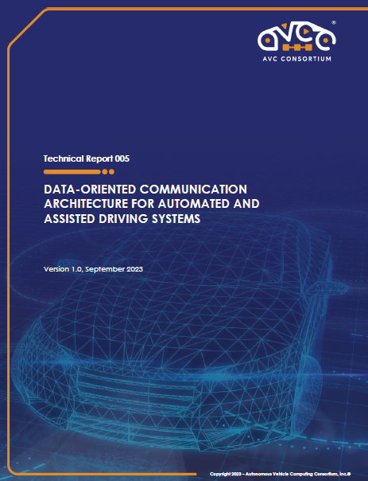
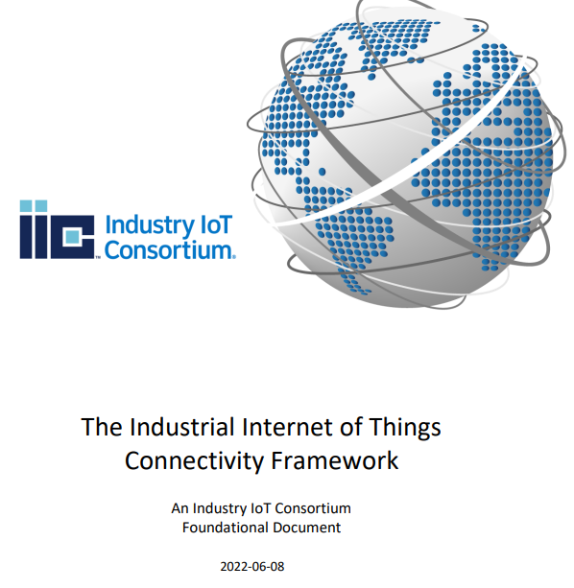



For a Deeper Dive
Source material for this presentation was derived from AVCC Publication TR-005: Data-Oriented Communication Architecture for Automated and Assisted Driving Systems. ver 1.0, September 2023,
and the IIC Connectivity Framework, June 2022
Contributing Organizations: RTI, ARM Ltd, Arriver Software GmbH, ETAS, Robert Bosch LLC, DENSO Corp, Veoneer AB, Cisco, Ericsson, Nokia
Free Trial and Examples
https://www.rti.com/
https://avcc.org/tr005/
https://www.iiconsortium.org/iicf/

Slide 17
Thank You!

