Slide 1
Using MBD for COVESA
Developing COVESA VSS Applications with Model-Based Design
Mark McBroom, MathWorks Application Engineering Manager
26 September 2024

Slide 2
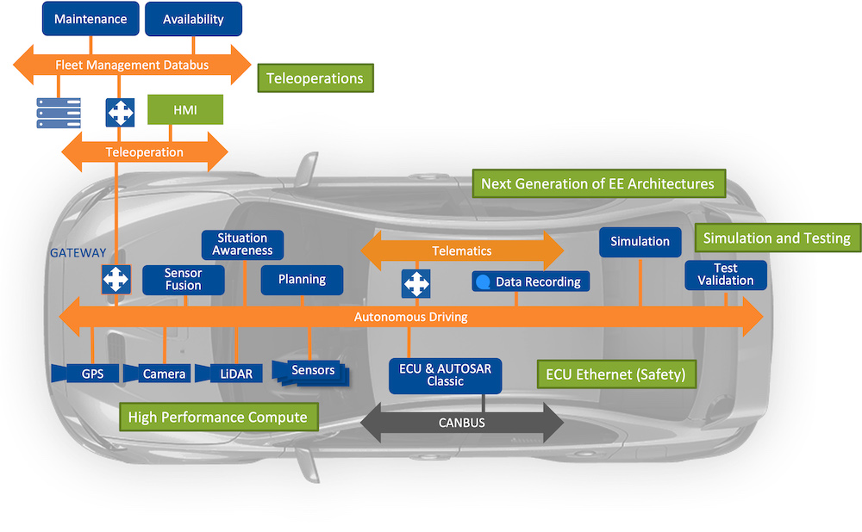
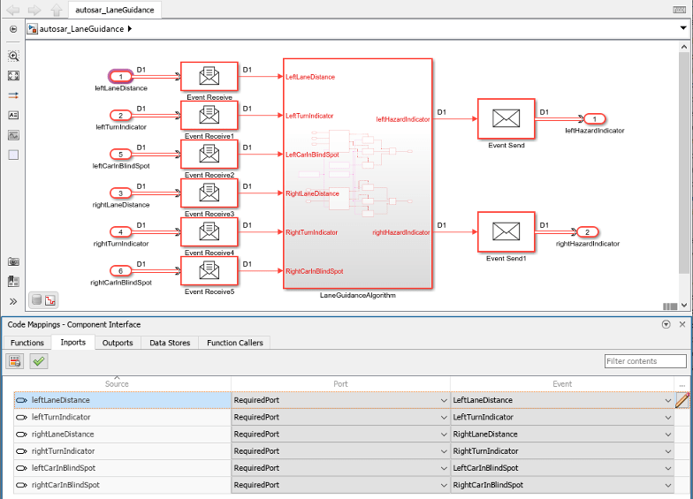
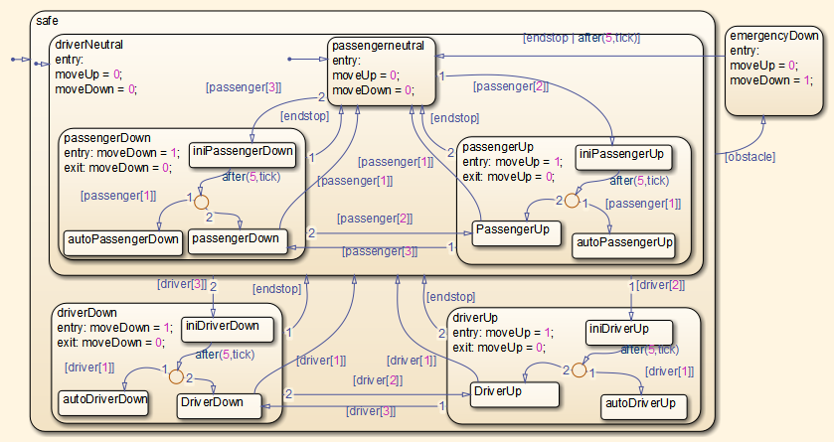
Intro
OEMs moving to zonal architectures with middleware to simplify integration and updates of on-board software
Following an agile Digital Engineering workflow
Result is need for MBD support for algorithm + middleware
  Modeling, simulation, test, code generation
Build Output, Artifacts, Test Results & Reports
Merge
Test
Package
Test
Development
Continuous
Integration
Review
Develop
Deploy
Build
Submit
Verify
Trigger
Notes:
In my role as an application engineer for the auto industry I work with many different OEMs and suppliers.
We are seeing two trends
OEMs moving to zonal architectures to simplify the development, integration and update of on-board software
Following an agile, Digital engiering workflow in which as many of the code generation, test and deployment steps as possible are automated.
As a result, customers are asking MathWorks to support not only MBD for algorithms/business logic but also the ability to model, simulate, test and genreeate code for the middleware
Many OEMs moving to middleware-based system architectures
And utilizing a DE workflow with a sprint-based agile workflow and CI/CD pipelines to automate build, test and release.
As a result, we are seeing an increase demand in model-based design for not just the business logic but for the middleware also.
I ve seen the trend of customers to move from using MBD to develop algorithms or features to large components, systems and applications.
This is occurring to address the increased complexity of vehicle software while improving time to market and quality.
Customkers are adopting Digeigal engineering workflows and toolls to model Architecture, requirements, design implementation and test all managed and tracked with model-based design tools

Slide 3
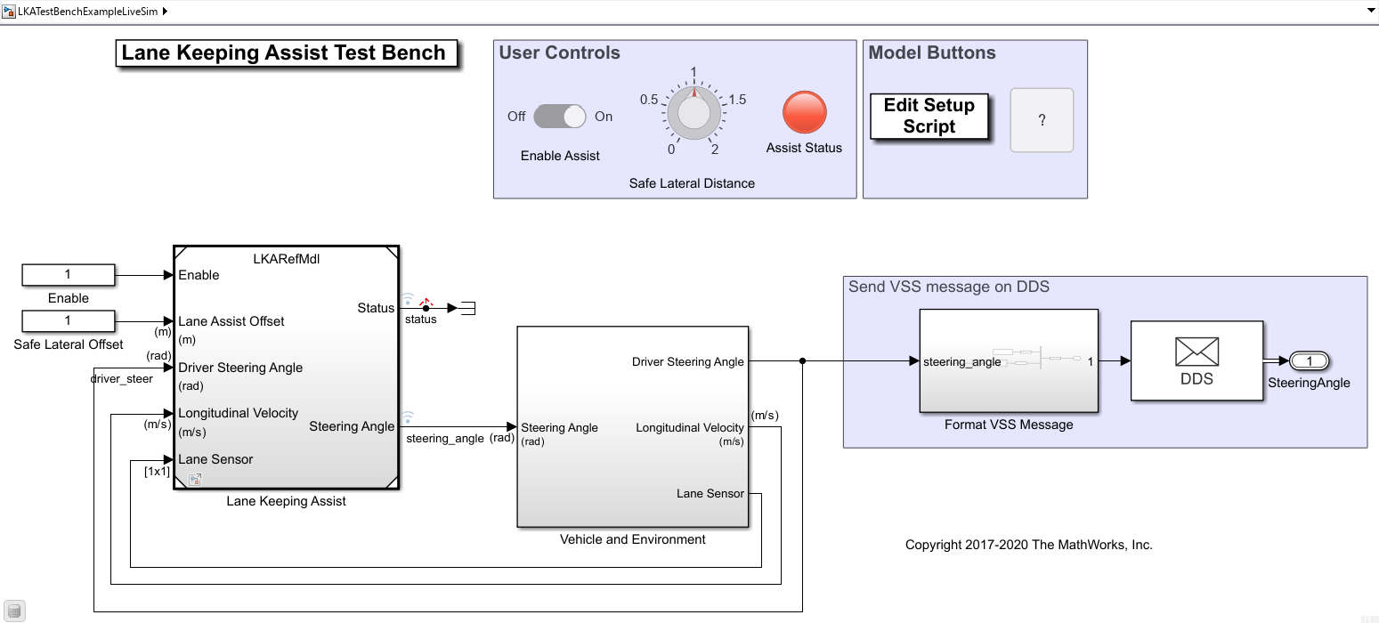
Intro
Demonstrate using MBD to model, simulate and deploy an ADAS component communicating via VSS messages on DDS.

Slide 4
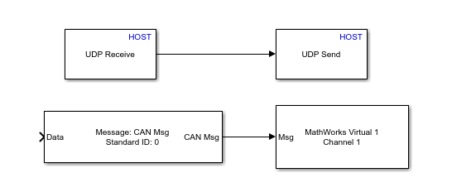
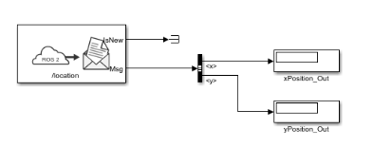
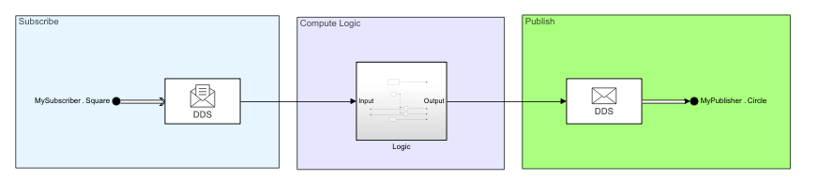
Developing Apps with a Middleware Interface
Communication protocols
  CAN, UDP, TCP
Middleware
  ROS, DDS, SOME/IP
MBD allows you to:
  Simulate with simulated network messages
  Co-simulate with live network messages
  Generate and deploy C/C++ code
Notes:
Middlewar
Layered architecture on top of comm protocols such as UDP
Service discovery
Serialization
Wire protocol
Event notifications
Quality of Service

Slide 5
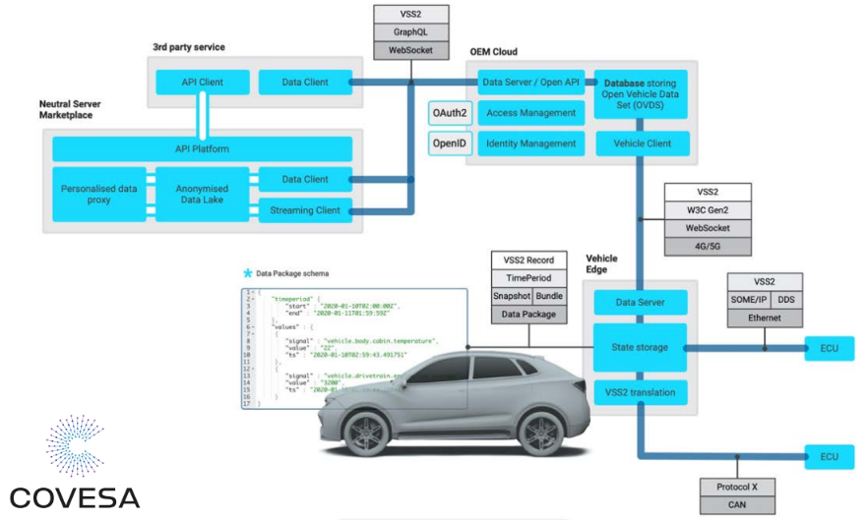
COVESA Vehicle Network Architecture
VSS is network agnostic

Slide 6
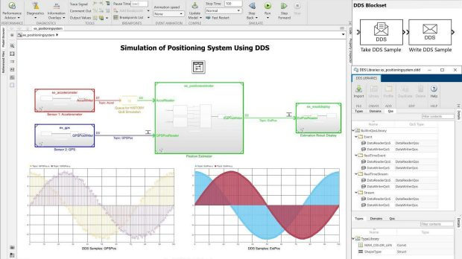
DDS Support
For | System and algorithm engineers
Who | Develop software for DDS (Data Distribution Service) based embedded systems
Provides | Apps and blocks to model and simulate DDS software applications DDS dictionary to manage DDS definitions API to Import and Export DDS definitions C++ production code generation with DDS APIs (with Embedded Coder)
DDS Blockset fully integrates with third-party DDS stacks including RTI Connext, Cyclone DDS and eProsima Fast DDS

Slide 7
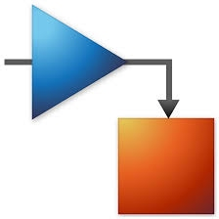
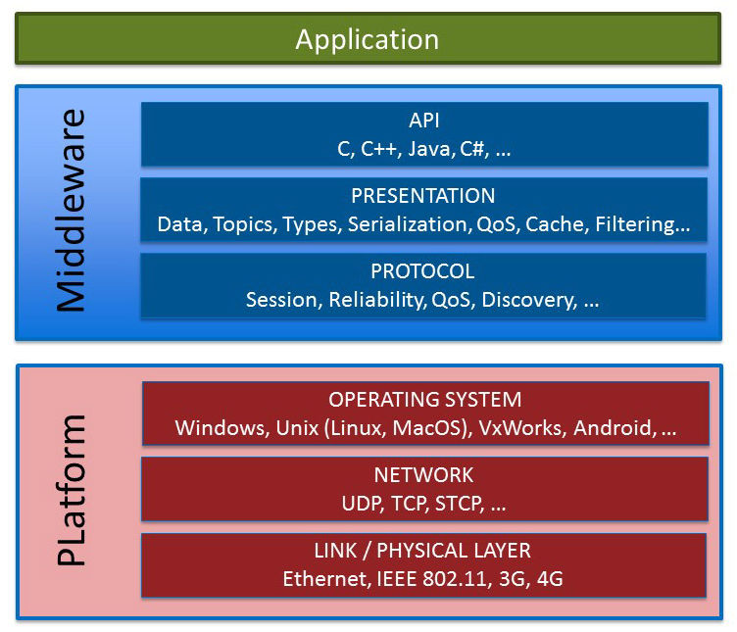
Layered Software Architecture
Application generated from Simulink® model
Middleware implemented in 3rd party libraries
Code from Simulink® model links to 3rd party middleware libraries
RTI Connext DDS Libraries
Notes:
VSS messages are predefined and can be easily imported into the Simulink Data Dictionary
Hierarchy/namespaces are maintained.

Slide 8
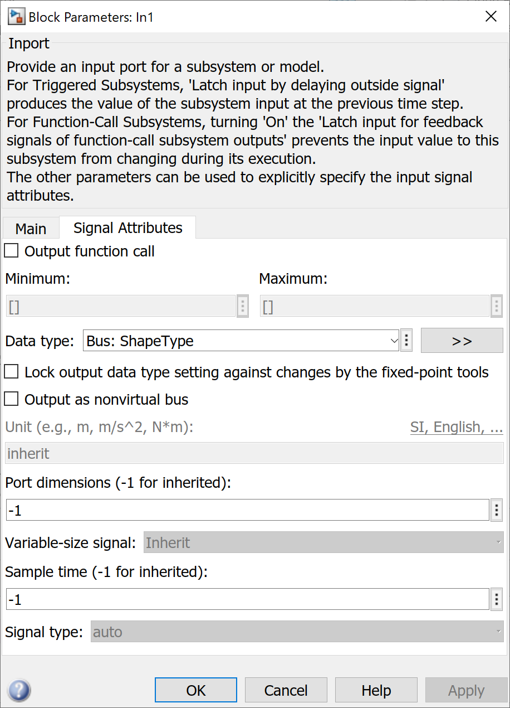
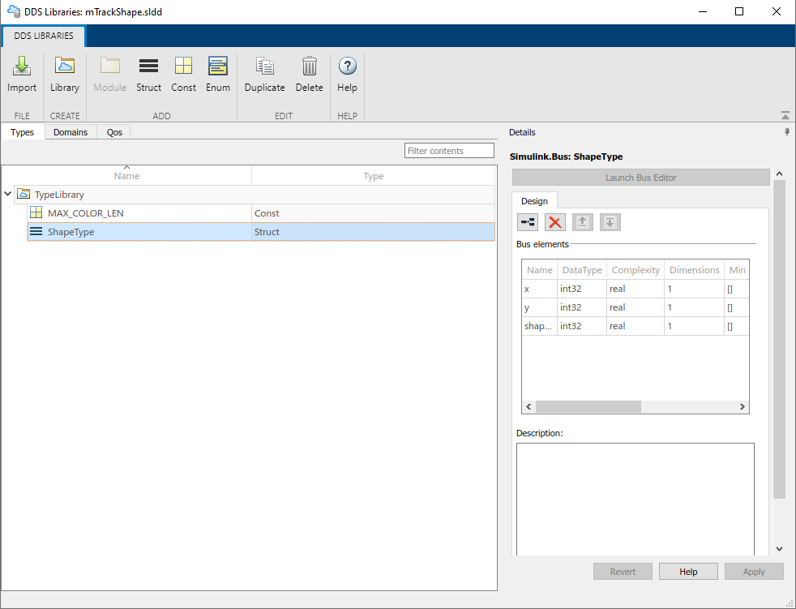
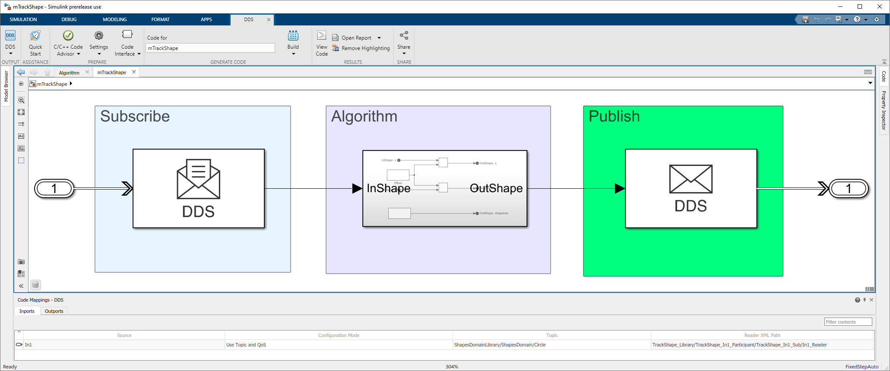

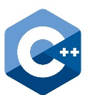
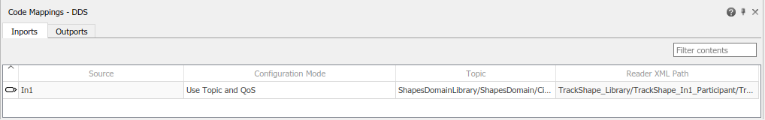
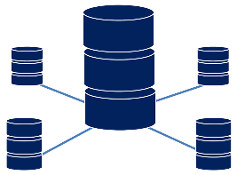
User Workflow
2
DDS UI
3
5
Import
Simulink
Data
Dictionary
Generate
1
From central repo
XML
+
Vendor support
Creates
4
6
Deploy
Define/convert VSS messages to IDL
DDS Databus
Notes:
.vspec files that define VSS messages are YAML.

Slide 9
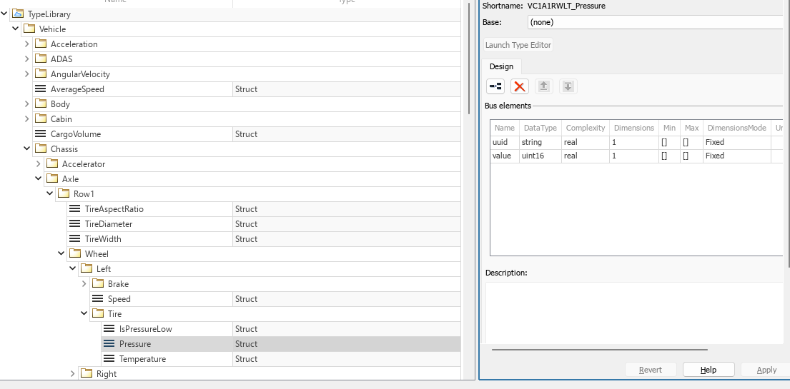
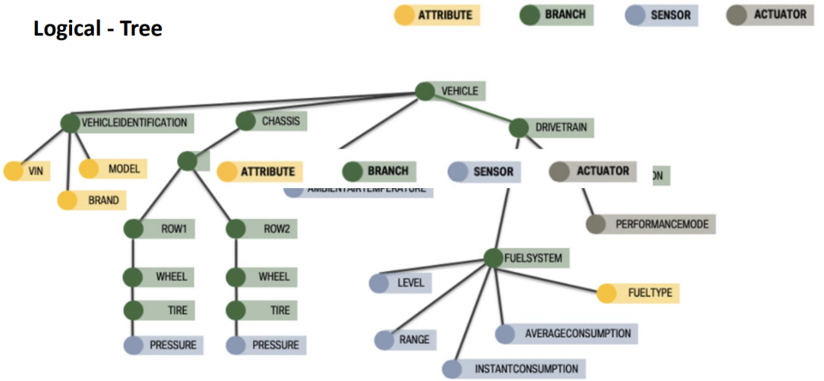
VSS Messages in Simulink Data Dictionary
Notes:
Version 3.1.1 of VSS Spec

Slide 10
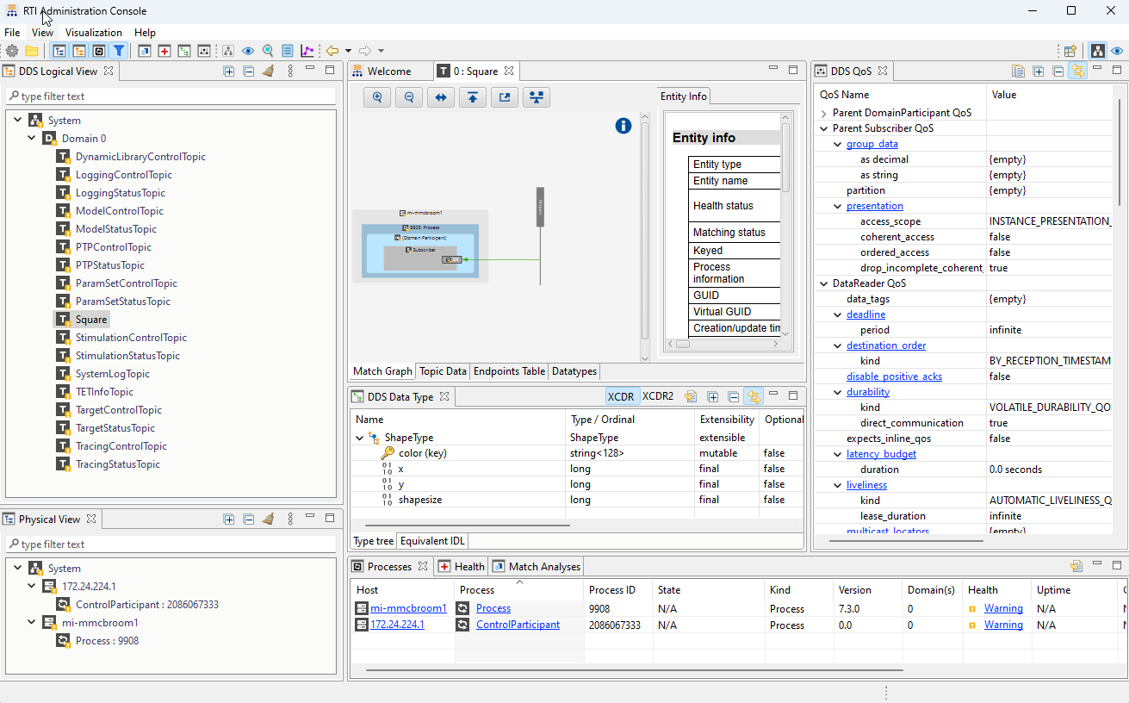
Demo
Simulink to model, simulate and deploy an ADAS application that sends VSS messages
RTI Connext DDS for middleware
RTI Connext Admininstration Console to monitor DDS Network

Slide 11
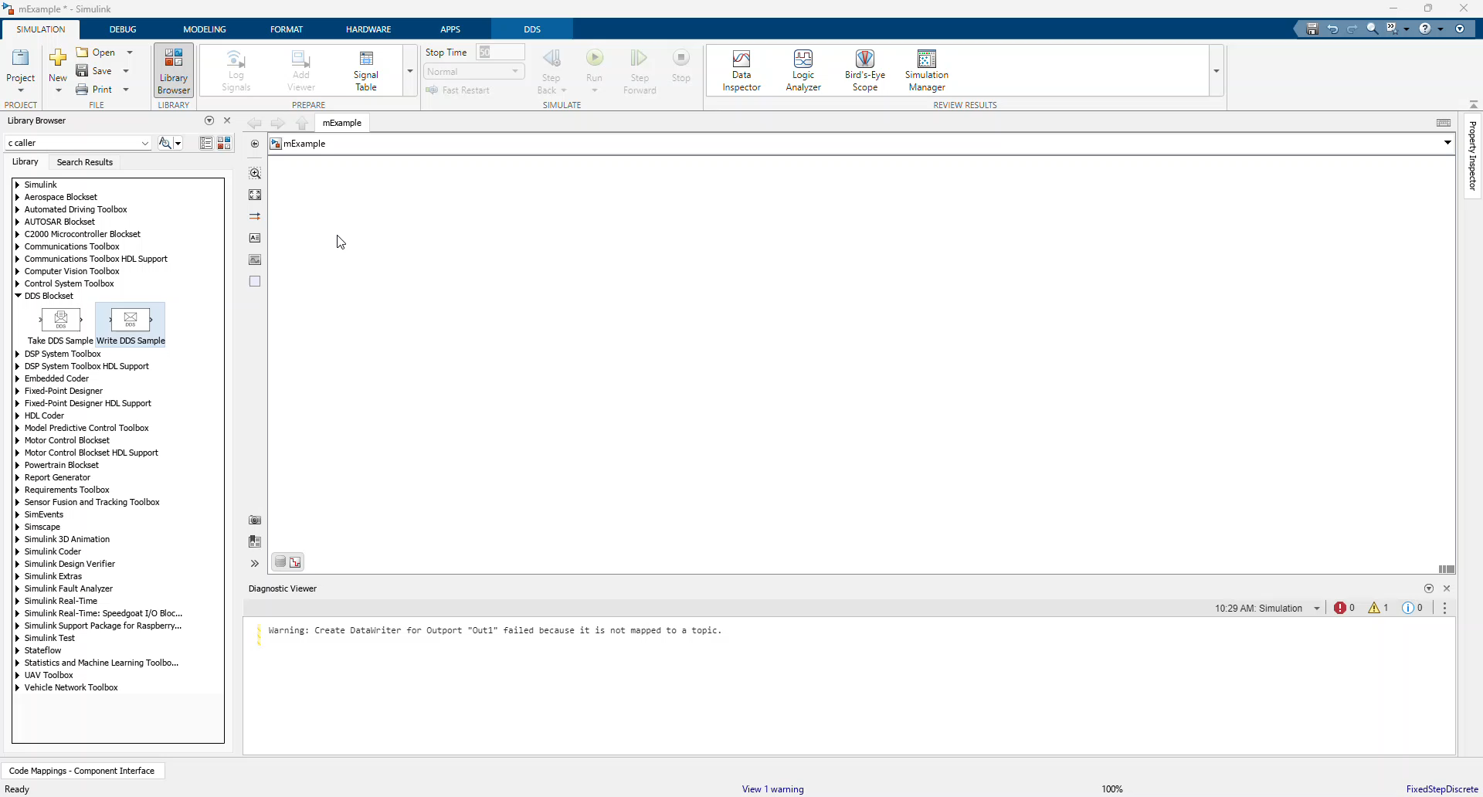
Simulink Model with COVESA VSS Messages
Notes:
Show SLDD
Show block library
Build model that Sends sine wave on Vehicle/ADAS/CruiseControl/SpeedSet message
Code Mapping
LiveSim/External Mode
Show in admin console
Generate code
Show code
Run .exe
Show in admin console again.

Slide 12
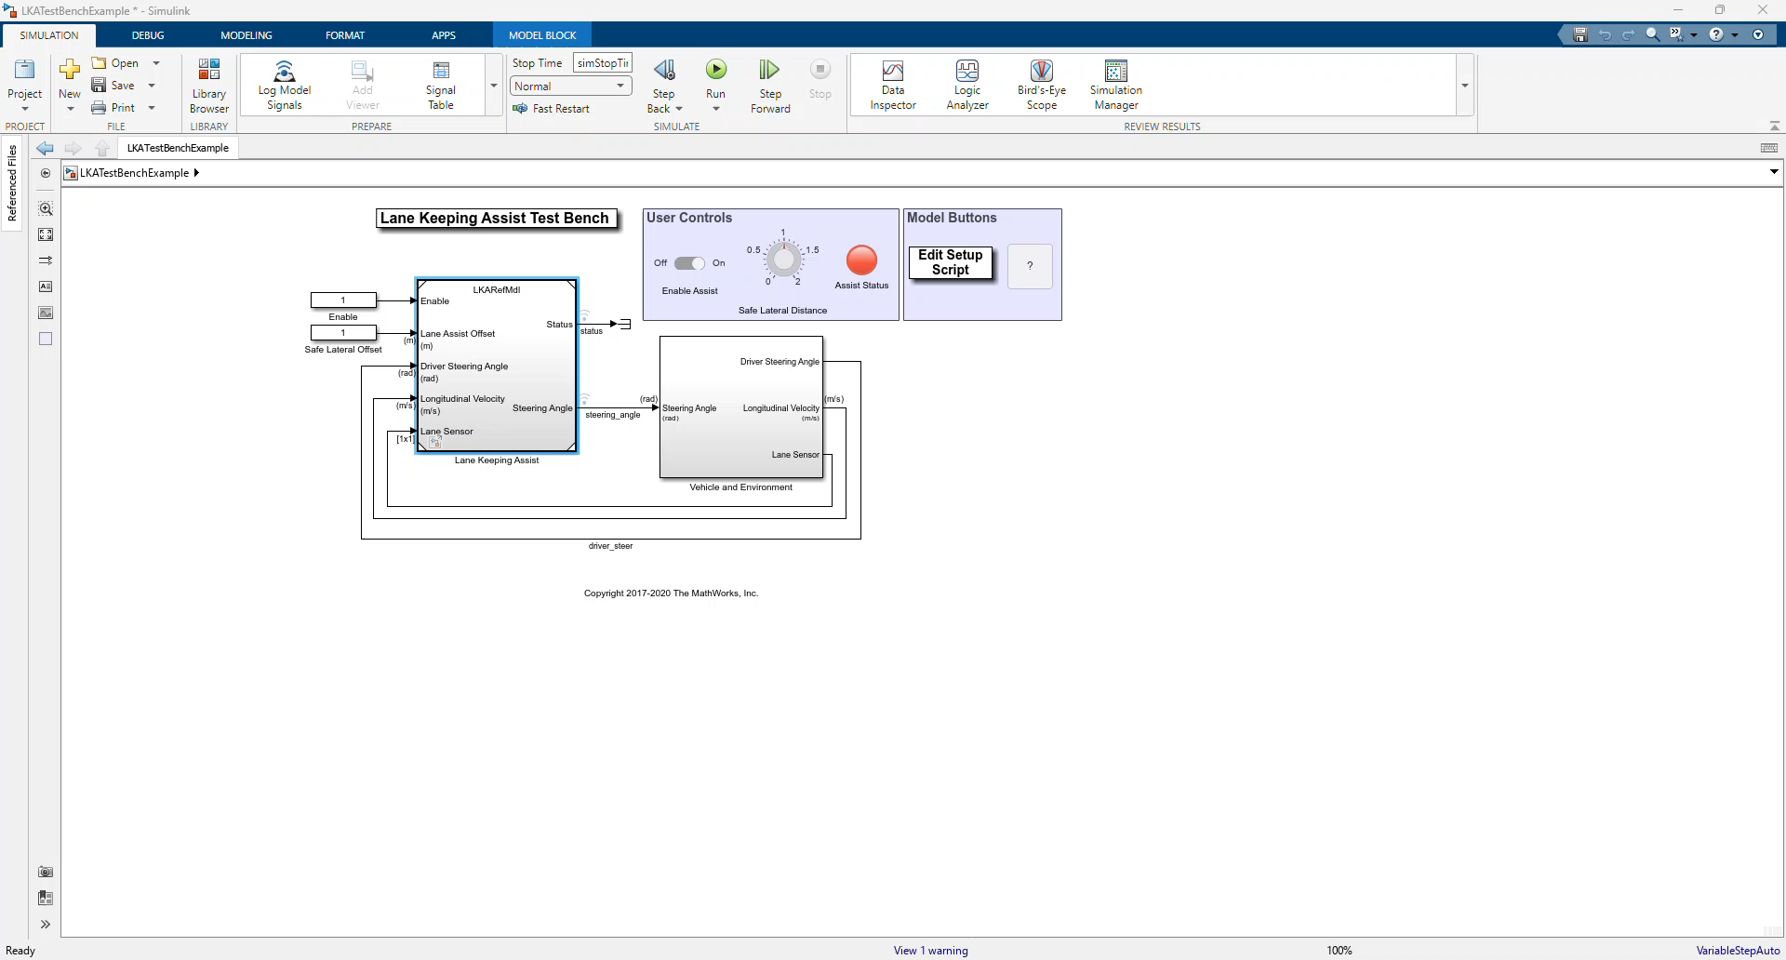
Lane Keeping Assistant
Notes:
Closed loop with models of vehicle, environment and controller
Controller takes steering angle, velocity and lane sensor as inputs and computes new steering angle. Status of true indicates assist is active.
Birds eye view with both world and vehicle coordinates
Simulate first with LKA active
Rerun with LKA disabled.

Slide 13
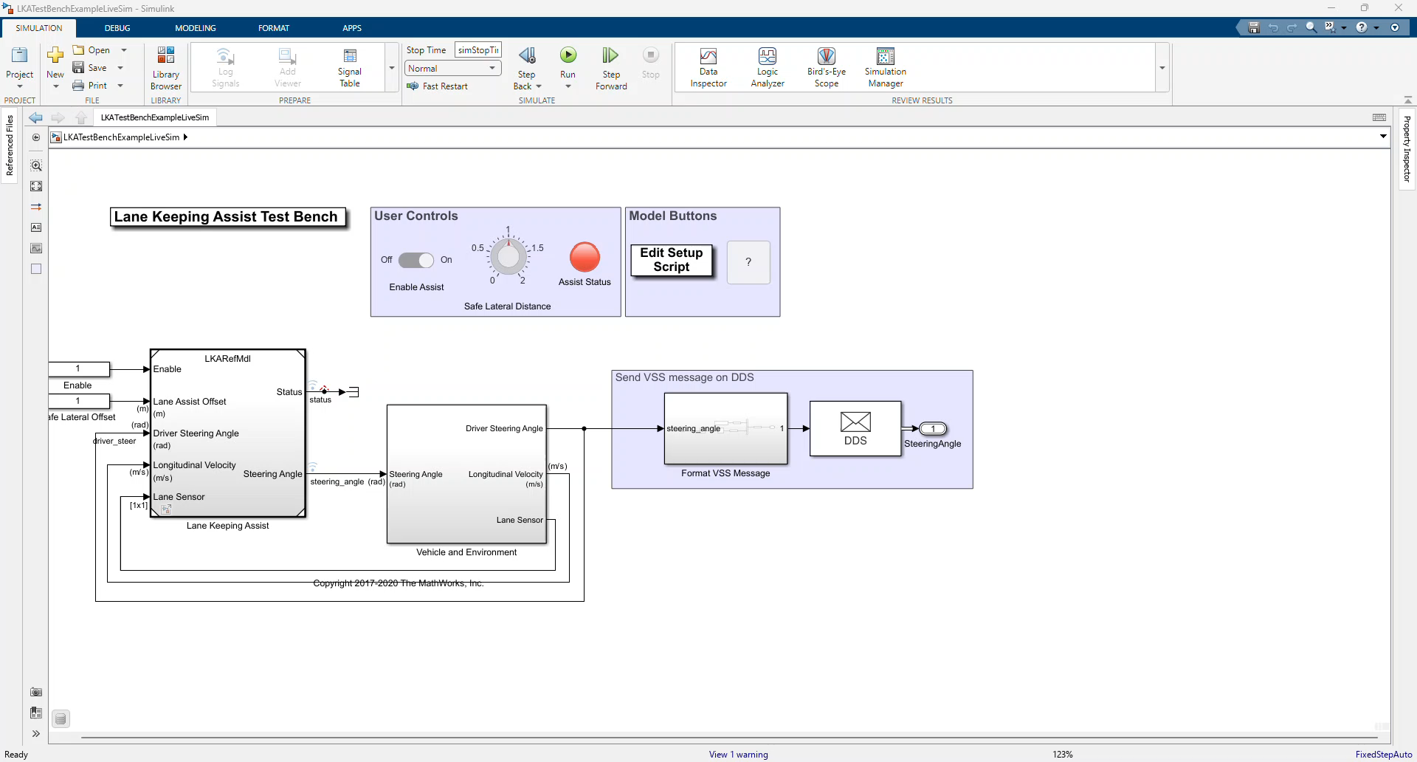
Lane Keeping Assist with VSS Messages
Notes:
Send live DDS/VSS message
Use RTI Admin Console to confirm proper content and frequency

Slide 14
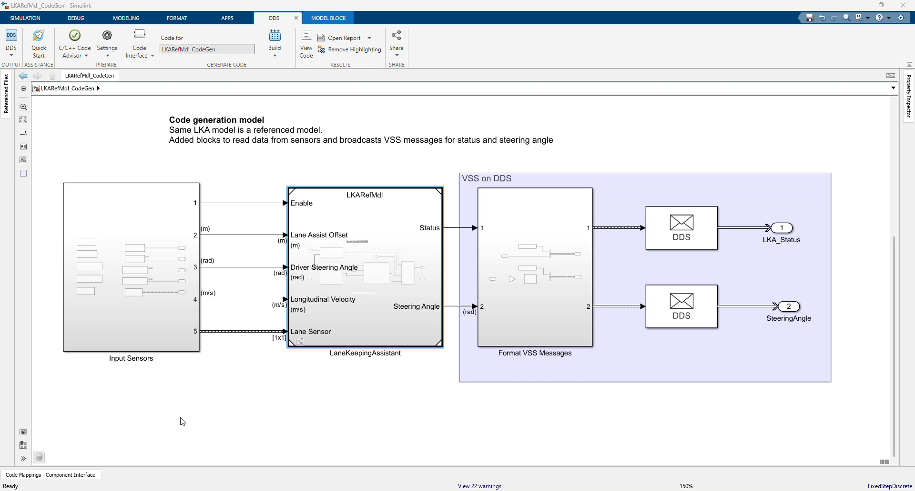
Deploy LKA Controller application
Notes:
Show code harness model
Generate code
Run exe
Show Admin Console

Slide 15
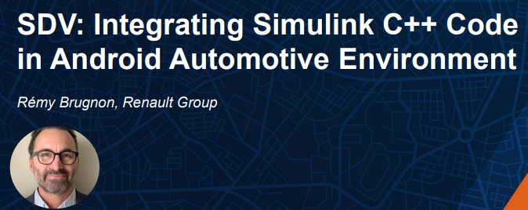
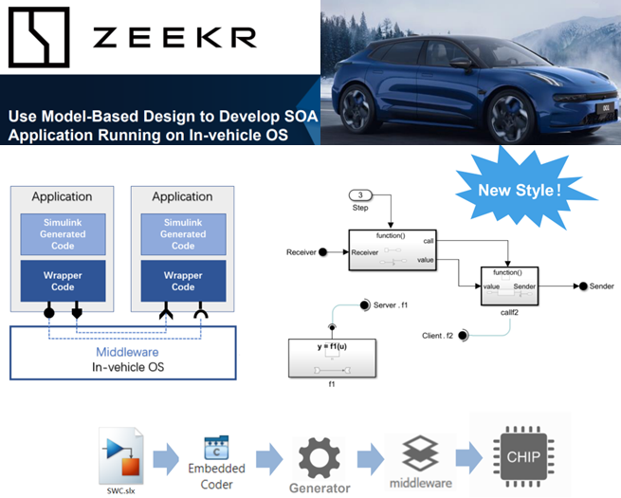
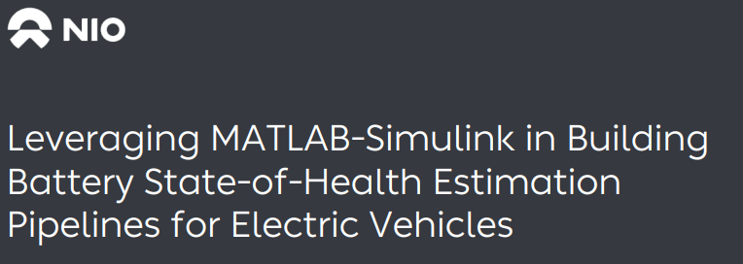
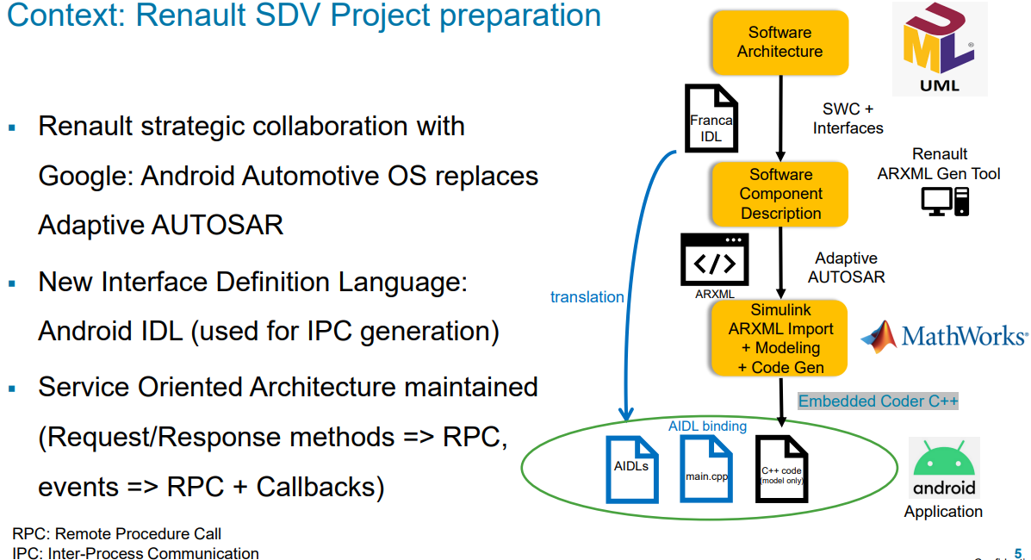
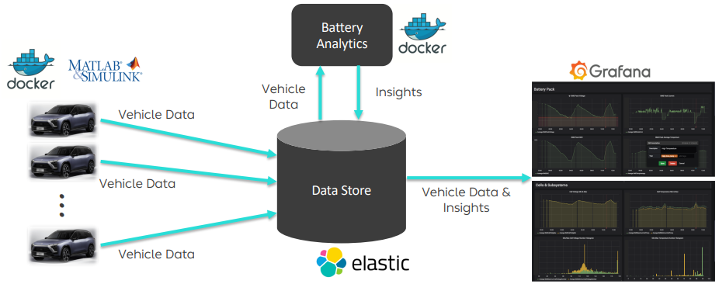










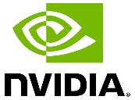










MathWorks is Collaborating with the Ecosystem to Mature the Tooling for Software Defined Vehicle Development
Semiconductor eco-system
Supplier eco-system
OEMs
Notes:
MathWorks is an Associate Member of COVESA

Slide 16
Background

Slide 17
Section Title

Slide 18
Title

