Slide 1
Unleashing Vehicle Telematics
A Cost-Effective Future for Tolling and Road Usage Charging
Naveen Radhakrishna
Verra Mobility

Slide 2
Unleashing Vehicle Telematics
Building the Future of Tolling with Connected Vehicles
Naveen Radhakrishna
Director, Product Management
Sept 26, 2024

Slide 3
Who We Are
Verra Mobility is a global leader in smart transportation, focusing on smart cities, smart roadways and the connected systems that tie them seamlessly together.
We work alongside our customers and behind the scenes to innovate and develop customized technology solutions that solve complex mobility challenges at scale.
Notes:
Global Leader in smart transportation, focused on making transit easy, safe and connected for all users
We work with everybody in the transportation ecosystem to build customized solutions to solve various complex mobility problems
So be it our customers, end users, government agencies or industry partners we strive to work collaboratively
Making life safer, easier and more connected for the customers and communities we serve

Slide 4
Our Businesses: Breadth and Depth of Expertise
Commercial Services
Government Solutions
Parking Solutions (T2 Systems)
#1 Provider of toll management to Rental Car Companies (RAC) and Fleet Management Companies (FMC) in North America
#1 Provider of road safety cameras in the world, partnering with ~300 jurisdictions and school districts
#1 Provider of parking solutions to large universities in North America, serving ~2,000 customers with end-to-end solutions
Core Products and Solutions
Toll Management Solutions
Violation Processing Solutions
Title & Registration Services
Speed Safety Cameras
School Bus Stop-Arm Cameras
Red-Light Safety Cameras
Bus Lane Enforcement Cameras
SaaS: Permits & Enforcement
Access & Revenue Control Systems
Pay Stations
Services
Business Highlights
7M
vehicles supported by our services
10K
safety camera systems deployed globally
2K+
parking customers supported
300M
tolls processed annually
40M
traffic events processed for clients globally
380M
parking permits issued
7M
violations processed annually
300+
customers around the world
2.5B
in parking commerce processed
16K
parking pay stations across North America
Notes:
A little more info about Verra Mobility – we are a portfolio of companies that are focused on smart mobility and address different markets and segments with totally different sets of products and services, and today I’ll focus on our work in the tolling space
We’ve developed customized solutions alongside our customers to handle complex mobility challenges.
We are a leading provider of toll management services with over twenty years of operating history and we are a publicly traded company on the New York Stock Exchange under VRRM

Slide 5
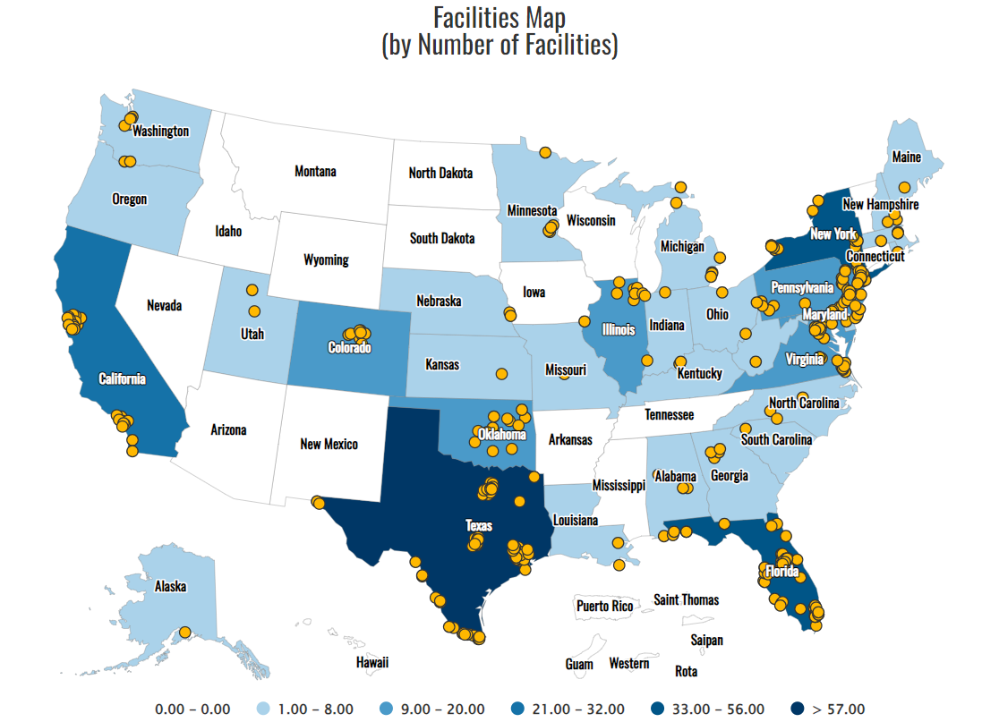
Overview of US Tolling Industry
Tolling Operators
Tolling Facilities
Miles of Toll Roads
States
Toll Revenues
# Toll Transactions
131
358
6,800
33
$22B+
8.8B+
Key Tolling Trends
Shift to All-Electronic Tolling (AET)
Continued replacement of cash and barriered lanes with wireless tolling; ~97% of tolling facilities in the US
Road Usage Charging
New form of road tax that charges customers based on miles driven in a jurisdiction
Price Managed Lanes
Increasing number of states (11) and roads (1,100 miles) with peak and dynamic pricing methods
Equitable Tolling
Accelerating low-cost payment schemes for circumstantial use like low-income drivers, carpoolers, etc.
Toll Facility
Source: IBTTA Toll Miner

Slide 6
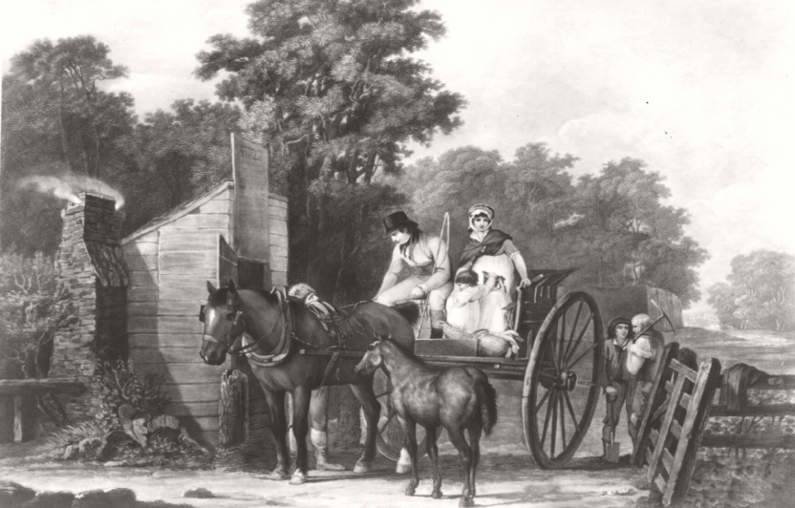
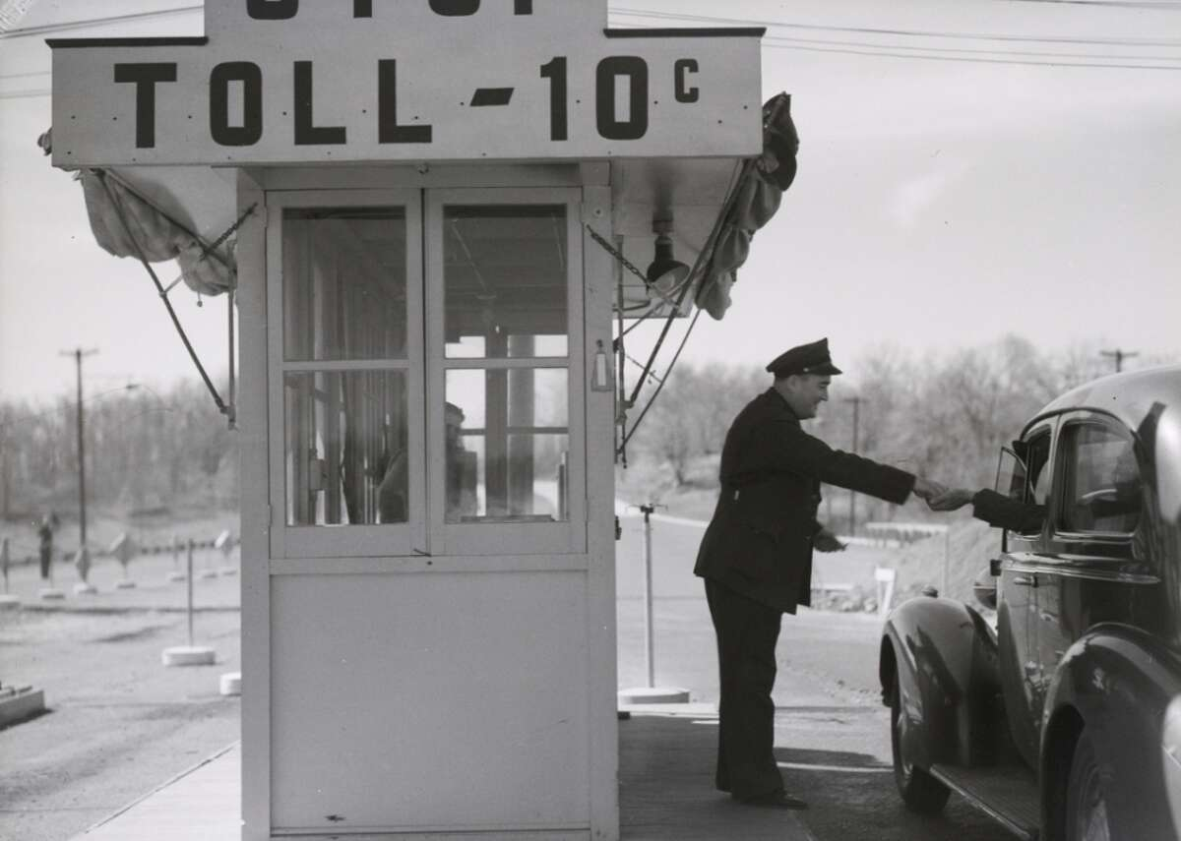
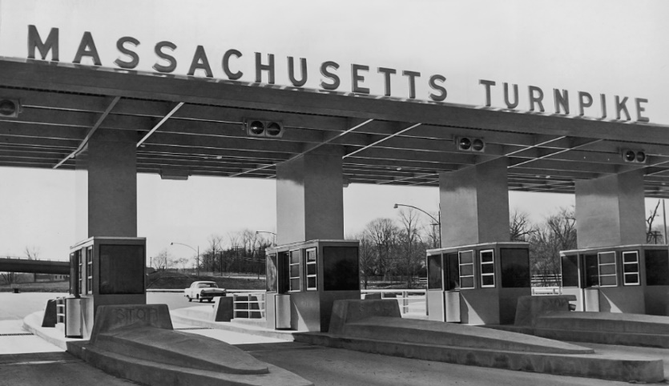
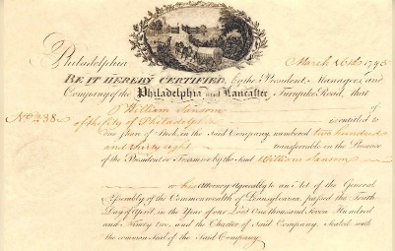
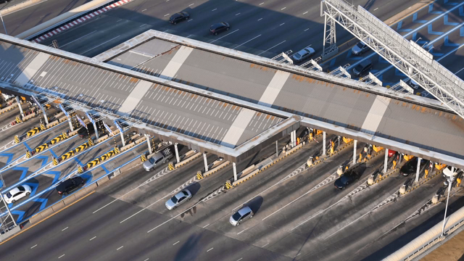
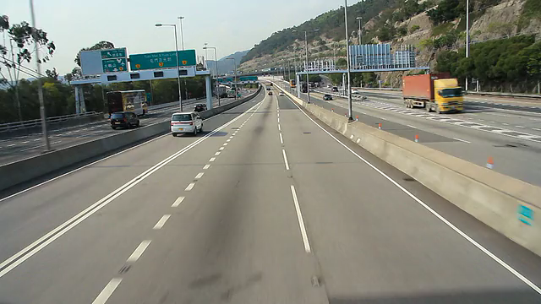
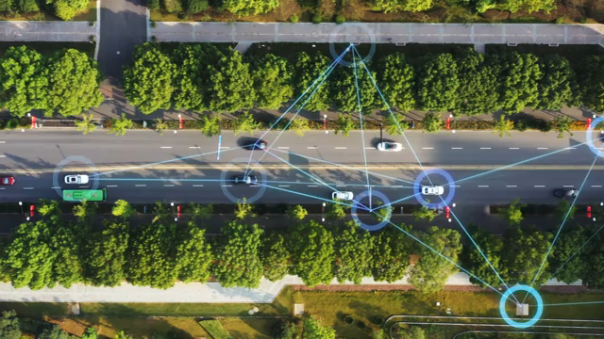
The Evolving Landscape of Tolling
Medieval Tolling
First Tolling Booths
Expansion to States
Electronic Toll Collection
Open Road Tolling
What’s Next?
Notes:
The first toll road in the United States was the Philadelphia and Lancaster Turnpike, which opened in 1795. It was the first road in the country to be covered with crushed stone.

Slide 7
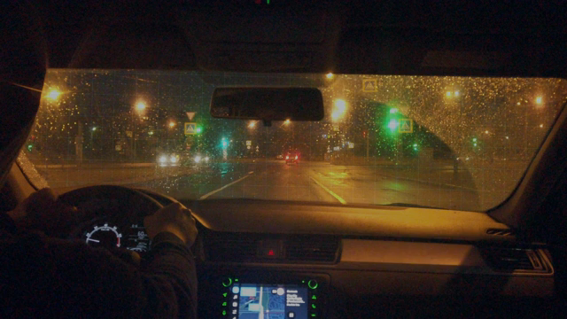

Connected Vehicle Tolling
Connected Vehicles
Expected to Double by 2030
2023
2030
+10% p.a.
600M
Global
connected vehicles
300M
255M
US connected vehicles
130M
110M
Enhanced technology in the cars
Advancement of communication technologies
Opportunity to offer personalized services
Growing interest among customers
Toll Region connected vehicles*
55M
Source: McKinsey, Statista and Ptolemus as of 2030
*Toll region connected vehicles estimated based on 43% of states with toll roads
Note: 2030 US connected vehicles assumes ~85% of US vehicles will be connected based on Ptolemus report
Notes:
Modern day automobiles are far more sophisticated than their predecessors
The advent of 5G and other communication technologies has propelled connectivity
Autonomous cars are no more a talk of the future, it’s here in the present
Growing consumer interest in EV and Hybrid vehicles
Statista projects that 96% of all new vehicles will be connected by 2030, as opposed to just 48% in 2020
McKinsey
Statista. Connected Car Statistics; Global Connected Vehicle Market Forecast
Ptolemus. Vehicle Payment Report.

Slide 8
Connected Vehicle Voice of Customer Insights
Drivers have a growing awareness of Connected Vehicle services and vehicle-related payments.
50% of respondents would like the vehicle to be another digital wallet to make automatic payments.
53% of respondents would prefer using their car vs. the phone to pay for services.
66% of respondents are willing to share geolocation data to enables services like toll payments.
70% of respondents would prefer not to connect their phone to a car to enable CV services.
40% of respondents are paying for a CV service.
70% of respondents are aware
of connected vehicle services.
49% currently use at least one
connected vehicle service.
Source: Survey by Verra Mobility conducted online via Pollfish July 11-12, 2024

Slide 9
The Approach
Build and Educate
Industry Partnerships
Agency Partners
Investment in R&D to explore the possibilities
Develop Connected Vehicle Services platform to enable quick and efficient deployment of services
Help customers embrace the change and leverage capabilities
Develop relationships with Automakers and OEM partners
Collaborate with OEMs to create customer-centric products and services
Help expedite technology roadmap and build new avenues for growth
Involve with agencies and partners to prove out technologies and use cases
Conduct POCs and pilots
Work on solutions that promote sustainability
and equity
Augment current capabilities to reduce revenue leakage

Slide 10
AutoKinex Connected Vehicle Services Platform
A cloud-based, software-driven platform that enables OEMs and service providers to easily integrate and provide connected vehicle services to drivers.
The core platform is technology agnostic, and a flexible architecture allows fast plug-n-play approach to adding services and onboarding customers.
Vehicle Payments
Tolling
Charging
Parking
Fueling
Road Usage Charging
Title & Reg.
Low Emission Zones
Non-Toll
Violations
Congestion
Available today; Roadmap 2024/2025

Slide 11
Customer Journey - Automated Tolling
“You are entering a Toll Road”
(In-Vehicle Messaging)
“Approaching [Toll Plaza Name]
Your Toll Charge is [Rate]”
(In-Vehicle Messaging)
GO!
Vehicle Enters Toll Network
Automated Enrollment
Toll Charge Point
Agency
Account Charge
“Register Your Vehicle?”
(In-Vehicle Messaging)

Slide 12
Customer Journey - Road Usage Charge
“You are entering a RUC Zone”
(In-Vehicle Messaging)
“Your RUC Charge is [Rate]”
(In-Vehicle Messaging)
GO!
Vehicle Enters RUC Zone
Vehicle Reports Miles Driven and Other Attributes*
End of Trip or Periodic RUC Calculation Based on Vehicle Reporting
Automated Payment or Authorization Request
Agency
Account Charge
*Attributes include Location and positioning Data, Speed, Odometer, Fuel Type, MPG/eMPG, Passengers, Exclusion Zones, Equity Flags

Slide 13

How Does it Work?
Data Flow
Non-Tolling Area
(Location Capture Frequency 1-3 Minutes)
Customer ID, Location & Positioning Data, Speed,
# of Passengers
Toll Infotainment Message
OEM
Data Stream
Verra Mobility
CVS Platform
Within Tolling Area (Increased Location Capture Frequency)
Telematics
Data
Notification
of Toll Road
Notification
of Toll Charge
Authorization of Payment (Optional)
Infotainment Messaging

Slide 14

Challenges
Customer
OEM
Agency
Lack of Awareness
Complexity
Data Privacy
Willingness to Pay
Reliability
Lack of Trust
Customer Adoption
Privacy Concerns
Data Costs
Security Risks
Technological Limitations
Regulatory Challenges
Data Accuracy
Interoperability
Infrastructure Compatibility
Technological Uncertainty
Public Acceptance
Regulatory Challenges
Solutions
Multimodal Messaging
Simplified User Experience
Ease of Use
Customer Consent
Enhanced Data Governance
Streamlined Data Exchange
Simple Flexible Architecture
Software-Based Solutions
Tech Evangelism
Public-Private-Partnership Approach
Agency Backed Pilots

Slide 15

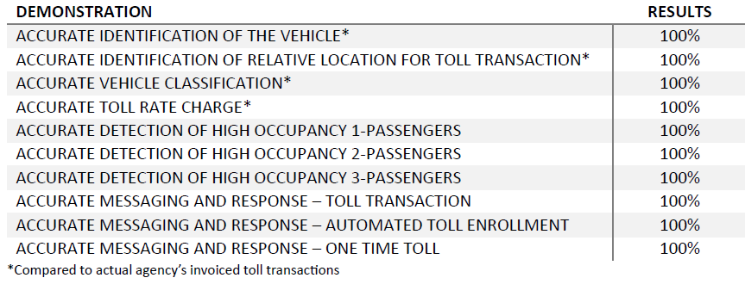
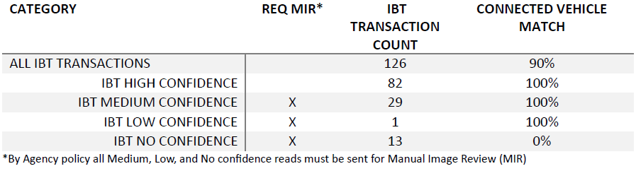
Industry Demos & POCs – CV Tolling
Agency Adjudication with Connected Vehicle Data
Demonstrate the value of supplementing Image-Based Transaction (IBT) with connected vehicle tolling transactions as a part of the transaction adjudication process.
Tolling
Demonstrated ability to identify a toll transaction using GNSS location data, pay of it automatically and provide in-vehicle notifications to drivers.
Toll Transaction Processing
Demonstrated ability to capture and process a toll transaction from only using GNSS location data, without the aid of any road-side infrastructure.
Image-Based Transaction
GNSS Transaction
High Confidence Transaction
Connected Vehicle Tolling System - Evaluation Results
Connected Vehicle IBT Transaction Adjudication Evaluation Results

Slide 16

Industry Demos & POCs – HOV Tolling
Test Case | Description | Expected outcome
Express Lane Tolling | Driving on the HOV Toll lane with no passengers | The GNSS captures match the toll transactions read by the transponder
Toll lane proximity testing | Driving on the lane adjacent to the HOV Toll lane | There should not be any toll transaction captured through GNSS data
Occupancy testing | Driving on the HOV Toll lane with a passenger (2+ configuration) | The vehicle data indicates 2 occupants in the vehicle and notifies the system that the vehicle qualifies for HOV rates.
Toll Evasion | Driving in a way such that a transponder read is avoided at the gantry | The GNSS data captures the path taken by the vehicle on the HOV Lane and identifies lane usage and calculates toll charge accordingly, even if the vehicle evades toll gantry.
HOV Tolling
Demonstrated ability to identify number of passengers and vehicles entering HOV Toll/Express Lanes using GNSS and vehicle data, pay for the trip and provide in-vehicle notifications to drivers.
Connected Vehicle HOV Tolling - Evaluation Results
Demonstration | GNSS Toll Accuracy
Accurate Identification of THE VEHICLE | 100%
Accurate Identification of RELATIVE Location for Toll Transaction* | 94%
Accurate LANE Discrimination | 97.5%
Accurate Vehicle Classification | 100%
Accurate Detection of High Occupancy Passengers | 100%
Accurate Messaging and Response – Toll Transaction | 100%
GNSS missing transactions – coordinates outside the geo-fenced area due to road curvature &/or GPS drift.
  Course correction algorithms to account for directional GPS drift
  Recalibration of geo-fence coordinates and area definition based on extensive data mapping
Temporary loss of connectivity – sporadic network issues between the vehicle and the CVS platform infrastructure.
  Dead reckoning of GPS coordinates when there is a temporary loss of communication
  Queuing of data at the time of network loss and upload of queued data to back-end systems once network connectivity is restored

Slide 17
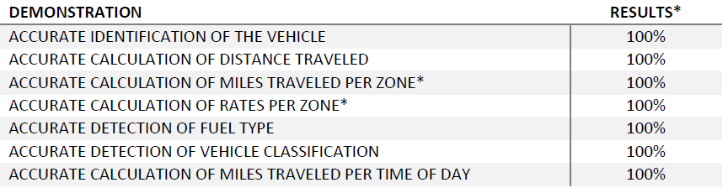

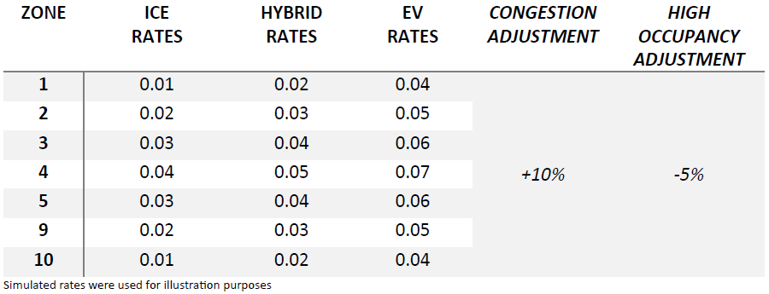
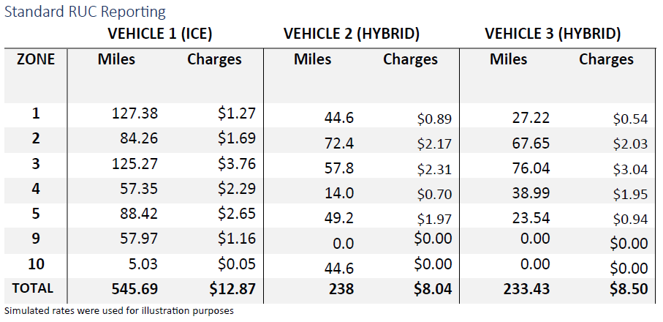
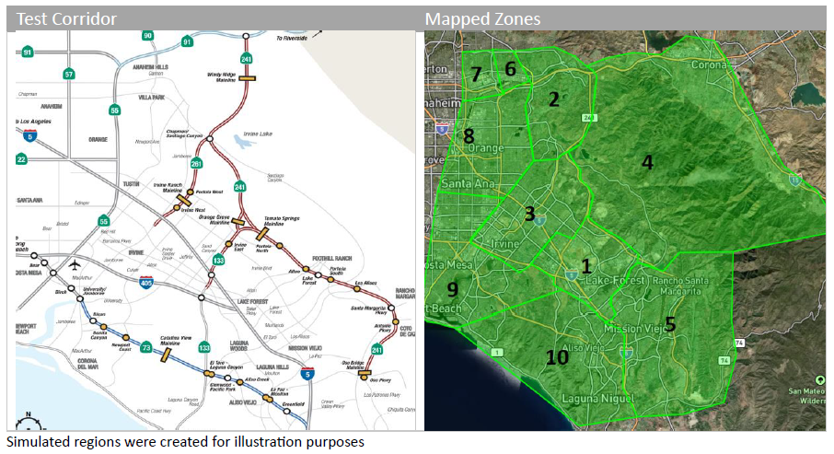
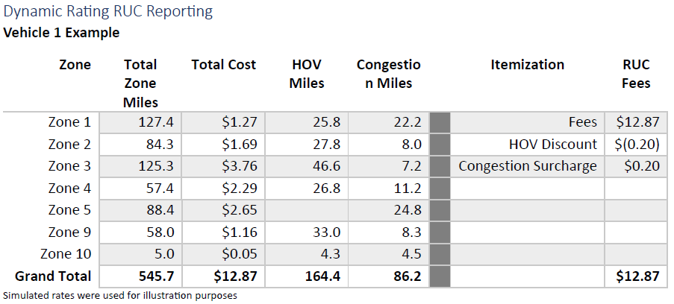
Industry Demos & POCs – RUC
Road Usage Charging
Demonstrated collection of needed information to process Road Usage Charges using GNSS location data.
Zone and Rate Data
Official rates and zones were not provided, so simulated data was used. Additionally, to demonstrate dynamic pricing capabilities related to congestion and high occupancy variable adjustments to rates were also simulated.

Slide 18

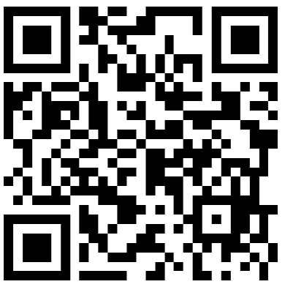
"Innovation rarely happens in isolation. The best ideas often come from the collaboration of diverse teams working together to solve problems and invent new solutions.”
- Rosabeth Moss Kanter
Naveen Radhakrishna
Connected Vehicle Services
Verra Mobility
naveen.radhakrishna@verramobility.com
mobile: 480.371.8945
verramobility.com
Connect with me on LinkedIn

