Slide 1
Vehicle Data
The Intersection Between Innovation and Privacy
Michael O’Shea
Moter

Slide 2
Vehicle Data: The Intersection Between Innovation and Privacy
September 26, 2024

Slide 3

Michael O’Shea
COO & CTO
MOTER Technologies
michael.oshea@moter.ai

Slide 4
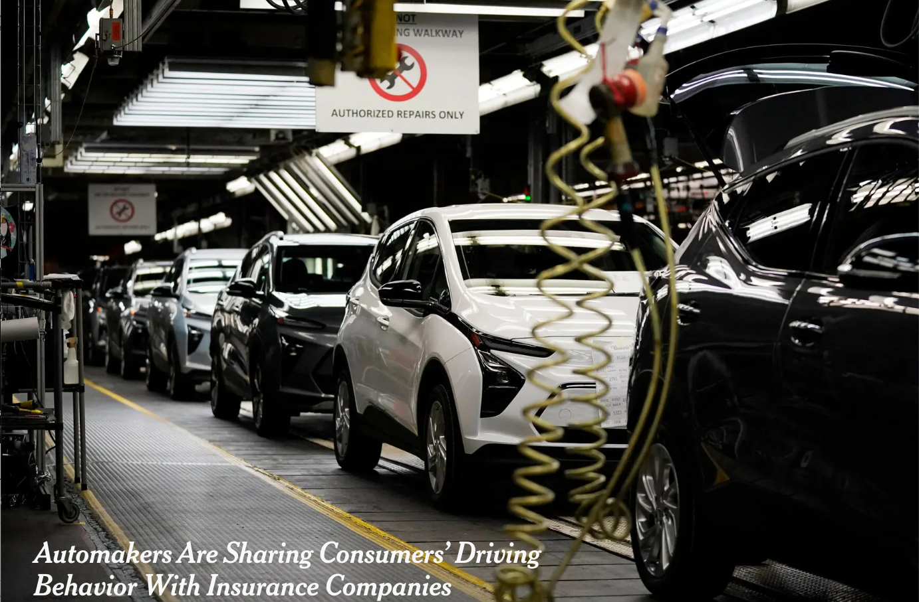

Vehicle Data Sharing Concerns Make the Headlines Again!
By Kashmir Hill

Slide 5
… and not for the first time
The vast majority (78%) of American drivers are uncomfortable or extremely uncomfortable with automakers collecting data such as location history from their cars.
Automakers Sold Driver Data To Insurance Companies For Next To Nothing
Over half of Americans feel uncomfortable sharing personal data with auto and insurance companies.
Notes:
https://www.jdpower.com/sites/default/files/file/2023-07/2023007%20U.S.%20Auto%20Insurance%20Study.pdf
https://getjerry.com/studies/american-drivers-seek-control-over-their-car-data
https://jalopnik.com/automakers-sold-driver-data-to-insurance-companies-for-1851606587
https://www.marketwatch.com/guides/buy-or-sell-car/how-data-privacy-concerns-impact-car-buying-choices-in-the-u-s/

Slide 6



Data Exchanges Proved a Passing Fad
“ Connected vehicle data market faces setbacks as two of its largest players exit ”
Notes:
https://www.spglobal.com/marketintelligence/en/news-insights/research/connected-vehicle-data-market-faces-setbacks-as-two-of-its-largest-players-exit

Slide 7


Data Monetization Vs. Value Creation
Data monetization focuses on extracting profit from consumer data
Value creation prioritizes enhancing the customer experience through tangible, personalized benefits
Data Monetization
Value Creation
Popularized by the McKinsey & Company “Monetizing Car Data: New Service Business Opportunities to Create New Customer Benefits” report in 2016
Customers might be willing to share their browsing data, but vehicle data is seen as more sensitive and personal.
The industry has not always handled consumer consent in a sufficiently open way
OEMs haven’t made a lot of money, and their brands were put at risk
Consumers have demonstrated a willingness to share data for value, e.g. Waze
The benefits should be clear, direct, and easily understood by the consumer without ambiguity
Trust must be a foundation and there must be transparency in data use
By being proactive in prioritizing consumer benefits, we can align better with data privacy regulations

Slide 8
Case Study: Insurance
Notes:
After purchase costs and fuel, insurance is the biggest cost item

Slide 9
Consumers’ Willingness
Participation in usage-based insurance programs has more than doubled since 2016… Price satisfaction among customers participating in these programs is 59 points higher on average than among non-participants.
As car insurance rates rise, telematics programs are becoming increasingly popular among consumers…More than half (54%) of the people surveyed for Jerry’s 2024 State of the American Driver report said they would be open to allowing their insurance company to monitor their driving if it meant a lower premium.
72% of respondents were willing to share specific data points in exchange for reduced insurance premiums— especially Gen Zers (78%).
Notes:
https://www.jdpower.com/sites/default/files/file/2023-07/2023007%20U.S.%20Auto%20Insurance%20Study.pdf
https://getjerry.com/studies/american-drivers-seek-control-over-their-car-data
https://www.marketwatch.com/guides/buy-or-sell-car/how-data-privacy-concerns-impact-car-buying-choices-in-the-u-s/

Slide 10
Problem: The Rising Cost of Insurance
Automakers
Are building more complex vehicles that are expensive to repair and insure.
Insurers
Are faced with rising claims costs and current UBI solutions have plateaued in the insights they offer.
Consumers
Are paying even more for insurance today despite the advancements in vehicle safety technology.

Slide 11
Key Considerations
Informed Consumer Consent: Ensuring that customers fully understand and explicitly agree to share their data, with clear communication about what is being shared and how it will be used.
Data Privacy: By processing on edge consumers retain control of their vehicle data.
Consumer Empowerment: Empowering drivers with insights to improve and save on insurance.

Slide 12






Informed Consumer Consent
01
02
03
60-90 days later, Customer asked through OEM’s app if they agree to send data anonymously to insurer
Dealer recommends opt-in for connected services and data sharing
Driving behavior analyzed and vehicle data collected
CUSTOMER Purchases New Vehicle
04
Insurer provided with anonymized driver score
Periodic reminders that data is being shared
05
CUSTOMER Purchases Insurance
Insurer provides premium offer incorporating
driving behavior
06

Slide 13
Data Privacy Through Edge Processing
Data Minimization: By processing data on the vehicle, only the necessary insights are shared, reducing the amount of raw personal data that leaves the vehicle, minimizing exposure to privacy risks.
Enhanced Data Security: Edge processing limits the need to transmit sensitive data over networks, reducing the risk of interception, breaches, and unauthorized access during data transfer.
Reduced Dependency on Cloud Storage: Processing data on the vehicle eliminates the need to store large amounts of data in cloud services, reducing vulnerabilities associated with remote data storage and external servers.
Compliance with Privacy Regulations: Edge processing aligns with data privacy regulations by keeping more data localized, which helps automakers and insurers comply with strict data residency and privacy laws.
Transparency and Consumer Trust: When data processing happens on the vehicle, consumers have greater visibility into how their data is used, enhancing transparency and building trust in the system.

Slide 14

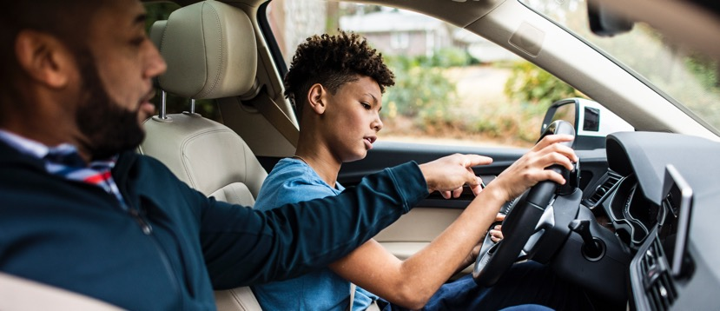
Consumer Empowerment Through Contextualized UBI
Enhanced vehicle safety through actionable insights
TRADITIONAL UBI
CONTEXTUALIZED UBI
Uses Basic Data: Odometer, GPS, time, velocity, acceleration
Plateaued in terms of value it offers to insurers
Harder for consumers to understand the connection between their driving behavior and associated risk
Basic data plus new data sources ADAS sensors, DMS
Sophisticated ML techniques to improve accuracy giving insurers far greater underwriting precision
Provide consumers clear guidance on how to change their driving behavior to lower risk

Slide 15
Outcomes
Notes:
After purchase costs and fuel, insurance is the biggest cost item

Slide 16
Outcomes: Value Unlocked from Vehicle Data
Automakers
Generate insights to enable OEMs to design safer, more affordable vehicles.
Better understand product liability exposure
Insurers
Modern vehicles have data that can transform insurance pricing precision and allows for faster and more efficient claims resolution
Consumers
Contextualized UBI gives drivers understanding of their driving behavior and allows ability to control their insurance cost
Monetization of advanced vehicle data
Customized insurance solutions for OEMs brands and their consumers
Reduction in costs and privacy risks
ADAS and computer vision-based insurance products
Deeper insights into collisions that simplify the claims value chain and reduce claims processing costs
Insurance savings
Convenience in filing claims
Improving driver safety

Slide 17




National Collision Statistics
50% of passengers killed in traffic accidents are not wearing seatbelts
Traffic collisions are the leading cause of death among children 4-7 years old and teens 16-20 years old
This year alone, we expect:
Over 40,000 traffic fatalities in the US
Over 2 million injuries
Over 5 million crashes
29% of traffic fatalities are speeding-related
8% of traffic fatalities involve distracted drivers
Source: NHTSA

Slide 18
Outcomes: Safer Driving
Human Error is a Leading Cause of Accidents: 90% of crashes are attributed to driver-related factors like driver error, impairment, fatigue, and distraction.⁽¹⁾
Improved Driving Behavior: Cambridge Mobile Telematics found that drivers who used telematics-based UBI programs had 50% fewer distracted driving incidents and significantly fewer harsh braking events, both of which are critical factors in preventing accidents.⁽²⁾
(1) Dingus et al. Driver crash risk factors and prevalence evaluation using naturalistic driving data. (2) Lisa Pinals et al. Motivating Safer Driving with Telematics

Slide 19
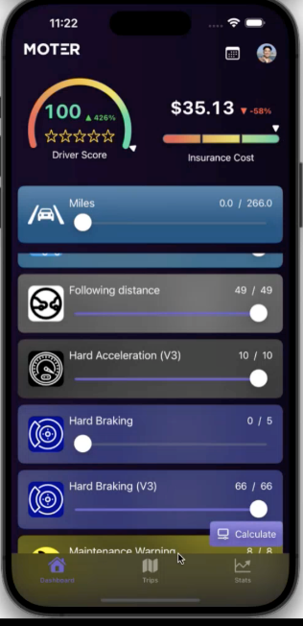
Outcome: Fairer Pricing and User Control
Empowering users to control insurance cost
Risk Monitoring
Driver Coaching
Traditional insurance leverages models based on financial records, age, sex, claims history, driving records, and vehicle characteristics
UBI leveraging modern vehicle data is customizable and tailored to individual driving behaviors
Combined with driver coaching consumers are empowered to improve their driving and control their insurance costs

Slide 20




Generating Value From Connected Car Data
DRIVER RISK INTELLIGENCE
Customer Segmentation
Risk Monitoring
New Customer Acquisition
Fleet Risk Management
OEM BRANDED INSURANCE SOLUTIONS
White Label Insurance
OEM Insurance Operations
OEM Replacement Parts
Customer Retention
COLLISION ANALYTICS
VEHICLE PERFORMANCE ANALYTICS
Crash Assessment
Claims Handling
Smart Warranty
Battery Warranty

Slide 21
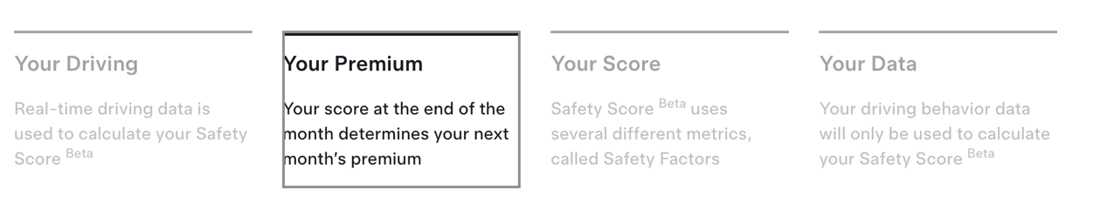

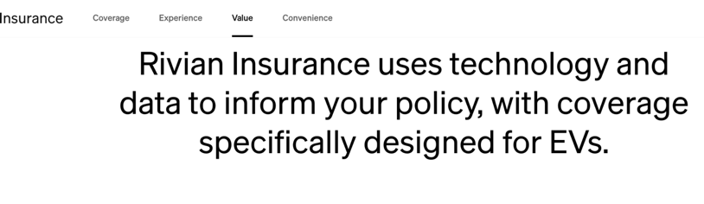


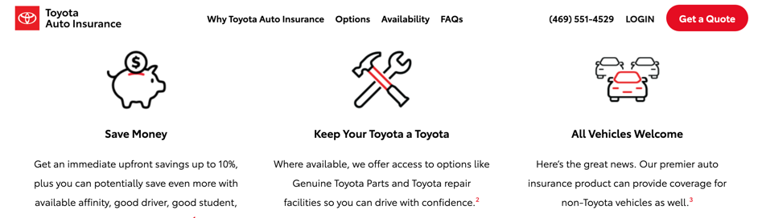
OEMs Ahead Of The Curve

Slide 22





Choose Your Own Adventure
Driving Data
OEM
Insurer
Data Monetization
White Label Insurance
Insurance Agency
Insurance Company

Slide 23
Thank You!
Michael O’Shea
COO & CTO
MOTER Technologies
michael.oshea@moter.ai

