Slide 1
Automotive AI & VSS
Unleashing New Possibilities Modeling Vehicle Data
Panel Discussion

Slide 2
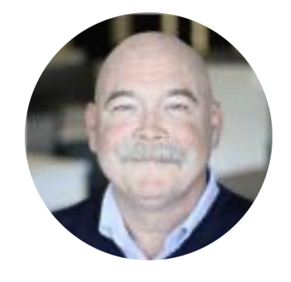
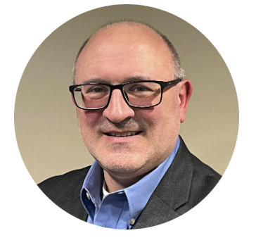
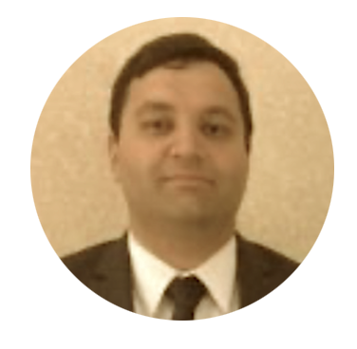

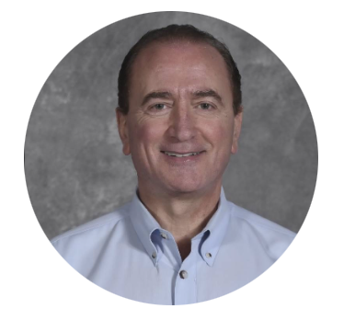
Moderator:
Panelists:
Jeff Blackburn
Senior Product Sales Manager
Ansys Autonomy
Tim Yerdon
Executive Director
SAE Industry Technologies Consortia
Jean-Louis Rivard
Global VP, XR & Physical Computing
Endava Inc.
Ephrem Anthony Chemaly
VP, Automotive
MediaTek
Richard Fernandes
Connectivity Standards Engineer
General Motors

