Slide 1
Changing Lanes Safely
AI and New Vehicle Technologies
Fireside Chat

Slide 2
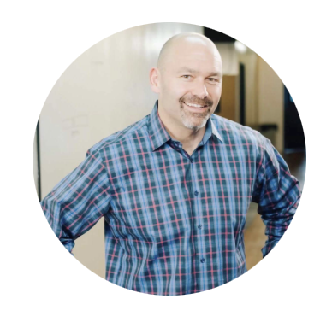
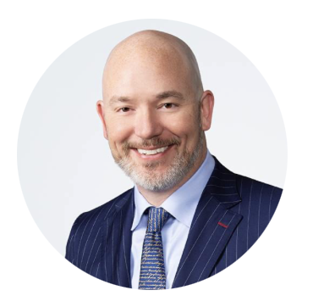
Keith O’Neill
Managing Director
Globant
Brian Wassom
Partner
Warner, Norcross + Judd

