Slide 1
Leveraging COVESA VSS for Enhanced Risk Analytics
Integrating ADAS and Telematics Data in Next Generation UBI Models
Ian Chaffey – Data Scientist - MOTER Technologies, Inc
2025/05/15

Slide 2
Overview
Who is MOTER and what is Insurtech?
How is vehicle data valuable for insurance?
What is fair pricing?
Roles for VSS in insurance
What data is needed?
Implementation

Slide 3
Who is MOTER?
Mission: Enable smarter, data-driven decisions in the insurance industry
Vision: Unify automotive and insurance sectors, enhancing modern mobility by bridging the needs of the insured, equipment manufacturers (OEMs, dash cam vendors, etc.. ) and insurance operators (carriers, MGAs, brokers)
Monetization: Advanced data leads to profitable insights with tailored insurance products and services

Slide 4

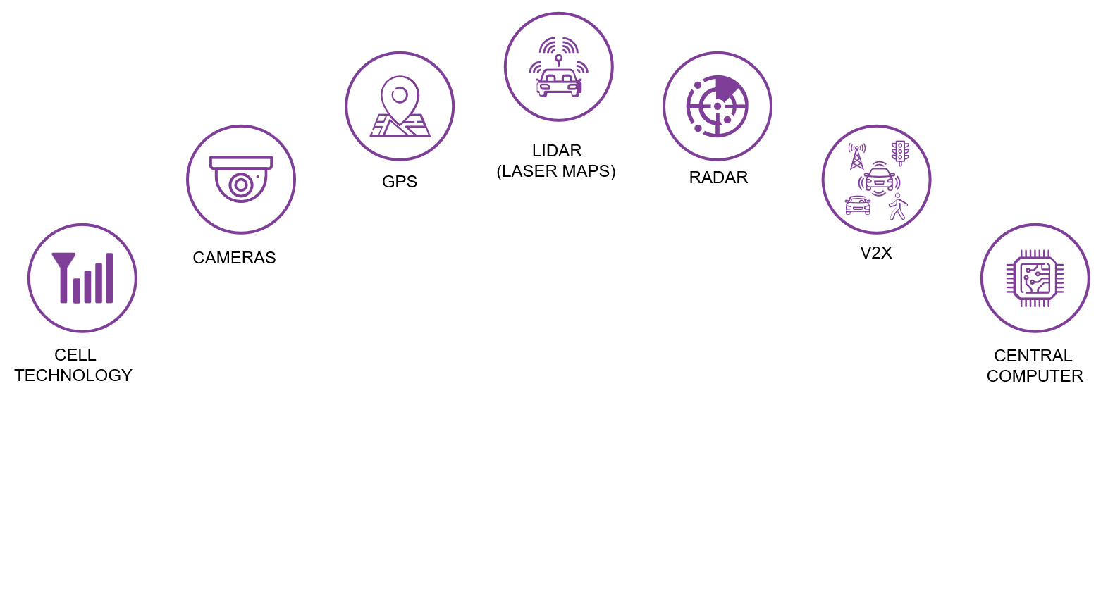






Insurtech on the Edge
1
Data science software is deployed in the vehicle
2
Software uses edge computing to calculate advanced insurance insights from next-gen data
3
Data-driven insurance insights are uploaded to the cloud, removing need for heavy data volume and PII
4
Insurance insights are then monetized via different data
products and services
1
Driver Risk Modeling
Collision Analysis
Coaching/Risk Prevention
4
3
Upload insights to cloud
1
2
Advanced Insights
Embedded Data Science Software

Slide 5
How is Vehicle Data Valuable for Insurance?
Traditional UBI primarily relies on telematic signals often implemented through a dongle or other third-party device
Modern Vehicles contain a diverse set of signals due to the advancement and standardization of the inclusion of ADAS and more recently DMS systems
Context Aware Risk Analytics requires multiple signals to understand the true reason a risk factor event occurred
Realtime processing of VSS signals on the edge allows for seamless coaching, risk prevention measures and more accurate premium pricing

Slide 6
Usage-Based Insurance (UBI)
Usage-Based Insurance: Insurance where cost is determined by factors such as distance driven, time of day, location and driving behavior
Differs from Traditional Insurance which focuses on historical patterns rather than present behavior
Common complaints include poor differentiation between the user of the vehicle, unfair risk factors and unclear metrics relating driving behavior and premium pricing
With VSS signals we can achieve Fair Pricing

Slide 7

What is Fair Pricing?
The insured (Drivers) tend to take the glass ¾ full perspective
  “I only had one phone distraction…”
Carriers on the other hand take the glass ¼ empty view
  “This driver had a phone distraction event”
Fair pricing focuses on bridging the gap in perspectives through a more detailed understanding of risk factors and the events leading up to a collision/claim
A common criticism of Usage-Based Insurance is that risk events are often not the fault of the driver
While some risk factors like phone use should never be acceptable, for example understanding if a driver was cut off before a hard braking event can help determine a more accurate risk score resulting in better driver segmentation
VSS signals provide context aware vehicle data

Slide 8
Context Aware Usage-Based Insurance
Context Aware UBI is usage-based insurance which considers a diverse collection of signals to assess risk associated with driving behavior.
While Traditional UBI covers telematic signals and often distraction via phone use, Context Aware UBI leverages the availability of advanced ADAS and DMS signals to determine the true risk of an event and what role the driver played
With this added context, determining whether a risk event such as hard braking is truly part of a driver’s habitual behavior or the result of an evasive maneuver due to another vehicle’s actions

Slide 9



VSS Role in Context Aware UBI
Risk Modeling
  Collect historical data about driving habits to understand correlation with risk
Collision Analysis
  Use sensor data in combination with driving behavior and environmental data to detect accidents, estimate severity and determine fault
Coaching/Prevention
  Use real time sensor data and analytics to provide feedback and influence a diver’s behavior in-order-to align with statistically safer practices

Slide 10
Data Categories
Driving Behavior
Traditional telematic signals such as hard braking, hard acceleration and hard turns. Advanced signals such ADAS and DMS warnings and measurements (distance to obstacle, time to obstacle).
Vehicle Details
VIN, Vehicle installed specifications, real time feature configuration, number of seats, etc
Environment
Road type, weather, time of day, traffic conditions, location

Slide 11
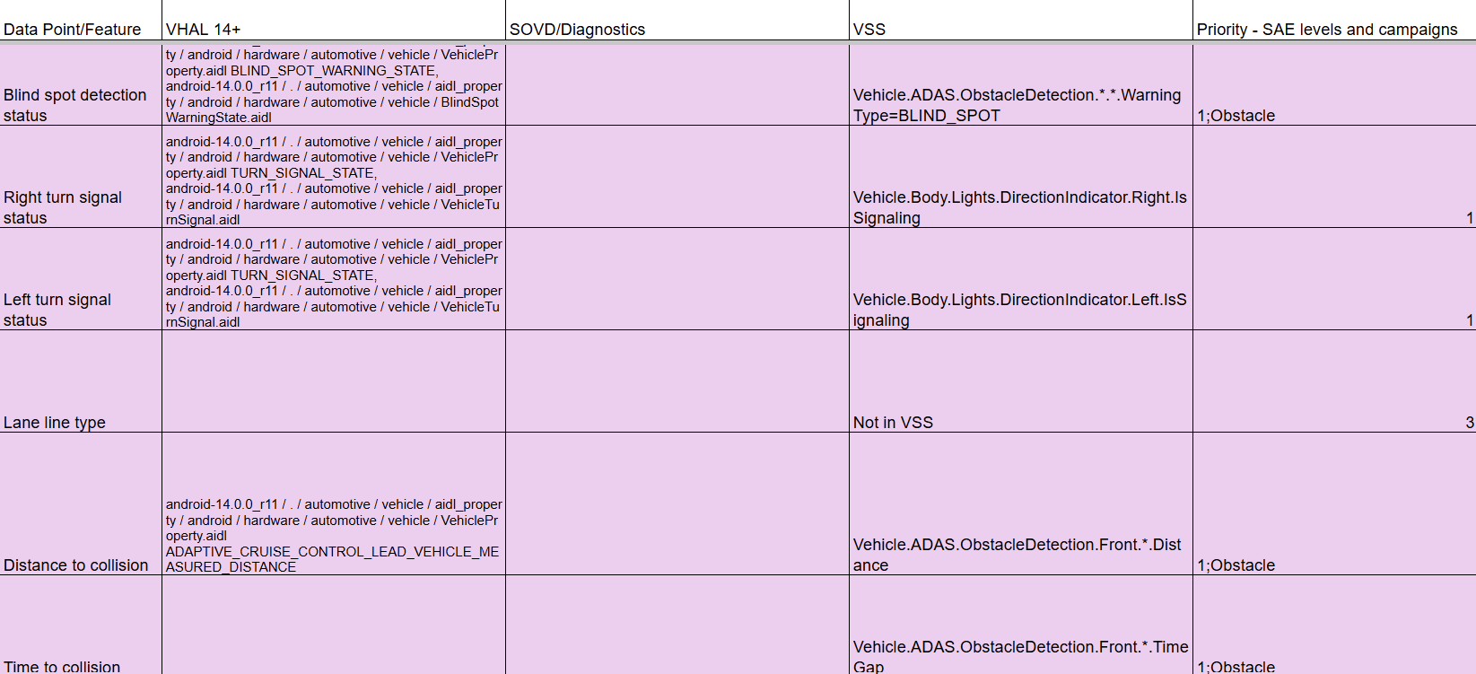
Insurance Signals Working Group
In the insurance signals group, we created a spreadsheet of signals desired for the insurance use case
Excerpt from full spreadsheet: https://docs.google.com/spreadsheets/d/1Np9uLvwEESZ09dMcXoSvoyoyj5L_Le0k/edit?usp=sharing&ouid=104086159685457159124&rtpof=true&sd=true

Slide 12
Examples of Signals and Use Cases
Vehicle.Acceleration.*, Vehicle.AngularVelocity.*, Vehicle.Speed
  Needed for risk modeling, collision analysis and driver coaching
    Used to create traditional telematic risk factors as well as detailed accident analysis
Vehicle.ADAS.*, Driver.DistractionLevel, Driver.IsHandsOnWheel
  Critical for risk modeling and driver coaching and can provide enhanced context for collision analysis. Key to differentiate context aware UBI from traditional UBI
    Used to create advanced risk factors such as close following, lane departure, driver distraction and determine real time configuration of ADAS features
Vehicle.CurrentLocation.*, Vehicle.ADAS.ESC.RoadFriction, Vehicle.WindShield.Front.Wiping.System.IsWiping
  Needed for risk modeling, collision analysis and driver coaching
    Help determine the environment the vehicle is in and provide enhanced context

Slide 13
VSS Implementation Demonstration
Example Implementation Architecture
Data Generator (Vehicle)
Data Consumer
(Visualization/Trip report/Coaching)
Data
Listener
Data Aggregation Engine
Data Analytics Engine

Slide 14
Thank you!
ian.chaffey@moter.ai
Contact Us: info@moter.ai

