Slide 1

Europe’s Approach to SDV – An Update from the FEDERATE Project
Graham Smethurst

Slide 2

The Software defined vehicle (sdv)
Creation vs. exploitation
Stakeholder group ..
Stakeholder group ..
Stakeholder group C
Stakeholder group X
Stakeholder group B
Stakeholder group B
Stakeholder group
Stakeholder group
OEM
OEM
Create the SDV
Exploit the SDV
What´s an OEM´s motivation to create an SDV?
What´s an OEM´s motivation do this collaboratively?

Slide 3
The Software defined vehicle (sdv)
What´s the motivation to create an SDV? – AN OEM perspective
Create the SDV
Exploit the SDV
Increased development speed – creation, integration, test.
Reduced time to market, increased update frequency
Long-term product support
Targeted deployment of developer skills
Enable flexible component sourcing by creating areas of automotive commodity
Technical consistency between automotive OEMs at selected data touchpoints.
  Integrating the vehicle in the digital life of each customer
  Integrate the vehicle in the pervasive ecosystems – „vehicle as a device“
  Gain access to data in adjacent industry sectors
OEM In-house community
External Community
What´s the motivation to create an SDV?
What´s an SDV?
What´s the motivation do this collaboratively?

Slide 4
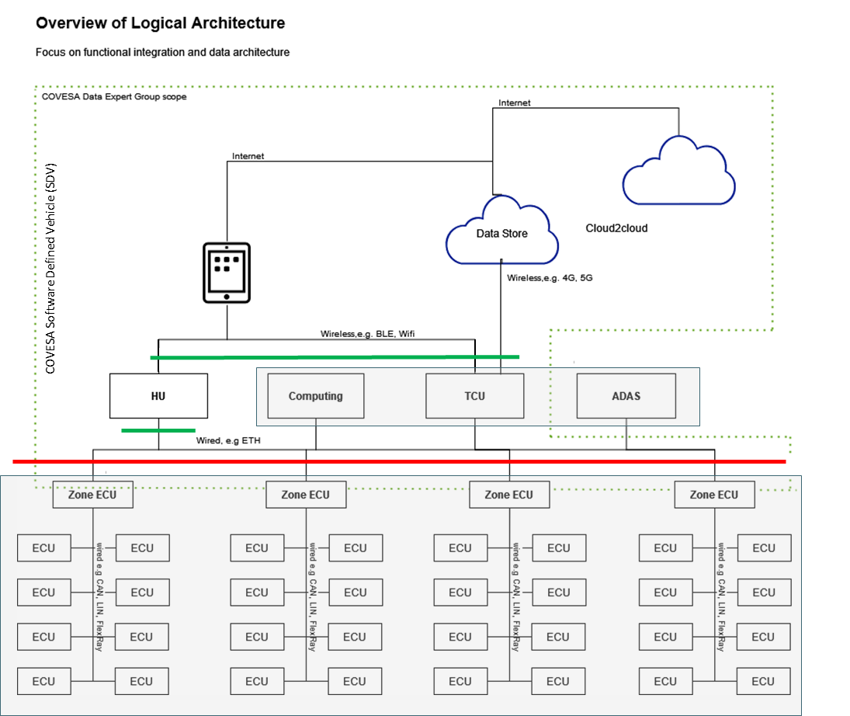

Approach to creating the SDV? - OEM perspective
Improved efficiency & speed in development + flexibility in sourcing.
Digital Experience (QM) differentiating IP
Abstraction
Differentiating IP
Commodity IP (Rolling Chassis)
Separating differentiating IP from commodity IP (Red-Line)
  We believe that some vehicle functions could be made commodity.
  User experience can be built using commodity functionality (using off-the-shelf industry components), controlling it via defined software interfaces (Vehicle abstraction API).
Encapsulating automotive technologies to simplify the rapid development and frequent deployment of evolving digital experiences (Green-Line)
  The digital developer must be provided with access to relevant vehicle capabilities without the need to understand automotive complexity, this can be achieved by establishing a managed Developer API.
Separating safety critical / safety related functionality from non-safety critical (QM)
  The separation of safety and non-safety functionality would allow the non safety functionality to be updated independently from the safety content without the risk of negative impact.
  To be able to deliver frequent and evolving digital experience updates it is necessary to apply different development, integration and test methods to those necessary in safety critical functionality.
COVESA

Slide 5
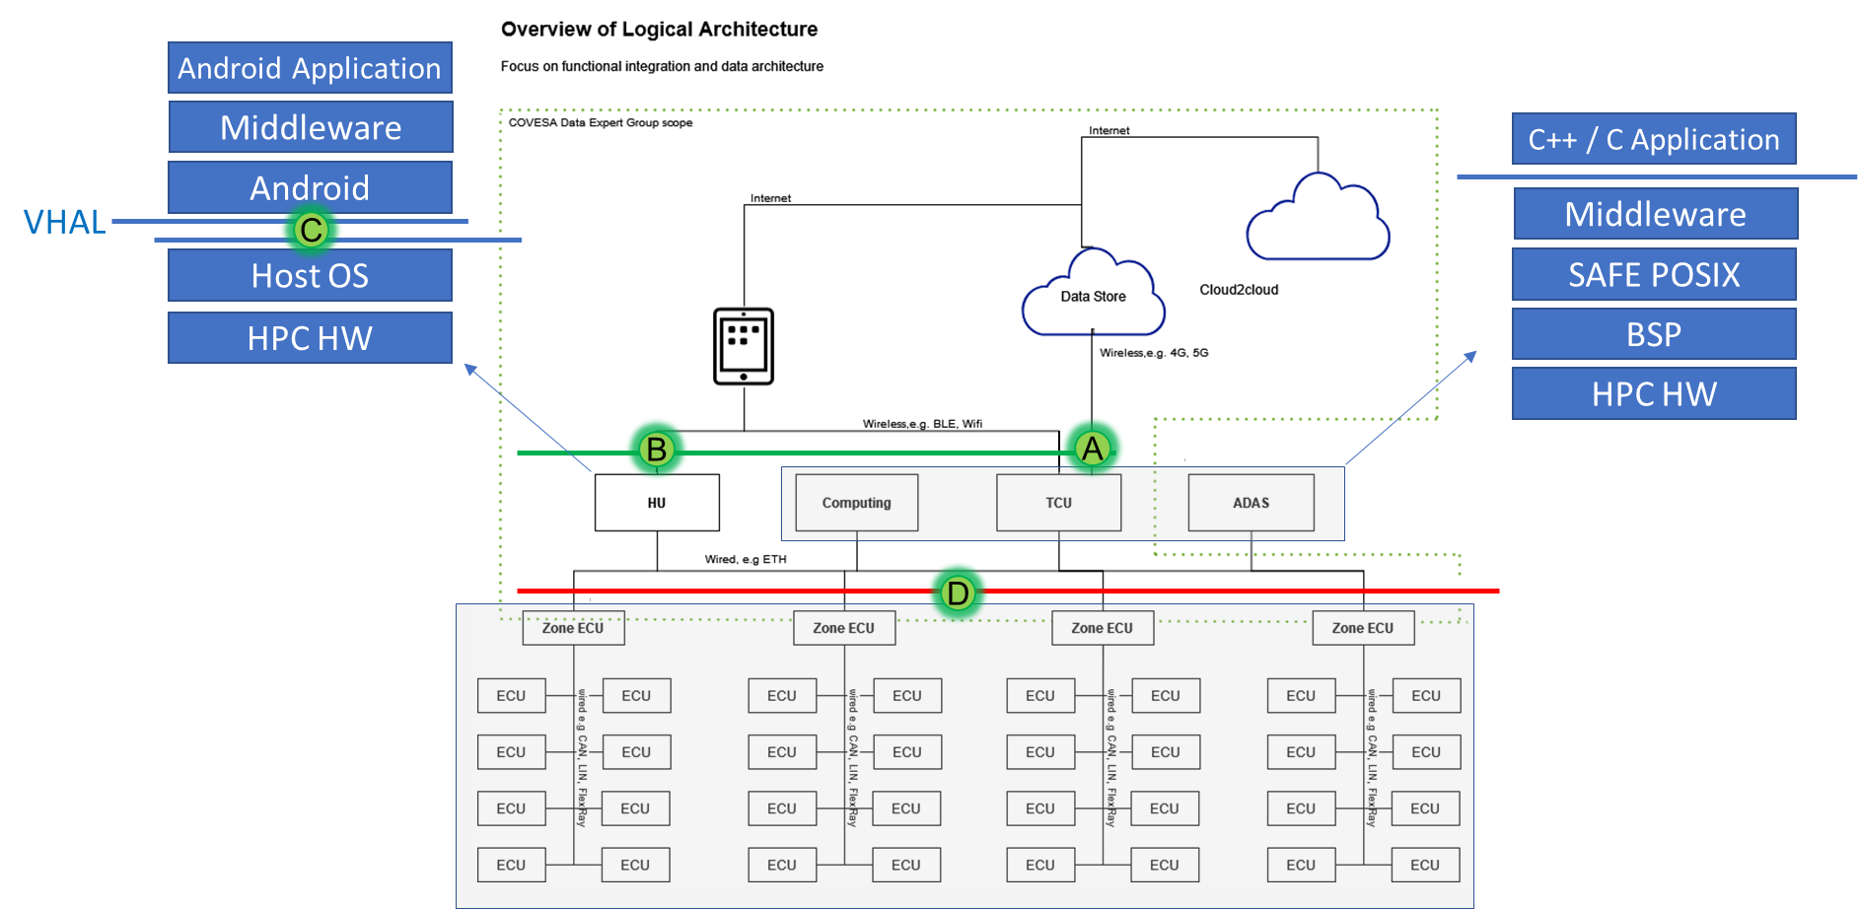
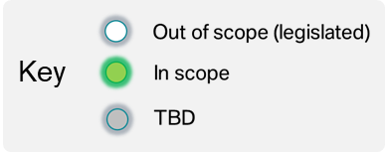

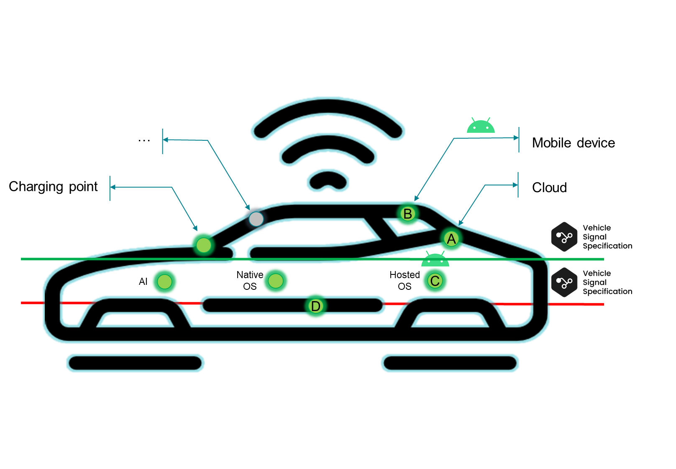
Covesa contribution to solving the sdv challenge
Although COVESA can make an extremely valuable contribution to solving parts of the SDV challenge, the scope of SDV is bigger than COVESA alone.

Slide 6

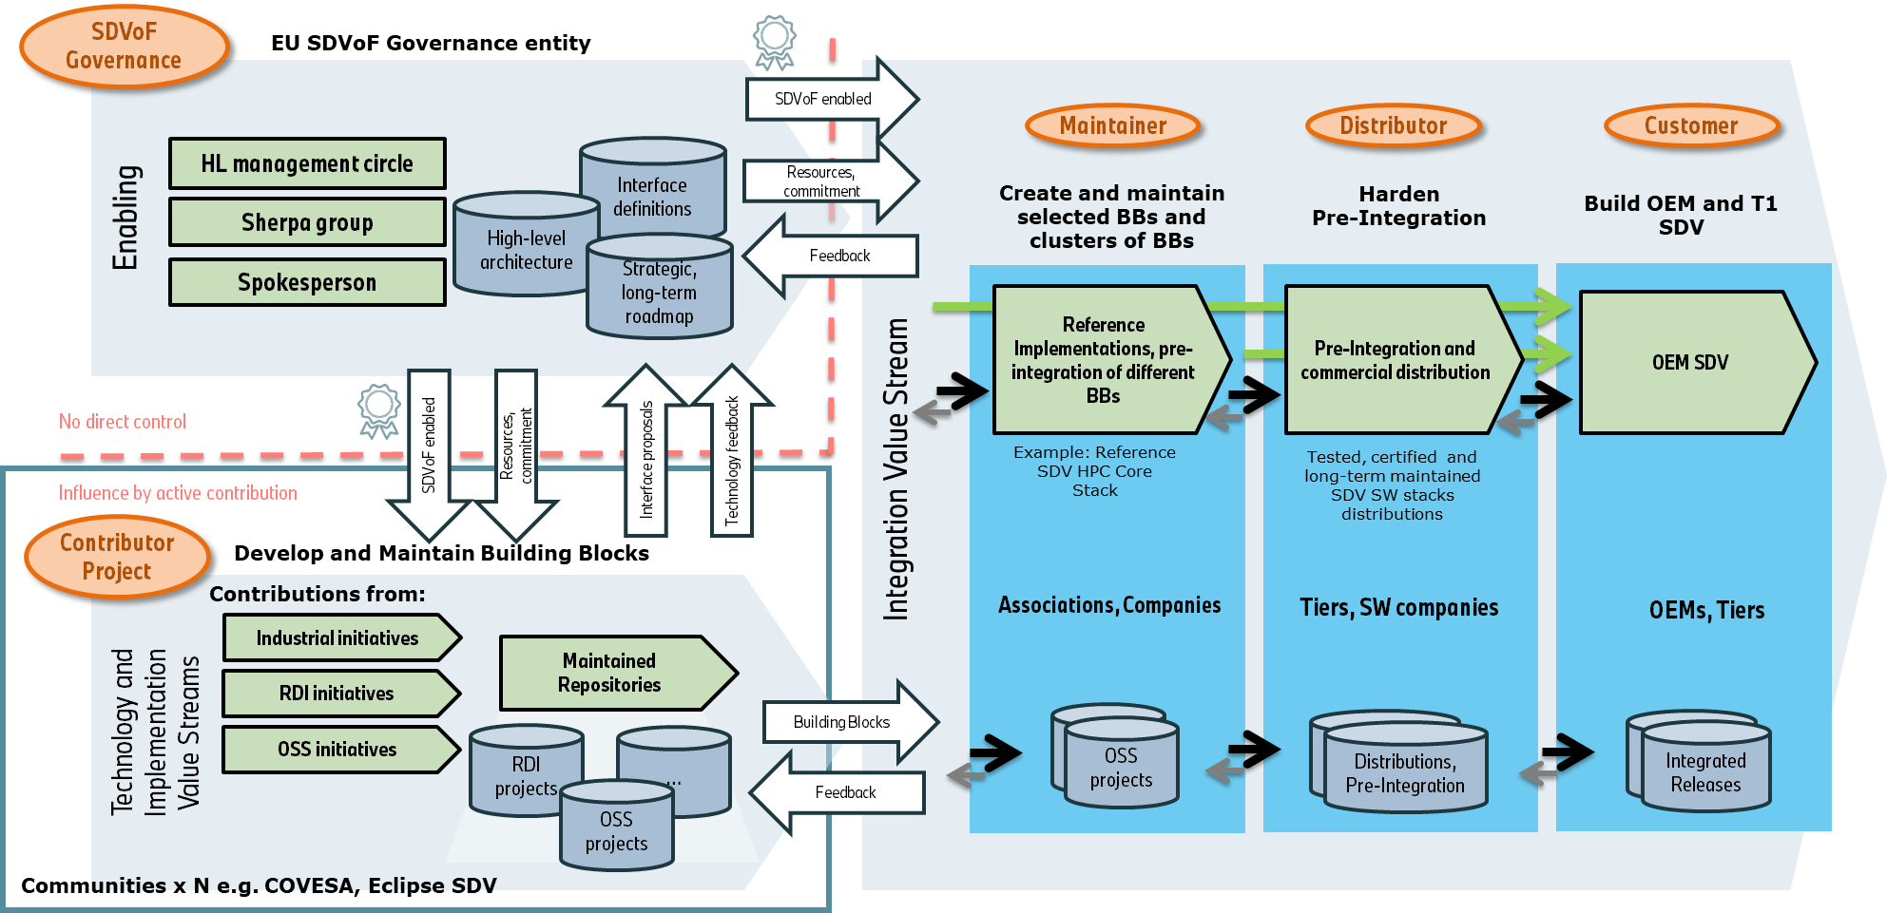
EU SDVoF governance and interaction model
#
SOURCE: https://federate-sdv.eu/2024/04/12/european-software-defined-vehicle-of-the-future-sdvof-initiative-vision-and-roadmap/
#
"Dieses Foto" von Unbekannter Autor ist lizenziert gemäß CC BY

Slide 7
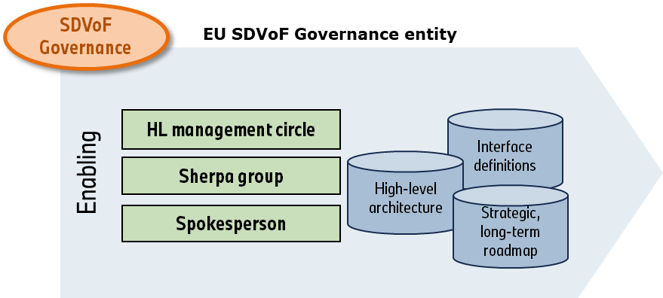



Alignment of sdv activities in Europe
Software Defined Vehicle of the Future
SDVoF
Topic Areas
Workpackage Execution
In open source
2024
2026
1
HAL4SDV
SDV Landscape
SDVoF
Phases
2025
2027
2
SHIFT2SDV
3
…
2026
2028
…
4
…
2027
2029
COVESA AMM Gothenburg | 2024 | Graham Smethurst

Slide 8
Consolidation of HAL4SDV painpoints EU commission + project partners
BUILDING BLOCKS – TOPIC AREAS
A Hardware/Software Abstraction
B API
C Development Process Tools
D Integration, Testing, Simulation
HW Abstraction – Hypervisor
Middleware for automotive HPC
Communication Middleware (DDS and other solutions)
Defragmentation of interfaces
Interface concept for service oriented and signal-oriented functions
Data Architecture for Automotive
Container/isolation for complex application (like HMI)
VSS – Vehicle Signal Specification
Efficiently integrating SDV
Mapping for internationalization
Plug & charge according to ISO standards available as open implementations
Linux Ecosystem for Safety
Memory safe languages for critical systems
Open tool for architecture modelling following a model-based-systems-engineering approach for overall vehicle definition
Tooling for performance
Tools interoperability in automotive SW dev area
Software testing on integration – level
Virtualisation for vehicle subsystems
Reprocessing / replay and simulation
ENABLER
DEFINITIONS
E SW Maintenance & Updateability
F Open Source
G Mindset & Ecosystem
H Governance
Isolation of applications
Sustainable maintenance
OSS blueprints for compliance with EU regulations (e.g. cyber security)
Define and show “automotive grade”
Process Mapping: CRA Compliance with OSS supply chains
Open-Source Governance Model

Slide 9
Status SDVoF
SDV Architecture/Landscape (SDVoF – HAL4SDV)
ON-BOARD
Software Development Kit (SDK):
DevOps, Toolboxes, Tool-integration
Programming Model, Process
OFF-BOARD
Safety
Non-Safety
Non-Safety
F01
Application
AD
ADAS
Chassis
Powertrain
Body
Comfort
Cockpit
Multimedia
B02
SUMS
A04
Marketplace
B04
Digital Twin
B01
A05
B03
Middleware
A03
A02
D01
D05
E01
OS
OS
µC (e.g. OSEK)
A07
µP (POSIX)
C01
Hardware & Virtualization
Central / Zonal Computing – Smart Sensors – Smart Actuators
A01
E02
H02
G01
C02
A06
C03
D04
D02
D03
H01

Slide 10
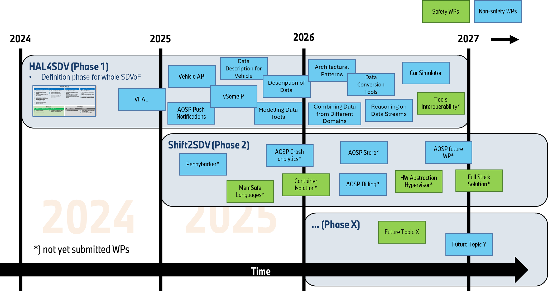
EU iniative SDVof - Timeline and operational scaling

Slide 11
Summary
The SDV is currently an aspiration, not yet a reality.
To develop the SDV requires structure, discipline and co-operation across companies and alliances.
COVESA must make clear, on a world stage, which areas of SDV we intend to take the lead.
The full potential of the SDV will only be realized if it meets the in-house needs of the vehicle OEMs AND the needs of additional stakeholders that would like to exploit the existence of SDVs.

Slide 12


How to align sdv activities worldwide?
SDV America
SDV Europe
SDV Asia

