Slide 1
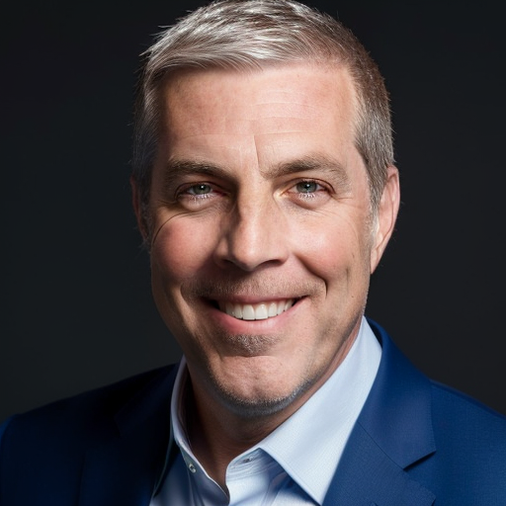
Lessons Learned from My Attempts to Change the World
John Ellis, President & Head of Product, Codethink

Slide 2









A clear business objective is critical to success
Code beats paper
CODETHINK.CO.UK | CC BY-SA 4.0
Understand the self-interests of those involved and those impacted
Own the narrative of what you are doing
Do not be afraid to write and share your story
2

