Slide 1
Capabilities Project - Update
Spring All Member Meeting - Berlin
May 14th

Slide 2
Capabilities Project
Overview
Today OEMs implement common vehicle capabilities, such as Seating and HVAC differently on a variety of electronic and software architectures with different interfaces often tied to the chosen architecture. The result is unnecessary complexity and inefficiency in integration and long term support.
Shared capability definitions, abstracting and encapsulating vehicle capabilities from specific technical implementations and hardware can reduce the complexity of integration, ease long term support, and promote re-use.
Goal
Identify and describe vehicle capabilities in a consistent technology neutral manner/format abstracted from underlying hardware such that down stream apis and components are consistent.
Components may be sourced consistently and economically across vendors
Developers (internal or 3rd party) have consistent apis across vehicles

Slide 3
Capabilities
Capability - the power or ability to do something
Engage the right stakeholders
Keep the conversation at the at the right level
Don’t start with technology
Focus on what you what can done together vs “We do it differently”
Process
Conceptual
Logical
Implementation/Physical
uServices
Data Model
VSS
Behavior
FRANCA
Interface Definition
Logical Architecture
Capabilities
OpenAPI
VDM
IFEX
Running Code
Terminology
Business Requirements
The primary focus to date has been Conceptual. However, a Pull Request was made to the VSS repository.

Slide 4
Simple Repeatable Process
Scope
Terminology
Capability
Validate
Common
Not Competitive
Common Components / Things
Collaborative
What does it do?
Behavior/Function
Feedback from Stakeholders
What is it?
Define/Refine
Identify Define/Refine
Identify/Define/Refine
Identify Domain
  Common
  Collaborative
  Not Competitive
Identify Stakeholders
  Decision Makers
  Understand Domain Well Enough
  Ready to Collaborate
Notes:
Identify Domain
Identify stakeholders
Define/Refine Scope
Focus on common areas where you can collaborate
Do not focus on areas where you cannot collaborate
Define Core Terminology
What are the main components/things you need to define
Define Core Behavior
What does it need to do
Validate with Stakeholders
Agree?

Slide 5
Work Product
Terminology
The terms and descriptions of the concepts/things of interest for the domain in focus (e.g. Seat Components)
Capabilities
Definition of what the concepts/things can do/behave (e.g. Move Seat to Position)

Slide 6
Capabilities Project Status
Seating Capabilities Working Wiki Page
We started with Seats:
Seats are very competitive
Seats are also very common
Seats account for about 1/5 of VSS today
Who has been engaged?
OEMs: BMW, Ford, GM, and Volvo
Groups: TST and VSS
What has been done?
First iteration of Seating Capabilities defined and agreed
Pull Request (821) made to VSS repository. It is still open.
Thin/Fat API examples discussed
Next Steps (We will come back to these at the end)
Identify handoff/definition to logical Interface Definition (Franca, uProtocol, IFEX, ...)
Iterate and refine Terminolgy and handoff to VSS (and other data models as needed)
Document and agree on repeatable process
Engage wider review and participation
Identify other potential target domains.

Slide 7
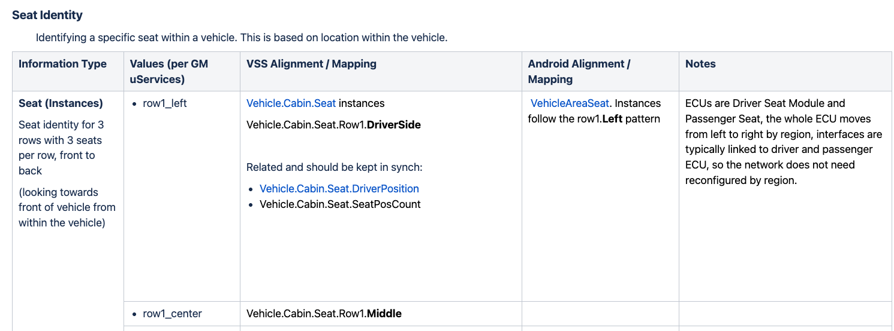
Terminology Example

Slide 8
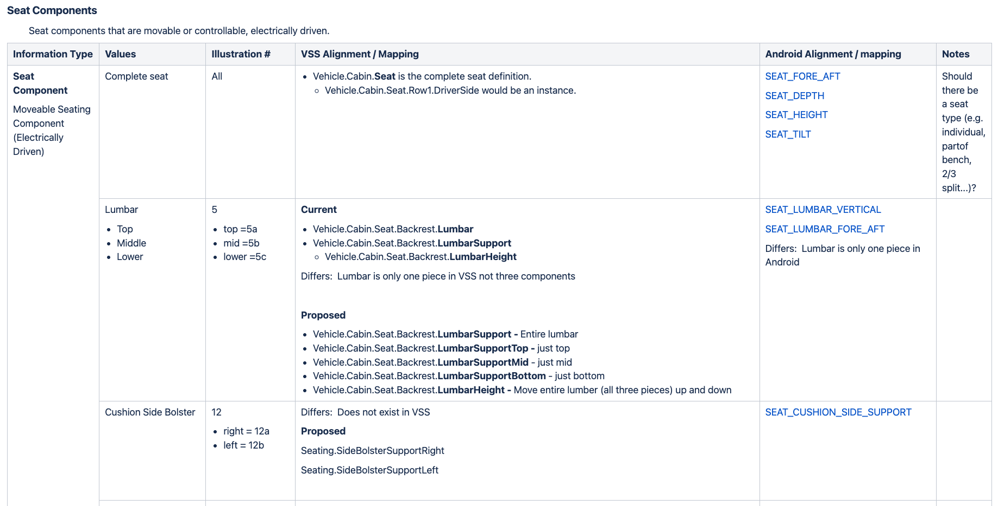
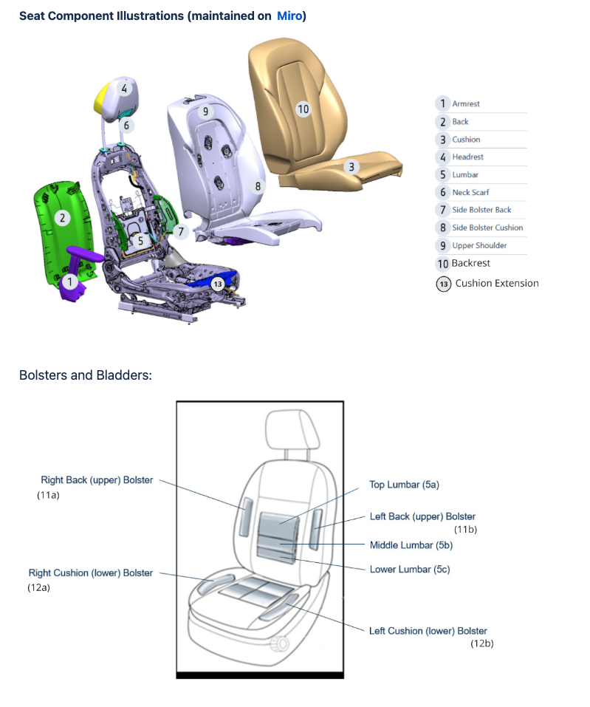
Terminology Example

Slide 9
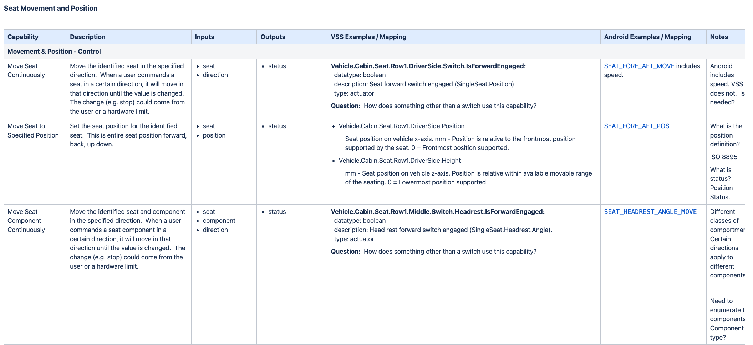
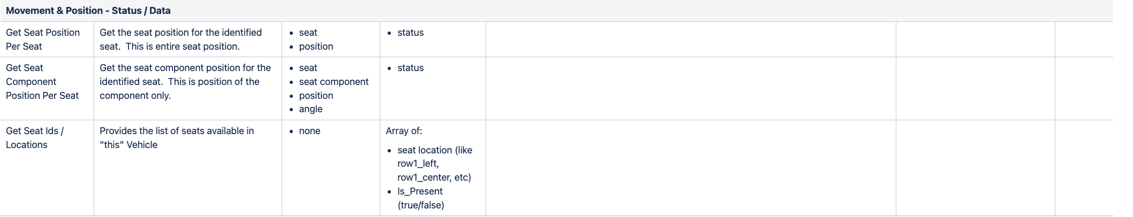
Capability Example

Slide 10
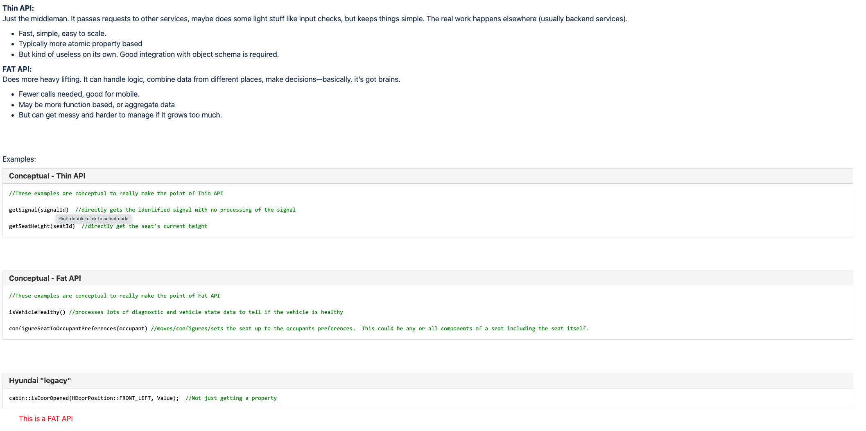
Interface/API Examples

Slide 11
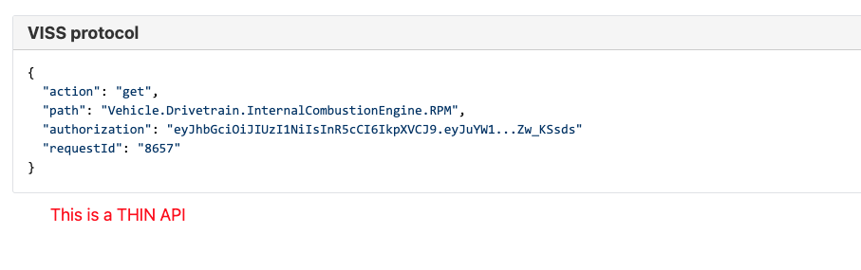
Interface/API Examples - VISS Protocol

Slide 12
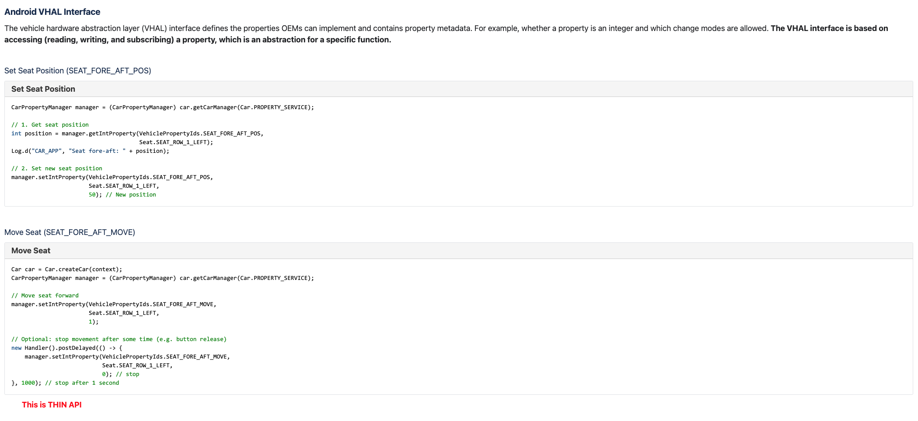
Interface/API Examples - Android VHAL

Slide 13
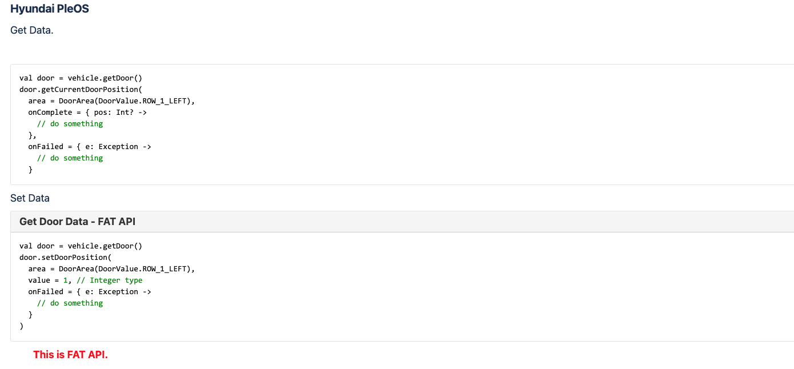
Interface/API Examples - Hyundai PleOS

Slide 14
Discussion and Next Steps

Slide 15
Contact Paul Boyes
pboyes@covesa.global

