Slide 1
Emulator and App Host
AOSP App Framework Standardization Expert Group
14 May 2025

Slide 2
Antitrust Note Well
Before we begin, we would like to make clear that COVESA is committed to compliance with the antitrust laws in all of its activities, and that it expects all participants to similarly comply with the antitrust laws. We will not engage in--and members must refrain from--any discussion of, or understandings regarding competitively sensitive topics. If you have any doubts regarding whether a matter is appropriate for discussion, please consult with your antitrust counsel.

Slide 3


Who we are
José Freitas
Appning by FORVIA
Head of Product
Viktor Mukha
Paradox Cat GmbH
Principal Software Architect

Slide 4
Agenda
AOSP App Framework Standardization recap
COVESA AOSP Emulator
  Why another Android emulator?
  Achievements
  Demo
Next steps
  Support for additional Android version(s)
  Push Notifications
  Maps
  Template Host
  Support for COVESA AOSP Data Workstream

Slide 5
Why another Android emulator?
Problem Statement
App developers need to test their apps in Automotive AOSP representative environments
Existing Google/Android emulators are not fully representative of Automotive AOSP environments:
Without a representative test environment, problems integrating 3rd party apps are found too late, after the apps have been submitted to the Automotive AOSP stores
AOSP Emulator but does include COVESA specific developments (e.g. Push notifications, COVESA SDK, future automotive host)
OEMs and App Store providers (Harman Ignite, Appning by FORVIA) emulators are proprietary and may not include all the COVESA features

Slide 6
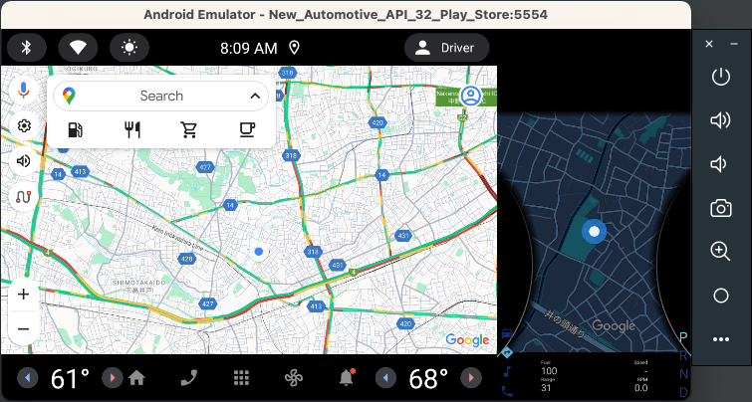
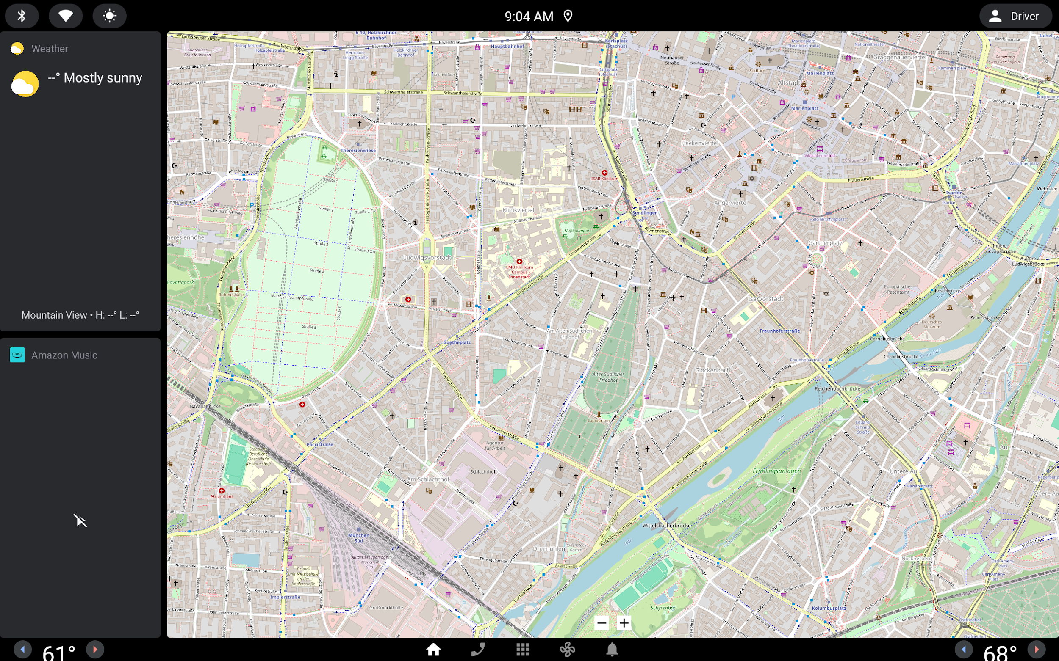

Why another Android emulator?
Emulator | Has features not supported in Automotive AOSP | Has features provided by COVESA (supported in Automotive AOSP) | Includes an Automotive Host
Android Emulator with Play Store | Yes, Play Services/Store | No | Yes, GAS (API 8) ^{(*)}
Android Emulator without Play Store | Yes, Play Services | No | Yes, GAS (API 8) ^{(*)}
AOSP “vanilla” | No | No | No
SNAPP | No | No | Yes, AOSP (API 4)
COVESA | No | Yes (**) | Planned, COVESA (planned API 7)
Google / Android
SNAPP
COVESA
(*) Car App Library (CAL) API level supported by GAS Automotive Host – API level 8 – is different from AOSP. CAL and GAS host supports features not available today in Automotive AOSP cars and thus test environment is not fully representative for app developers.

Slide 7
COVESA AOSP Emulator: Requirements
High Level: representative test environment for Automotive AOSP
COVESA branded Automotive AOSP Emulator, hosting and update site
Emulator including the needed tools for app developers to test their apps:
  For Audio Templated Apps:
    Media Center (to test UI of Audio Apps) (1)
    Media Controller Test (test tool to stimulate Audio Apps) (2)
  For Car App Library (CAL) Templated Apps (POI, Navigation, IoT, etc.)
    Automotive Host (ability to render maps, support for CAL templates) (3)
  Multi display support e.g. Instrument Cluster
  Maps on the Emulator Home Screen
Support for COVESA’s new developments
(1) https://source.android.com/docs/automotive/hmi/media
(2) https://developer.android.com/media/optimize/mct
(3) https://source.android.com/docs/automotive/hmi/aosp_host

Slide 8
Emulator: Achievements
Repositories on GitHub:
  https://github.com/COVESA/aosp_platform-manifest – repo manifest
  https://github.com/COVESA/aosp_device_covesa_emulator – device configuration (start here)
GitHub Actions to fetch AOSP and build both arm64 and x86_64 images:
  https://github.com/COVESA/aosp_platform-manifest/tree/android-12/.github/workflows
1 GitHub Self-Hosted Runner hosted by https://www.hetzner.com
  builds android 12 emulator in ~1h from scratch
  512GB NVMe – enough for system + hot cache of 1 android version
  android 12 build for both variants is 256GB
Binary storage for artifacts hosted by https://www.hetzner.com
  1TB
  https://emulator.covesa.global

Slide 9

Emulator: Demo
If you want to try it out yourself right now, follow instructions here:
  https://github.com/COVESA/aosp_device_covesa_emulator
  you must have Android Studio installed
  ARM64 ~ 700 MB
  x86_64 ~ 850 MB

Slide 10
Emulator: Next Steps
GitHub Issues: https://github.com/COVESA/aosp_device_covesa_emulator/issues
Currently on the list:
Support for Additional Android Version(s)
Integrate UnifiedPush distributor
Support for maps
Support for templated apps

Slide 11
Support for Additional Android Version(s)
Currently COVESA Emulator is available for API 31, Android 12
Planned support for at least one additional version, but trade-off needed:
  More recent Android versions, e.g. 15 or 16, not yet in relevant
  State of the art within Automotive AOSP is Android 13 and 14
API Level | Android version | Comment
9 - 10 | 9-10 | Legacy systems
30, 31, 32 | 11, 12, 12L | Most frequent in production cars
33, 34 | 13, 14 | Most up to date OEMs systems
35, 36 | 15-16 | Not needed yet
target Android 14 (API level 34) recommended by Play Store ⁽¹⁾ and Appning ⁽²⁾
https://apilevels.com/
(1) https://developer.android.com/google/play/requirements/target-sdk
(2) https://appning.com/developers/#prepare_your_app

Slide 12
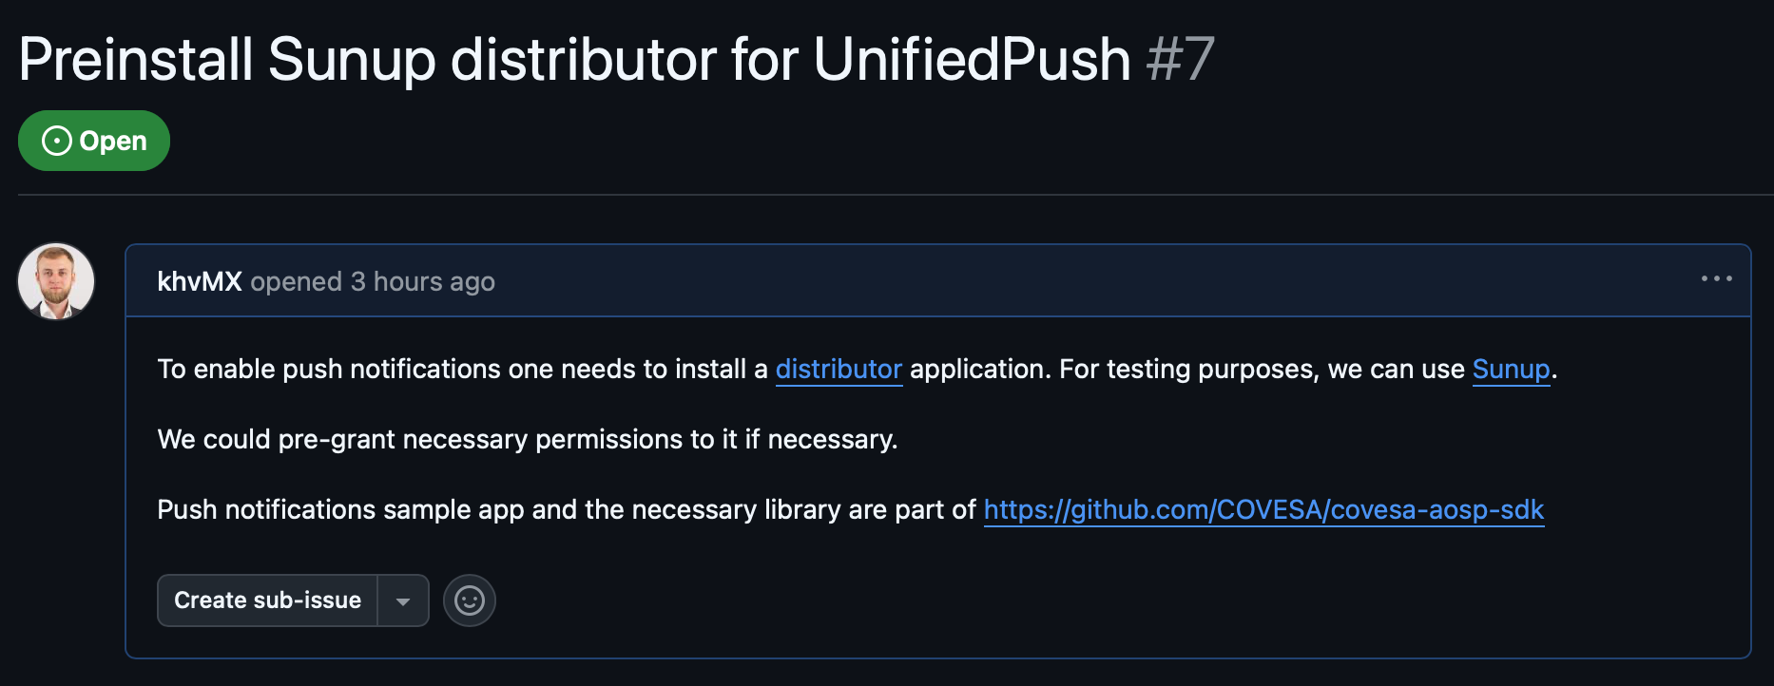
Emulator: UnifiedPush
We have a library and a sample application to enable UnifiedPush in https://github.com/COVESA/covesa-aosp-sdk
https://github.com/COVESA/aosp_device_covesa_emulator/issues/7

Slide 13
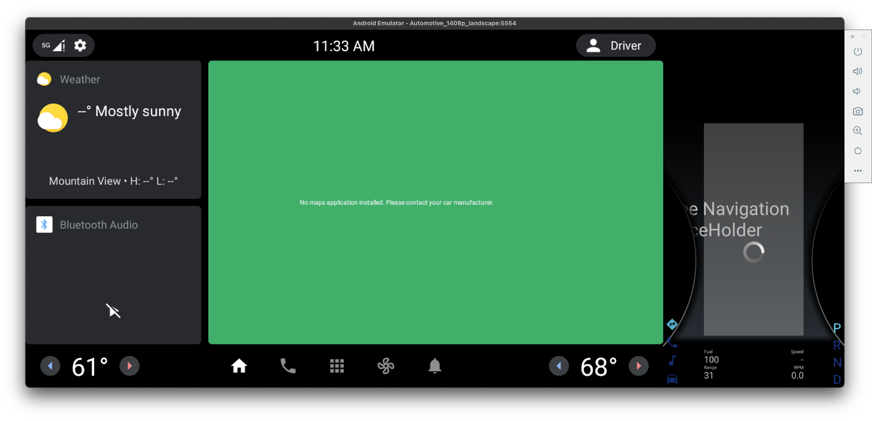
Emulator: Maps on Home Screen
AOSP: stub implementation
GAS: Google Maps
https://github.com/COVESA/aosp_device_covesa_emulator/issues/8

Slide 14
Automotive Host and Car App Library (CAL)
App relies on host
to be executed
3rd PARTY APP
AUTOMOTIVE APP HOST (*)
CarAppService is an abstract Service class that your app must implement and export to be discovered and managed by the host.
App built with Cars App library
https://developer.android.com/training/cars/apps
CARS APP LIBRARY
OEM Skinning /
UI Customization
OEM CAR APP LIBRARY CUSTOMIZATION
getCarAppApiLevel()
“API levels are used during client and host connection handshake to negotiate a common set of elements that both processes can understand. (…)
Clients must ensure no elements annotated with a RequiresCarApi value higher than returned by this method is used at runtime”.
(*) Can be provided by COVESA or App Store providers and integrated by OEMs
PROVIDED BY
ANDROID
OEM
3RD PARTY
https://developer.android.com/reference/androidx/car/app/CarContext#getCarAppApiLevel()
Android is a trademark of Google LLC.

Slide 15
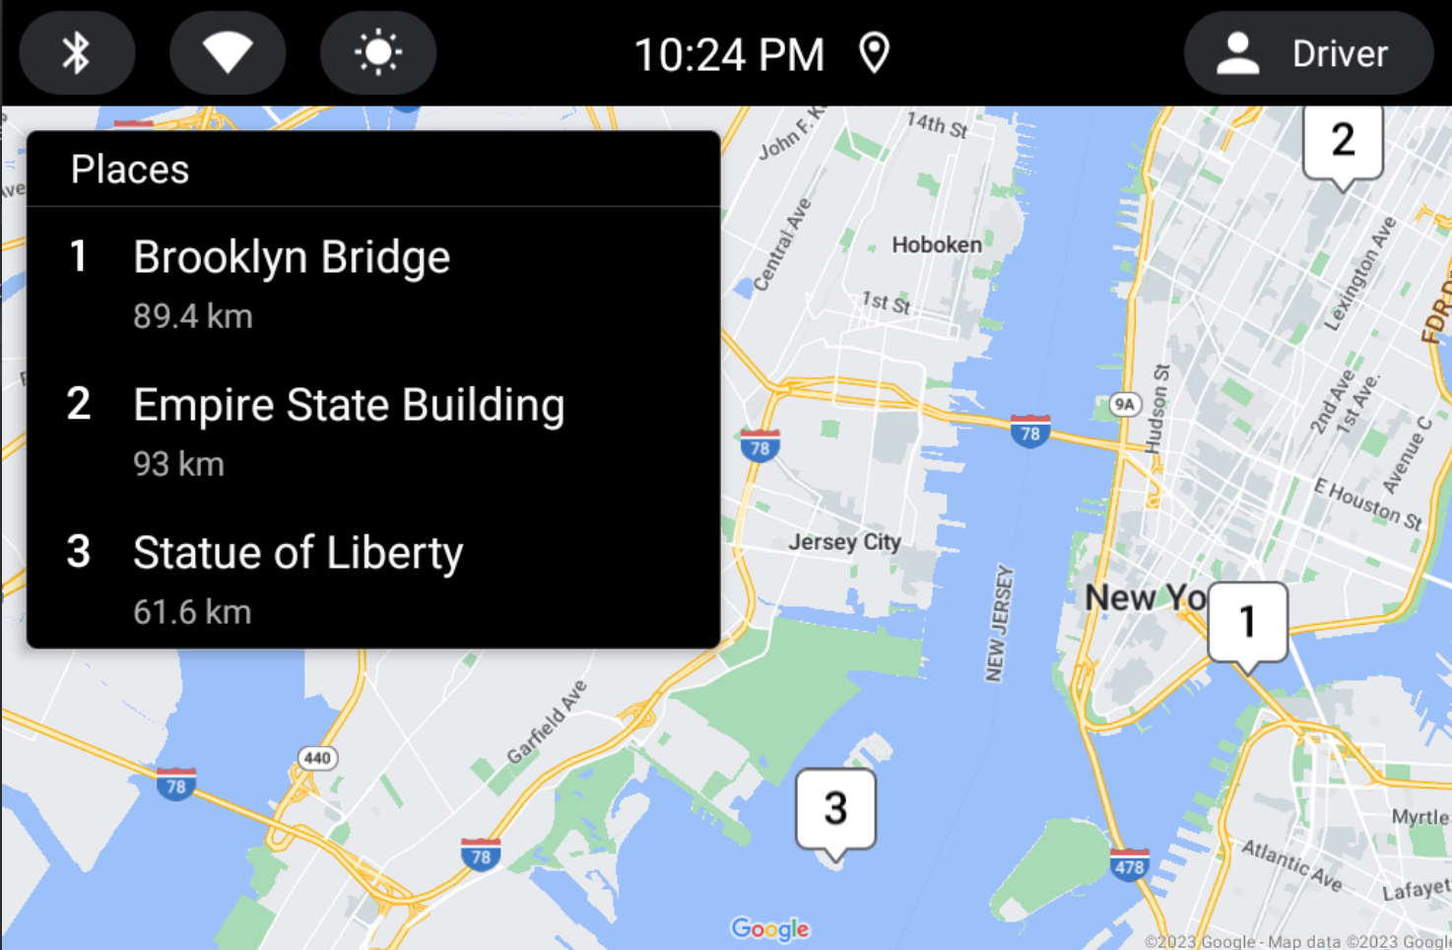
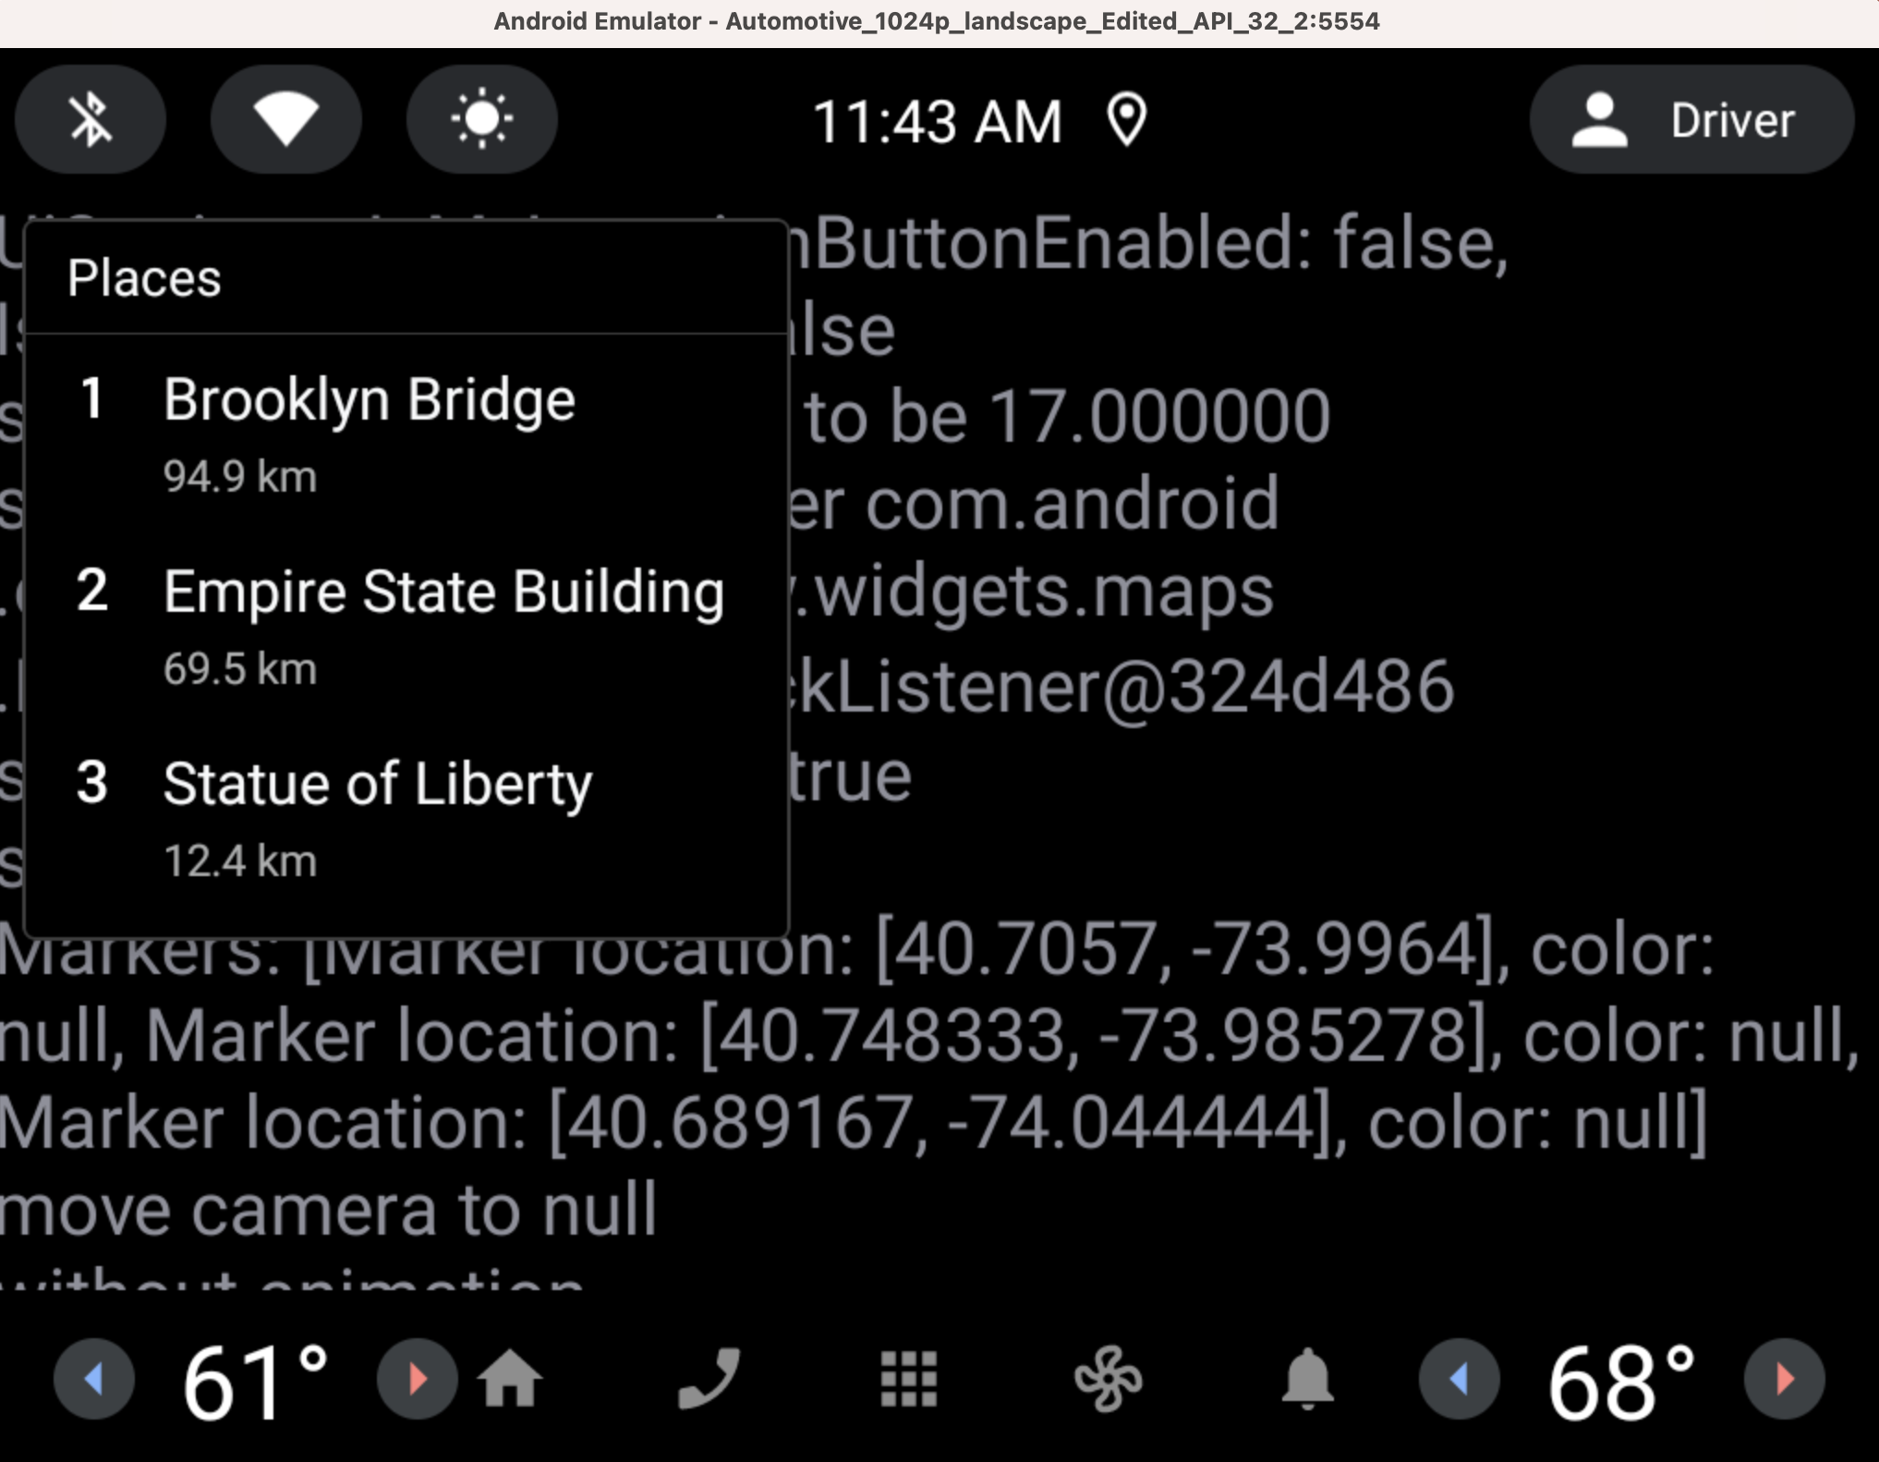
AOSP Automotive App Host
GAS Version ⁽¹⁾
AOSP Version ⁽²⁾
Screenshot from a GAS Emulator, using GAS Automotive Host (with Google Maps), displaying a POI example app
Screenshot from a non-GAS Emulator, using AOSP Automotive Host (without maps), displaying a POI example app
(1) https://play.google.com/store/apps/details?id=com.google.android.apps.automotive.templates.host
(2) https://android.googlesource.com/platform/packages/apps/Car/Templates/+/refs/heads/master/Host

Slide 16
Problems with AOSP Automotive App Host
Last update of AOSP Automotive Host occurred almost 3 years ago
(proprietary GAS Version is being updated regularly but not AOSP version)
AOSP version does not render any map
API level on Car App Library is evolving (currently API 7, API 8 coming soon):
  AOSP Host is at API level 4
  GAS Host is at API level 8
  Need a COVESA host to bridge the gap

Slide 17
AOSP Automotive App Host: Way Forward
Technical Feasibility assessed by Paradox Cat, split into WPs: https://wiki.covesa.global/download/attachments/127828103/COVESA%20AOSP%20Template%20Host%20v0.1.0.docx?version=1&modificationDate=1742904894935&api=v2
Way forward still being clarified between COVESA Board and Co-chairs
  Full Funding from COVESA of initial “bridge the GAS Gap development”, follow-up maintenance driven by members
  No COVESA funding, Full Member driven contributions
  Mixed Approach: Partial Funding from COVESA for initial WPs to “get started”, followed by member driven contribution
Open to contributions

Slide 18
Emulator: COVESA AOSP Data Workstream
Accommodate necessary AOSP changes
Integrate additional components (e.g., for finer permission control)
Simulate data

Slide 19
Emulator: Call to Action
You can contribute too:
try it out
engage in discussions, create one
request features
report bugs
solve existing issues

Slide 20
Emulator and App Host
Viktor Mukha
José Freitas
https://wiki.covesa.global/display/WIK4/COVESA+AOSP+Emulator+Weekly

