Slide 1
AOSP App Challenge
José Freitas
14.05.2025

Slide 2
Antitrust Note Well
Before we begin, we would like to make clear that COVESA is committed to compliance with the antitrust laws in all of its activities, and that it expects all participants to similarly comply with the antitrust laws. We will not engage in--and members must refrain from--any discussion of, or understandings regarding competitively sensitive topics. If you have any doubts regarding whether a matter is appropriate for discussion, please consult with your antitrust counsel.
14 May 2025 |
Copyright ©2025 COVESA

Slide 3
Agenda
App Challenge
  What was it about?
  How was it framed?
  Winner
  Participants
Challenges
Lessons learned

Slide 4
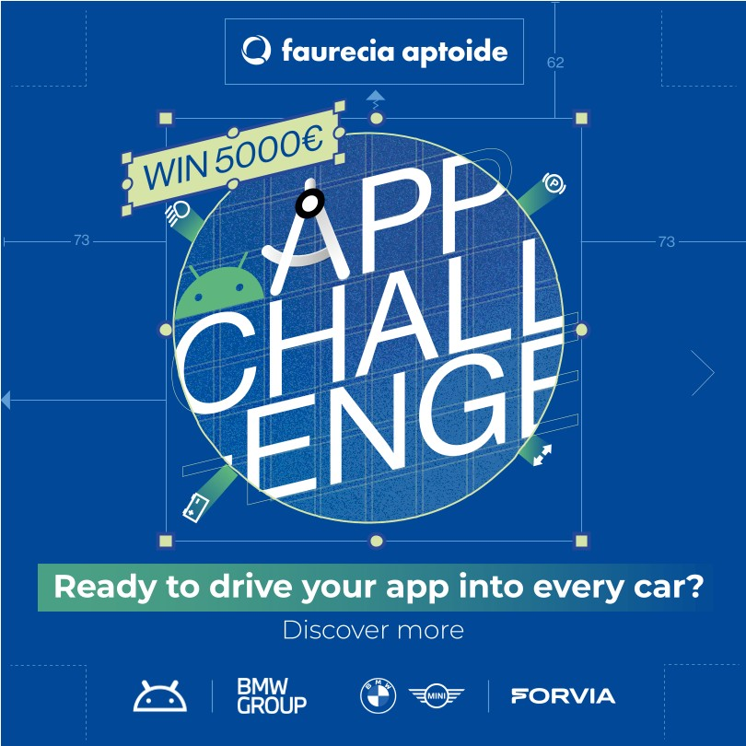
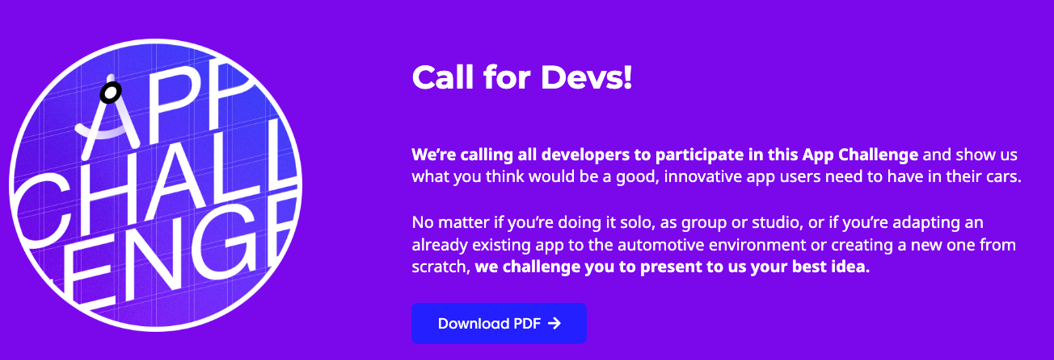
App Challenge: What was it about?
Promoted by Appning together with BMW
Objective: attract innovative ideas for automotive apps & services
Targeted at individual developers or small agencies
https://appning.com/developers/#app%20challenge
https://www.linkedin.com/posts/appning-by-forvia_faapchallenge-activity-7214538382259978241-oV6Y

Slide 5
App Challenge: How was it framed?
Launched at the Droidcon Berlin 2024, targeting developer community
Incentives: 5K€ Prize Money + BMW launch
When: July 2024 to March 2025 (initially planned to conclude in November 2024)
Apps rated by a Juri (BMW, Snapp and Appning) on 3 criteria:
  Innovation (40%)
  User Experience (30%)
  Technical Feasibility (30)
Discord channel created
Phased approach:
  Launch: July 2024
  Touch point / Mid term review: September 2024
  Submissions: February 2025 (initially October 2024)
  Winner announcement: March 2025 (initially November 2024)
https://www.linkedin.com/posts/droidcon_androiddevs-android-app-activity-7223986186480996352-XNuT/

Slide 6


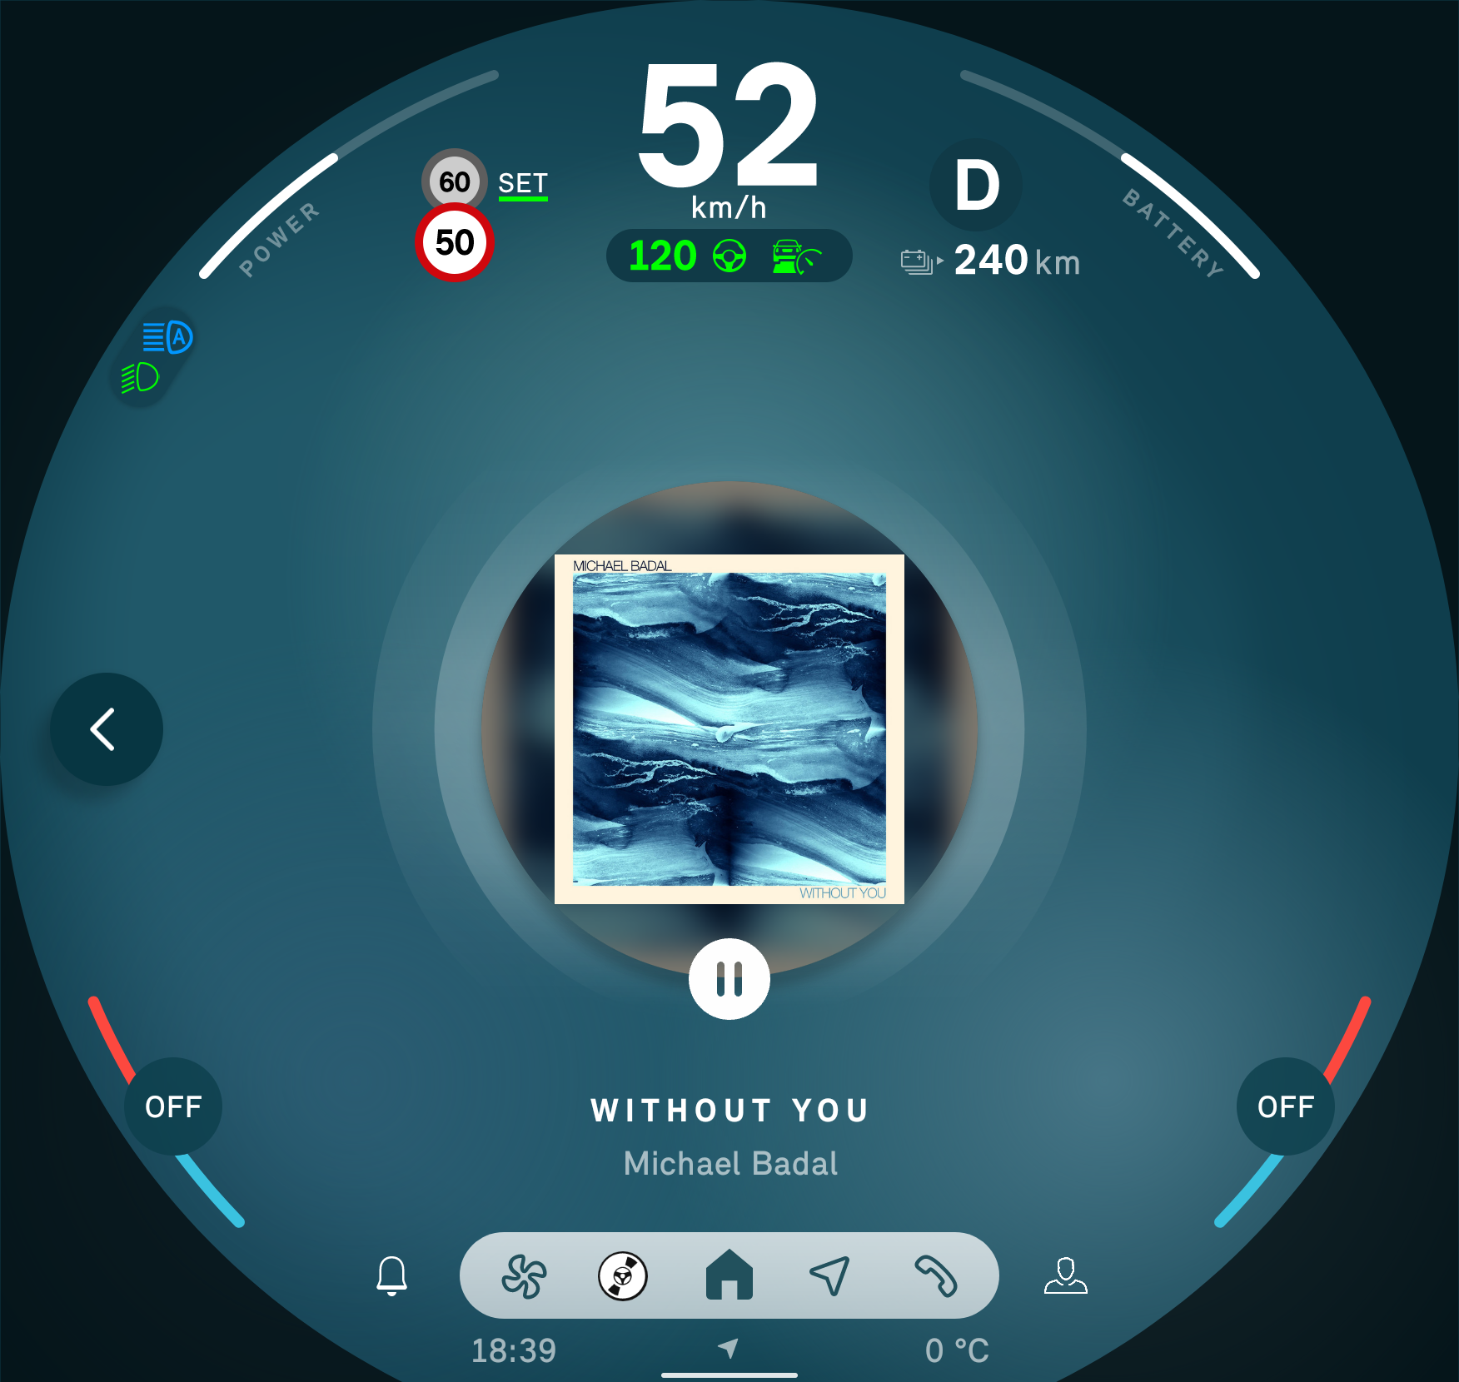
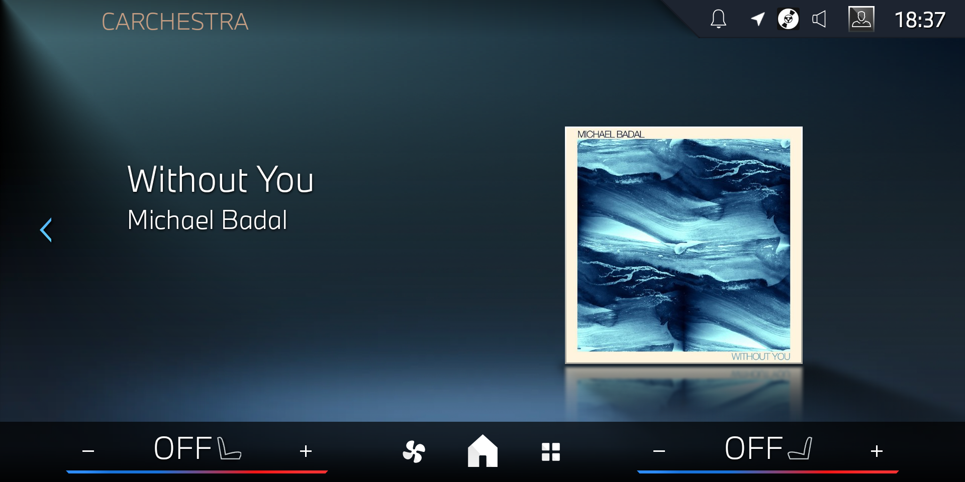
App Challenge Winner: Carchestra
Carchestra by Paradox Cat
Built on AAOS Media Template
Leverages Vehicle Properties (e.g., speed)
Dynamically adjusts sound intensity as you drive
“As you accelerate, turn and cruise, our revolutionary app dynamically adapts the music to match your driving style, creating a seamless blend of movement and melody that makes every drive unforgettable.”

Slide 7
Participants
Funnel of participants
  Engaged ~ 30
  Registered ~ 20
  1-on-1 Touch Point/Clarification meetings ~ 5
  Submitted apps ~ 10
Profile of actual submitters of apps
  Game Studios (adaptions from Mobile)
  Companies or individual developers already engaged with Automotive
Range of ideas / initial topics
  Audio/Entertainment
  Fleet management
  B2B
  Car Management / Driver monitoring
  Driver health monitoring
  Tourism related (tour guides)
  EV Points of Interest
  Content discovery (video, podcasts)
  Voice based casual games
  Casual Games for the family

Slide 8
Agenda
App Challenge
  What was it about?
  How was it framed?
  Winner
  Participants
Challenges
Lessons learned

Slide 9
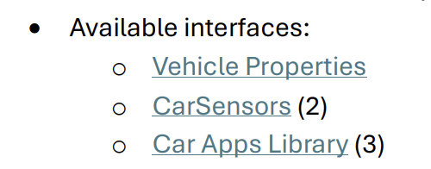
Challenges: API Availability
Not all properties are available on standard AAOS images
Limited access to several Vehicle Properties (e.g., require system signature and/or privileged access rights)
Uncertainty about AOSP Template Host / BMW's Template Host
Fleet and Car/Driver Monitoring apps gave up here
Some POI / Tourism related ideas may have gave up here
“App Challenge” Rules, with several “caveats”
(2) If you need access to specific CarSensors, please contact us to assess the technical feasibility.
(3) Please contact Faurecia Aptoide’s team to confirm that the Car Apps Library templates you’re planning to use are available.

Slide 10
Challenges: API Availability
“links to the Android documentation without any more information on which car properties and sensors we can actually rely on being available”
“no good documentation if some OEMs allow more or fill some signals or keep them unfilled”
Participant feedback, by email
Question raised by a participant through the app challenge's discord channel.

Slide 11
Challenges: API Availability
“links to the Android documentation without any more information on which car properties and sensors we can actually rely on being available”
“no good documentation if some OEMs allow more or fill some signals or keep them unfilled”
Participant feedback, by email
Question raised by a participant through the app challenge's discord channel.

Slide 12
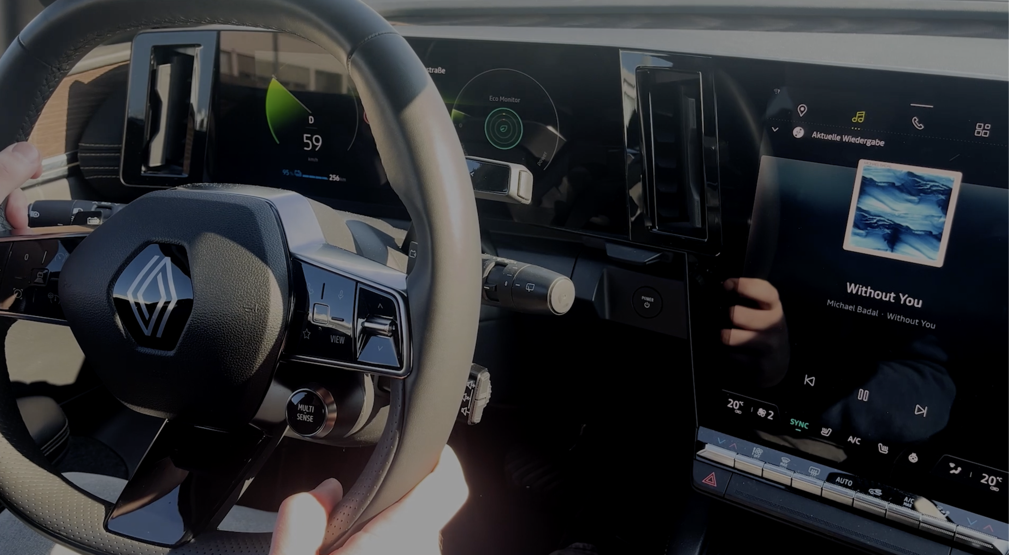
Challenges: Testing
“There is an internal test track on the Google Play console that can be used to test the app on (rental) cars.”
Access to emulators / test tools
Carchestra tested on a GAS car

Slide 13
Summary of Lessons Learned
Problem | What can be done​ | Responsible stakeholders
API Availability / Fragmentation | Document which properties are available in each OEMs, as well as OEM specific extensions | OEMs, App Store Providers, COVESA (?)
Platform Signature for some Vehicle Properties | Subject of the COVESA Data Working stream | COVESA
Access to emulators | COVESA Emulator: provide representative emulator(s) with test tools (e.g. to simulate input properties) | COVESA, App Store Providers
Consistent templates support | COVESA Emulator/Automotive Host: provide consistent automotive support cross OEMs | COVESA, App Store Providers, OEMs
Access to test cars | Support “beta testing” (or test track) features on App Stores | App Store Providers, OEMs
Barrier to entry for non-automotive developers | Provide better documentation, example apps, codelabls to reduce adoption barrier | App Store Providers, COVESA
Low reach | More promotion of automotive ecosystem | OEMs, COVESA, App Store Providers

Slide 14
AOSP App Challenge
José Freitas
Appning by FORVIA

