Slide 1
CVIS Status spring 2025
Ulf Bjorkengren, Ford Motor Company
AMM Berlin 2025-05-14

Slide 2
CVIS goals
Create a framework for development of vehicle signal trees for different vehicle types.
Create signal trees for different vehicle types, such as:
  Truck / Trailer / Bus / Car / Van / Pick-up / Motorcycle / …
VSS alignment has high priority.
  Development of apps that can be used with trees for multiple vehicle types shall not be too cumbersome.

Slide 3
Data model supporting multiple trees
Hierarchical Information Model (HIM)
  Resource profile: Vehicle signal rule set identical with the VSS rule set.
  Service profile: Vehicle service(Procedure-based) rule set, syntax inherited from the VSS rule set.
  Support for definition of a forest of multiple trees.
    Used by a server to manage the set of trees.
    Can be used for client inquiry on what “domains” that are available from the server.
The CVIS project will use the HIM resource profile for defining trees for different vehicle types.

Slide 4
CVIS Development framework (1)
Generation 1 (symbolic links):
  Trees for different vehicle types are separately created “from scratch”.
  “Objects” that are commonly used in different trees are located on a common “vspec object files” directory branch.
  The vspec tree includes the vspec objects using symbolic links.
  Vspec files with symbolic links are compatible with VSS-tools exporters.
Generation 2 (HIM configurator):
  A tool is used that pre-processes vspec2 files, converting them to vspec format.
  Vspec2 files are vspec files that also include pre-processing commands.
  Preprocessing features:
    Asymmetric instantiation
    Overlays support
      All VSS-tools overlays features
      Instantiation overlays
    Variation points
      Global
      Local
    Common allowed definition
  The pre-processed vspec tree is used as input to the VSS-tools exporters.

Slide 5
CVIS Development framework (2)
Generation 2+ (Overlays creator):
  A tool that supports to “pick” parts of an existing tree that can then be applied to another tree using the HIM configurator overlays mechanism.
  Can be seen as an alternative to the “common objects / symlinks” solution.

Slide 6
HIM configurator features
Asymmetric instantiation
  Enables e. g. axles to have different number of wheels.
Overlays support
  Overlay files are forwarded to the VSS-tools exporter together with the configured vspec files.
  All features of the VSS-tools overlays mechanism are available.
  Overlays can be applied to instantiated nodes.
Variation point
  Global
    Enables selection of zero or more subtrees
  Local
    Enables e. g. instantiated axles to be differently configured
Common allowed definition
  Allowed definitions can be stored in a Types tree.
  The datatype property is set to the path to the allowed definition in the Types tree.

Slide 7
CVIS trees under development
Generation 1:
  Separate trees referencing common objects.
  Separate input configuration to the HIM configurator.
  Trees started (not completed): Truck / Trailer / Bus / Driver (supplementary tree for Trucks)
Generation 2:
  A common, vehicle type agnostic tree that after HIM configuration becomes vehicle specific.
  Separate input configurations for different vehicle types (Truck and Passcar exists).
    Car configuration produces a YAML file that is identical to the standard VSS YAML tree (except for instantiated descriptions).
  Trees started (not completed):
    VSS-core: uses Global and Local Variation point features
      Requires modifications to the vspec/vspec2 files
    VSS-core2: uses Overlays and Instantiation overlays
      No modification of vspec/vspec2 files required

Slide 8
Supplementary slides

Slide 9
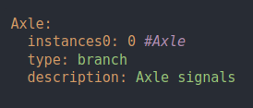
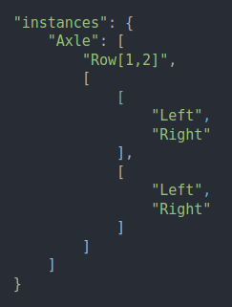
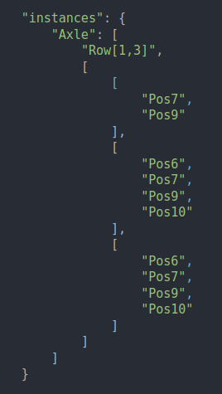
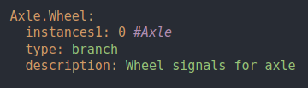
Pre-processor asymmetric instantiation
Chassis.vspec2 himConfig-car.json himConfig-truck.json

Slide 10
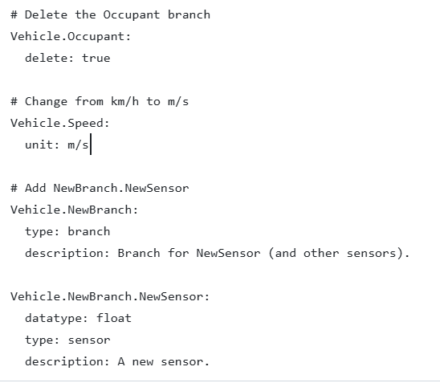
Pre-processor overlays
Overlays are transparent to the vspec / vspec2 files, so nothing overlay-specific needs to be added to these files.
himConfig-xxx.json overlay1.vspec

Slide 11
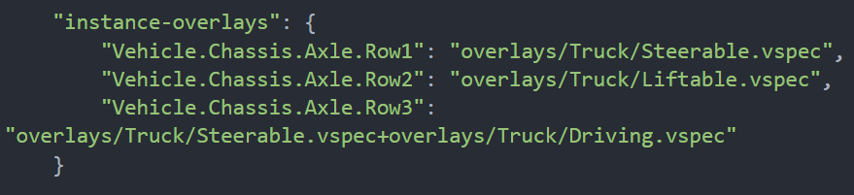
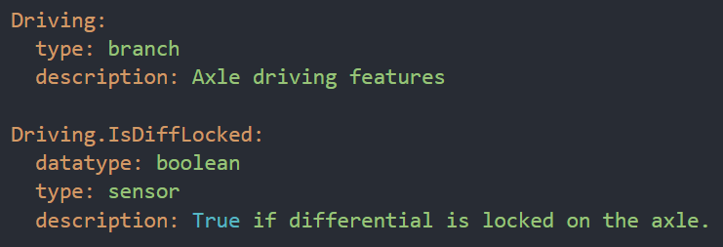
Pre-processor instantiation overlays
Instantiation overlays are transparent to the vspec / vspec2 files, so nothing specific needs to be added to these files.
himConfig-xxx.json overlays/Truck/Driving.vspec
Instantiation overlays shall have “relative” paths, the pre-processor modifies them to become absolute paths.

Slide 12
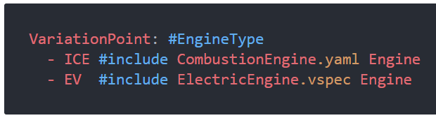
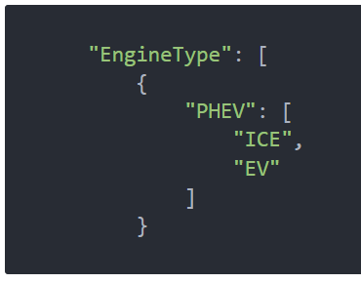
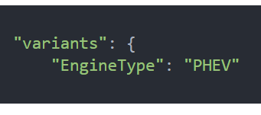
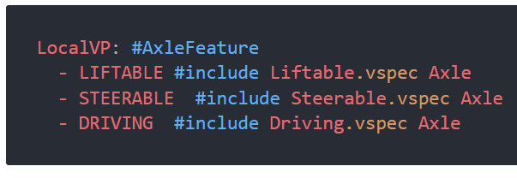
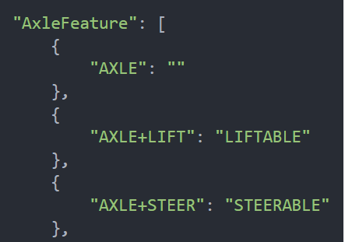
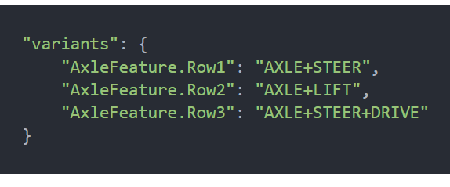
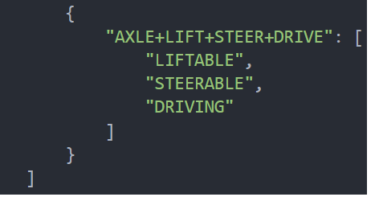
Pre-processor variation points
Global variation point
VssCoreSignalSpecification.vspec2 Variability.json himConfig-xx.json
Local variation point
Chassis.vspec2 Variability.json himConfig-xx.json

