Slide 1
VISS and VISSR Status spring 2025
Ulf Bjorkengren, Ford Motor Company
AMM Berlin 2025-05-15

Slide 2
VISS specification overview
VISSv1 features (Websocket; Get/Set/Subscribe/Unsubscribe; limited filter support)
VISSv2.0 features (released April 2024)
  Supported transport protocols: HTTP / Websocket / MQTT
  Methods: Get / Set / Subscribe / Unsubscribe
  Subscription filters: Timebased / Change / Range / Paths / Curve logging / History
  Access control: Token based, OAuth2 inspired, RBAC support, single node granularity
  Consent support: Obtaining consent delegated to an External Consent Framework, acts as firewall
VISSv3.0 features (released May 2025)
  All features from VISSv2.0
  Primary payloads (JSON) are normative, transport protocols are not normatively specified
  gRPC added to the mentioned protocols
  File transfer. Upload/download of files
  Payload encoding
  Data compression
  JSON scheme defining the content of all primary payloads
  A tree describing the VISS server capabilities that can be accessed by clients
  Error messages updated

Slide 3
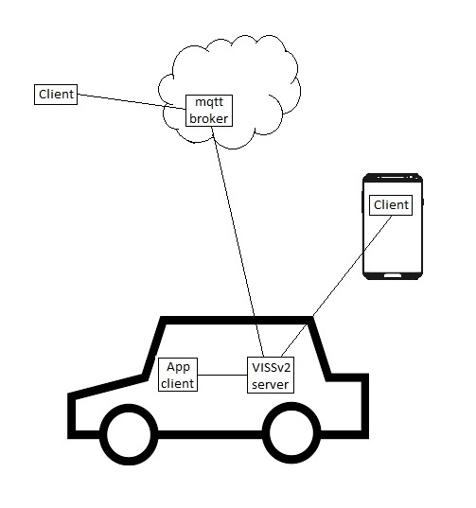
Deployment of VISS actors
Client deployment alternatives:
- Cloud
- Vehicle proximity
- In-vehicle (typically in app runtime)
Server deployment alternatives:
- In-vehicle (typically at the ”edge”)
- (Cloud)
Normative payload definitions:
- Client implementations at different deployments can (re)use the same requests also when using different transport protocols.

Slide 4
VISS MQTT based protocol
MQTT uses a consumer / producer / broker model
VISS uses a client / server model
The VISS client / server model is abstracted on MQTT by adding a thin application layer protocol.
  The server subscribes to a topic that is unique for the vehicle, e. g. a pseudo-VIN.
  A client must obtain the server topic over a side channel.
  A client that is about to issue a request does the following:
    It subscribes to a client unique topic.
    It publishes a message to the server unique topic. The message contains two parts:
      The VISS request
      The client unique topic
  The server processes the VISS request and then publishes the response / event using the client unique topic.
A cloud-based broker provides the following features:
  Solves the “firewall/NAT traversal” issue.
    The server always initiates the vehicle-to-cloud (broker) communication.
  Decouples client and vehicle (server).
  The broker can act as an extra security layer.

Slide 5
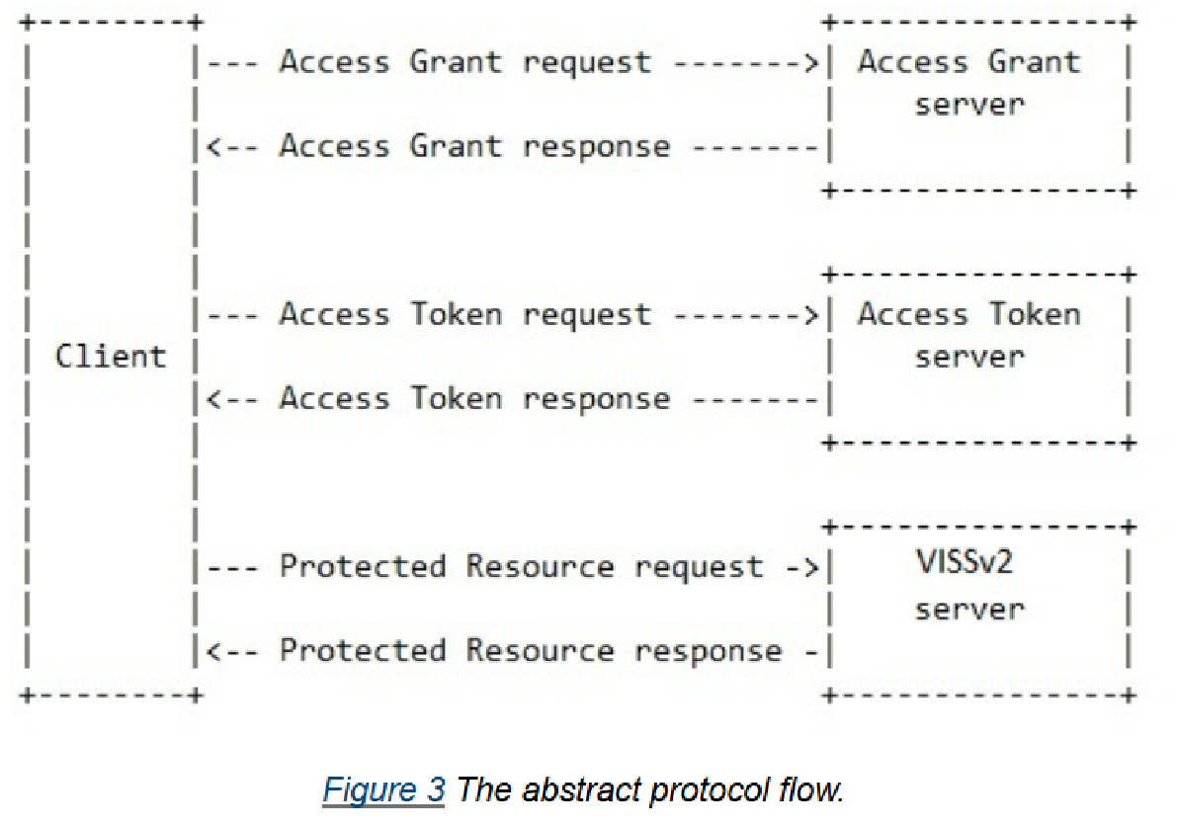
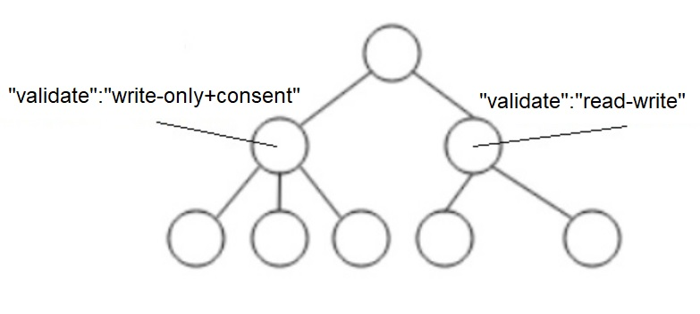
VISS access control model
JSON web-token based, Oauth 2.0 inspired
Role based access control
GDPR alignment through a purpose-based service offering
Access control can be applied per signal through the VSS tree “tagging”. Tag is inherited by children.

Slide 6
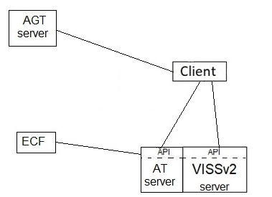
VISS consent support
Piggy-backs on the access control model
Relies on an External Consent Framework (ECF) to obtain consent from the data owner.
Supports cancelling of previously given consent.
  Data received by client cannot be retracted/cancelled.
Demoed at the 2024 spring AMM
  https://drive.google.com/file/d/1w0bV2g6RuebfgZoxZlvLkwTGIEjMuCPZ/view?usp=drive_link

Slide 7
VISS references
AUTOSAR uses VISS for the Automotive API in the R24-11 release.
  AUTOSAR R24-11
  Automotive API Explainer
  VISSv3.0 is the target version
COVESA EU Data Act project
  Proposed vehicle API candidate
COVESA Central Data Service Playground project (CDSP)
  VISSR is an available component for realizing data services
https://github.com/COVESA/vehicle-information-service-specification
https://wiki.covesa.global/display/WIK4/VISS+Meeting+Topics+and+Meeting+Notes

Slide 8
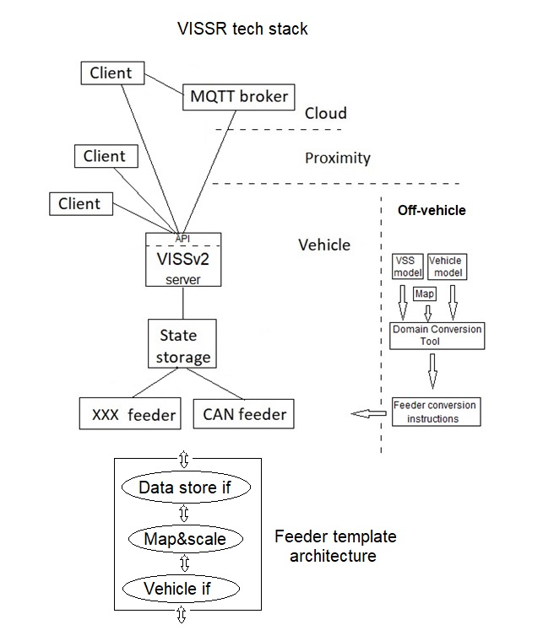
VISS reference implementation - VISSR
  https://github.com/COVESA/vissr
Complete VISSv3.0 feature support, plus
  SwCs to realize a complete tech stack:
    Data store: SQLite / Redis / Memcached / IotDB / ..
    Feeder: Template where only the vehicle interface client needs implementation / RL-feeder / EVIC-feeder / …
    Client: JS based: AGT, AT, HTTP, WS, integrated access control,.. / Go-based: MQTT, curve log to CSV file, …
    Access Grant Token server (authentication excl)
    Access Token server
    External Consent Framework simulator
    Domain Mapping Tool: creates feeder conversion instructions from YAML input
VISSR is a reference implementation written in Go.
  Although it is quite stable and with decent performance, a production ready implementation in RUST/C++ would be attractive.
  Start a new COVESA project to develop it?

Slide 9
Supplementary slides

Slide 10
VISS specification history
The Vehicle Information Service Specification development was started at W3C
  https://github.com/w3c/automotive
Where it was discontinued and in March 2024 migrated to
  https://github.com/COVESA/vehicle-information-service-specification
VISSv2.0 released in April 2024
  https://github.com/COVESA/vehicle-information-service-specification/releases/tag/v2.0
VISSv3.0 to be released April/May 2025
  Release candidate 1
    https://github.com/COVESA/vehicle-information-service-specification/releases/tag/v3.0rc1

Slide 11
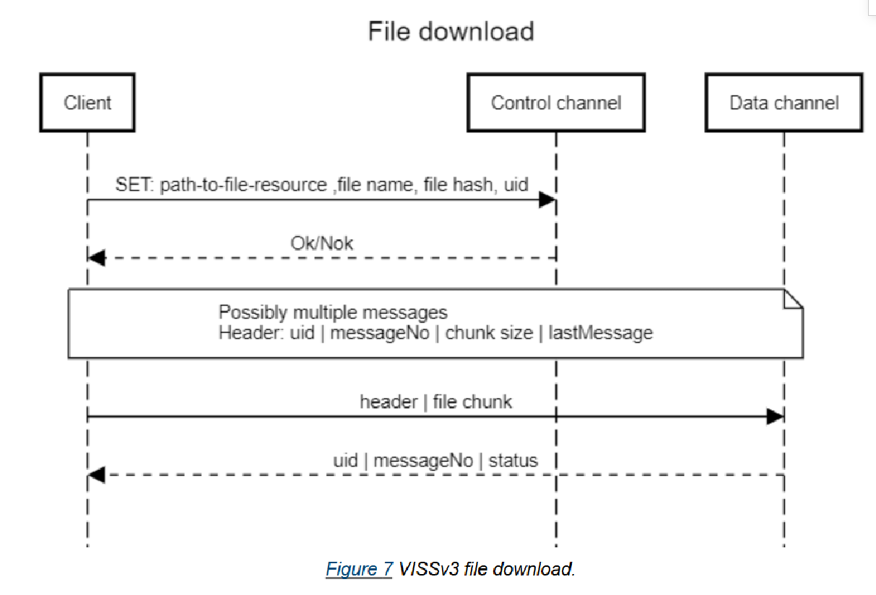
VISS file transfer
Upload of file to client
Download of file to server
Modeled using control and data channels
File node representation:
  File name (incl extension)
  File hash
  Uid (unique per session)
An alternative to this integrated file transfer support is to define a node with control information that also includes data about external file transfer resources.

Slide 12
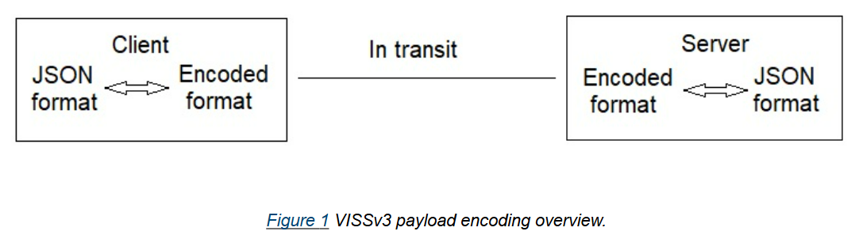
VISS payload encoding
Payload encoded when in transit over the transport protocol
Primary (JSON) format at end points
Integrated part of the gRPC protocol
Can be combined with other protocols
  Then it is run on a different logical channel than the “primary” channel

Slide 13
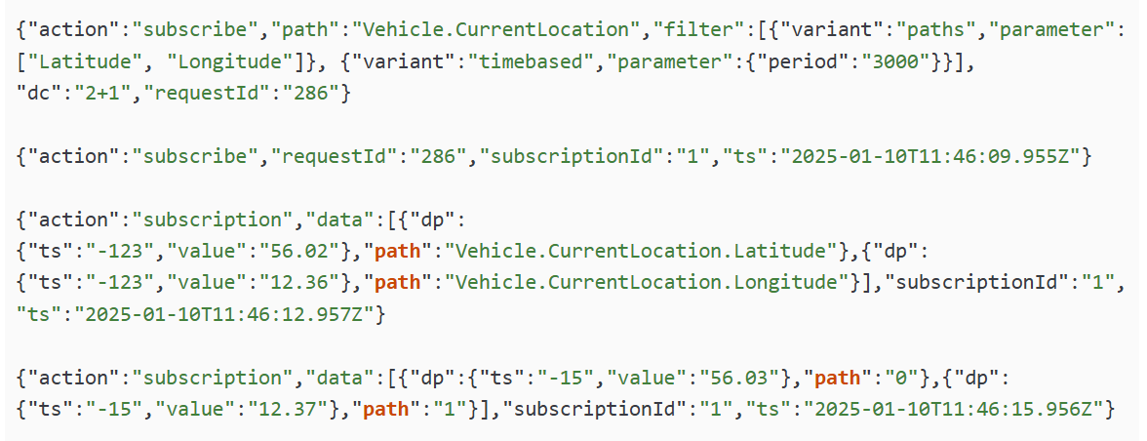
VISS data compression
Path compression: Path is replaced by index from sorted list of paths in response.
Timestamp compression: Data point timestamp is relative to message timestamp
Can be combined with payload encoding
Can be combined with curve logging

Slide 14
VISS server capabilities
Most VISSv3.0 features are optional
A client needs to know which features are supported by the server it connects to.
As all transport protocols are optional client is expected to find this information over a side channel.
The client can then use the VISS API to request data from the Server tree that contains the server capabilities description.
If a feature is supported on any transport protocol it should be represented on the mandatory Support branch.
The mandatory Config branch can be accessed to find out the details of a supported feature.
  Which protocol(s) support which features?
  Specific port number?
  Other specific config data?

