Slide 1
Data Expert Group Update
2025-05-14

Slide 2

Introduction

Slide 3
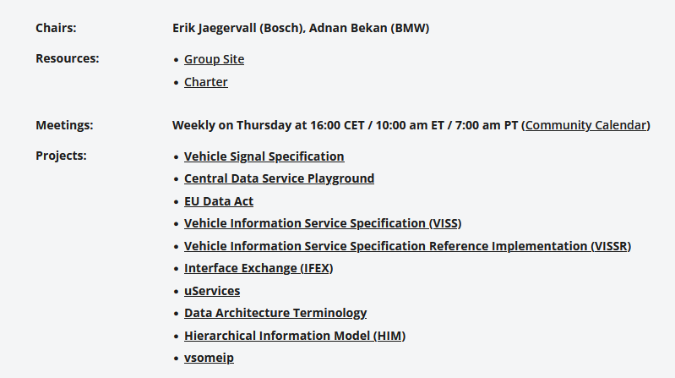
Introduction
Data Expert Group Wrap-Up
16.00 – 16.25 Thursday
https://covesa.global/project/data-expert-group/

Slide 4
Introduction
Data Expert Group Wrap-Up
16.00 – 16.25 Thursday
https://covesa.global/project/data-expert-group/

Slide 5
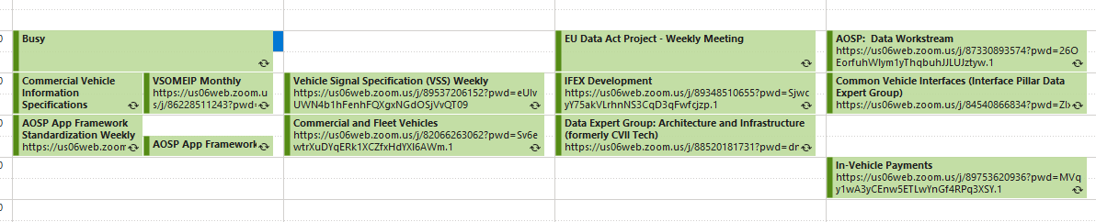
Regular Meetings related to Data Expert Group
Meetings almost every day (Except Fridays)
All welcome to join!
All meetings visible in the COVESA Community Calendar

Slide 6
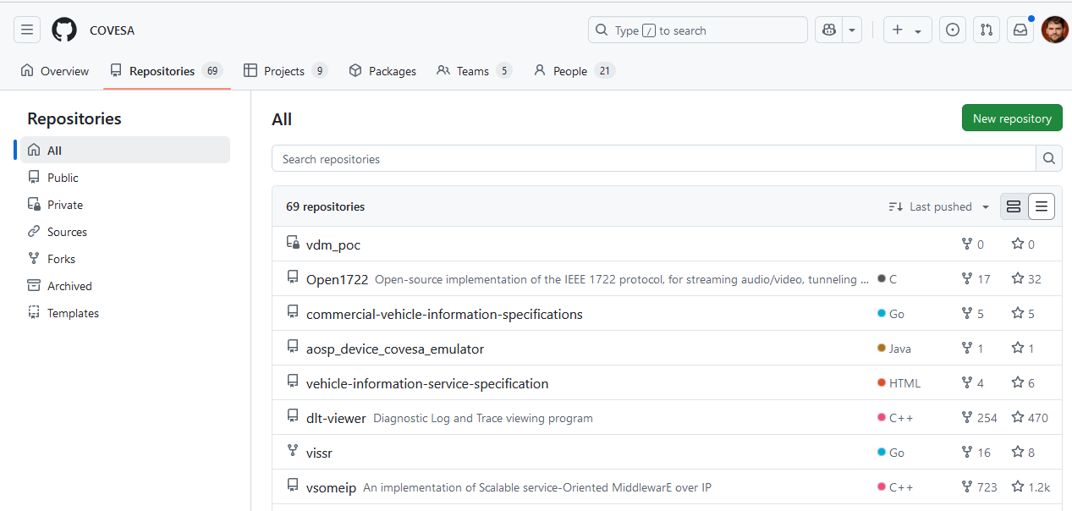
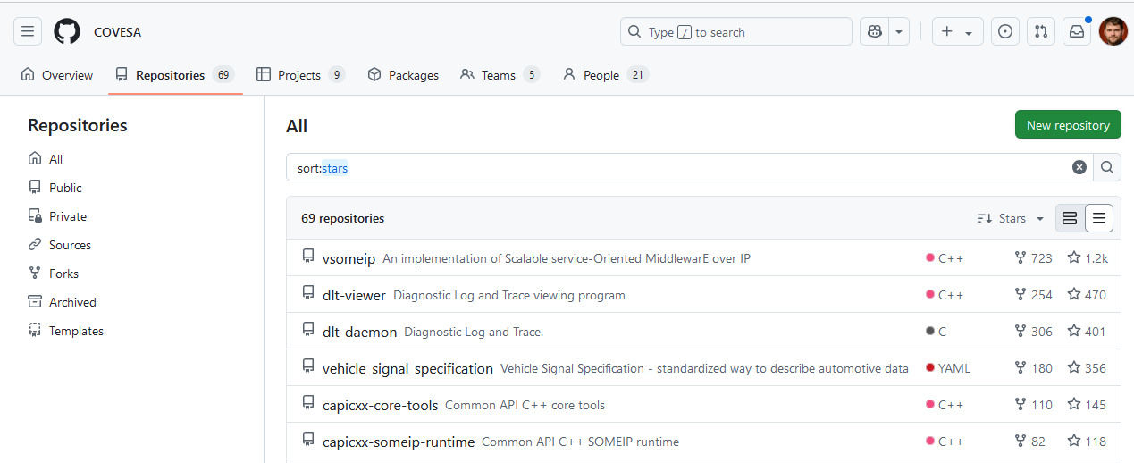
Github Activity

Slide 7
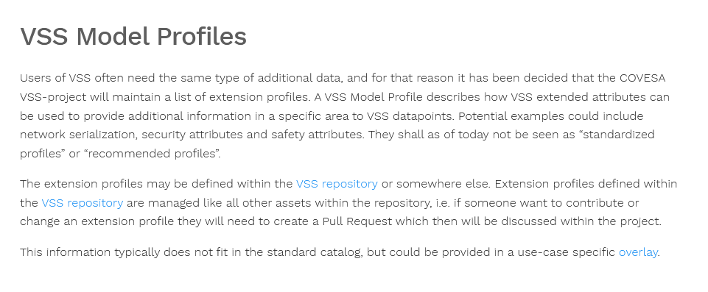
VSS News
Signals for Motion Management added
Minor tooling improvements
Concept of VSS profiles added
https://covesa.github.io/vehicle_signal_specification/extensions/index.html#vss-model-profiles

Slide 8
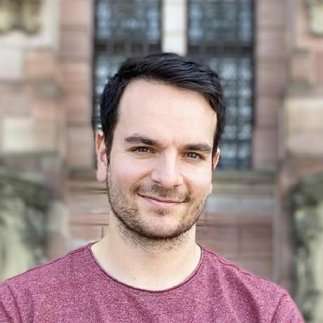
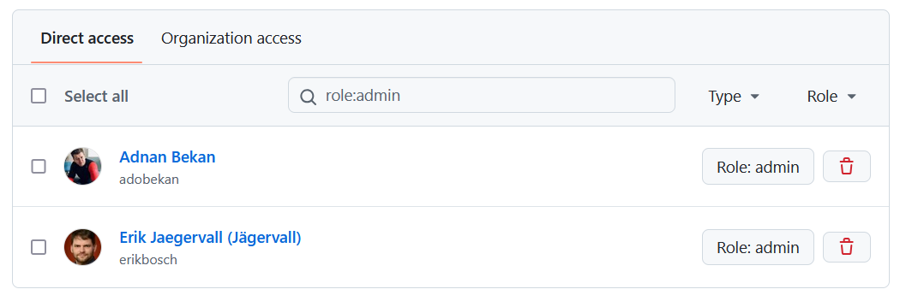
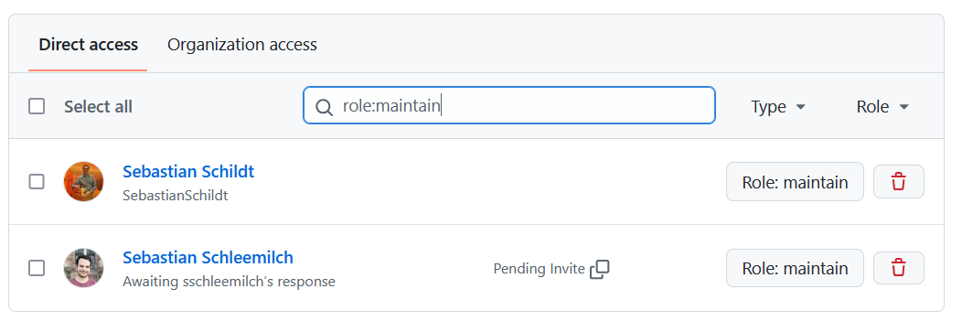
The VSS Crew
Four levels: Triage, Write, Maintain, Admin
New maintainer: Sebastian Schleemilch, BMW
  Has been very active in tool development

Slide 9
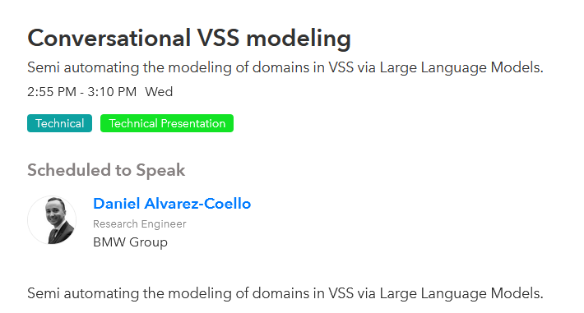
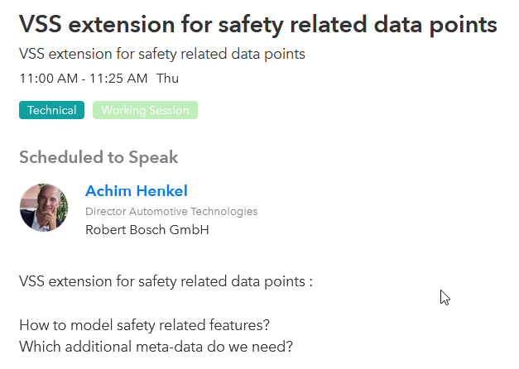
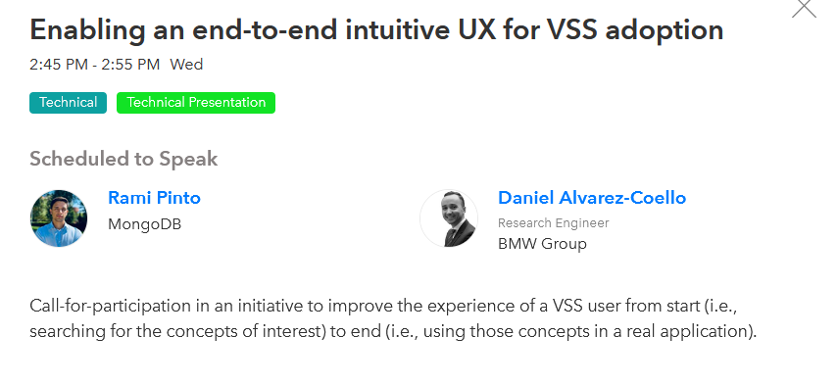
VSS Trends
Modelling support for VSS-like data
  “Vehicle Data Model”
  “VSS Next Gen”
Profile Extensions
  Network serialization
  Security
  Safety

Slide 10
VSS Working Sessions (9.00-10.25 Thursday)
Overlays as extension mechanism
  Moderator: Adnan
Hands-on overlays
  Overlays for changing tree and adding deployment information.
  Moderator: Adnan & Erik
Vehicle Data Model
  Moderator: Daniel Alvarez

Slide 11
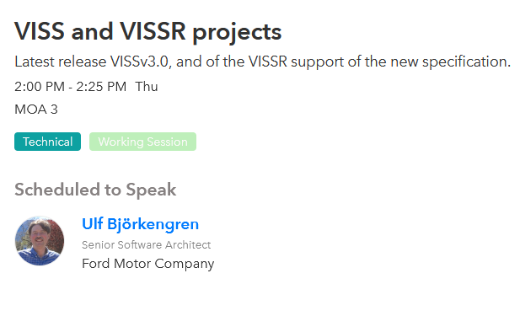
VISS
VISS 3.0 Released
  https://github.com/COVESA/vehicle-information-service-specification

